Slide 1
Introduction

Slide 2
Lesson Objectives
After completing this lesson, you should be able to do the following:
  Discuss the goals of the course
  Identify the available environments that can be used in the course
  Describe the database schema and tables that are used in the course
  Review the basic features of SQL Developer
  Review some of the basic concepts of SQL
Notes:
Oracle Database 11g: SQL Fundamentals II I - <number>

Slide 3
Lesson Agenda
  Course objectives and course agenda
  The database schema and appendixes used in the course and the available development environment in this course
  Overview of Oracle SQL Developer
  Review of some basic concepts of SQL
  Oracle Database 11g documentation and additional resources
Notes:
Oracle Database 11g: SQL Fundamentals II I - <number>

Slide 4
Course Objectives
After completing this course, you should be able to do the following:
  Control database access to specific objects
  Add new users with different levels of access privileges
  Manage schema objects
  Manage objects with data dictionary views
  Manipulate large data sets in the Oracle database by using subqueries
  Manage data in different time zones
  Write multiple-column subqueries
  Use scalar and correlated subqueries
Notes:
Oracle Database 11g: SQL Fundamentals II I - <number>

Slide 5
Course Prerequisites
The Oracle Database 11g: SQL Fundamentals I course is a prerequisite for this course.
Notes:
Oracle Database 11g: SQL Fundamentals II I - <number>
Course Prerequisites
Required preparation for this course is Oracle Database 11g: SQL Fundamentals I.
This course offers you an introduction to Oracle Database 11g database technology. In this course, you learn the basic concepts of relational databases and the powerful SQL programming language. This course provides the essential SQL skills that enable you to write queries against single and multiple tables, manipulate data in tables, create database objects, and query metadata.

Slide 6
Course Agenda
  Day 1:
    Introduction
    Controlling User Access
    Managing Schema Objects
    Managing Objects with Data Dictionary Views
  Day 2:
    Manipulating Large Data Sets
    Managing Data in Different Time Zones
    Retrieving Data Using Subqueries
Notes:
Oracle Database 11g: SQL Fundamentals II I - <number>

Slide 7
Lesson Agenda
  Course objectives and course agenda
  The database schema and appendixes used in the course and the available development environment in this course
  Overview of Oracle SQL Developer
  Review of some basic concepts of SQL
  Oracle Database 11g documentation and additional resources
Notes:
Oracle Database 11g: SQL Fundamentals II I - <number>

Slide 8
Human Resources (HR) Schema Used in This Course
DEPARTMENTS
department_id
department_name
manager_id
location_id
LOCATIONS
location_id
street_address
postal_code
city
state_province
country_id
JOB_HISTORY
employee_id
start_date
end_date
job_id
department_id
EMPLOYEES
employee_id
first_name
last_name
email
phone_number
hire_date
job_id
salary
commission_pct
manager_id
department_id
COUNTRIES
country_id
country_name
region_id
JOBS
job_id
job_title
min_salary
max_salary
REGIONS
region_id
region_name
JOB_GRADES
grade_level
lowest_sal
highest_sal
Notes:
Oracle Database 11g: SQL Fundamentals II I - <number>
Human Resources (HR) Schema Description
The Human Resources (HR) schema is part of the Oracle Sample Schemas that can be installed in an Oracle database. This course uses data from the HR schema.
Table descriptions
The EMPLOYEES table contains information about all the employees such as their first and last names, job IDs, salaries, hire dates, department IDs, and manager IDs. This table is a child of the DEPARTMENTS table.
The DEPARTMENTS table contains information such as the department ID, department name, manager ID, and location ID. This table is the primary key table to the EMPLOYEES table.
The LOCATIONS table contains department location information. It contains location ID, street address, city, state province, postal code, and country ID information. It is the primary key table to the DEPARTMENTS table and is a child of the COUNTRIES table.
The COUNTRIES table contains the country names, country IDs, and region IDs. It is a child of the REGIONS table. This table is the primary key table to the LOCATIONS table.
The REGIONS table contains region IDs and region names of the various countries. It is a primary key table to the COUNTRIES table.
The JOB_GRADES table identifies a salary range per job grade. The salary ranges do not overlap.
The JOB_HISTORY table stores job history of the employees.
The JOBS table contains job titles and salary ranges.

Slide 9
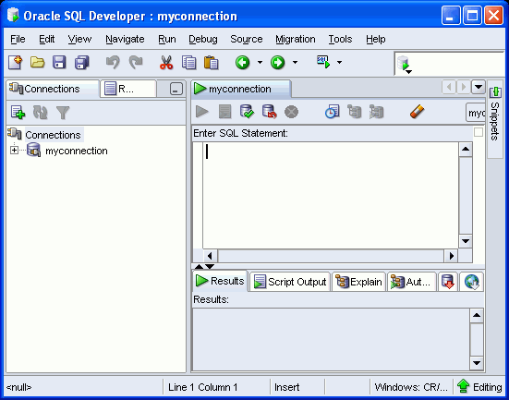
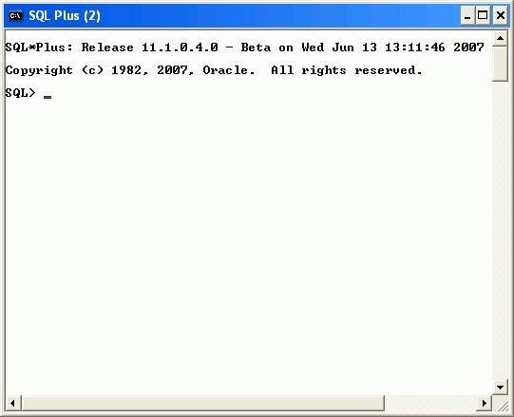
Development Environments
In this course:
  Primarily use SQL Developer 1.2
    Included in the Oracle Database 11g Client installation for Windows
  Use SQL*Plus
    In case you do not have access to SQL Developer
SQL Developer
SQL*Plus
Notes:
Oracle Database 11g: SQL Fundamentals II I - <number>
Development Environments
Oracle provides several tools for SQL development. Some of the development tools that are available for use in this course are:
Oracle SQL Developer: A graphical tool (Oracle SQL Developer 1.2 is used in this course.)
Oracle SQL*Plus: A window or command-line application
Note: The code and screen examples presented in the course notes were generated from output in the SQL Developer environment.

Slide 10
Lesson Agenda
  Course objectives and course agenda
  The database schema and appendixes used in the course and the available development environment in this course
  Overview of Oracle SQL Developer
  Review of some basic concepts of SQL
  Oracle Database 11g documentation and additional resources
Notes:
Oracle Database 11g: SQL Fundamentals II I - <number>

Slide 11

Review of Using Oracle SQL Developer
  Oracle SQL Developer is a free graphical tool that enhances productivity and simplifies database development tasks.
  You can connect to any target Oracle database schema using standard Oracle database authentication.
  You use SQL Developer in this course.
SQL Developer
Notes:
Oracle Database 11g: SQL Fundamentals II I - <number>
Review of Using Oracle SQL Developer
Oracle SQL Developer is a free graphical tool designed to improve your productivity and simplify the development of everyday database tasks. With just a few clicks, you can easily create and debug stored procedures, test SQL statements, and view optimizer plans.
SQL Developer, the visual tool for database development, simplifies the following tasks:
Browsing and managing database objects
Executing SQL statements and scripts
Editing and debugging PL/SQL statements
Creating reports
You can connect to any target Oracle database schema using standard Oracle database authentication. When connected, you can perform operations on objects in the database.
Note: The Oracle SQL Developer, release 1.2 is called the Migration release because it tightly integrates with Developer Migration Workbench. Therefore, it provides users with a single point to browse database objects and data in third party databases, and to migrate from these databases to Oracle. You can also connect to schemas for selected third-party (non-Oracle) databases, such as MySQL, Microsoft SQL Server, and Microsoft Access, and view metadata and data in these databases. Additionally Oracle SQL Developer, release 1.2 includes support for Oracle Application Express, release 3.0.1 (Oracle APEX).
For more information about using SQL Developer, see Appendix C.

Slide 12

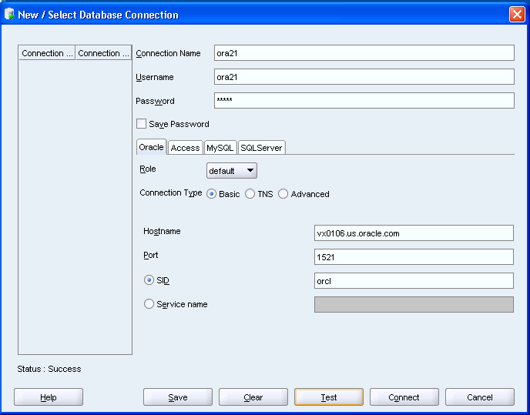
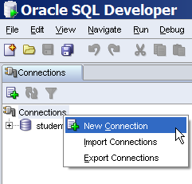
Creating a Database Connection
1
3
2
4
5
Notes:
Oracle Database 11g: SQL Fundamentals II I - <number>
Creating a Database Connection
To create a database connection, perform the following steps:
1. Double-click <your_path>\sqldeveloper\sqldeveloper.exe.
2. On the Connections tabbed page, right-click Connections and select New Connection.
3. Enter the connection name, username, password, host name, and SID for the database you want to connect.
4. Click Test to make sure that the connection has been set correctly.
5. Click Connect.
On the basic tabbed page, at the bottom, enter the following options:
Hostname: Host system for the Oracle database
Port: Listener port
System Identifier (SID): Database name
Service Name: Network service name for a remote database connection
If you select the Save Password check box, the password is saved to an XML file. So, after you close the SQL Developer connection and open it again, you will not be prompted for the password.

Slide 13
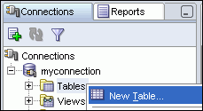
Creating a Schema Object
  You can create any schema object in SQL Developer using one of the following methods:
    Executing a SQL statement in the SQL Worksheet
    Using the context menu
  Edit the objects using an edit dialog box or one of the many context-sensitive menus.
  View the data definition language (DDL) for adjustments such as creating a new object or editing an existing schema object.
Expand Connections. Right-click Tables and select New Table.
Notes:
Oracle Database 11g: SQL Fundamentals II I - <number>
Creating a Schema Object
SQL Developer supports the creation of any schema object by executing a SQL statement in the SQL Worksheet. Alternatively, you can create objects using the shortcut menus. After they are created, you can edit the objects using an edit dialog box or one of many context-sensitive menus.
As new objects are created or existing objects are edited, the DDL for those adjustments is available for review. An Export DDL option is available if you want to create the full DDL for one or more objects in the schema.
The slide shows creating a table using the shortcut menu. To open a dialog box for creating a new table, right-click Tables and select New Table. The dialog boxes for creating and editing database objects have multiple tabs, each reflecting a logical grouping of properties for that type of object.

Slide 14
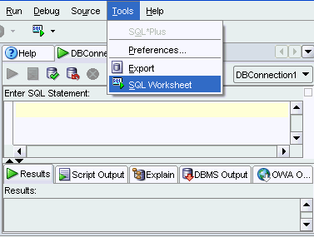
Using the SQL Worksheet
  Use the SQL Worksheet to enter and execute SQL and SQL*Plus statements.
  Specify any actions that can be processed by the database connection associated with the worksheet.
Notes:
Oracle Database 11g: SQL Fundamentals II I - <number>
Using the SQL Worksheet
When you connect to a database, a SQL Worksheet window for that connection is automatically opened. You can use the SQL Worksheet to enter and execute SQL, PL/SQL, and SQL*Plus statements. The SQL Worksheet supports most of the SQL*Plus statements. SQL*Plus statements that are not supported by the SQL Worksheet are ignored and not passed to the database.
You can specify any actions that can be processed by the database connection associated with the worksheet, such as:
Creating a table
Inserting data
Creating and editing a trigger
Selecting data from a table
Saving the selected data to a file
You can display a SQL Worksheet by using any of the following two options:
Select Tools > SQL Worksheet.
Click the Open SQL Worksheet icon.
Note: For the complete list of SQL*Plus statements that are supported, and not supported by the SQL Worksheet, refer to the “SQL*Plus Statements Supported and Not Supported in SQL Worksheet” topic in the SQL Developer online Help.

Slide 15
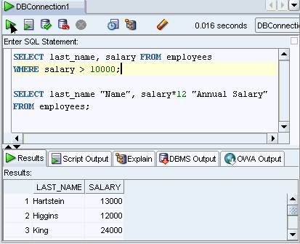
Executing SQL Statements
Use the Enter SQL Statement box to enter single or multiple SQL statements.
Notes:
Oracle Database 11g: SQL Fundamentals II I - <number>
Executing SQL Statements
In the SQL Worksheet, you can use the Enter SQL Statement box to type a single or multiple SQL statements. For a single statement, the semicolon at the end is optional.
When you enter the statement, the SQL keywords are automatically highlighted. To execute a SQL statement, ensure that your cursor is within the statement and click the Execute Statement icon. Alternatively, you can press [F9].
To execute multiple SQL statements and see the results, click the Run Script icon. Alternatively, you can press [F5].
In the example in the slide, because there are multiple SQL statements, the first statement is terminated with a semicolon. The cursor is in the first statement and so when the statement is executed, results corresponding to the first statement are displayed in the Results box.
Note: In this course, the following output options in SQL Developer are used for code examples and practices.
The Results pane for simple SELECT statements
The Script Output pane to display the output of DML and DDL operations

Slide 16
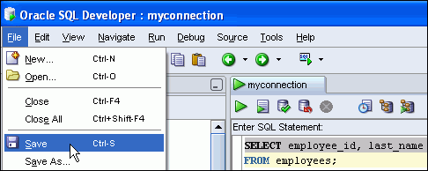
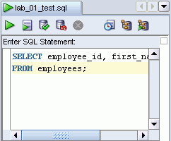

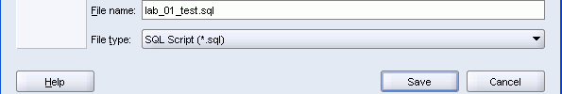
Saving SQL Statements
1
The contents of the saved file are visible and editable in your SQL Worksheet window.
3
2
Enter a file name and identify a location to save the file in the Save dialog box.
Notes:
Oracle Database 11g: SQL Fundamentals II I - <number>
Saving SQL Statements
In most of the practices that you will perform, you will need to save a particular query in the SQL Worksheet as a .sql file. To do so, perform the following:
1. From the File menu, select Save or Save As (if you are renaming a current .sql script) or you can right-click in the SQL Worksheet and select Save File. Alternatively, you can use [CTRL] + [S].
2. In the Save dialog box, enter the appropriate file name. Make sure the extension is .sql or the file type is selected as SQL Script (*.sql). Click Save.
Note: For this course, you need to save your .sql scripts in the D:\labs\sql2\labs folder.
3. The SQL Worksheet is renamed to the file name you saved the script as. Make sure you do not enter any other SQL statements in the same worksheet. To continue with other SQL queries, open a new worksheet.
After you save the contents to a file, the Enter SQL Statement box displays a tabbed page of your file contents. You can have multiple files open at once. Each file appears as a tabbed page.
Script Pathing
You can select a default path to look for scripts and to save scripts. Under the Tools > Preferences > Database > Worksheet Parameters, enter a value in the Select default path to look for scripts field.

Slide 17
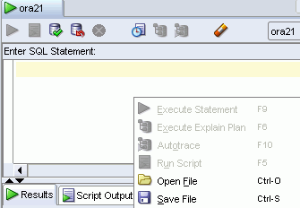
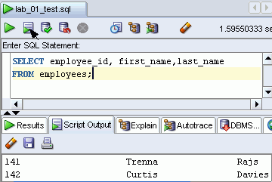
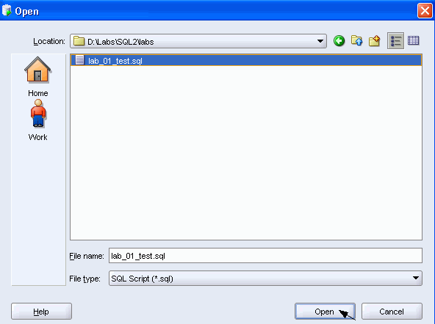
Executing SQL Scripts
3
1
The output from the script is displayed in the Script Output tabbed page.
2
Notes:
Oracle Database 11g: SQL Fundamentals II I - <number>
Executing SQL Scripts
To run the saved SQL scripts, perform the following steps:
1. Right-click in the SQL Worksheet and select Open File or from the File menu, select Open. Alternatively, you can use [CTRL] + [O].
2. In the Open dialog box, move to the D:\labs\sql2\labs folder or to the location you saved the script file, select the file, and click Open.
3. The script file opens in a new worksheet. Now, you can run the script by either clicking the Execute Statement icon or the Run Script icon. Again, make sure you do not enter any other SQL statements in the same worksheet. To continue with other SQL queries, open a new worksheet.
Alternatively, to run a saved SQL script, perform the following steps:
1. In the Enter SQL Statement window, use the @ command, followed by the location and name of the file you want to run.
2. Click the Run Script icon.
When you execute a SQL script, the results are displayed on the Script Output tabbed page. You can also save the script output by clicking the Save icon on the Script Output tabbed page. The Windows File Save dialog box appears and you can identify a name and location for your file.

Slide 18
Lesson Agenda
  Course objectives and course agenda
  The database schema and appendixes used in the course and the available development environment in this course
  Overview of Oracle SQL Developer
  Review of some basic concepts of SQL
  Oracle Database 11g documentation and additional resources
Notes:
Oracle Database 11g: SQL Fundamentals II I - <number>
Lesson Agenda
The next few slides provide a brief overview of some of the basic concepts that you learned in the course titled Oracle Database 11g: SQL Fundamentals I.

Slide 19

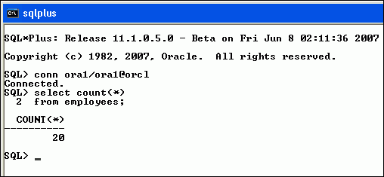
SQL Statements in SQL*Plus
In Oracle Database 11g, SQL*Plus is a command-line interface.
Notes:
Oracle Database 11g: SQL Fundamentals II I - <number>
SQL Statements in SQL*Plus
Oracle SQL*Plus is a command-line interface that enables you to submit SQL statements and PL/SQL blocks for execution and receive the results in an application or command window.
SQL*Plus is:
Shipped with the database
Installed on a client and on the database server system
Accessed from an icon or the command line
Note: If you do not have access to SQL Developer and would prefer to use SQL* Plus, the classroom setup provides the SQL*Plus icon on your desktop. It may also be useful to use it in cases when SQL Developer does not support any SQL* Plus command.

Slide 20
Review of Restricting Data
  Restrict the rows that are returned by using the WHERE clause.
  Use comparison conditions to compare one expression with another value or expression.
  Use logical conditions to combine the result of two component conditions and produce a single result based on those conditions.
Operator | Meaning
BETWEEN ...AND... | Between two values (inclusive)
IN(set) | Match any of a list of values
LIKE | Match a character pattern
Notes:
Oracle Database 11g: SQL Fundamentals II I - <number>
Review of Restricting and Sorting Data
You can restrict the rows that are returned from the query by using the WHERE clause. A WHERE clause contains a condition that must be met, and it directly follows the FROM clause.
The WHERE clause can compare values in columns, literal values, arithmetic expression, or functions. It consists of three elements:
Column name
Comparison condition
Column name, constant, or list of values
You use comparison conditions in the WHERE clause in the following format:
... WHERE expr operator value
Apart from those mentioned in the slide, you use other comparison conditions such as =, <, >, <>, <=, and >=.
Three logical operators are available in SQL:
AND
OR
NOT

Slide 21
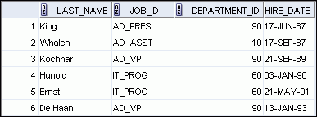
Review of Sorting Data
  Sort retrieved rows with the ORDER BY clause:
    ASC: Ascending order, default
    DESC: Descending order
  The ORDER BY clause comes last in the SELECT statement:
SELECT last_name, job_id, department_id, hire_date
FROM employees
ORDER BY hire_date ;
…
Notes:
Oracle Database 11g: SQL Fundamentals II I - <number>
Review of Sorting Data
The order of rows that are returned in a query result is undefined. The ORDER BY clause can be used to sort the rows. If you use the ORDER BY clause, it must be the last clause of the SQL statement. You can specify an expression, an alias, or a column position as the sort condition.
Syntax
SELECT expr
FROM table
[WHERE condition(s)]
[ORDER BY {column, expr, numeric_position} [ASC|DESC]];
In the syntax:
ORDER BY Specifies the order in which the retrieved rows are displayed
ASC Orders the rows in ascending order (This is the default order.)
DESC Orders the rows in descending order
If the ORDER BY clause is not used, the sort order is undefined, and the Oracle server may not fetch rows in the same order for the same query twice. Use the ORDER BY clause to display the rows in a specific order.

Slide 22
Review of SQL Functions
Functions
Single-row
functions
Multiple-row
functions
Return one result
per row
Return one result
per set of rows
Notes:
Oracle Database 11g: SQL Fundamentals II I - <number>
Review of SQL Functions
There are two types of functions:
Single-row functions
Multiple-row functions
Single-Row Functions
These functions operate on single rows only and return one result per row. There are different types of single-row functions such as character, number, date, conversion, and general functions.
Multiple-Row Functions
Functions can manipulate groups of rows to give one result per group of rows. These functions are also known as group functions.

Slide 23
Review of Single-Row Functions
Character
General
Single-row
functions
Number
Conversion
Date
Notes:
Oracle Database 11g: SQL Fundamentals II I - <number>
Review of Single-Row Functions
The following are different types of single-row functions:
Character functions: Αccept character input and can return both character and number values
Number functions: Accept numeric input and return numeric values
Date functions: Operate on values of the DATE data type (All date functions return a value of the DATE data type except the MONTHS_BETWEEN function, which returns a number.)
Conversion functions: Convert a value from one data type to another
General functions:
NVL
NVL2
NULLIF
COALESCE
CASE
DECODE

Slide 24
Review of Types of Group Functions
  AVG
  COUNT
  MAX
  MIN
  STDDEV
  SUM
  VARIANCE
Group
functions
Notes:
Oracle Database 11g: SQL Fundamentals II I - <number>
Review of Types of Group Functions
Each of the functions accepts an argument. The following table identifies the options that you can use in the syntax:

Slide 25
Review of Using Subqueries
  A subquery is a SELECT statement nested in a clause of another SELECT statement.
  Syntax:
  Types of subqueries:
SELECT select_list
FROM table
WHERE expr operator
(SELECT select_list
FROM table );
Single-row subquery | Multiple-row subquery
Returns only one row | Returns more than one row
Uses single-row comparison operators | Uses multiple-row comparison operators
Notes:
Oracle Database 11g: SQL Fundamentals II I - <number>
Review of Using Subqueries
You can build powerful statements out of simple ones by using subqueries. Subqueries are useful when a query is based on a search criterion with unknown intermediate values.
You can place the subquery in a number of SQL clauses, including the following:
WHERE clause
HAVING clause
FROM clause
The subquery (inner query) executes once before the main query (outer query). The result of the subquery is used by the main query.
A single-row subquery uses a single-row operator such as =, >, <, >=, <=, and <>. With a multiple-row subquery, you use a multiple-row operator such as IN, ANY, and ALL.
Example: Display details of employees whose salary is equal to the minimum salary.
SELECT last_name, salary, job_id
FROM employees
WHERE salary = (SELECT MIN(salary)
FROM employees );
In the example, the MIN group function returns a single value to the outer query.
Note: In this course, you learn how to use multiple-column subqueries. Multiple-column subqueries return more than one column from the inner SELECT statement.

Slide 26
Review of Manipulating Data
A data manipulation language (DML) statement is executed when you:
  Add new rows to a table
  Modify existing rows in a table
  Remove existing rows from a table
Function | Description
INSERT | Adds a new row to the table
UPDATE | Modifies existing rows in the table
DELETE | Removes existing rows from the table
MERGE | Updates, inserts, or deletes a row conditionally into/from a table
Notes:
Oracle Database 11g: SQL Fundamentals II I - <number>
Review of Manipulating Data
When you want to add, update, or delete data in the database, you execute a DML statement. A collection of DML statements that form a logical unit of work is called a transaction. You can add new rows to a table by using the INSERT statement. With the following syntax, only one row is inserted at a time.
INSERT INTO table [(column [, column…])]
VALUES (value[, value...]);
You can use the INSERT statement to add rows to a table where the values are derived from existing tables. In place of the VALUES clause, you use a subquery. The number of columns and their data types in the column list of the INSERT clause must match the number of values and their data types in the subquery.
The UPDATE statement modifies specific rows if you specify the WHERE clause.
UPDATE table
SET column = value [, column = value, ...]
[WHERE condition];
You can remove existing rows by using the DELETE statement. You can delete specific rows by specifying the WHERE clause in the DELETE statement.
DELETE [FROM] table
[WHERE condition];
You learn about the MERGE statement in the lesson titled “Manipulating Large Data Sets.”

Slide 27
Lesson Agenda
  Course objectives and course agenda
  The database schema and appendixes used in the course and the available development environment in this course
  Overview of Oracle SQL Developer
  Review of some basic concepts of SQL
  Oracle Database 11g documentation and additional resources
Notes:
Oracle Database 11g: SQL Fundamentals II I - <number>

Slide 28
Summary
In this lesson, you should have learned the following:
  The course objectives
  The sample tables used in the course
Notes:
Oracle Database 11g: SQL Fundamentals II I - <number>

Slide 29
Practice I: Overview
This practice covers the following topics:
  Running the SQL Developer online tutorial
  Starting SQL Developer and creating a new database connection and browsing the HR tables
  Executing SQL statements using the SQL Worksheet
  Reviewing the basic concepts of SQL
Notes:
Oracle Database 11g: SQL Fundamentals II I - <number>
Practice I: Overview
In this practice, you use SQL Developer to execute SQL statements to examine data in the HR schema.
Note: All written practices use SQL Developer as the development environment. Although it is recommended that you use SQL Developer, you can also use the SQL*Plus environment that is available in this course.

Slide 30
Practice 1
  This is the first of many practices in this course. Practices are intended to cover most of the topics that are presented in
  the corresponding lesson.
    Accessing SQL Developer resources
    1. Access the SQL Developer home page.
      a. Access the online SQL Developer Home Page available at:
      http://www.oracle.com/technology/products/database/sql_developer/index.html
      b. Bookmark the page for easier future access.
    2. Access the SQL Developer tutorial available online at:
    https://download.oracle.com/oll/tutorials/SQLDeveloper/index.htm
    Then review the following sections and associated demos:
      a. What to Do First
      b. Working with Database Objects
      c. Accessing Data
  Starting SQL Developer, Creating and Testing a New SQL Developer Database
  Connection, and Connecting to your oraxx account
    3. Start up SQL Developer using the Desktop icon.
    4. Create a database connection using the following information:
      a. Connection Name: myconnection
      b. Username: oraxx where xx is the number of your PC (Ask your instructor to assign you one ora account out of the ora21-ora40 range of accounts.)
      c. Password: oraxx
      d. Hostname: Enter the host name for your PC.
      e. Port: 1521
      f. SID: ORCL (or the value provided to you by the instructor)
    5. Test the new connection. If the status is Success, connect to the database using this new connection.
      a. Click the Test button in the New/Select Database Connection window.
      b. If the status is Success, click the Connect button.
  Browsing the Tables
    6. Browse the structure of the EMPLOYEES table and display its data.
      a. Expand the myconnection connection by clicking the plus sign next to it.
      b. Expand the Tables icon by clicking the plus sign next to it.
      c. Display the structure of the EMPLOYEES table.
    7. View the data of the DEPARTMENTS table.
Notes:
Oracle Database 11g: SQL Fundamentals II I - <number>
Practice 1
This is the first of many practices in this course. Practices are intended to cover most of the topics that are presented in
the corresponding lesson.
Accessing SQL Developer resources
1. Access the SQL Developer home page.
a. Access the online SQL Developer Home Page available at:
http://www.oracle.com/technology/products/database/sql_developer/index.html
b. Bookmark the page for easier future access.
2. Access the SQL Developer tutorial available online at:
https://download.oracle.com/oll/tutorials/SQLDeveloper/index.htm
Then review the following sections and associated demos:
a. What to Do First
b. Working with Database Objects
c. Accessing Data
Starting SQL Developer, Creating and Testing a New SQL Developer Database
Connection, and Connecting to your oraxx account
3. Start up SQL Developer using the Desktop icon.
4. Create a database connection using the following information:
a. Connection Name: myconnection
b. Username: oraxx where xx is the number of your PC (Ask your instructor to assign you one ora account out of the ora21-ora40 range of accounts.)
c. Password: oraxx
d. Hostname: Enter the host name for your PC.
e. Port: 1521
f. SID: ORCL (or the value provided to you by the instructor)
5. Test the new connection. If the status is Success, connect to the database using this new connection.
a. Click the Test button in the New/Select Database Connection window.
b. If the status is Success, click the Connect button.
Browsing the Tables
6. Browse the structure of the EMPLOYEES table and display its data.
a. Expand the myconnection connection by clicking the plus sign next to it.
b. Expand the Tables icon by clicking the plus sign next to it.
c. Display the structure of the EMPLOYEES table.
7. View the data of the DEPARTMENTS table.

Slide 31
    8. Execute some basic SELECT statements to query the data in the EMPLOYEES table in the SQL Worksheet area. Use both the Execute Statement (or press [F9]) and the Run Script (or press [F5]) icons to execute the SELECT statements. Review the results of both methods of executing the SELECT statements on the appropriate tabbed pages.
      a. Write a query to select the last name and salary for any employee whose salary is less than
      or equal to $3,000.
      b. Write a query to display last name, job ID, and commission for all employees who are not
      entitled to receive a commission.
    9. Set your script pathing preference to c:\labs\SQL2.
      a. Select Tools > Preferences > Database > Worksheet Parameters.
      b. Enter the value in the Select default path to look for scripts field.
    10. Enter the following in the Enter SQL Statement box.
    SELECT employee_id, first_name, last_name,
    FROM employees;
    11. Save the SQL statement to a script file using the File > Save As menu item.
      a. Select File > Save As.
      b. Name the file intro_test.sql.
      c. Place the file under your D:\labs\labs folder.
    12. Open and run confidence.sql from your D:\Labs\labs folder, and observe the output.
  Quiz
    1. What condition do you use to display rows based on a range of values?
    _____________________________________________________________________
    2. The character pattern–matching operation is also referred to as:
    _____________________________________________________________________
    3. Group functions return one result per row. True/False.
    _____________________________________________________________________
    4. Which function converts mixed case or lowercase character strings to uppercase?
    _____________________________________________________________________
    5. Which among the following are group functions?
      a. MAX
      b. TRUNC
      c. STDDEV
      d. MOD
      e. CONCAT
      f. SUM
    _____________________________________________________________________
    6. What is the default sorting order of rows?
    _____________________________________________________________________
    7. You can sort by a column that is not in the SELECT list. True/False.
    _____________________________________________________________________
    8. You cannot specify a column position as the sort expression. True/False. _____________________________________________________________________
    9. Which statement do you use to modify existing rows in a table? _____________________________________________________________________
Notes:
Oracle Database 11g: SQL Fundamentals II I - <number>
Practice 1 (continued)
Using the SQL Worksheet
8. Execute some basic SELECT statements to query the data in the EMPLOYEES table in the SQL Worksheet area. Use both the Execute Statement (or press [F9]) and the Run Script (or press [F5]) icons to execute the SELECT statements. Review the results of both methods of executing the SELECT statements on the appropriate tabbed pages.
a. Write a query to select the last name and salary for any employee whose salary is less than
or equal to $3,000.
b. Write a query to display last name, job ID, and commission for all employees who are not
entitled to receive a commission.
9. Set your script pathing preference to c:\labs\SQL2.
a. Select Tools > Preferences > Database > Worksheet Parameters.
b. Enter the value in the Select default path to look for scripts field.
10. Enter the following in the Enter SQL Statement box.
SELECT employee_id, first_name, last_name,
FROM employees;
11. Save the SQL statement to a script file using the File > Save As menu item.
a. Select File > Save As.
b. Name the file intro_test.sql.
c. Place the file under your D:\labs\labs folder.
12. Open and run confidence.sql from your D:\Labs\labs folder, and observe the output.
Quiz
1. What condition do you use to display rows based on a range of values?
_____________________________________________________________________
2. The character pattern–matching operation is also referred to as:
_____________________________________________________________________
3. Group functions return one result per row. True/False.
_____________________________________________________________________
4. Which function converts mixed case or lowercase character strings to uppercase?
_____________________________________________________________________
5. Which among the following are group functions?
a. MAX
b. TRUNC
c. STDDEV
d. MOD
e. CONCAT
f. SUM
_____________________________________________________________________
6. What is the default sorting order of rows?
_____________________________________________________________________
7. You can sort by a column that is not in the SELECT list. True/False.
_____________________________________________________________________
8. You cannot specify a column position as the sort expression. True/False. _____________________________________________________________________
9. Which statement do you use to modify existing rows in a table? _____________________________________________________________________

Slide 32
    10. What happens if you do not specify the WHERE clause in a DELETE statement?
      __________________________________________________________________________
    11.Consider a SELECT statement that consists of three query blocks: the outer query and two inner queries. If both the inner queries return single values, what do you call such a SQL statement?
      __________________________________________________________________________
    12.You can use subqueries only in the WHERE clause but not in the HAVING clause. True/False.
    __________________________________________________________________________
    13.Observe the following SELECT statement. What happens when there is no employee named Kiran?
        SELECT last_name, job_id
        FROM employees
        WHERE job_id =
        (SELECT job_id
        FROM employees
        WHERE last_name = ‘Kiran’);
  __________________________________________________________________________
    14. The subqueries are processed first by the Oracle server, after which the WHERE or HAVING clause uses the results. True/False.
  __________________________________________________________________________
Notes:
Oracle Database 11g: SQL Fundamentals II I - <number>
Practice 1 (continued)
Quiz (continued)
10. What happens if you do not specify the WHERE clause in a DELETE statement?
__________________________________________________________________________
11. Consider a SELECT statement that consists of three query blocks: the outer query and two inner queries. If both the inner queries return single values, what do you call such a SQL statement?
__________________________________________________________________________
12. You can use subqueries only in the WHERE clause but not in the HAVING clause. True/False.
__________________________________________________________________________
13. Observe the following SELECT statement. What happens when there is no employee named Kiran?
SELECT last_name, job_id
FROM employees
WHERE job_id =
(SELECT job_id
FROM employees
WHERE last_name = ‘Kiran’);
__________________________________________________________________________
14. The subqueries are processed first by the Oracle server, after which the WHERE or HAVING clause uses the results. True/False.
__________________________________________________________________________

