Slide 1
Title: StockFlow (Inventory Management System) (Database-Only Project)
Subtitle: Database Design and Query of Data Using SQL and Python

Slide 2
Introduction
The objective of this project is to design and implement an efficient database system for managing and tracking inventory data for hardware products. The system should enable the storage, retrieval, and modification of key inventory information, including product details, suppliers, customer orders, and stock levels. Using SQL for data querying and Python for interaction with the database.
Objective:
Tech stack: Mysql workbench , SQL ,python, Jupyter Notebook

Slide 3
Project Goals
The goal of this project is to develop a robust and scalable database system for an Inventory Management System focused on hardware products. This system will:
Centralize inventory data for efficient tracking of products, suppliers, orders, and stock levels.
Streamline the process of managing stock inflows and outflows, ensuring optimal stock levels are maintained.
Facilitate accurate and efficient querying of data using SQL for business insights, including stock availability, product performance, and order tracking.

Slide 4


Entities in the System
Products: Information about items in stock.
Category – Information about Products category
Customers: Information about customer name, phone, email, address
Order details: Product order detail such as Order date, quantity, price customer, product
Inventory Transactions: information about stock and warehouse
Warehouse- Information about warehouse location

Slide 5
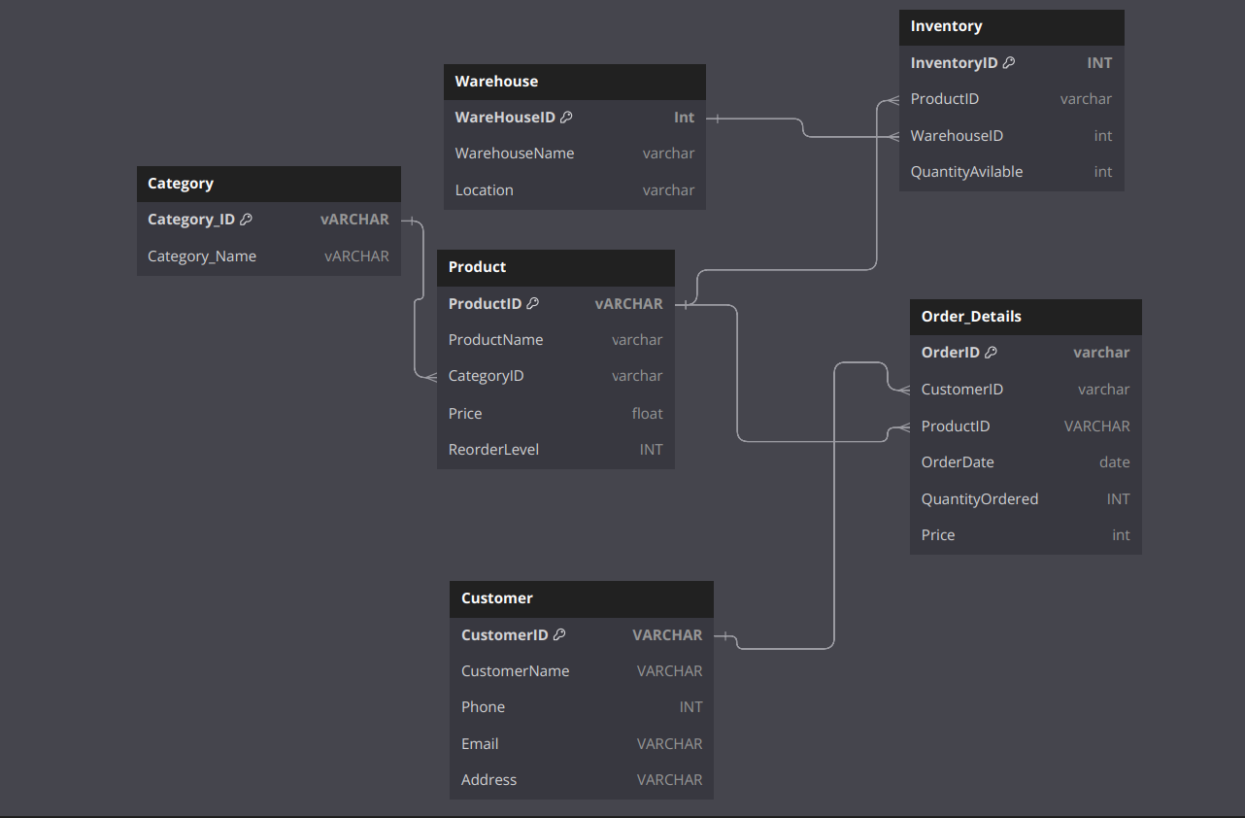
Database Design Overview
ER Diagram:

Slide 6
SQL Queries for Operations
Data Base and Table Creation
Insertion of the data into all table
Track of the product Order based analysis.
Monitor the product quantity before being out of stock
Implement the store procedure to automate the analysis of product, price and quantity
Sales Tracking: Query to track daily, weekly, or monthly sales volumes.

Slide 7
Thank you

