Slide 1
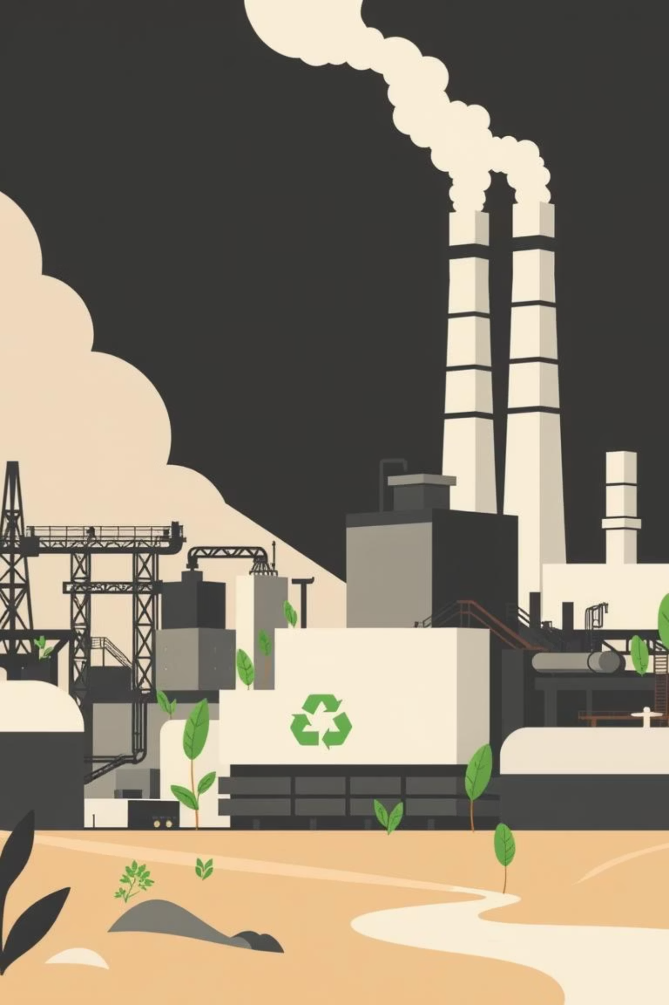
Turning Steel Waste into Permanent Carbon Storage
A Circular Economy Solution for Decarbonising Steel
Team: The Glitch Syndicate.
Challenge: Decarbonising Steel Industry

Slide 2
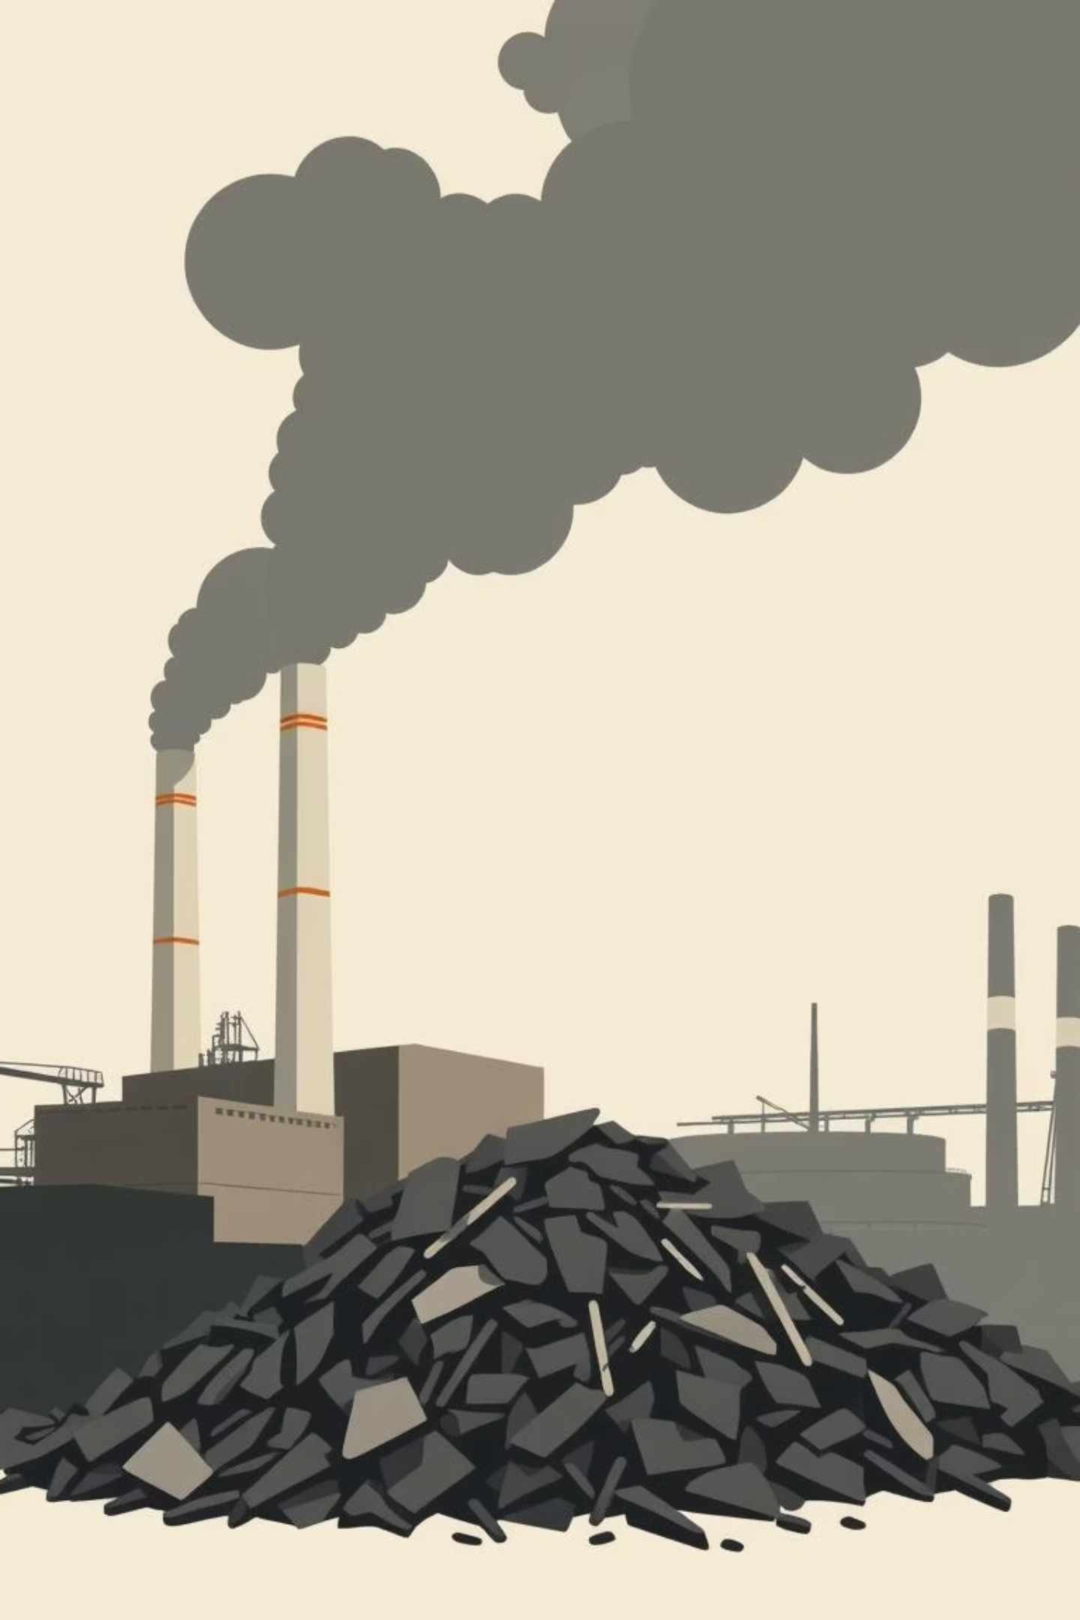
The Problem: Steel's Carbon Footprint
Significant CO2 Emissions
Steel Slag Waste
7-9% of all global CO2 emissions come from producing steel.
India alone produces 20+ Mt of steel slag annually which is typically landfilled.
Inefficient Carbon Capture
Current carbon capture technologies are expensive and energy-intensive.
The industry requires affordable and sustainable technologies for carbon emissions reduction and steel slag valorization to achieve decarbonization objectives.

Slide 3
Our Solution: Accelerated Mineralisation Reactor
Our Accelerated Mineralisation Reactor captures industrial flue gas CO2 and reacts it with industrial steel slag waste. It transforms the CO2 and slag into stable carbonates in the process, turning waste into value-added green cement.
Carbon Capture
Waste Management
Revenue Stream
Process Diagram
Capture Co2
React with Slag
From Carbonates
Produce Green Materials
Capture CO2
Steel plant generates slag (waste).
Flue gases (CO₂) routed to mineralisation reactor.
Slag reacts → calcium carbonates (caps CO₂).
Product: Eco-construction materials.
Key Points:
Minimal modification to current plants.
Low CAPEX compared to traditional CCS.
Scalable, modular reactors.
How it works
Produce Green Materials

Slide 4
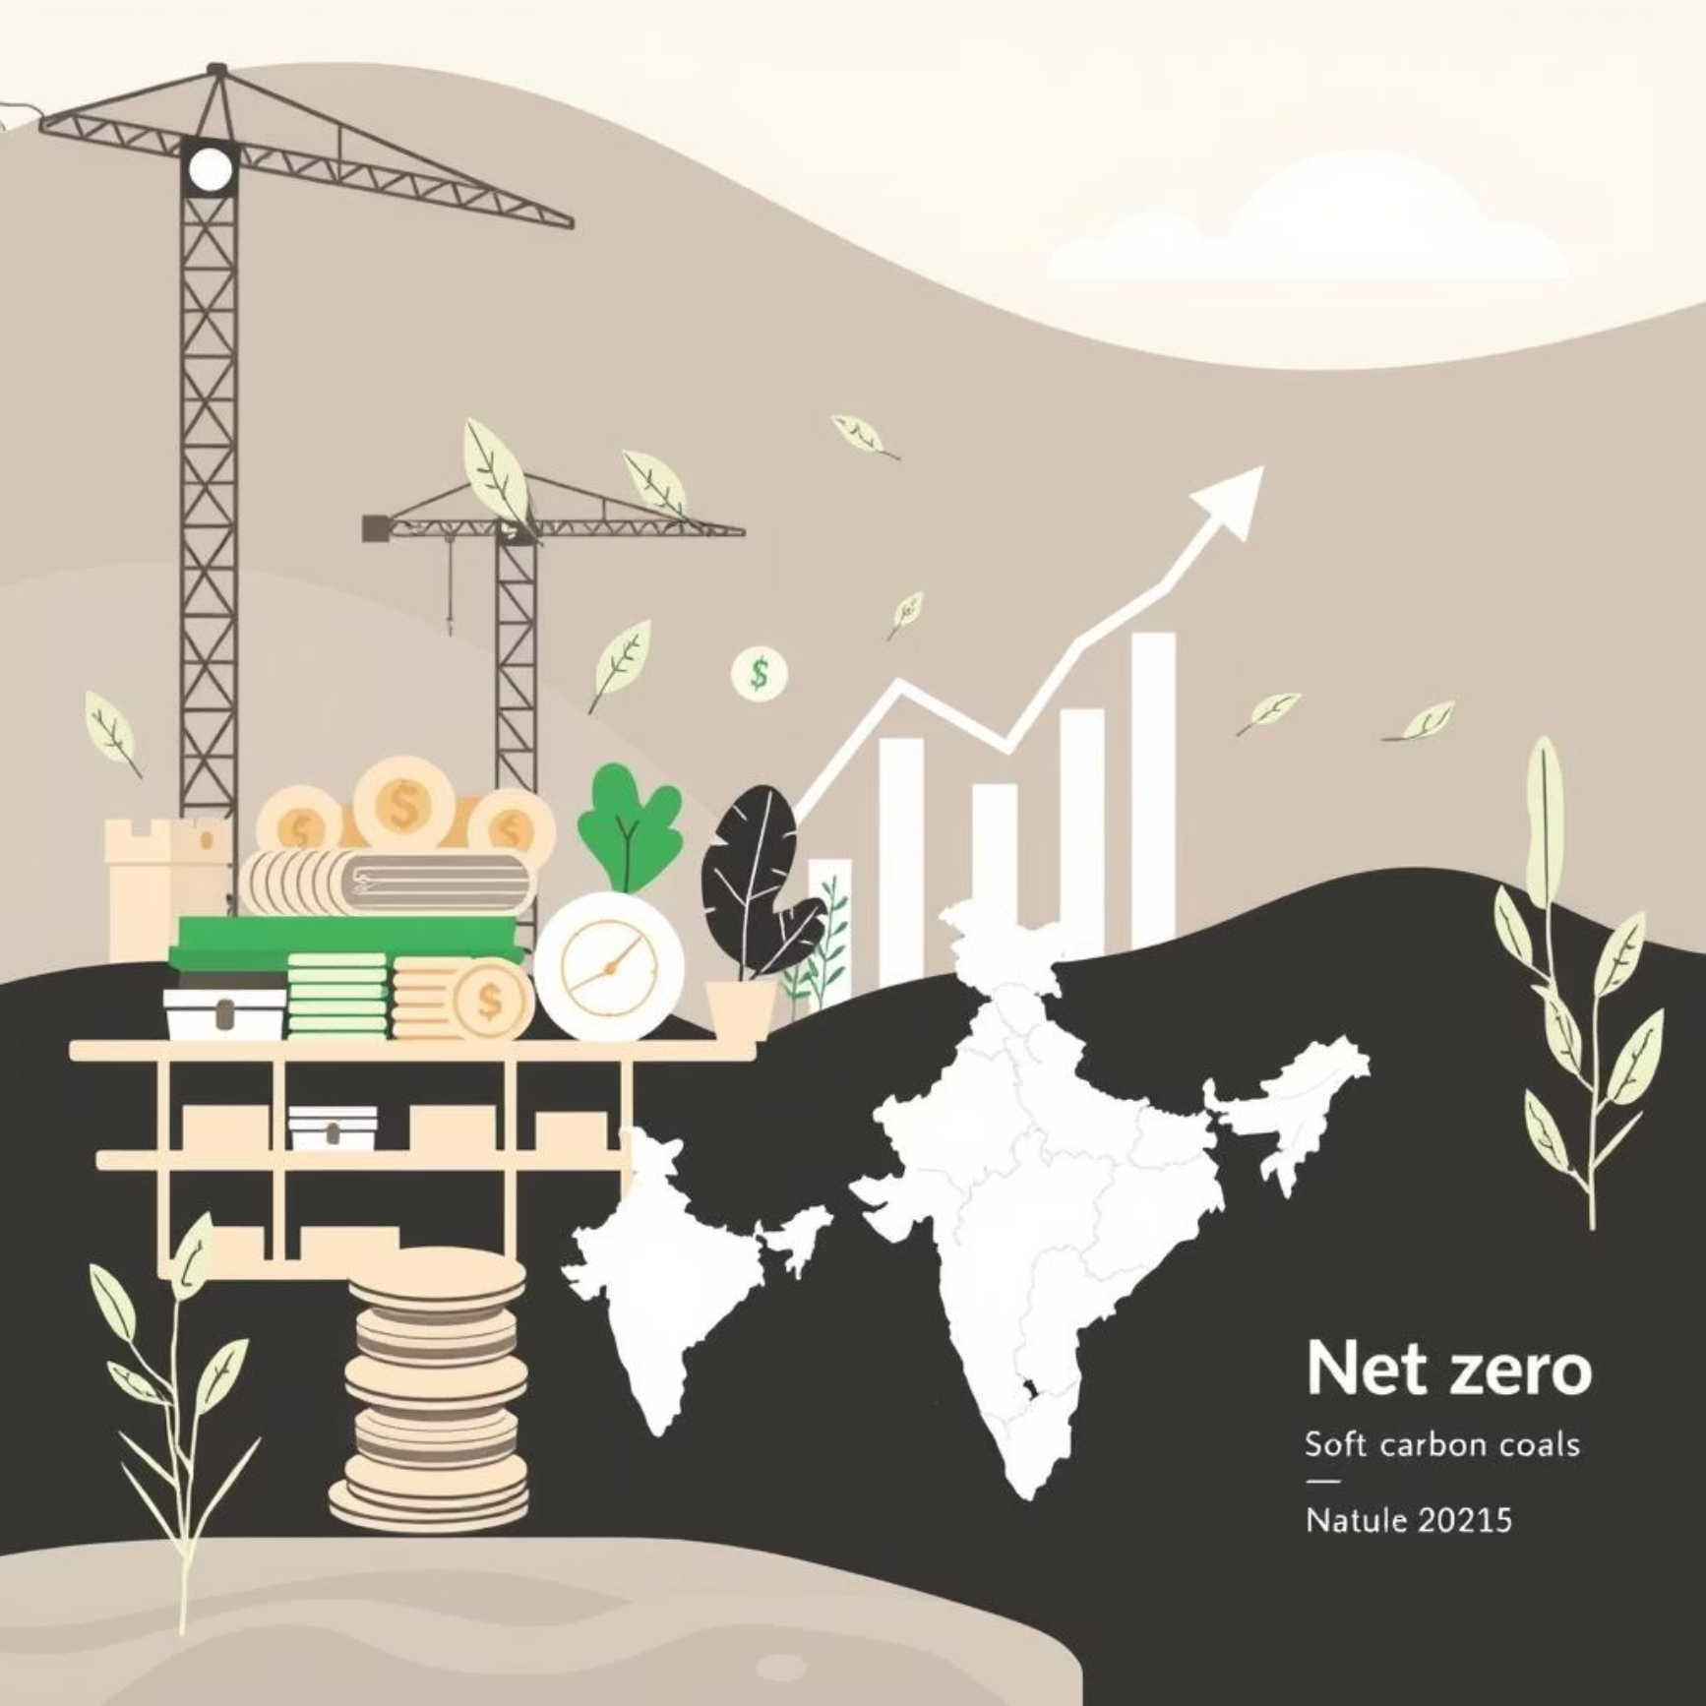
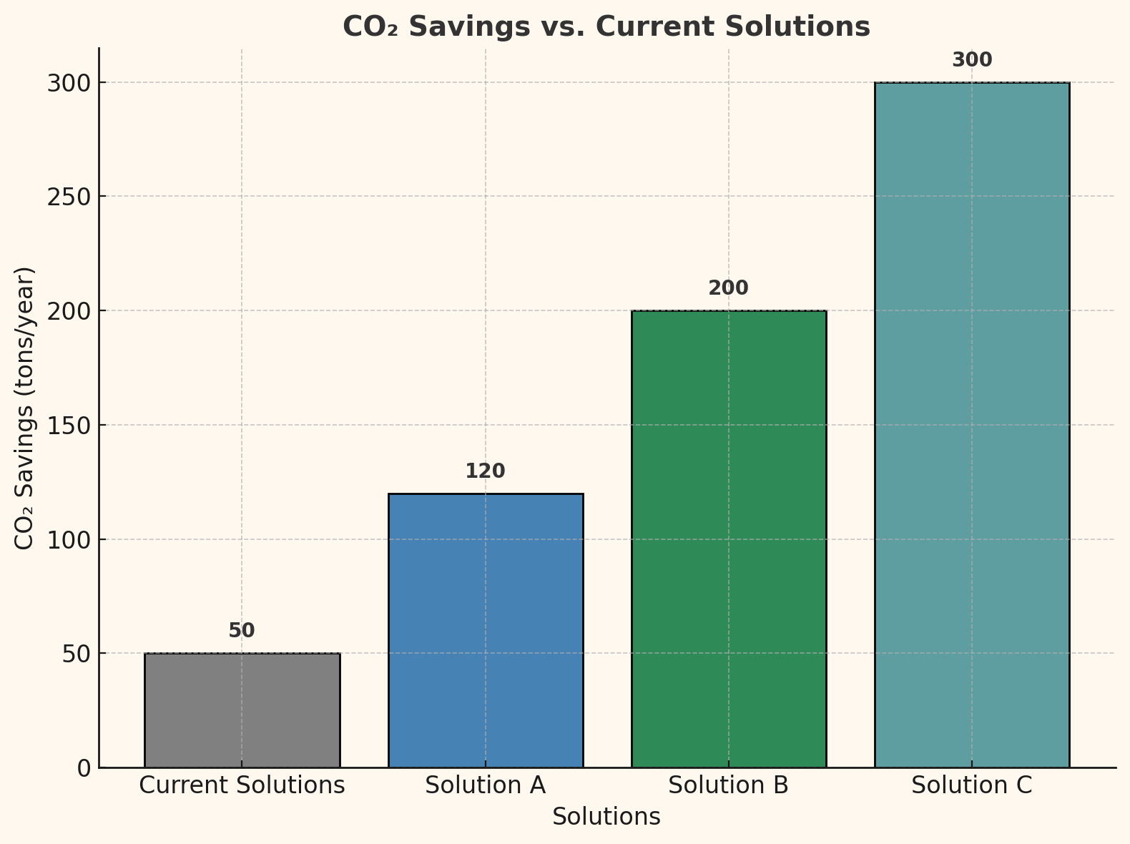
Environmental & Market Impact
Environmental Impact:
1 ton slag
If scaled to 50% of India’s slag
sequesters 300–350 kg CO₂
6–7 Mt CO₂ locked annually.
Market Impact:
Green construction materials market = $400B+ globally.
Steel mills receive carbon credits + new revenue.
Aligns with India’s Net Zero 2070 goals.
1 ton of slag captures 300-350 kg of CO2, scaling to 50% of India's slag could lock 6-7 Mt CO2 annually.
green construction materials market worth $400B+ globally, steel plants gain carbon credits and new revenue streams, aligns with India's Net Zero 2070 goals.

Slide 5

Next Steps & Partnership
Implementation Timeline
1
Phase 1: Build Prototype
Design and test a lab-scale reactor prototype.
2
Phase 2: Pilot Program
Partner with a steel plant for a pilot program to validate performance.
3
Phase 3: Scale Operations
Scale operations through industry licensing and commercial roll-out.
What We Need
Mentorship from industry leaders
Direction and technical experience to breach market entry and technical challenges.
Funding for development
Capital to accelerate R&D, prototype manufacture, and pilot project deployment.
Industry partnerships
Strategic collabrations with steel producers and material suppliers for adoption and scaling.

Slide 6
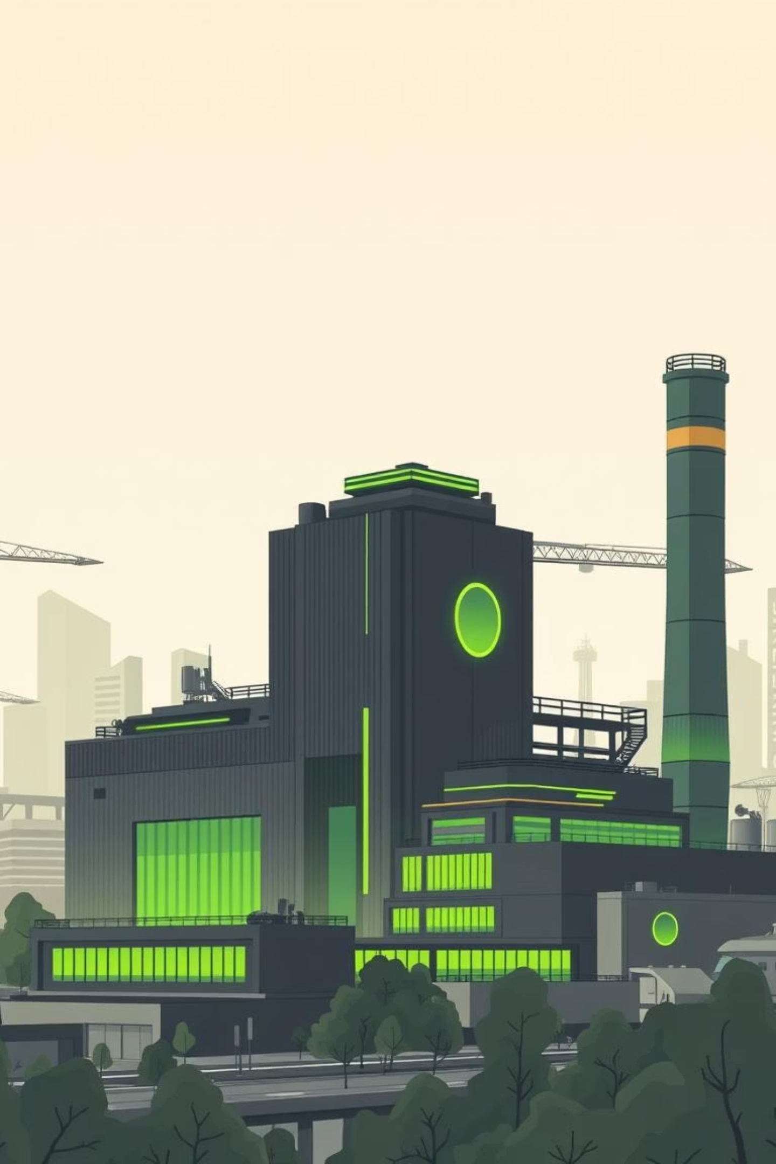
A Greener Future for Steel
By transforming the steel waste into a sustainable source of carbon capture and a circular economy, we are shaping the future for a more sustainable steel industry.
Join us on this journey to innovate and build a truly sustainable future for steel.

