Slide 1
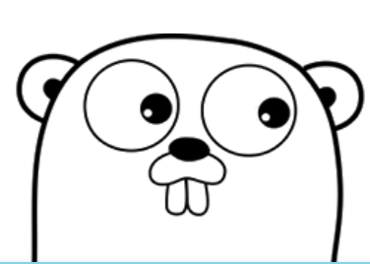
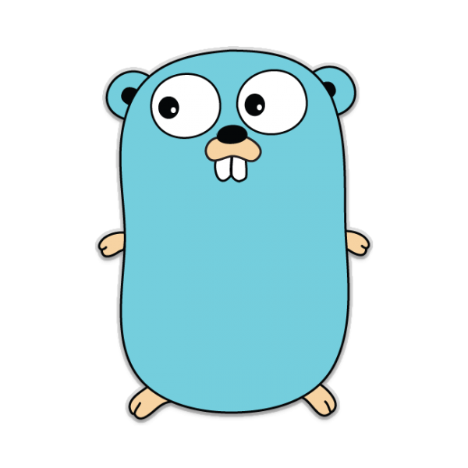
Programming Language：GO
Group：12
Shudong Lai, Jingzhou Shen, Jie Zhu
Notes:
Logo is a gopher created by Renee.

Slide 2
Go
Go is a statically typed, compiled programming language designed at Google by Robert Griesemer, Rob Pike, and Ken Thompson.
Go is syntactically similar to C, but with memory safety, garbage collection, structural typing, and CSP-style concurrency.

Slide 3
Content
Names, Binding, and Scopes
Data Types
Expressions and Assignment Statements
Support to OO programming
Concurrency
Exception Handling and Event Handling
Functional Programming

Slide 4
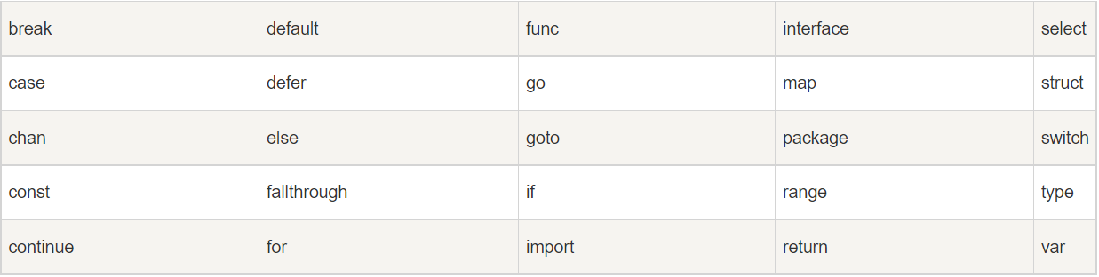
Names, Binding, and Scopes
A variables name can use letters, numbers and underline(“_”). But first character must be letters or underline. And it is Case sensitive.
Reserved Word

Slide 5
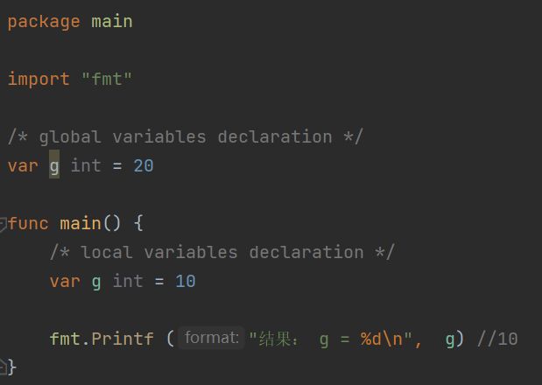
Names, Binding, and Scopes
It also has local variables and global variables. Local variables have the first priority. For example:

Slide 6
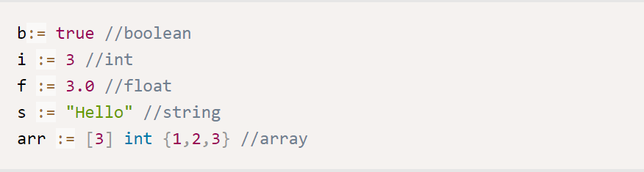
Data Types
Go has different data types such as boolean, int, float, pointer, array, struct, function, slice, interface and so on.

Slide 7
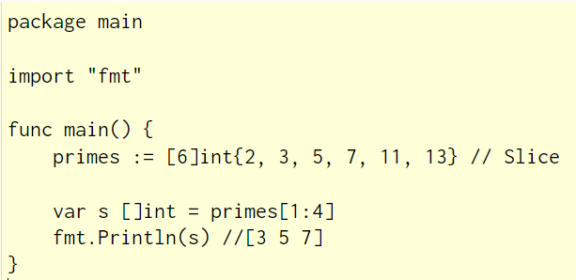
Slice
An array has a fixed size. A slice, on the other hand, is a dynamically-sized, flexible view into the elements of an array. In practice, slices are much more common than arrays.
Notes:
And we can use append() to expand the capacity of slice.

Slide 8
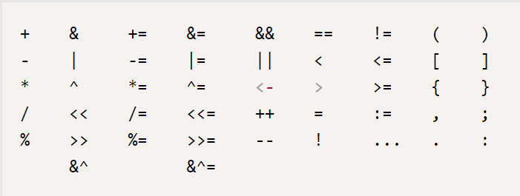
Expressions and Assignment Statements
Go has the following character represent operators to make the language more convenient and shorter.
Warning: the golang cannot allow variables with different data type to operator with each other

Slide 9



Expressions and Assignment Statements
There are three ways for assignment:
Var v1, vtype1
V1 = value
//If not initialize it, the value would be 0
Var v1 = value
//The type of the v1 would depend on the data type of the value
V1 := value
//Identify and initialize the variable
//This method cannot be used if the variable has already been declared

Slide 10
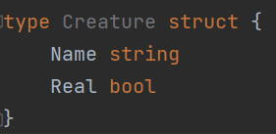
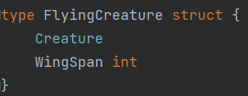
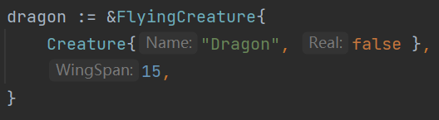
OO programming: Struct
Go is an OOP language.
It doesn’t have “class”, but it supports struct, like:
type Creature struct {
Name string
Real bool
}
Structs are user-defined types. Struct types (including methods) provide services similar to classes in other languages.
You can embed anonymous structs into each other, like:
type FlyingCreature struct {
Creature
WingSpan int
}
And at that time you can do things like that:
dragon := &FlyingCreature{
Creature{"Dragon", false },
15,
}

Slide 11
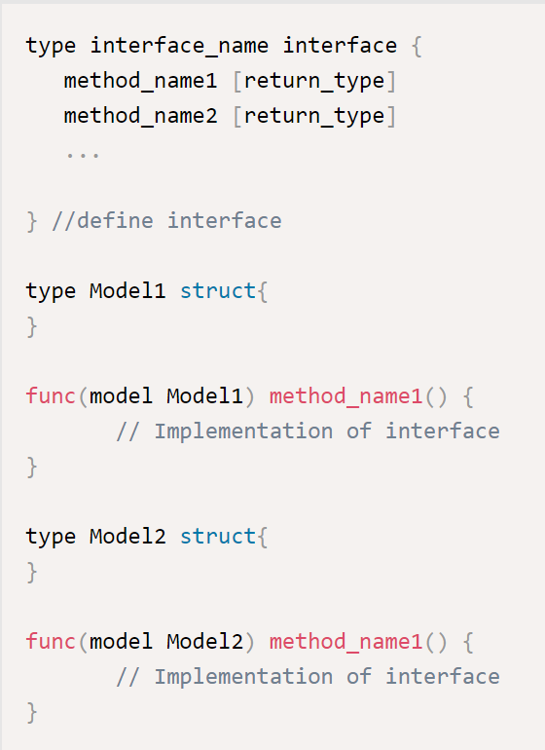
OO programming: Interface
Interfaces are a hallmark of the Go language's object-oriented support. An interface is a type that declares a set of methods. Like interfaces in other languages, they do not contain implementations of methods.
Objects that implement all interface methods automatically implement the interface. It has no inheritance or subclass or "implements" keyword.

Slide 12
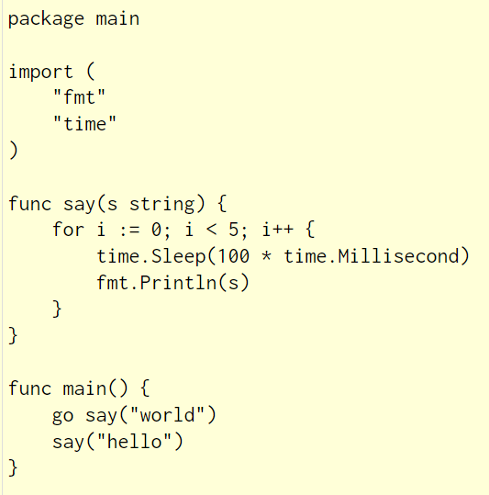
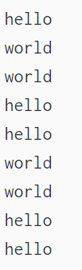
Concurrency
Goroutine is at the heart of Go's parallel design. A Goroutine is essentially a coroutine, but it's smaller than a thread. It's not strictly a thread, They are not true threads because they do not always execute in parallel. However, because of multiplexing and synchronization, you get concurrent effects. Just like the example below:
It will generate a random series of “world”, ”hello”.

Slide 13
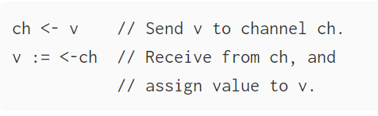

Concurrency: Channels
Channels are a typed conduit through which you can send and receive values with the channel operator, <-.
Like maps and slices, channels must be created before use:
By default, sends and receives block until the other side is ready. This allows goroutines to synchronize without explicit locks or condition variables.

Slide 14
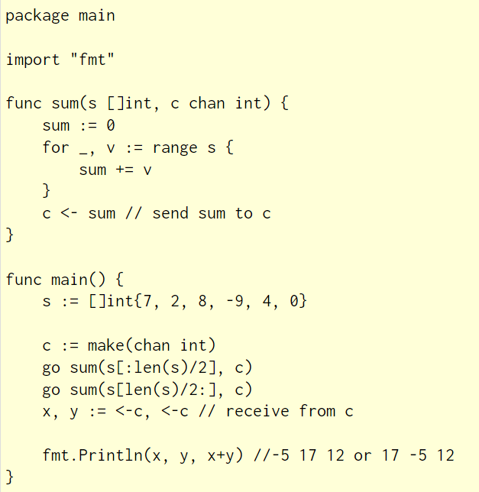
Channels example
Notes:
The example code sums the numbers in a slice, distributing the work between two goroutines. Once both goroutines have completed their computation, it calculates the final result.

Slide 15
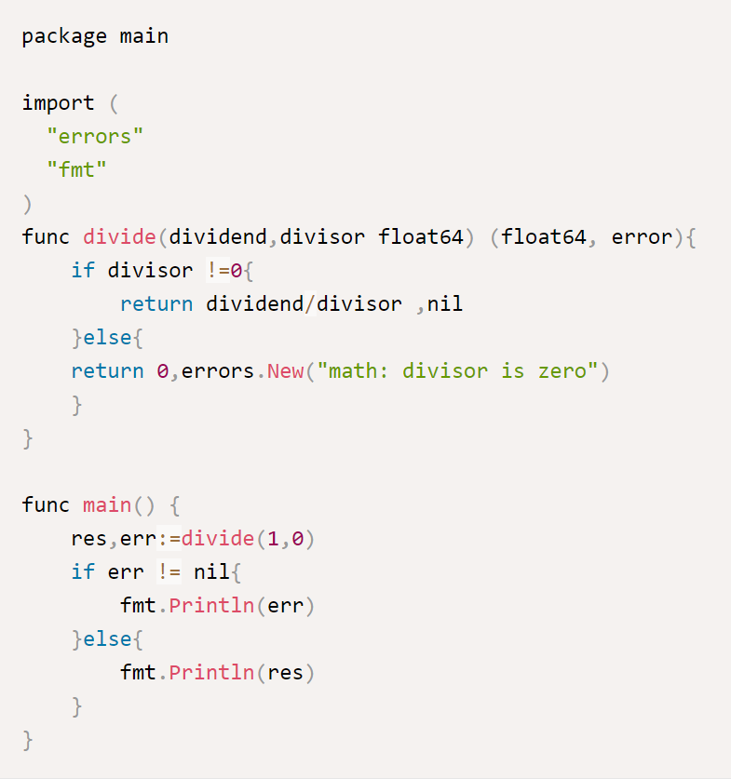
Exception Handling and Event Handling
It uses interfaces to provide simple exception handling. For example:
Notes:
Tell something about nil & NULL https://gfw.go101.org/article/nil.html

Slide 16
Functional Programming
In computer science, functional programming is a programming paradigm where programs are constructed by applying and composing functions. It is a declarative programming paradigm in which function definitions are trees of expressions that map values to other values, rather than a sequence of imperative statements which update the running state of the program.

Slide 17
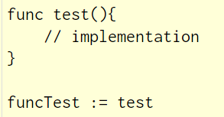

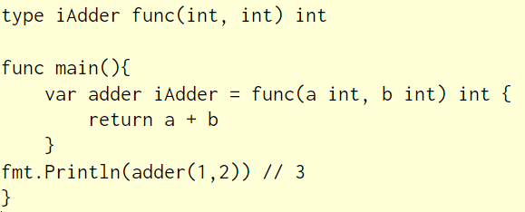
Functional Programming
Although Golang supports functional programming, it is not designed for this purpose, such as the lack of Map, Filter, and Reduce functions
as a variable
as an anonymous function
as a type
func test(){
// implementation
}
funcTest := test
test := func(){
// implementation
}
type iAdder func(int, int) int
func main(){
var adder iAdder = func(a int, b int) int {
return a + b
}
fmt.Println(adder(1,2)) // 3
}

Slide 18
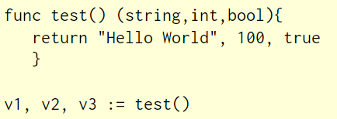
Functional Programming
multiple return value
Use functions to implement interfaces
func test() (string,int,bool){
return "Hello World", 100, true
}
v1, v2, v3 := test()

Slide 19
Question

Slide 20
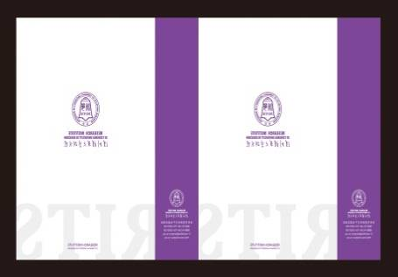
Thanks for listening！

