Slide 1


GitHub Trending Dashboard: —— A visualization dashboard website of GitHub Trending data
Group：12
Jie Zhu, Jingzhou Shen, Shudong Lai
Notes:
Logo is a gopher created by Renee.

Slide 2
Content
Project Purpose
Technology
Project Structure
Features
Application

Slide 3
Project Purpose
Used to analyze the population of different programming languages
Focused areas of different programming languages

Slide 4
Technology We Use
Spider
Go-echarts
Html、JavaScript
Gin

Slide 5
Project Structure
GitHub Trending Spider （Go）
Data Visualization Tool (Go)
Dashboard Template (Html)
Back-end (Go)

Slide 6

Architecture
*.txt
*.json
*.csv
Spider
Server
User Interface
Visualization Tool
*.html
Render
Authorized User

Slide 7
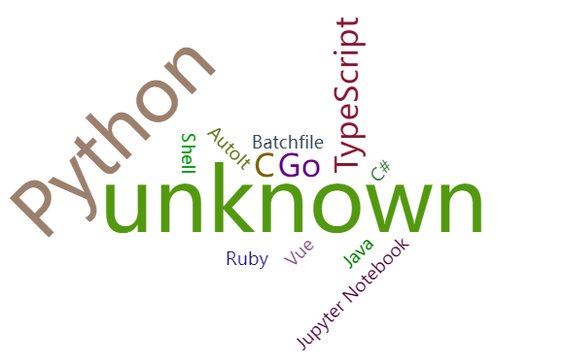
Features
User Login
Visualization Data Charts
Multiple types of data

Slide 8
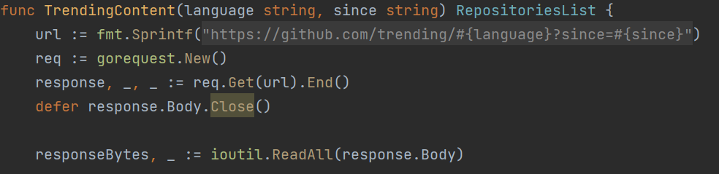
Features
Some Go programming language characteristic we use Like:
Multiple return value
Error handling

Slide 9
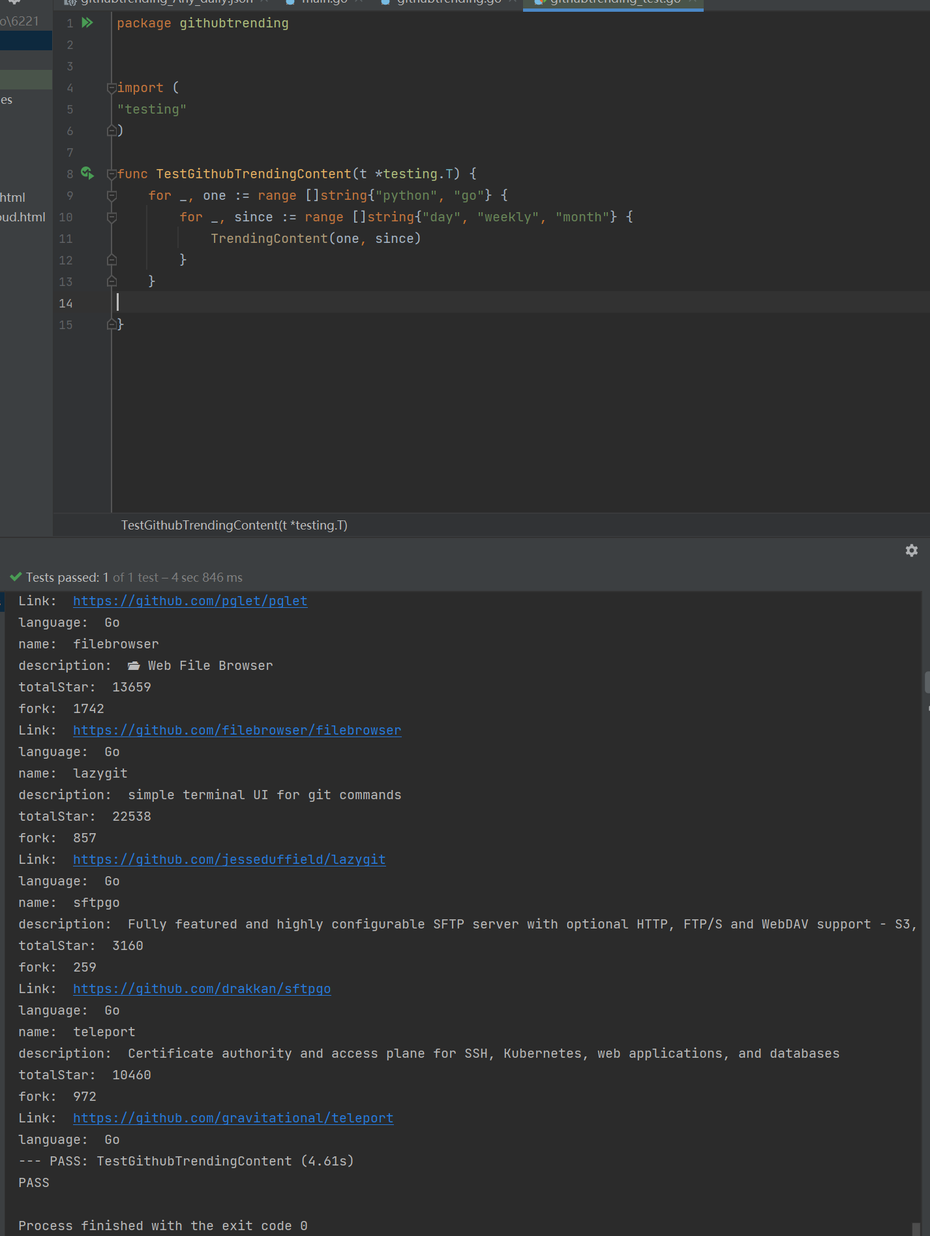
Features
Testing Capabilities

Slide 10
Application
Seasonal Programming Language Report :)
Knowing the recent focused areas of Programming
CSCI 6221 Final Project

Slide 11
Question

Slide 12

Thanks for listening！

