Slide 1

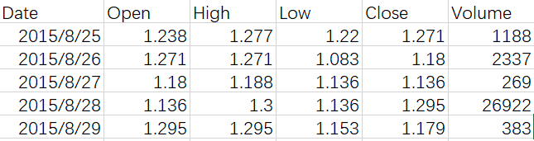
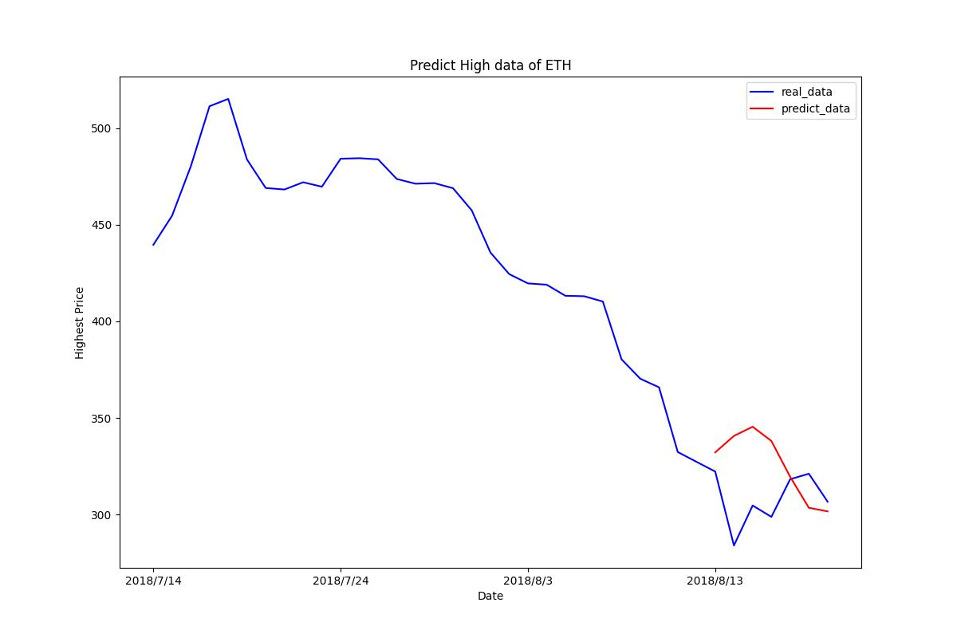


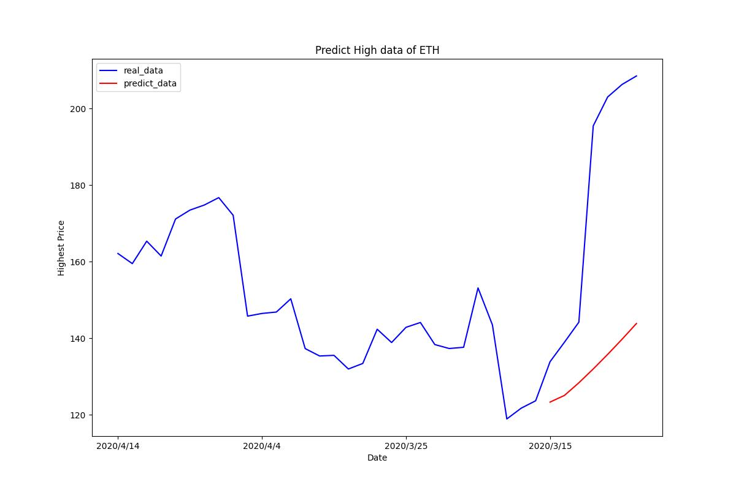
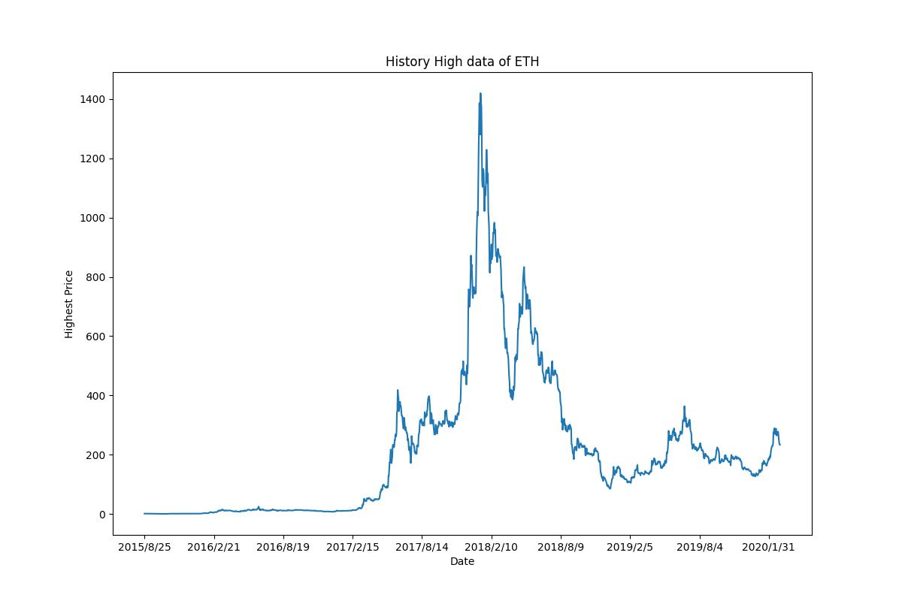
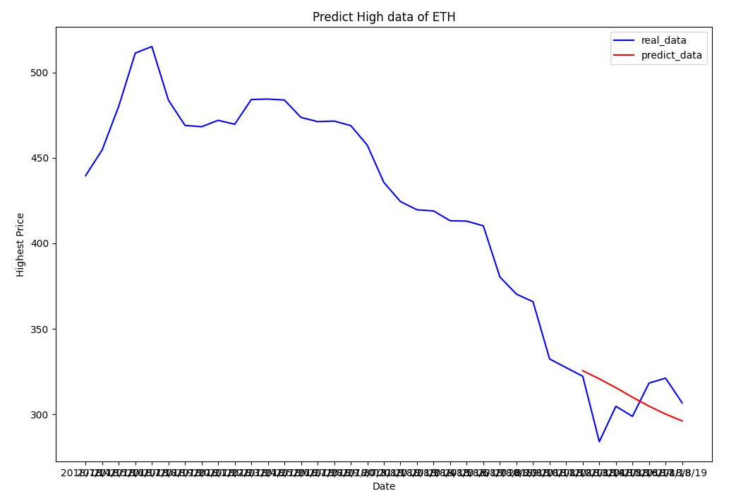
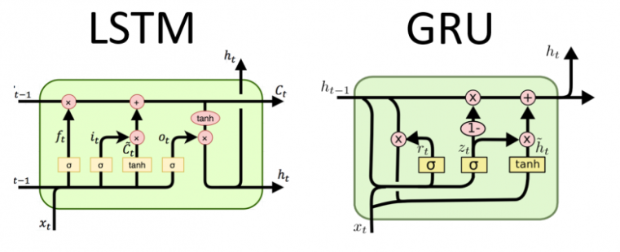
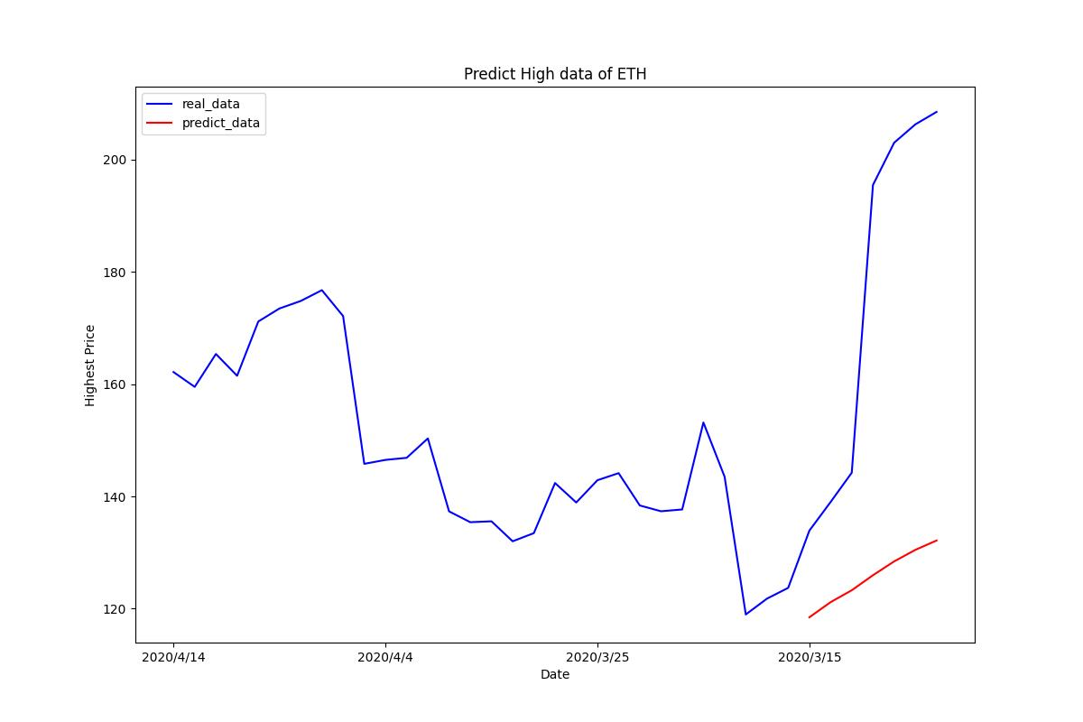
Cryptocurrency Price Prediction
Using LSTM and GRU
Jie, Zhu
Department of Computer Science, George Washington University
Abstract
Methodology
Results
Conclusion
Nowadays, cryptocurrency is a hot topic in our lives and most people are familiar with Bitcoin which is the first type of cryptocurrency. In this scenario, learning the future price of cryptocurrency and market behavior becomes valuable for research. In this project, I build a Cryptocurrency Price Prediction model using LSTM (Long Short Term Memory) and GRU (Gate Recurrent Unit) to predict the future highest price of Ethereum.
I used 3 years daily data of Ethereum to train the model and suppose that current highest price of Ethereum will be correlative to previous 30 days of data. I trained on the LSTM and GRU separately and the result shows that LSTM model will have a better performance than GRU when giving the same parameter of model and data.
This project uses Pytorch platform to build the framework. For the data preprocessing, I use sklearn, a simple and efficient machine learning package in Python to normalize the data to make a better prediction.
Environment Setup
For this project, I use Python3.8, with Pytorch 1.10.1 with GPU version and sklearn 1.0.2. And Pytorch is downloaded from official website.
Data Preparation
I collected Ethereum daily price data from both GitHub and Kaggle since most of API can’t be used for individual free account, I found the data of 2015-2020 with open price, highest price, lowest price, close price and volume of the day. In order to test the performance, I split about 1 month data from the dataset as test set.
In order to have a better performance, when loading the training dataset, it will make a data normalization to scale the features by using StandardScaler() in sklearn and store the mean and standard deviation values into the dataset class, which will be used during prediction.
Furthermore, I wrote a consecutive sampling function to load the dataset and transform them to the size like (batch_size, num_steps, input_features).
Model Structure
Figure 3 shows the different structure between LSTM and GRU. In our model, I used 2-layer: first layer is LSTM or GRU, and the second layer is a dense layer, which will generate the predict results of price.
For the parameter of model, I set num_steps=30 which means the model will learn 30 days of data to predict the next day data. And In the prediction procedure, the output will be the next 7 days highest price. I trained 1,000 epochs, with 3-year history data and use another test dataset to evaluate the model. I choose all the last saving checkpoints (900 epochs) for each model.
I tested on one slice in training set and test set:
LSTM
GRU
Price prediction problem is considered a very challenging task since its chaotic and very complex data correlation. However, Machine Learning especially deep learning, could help to learn the potential features between the data and achieve greater performance on forecasting time series problem. In this project, both LSTM and GRU can learn the tendency of price increment or decrescent, but not too accurate.
For the model comparison, we can make a conclusion from the Figure 4 and 5 that LSTM perform better than GRU since the prediction price are much closer to the ground truth. And both model show the right tendency as the real data.
Also, features engineering is important in machine learning. At the first time, I didn’t do the feature scaling for the training dataset. It came out that it had a huge loss during training and the model can’t learn well from the data. So the prediction was not good. But after I implement data normalization, the result looks more reasonable and correctly. Because all those features are numerical, and you can find that volume has a much bigger scale than others. If we don’t do feature scaling, volume will have most influence on model prediction and ignore other features, which we don’t want it happen.
However, all the model can’t fit well in real data properly because the fact that price prediction problem is a very complicated one that even deep learning can’t figure it out. Some papers said that cryptocurrency prices follow almost a random walk process while few hidden patterns may probably exist in^{[4]}. At this time, we might need a more sophisticated algorithm to solve this problem. But we can still use this method to predict the likelihood of ups and downs of the price instead of predicting the actual price, which will have more accuracy.
Figure 1: First 5 days training dataset of Ethereum
Figure 4: Prediction of LSTM Model (Training set)
Introduction
Cryptocurrency, sometimes called crypto-currency or crypto, is any form of currency that exists digitally or virtually and uses cryptography to secure transactions. Cryptocurrencies don't have a central issuing or regulating authority, instead using a decentralized system to record transactions and issue new units. It is a digital payment system that doesn't rely on banks to verify transactions. Nowadays, cryptocurrency likes the stock market and a lot of people try to invest in it.
Price prediction problem is a time series forecasting problem. Cryptocurrency price prediction can provide a lending hand to cryptocurrency investors for making proper investment decisions in order to acquire higher profits while it can also support policy decision-making and financial researchers for studying cryptocurrency markets behavior. We assume that the current price of Ethereum is proportional to the history price. For the dataset, I collected the 3 years daily data of Ethereum price(2015-2018) to train the model. And about the data features, it has OHLCV data (Open, High, Low, Close and Volume), and all of these features are numerical data and have correlation to the price potentially.
For the model selection, there have several existed models which are suitable for training sequential data. For traditional method like ARIMA. For deep learning, there have LSTM^{[1]}, GRU^{[2]} for example. For this project, I select LSTM and GRU to predict the price and try to analysis the result and different characteristics of different models.
Figure 4: Prediction of LSTM Model (Test set)
Figure 2: Highest price in Training dataset
References
Figure 5: Prediction of GRU Model (Training set)
Sepp Hochreiter; Jürgen Schmidhuber (1997). "Long short-term memory". Neural Computation. 9 (8): 1735–1780. doi:10.1162/neco.1997.9.8.1735. PMID 9377276. S2CID 1915014.
Cho, Kyunghyun; van Merrienboer, Bart; Bahdanau, DZmitry; Bengio, Yoshua (2014). "On the Properties of Neural Machine Translation: Encoder-Decoder Approaches". arXiv:1409.1259.
Vaswani, Ashish; Shazeer, Noam; Parmar, Niki; Uszkoreit, Jakob; Jones, Llion; Gomez, Aidan N.; Kaiser, Lukasz; Polosukhin, Illia (2017-06-12). "Attention Is All You Need". arXiv:1706.03762
Pintelas, E., Livieris, I.E., Stavroyiannis, S., Kotsilieris, T., Pintelas, P. (2020). Investigating the Problem of Cryptocurrency Price Prediction: A Deep Learning Approach. In: Maglogiannis, I., Iliadis, L., Pimenidis, E. (eds) Artificial Intelligence Applications and Innovations. AIAI 2020. IFIP Advances in Information and Communication Technology, vol 584. Springer, Cham. https://doi.org/10.1007/978-3-030-49186-4_9
Figure 3: LSTM structure vs GRU structure
Figure 5: Prediction of GRU Model (Test set)

