Slide 1
Class management System
Realized by :
-Jaziri Taha
-Mannai azza
LA2 Informatique TP2
Java2 Project

Slide 2
General Presentation of the project
Seen that we are Always having trouble with accessing Our grades and results we chose to work on the first step of an application that Is still as its primitive form to help solve that problem.
The main objective of This Project is to put in place a new system of class management in which entry, sharing and deliberation are very easy to access, our application mainly consists on establishing a completed work of schooling: saving lists of students as well as their overall averages.

Slide 3
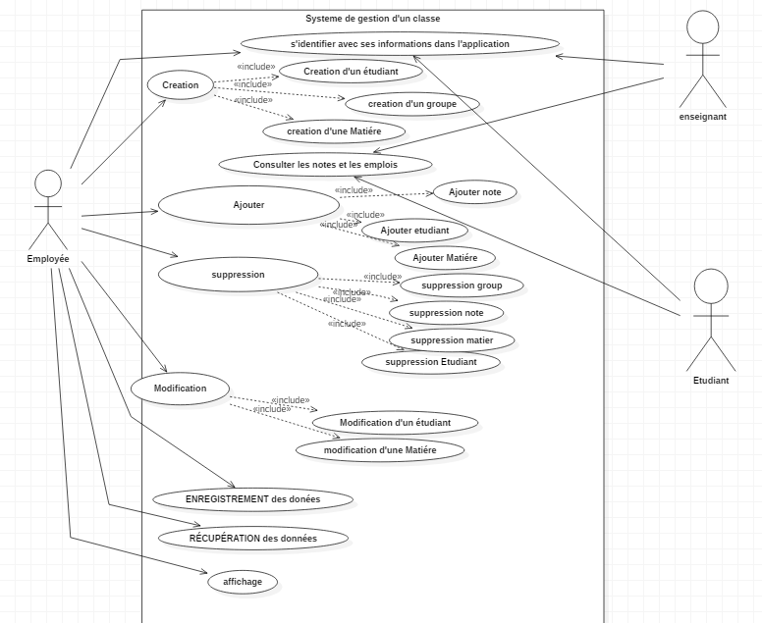
Use case DiagraM

Slide 4
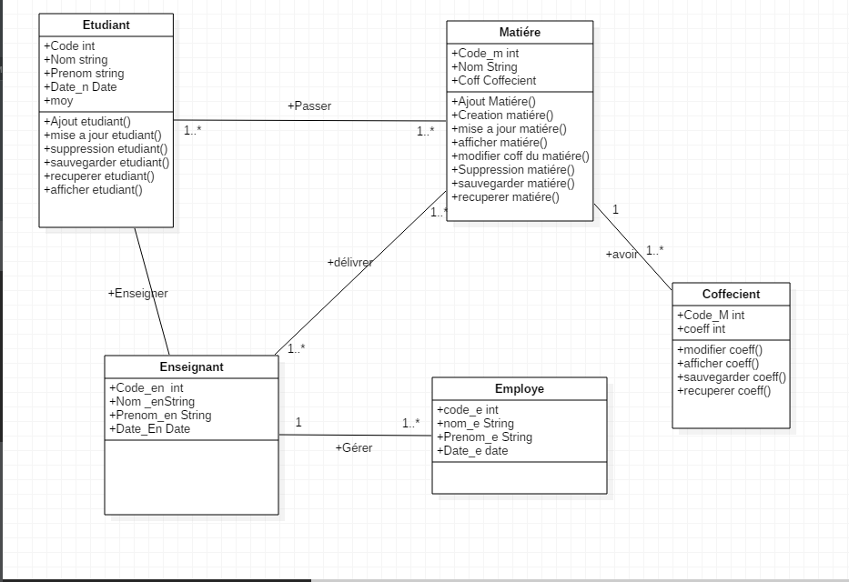
Class Diagram

Slide 5
What we used ?
Used languages
Java
UML
Used Logicians
NetBeans
MYSQL Server
MYSQL
StarUML

Slide 6
Thank you for your attention !!

