Slide 1
An Introduction To AJAX
Andrew Huntwork
ash@huntwork.net

Slide 2
What is AJAX?
Javascript
XML
DOM
CSS
XSLT
XMLHttpRequest
  Browser talks to server without loading a new page
Nothing new

Slide 3
Browser Compatibility
Different browsers have different
  Event models
  Supported events
  DOM APIs
  …
Libraries provide compatibility layer
  DOJO
  Prototype

Slide 4
Intro to Javascript
Generally C-like
But very dynamic
Anonymous function
Lexical Scoping
See examples

Slide 5
JSON
JavaScript Object Notation
Serialization for Javascript objects
See example

Slide 6
What is XMLHttpRequest?
An API for making a non-blocking request to an HTTP server and handling the reply asynchronously.
Response may be arbitrary data, but is usually XML, plain text, serialized Javascript objects, or nothing.

Slide 7
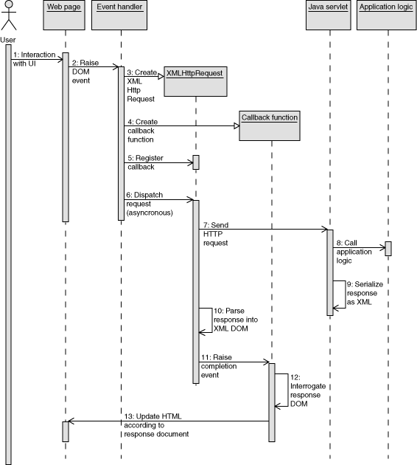
XMLHttpRequest Call Sequence

Slide 8
How to Use XMLHttpRequest
See example.

Slide 9
Prototype
Enables object-oriented Javascript
  Inheritance
  Multiple Inheritance
Provides utility/compatibility methods
  New PeriodicalExecuter(function() {alert(“hi”); },1);
  Form.serialize(nodeId)
  Event.element = function(event) {
  return event.target || event.srcElement;
  };
Browser-specific hacks
  /* prevent memory leaks in IE */
  Event.observe(window, 'unload', Event.unloadCache, false);
See example

Slide 10
DOJO Javascript Library
Provides many services
  XML parsing
  Event handling
  AOP for Javascript
  Fast widget development
  See examples

Slide 11
Script.aculo.us/Rico
Pretty widgets
See example

Slide 12
Example - AJAX Chat Client
See example

Slide 13
Resources
Prototype: http://prototype.conio.net/
Rico: http://openrico.org/
Script.aculo.us: http://script.aculo.us/
Dojo: http://dojotoolkit.org/
Behavior: http://bennolan.com/behaviour/
JsUnit: http://www.edwardh.com/jsunit/
JsUnit Presentation: http://www.edwardh.com/jsunit/talks/jsunit.ppt
AJAX In Action: http://www.manning.com/books/crane (ebook,sample chapters, source code)

