Slide 1
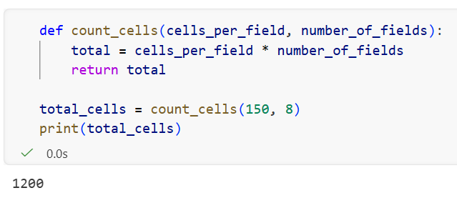
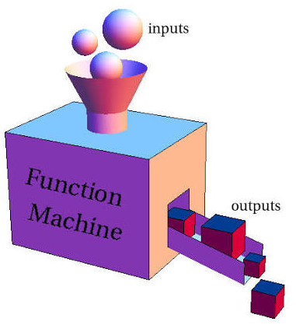
Functions
A function in programming is a block of code that performs a specific task and can be reused whenever needed.
Think of a function as a machine:
It can receive input
It performs an action
It can return a result
Example
Imagine you're a biologist who often needs to count cells in a sample.
Instead of writing the same calculation over and over, you can create a function:

Slide 2


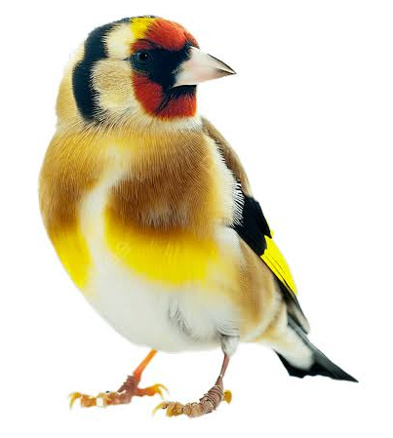
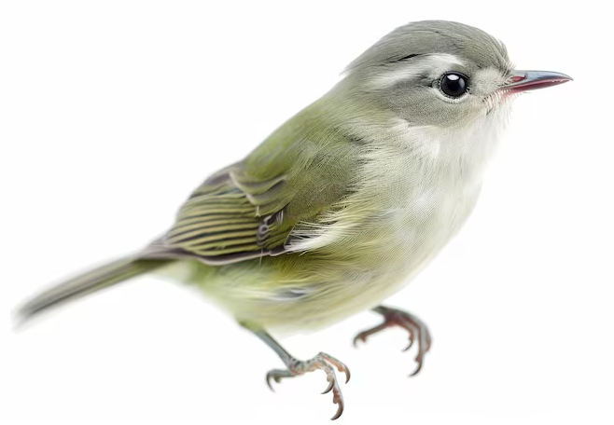
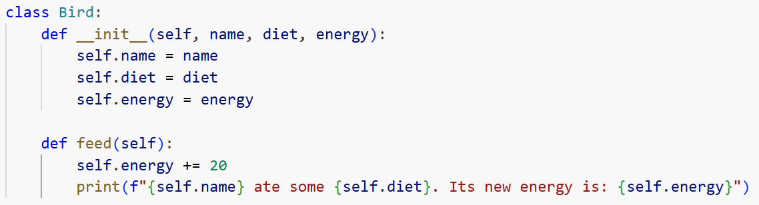
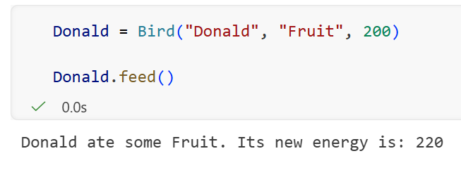
Classes and Objects
Class
Object
It’s like the theoretical description of a species in a field guide. It dictates the characteristics and behaviors that this type of organism has. However, the description itself is not alive; it’s just a blueprint
A concrete realization created from the class. It contains actual values assigned to the blueprint's requirements

Slide 3
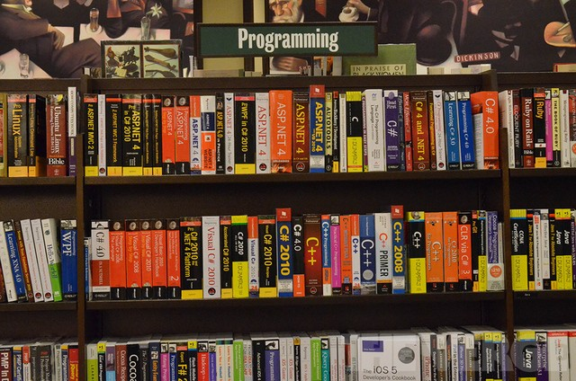



Libraries
A programming library is a collection of pre-written, reusable code that developers use to perform specific tasks without building features from scratch
Install (you only need to do it once)
Pip install library-name
Import (once per code)
Pip import library-name

