Slide 1
10 ELEMENTS THAT ARE NOT CREATED VIA STELLAR NUCLEOSYNTHESIS

Slide 2
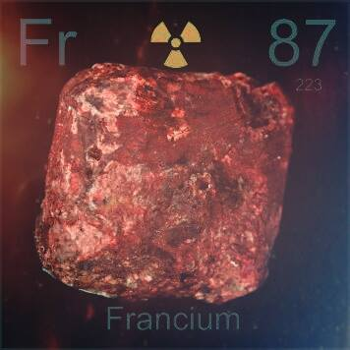
Francium (Fr)
Origin of the name: named after "France
Creation:
Francium occurs as a result of α disintegration of actinium. Francium is found in uranium minerals, and can be made artificially by bombarding thorium with protons. It is the most unstable of the first 101 elements. The longest lived isotope, ²²³Fr, a daughter of ²²⁷Ac, has a half-life of 22 minutes
Chemical and Physical Properties:
Name: francium
Symbol: Fr
Atomic number: 87
Relative atomic mass (A_{r}): [ 223 ]
Standard state: solid at 298 K
Color: metallic
Classification: Metallic
Group in periodic table: 1
Group name: Alkali metal
Period in periodic table: 7
Block in periodic table: s-block
Electron shell structure: 2.8.18.32.18.8.1
CAS Registry ID: 7440-73-5

Slide 3
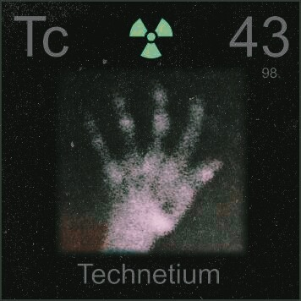
Technetium (Tc)
Origin of the name: from the Greek word "technikos" meaning "artificial“
Creation:
Technetium has no biological role. Technetium does not occur naturally in the biosphere and so normally never presents a risk. All technetium compounds should be regarded as highly toxic, largely because of its radiological toxicity. Technetium has been found in the spectra of S-, M-, and N-type stars, but is not found in earth's geosphere.
Chemical and Physical Properties:
Name: technetium
Symbol: Tc
Atomic number: 43
Relative atomic mass (A_{r}): [ 98 ]
Standard state: solid at 298 K
Color: silvery grey metallic
Classification: Metallic
Group in periodic table: 7
Group name: (none)
Period in periodic table: 5
Block in periodic table: d-block
Electron shell structure: 2.8.18.14.1
CAS Registry ID: 7440-26-8

Slide 4
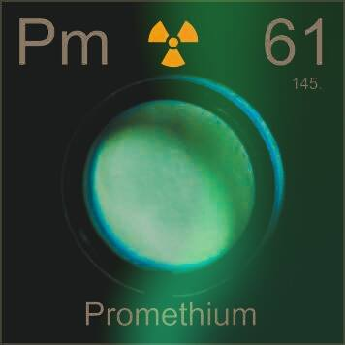
Promethium (Pm)
Origin of the name: named after "Prometheus" in Greek mythology, who stole fire from the gods.
Creation:
Promethium has no biological role.
It appears that there is no known Pm existing in the earth's crust other than in very small quantities in uranium ores where it is present as a uranium decay product.
Chemical and Physical Properties:
Name: promethium
Symbol: Pm
Atomic number: 61
Relative atomic mass (A_{r}): [ 145 ]
Standard state: solid at 298 K
Color: metallic
Classification: Metallic
Group in periodic table:
Group name: Lanthanoid
Period in periodic table: 6 (lanthanoid)
Block in periodic table: f-block
Electron shell structure: 2.8.18.23.8.2
CAS Registry ID: 7440-12-2

Slide 5
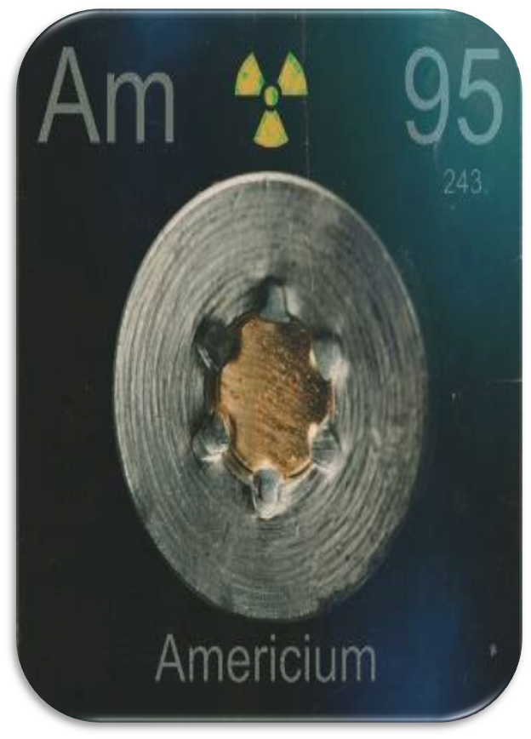
Americium (Am)
Origin of the name: Americium is named for America where it was first made.
Creation:
Americium was discovered by Glenn Seaborg, Ralph James., L. Morgan, Albert Ghiorso in 1944 at USA. Americium was was identified by Seaborg and others in 1944 as the result of successive neutron capture reactions by plutonium isotopes in a nuclear reactor.
Chemical and Physical Properties:
Name: americium
Symbol: Am
Atomic number: 95
Relative atomic mass (A_{r}): [ 243 ]
Standard state: solid at 298 K
Color: silvery white
Classification: Metallic
Group in periodic table:
Group name: Actinoid
Period in periodic table: 7 (actinoid)
Block in periodic table: f-block
Electron shell structure: 2.8.18.32.25.8.2
CAS Registry ID: 7440-35-9

Slide 6
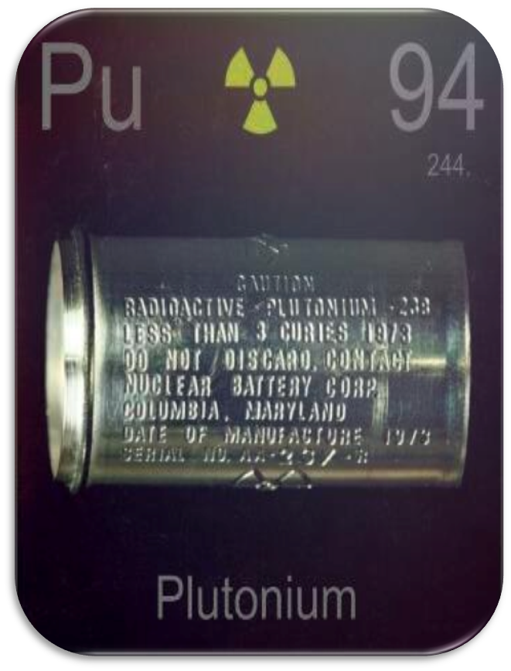
Plutonium (Pu)
Origin of the name: Plutonium, is named after the then planet Pluto, following from the two previous elements uranium and neptunium.
Creation:
Plutonium was discovered in 1941 by Dr. Glenn T. Seaborg and Edwin McMillan, Kennedy, and Wahl by deuteron bombardment of uranium in the 60-inch cyclotron of the Berkeley Radiation Laboratory at the University of California, Berkeley, but the discovery was kept secret. It was named after the planet Pluto, having been discovered directly after Neptunium.
Chemical and Physical Properties:
Name: plutonium
Symbol: Pu
Atomic number: 94
Relative atomic mass (A_{r}): [ 244 ]
Standard state: solid at 298 K
Color: silvery white
Classification: Metallic
Group in periodic table:
Group name: Actinoid
Period in periodic table: 7 (actinoid)
Block in periodic table: f-block
Electron shell structure: 2.8.18.32.24.8.2
CAS Registry ID: 7440-07-5

Slide 7
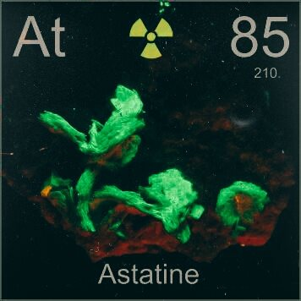
Astatine (At)
Origin of the name: from the Greek word "astatos" meaning "unstable".
Creation:
Astatine has no biological role.
Astatine is not found in any significant quantity in the geosphere. Some isotopes of astatine (²¹⁵At, ²¹⁸At and ²¹⁹At) are present in uranium and thorium minerals as part of radiodecay series. The total amount present in the Earth's crust is probably less than 30 g at any one time.
Chemical and Physical Properties:
Name: astatine
Symbol: At
Atomic number: 85
Relative atomic mass (A_{r}): [ 210 ]
Standard state: solid at 298 K
Colour: metallic
Classification: Semi-metallic
Group in periodic table: 17
Group name: Halogen
Period in periodic table: 6
Block in periodic table: p-block
Electron shell structure: 2.8.18.32.18.7
CAS Registry ID: 7440-68-8

Slide 8
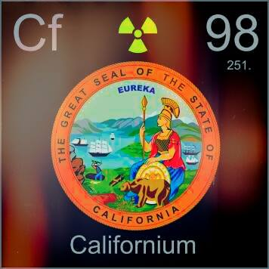
Californium (Cf)
Origin of the name: named after the State and University of "California", USA.
Creation:
Californium was discovered by Glenn T. Seaborg, Stanley G. Thompson, Albert Ghiorso, Kenneth Street in 1950 at USA. Californium was produced by Ghiorso and others at the University of California, Berkeley, USA in 1950 who bombarded ²⁴²Cm with helium ions.
Chemical and Physical Properties:
Name: californium
Symbol: Cf
Atomic number: 98
Relative atomic mass (A_{r}): [ 251 ]
Standard state: solid at 298 K
Colour: unknown, but probably metallic and silvery white or grey in appearance
Classification: Metallic
Group in periodic table:
Group name: Actinoid
Period in periodic table: 7 (actinoid)
Block in periodic table: f-block
Electron shell structure: 2.8.18.32.28.8.2
CAS Registry ID: 7440-71-3

Slide 9
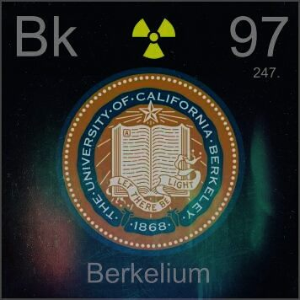
Berkelium (Bk)
Origin of the name: named after the city of Berkeley, California, where it was first made.
Creation:
Berkelium is a radioactive, silvery metal. An abstract metal symbol is against a background of vibrant colours representing the creation of the element in nuclear reactors. Because it is so rare, berkelium has no commercial or technological use at present. Berkelium has no known biological role. It is toxic due to its radioactivity. Less than a gram of berkelium is made each year. It is made in nuclear reactors by the neutron bombardment of plutonium-239.
Chemical and Physical Properties:
Name: Berkelium
Symbol: Bk
Atomic number: 97
Relative atomic mass (A_{r}): [ 247 ]
Standard state: solid at 298 K
Colour: silvery-white or grey
Classification: Metallic
Group in periodic table:
Group name: Actinoid
Period in periodic table: 7 (actinoid)
Block in periodic table: f-block
Electron shell structure: 2.8.18.32.27.8.2
CAS Registry ID: 7440-40-6

