Slide 1
LOGIC LEAGUE · IDEATHON
SPENDWISE
Your AI Personal Financial Copilot
HackForge × HackerRank

Slide 2

THE PROBLEM
Most people can see their transactions. Few can see what to do next.
Money leaves through UPI, cards, cash, bills, subscriptions, and small daily purchases.
The result is fragmented spending, missed obligations, and goals that drift.
SpendWise turns financial noise into a next-best decision.

Slide 3
THE MISSING LAYER
Tracking tells you what happened. Guidance helps you decide what happens next.
CONVENTIONAL APPS
SPENDWISE
Record and visualize the past
Turn context into better decisions
Transaction lists, categories, charts, and budgets show where your money went.
SpendWise connects your behavior, obligations, and goals to what you should do next.
Useful history, limited context
Reactive: you look back after spending
Safe-spending guidance and proactive warnings
Recurring-expense and major-purchase planning
AI recommendations, plus Money Locker savings discipline

Slide 4
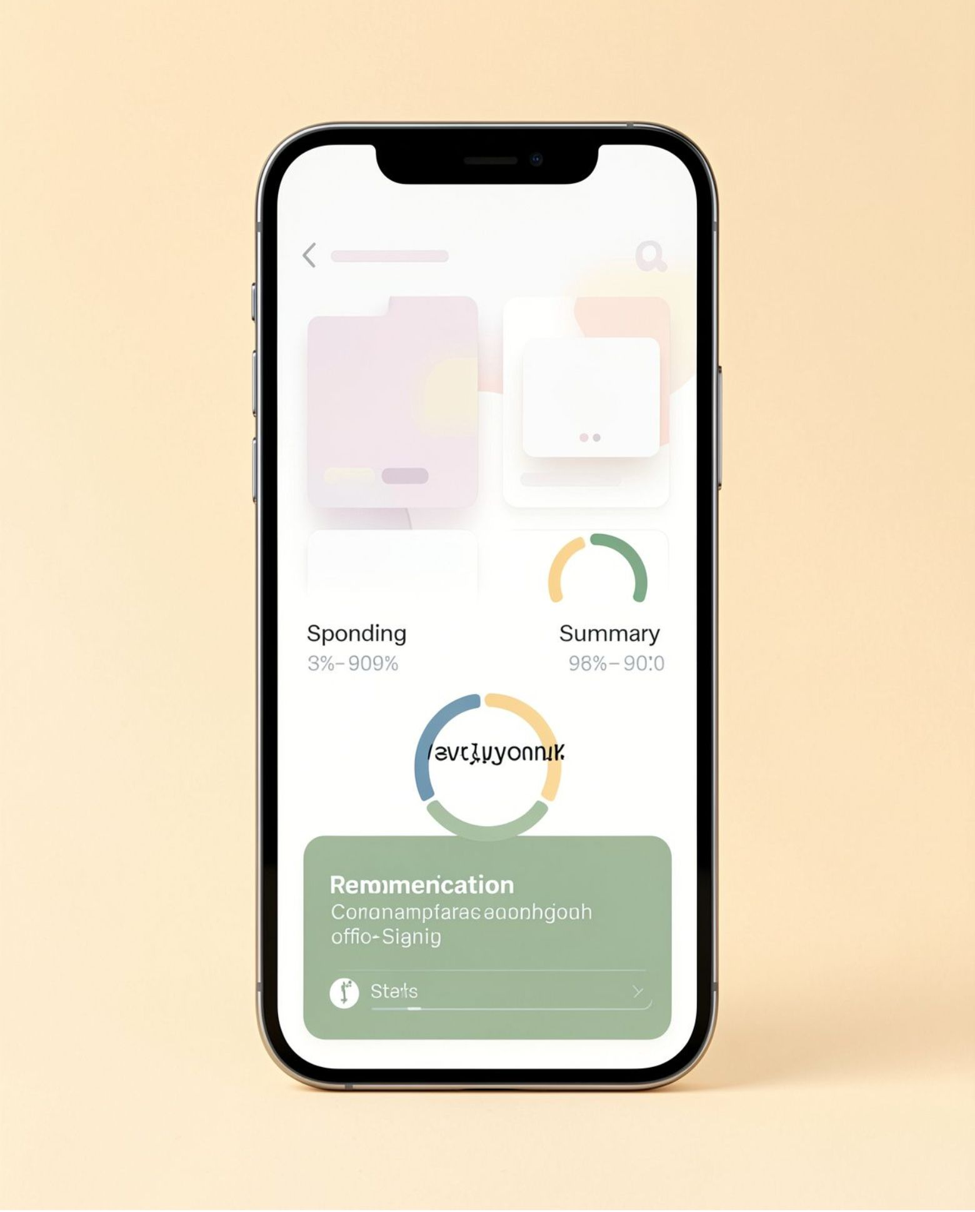
THE PRODUCT
SpendWise is the decision layer for everyday money.
One financial picture across expenses, recurring commitments, savings, and goals.
AI guidance explains the trade-offs behind each recommendation.

Slide 5










THE OPERATING LOOP
One loop connects today’s spending to tomorrow’s goals.
Reserve essentials
Income enters
Fixed expenses are set aside first.
The month starts with the money available.
Understand spending
Daily behavior becomes visible in context.
Stay on track
Recommendations adjust the plan as life changes.
Fund goals
Savings and goals receive a clear contribution.

Slide 6
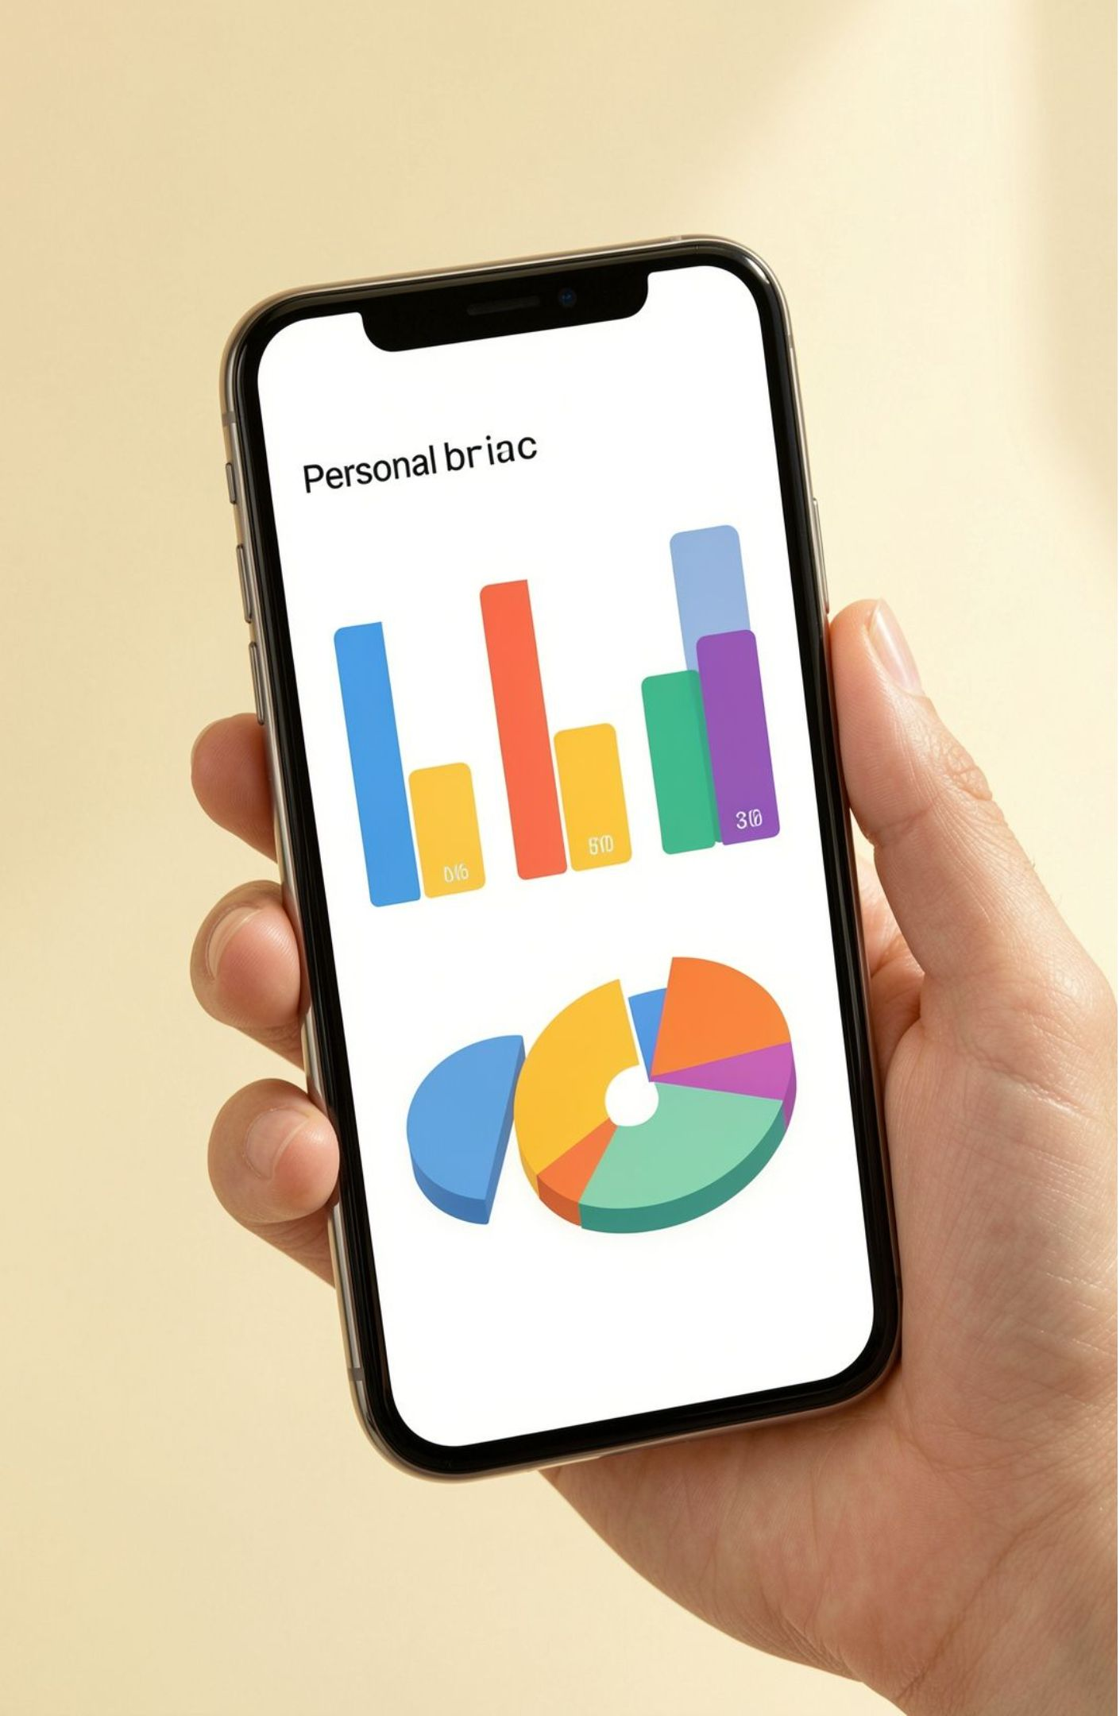
FROM PAYMENT TO SIGNAL
Every payment becomes a useful signal.
Log payments across Food, Grocery, Travel, Transport, Shopping, Education, Healthcare, Entertainment, Household, and Other.
See category patterns, not just a transaction list.
Authentication supports email, phone, and OTP without storing banking passwords or UPI PINs.

Slide 7




Recurring expenses stop becoming recurring surprises.
Monthly
Yearly
Rent, EMI, electricity, internet, subscriptions, insurance.
College fees, health insurance, vehicle insurance, annual subscriptions.
Plan ahead
Future capability
Receive reminders and plan ahead.
Automatic payment execution requires integrations and authorization.

Slide 8
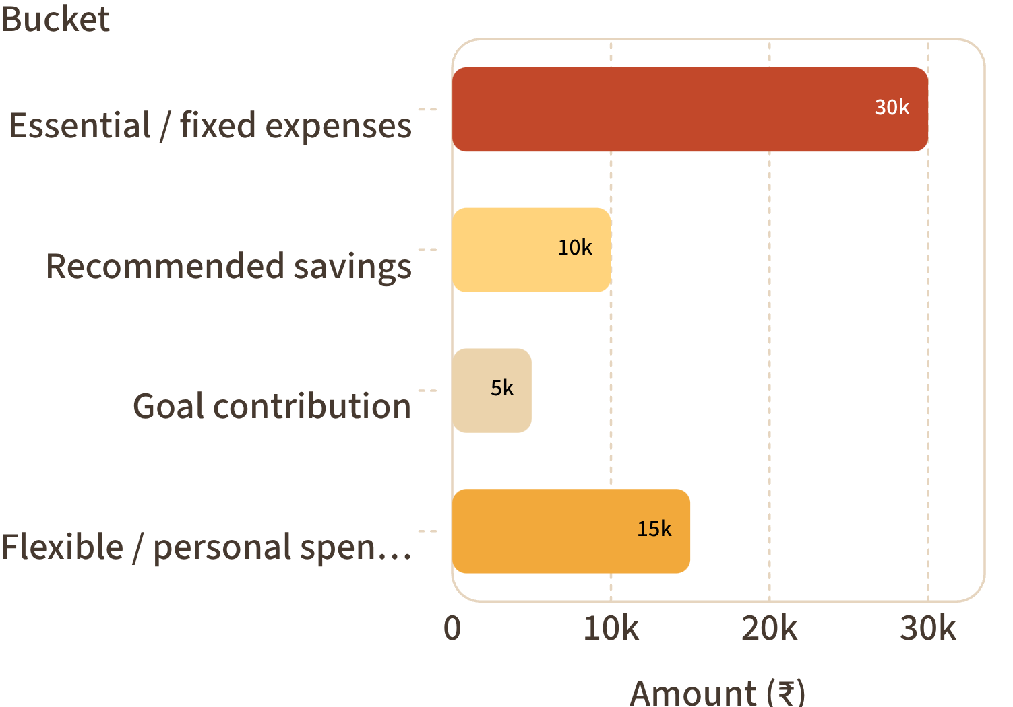
ILLUSTRATIVE GUIDANCE
₹60,000 becomes a plan, not a guess.
Separate essential expenses, recommended savings, goal contribution, and flexible spending.
Safe daily spending: approximately ₹833 while staying on track.
Illustrative ₹60,000 monthly allocation
The user sees the assumptions and can adjust them. Figures are illustrative, not universal financial advice.

Slide 9

BEHAVIORAL DISCIPLINE
Money Locker makes good intentions harder to break.
Money Locker is a wallet-style system for setting aside money toward a goal for 15 days, 1 month, 3 months, 6 months, or a custom duration.
Designed to reduce impulse spending by making the commitment visible and deliberate.
15 days
1 month
3 months
6 months
Conceptual product feature, not a regulated deposit or payment product.

Slide 10
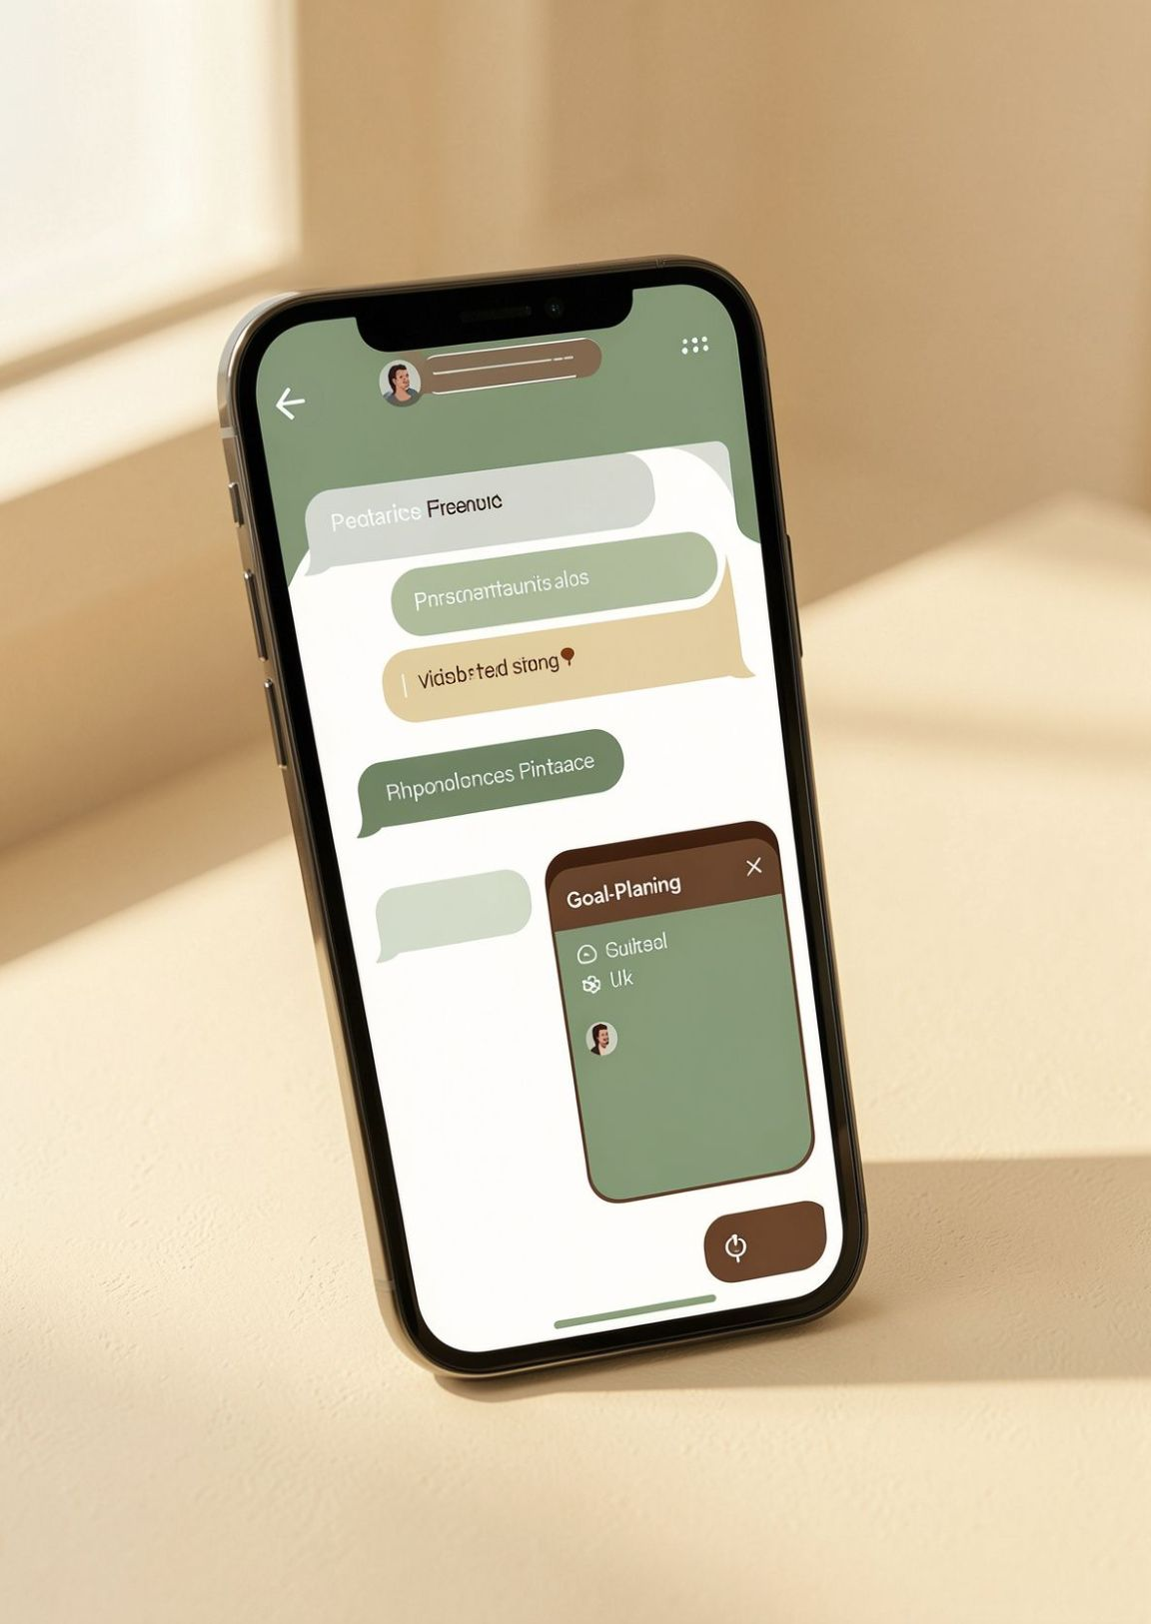
ASK SPENDWISE
Ask a money question. Get the reasoning, not a generic tip.
User: “Can I buy a ₹75,000 laptop?”
SpendWise: “January would be safer than November. Saving ₹12,500 per month and reducing discretionary spending by approximately ₹2,000 per month could help you reach the goal without affecting essentials.”
Reasoning inputs: income, fixed expenses, savings, goals, upcoming expenses, historical behavior. Guidance is based on user-provided information and calculations—not guaranteed financial advice.

