Slide 1
RM Client Extrensions
Extending DOORS NG with JavaScript
Author: Donat Hutter, 3531
Revision: 1, 23-Jun-2015

Slide 2
Content
Introduction, Idea, Prerequisites
Anatomy of an Extension
Deployment of the Extensions
Service API, Functionality
Challenges

Slide 3
Extending DOORS Next Generation
Extending RM
Currently this new functionality in DOORS Next Generation doesn’t have the power and immense library of scripts that have been written in DXL.
It is providing some other means of customization to suit the enterprise’s needs.
Anatomy of an Extension
An extension starts with an XML file that acts as an “envelope.” This XML file will contain the following:
HTML used for displaying your output
Link to your CSS stylesheet
Link to the JavaScript file or set of files.

Slide 4
Client extension API for the RM application
Needed knowledge
HTML and JavaScript (Typescript support)
Browser Developer Tools
Understanding API specification
See “Extending the Requirements Management application” https://jazz.net/wiki/bin/view/Main/RMExtensionsMain
Hosting
Extensions must be accessible from a web server via HTTPS.
The extension files accessible without any form of authentication (read)
Web server with a valid certificate matching the server name.
Access/Usage
add OpenSocial gadgets to your mini dashboard (url to extension module)
Select from Catalog
Every user can write its own gadget!

Slide 5
Content
Introduction, Idea, Prerequisites
Anatomy of an Extension
Deployment of the Extensions
Service API, Functionality
Challenges

Slide 6
Extendion = Widget = Module Definition (xml)
<?xml version="1.0" encoding="UTF-8" ?>
<Module specificationVersion="2.0">
<ModulePrefs title="Link by Attribute" scrolling="true">
<Optional feature="com.ibm.rdm.rm.api"/>
<Require feature="dynamic-height"/>
</ModulePrefs>
<Content type="html">
<![CDATA[
<script src="//code.jquery.com/jquery-2.1.3.min.js"></script>
<script src="js/link-by-attribute.js"></script>
<link rel="stylesheet" type="text/css" href="css/link-by-attribute.css">
<div id="content" class="content">
</div>
]]>
</Content>
</Module>
Feature must be declared “Optional”, otherwise you get an error in ccm, qm https://jazz.net/wiki/bin/view/Main/RMExtensionsMissingFeatureHandling502
Web content is included as Data block
Functionality written in JavaScript

Slide 7
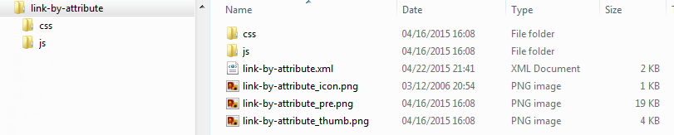
Extension = content in one single folder
Create new extension by copying the template folder and …
rename all items (use same name for xml file, images, css file, script file)
Replace images and icons
_icon = 16 x 16
_pre = 280 x 170
_thumb = 200 x 95
Adjust basic html layout
Implement functionality
Test/Debug

Slide 8
Content
Introduction, Idea, Prerequisites
Anatomy of an Extension
Deployment of the Extensions
Service API, Functionality
Challenges

Slide 9
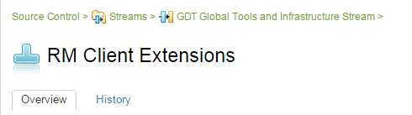
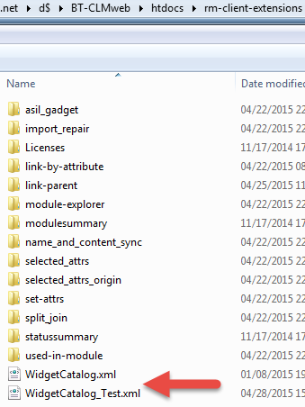
Deployment
Source under CLM Source Control
Deployment
<clm-server>\BT-CLMweb\htdocs\rm-client-extensions
Deployment method (UrbanCode, …)?
Currently I have only one set of widgets, but 2 catalogs
one for production server (with tested widgets only) category = Requirements Extensions
one for test server (with additional “sample” widgets) category = Sample Extensions

Slide 10
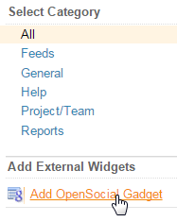
Deployment – test module
deploy module to a (test) web server
Add “OpenSocial Gadget” browse for XML file = widget definition
Test
Browser Developer Tools
Fiddle (https://jsfiddle.net/)
Unit Test framework (https://qunitjs.com/)?
Debug / Log output
Use Test Server (https://bt-clmtestserver01.hqs.sbt.siemens.com/rm/web)

Slide 11
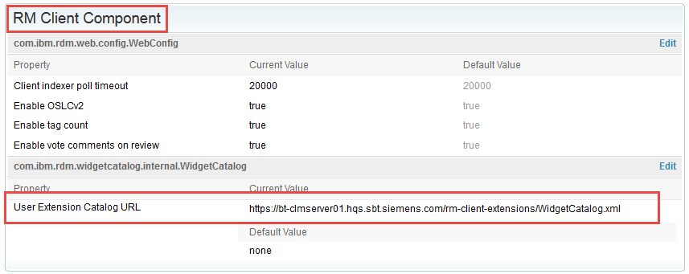
Deployment – create/refer to Widget Catalog in RM
In RM application add reference to widget catalog (if not already exists)
https://server/rm/admin > Advanced Properties
com.ibm.rdm.widgetcatalog.internal.WidgetCatalog = path to catalog.xml

Slide 12
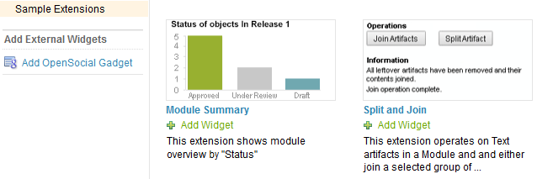
Deployment – Add widget to Widget Catalog in RM
<ju:catalog-entry>
<dc:title>Module Summary</dc:title>
<dc:description>This extension shows module overview by "Status"</dc:description>
<ju:gadget rdf:resource='./modulesummary/status.xml' />
<ju:icon rdf:resource="./modulesummary/graph.gif"/>
<ju:preview rdf:resource="./modulesummary/graphs_pre.png"/>
<ju:thumbnail rdf:resource="./modulesummary/graphs_thumb.png"/>
<ju:category>Sample Extensions</ju:category>
</ju:catalog-entry>
Path to gadget
icon in title bar of gadget
Add widget to widget catalog
Catalog is a xml file
Each widget has a catalog entry (paths in file are relative to catalog)

Slide 13
Content
Introduction, Idea, Prerequisites
Anatomy of an Extension
Deployment of the Extensions
Service API, Functionality
Challenges

Slide 14
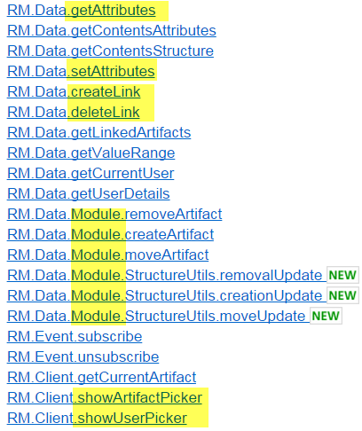
Service API ( https://jazz.net/wiki/bin/view/Main/RMExtensionsMain )
JavaScript library as an abstraction layer to access and modify data with RM:
read/write attributes
create/delete links
manipulate module structure
…
Limitations
only artifacts within RM direct accessible (“external” links provided as string)
not all data accessible (e.g. no comments)
designed for context sensitive usage (mini-dashboard)
Not evaluated so far
Are there security constraints (JavaScript, browser), e.g. access to file system?

Slide 15
Content
Introduction, Idea, Prerequisites
Anatomy of an Extension
Deployment of the Extensions
Service API, Functionality
Challenges

Slide 16
Challenges
The tough parts which might need more time then expected
writing asynchronous JavaScript program
All service calls with asynchronous callbacks (nested callbacks, callback hell)
understanding JavaScript closures
error handling
flexibility in the extension usage
designing html for extension layout and output (limited space)

Slide 17
callback hell … not suited for complex tasks
$("#targetPick").on("click", function () {
pickTargetCollection(function(err, ref, name){
if (err.length > 0) {
… error / success handling
});
});
function pickTargetCollection(callback) {
RM.Client.showArtifactPicker(function(pickResult) {
if (pickResult.data.length == 1) {
var collectionRef = pickResult.data[0];
RM.Data.getAttributes(collectionRef, [Attributes.NAME,Attributes.FORMAT], function(opResult){
if (opResult.code === RM.OperationResult.OPERATION_OK){
var artType = opResult.data[0].values[RM.Data.Attributes.FORMAT];
if ((artType === RM.Data.Formats.MODULE) || (artType === RM.Data.Formats.COLLECTION)) {
callback("", collectionRef, opResult.data[0].values[RM.Data.Attributes.NAME]);
} else {
callback("Target must be module or collection");
}
} else {
callback(opResult.message);
}
});
} else {
callback("Only one artifact allowed");
}
});
}

