Slide 1
PING ME– to send a message in chat
CC ME – including someone in the email, sending one copy to the person (Carbon copy)
EOD – End of the Day (usually goes by EOD)
OOO – Out Of Office
ETA – Estimated Time of Arrival (usually about fix or deployment of the code)
Parking lot – Lets talk outside
Root cause – main cause of the defect}
Validation, Validate, Validating – The process of evaluating software during the development process Acceptance Criteria: The exit criteria that a component or system must satisfy in order to be accepted by a user, customer or other authorized entity.
Expected Result: The behavior predicted by the specification. Peer Review: Reviewing the code of your teammate.
Test Execution: The process of running tests. Logging the Defect– Creating a defect/bug Subject Matter Expert – (SME) is a person who has special skills or knowledge on a particular job or topic.
Collaboration – working as a team, helping each other

Slide 2

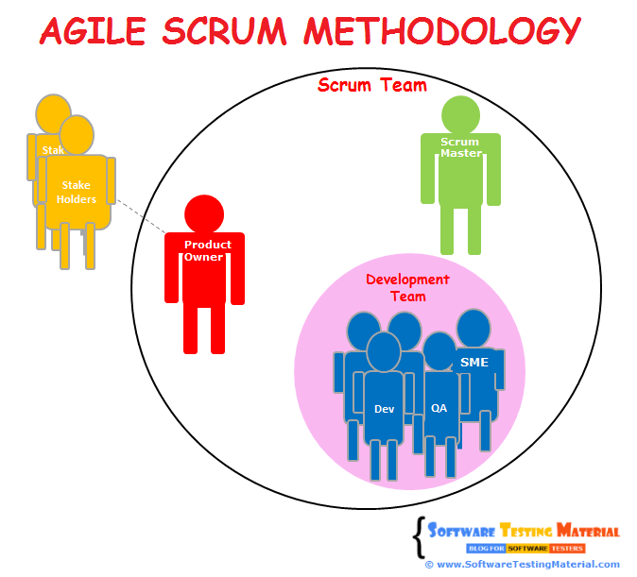
Who’s a Subject Matter Expert?
A Subject Matter Expert (aka SME) is an authority in a particular technology, process, function, machine, etc. It’s said that SMEs in software development are individuals with the greatest expertise in technical topics. They’re often asked to review, approve or improve technical work, also to guide and teach people with smaller experience.

Slide 3

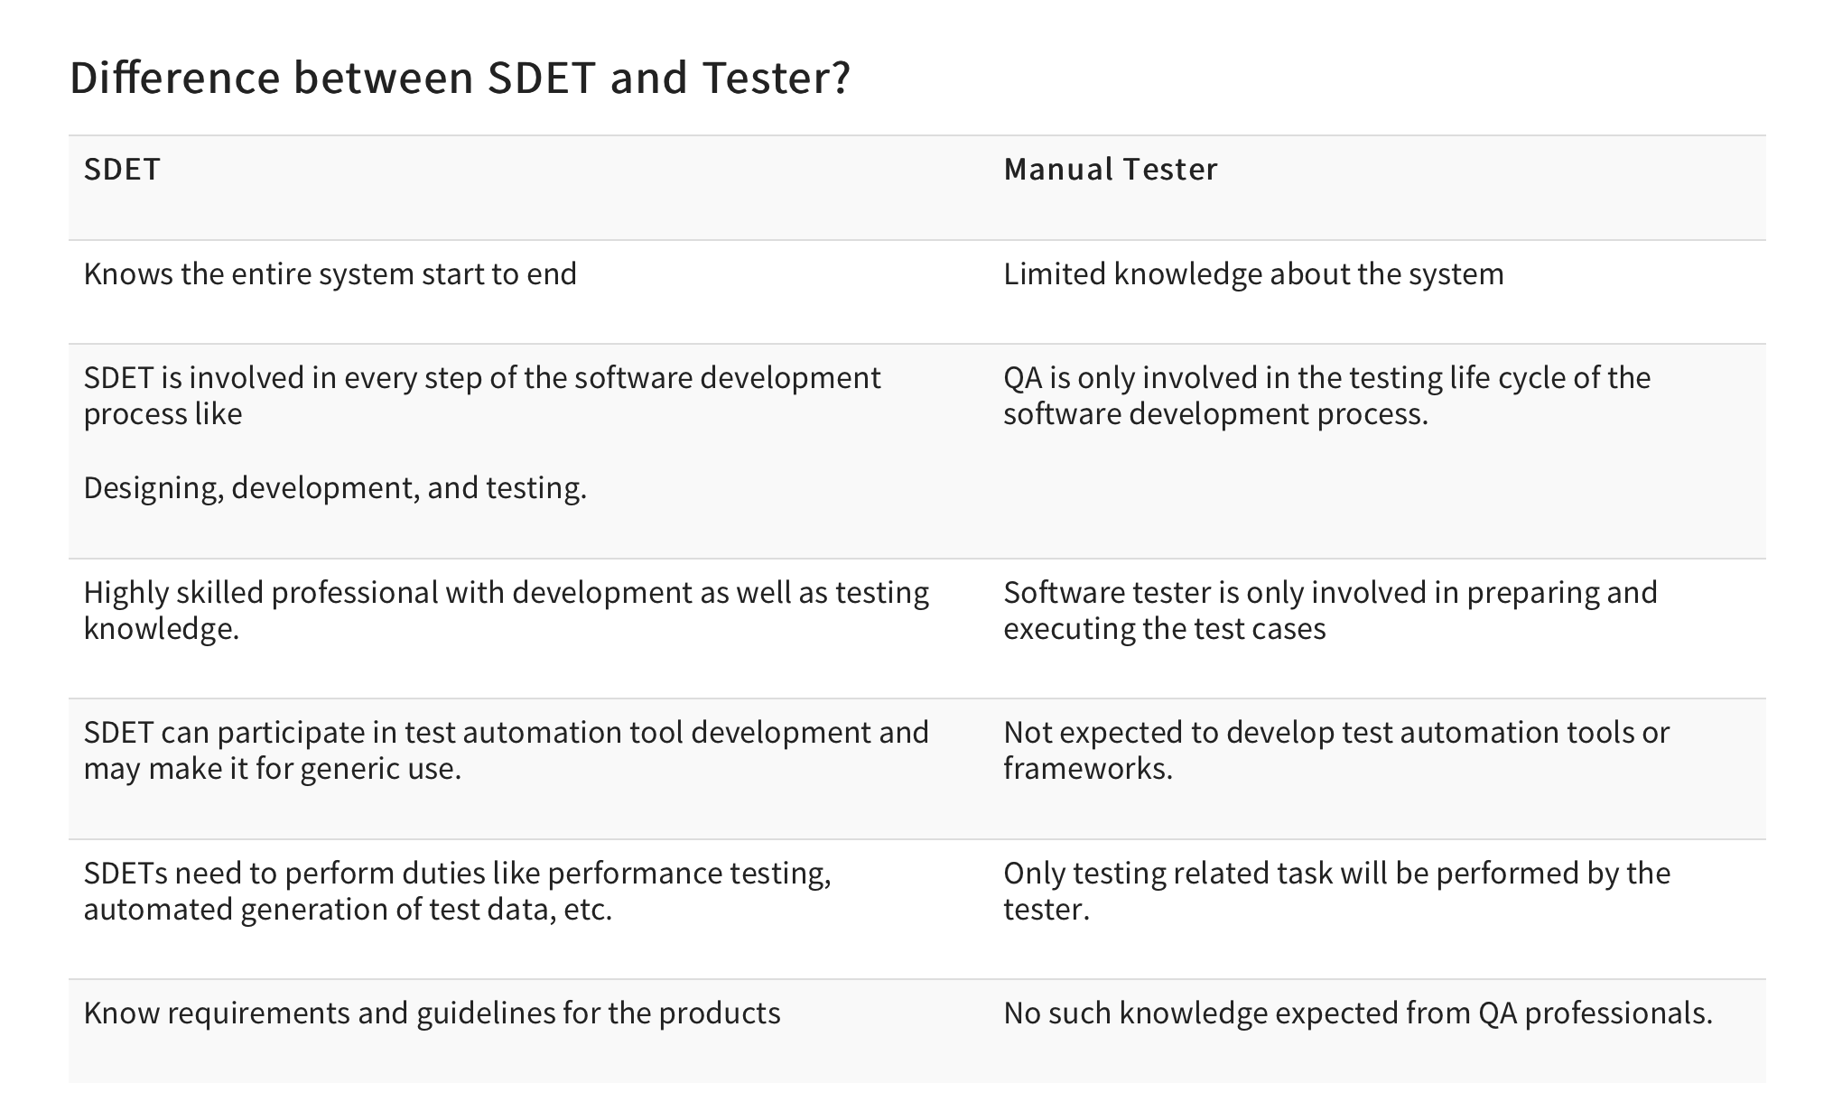

Slide 4
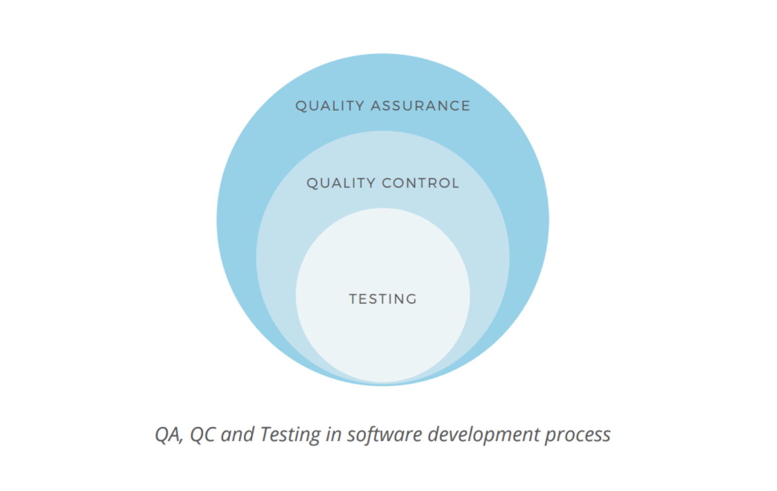
QA vs Testing
Quality Assurance is a broad term. QA focuses more on organizational aspects of quality management, monitoring the consistency of the production process. It is a is a set of methods and activities designed to ensure that the developed software corresponds to all the specifications (Requirement documents).
Testing is a way of exploring the system to check how it operates and find the possible defects. It has a very narrow focus and is performed by the test engineers in parallel with the development process or at the dedicated testing stage.

Slide 5
Which of the following statements about early test design are true and which are false?
1. Defects found during early test design are more expensive to fix.
2. Early test design can find defects.
3. Early test design can cause changes to the requirements.
4. Early test design takes more effort.
A) 1 and 3 are true. 2 and 4 are false.
B) 2 is true. 1, 3 and 4 are false.
C) 2 and 3 are true. 1 and 4 are false.
D) 2, 3 and 4 are true. 1 is false.

