Slide 1
Methodologies
Waterfall Methodology
Agile Methodology

Slide 2
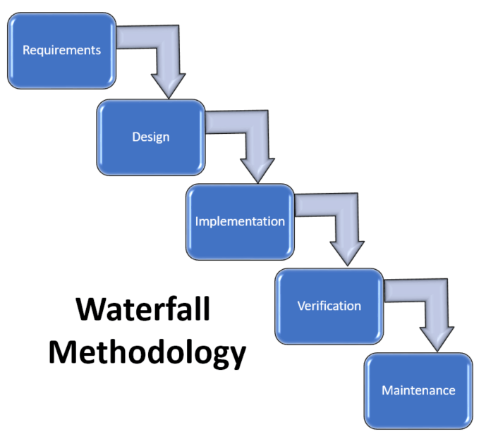
Waterfall Methodology
Each phase has to be completed before going to next phase
There is no overlapping between phases

Slide 3

Advantages of Waterfall
Requirements are well documented
Works well for small Projects
Easy to arrange tasks
Accurate budget planning

Slide 4


Disadvantages of Waterfall
Hard to make changes
No Software until all phases are completed
High cost if requirement is missed
Testing is done at the end which can lead to big challenges

Slide 5
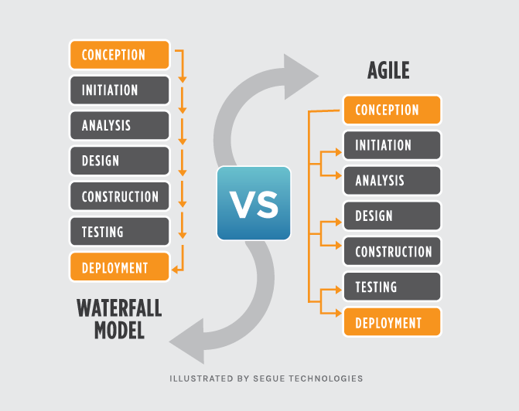
AGILE Methodology
Agile is iterative, team based approach of Software development.

Slide 6
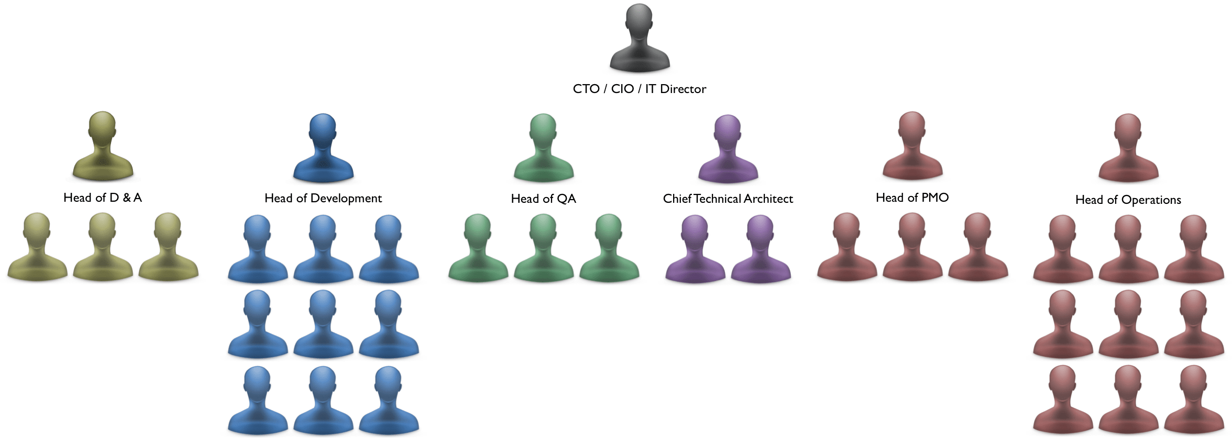
Team Compositions Waterfall

Slide 7
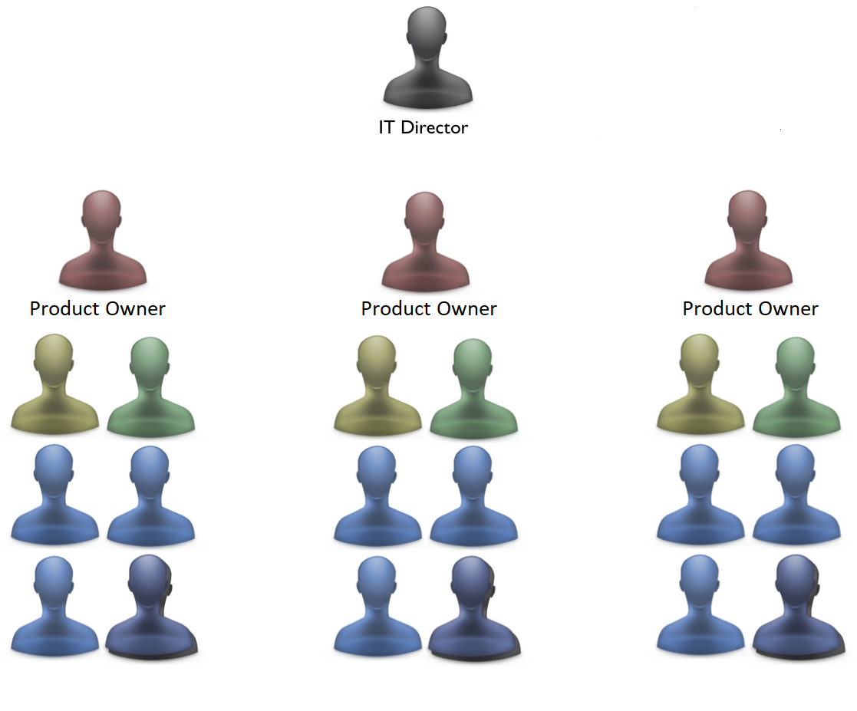
team composition AGILE

Slide 8
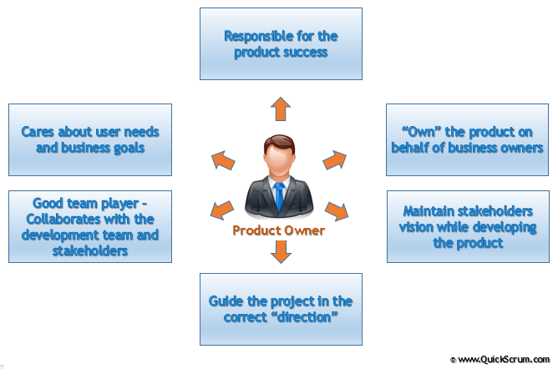
Product Owner
The Product Owner is the keeper of the requirements

Slide 9
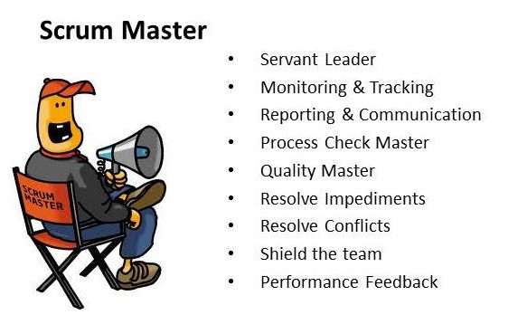

Slide 10
Scrum Master
The Scrum Master is responsible for making the process run smoothly, for removing obstacles that impact productivity.
Improve the productivity of the development team in any way possible.
Keep information about the Team’s progress up to date and visible to all parties

Slide 11
AGILE SCRUM
Scrum is framework for agile development, and most widely-used one.
Scrum time is “time-boxed” into phases called “SPRINTS.”

Slide 12
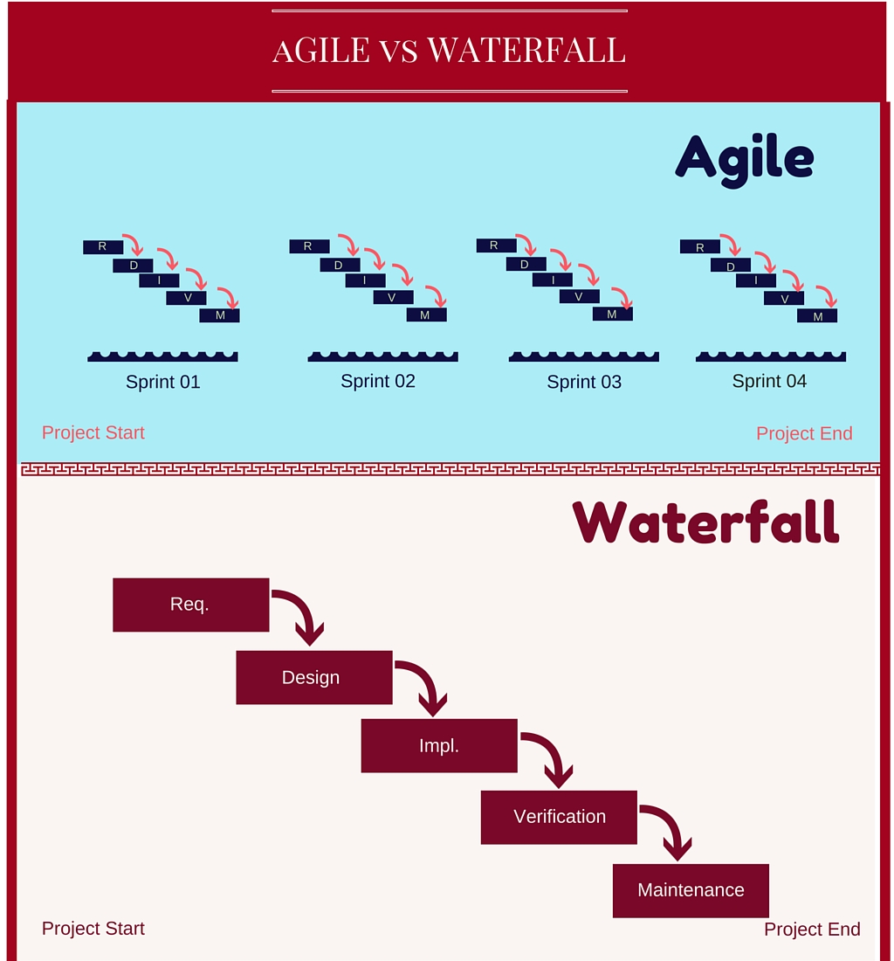

Slide 13
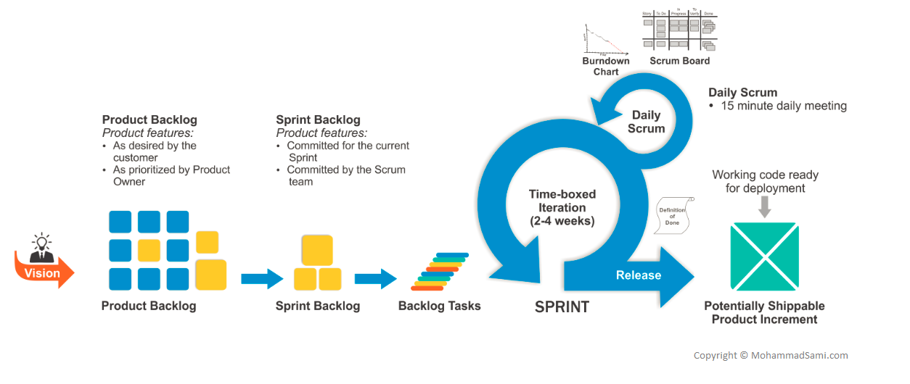

Slide 14
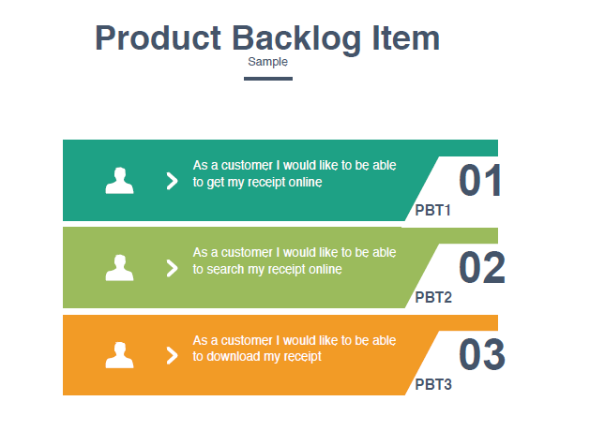

Slide 15
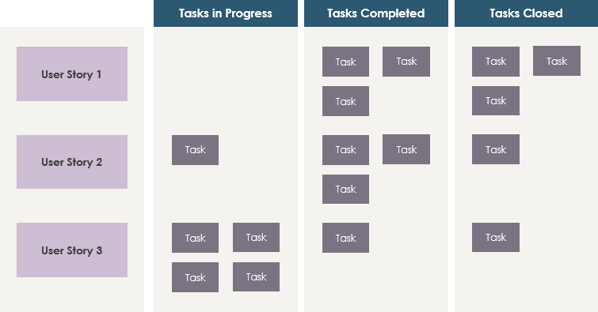
A product backlog is a prioritized list of work for the development team

Slide 16
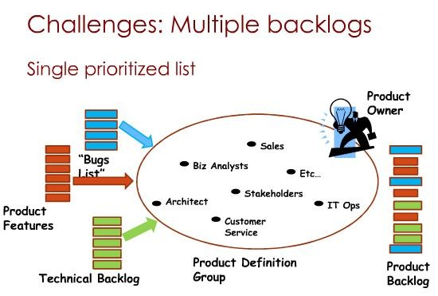

Slide 17
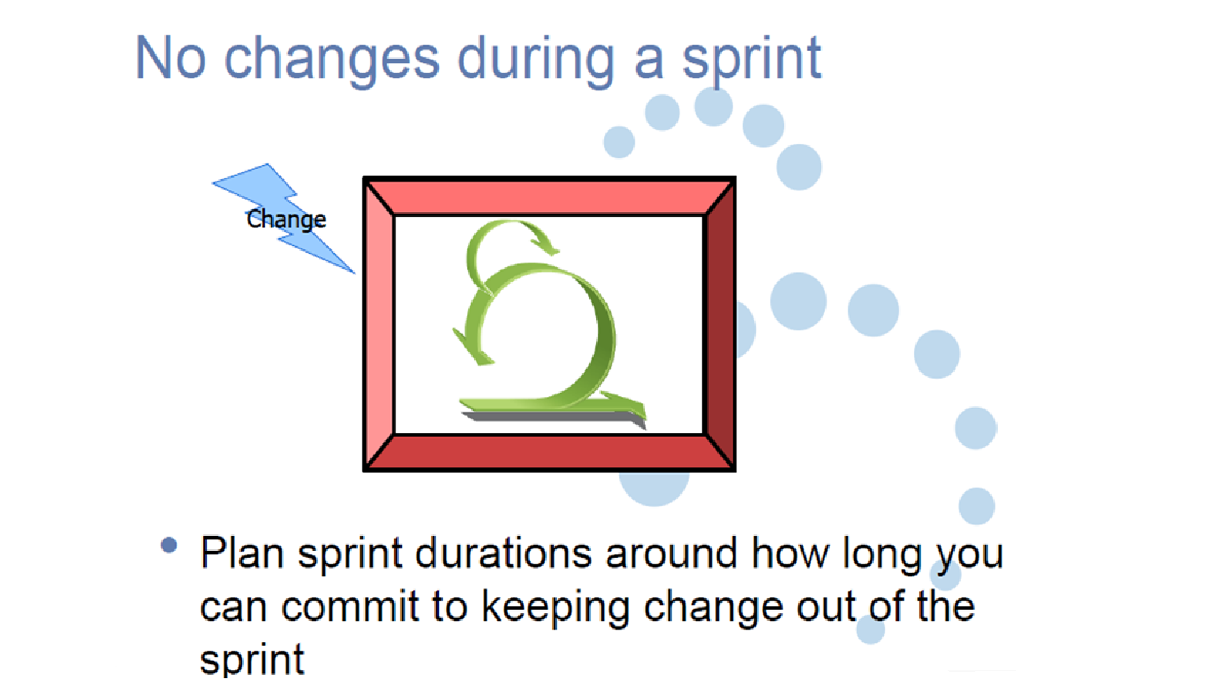

Slide 18
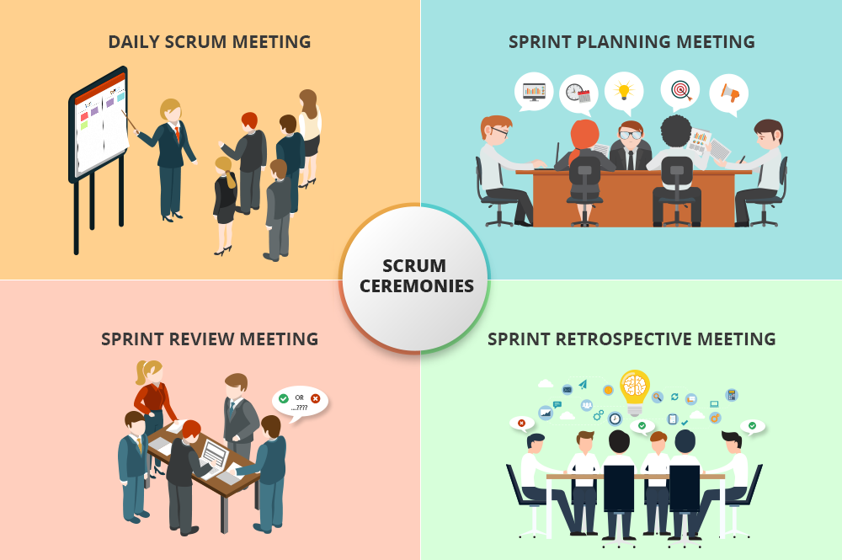

Slide 19
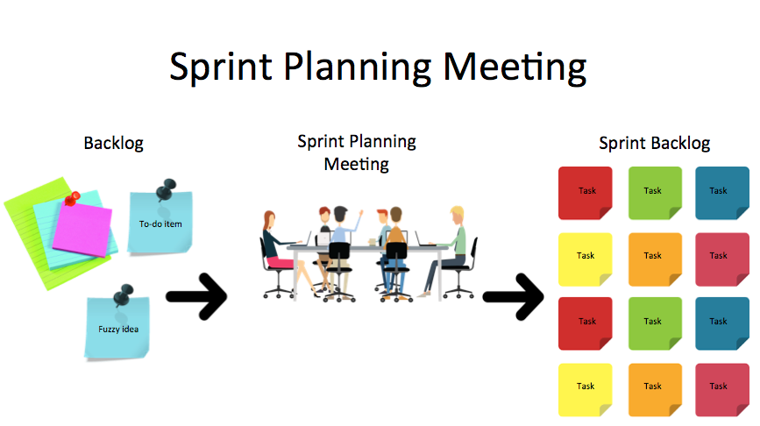
Determine product backlog items they will work during that sprint

Slide 20
Sprint Points
Points can be measured in range of 4 – 12 hours
Usually 8 hours (1 day)→ 1 point
For example:
2 weeks sprint (10 business days)
4 Developers
2 Testers
6 team members = 6*10 =60 points
60 – 10 (1 point person) = 50 points → this is CAPACITY of team

Slide 21
Velocity and Capacity of Scrum Team
Capacity → available points for team is called CAPACITY
Velocity → average of used points
For Example: Sprint 1 → 48 points Sprint 2 → 46 points
Sprint 3 → 52 points ------------
Velocity (average) → (48+46+52)/3 = 48.67

Slide 22

Daily Stand UP Meeting
Purpose: Quick status update Lasts for 15 minutes What did you do Yesterday? What you going to do today? Is there any blocker?

Slide 23
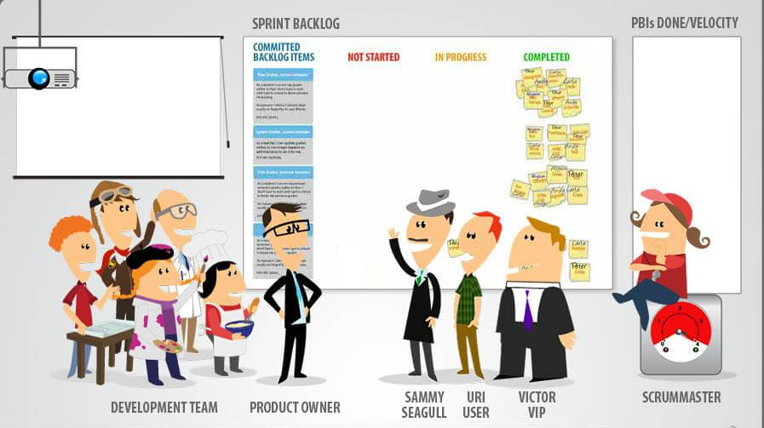
SPRINT REVIEW MEETING
Product Owner, Scrum Master, and Stakeholders attending this meeting. Team members are demonstrating their job and determine what are finished and what are not

Slide 24

SPRINT RETROSPECTIVE MEETINGS
It happens at the end of Sprint (Last day of sprint) Will discuss what they did wrong and how they can improve it next sprint.

Slide 25
Sprint grooming meeting
Usually happens at the end of Sprint
Discuss next sprint Backlog (User Stories) and prioritize them.

Slide 26
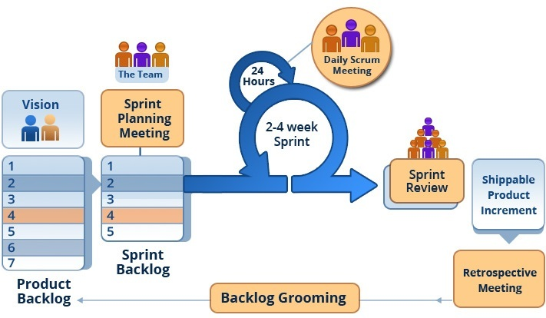

Slide 27
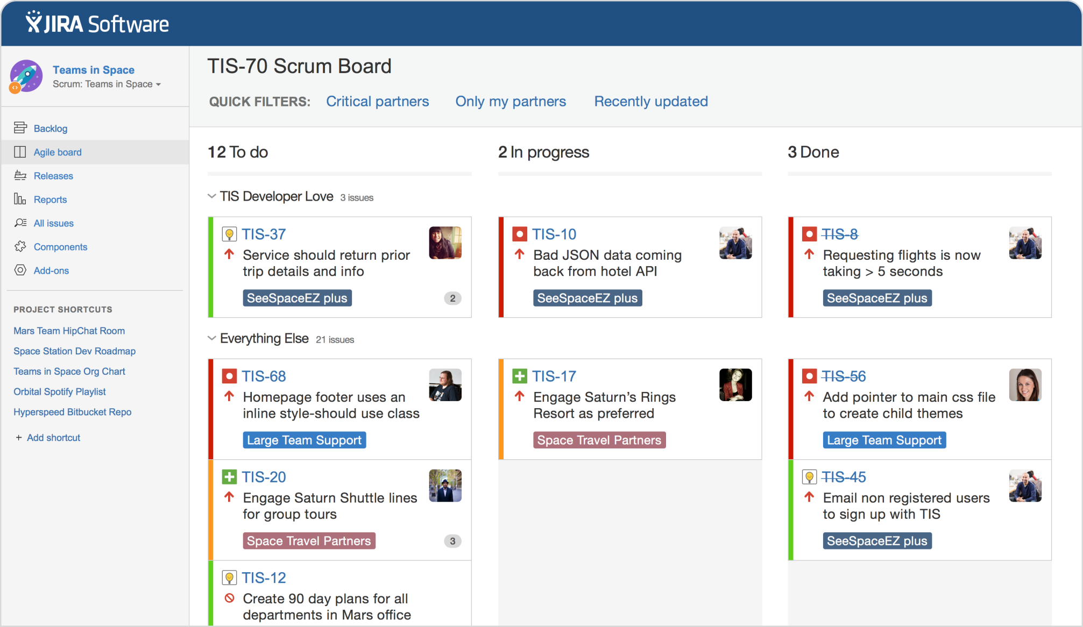
SCRUM BOARD

Slide 28
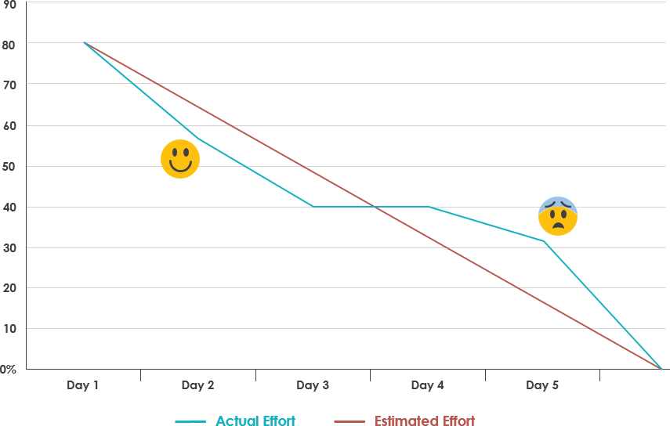
Scrum Burndown Chart

Slide 29
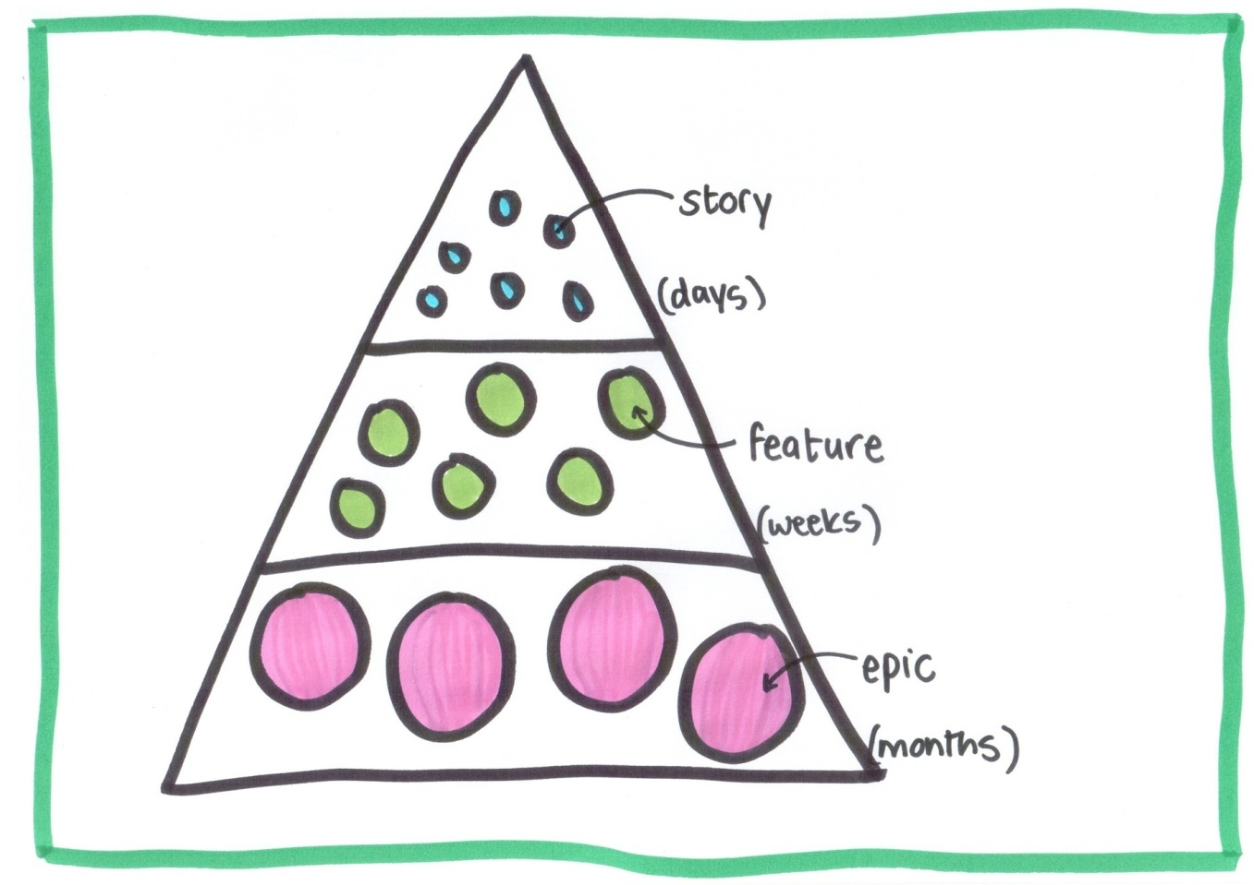

Slide 30
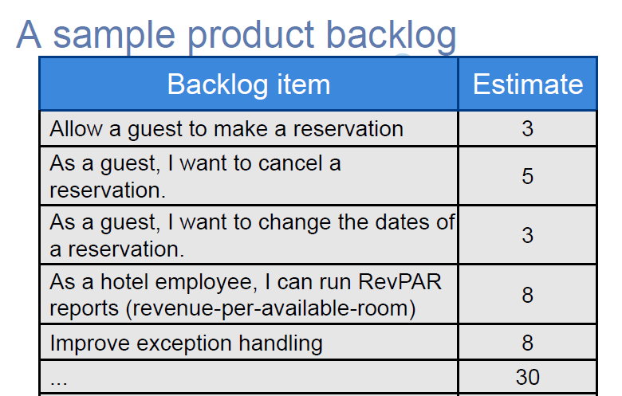

Slide 31
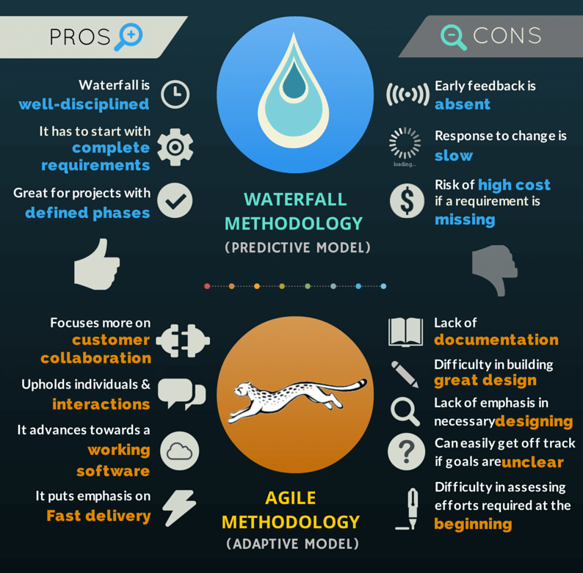

Slide 32

Thank You!
Arslan K.

