Slide 1
Soft Skills class

Slide 2
Soft Skills Topics
SDLC
Agile/Waterfall Methodologies
Testing types
STLC/Defect Life Cycle
Manual Testing
Testing Strategies
Application Environments
JIRA
Review Classes
Interview Preparation

Slide 3

SDLC
Software Development Life Cycle

Slide 4
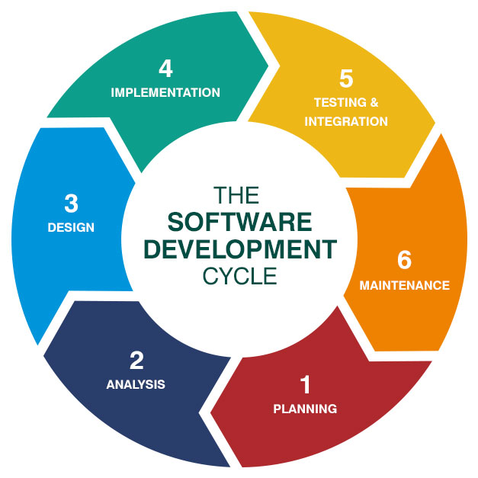
SDLC or the Software Development Life Cycle is a process
that produces software with the highest quality and lowest cost in the shortest time.

Slide 5

PLANNING

Slide 6
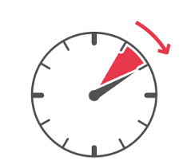

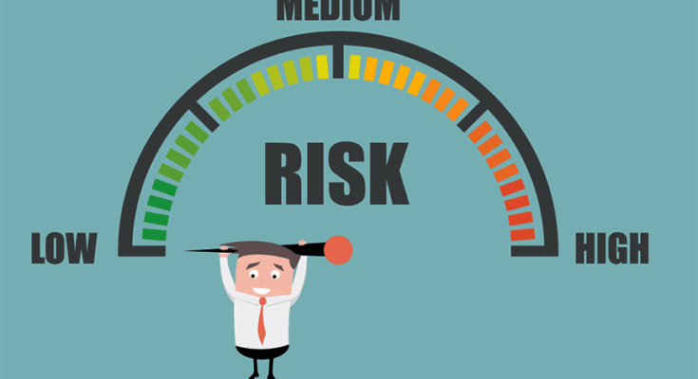

Outputs of Planning phase
Time
Budget
Risk
Quality

Slide 7
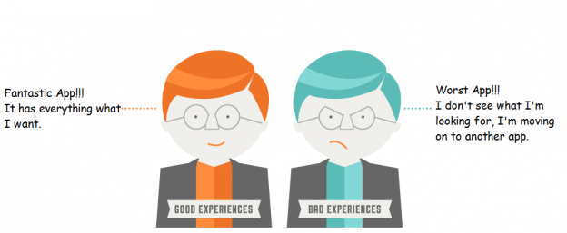
ANALYSIS
ROI (Return On Investment)
Requirements
Needs of End User

Slide 8
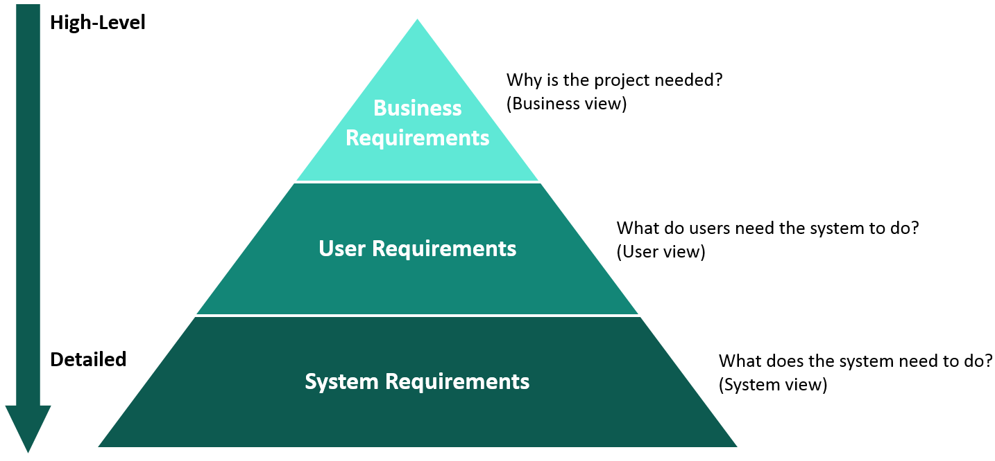

Slide 9
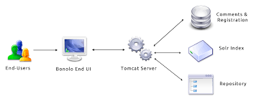
Who is End User?
End User is person that software program is designed for

Slide 10
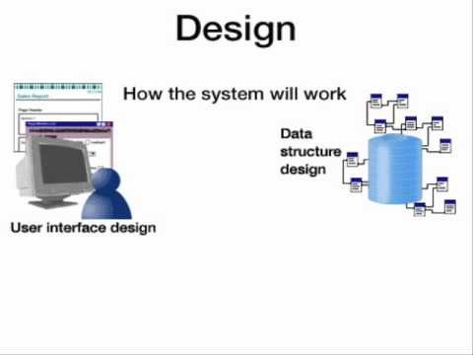
Design
Decision of: Application Design Programming language
Application framework
Database Security
User Interface Functions

Slide 11
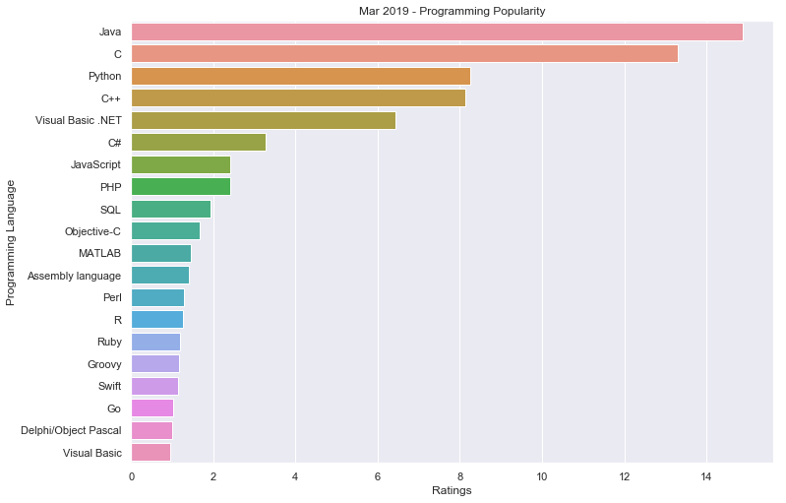
Popular programming languages

Slide 12
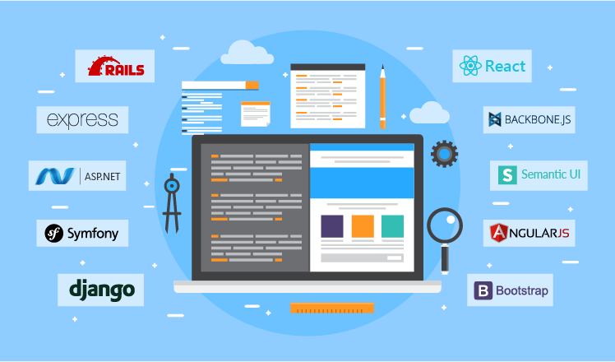
Application framework
Frameworks are software that is developed and used by programmers to build applications. BDD -> Behavior Driven Development TDD -> Test Driven Development

Slide 13
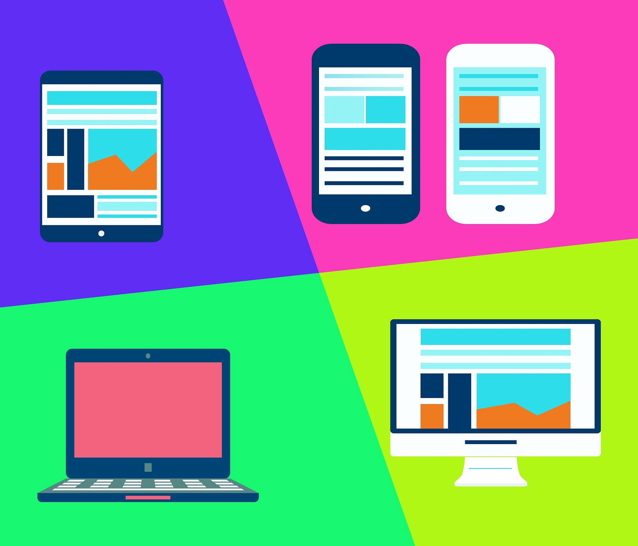
User Interface or UI
A place where interaction between End User and Software applications.

Slide 14
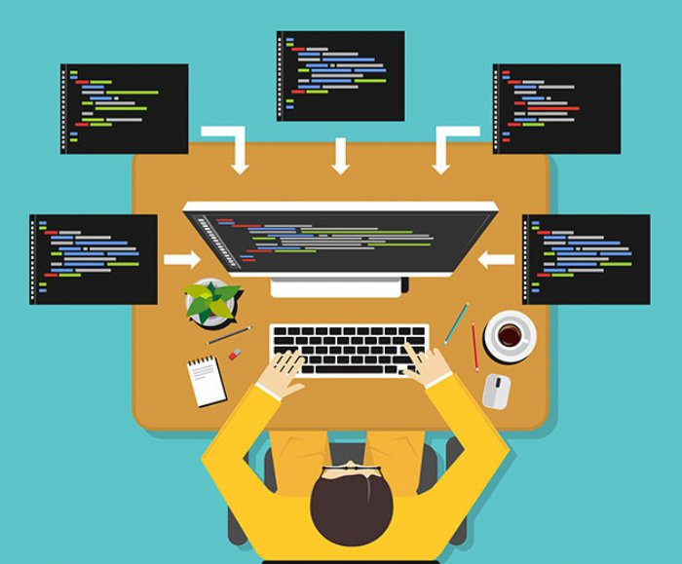
Implementation (Development)

Slide 15
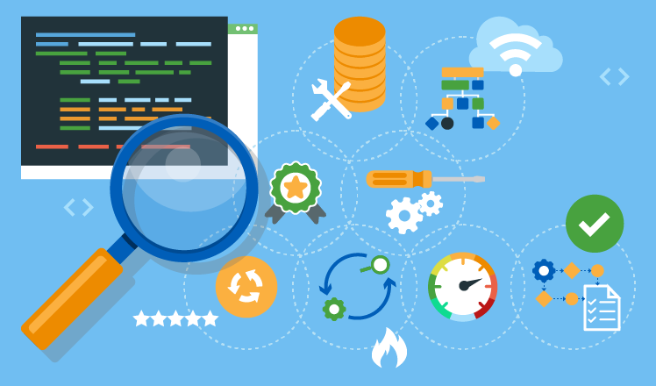
TESTING

Slide 16
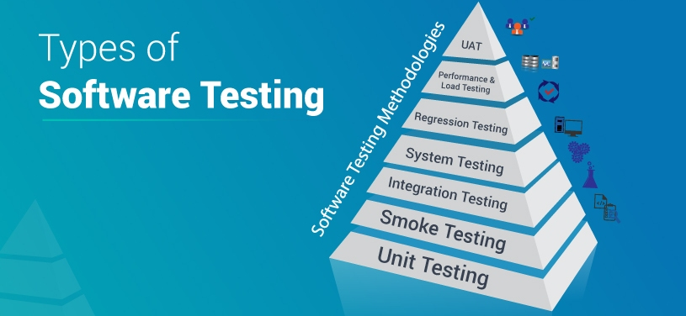

Slide 17
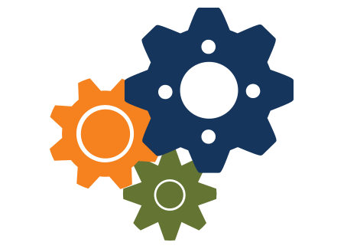
Unit Testing
Is done by Developers
Testing small piece of code

Slide 18
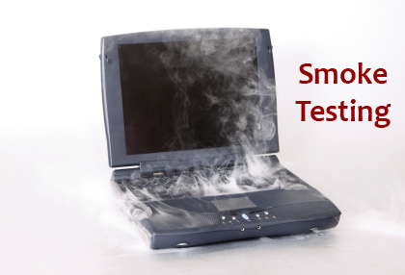
Smoke Testing
Testing main functionalities to verify it is up and running.
Tested on daily basis

Slide 19
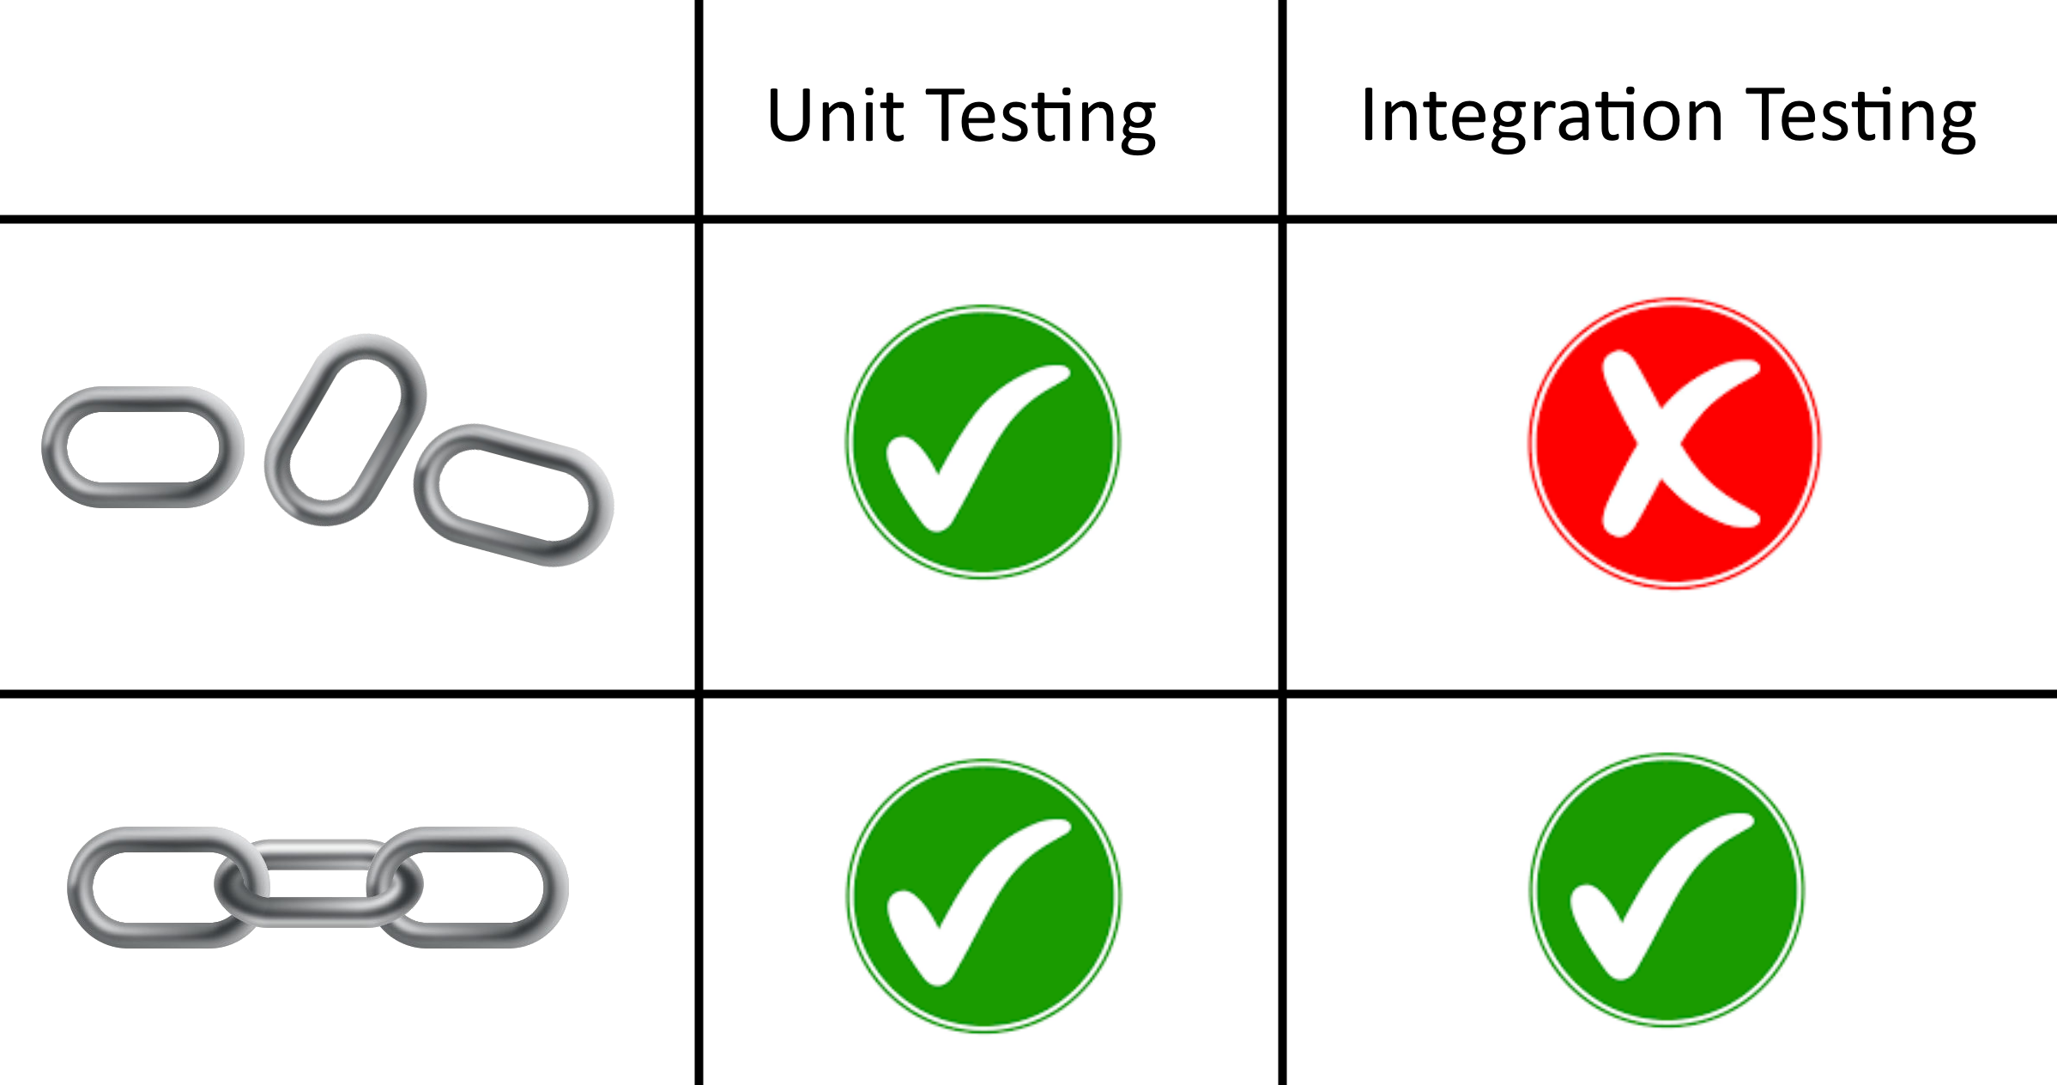
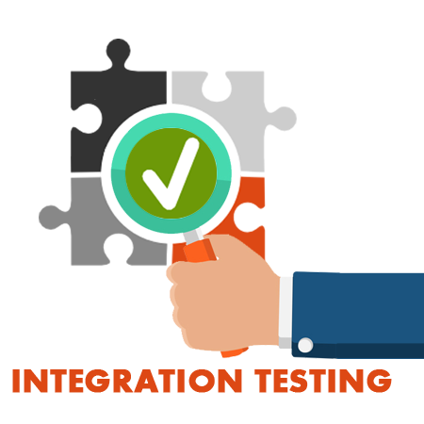
Integration Testing

Slide 20
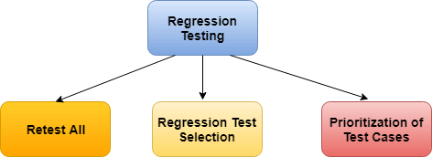
Regression Testing
Should be done every month (2 sprints)

Slide 21
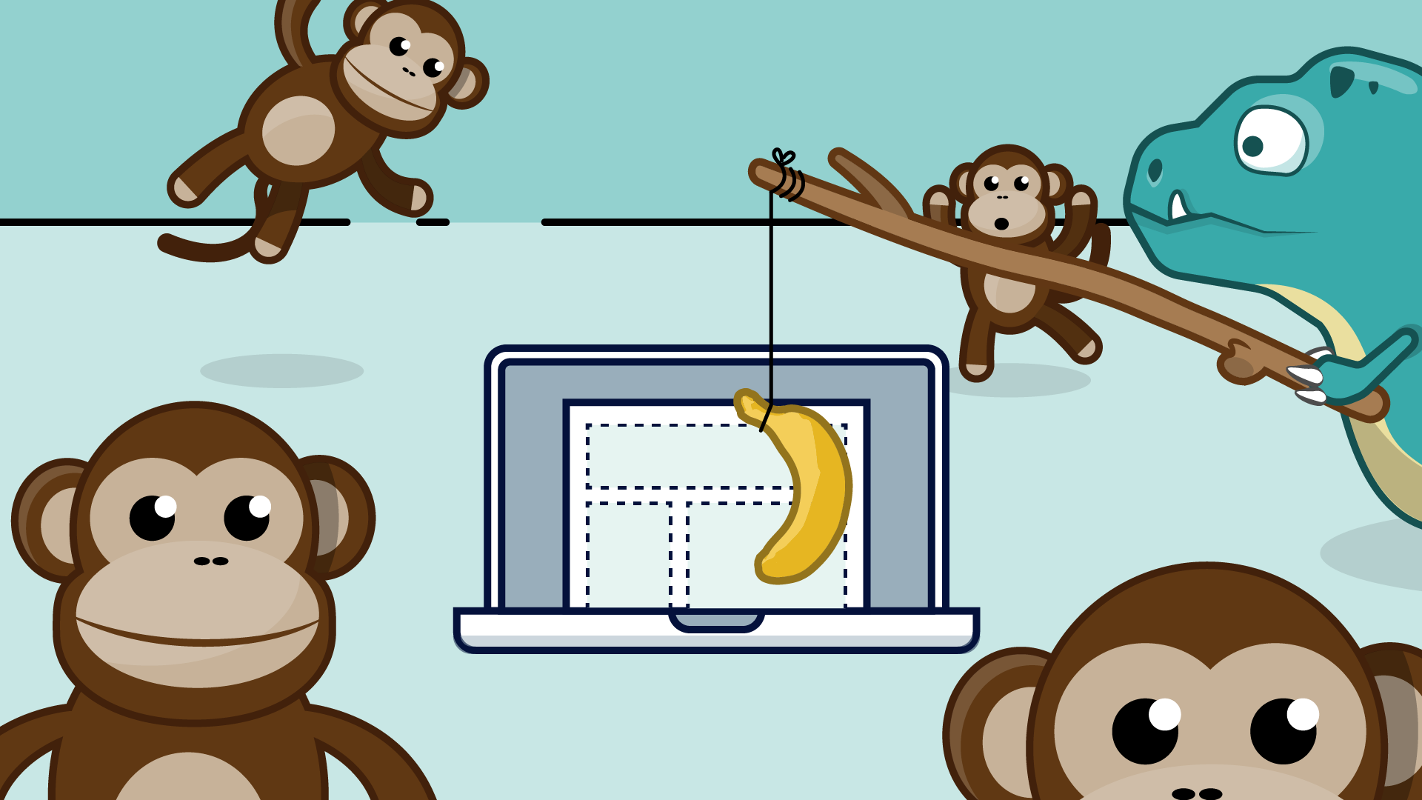
Ad – Hoc ( Monkey ) Testing
Informal Testing which is performed by Testers.
Application is tested randomly with random inputs.

Slide 22
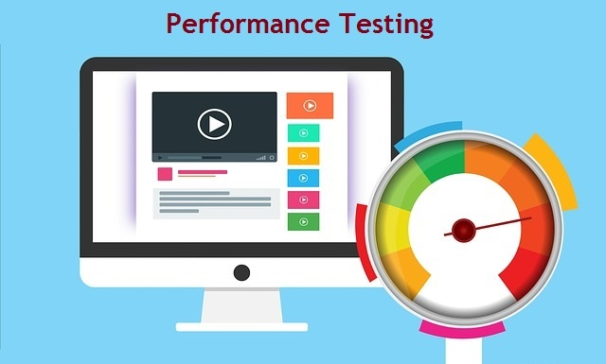
Performance Testing
Speed
Stability of Software
Capacity

Slide 23
Basic Testing Glossary
Bug (Defect)
Test Case
Business requirement
Expected Result
Actual Result
Positive Testing
Negative Testing
Front End
Back End
Functionality

Slide 24
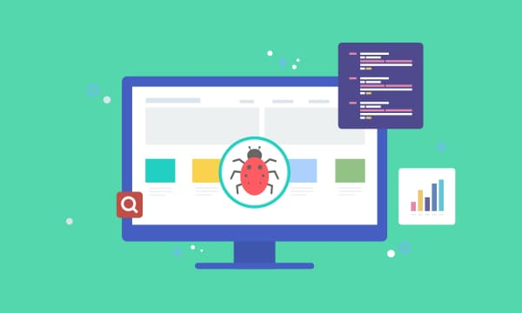
What is BUG / Defect ?
Unexpected result
Invalid Output

Slide 25
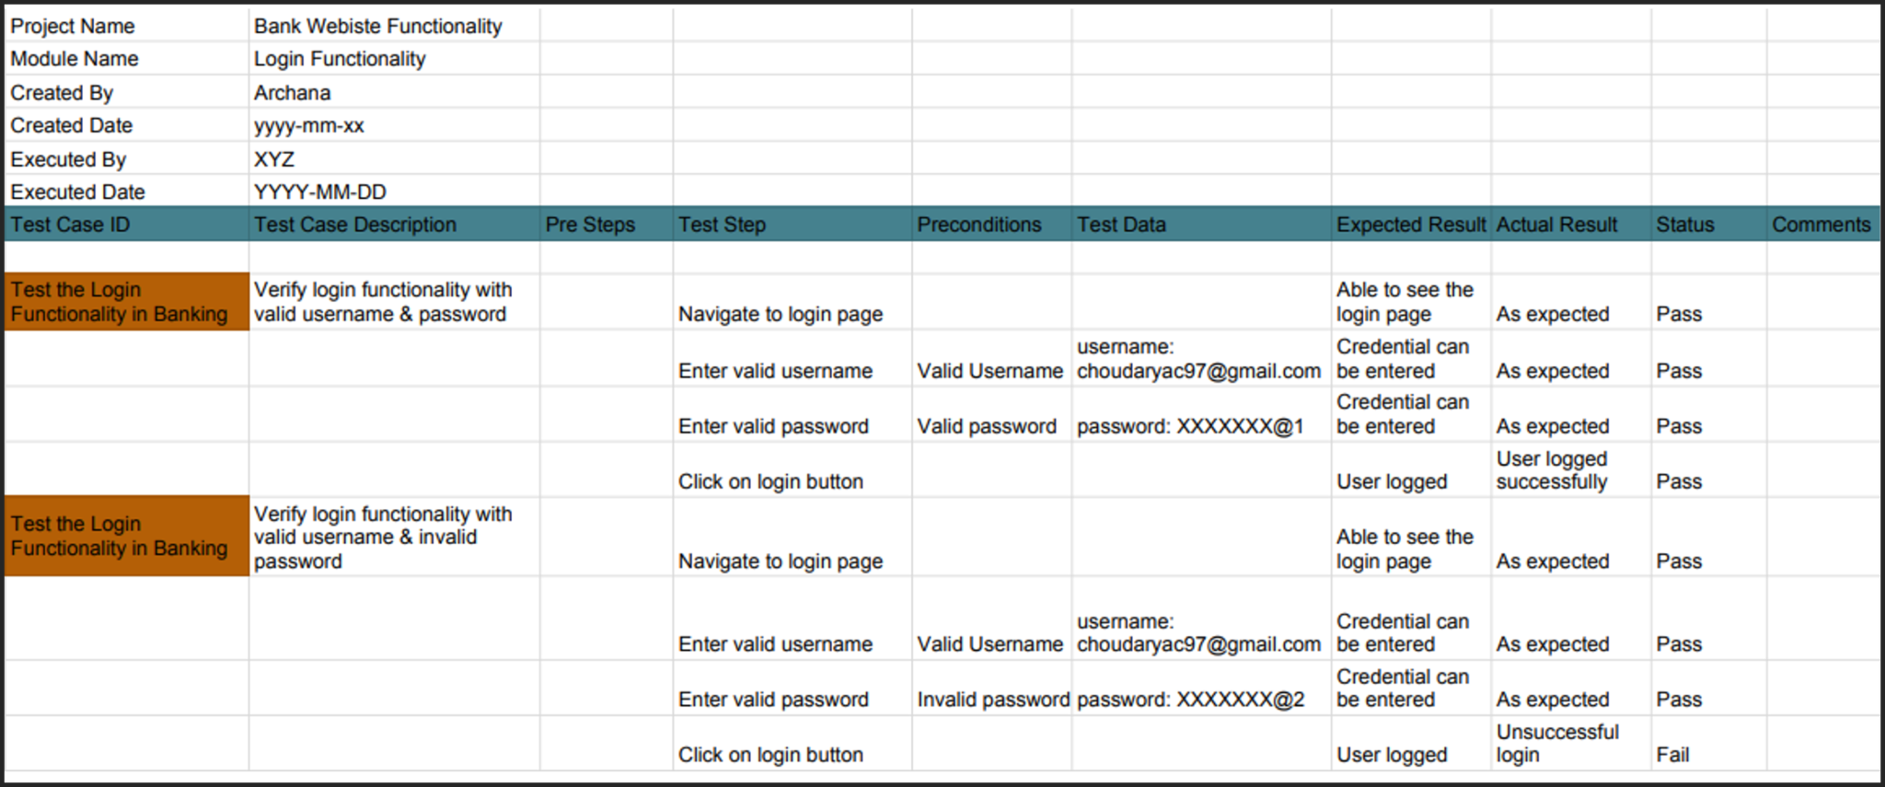
Test Case

Slide 26
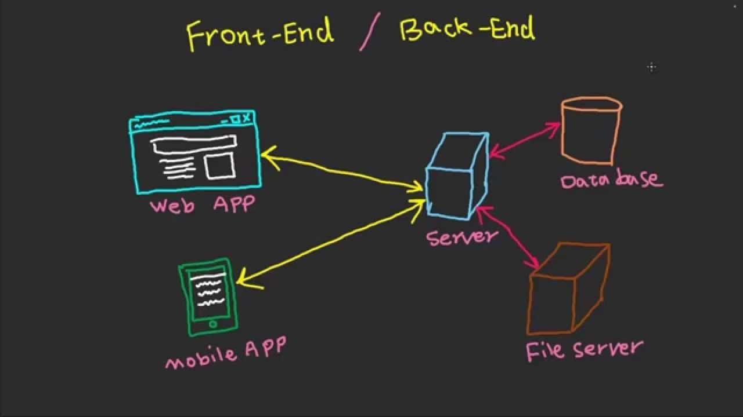
Front End (UI) and Back end Full Stack SDET (Software Development Engineer in Test)

Slide 27
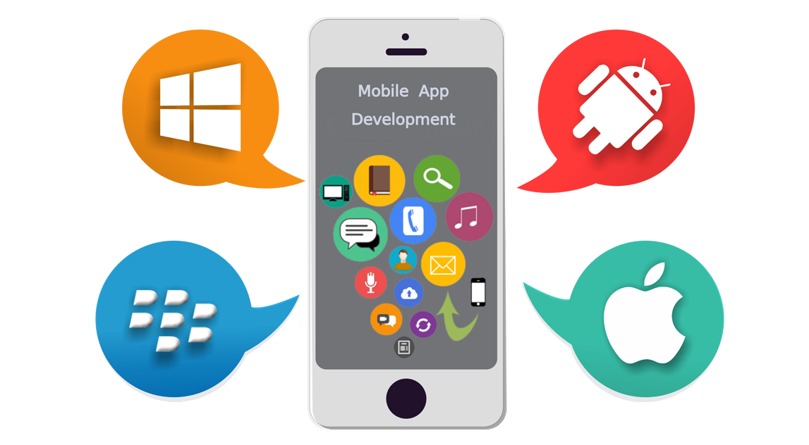
Functionality
“To Perform” from Latin language

Slide 28
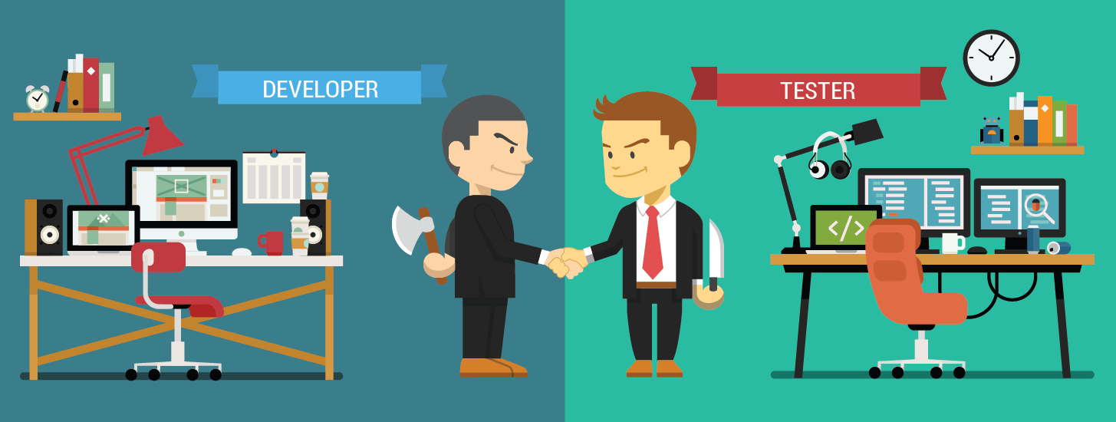

Slide 29
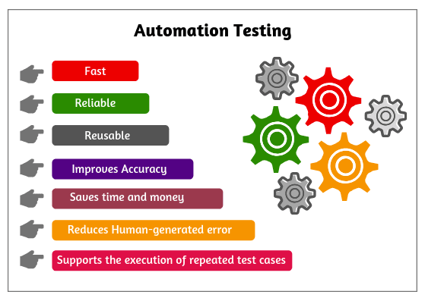
Benefits Of Automation Test

Slide 30

Deployment
This step is done after Application been tested and Accepted by Client.
Release the Application to Production
Production is where end users have an access to application

Slide 31
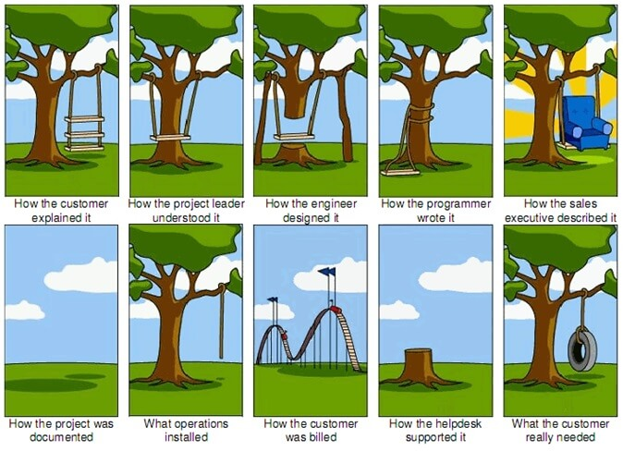

Slide 32
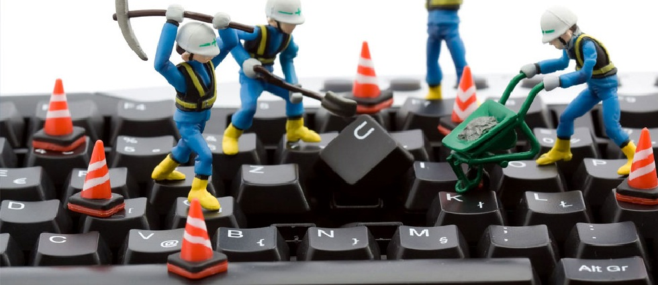
Maintenance
Software updates
Repairs
Fixes

Slide 33


Slide 34
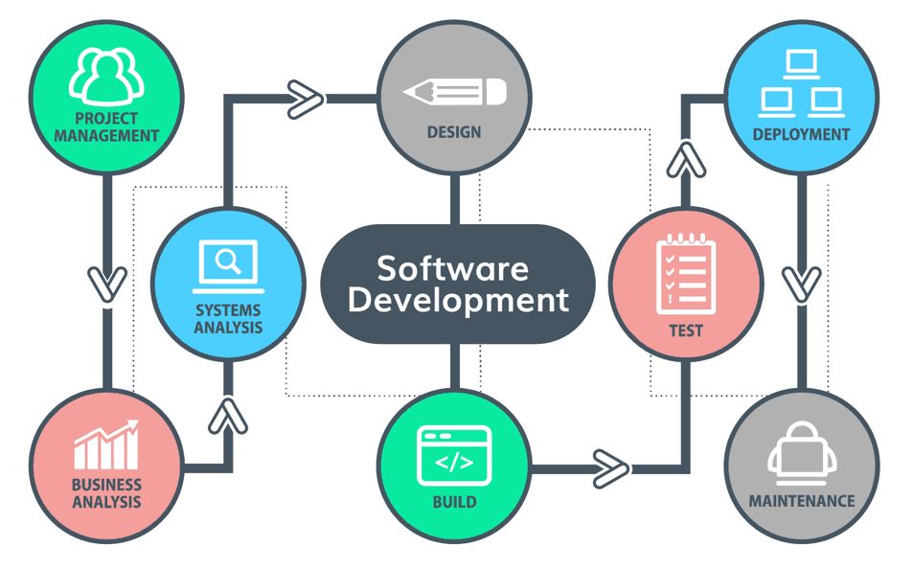

Slide 35
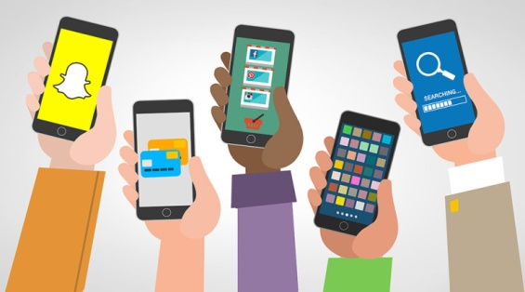

Applications
External Application
Internal Application

Slide 36
Thank You!

