Slide 1


Software Testing types
Software testing is generally classified into two main broad categories: functional testing and non-functional testing

Slide 2
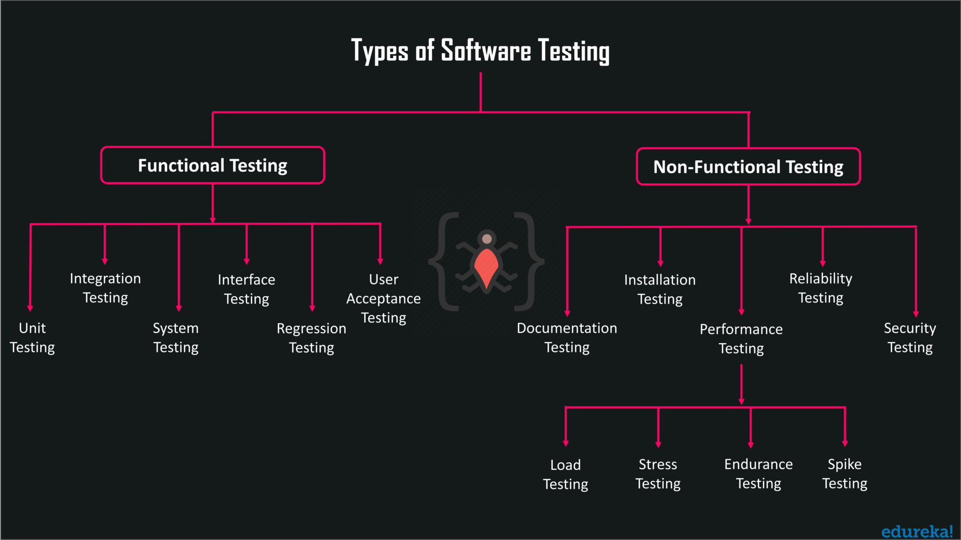

Slide 3
Functional testing involves the testing of the functional aspects of a software application. When you’re performing functional tests, you have to test each and every functionality. You need to see whether you’re getting the desired results or not.
Non-functional testing is the testing of non-functional aspects of an application, such as performance, reliability, usability, security, and so on. Non-functional tests are performed after the functional tests.

Slide 4


Slide 5
Criteria | Black Box Testing | White Box Testing
Definition | Black Box Testing is a software testing method in which the internal structure/ design/ implementation of the item being tested is NOT known to the tester. | White Box Testing is a software testing method in which the internal structure/ design/ implementation of the item being tested is known to the tester.
Levels Applicable To | Mainly applicable to higher levels of testing: Acceptance Testing & System Testing | Mainly applicable to lower levels of testing: Unit Testing & Integration Testing
Responsibility | Generally, independent Software Testers | Generally, Software Developers

Slide 6
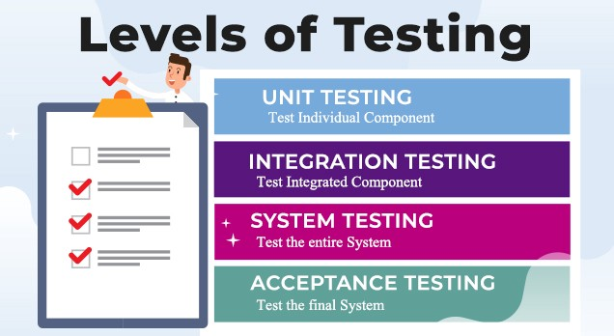

Slide 7
Unit testing is a level of software testing where individual units/ components of a software are tested. The purpose is to validate that each unit of the software performs as designed. A unit is the smallest testable part of any software. It usually has one or a few inputs and usually a single output.
Integration Testing is a level of software testing where individual units are combined and tested as a group. The purpose of this level of testing is to expose faults in the interaction between integrated units.
User acceptance testing (UAT) is the last phase of the software testing process. During UAT, actual software users test the software to make sure it can handle required tasks in real-world scenarios, according to specifications. UAT is one of the final and critical software project procedures that must occur before newly developed software is rolled out to the market.
System testing is a level of software testing where a complete and integrated software is tested. The purpose of this test is to evaluate the system’s compliance with the specified requirements.

Slide 8
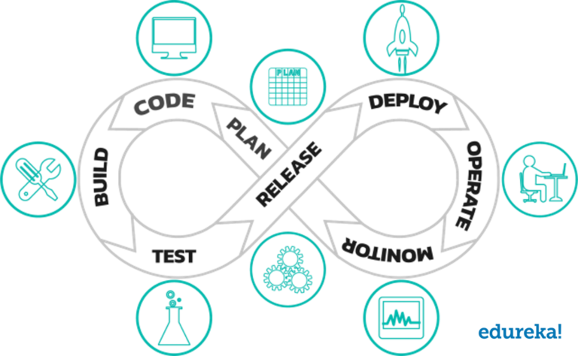
Regression testing is a testing that is done to verify that a code change in the software does not impact the existing functionality of the product.

Slide 9
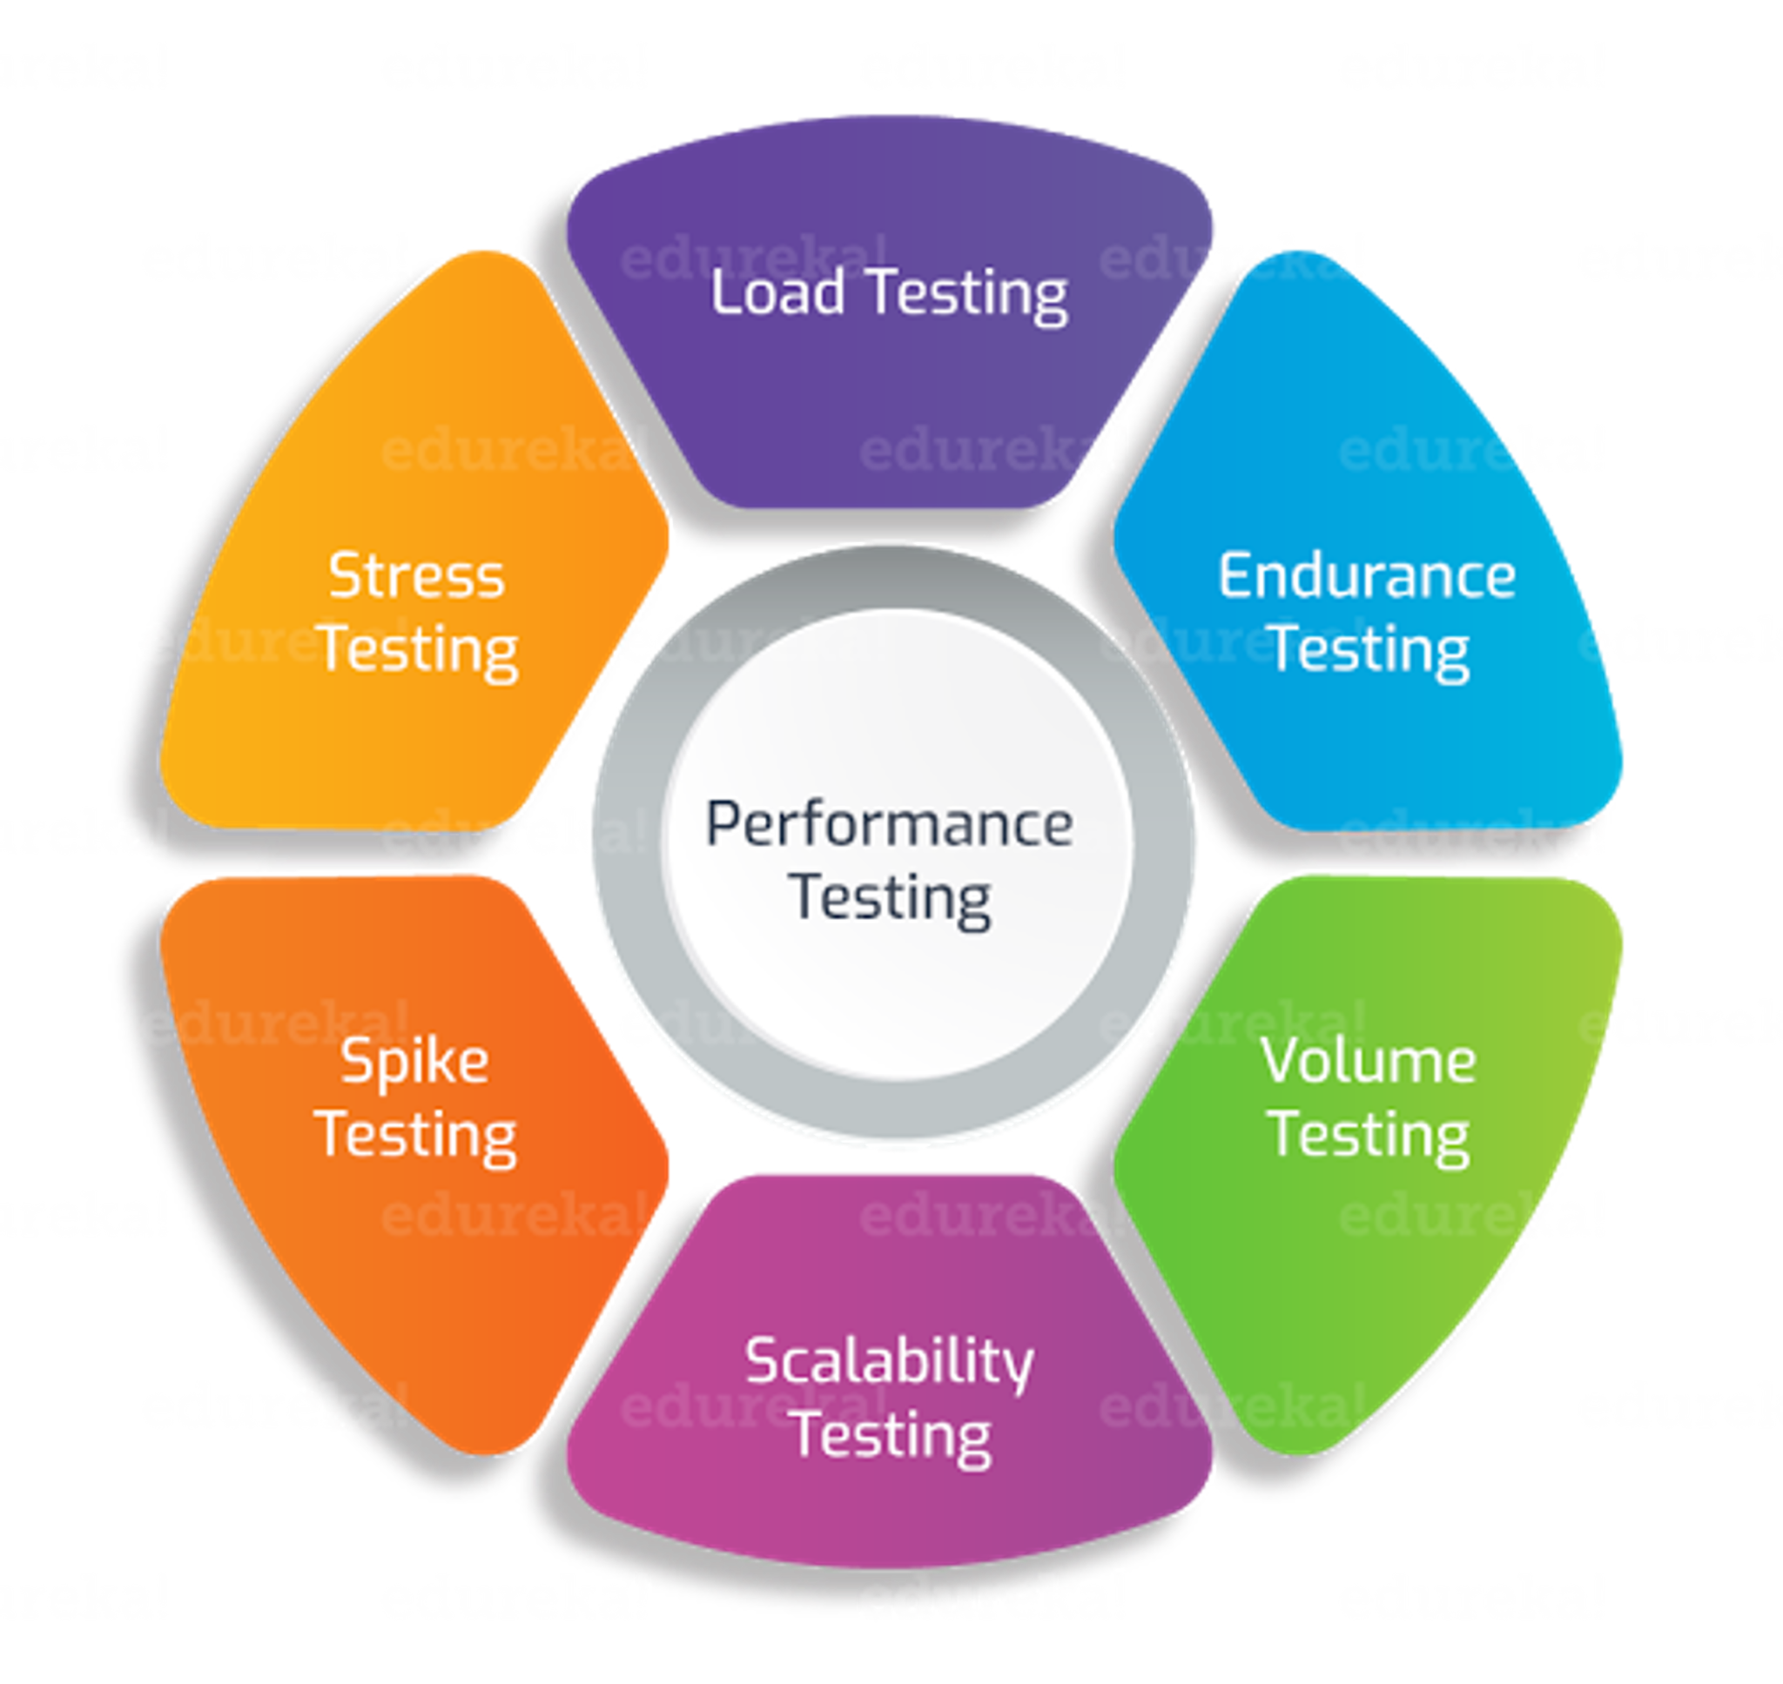
LT is a type of performance testing conducted to evaluate the behavior of a system at increasing workload
ET is a type of performance testing conducted to evaluate the behavior of a system when a significant workload is given continuously.
ST is a type of performance testing conducted to evaluate the behavior of a system at or beyond the limits of its anticipated workload
The objective is to check software application's performance under varying database volumes
ST is a type of performance testing conducted to evaluate the behavior of a system when the load is suddenly and substantially increased.
The objective of scalability testing is to determine the software application's effectiveness in "scaling up" to support an increase in user load

Slide 10
What in your life you differently than other people ?
Sh. Davletova

