Slide 1
11/23 進度報告
周杰士

Slide 2
Outline
3D Modeling Demo
Scene graph Tree
Template
Edit space
Distance Field
CDT 陳陸剛實作
VDT
3D Printing Class Pipeline
Program
Data

Slide 3
Scene graph Tree
r
Three method to create a model.
Open existing data.
.vm (Including scene graph Tree)
.vdata (raw data)
Make model from nothing to a tree.
Create a basic root object.
Add data into root object or node object.
Make some leaf object to one group.
Method 1 + Method 2 combine
Basic model
root obj
r
node obj
leaf obj

Slide 4
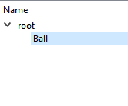
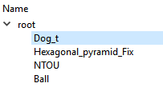
Method 2 Algorithm
Start
r
r
r
root obj
r
r
node obj
leaf obj
Group

Slide 5
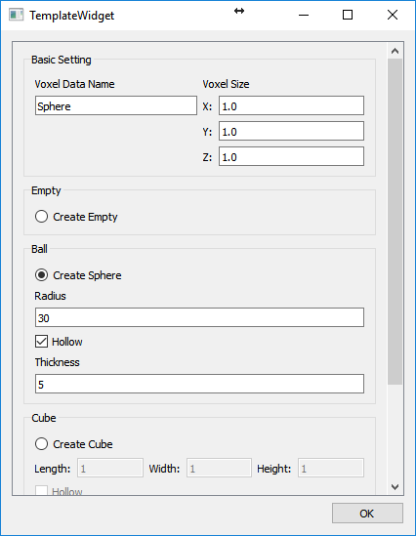
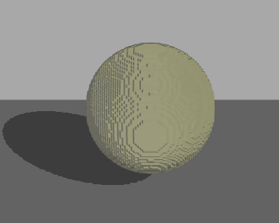
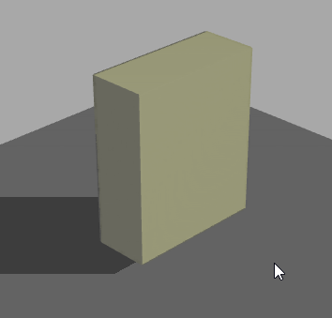
Template
Basic voxel data
Sphere
Cube
Cylinder
etc…
Input equation and range.

Slide 6
Make a sphere
Sphere equation:
x^2+y^2+z^2 = radius^2 center(0,0,0)
for(x form 0 to resolutionX) for(y form 0 to resolutionY) for(z form 0 to resolutionZ) index = x + y * resolutionX + z * resolutionX * resolutionY; y = (x—h)^2+(y-k)^2+(z-w)^2; if( y < radius^2 && y> (radius-thickness)^2 ) data[index] = VOX_SOLID;
Expand:
Spheroid: (x^2+y^2)/a^2+z^2/b^2 = r^2 center(0,0,0)
Ellipsoid: x^2/a^2+y^2/b^2+z^2/c^2 = r^2 center(0,0,0)
etc.

Slide 7
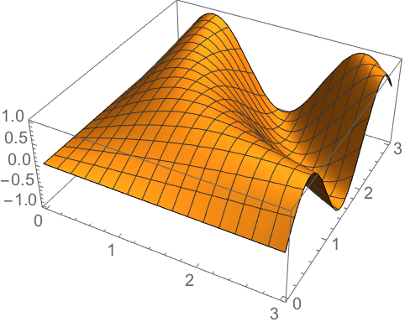
Input equation
Input some equation just like f(x)/g(x).
Set the range of x、 y、z.
Calculate the surface in a fixed range space by a certain number of threshold.
Voxelize

Slide 8
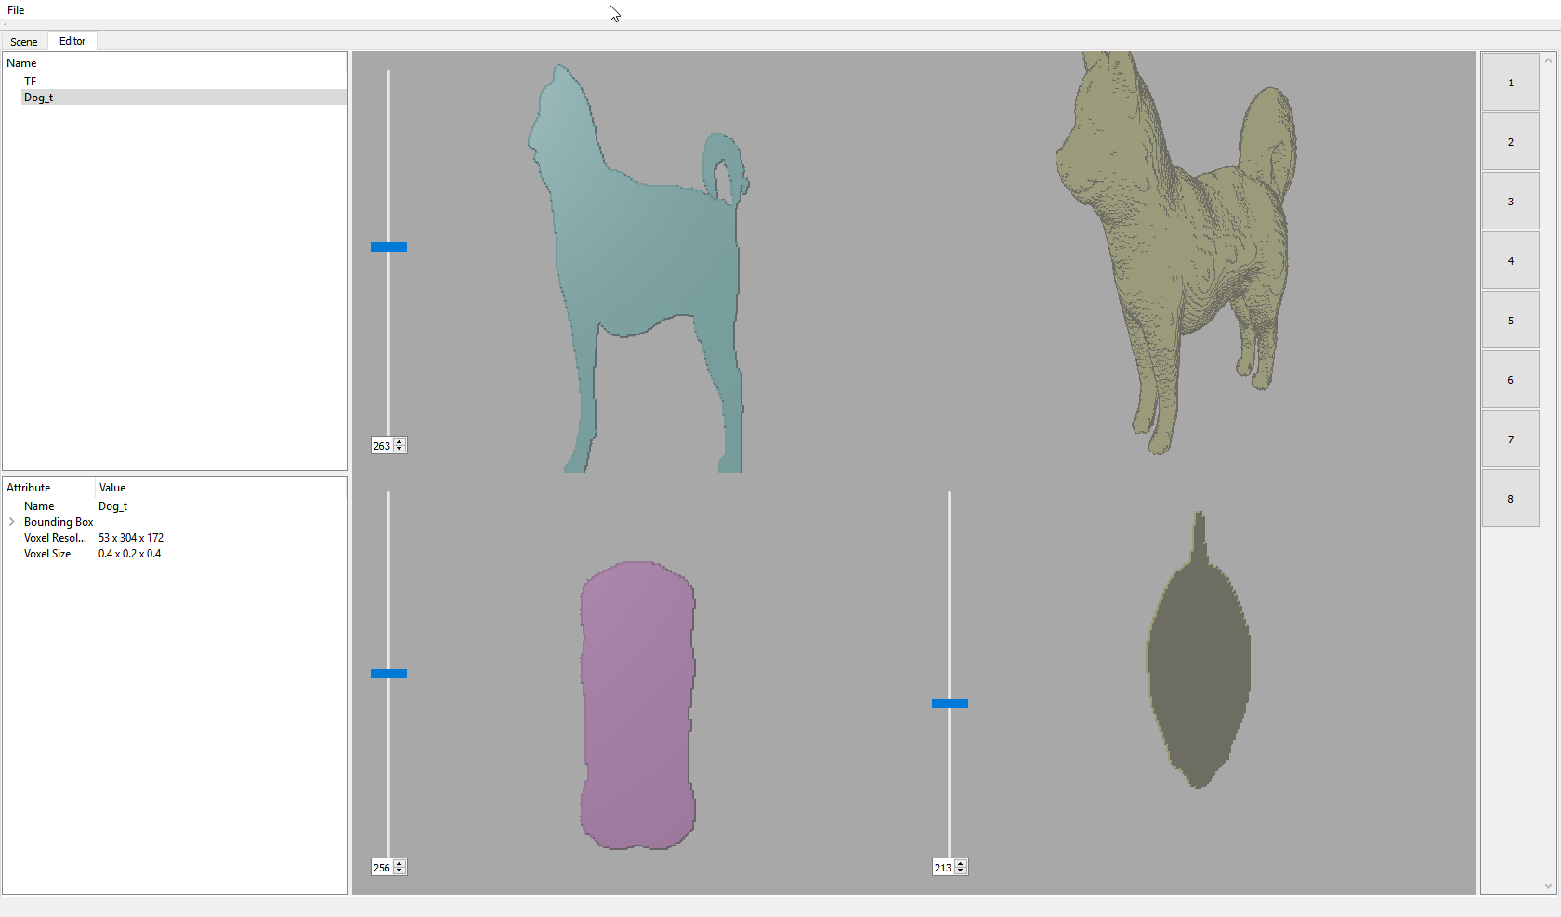
Edit Space
Space resolution 512*512*512
Method:
Control (view)
Pen
Eraser
Smoothing (morphological)
CSG (set op)

Slide 9
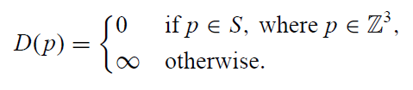
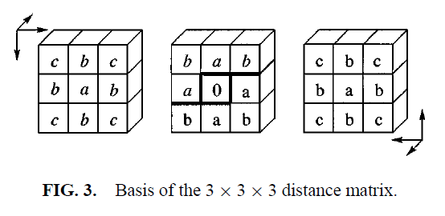
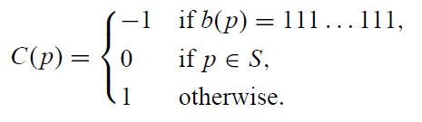


Distance Field - CDT
Initial
Sign
$D\left(x,y,z\right)=min(\left(D\left(x+i,y+j,z+k\right)+d_{mat}\left(i,j,k\right)\right)∀i,j,k∈d_{mat})$
$where x,y,z,i,j,k∈Z$
$$d_{mat}=$$
Internal
External

Slide 10
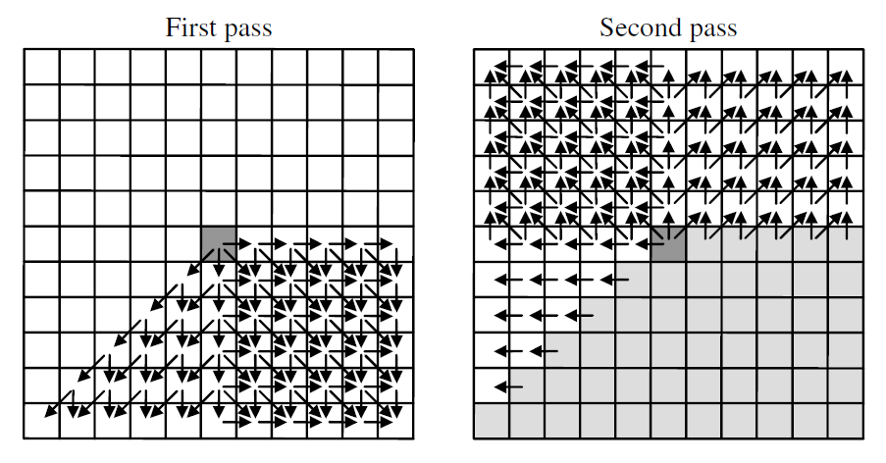
Distance Field - CDT
Data flow

Slide 11


Distance Field - VDT
VDT (Vector Distance Transforms)
Initial
$\vec{V}\left(x,y,z\right)=\min\left(\left|\vec{V}\left(x+i,y+j,z+k\right)+d_{mat}\left(i,j,k\right)\right|∀i,j,k∈d_{mat}\right),$
$$where x,y,z,i,j,k∈Z and d_{mat}\left(i,j,k\right)=({mat}_{x},{mat}_{y},{mat}_{z})$$
$$|\vec{V}\left(x,y,z\right)|= \sqrt{{\vec{V}}_{x}^{2}+{\vec{V}}_{y}^{2}+{\vec{V}}_{z}^{2}}$$

Slide 12
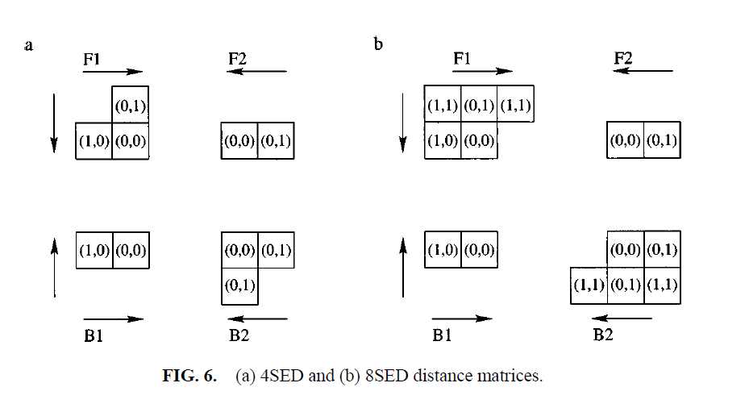
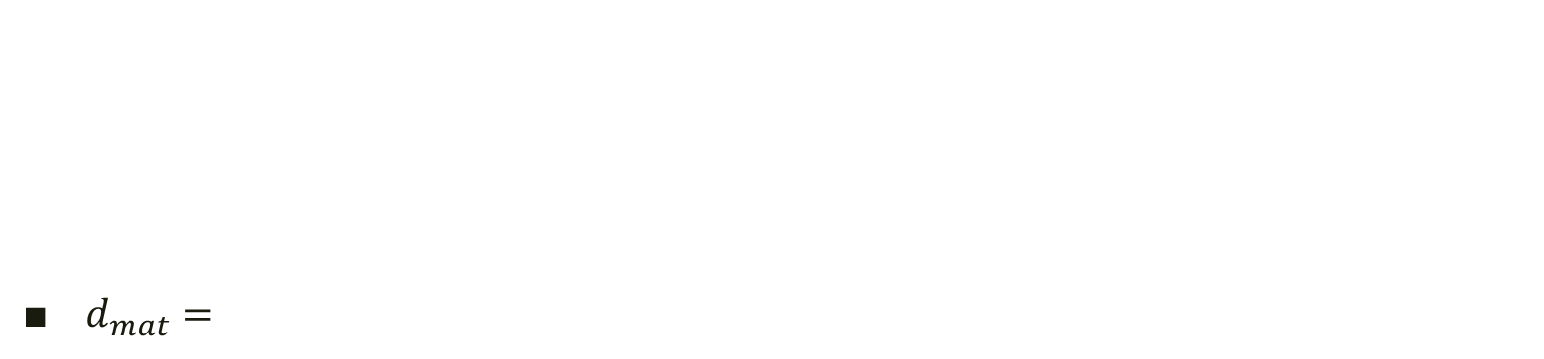
Distance Field - VDT
$d_{mat}=$

Slide 13
3D Printing Class Pipeline
Isosurface
Voxelization
Distance Field
Raw data
STL
vm
Raw data
Printing
Cura Slicing
Isosurface
Gcode
STL

Slide 14
3D Printing Class Program
Function | Program | Input | Output
Isosurface |  | rawdata | STL | 任思堯
Voxelization | ModelViewer | STL | Vm | 周杰士
Distance Field | VoxelProcessor | vm | rawdata | 周杰士

Slide 15
Conclusion & Discussion
如何建造Scene graph Tree已經有基礎模式
Template 可以時做更多種不同的
四面體?
圓錐?
時做Equation需要Parse字串，建立樹狀運算式
Set operation操作方式
需要同時使用兩筆資料，並對兩筆資料做對齊
實作VDT
將要使用的程式主要功能輸出與輸入確定

Slide 16
The End

