Slide 1
3/9 報告
Connecting component
Morphological operation
報告者:周杰士

Slide 2
Outline
Connecting Component Algorithm
Pseudo code
Example
Morphological operation
Erosion
Dilation
Opening and Closing

Slide 3
Connecting Component Algorithm Pseudo Code
// first pass
for row in data:
for column in row:
if( raw_Data[raw][colume] != background ){
neighborsID[] = getNeighborsComponentID(); // in 3d data we have three neighbors
if( all ID in neighborsID[] are background ID )
raw_Data[row][column] = componentCount;
componentCount++;
else
int L = min( neighborsID );
raw_Data[row][column] = L;
linked[L].add ( the other ID in neighborsID[] );

Slide 4
Connecting Component Algorithm Pseudo Code (cont.)
// merge Equivalent Labels
for all labels in linked:
linked[].merge();
// second pass
for row in data:
for column in row:
if data[row][column] is not Background
data[row][column] = find(data[row][column] );
//拿每筆資料的原始ID 去 linked內尋找最小的 Equivalent Labels

Slide 5
Connecting Component Algorithm Example
Start
0 | 0 | 0 | 0 | 0 | 0 | 0 | 0 | 0 | 0 | 0 | 0 | 0 | 0 | 0
0 | 0 | 0 | 0 | 0 | 0 | 0 | 0 | 0 | 0 | 0 | 0 | 0 | 0 | 0
0 | 0 | 0 | 1 | 1 | 1 | 0 | 0 | 1 | 1 | 1 | 0 | 0 | 0 | 0
0 | 0 | 1 | 1 | 1 | 1 | 1 | 1 | 1 | 1 | 1 | 1 | 0 | 0 | 0
0 | 0 | 0 | 1 | 1 | 0 | 0 | 0 | 1 | 1 | 1 | 0 | 0 | 0 | 0
0 | 0 | 0 | 1 | 1 | 1 | 0 | 0 | 0 | 0 | 0 | 0 | 1 | 1 | 0
0 | 0 | 0 | 1 | 1 | 0 | 0 | 1 | 1 | 1 | 0 | 1 | 1 | 1 | 0
0 | 0 | 0 | 1 | 1 | 0 | 0 | 1 | 1 | 1 | 0 | 1 | 1 | 1 | 0
0 | 0 | 0 | 1 | 1 | 0 | 0 | 1 | 1 | 1 | 0 | 0 | 0 | 1 | 0
0 | 0 | 0 | 1 | 1 | 0 | 0 | 0 | 1 | 1 | 0 | 0 | 0 | 1 | 0
0 | 0 | 0 | 1 | 1 | 0 | 0 | 0 | 0 | 0 | 0 | 0 | 0 | 1 | 0
0 | 0 | 0 | 1 | 1 | 1 | 1 | 1 | 1 | 1 | 1 | 0 | 0 | 1 | 0
0 | 0 | 0 | 1 | 1 | 1 | 1 | 1 | 1 | 1 | 1 | 0 | 0 | 1 | 0
0 | 0 | 0 | 1 | 1 | 1 | 1 | 1 | 1 | 1 | 1 | 0 | 0 | 1 | 0
0 | 0 | 0 | 1 | 1 | 0 | 0 | 0 | 0 | 0 | 0 | 0 | 0 | 0 | 0
componentCount = 1

Slide 6
Connecting Component Algorithm Example
0 | 0 | 0 | 0 | 0 | 0 | 0 | 0 | 0 | 0 | 0 | 0 | 0 | 0 | 0
0 | 0 | 0 | 0 | 0 | 0 | 0 | 0 | 0 | 0 | 0 | 0 | 0 | 0 | 0
0 | 0 | 0 | 1 | 1 | 1 | 0 | 0 | 1 | 1 | 1 | 0 | 0 | 0 | 0
0 | 0 | 1 | 1 | 1 | 1 | 1 | 1 | 1 | 1 | 1 | 1 | 0 | 0 | 0
0 | 0 | 0 | 1 | 1 | 0 | 0 | 0 | 1 | 1 | 1 | 0 | 0 | 0 | 0
0 | 0 | 0 | 1 | 1 | 1 | 0 | 0 | 0 | 0 | 0 | 0 | 1 | 1 | 0
0 | 0 | 0 | 1 | 1 | 0 | 0 | 1 | 1 | 1 | 0 | 1 | 1 | 1 | 0
0 | 0 | 0 | 1 | 1 | 0 | 0 | 1 | 1 | 1 | 0 | 1 | 1 | 1 | 0
0 | 0 | 0 | 1 | 1 | 0 | 0 | 1 | 1 | 1 | 0 | 0 | 0 | 1 | 0
0 | 0 | 0 | 1 | 1 | 0 | 0 | 0 | 1 | 1 | 0 | 0 | 0 | 1 | 0
0 | 0 | 0 | 1 | 1 | 0 | 0 | 0 | 0 | 0 | 0 | 0 | 0 | 1 | 0
0 | 0 | 0 | 1 | 1 | 1 | 1 | 1 | 1 | 1 | 1 | 0 | 0 | 1 | 0
0 | 0 | 0 | 1 | 1 | 1 | 1 | 1 | 1 | 1 | 1 | 0 | 0 | 1 | 0
0 | 0 | 0 | 1 | 1 | 1 | 1 | 1 | 1 | 1 | 1 | 0 | 0 | 1 | 0
0 | 0 | 0 | 1 | 1 | 0 | 0 | 0 | 0 | 0 | 0 | 0 | 0 | 0 | 0
componentCount = 1
neighbors[] are background
rawdata[] = componentCount componentCount++;

Slide 7
Connecting Component Algorithm Example
0 | 0 | 0 | 0 | 0 | 0 | 0 | 0 | 0 | 0 | 0 | 0 | 0 | 0 | 0
0 | 0 | 0 | 0 | 0 | 0 | 0 | 0 | 0 | 0 | 0 | 0 | 0 | 0 | 0
0 | 0 | 0 | 1 | 1 | 1 | 0 | 0 | 1 | 1 | 1 | 0 | 0 | 0 | 0
0 | 0 | 1 | 1 | 1 | 1 | 1 | 1 | 1 | 1 | 1 | 1 | 0 | 0 | 0
0 | 0 | 0 | 1 | 1 | 0 | 0 | 0 | 1 | 1 | 1 | 0 | 0 | 0 | 0
0 | 0 | 0 | 1 | 1 | 1 | 0 | 0 | 0 | 0 | 0 | 0 | 1 | 1 | 0
0 | 0 | 0 | 1 | 1 | 0 | 0 | 1 | 1 | 1 | 0 | 1 | 1 | 1 | 0
0 | 0 | 0 | 1 | 1 | 0 | 0 | 1 | 1 | 1 | 0 | 1 | 1 | 1 | 0
0 | 0 | 0 | 1 | 1 | 0 | 0 | 1 | 1 | 1 | 0 | 0 | 0 | 1 | 0
0 | 0 | 0 | 1 | 1 | 0 | 0 | 0 | 1 | 1 | 0 | 0 | 0 | 1 | 0
0 | 0 | 0 | 1 | 1 | 0 | 0 | 0 | 0 | 0 | 0 | 0 | 0 | 1 | 0
0 | 0 | 0 | 1 | 1 | 1 | 1 | 1 | 1 | 1 | 1 | 0 | 0 | 1 | 0
0 | 0 | 0 | 1 | 1 | 1 | 1 | 1 | 1 | 1 | 1 | 0 | 0 | 1 | 0
0 | 0 | 0 | 1 | 1 | 1 | 1 | 1 | 1 | 1 | 1 | 0 | 0 | 1 | 0
0 | 0 | 0 | 1 | 1 | 0 | 0 | 0 | 0 | 0 | 0 | 0 | 0 | 0 | 0
componentCount = 2
L = min(neighbors[]) = 1
rawdata[] = L;
linked[L].add ( the other ID in neighborsID[] );

Slide 8
Connecting Component Algorithm Example
0 | 0 | 0 | 0 | 0 | 0 | 0 | 0 | 0 | 0 | 0 | 0 | 0 | 0 | 0
0 | 0 | 0 | 0 | 0 | 0 | 0 | 0 | 0 | 0 | 0 | 0 | 0 | 0 | 0
0 | 0 | 0 | 1 | 1 | 1 | 0 | 0 | 1 | 1 | 1 | 0 | 0 | 0 | 0
0 | 0 | 1 | 1 | 1 | 1 | 1 | 1 | 1 | 1 | 1 | 1 | 0 | 0 | 0
0 | 0 | 0 | 1 | 1 | 0 | 0 | 0 | 1 | 1 | 1 | 0 | 0 | 0 | 0
0 | 0 | 0 | 1 | 1 | 1 | 0 | 0 | 0 | 0 | 0 | 0 | 1 | 1 | 0
0 | 0 | 0 | 1 | 1 | 0 | 0 | 1 | 1 | 1 | 0 | 1 | 1 | 1 | 0
0 | 0 | 0 | 1 | 1 | 0 | 0 | 1 | 1 | 1 | 0 | 1 | 1 | 1 | 0
0 | 0 | 0 | 1 | 1 | 0 | 0 | 1 | 1 | 1 | 0 | 0 | 0 | 1 | 0
0 | 0 | 0 | 1 | 1 | 0 | 0 | 0 | 1 | 1 | 0 | 0 | 0 | 1 | 0
0 | 0 | 0 | 1 | 1 | 0 | 0 | 0 | 0 | 0 | 0 | 0 | 0 | 1 | 0
0 | 0 | 0 | 1 | 1 | 1 | 1 | 1 | 1 | 1 | 1 | 0 | 0 | 1 | 0
0 | 0 | 0 | 1 | 1 | 1 | 1 | 1 | 1 | 1 | 1 | 0 | 0 | 1 | 0
0 | 0 | 0 | 1 | 1 | 1 | 1 | 1 | 1 | 1 | 1 | 0 | 0 | 1 | 0
0 | 0 | 0 | 1 | 1 | 0 | 0 | 0 | 0 | 0 | 0 | 0 | 0 | 0 | 0
componentCount = 2
neighbors[] are background
rawdata[] = componentCount componentCount++;

Slide 9
Connecting Component Algorithm Example
0 | 0 | 0 | 0 | 0 | 0 | 0 | 0 | 0 | 0 | 0 | 0 | 0 | 0 | 0
0 | 0 | 0 | 0 | 0 | 0 | 0 | 0 | 0 | 0 | 0 | 0 | 0 | 0 | 0
0 | 0 | 0 | 1 | 1 | 1 | 0 | 0 | 2 | 2 | 2 | 0 | 0 | 0 | 0
0 | 0 | 1 | 1 | 1 | 1 | 1 | 1 | 1 | 1 | 1 | 1 | 0 | 0 | 0
0 | 0 | 0 | 1 | 1 | 0 | 0 | 0 | 1 | 1 | 1 | 0 | 0 | 0 | 0
0 | 0 | 0 | 1 | 1 | 1 | 0 | 0 | 0 | 0 | 0 | 0 | 1 | 1 | 0
0 | 0 | 0 | 1 | 1 | 0 | 0 | 1 | 1 | 1 | 0 | 1 | 1 | 1 | 0
0 | 0 | 0 | 1 | 1 | 0 | 0 | 1 | 1 | 1 | 0 | 1 | 1 | 1 | 0
0 | 0 | 0 | 1 | 1 | 0 | 0 | 1 | 1 | 1 | 0 | 0 | 0 | 1 | 0
0 | 0 | 0 | 1 | 1 | 0 | 0 | 0 | 1 | 1 | 0 | 0 | 0 | 1 | 0
0 | 0 | 0 | 1 | 1 | 0 | 0 | 0 | 0 | 0 | 0 | 0 | 0 | 1 | 0
0 | 0 | 0 | 1 | 1 | 1 | 1 | 1 | 1 | 1 | 1 | 0 | 0 | 1 | 0
0 | 0 | 0 | 1 | 1 | 1 | 1 | 1 | 1 | 1 | 1 | 0 | 0 | 1 | 0
0 | 0 | 0 | 1 | 1 | 1 | 1 | 1 | 1 | 1 | 1 | 0 | 0 | 1 | 0
0 | 0 | 0 | 1 | 1 | 0 | 0 | 0 | 0 | 0 | 0 | 0 | 0 | 0 | 0
componentCount = 3
neighbors[] are background
rawdata[] = componentCount componentCount++;

Slide 10
Connecting Component Algorithm Example
0 | 0 | 0 | 0 | 0 | 0 | 0 | 0 | 0 | 0 | 0 | 0 | 0 | 0 | 0
0 | 0 | 0 | 0 | 0 | 0 | 0 | 0 | 0 | 0 | 0 | 0 | 0 | 0 | 0
0 | 0 | 0 | 1 | 1 | 1 | 0 | 0 | 2 | 2 | 2 | 0 | 0 | 0 | 0
0 | 0 | 3 | 1 | 1 | 1 | 1 | 1 | 1 | 1 | 1 | 1 | 0 | 0 | 0
0 | 0 | 0 | 1 | 1 | 0 | 0 | 0 | 1 | 1 | 1 | 0 | 0 | 0 | 0
0 | 0 | 0 | 1 | 1 | 1 | 0 | 0 | 0 | 0 | 0 | 0 | 1 | 1 | 0
0 | 0 | 0 | 1 | 1 | 0 | 0 | 1 | 1 | 1 | 0 | 1 | 1 | 1 | 0
0 | 0 | 0 | 1 | 1 | 0 | 0 | 1 | 1 | 1 | 0 | 1 | 1 | 1 | 0
0 | 0 | 0 | 1 | 1 | 0 | 0 | 1 | 1 | 1 | 0 | 0 | 0 | 1 | 0
0 | 0 | 0 | 1 | 1 | 0 | 0 | 0 | 1 | 1 | 0 | 0 | 0 | 1 | 0
0 | 0 | 0 | 1 | 1 | 0 | 0 | 0 | 0 | 0 | 0 | 0 | 0 | 1 | 0
0 | 0 | 0 | 1 | 1 | 1 | 1 | 1 | 1 | 1 | 1 | 0 | 0 | 1 | 0
0 | 0 | 0 | 1 | 1 | 1 | 1 | 1 | 1 | 1 | 1 | 0 | 0 | 1 | 0
0 | 0 | 0 | 1 | 1 | 1 | 1 | 1 | 1 | 1 | 1 | 0 | 0 | 1 | 0
0 | 0 | 0 | 1 | 1 | 0 | 0 | 0 | 0 | 0 | 0 | 0 | 0 | 0 | 0
componentCount = 4
1
3
L = min(neighbors[]) = 1
rawdata[] = L;
linked[L].add ( the other ID in neighborsID[] );

Slide 11
Connecting Component Algorithm Example
0 | 0 | 0 | 0 | 0 | 0 | 0 | 0 | 0 | 0 | 0 | 0 | 0 | 0 | 0
0 | 0 | 0 | 0 | 0 | 0 | 0 | 0 | 0 | 0 | 0 | 0 | 0 | 0 | 0
0 | 0 | 0 | 1 | 1 | 1 | 0 | 0 | 2 | 2 | 2 | 0 | 0 | 0 | 0
0 | 0 | 3 | 1 | 1 | 1 | 1 | 1 | 1 | 1 | 1 | 1 | 0 | 0 | 0
0 | 0 | 0 | 1 | 1 | 0 | 0 | 0 | 1 | 1 | 1 | 0 | 0 | 0 | 0
0 | 0 | 0 | 1 | 1 | 1 | 0 | 0 | 0 | 0 | 0 | 0 | 1 | 1 | 0
0 | 0 | 0 | 1 | 1 | 0 | 0 | 1 | 1 | 1 | 0 | 1 | 1 | 1 | 0
0 | 0 | 0 | 1 | 1 | 0 | 0 | 1 | 1 | 1 | 0 | 1 | 1 | 1 | 0
0 | 0 | 0 | 1 | 1 | 0 | 0 | 1 | 1 | 1 | 0 | 0 | 0 | 1 | 0
0 | 0 | 0 | 1 | 1 | 0 | 0 | 0 | 1 | 1 | 0 | 0 | 0 | 1 | 0
0 | 0 | 0 | 1 | 1 | 0 | 0 | 0 | 0 | 0 | 0 | 0 | 0 | 1 | 0
0 | 0 | 0 | 1 | 1 | 1 | 1 | 1 | 1 | 1 | 1 | 0 | 0 | 1 | 0
0 | 0 | 0 | 1 | 1 | 1 | 1 | 1 | 1 | 1 | 1 | 0 | 0 | 1 | 0
0 | 0 | 0 | 1 | 1 | 1 | 1 | 1 | 1 | 1 | 1 | 0 | 0 | 1 | 0
0 | 0 | 0 | 1 | 1 | 0 | 0 | 0 | 0 | 0 | 0 | 0 | 0 | 0 | 0
componentCount = 4
1
3
L = min(neighbors[]) = 1
rawdata[] = L;
linked[L].add ( the other ID in neighborsID[] );
2

Slide 12
Connecting Component Algorithm Example
1
3
2
0 | 0 | 0 | 0 | 0 | 0 | 0 | 0 | 0 | 0 | 0 | 0 | 0 | 0 | 0
0 | 0 | 0 | 0 | 0 | 0 | 0 | 0 | 0 | 0 | 0 | 0 | 0 | 0 | 0
0 | 0 | 0 | 1 | 1 | 1 | 0 | 0 | 2 | 2 | 2 | 0 | 0 | 0 | 0
0 | 0 | 3 | 1 | 1 | 1 | 1 | 1 | 1 | 1 | 1 | 1 | 0 | 0 | 0
0 | 0 | 0 | 1 | 1 | 0 | 0 | 0 | 1 | 1 | 1 | 0 | 0 | 0 | 0
0 | 0 | 0 | 1 | 1 | 1 | 0 | 0 | 0 | 0 | 0 | 0 | 4 | 4 | 0
0 | 0 | 0 | 1 | 1 | 0 | 0 | 5 | 5 | 5 | 0 | 6 | 4 | 4 | 0
0 | 0 | 0 | 1 | 1 | 0 | 0 | 5 | 5 | 5 | 0 | 6 | 4 | 4 | 0
0 | 0 | 0 | 1 | 1 | 0 | 0 | 5 | 5 | 5 | 0 | 0 | 0 | 4 | 0
0 | 0 | 0 | 1 | 1 | 0 | 0 | 0 | 5 | 5 | 0 | 0 | 0 | 4 | 0
0 | 0 | 0 | 1 | 1 | 0 | 0 | 0 | 0 | 0 | 0 | 0 | 0 | 4 | 0
0 | 0 | 0 | 1 | 1 | 1 | 1 | 1 | 1 | 1 | 1 | 0 | 0 | 4 | 0
0 | 0 | 0 | 1 | 1 | 1 | 1 | 1 | 1 | 1 | 1 | 0 | 0 | 4 | 0
0 | 0 | 0 | 1 | 1 | 1 | 1 | 1 | 1 | 1 | 1 | 0 | 0 | 4 | 0
0 | 0 | 0 | 1 | 1 | 0 | 0 | 0 | 0 | 0 | 0 | 0 | 0 | 0 | 0
4
6
5

Slide 13
Connecting Component Algorithm Example
0 | 0 | 0 | 0 | 0 | 0 | 0 | 0 | 0 | 0 | 0 | 0 | 0 | 0 | 0
0 | 0 | 0 | 0 | 0 | 0 | 0 | 0 | 0 | 0 | 0 | 0 | 0 | 0 | 0
0 | 0 | 0 | 1 | 1 | 1 | 0 | 0 | 1 | 1 | 1 | 0 | 0 | 0 | 0
0 | 0 | 1 | 1 | 1 | 1 | 1 | 1 | 1 | 1 | 1 | 1 | 0 | 0 | 0
0 | 0 | 0 | 1 | 1 | 0 | 0 | 0 | 1 | 1 | 1 | 0 | 0 | 0 | 0
0 | 0 | 0 | 1 | 1 | 1 | 0 | 0 | 0 | 0 | 0 | 0 | 4 | 4 | 0
0 | 0 | 0 | 1 | 1 | 0 | 0 | 5 | 5 | 5 | 0 | 4 | 4 | 4 | 0
0 | 0 | 0 | 1 | 1 | 0 | 0 | 5 | 5 | 5 | 0 | 4 | 4 | 4 | 0
0 | 0 | 0 | 1 | 1 | 0 | 0 | 5 | 5 | 5 | 0 | 0 | 0 | 4 | 0
0 | 0 | 0 | 1 | 1 | 0 | 0 | 0 | 5 | 5 | 0 | 0 | 0 | 4 | 0
0 | 0 | 0 | 1 | 1 | 0 | 0 | 0 | 0 | 0 | 0 | 0 | 0 | 4 | 0
0 | 0 | 0 | 1 | 1 | 1 | 1 | 1 | 1 | 1 | 1 | 0 | 0 | 4 | 0
0 | 0 | 0 | 1 | 1 | 1 | 1 | 1 | 1 | 1 | 1 | 0 | 0 | 4 | 0
0 | 0 | 0 | 1 | 1 | 1 | 1 | 1 | 1 | 1 | 1 | 0 | 0 | 4 | 0
0 | 0 | 0 | 1 | 1 | 0 | 0 | 0 | 0 | 0 | 0 | 0 | 0 | 0 | 0

Slide 14
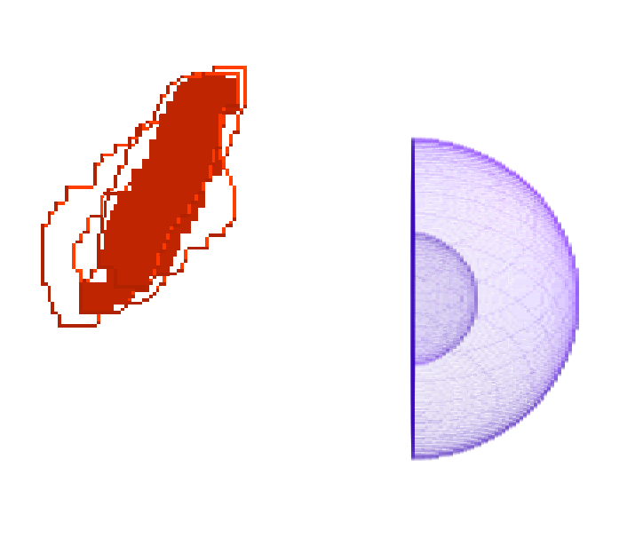
Connecting Component Result

Slide 15
Morphological operation Erosion
for (int z = 0; z < SIZE_Z; z++) {
for (int y = 0; y <SIZE_Y; y++) {
for (int x = 0; x <SIZE_X; x++) {
if( raw_data[z][y][x] == VOX_EMPTY) continue;
bool surface_flag = false; // check the target voxel is or not surface
for( int i = 0; i < neighborCount; i++ ) { // neighborCount is 6 or 26
checkOutOfRange( neighbor[].Index );
if( raw_data[neighbor[].Index ] == VOX_EMPTY ){
surface_flag = true;
break;
}
}

Slide 16
Morphological operation Erosion (cont.)
// erase to temp array
if(surface_flag){
tempArray[z][y][x] = VOX_EMPTY;
}
else {
tempArray[z][y][x] =raw_data[z][y][x];
}
}
}
}

Slide 17
Morphological operation Dilation
大部分與Erosion一致
1. raw_data[z][y][z] == VOX_EMPTY
raw_data[z][y][z] != VOX_EMPTY
2. if(surface_flag){
tempArray[z][y][z] = VOX_EMPTY;
tempArray[z][y][z] = VOX_SURFACE;
}

Slide 18
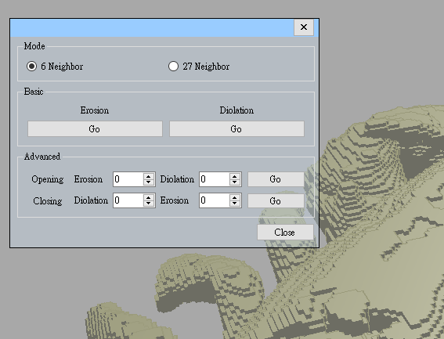
Morphological operation Opening and Closing
直接呼叫Erosion與Dilation
使用者自行設定Erosion次數與Dilation次數

Slide 19
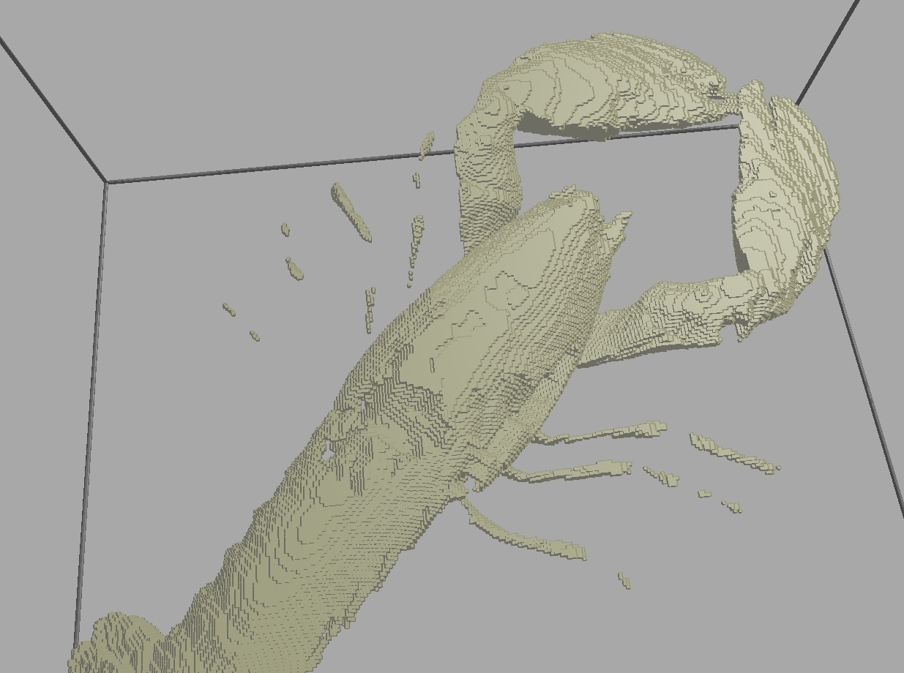
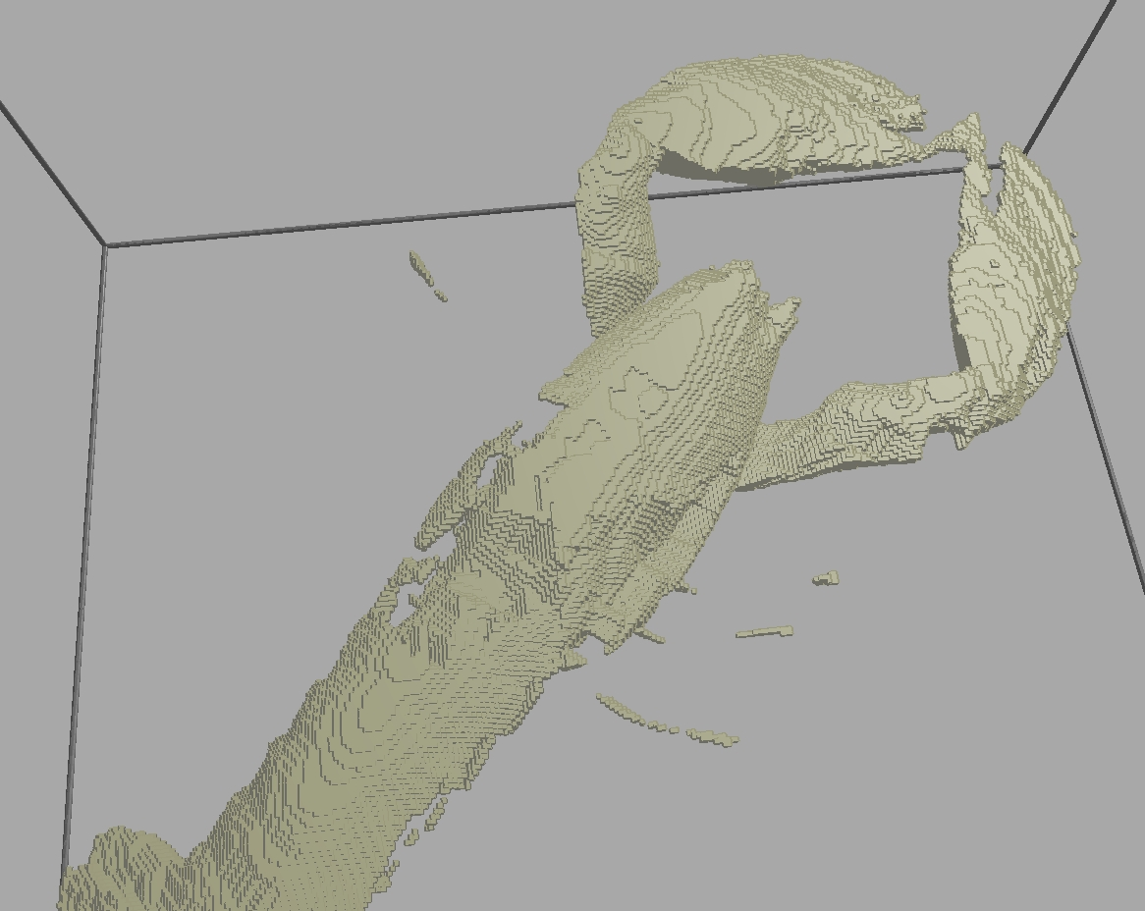
Morphological operation Result

Slide 20
The End

