Slide 1

Project : Olympics data Analysis
Course :Data warehouse
Name :Yasmin Muhamad Hammad
ID :32009304029
This Photo by Unknown Author is licensed under CC BY-SA

Slide 2
Index:
Project description
Visualization
About Dataset
Preprocessing

Slide 3

Project description
Is a project about using a Power BI to make sense of Olympic Games data by creating easy to understand charts and graphs that show how countries and athletes have performed in different sports over the years

Slide 4
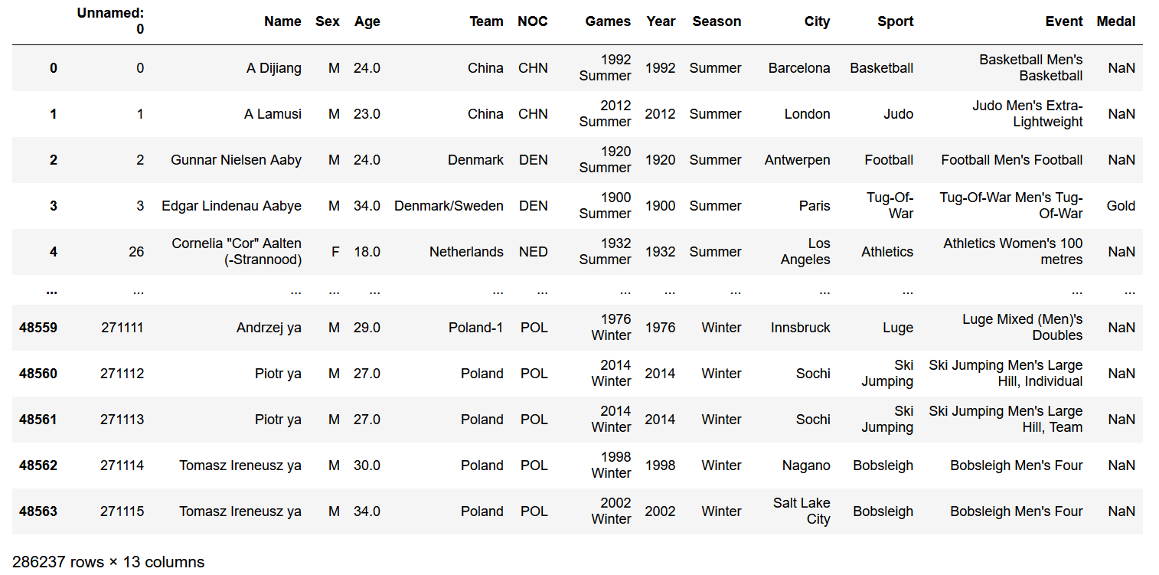
About Dataset
This dataset, sourced from Kaggle, provides a comprehensive view of the Olympic Games over a span of 124 years, from 1896 up to 2020. It is a combination of two separate datasets one for the Summer Olympics and the other for the Winter Olympics. Each dataset consists of 13 columns, which include:
Name: The name of the athlete
Sex: The gender of the athlete
Age: The age of the athlete
Team: The team or country the athlete represents
NOC: National Olympic Committee code
Games: The specific games the athlete participated in
Year: The year of the games
Season: The season of the games (Summer or Winter)
City: The city where the games were held
Sport: The sport in which the athlete competed
Event: The specific event within the sport
Medal: The medal won by the athlete, if any
ID: A unique identifier for each record

Slide 5
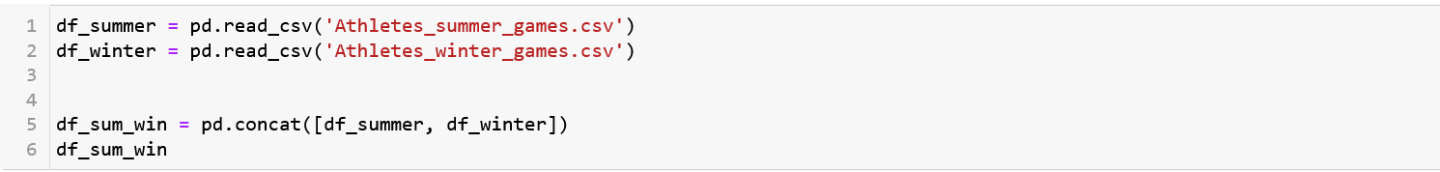
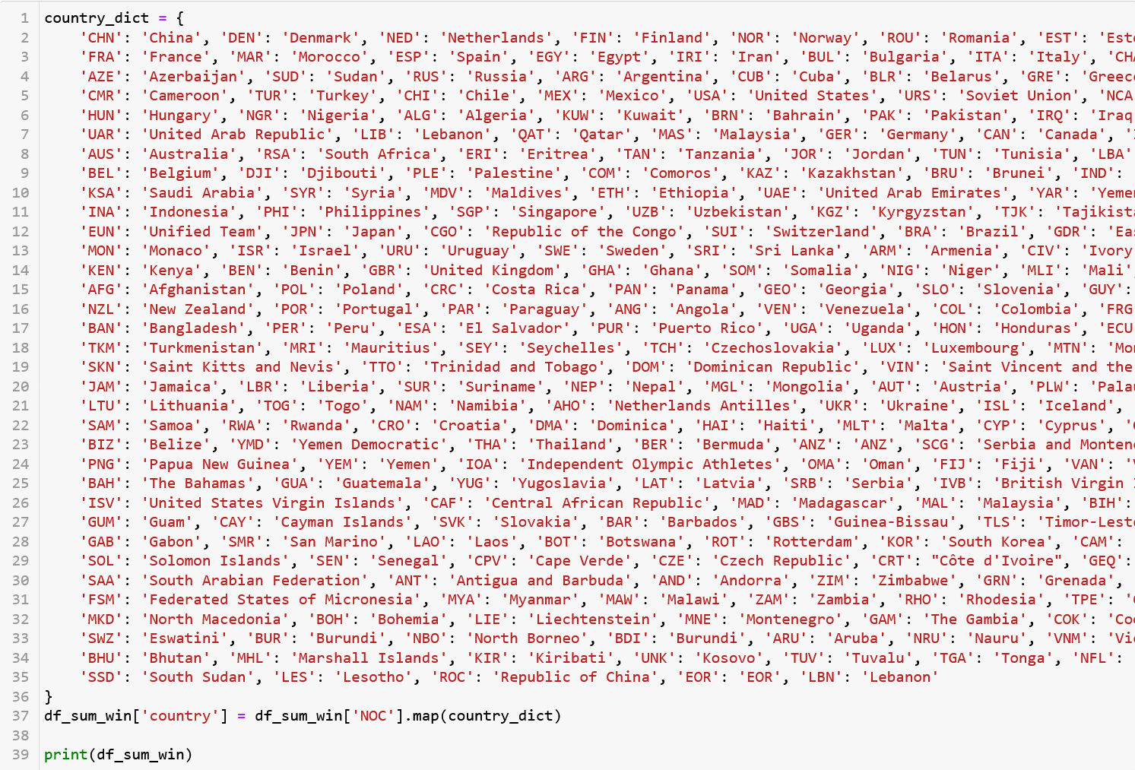
Preprocessing
First step was combining summer and winter files
Then renaming the column unnamed as ID
Change the NOC to the country name to make it easier to understand

Slide 6
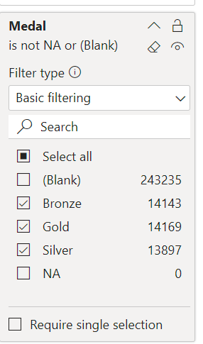
Preprocessing
In the medal column, there are many null values. This is expected because not every athlete wins a medal. I didn’t remove these null values. Instead, when counting the number of medals in Power BI, I only included gold, silver, and bronze medals and ignored the null values.
Add a few measures like the number of men and women calculation the gender gap
Lastly dropping duplicated rows

Slide 7

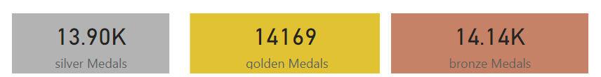
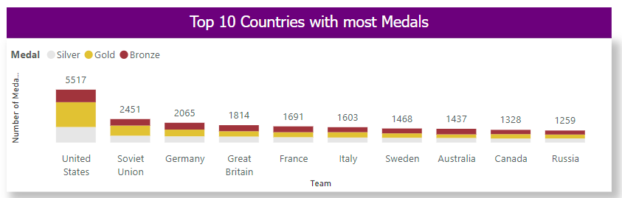
Visualization
Finding the number of athletes who participated in the Olympic, the average age for the competitors, the number of events, the number of medals and lastly the number of participated countries
Finding the number for each type of medal
Previewing the top 10 countries with the largest number of medals and the USA was the top one

Slide 8
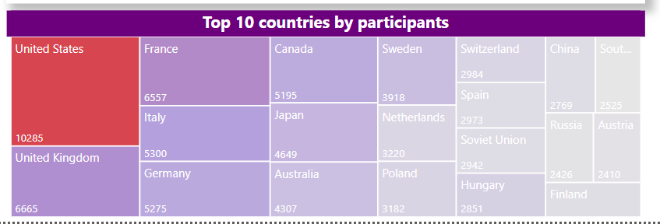
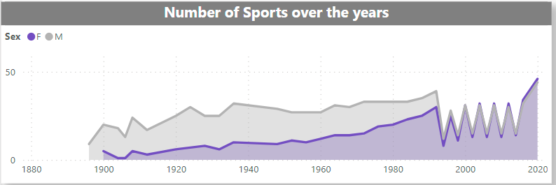
Visualization
Calculating the top 10 countries for the number of participant athletes and again the USA was at the top after its UK then France at the third place
Then showing the difference between the number of sport event Females and males participated in it over the years

Slide 9
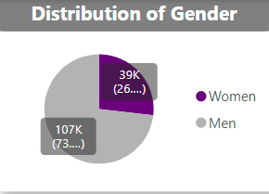
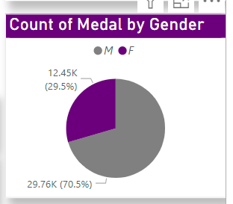
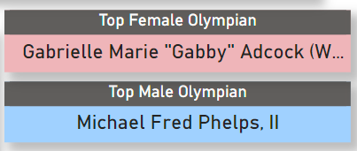
Visualization
Finding that the number of male athletes was more than female athletes and the same goes for number of medals it shows that males won more medals than females
Knowing how are the top female and male athlete based on the number of medals they got

Slide 10
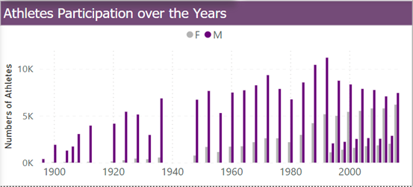
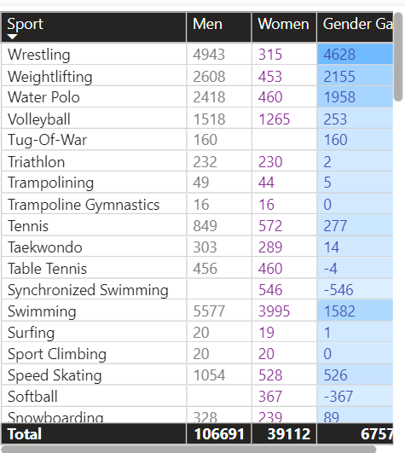
Visualization
Exploring the changes in the number of the participant athletes from both genders throughout the years
Seeing the gender gap between females and males in different sport events

Slide 11
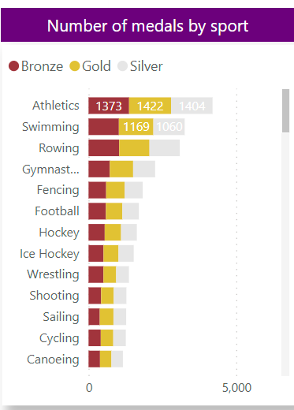
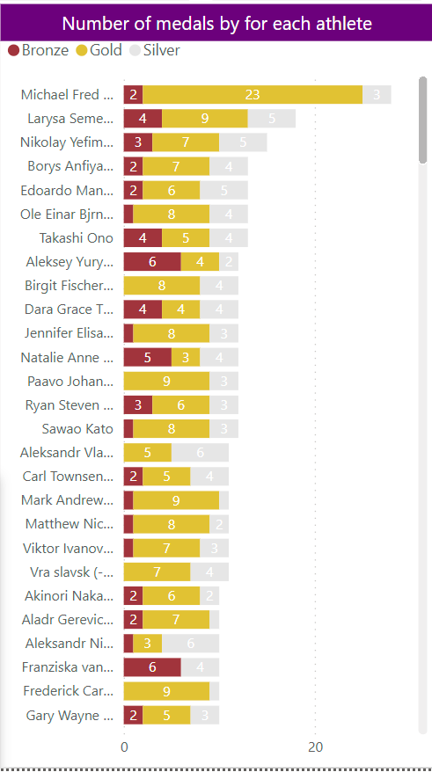



Visualization
Previewing the number of medals for each athlete and of each sport
Lastly showing the city where the event was held also the number of participating athletes and the number of medals

Slide 12
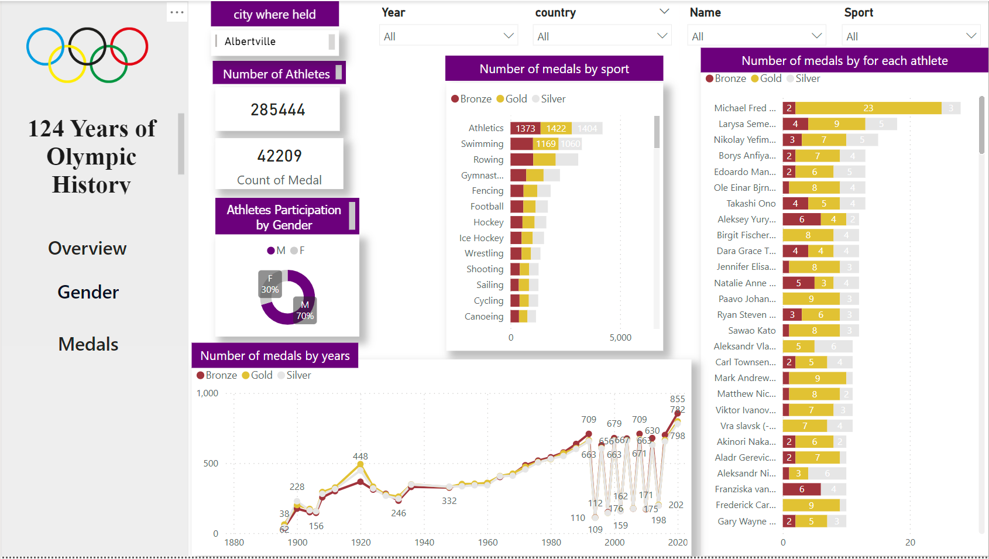
Visualization
There are tools enable you to engage with the visualizations to gather data from any of the participating countries. You also have the flexibility to select a particular year, sport, or athlete

Slide 13
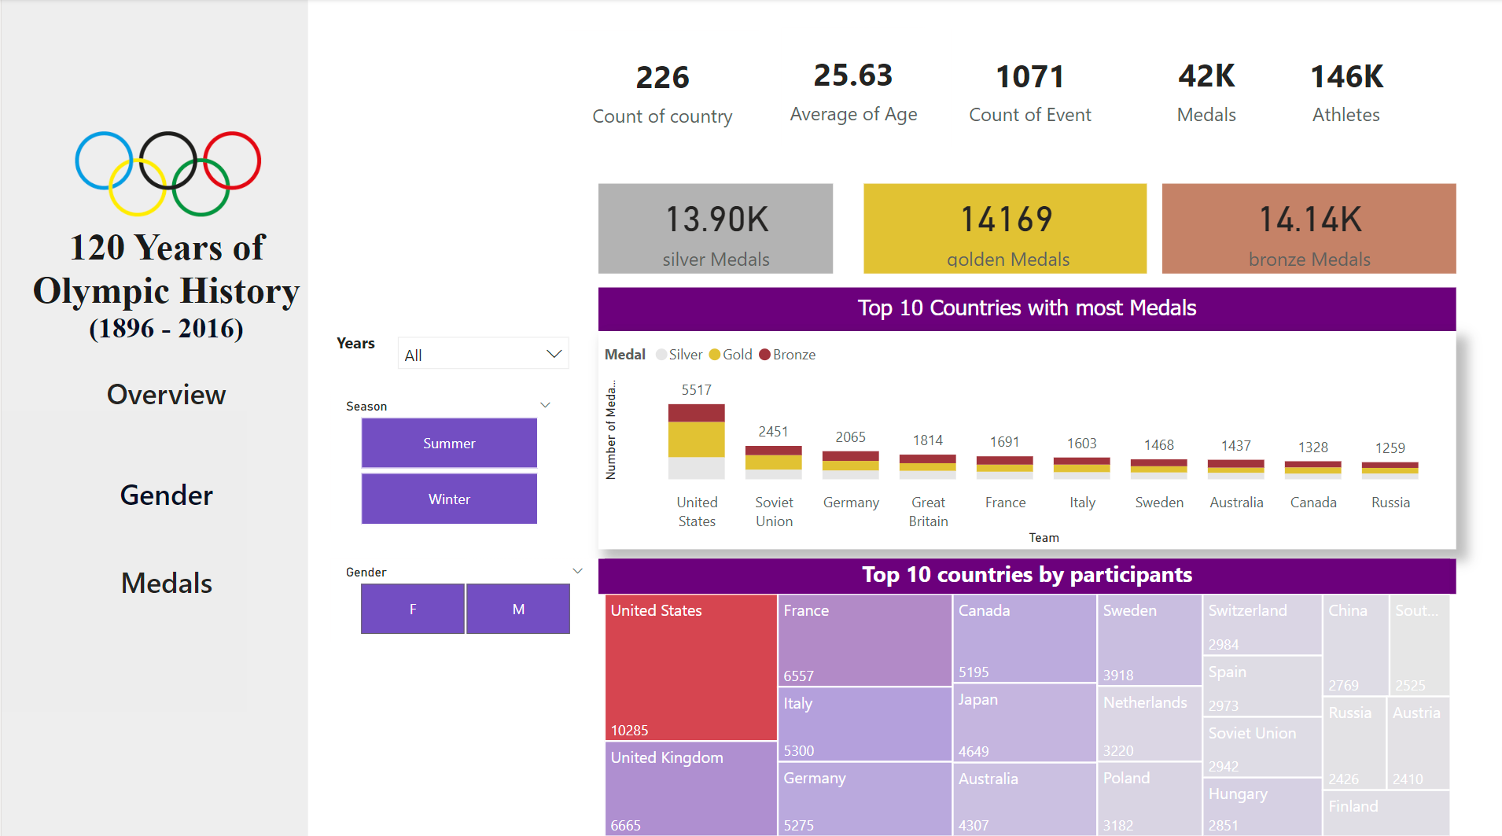

Slide 14
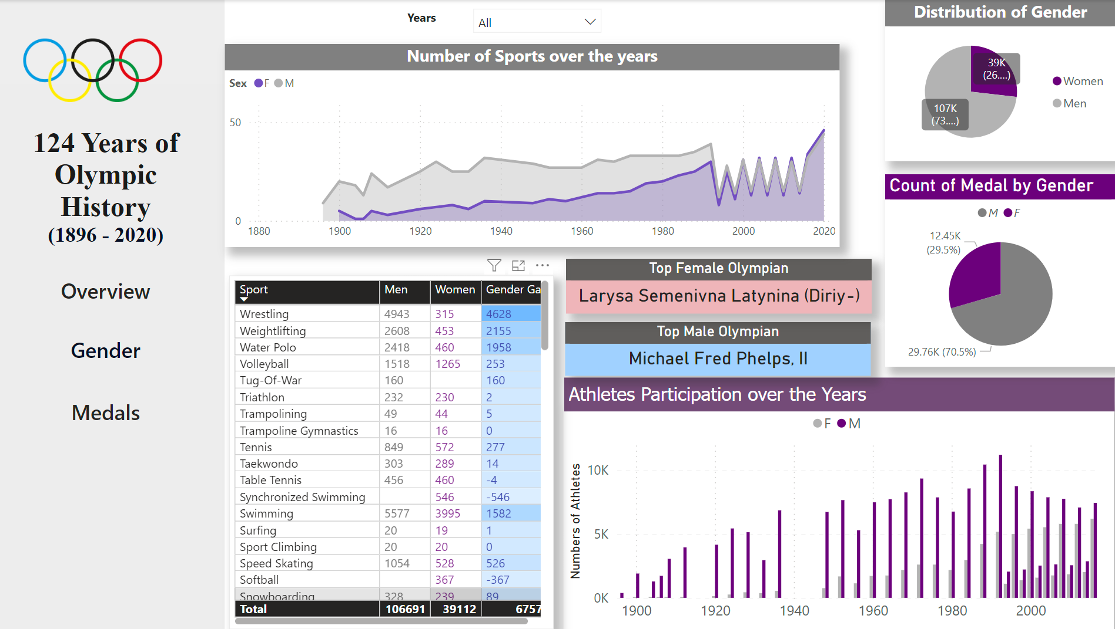

Slide 15

The end

