Slide 1
Object-Oriented Programming
Logic Expression Normalizer

Slide 2



Group
Members
Phạm Đinh Gia Dũng
20194428
Phùng Quốc Việt
20194428
Vũ Quốc Việt
20194428
ThreeVariableScreen
ThreeVariableScreenController
FourVariableScreen
FourVariableScreenController
Output Screen
Table & TruthTable
IntermediateColum
IntermediateColumContainer
Group
Term & MinTerm & CombinedTerm
ColumnBlock
PI Table
PIBlock

Slide 3
Project description
Requirement
This application is a logic expression normalizer using the Quine-McCluskey algorithm. It takes a Boolean expression as an input.
User can choose two cases of input (3 variables or 4 variables expression) and two cases of output (POS or SOP canonical form)
Application outputs: The minimal Boolean expression, intermediate columns and PI Table

Slide 4
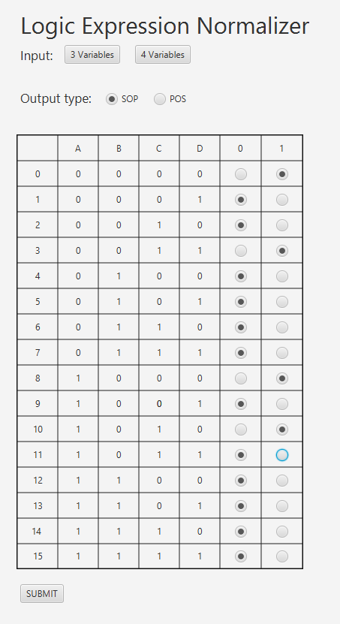
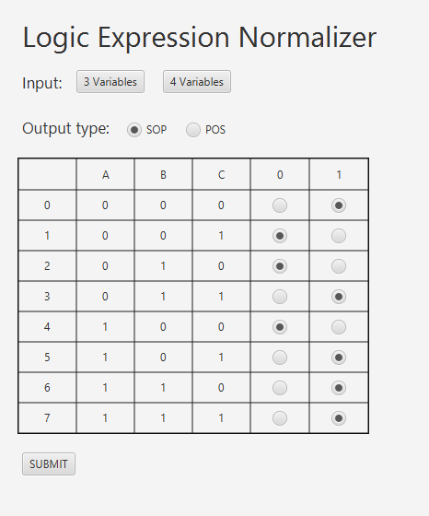
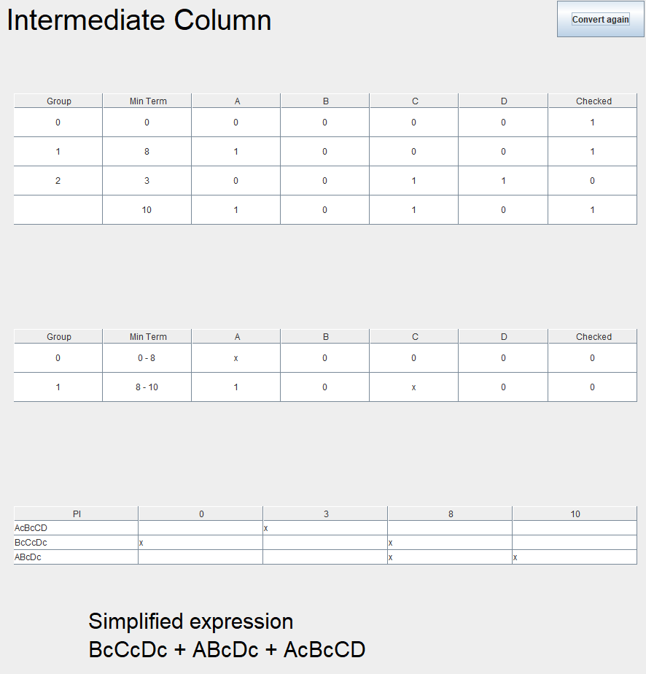
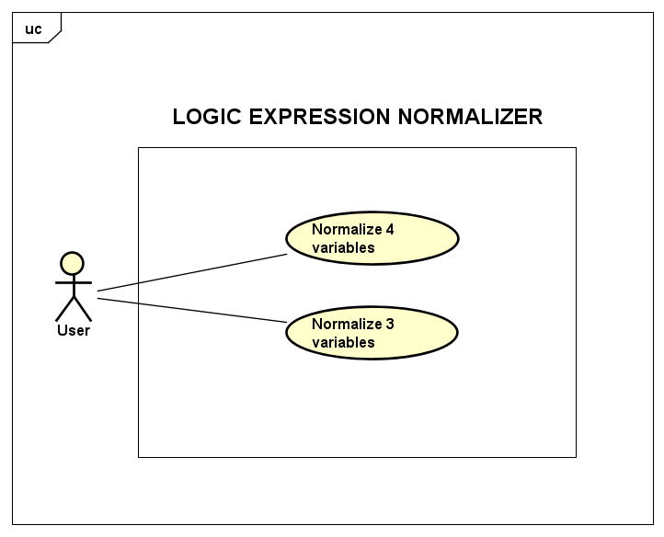
Usecase Diagram
`
`
Usecase Diagram
Normalize 3 variables
The default input screen of application
Users can choose the number of variables by pressing “3 Variables” or“4 Variables”
Users can choose the output type by pressing “SOP” or “POS”
User can submit input by pressing “SUBMIT”

Slide 5
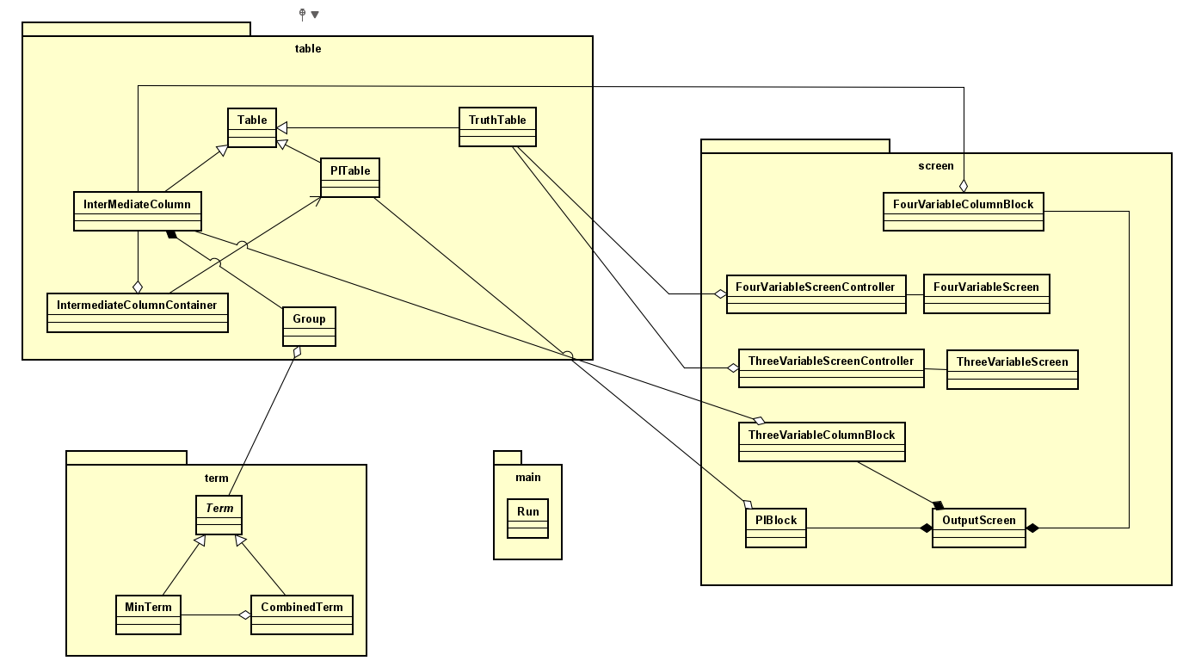
General class diagram
Class Diagram

Slide 6
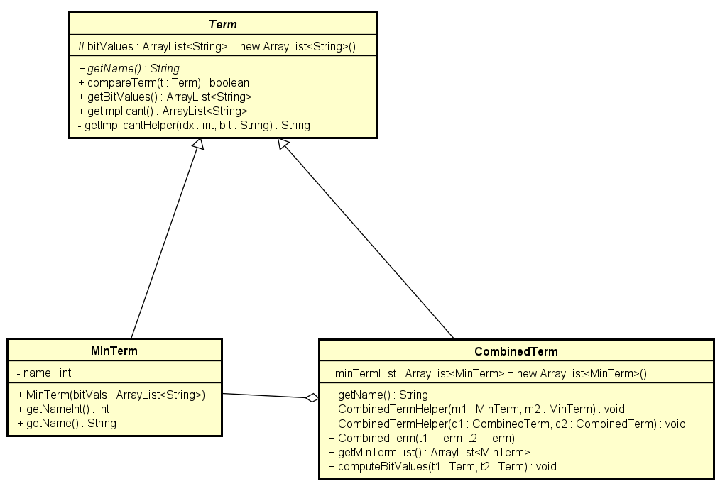
Package: term
Class Diagram

Slide 7
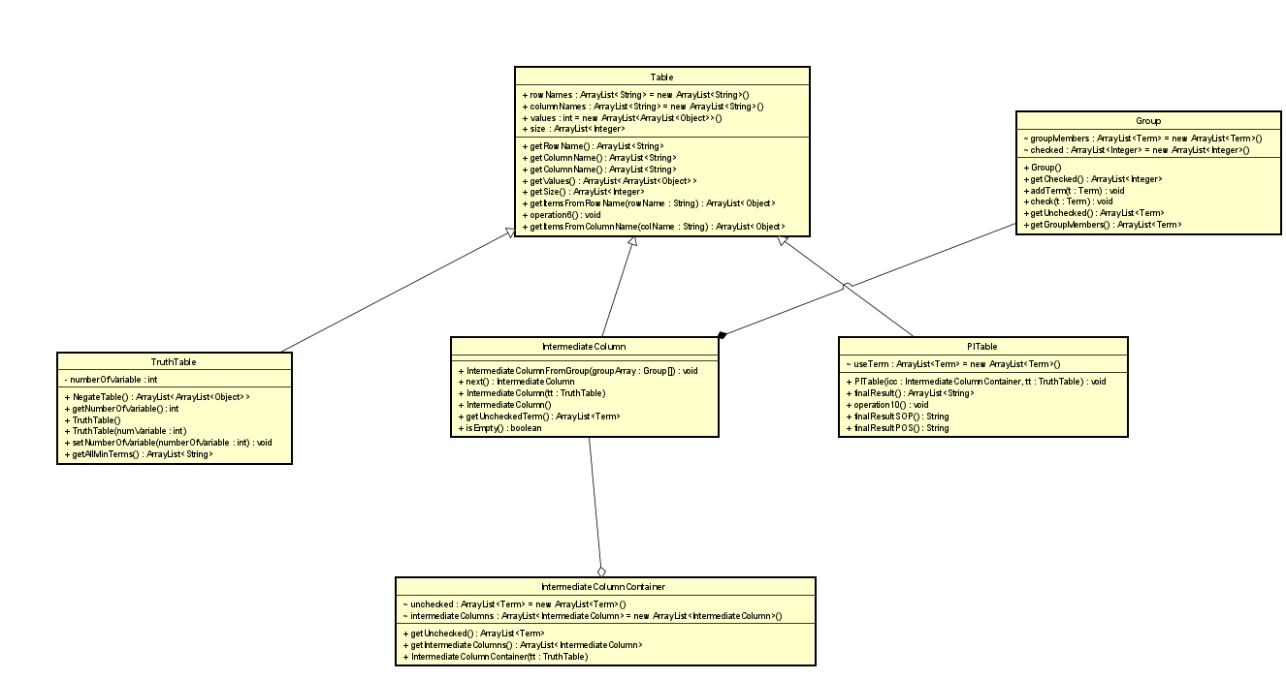
Package: table

Slide 8
Package: screen
Class Diagram

Slide 9
Principles
Aggregation
CombinedTerm
Object of the CombinedTerm class contains multiple objects of the MinTerm class. Object of Group class contains multiple objects of Term class, which means it can be MinTerm as well as CombinedTerm
IntermediateColumnContainer is designed to includes all IntermediateColumns associating with each step of Quine-McCluskey algorithm, thus objects of IntermediateColumnContainer class contains multiple objects of IntermediateColumn class
Object
- minTermList: ArrayList< >
Conclusion
Aggregation
MinTerm
Object
- MinTerm : ArrayList<String>
MinTerm

Slide 10
Principles
Inheritance
Table
Since TruthTable, IntermediateColumn and PITable all have in common attributes rowNames, columnNames, Values and Size, as well as methods getRowNames, getColumnNames, getValues… We create Table class from which TruthTable, IntermediateColumn and PITable inherit
Similarly, MinTerm and CombinedTerm have in common bitValues attribute, we create the Term class from which both of these classes inherit
- Attribute:
rowNames
rowNames
rowNames
TruthTable
PITable
- Attribute:
- Attribute:

Slide 11
Association
In order to construct the screen for each table, we need all the information about rows, columns and values of those tables. Thus, there’s an association between each table with its GUI
Principles
Polymorphism
MinTerm
Call getName()
from:
getName()
Class Term has an abstract method called getName(), which is further implemented by its child classes (MinTerm and CombinedTerm) in different manners. When we iterate through the list of PI to retrieve their names, we call the getName() method, and depending on the object’s class, it will execute the corresponding method.
- getName()
MinTerm
CombinedTerm
CombinedTerm
- getName()
getName()

Slide 13
The end
Thanks

