Slide 1
Object-Oriented Programming
Logic Expression Normalizer

Slide 2



Group
Members
Phạm Đinh Gia Dũng
20194428
Phùng Quốc Việt
20194428
Vũ Quốc Việt
20194428
ThreeVariableScreen
ThreeVariableScreenController
FourVariableScreen
FourVariableScreenController
Output Screen
Table & TruthTable
IntermediateColum
IntermediateColumContainer
Group
Term & MinTerm & CombinedTerm
ColumnBlock
PI Table
PIBlock

Slide 3
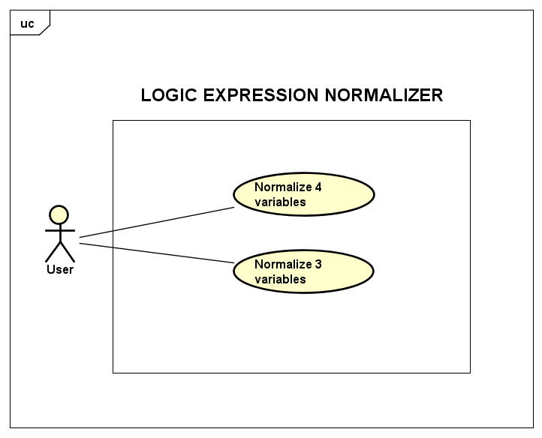
Project description
Usecase Diagram
Requirement
This application is a logic expression normalizer using the Quine-McCluskey algorithm. It takes a Boolean expression as an input.
User can choose two cases of input (3 variables or 4 variables expression) and two cases of output (POS or SOP canonical form)
Application outputs: The minimal Boolean expression, intermediate columns and PI Table

Slide 4
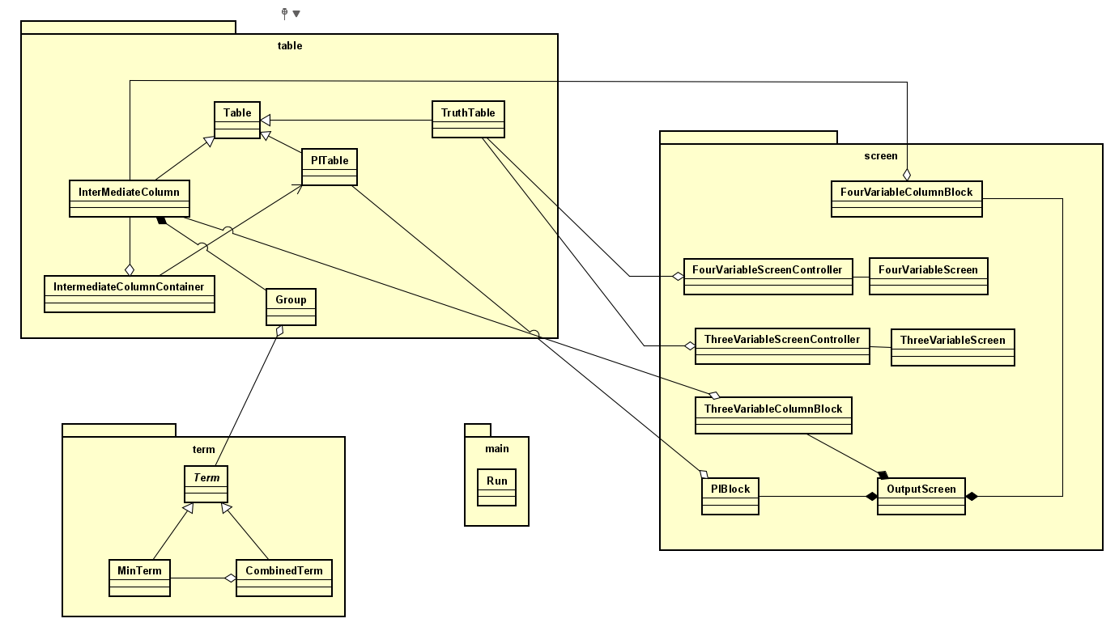
General class diagram
Class Diagram

Slide 5
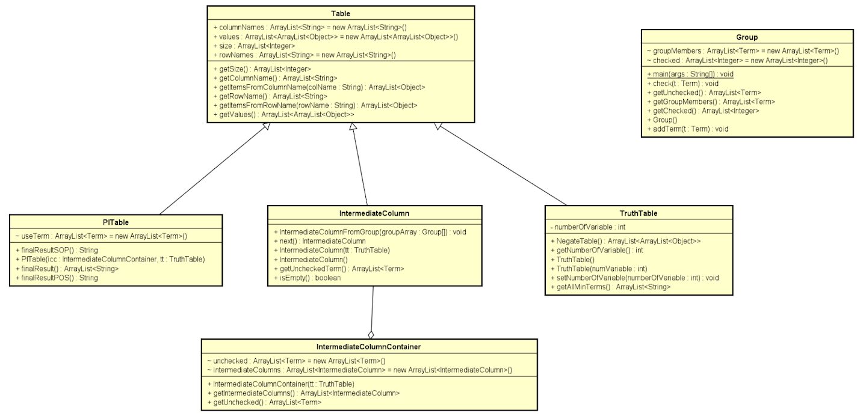
Package: table

Slide 6
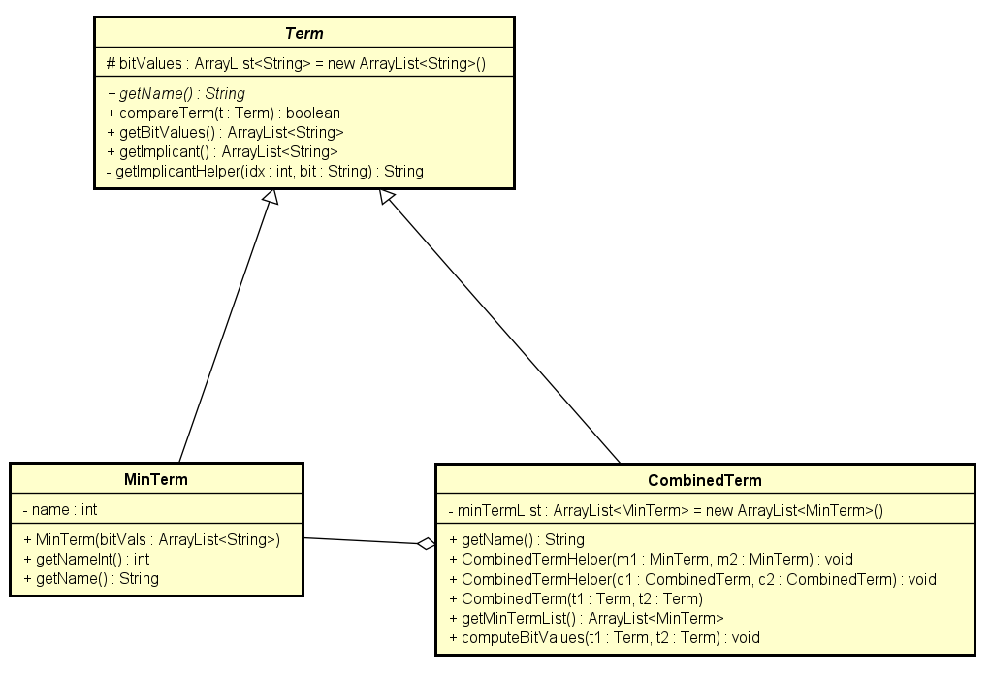
Package: term
Class Diagram

Slide 7
OOP Technique
Package: screen
Contain 2 input screen and 2 controller class, 1 output screen with 2 “Block” class, used to populate Intermediate Column and PI Table.
Important methods
CreateTruthTable():
Populate the TruthTable by creating all of the possible binary equivalents of Minterms in the form of an array list of “0” & “1”.
Take user input to complete the truth table, depending on the radio button, each binary equivalent will append “0” or “1” to their end.
Three/FourVariableColumnBlock():
Populate the output’s Intermediate column tables with the result returned by the algorithm
PIBlock():
Populate the output’s PITable with the result returned by the algorithm
Package: term
Contains an abstract class Term and 2 child classes MinTerm and CombinedTerm.
MinTerm is MinTerm: CompareTerm is the representation of a matched pair in the intermediate columns. It stores a list of minterms as well as the combined binary representation.
Important methods
getBitValues(): retrieve the binary representation of the MinTerm or CombinedTerm (e.g [0, 1, 0, 1])
compareTerm(Term t): return true if one term’s binary representation differs from another by exactly 1 variable, false otherwise
computeBitValues(): compute the binary representation after combining
Conclusion
Type something here

Slide 8
OOP Technique
Important methods
getAllMinTerms(): get all the minterms within TruthTable
NegateTable(): Replace all the “1” entries in the truth table with “0”, and vice versa
next(): generate the next Intermediate Column. This is done by iterating through all elements in each two adjacent groups and calling compareTerm() on each pair to check if they are combinable. If they are combinable, the terms are marked as 1 within their corresponding groups.
IntermediateColumn(TruthTable tt): construct IntermediateColumn from a TruthTable. This is done by dividing the minterms obtained from TruthTable into groups corresponding to the number of “1” in bit-value.
IntermediateColumnContainer(TruthTable tt): this will execute the whole intermediate columns building process. It will call next() until no more IntermediateColumn can be constructed.
getUnchecked(): return all the unchecked terms from every IntermediateColumn
PITable(IntermediateColumnContainer icc, TruthTable tt): construct PITable from all IntermediateColumns and the User-input TruthTable
finalResult(): produce the final simplified expression. finalResultSOP() and finalResultPOS(): convert to SOP and POS canonical form respectively
Package: table
Class: “Table” with 3 child classes “TruthTable”, “IntermediateColumn” & “PITable”, “Group”, “IntermediateColumnContainer”.
The basic idea is that the logical expression will be stored as a TruthTable. This TruthTable object will then be used to construct an initial IntermediateTable. At this point, all the unchecked terms are PIs (prime implicants). These terms will be used to build the PI Table.
The basic idea is that the logical expression will be stored as a TruthTable, IntermediateColumn & PITable will now perform the Quine-McCluskey algorithm to simplify the logical expression.
Conclusion
Type something here

Slide 9
Principles
Inheritance
Since TruthTable, IntermediateColumn and PITable all have in common attributes rowNames, columnNames, Values and Size, as well as methods getRowNames, getColumnNames, getValues… We create Table class from which TruthTable, IntermediateColumn and PITable inherit
Similarly, MinTerm and CombinedTerm have in common bitValues attribute, we create the Term class from which both of these classes inherit
Aggregation
Object of the CombinedTerm class contains multiple objects of the MinTerm class. Object of Group class contains multiple objects of Term class, which means it can be MinTerm as well as CombinedTerm
IntermediateColumnContainer is designed to includes all IntermediateColumns associating with each step of Quine-McCluskey algorithm, thus objects of IntermediateColumnContainer class contains multiple objects of IntermediateColumn class
Conclusion
Inheritance
In order to construct the screen for each table, we need all the information about rows, columns and values of those tables. Thus, there’s an association between each table with its GUI
Class Term has an abstract method called getName(), which is further implemented by its child classes (MinTerm and CombinedTerm) in different manners. When we iterate through the list of PI to retrieve their names, we call the getName() method, and depending on the object’s class, it will execute the corresponding method.

Slide 10
The end
Thanks

