Slide 1
Cracking the Code
How to ensure your assurance endures

Slide 2
Housekeeping
Toilets
Structure of the session:
1. Proportionate QA
Group practice
2. Testing
Unit testing practice
BREAK
3. Reviewing
Bad code practice
4. Version control and GitHub
Your facilitators are:
Alexander Newton (GSS FSer, MOJ)
Kim Ward (GSS FSer, ONS)
Olivia Podmore (GSS FSer, DIT)
Aimee North (GSS FSer, DWP)
Notes:
Write one thing they want to get out of the day on the orange sticky notes

Slide 3
Proportionate QA
Notes:
Let’s start by talking about Quality Assurance and finish by asking what is proportionate. We will then relate this to coding practices.
I’m not very good at parties. When I tell people that I’m a government analyst, most people turn off.
When I tell them that I’m really into quality assurance, they definitely do. So I’m very glad that I’m finally in a room where I can talk about QA for hours.

Slide 4
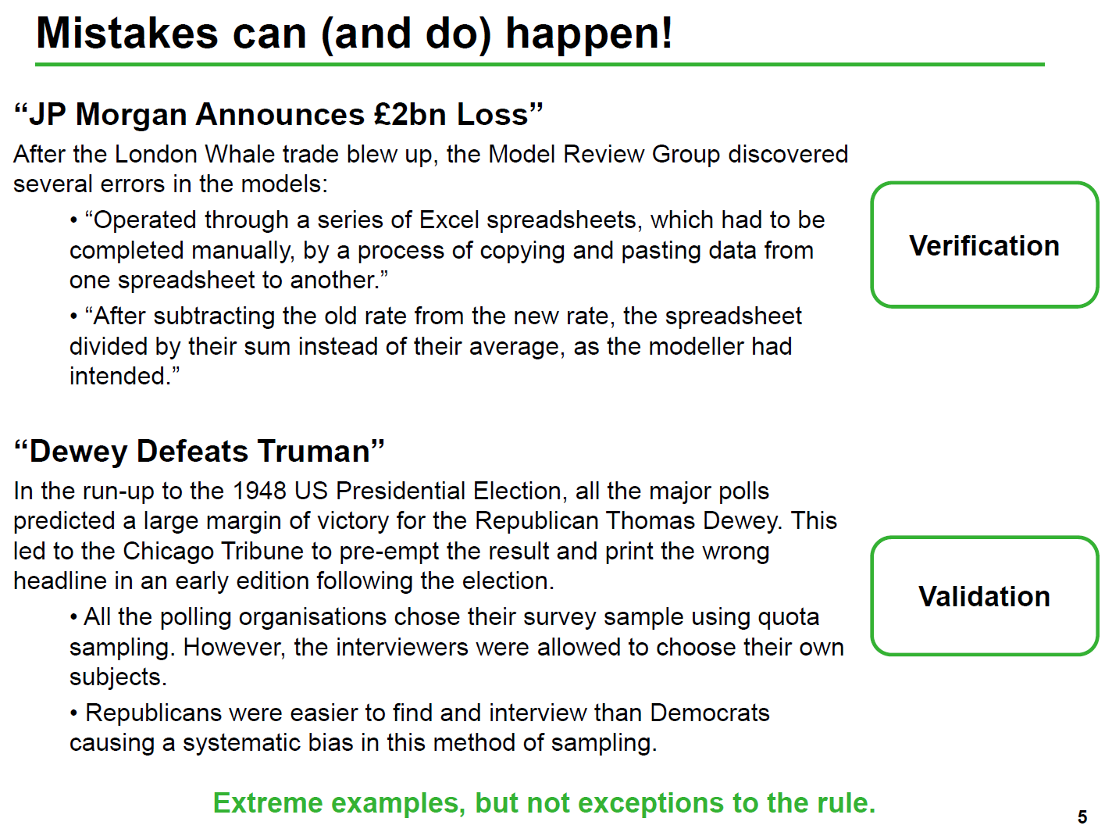
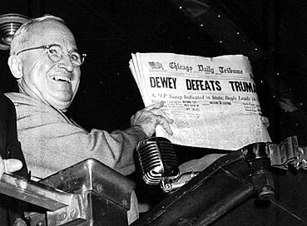
Notes:
Why do we do QA?
We are only human and we make mistakes
Sometimes these mistakes come from a place of ignorance, or not understanding the question. Sometimes they come from the process or the data, biases that we haven’t understood. Sometimes they come from not checking.
These mistakes can have profound implications both within and outside government.
Ask whether they know the difference between verification vs validation

Slide 5
Thinking about QA
What kind of analyses do we do?
What types of quality assurance should we be thinking about?
What are the risk events with each analysis?
What is the cost of the quality assurance we’re doing?
Routine (stats bulletins, MI dashboards…) | Bespoke (research reports, business case models…)
Predetermined outputs | Outputs defined through iteration
Expected frequency | Might only be produced once
Range of known users | Small group of known users, larger unknown group
Established methodology | Bespoke to specific needs
Notes:
There’s an easy split to make in analysis between routine analysis and bespoke analysis. It’s easier to frame proportionate QA in terms of these two modes of analysis, and identifying risk events with each.
The split really allows us to think about tailoring what QA means – for bespoke models we don’t necessarily need a fully unit-tested model as the peer review should cover this. But on routine outputs do we want to overburden our resources with quality assurance?
How critical is my analysis - use cases? - production analysis tends to be more business critical than exploratory as analysis will be incorporated into the outputs of other customers (e.g. other analytical customers); however exploratory has a greater variance (e.g. bespoke surveys for business cases)
Reputational risk? - if my analysis was wrong what could the effects be?
Reproducibility? - will my analysis have to be reproduced in the future? What are the events that could cause this? Audit? Academia? Exploratory has a greater need of reproducibility as there is no guarantee that there will be future, comparable publications to measure quality against.
Question to group: Spreadsheets are much easier to see the internal workings of, but they're much more liable to human error. What is the difference with coding? What are the risk events that might happen?

Slide 6
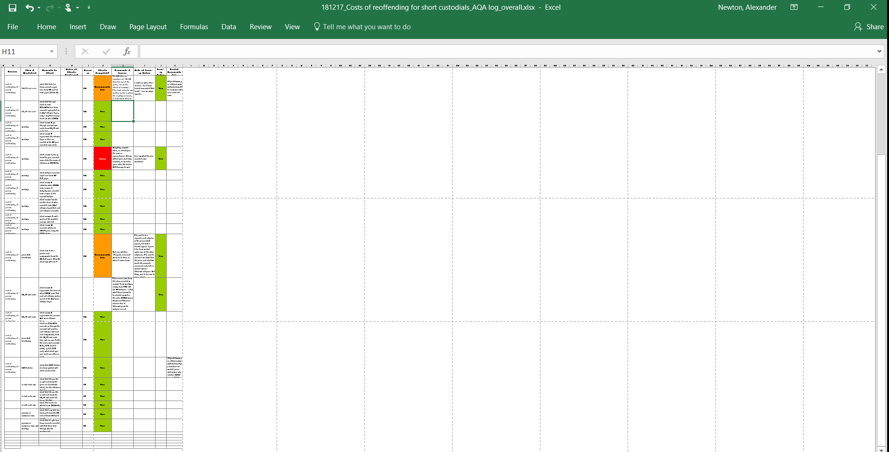
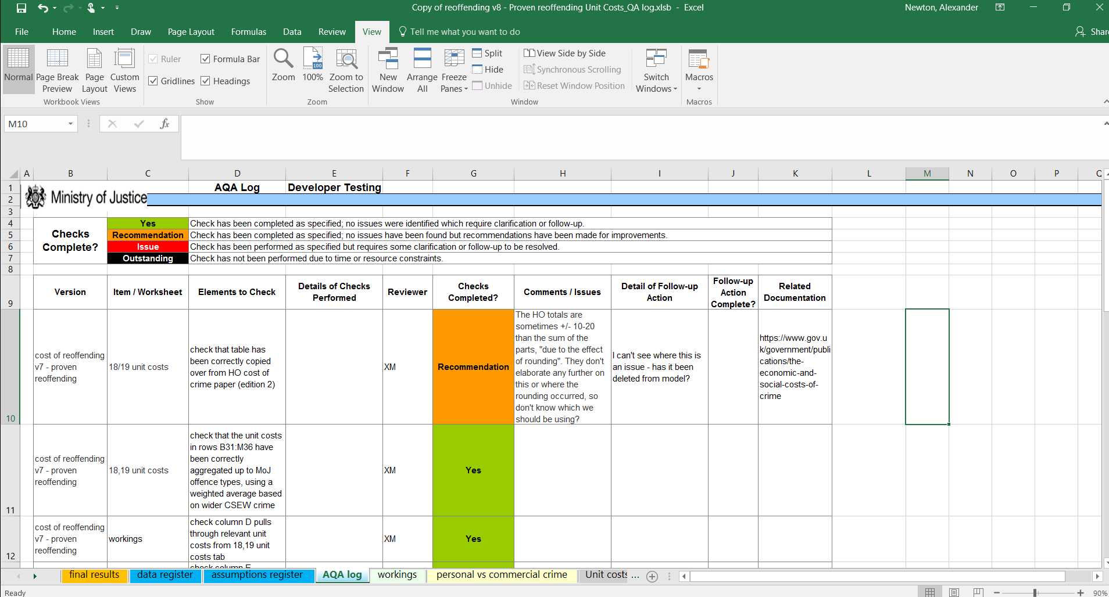
I used to Excel but now I’m in another class
Why code?
Notes:
Why code over excel? Open question up to floor. Quality assurance procedures in excel are often very manual and rely greatly on whether logs or relevant documentation cover the model adequately.
So for the rest of the presentation we’ll assume that everything you do is in R or Python, and that you’ve never touched Excel in your life.

Slide 7
Proportionate QA
We have produced a statistical bulletin according to a known methodology, using well known data. We have used standard SAS code to produce our data extracts and then we have updated the Excel sheets from last year to produce our report and tables.
We have developed a model in Excel. The model will be used once for a single business case. The business case is very high profile and will have to be signed off at investment committee.
We have developed a dashboard in R Shiny. The dashboard will be used by operational staff to direct daily activities. The data are drawn from data sources used in official statistics and are automatically drawn into the dashboard.
We have developed a model in R. The model is the key demand model for the department’s chief priority. It will be constantly updated with new data as it becomes available (sometimes twice daily).
What is the purpose of QA?
What is proportionate?
Keeping these questions in mind can you think of what types of quality assurance you would recommend for each case?
Notes:
Question to group: What is proportionate QA? What are the ends of QA? Split into groups, give them paper and ask them to come up with ideas for types of QA they could perform. Then give them examples and ask which would apply, which would be disproportionate, etc. Give each
Key points: Risk management, doesn’t just assure but improves quality.
Main point: Quality assurance is both a way to improve the quality of a product and to manage risk. Reduced risk and higher quality products are undeniably good things.

Slide 8
Testing

Slide 9
Testing 101
Why test?
Programs don't rely on humans, for the same type of input you should always get the same type of output.
How can we know this? How do we know that all cases are handled?

Slide 10
“An effective testing regime removes much of the difficulty of peer review and allows for non-experts in the coding language to help review code. Automatic testing is fundamental to DevOps and other Continuous Integration pipelines; these development practices have allowed for the rise of companies like Google, Facebook, Amazon and Apple.”
Notes:
DevOps and Continuous Integration – explain these are best practices in the software engineering

Slide 11
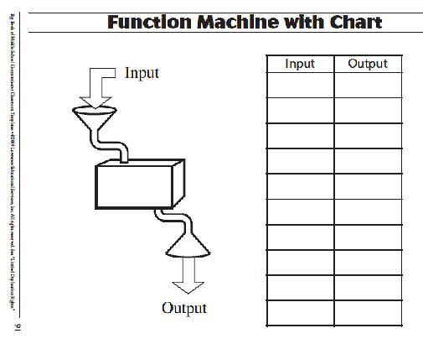
Unit testing
Unit testing is the cornerstone of modern software development.
Unit tests look at the smallest units of code (e.g. one function / one class / one method) and ask whether the known output is calculated for a known input.
If all tests are passing then all of the cases that are tested for will work. This removes a lot of the burden of review.
Notes:
Example: function machines (what are the use cases, what are the tests we could develop, try to get them to agree to an out of line use case), sqrt()

Slide 12
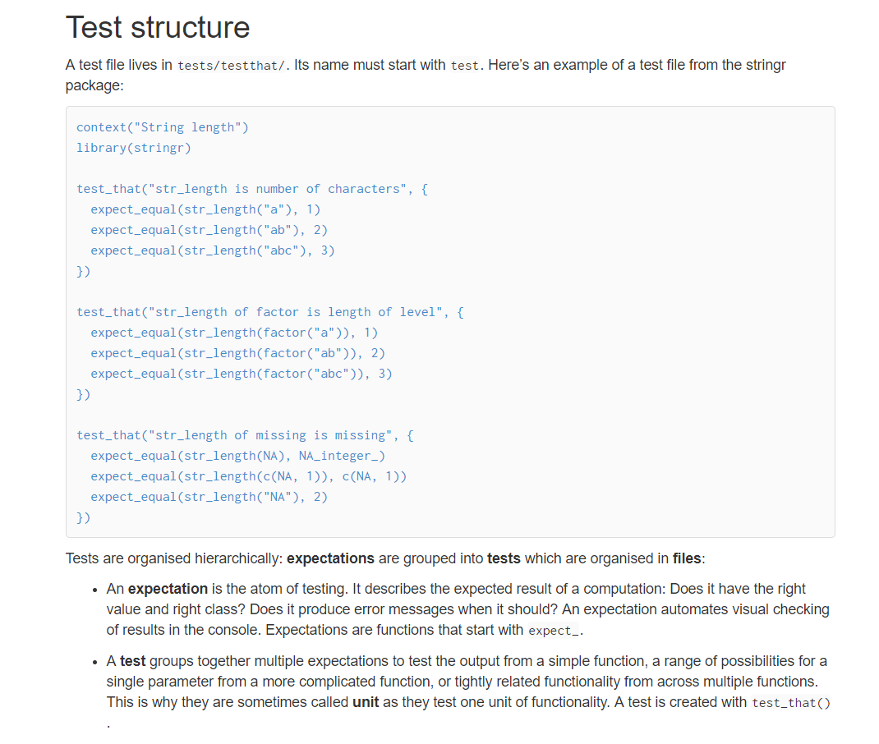
Unit testing in R
What do tests look like? In R?
Testthat

Slide 13
Types of test
Is true/false?
Is error?
Is almost?
Is equal?
Is match (RegEx)?
Is member?
Notes:
These are the basic units, can you think of ways to combine them into more complex tests?

Slide 14
Unit testing in python / SQL / SAS
In Python?
Pytest
SQL?
Views
SAS?
Change code into R

Slide 15
Integration testing
Like unit testing but focussing on the interactions of multiple units in a module.
Achieved in the same way as unit testing for many languages.
Notes:
For instance, even though two functions might be working correctly for the given inputs, are the right type of objects passed between them for every set of inputs?
Example: two function machines end-to-end, where might the integration be broken given the previous
Ln(x) -> sqrt(x)

Slide 16
Exercise
Go to https://notebooks.azure.com/kim-ward/projects/as-masterclass
Create an account
Clone it to your projects to use the notebooks

Slide 17
Reviewing

Slide 18
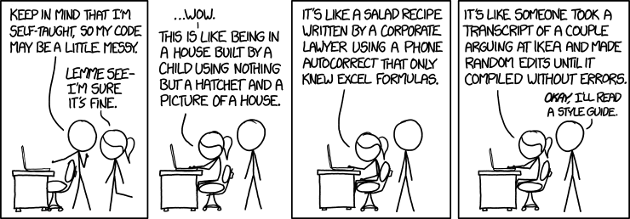
Reviewing 101
Review code with a checklist:
Am I able to understand the code easily?
Is the code written following the coding standards/guidelines?
Is the same code duplicated more than twice?
Can I unit test / debug the code easily to find the root cause?
Is this function or class too big? If yes, does this unit have too many responsibilities?
Does it throw informative errors if misused?
Notes:
Easy to read / easy to write / easy to maintain (pick two)

Slide 19
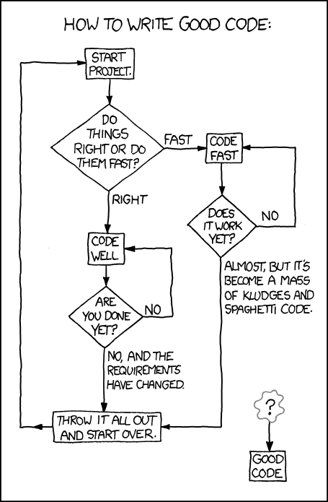
The dictionary of bad code
What makes code bad?
Notes:
Open for discussion, what makes code bad? Why is that easier to define than good code?

Slide 20
The dictionary of bad code
The bad code checklist:
Bad code is unreadable, not commented and difficult to understand.
Bad code is not unit tested.
Bad code is easy to break.
Bad code is undocumented.
Bad code has no version control so it is difficult to follow why decisions have been made or where errors were introduced into the code.
Bad code does not deal with edge cases.
Bad code does not manage its dependencies.
Bad code does not follow the DRY principle.
Notes:
It’s easier to define bad code than it is to define good code. The latter is subject specific. Bad code can run extremely fast - but very optimised code can often be worse than slower code for readability. Having said that, most modern languages are designed such that the most obvious way of doing something is also the fastest - in fact this is a guiding philosophy of python.
How do you review bad code? What are the things that you look out for?
Here are some examples:

Slide 21
import pandas as pd df1 = pd.read_csv("users/amp45/python/current_code/input_data/census/online_returns.csv") df2 = pd.read_csv("users/amp45/python/current_code/input_data/census/paper_returns.csv") df3 = pd.read_csv("users/amp45/python/current_code/input_data/census/total_returns.csv") df2['sum'] = df2['england'] + df2['wales’] df1['sum'] = df1['england'] + df1['wales’] df3['sum'] = df3['england'] + df3['wales’]
#TODO – fix the bug here df4 = pd.read_csv("users/amp45/python/current_code/input_data/population/2011_sample.csv") df4 = pd.read_csv("users/amp45/python/current_code/input_data/population/2021_estimates.csv") / df4 df2['2021'] = df2['sum'] * df4 df2.to_csv("users/amp45/python/current_code/input_data/census/paper_returns_2021.csv") df3['2021'] = df3['sum'] * df4 df1.to_csv("users/amp45/python/current_code/input_data/census/online_returns_2021.csv") df3.to_csv("users/amp45/python/current_code/input_data/census/total_returns_2021.csv")
Notes:
Exercise here?

Slide 22
Exercise
Go to

Slide 23
Version Control

Slide 24
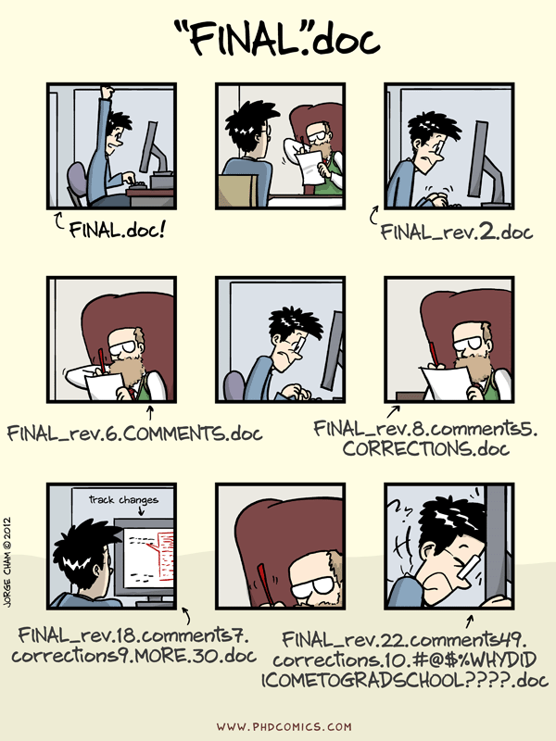
Version control 101
Why version control?
Which risk does this solve?
Notes:
Can easily see where bugs are introduced.

Slide 25
Version control 101
Version control allows you to see which bits of the code have been quality assured.
It facilitates a safe coding workflow where drastic changes can be reverted.
Allows commentary on decisions to be built into the coding.
Allows code to be repurposed for similar projects.
If you have code to deal with a specific dataset then those functions can be transferred to a new project.

Slide 26
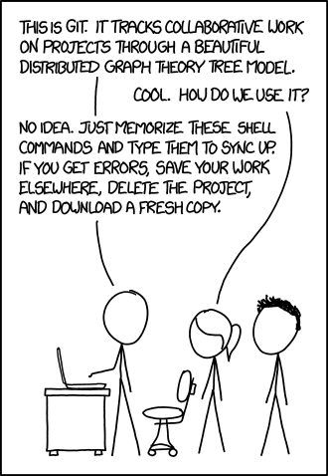
Git and GitHub
Tools have developed to fulfil this version control, the most renowned of which is git.
Several project management tools have developed such as github, gitlab and bitbucket. What does a good workflow look like?
Issue tracker allows you to specify QA issues that appear and attach them to the solutions.
Issue tracker also allows decisions and discussions to be tracked.
Notes:
What is git?
Issue tracking
Go to github and show them around

Slide 27
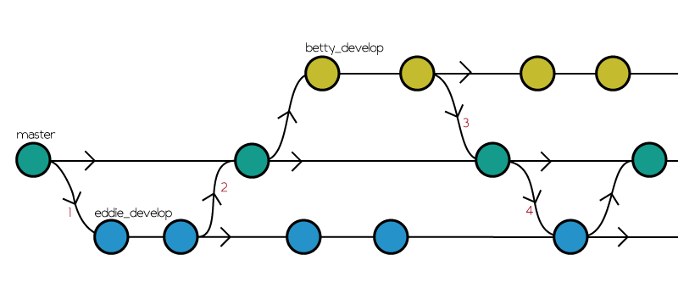
Repository – the project in git
Branch - within a repository an offshoot that might come back to be merged into the master or "main" branch
Fork - someone clones a repository to repurpose/rewrite the code
Merge - when you bring two branches together
Diff - comparing the difference between two different branches or commits
Commit - a step along a branch saying "this is how things were at this point“
Push - when you take your commits from your local repository and push it to the remote repo (e.g. github)
Pull - when you get the repository in its latest form from git
Notes:
Git-tionary

Slide 28
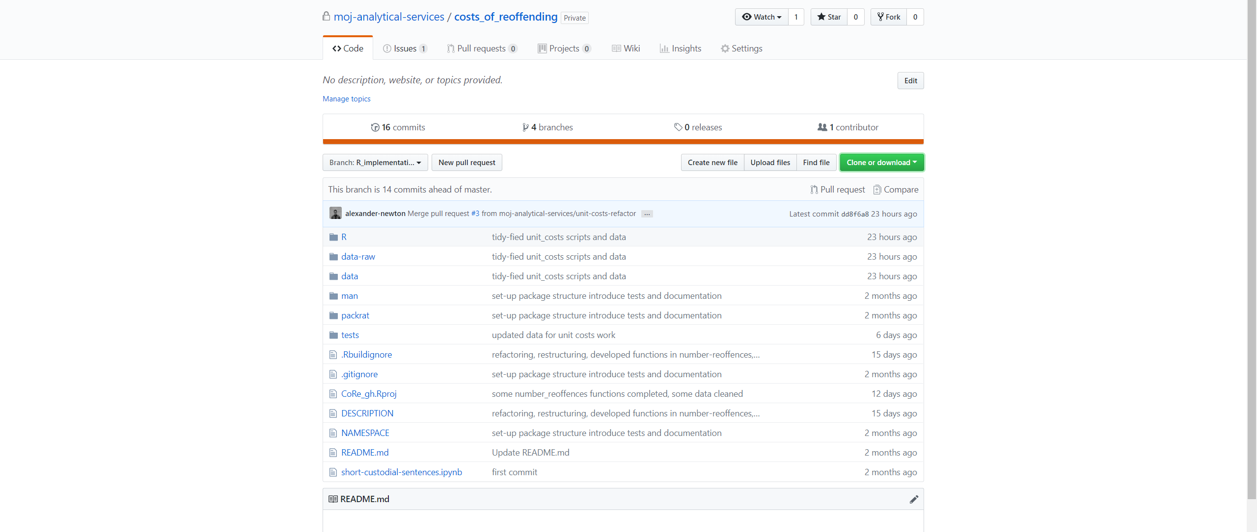
This is GitHub!
Notes:
Things to point out: Branch, Clone or Download, Costs of Reoffending, Issue tracking

Slide 29
Test-driven development
Write the tests first and then the function that fulfils the tests.
Similarly, write the issue first and then write the code that fills the issue - this way everyone knows exactly what needs to be done next.
Pull requests allow for quality assurance procedures to be recorded to the correct version and attached to specific issues.
Effective use of git(hub/lab) and decoupled code – reviews can be performed whilst code is still being written!

Slide 30
Bringing it all together
Bringing it all together: writing tests for some bad code and pushing your commits to github!

