Slide 1
Micro Credit Default Project
Submitted by
Sourav Chaudhury

Slide 2
Business Problem Framing
Microfinance is widely accepted as a poverty-reduction tool, representing $70 billion in outstanding loans and a global outreach of 200 million clients. The study here pertains client that is in Telecom Industry. They are a fixed wireless telecommunications network provider. They have launched various products and have developed its business and organization based on the budget operator model, offering better products at Lower Prices to all value conscious customers through a strategy of disruptive innovation that focuses on the subscriber.

Slide 3
They understand the importance of tele communication and how it affects a person’s life, thus, focusing on providing their services and products to low income families and poor customers that can help them in the need of hour. They are collaborating with an MFI to provide micro-credit on mobile balances to be paid back in 5 days. The Consumer is believed to be defaulter if he deviates from the path of paying back the loaned amount within the time duration of 5 days. For the loan amount of 5 (in Indonesian Rupiah), payback amount should be 6(in Indonesian Rupiah), while, for the loan amount of 10(in Indonesian Rupiah), the payback amount should be 12(in Indonesian Rupiah).

Slide 4
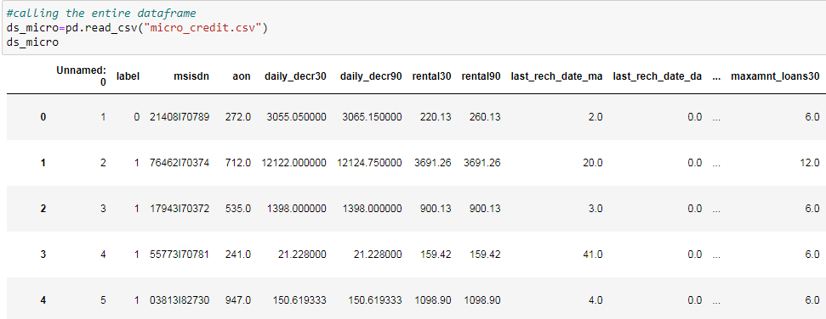
Data Sources and their formats

Slide 5
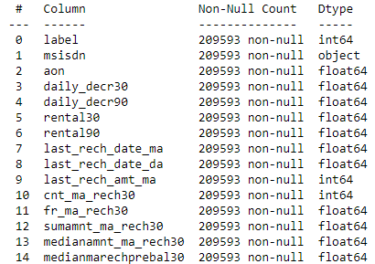

Slide 6
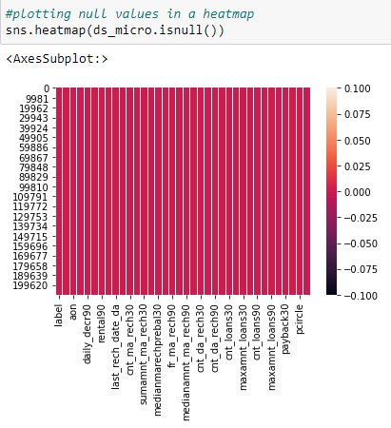
Checking for Null Values

Slide 7
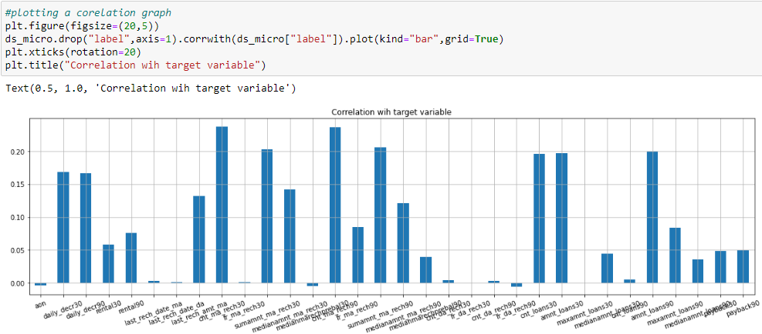
Data Pre-processing Done
Dropping Columns

Slide 8
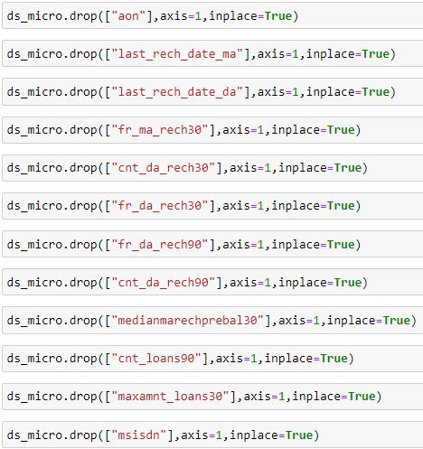

Slide 9
Converting to Absolute Values
There are some variables in the dataset with negative values. Below are the variables with negative values which are to be converted to absolute values. We will use the below code to convert them to absolute values.
Daily amount spent from main account, averaged over last 30 days (in Indonesian Rupiah)
Daily amount spent from main account, averaged over last 90 days (in Indonesian Rupiah)
Average main account balance over last 30 days
Average main account balance over last 90 days

Slide 10
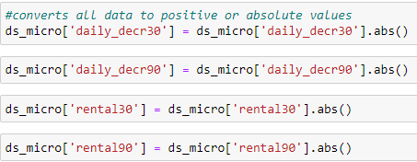

Slide 11
Plotting Outliers
Plotting outliers are also an essential part of pre processing and making an efficient machine learning model. Present of outliers will have affect on variance, and standard deviation of a data distribution. In a data distribution, with extreme outliers, the distribution is skewed in the direction of the outliers which makes it difficult to analyze the data and will result in biased insights.
Below are the data points of the variables plotted in a boxplot. We can clearly see the outliers from the below visualization

Slide 12
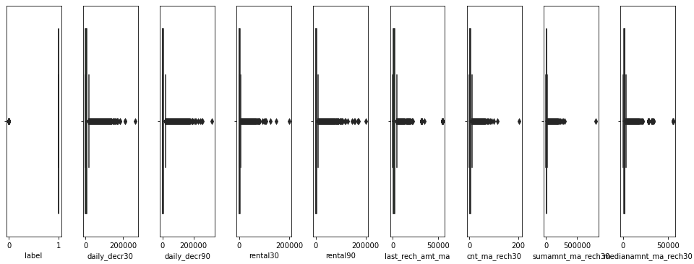
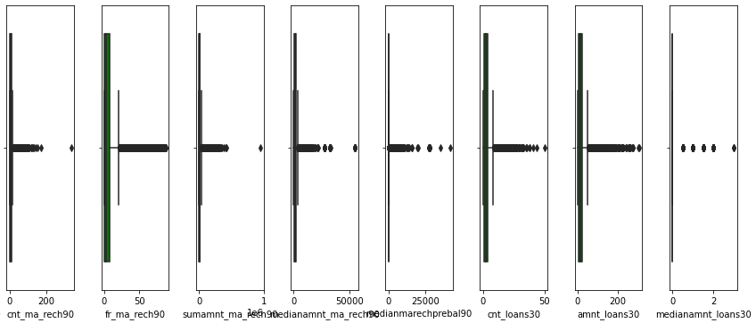

Slide 13
Removing Outliers
I have used Z score to remove the outliers. A Z-score is a numerical measurement that describes a value's relationship to the mean of a group of values. Z-score is measured in terms of standard deviations from the mean. If a Z-score is 0, it indicates that the data point's score is identical to the mean score. Any points that will be above Z-score 3 will be considered as outliers.

Slide 14
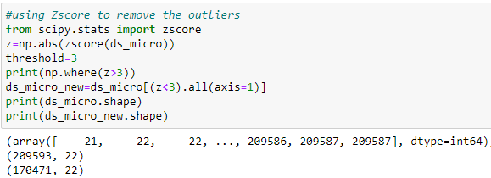

Slide 15
Checking Skewness
Skewness refers to a distortion or asymmetry that deviates from the symmetrical bell curve, or normal distribution, in a set of data. If the curve is shifted to the left or to the right, it is said to be skewed. A data can be right skewed or left skewed. A easy graphical representation of checking skewness of data is by plotting them in a distribution graph and also listing down there skew values.

Slide 16
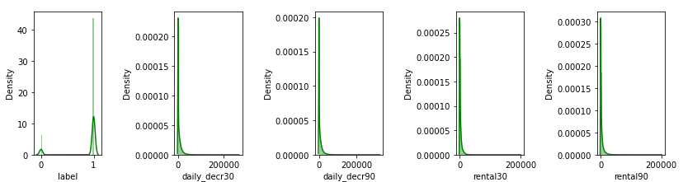
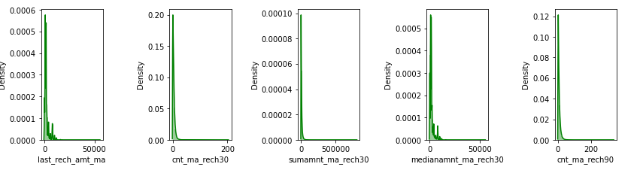
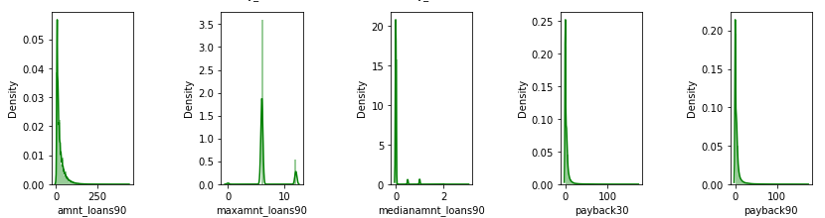

Slide 17
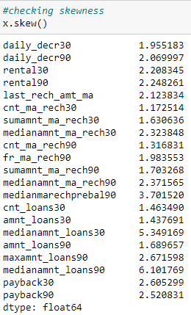


Slide 18
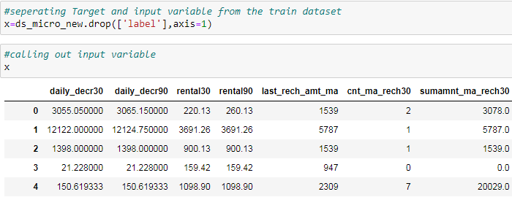
Separating Input and Target Variable

Slide 19
Scaling Input Variable
Feature scaling is a method used to normalize the range of independent variables or features of data. It is also known as data normalization. Unscaled input variables can result in a slow or unstable learning process, whereas unscaled target variables on regression problems can result in exploding gradients causing the learning process to fail. For this particular model I will be using standard scaler. Below is the code for the same.

Slide 20
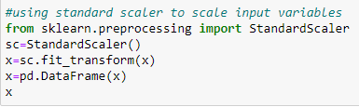
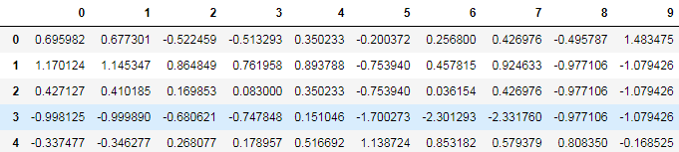

Slide 21
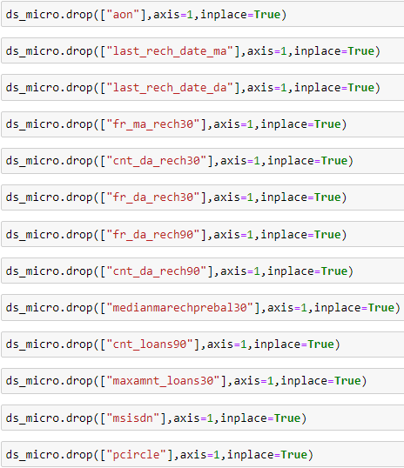
Removing Lesser or Negatively Correlated Data

Slide 22
Correlation Matrix, Heatmap and Graph
A Correlation matrix is also plotted where we can see the variables and their co-linearity with other variables and most importantly with the target variable. Below is a partial snapshot of the correlation matrix in a heatmap showing linear relationship of variables with each other. The co relation percentage is also mentioned where it shows either the variable is positively correlated or negatively correlated with each other. The co linearity of one variable with the other is more, then the matrix gets darker in shade and vice-versa.

Slide 23
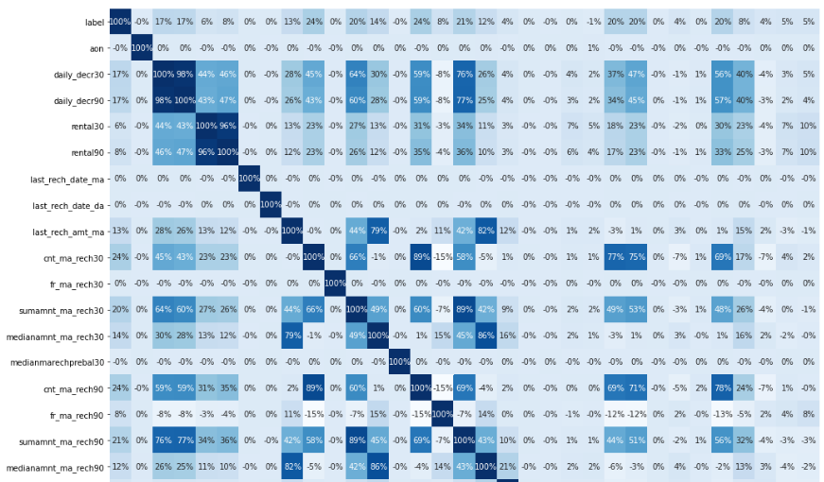
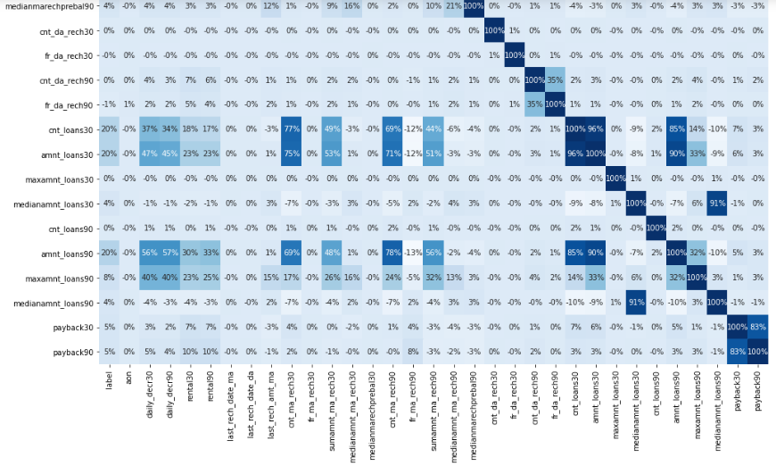

Slide 24
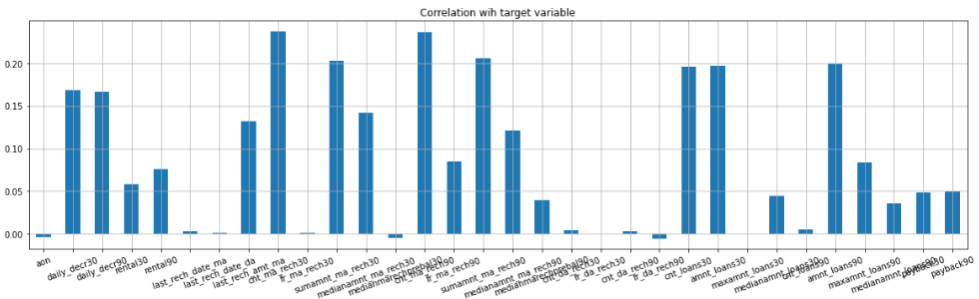
The Y axis shows the percentage of co-linearity with the target variable label and X axis shows the name of the numeric variables in the dataset. The variables which shows lesser co-linearity will be not considered in making the model as considering them might reduce the efficiency of the model. The above diagram is for the training dataset. All the variables that shows negative correlation will be removed.

Slide 25
Separating training and Testing dataset
The entire training dataset is splitted into training and testing data. The ratio used for this study id 80-20%. 80% of the data is used to train the model the rest 20% is used for testing the model. Below is the code to do the same.

Slide 26
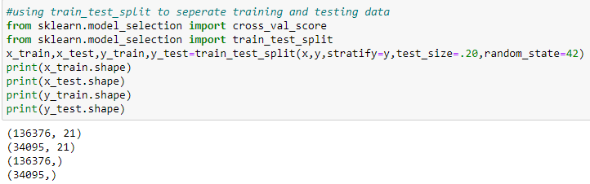

Slide 27
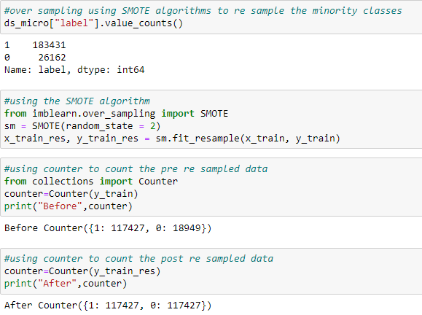
Over Sampling using SMOTE

Slide 28
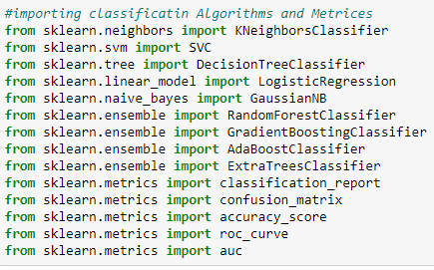
Importing Classification Algorithms and Metrics

Slide 29
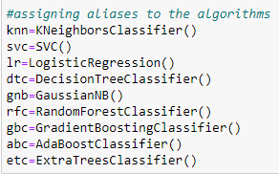
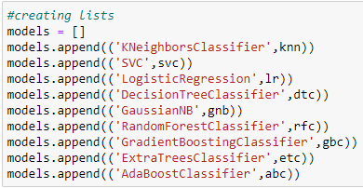
Assigning aliases and Creating Lists

Slide 30
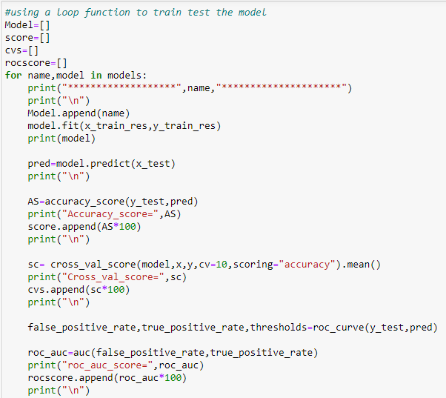
Machine learning

Slide 31
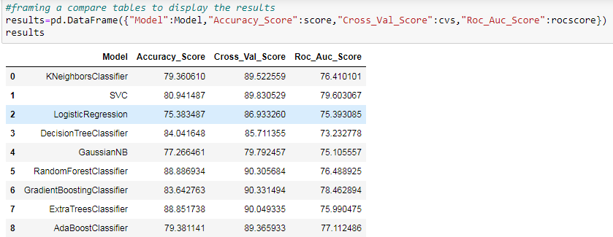
Compare Table

Slide 32
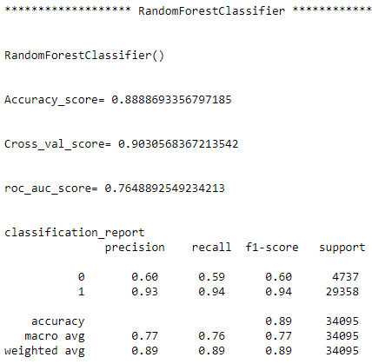

Slide 33
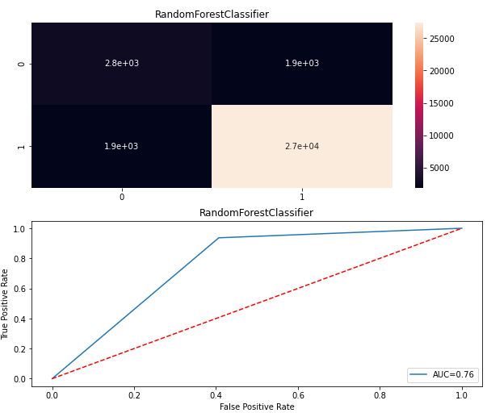

Slide 34
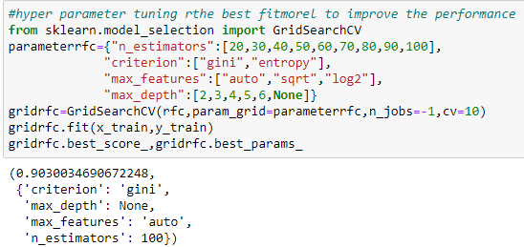
Hyper Parameter Tuning

Slide 35
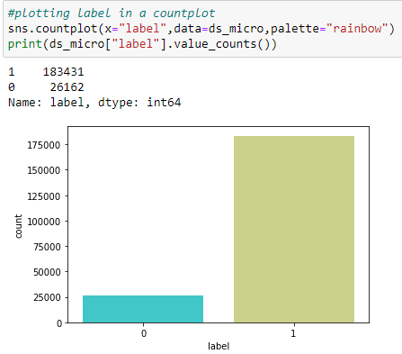
Visualizations
Univariate Analysis

Slide 36
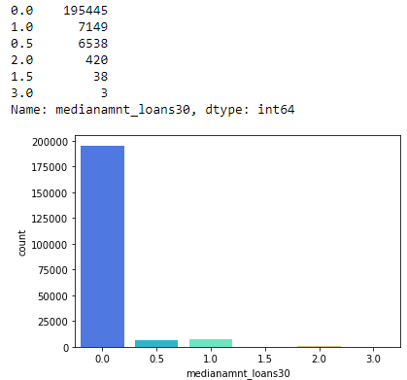

Slide 37
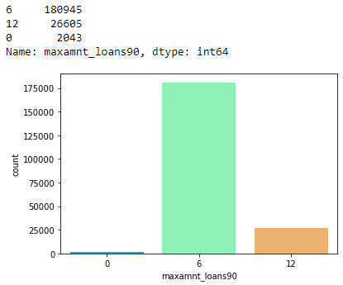

Slide 38
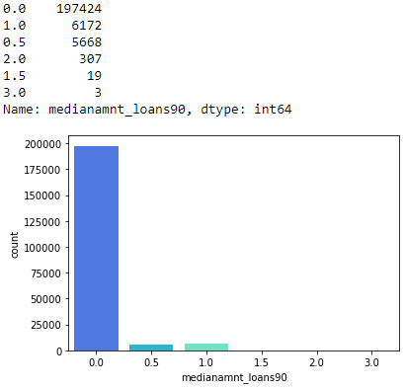

Slide 39
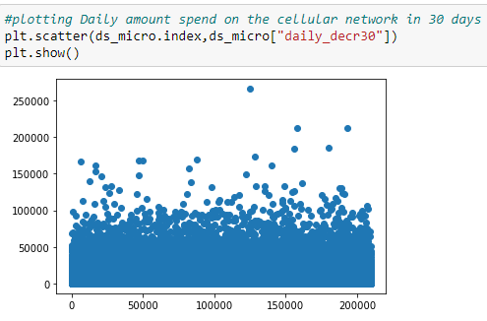

Slide 40
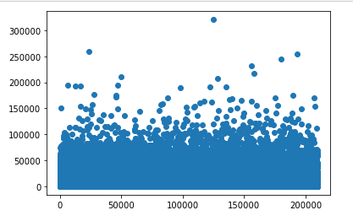

Slide 41
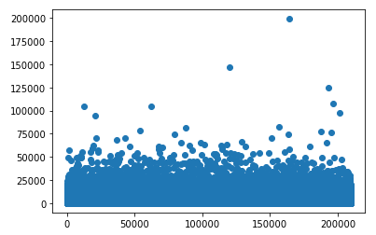

Slide 42
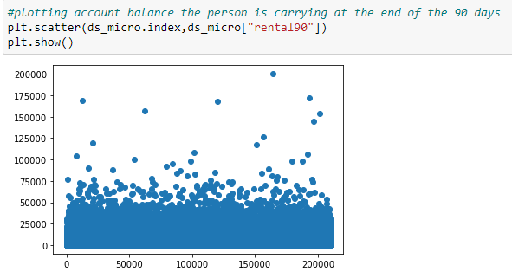

Slide 43
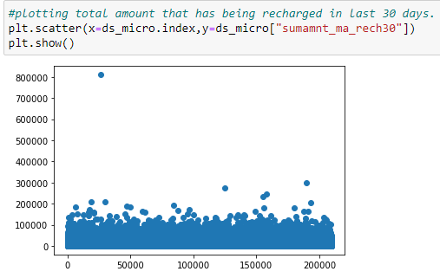

Slide 44
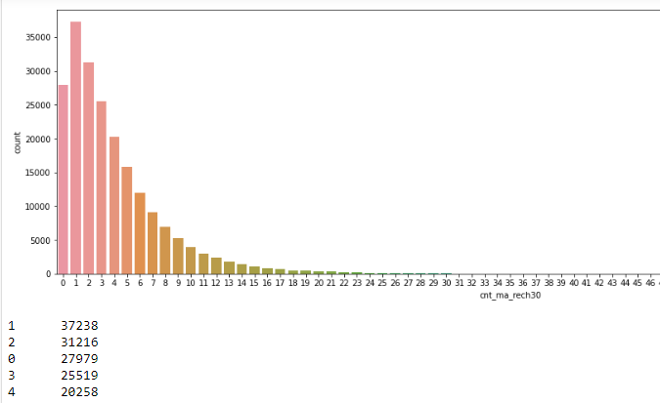

Slide 45
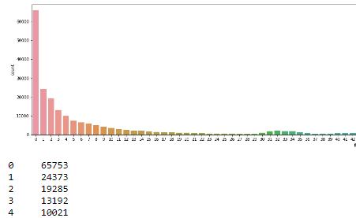

Slide 46
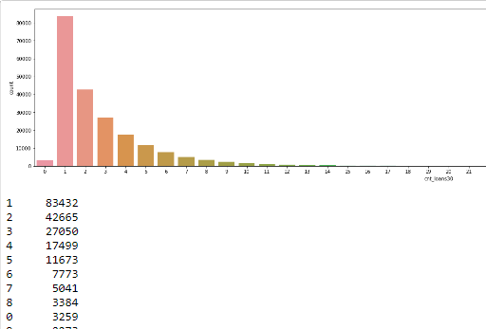

Slide 47
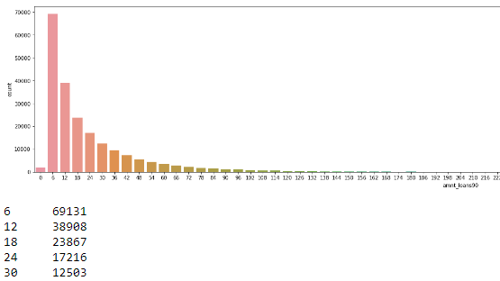

Slide 48
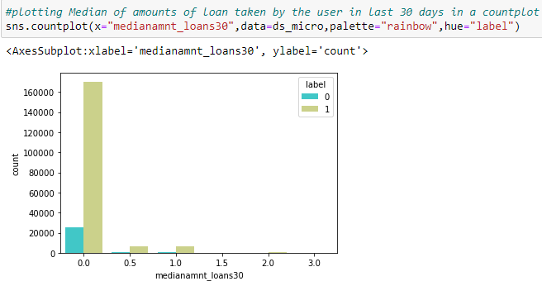
Bivariate Analysis

Slide 49
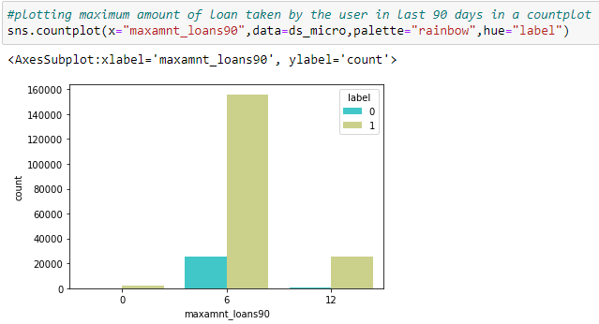

Slide 50
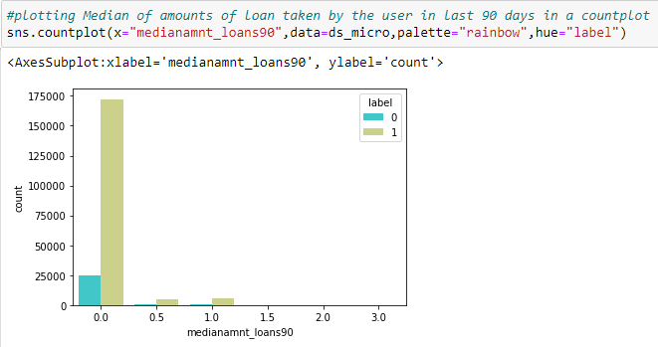

Slide 51
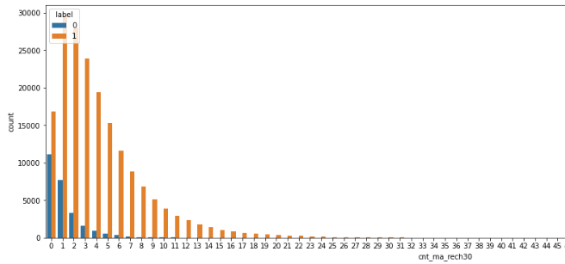

Slide 52
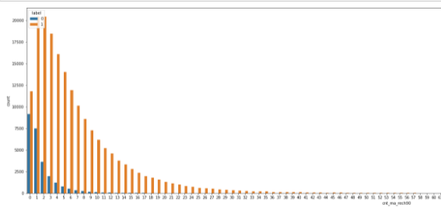

Slide 53
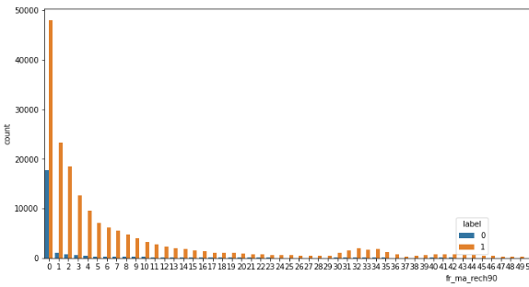

Slide 54
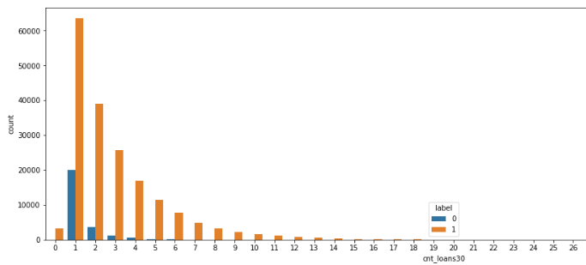

Slide 55


