Slide 1
Fake News Detection
Submitted by
Sourav Chaudhury

Slide 2
Business Problem Framing
The authenticity of Information has become a longstanding issue affecting businesses and society, both for printed and digital media. On social networks, the reach and effects of information spread occur at such a fast pace and so amplified that distorted, inaccurate, or false information acquires a tremendous potential to cause real-world impacts, within minutes, for millions of users.

Slide 3
Fake news is a major concern in our society right now. It has gone hand-in-hand with the rise of the data-driven era – not a coincidence when you consider the sheer volume of data we are generating every second
Fake news is such a widespread issue that even the world’s leading dictionaries are trying to combat it in their own way.

Slide 4
Conceptual Background of the Domain Problem
Fake news is an increasingly common feature of today’s political landscape. To help address this issue, researchers and media experts have proposed fake news detectors adopting natural language processing (NLP) to analyze word patterns and statistical correlations of news articles.

Slide 5
Mathematical/ Analytical Modeling of the Problem
In this project a machine learning model is constructed which is capable of classifying fake news from that of the real ones. An unclean dataset was given which was later cleaned using different strategies. Data preprocessing started with replacing missing values, then dropping columns followed by making required columns. Then a extensive feature engineering was done to reduce the data dimensionality. Visualizations are plotted to get a better understanding of the data and the problem statement. Text vectorization techniques are used to convert the text to numeric. Finally several algorithms are tested with the dataset in order to find the one that works best with the dataset.

Slide 6
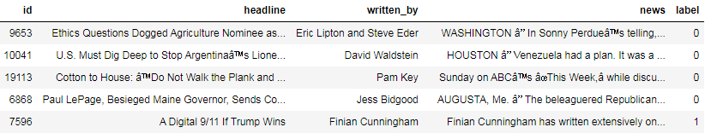
Data Sources and their formats

Slide 7
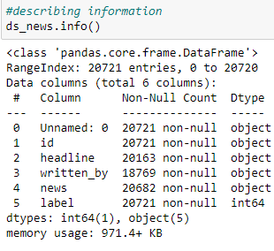
Data Preprocessing Done
Describing Information

Slide 8

Replacing Missing Values
The above snapshot shows three columns with missing values. As all the columns with missing values are categorical in nature we will use the mode strategy to replace the missing values. Below is the code to do the same.

Slide 9

Dropping Columns
In this step the columns those are not important and will not be considered in the model will be dropped. Below are the codes to drop two columns from the dataset.

Slide 10
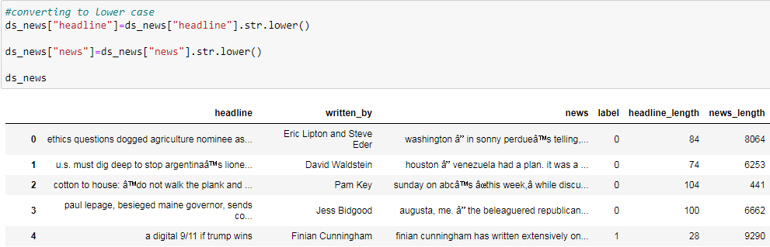
Converting to Lower Case
Converting the data to lower case will increase the models accuracy. It will be easier for the model to predict better in such scenarios. Below are the codes to convert the corpus to lower case.

Slide 11
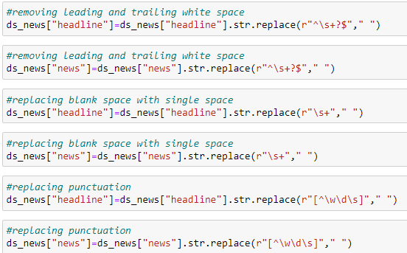
Feature Engineering

Slide 12
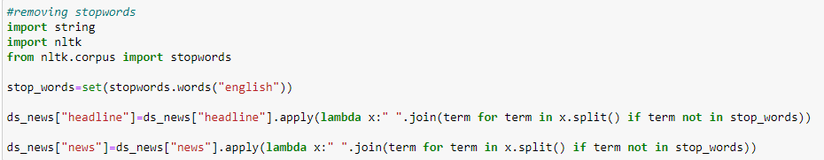
Removing Stopwords
Removing stopwords can potentially help improve the performance as there are fewer and only meaningful tokens left. Thus, it could increase classification accuracy.

Slide 13
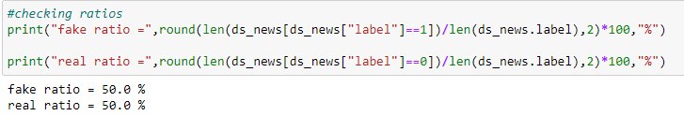
Model/s Development and Evaluation
The first thing that is laid down in understanding the problem statement understanding the distribution of the target variable. For this purpose, the ratios of the 0s and 1s are laid down

Slide 14
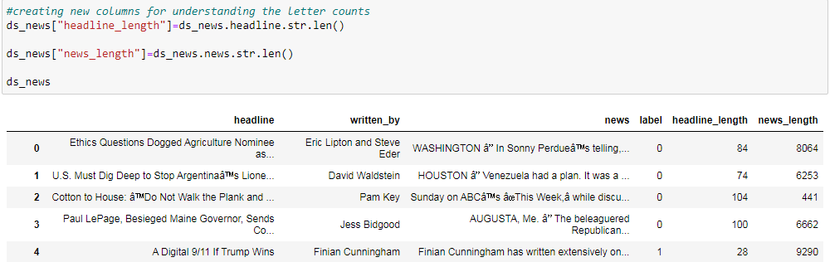
Making New Columns
Two new columns are added in order to get a count of the letters in the text columns. This will help us to differentiate if the letter distribution of fake news are different than that of real news. Below is the code.

Slide 15
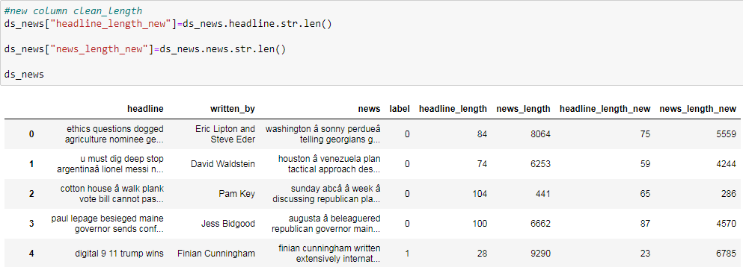
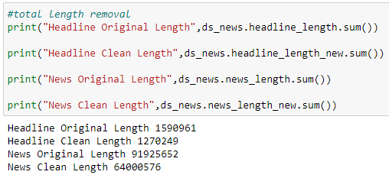
Length Removal
The removal of stopwords has resulted in reduction of the data dimension. Two more columns has being added to find the new length of words and also to compare the length removal from that of the unclean data. Below is the code.

Slide 16
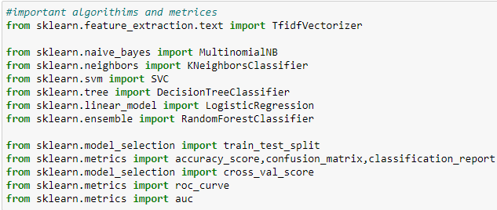
Importing Classification Algorithms and Metrics

Slide 17
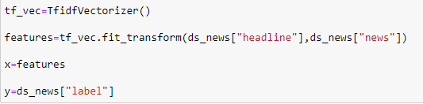
Vectorization and Splitting Target and Input Variables
TfIdf is used as a vectorize the text variables. There are two input variables "headline" and "news" and "label" is the target variable. A variable named features is made and the input variable is feeded into it and later it is treated as the "X" and the label is treated as "Y".

Slide 18
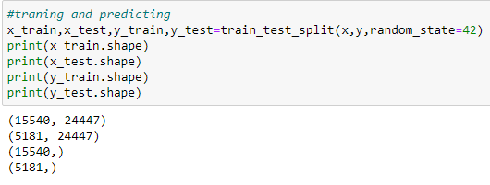
Splitting Training and Testing Data
Train test split is used to separate the training and testing data.

Slide 19
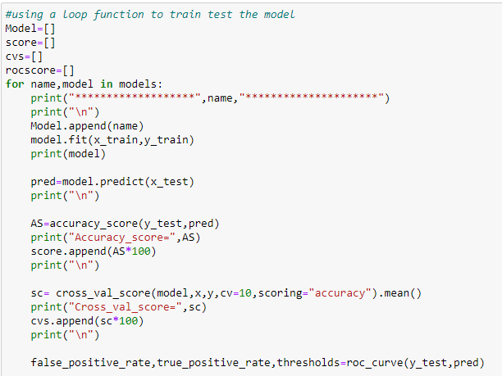
Machine Learning

Slide 20
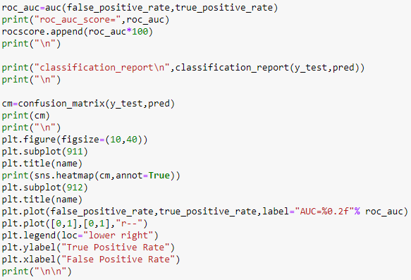

Slide 21
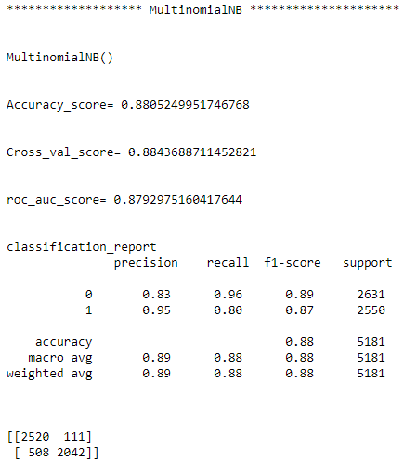
Run and Evaluate selected models

Slide 22
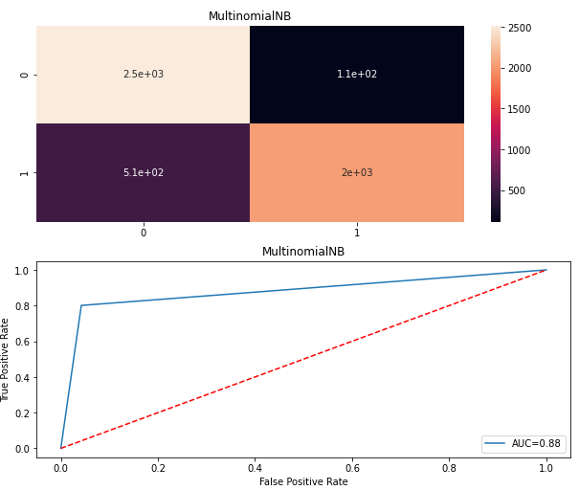

Slide 23
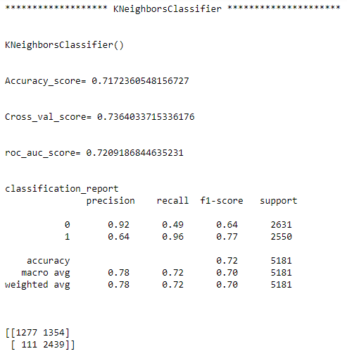

Slide 24
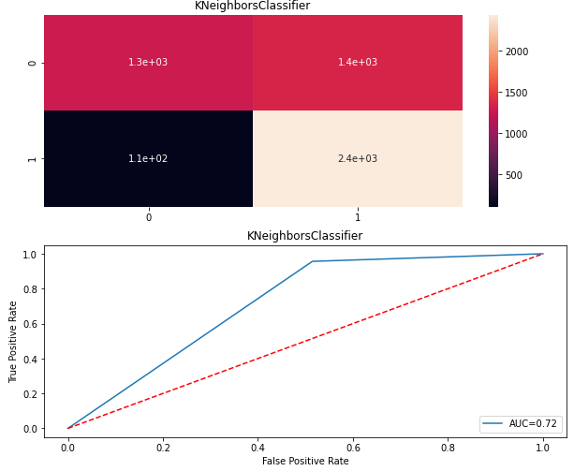

Slide 25
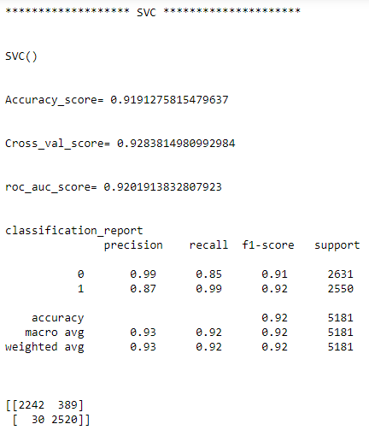

Slide 26
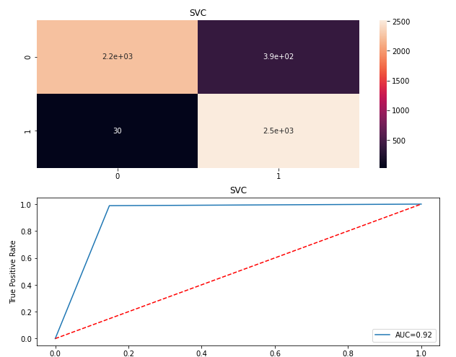

Slide 27
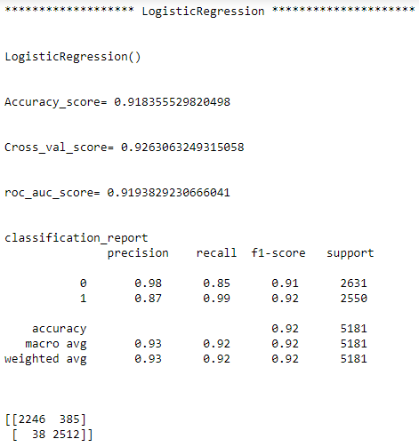

Slide 28
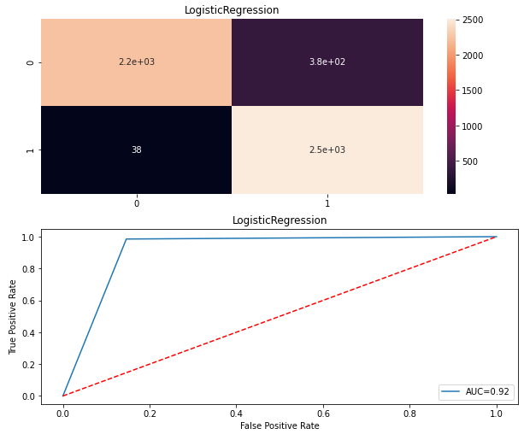

Slide 29
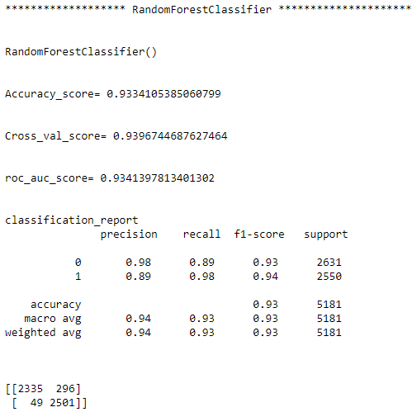

Slide 30
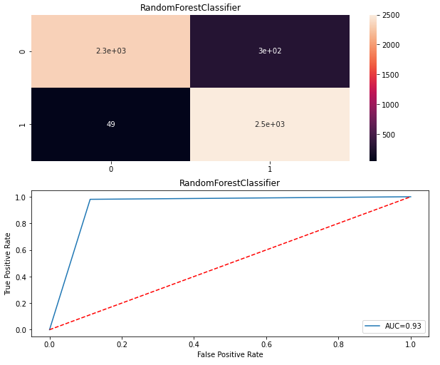

Slide 31
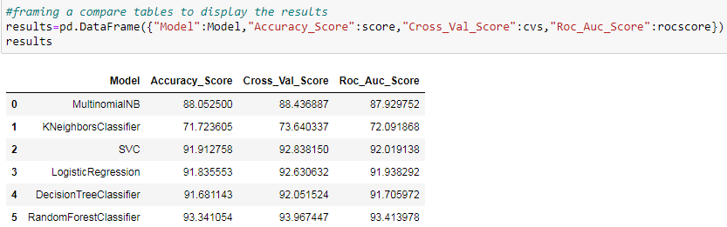
Framing Compare Table

Slide 32
Key Metrics for success in solving problem under consideration
Accuracy Score
Cross Validation Score
ROC_AUC Score
Recall
Precision
F1 Score
Confusion Matrix

Slide 33
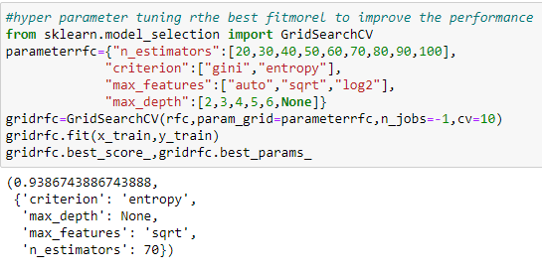
Hyper Parameter Tuning

Slide 34
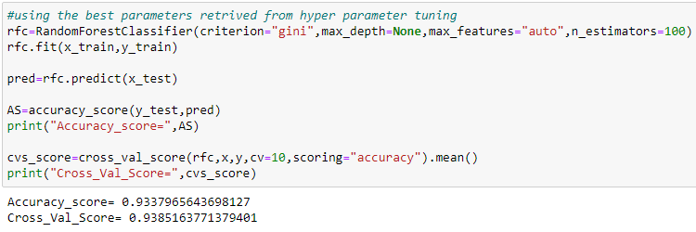
Using Best Parameter
The above parameters are the best considering the dataset. We will be using the above parameters to generate the best score for the model.

Slide 35
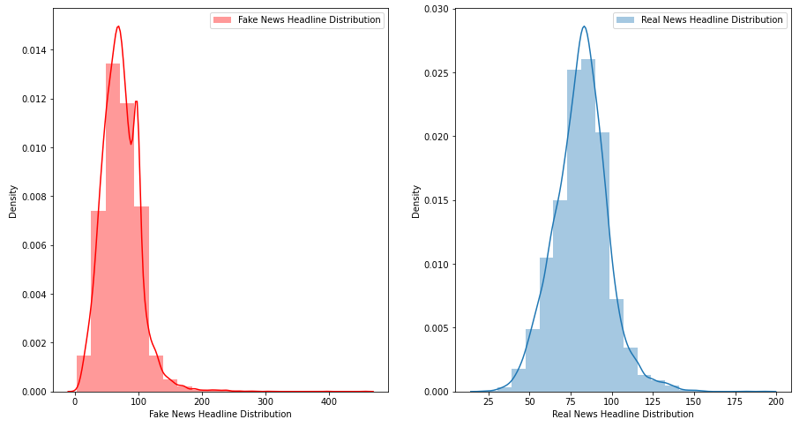
Visualizations

Slide 36
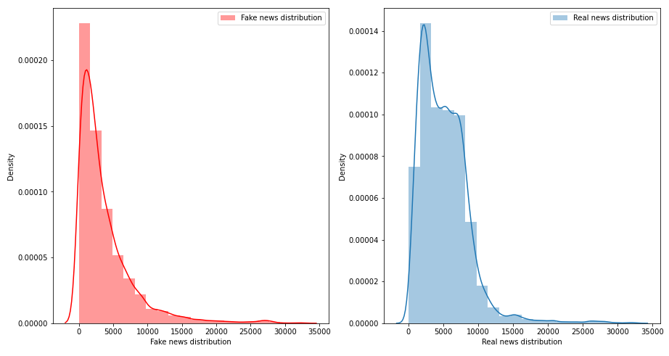

Slide 37
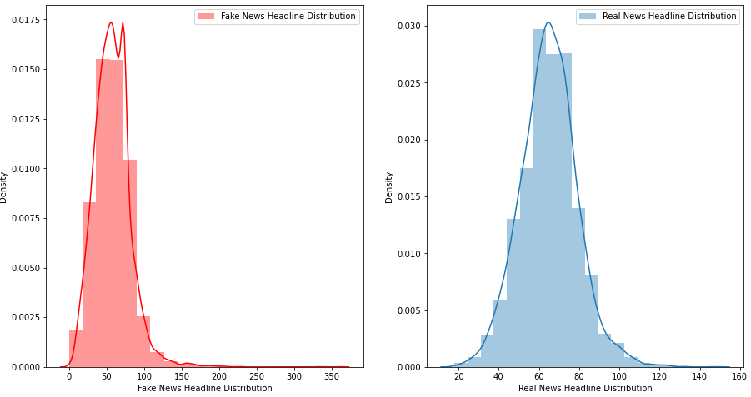

Slide 38
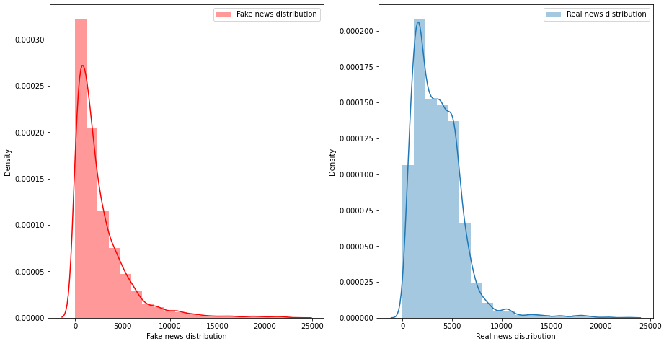

Slide 39
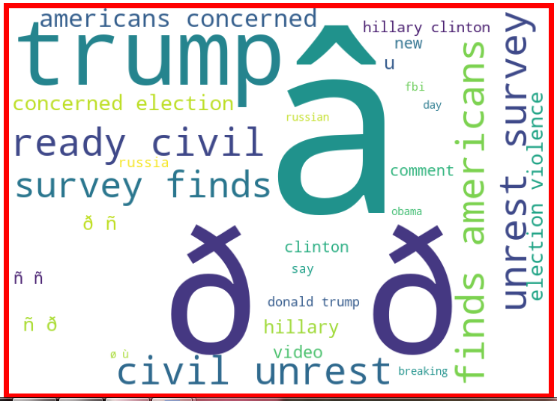
Creating WordCloud

Slide 40


Slide 41
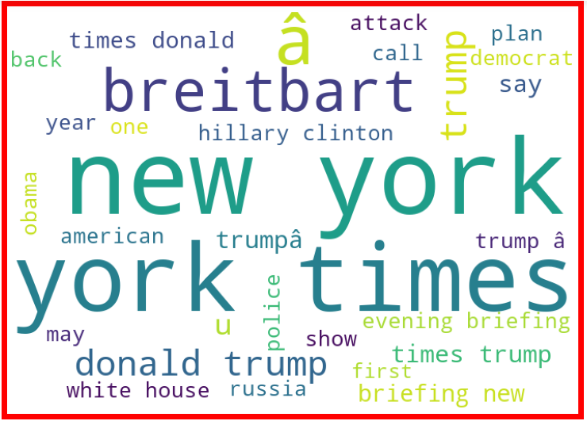

Slide 42
