Slide 1
Housing Project
Submitted by Sourav Chaudhury

Slide 2
Problem Statement
A US-based housing company named Surprise Housing has decided to enter the Australian market. The company uses data analytics to purchase houses at a price below their actual values and flip them at a higher price. For the same purpose, the company has collected a data set from the sale of houses in Australia.
The company is looking at prospective properties to buy houses to enter the market. We are required to build a model using Machine Learning in order to predict the actual value of the prospective properties and decide whether to invest in them or not. For this company wants to know:
Which variables are important to predict the price of variable?
How do these variables describe the price of the house?

Slide 3
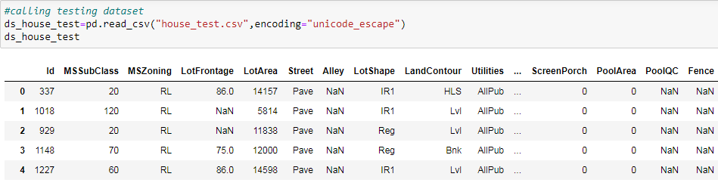
Data Files
Two datasets are provided
Training and Testing dataset.
The training dataset is to train the model and testing is for predicting the results.
Both the datasets are in csv formats.

Slide 4
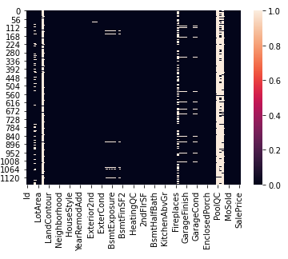
Data Preprocessing
The preprocessing started with removing Null values.
There are total of 19 columns which contains null values.
Null Values are replaced by using Mean and Mode strategies.
Numeric data replaced by mean and categorical data replaced by mode.

Slide 5
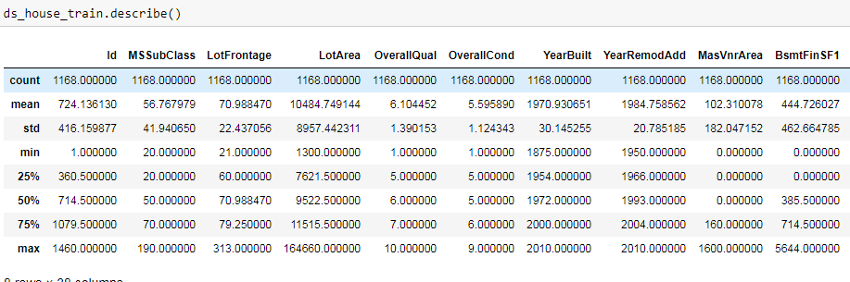
Descriptive Statistics
Descriptive statistics are laid down to describe different statistical inferences from the data.
The statistical inferences includes mean, median, mode, count, percentile minimum and maximum.

Slide 6
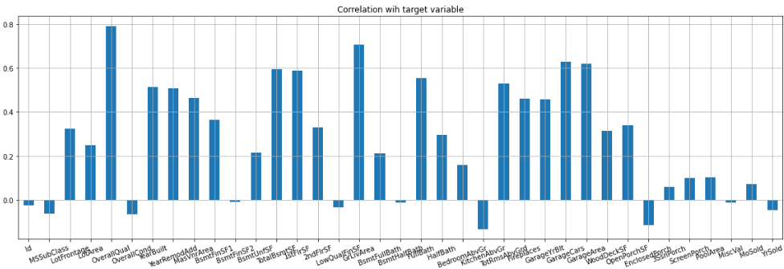
Plotting Correlation
Correlation matrix is plotted to find the correlation coefficient of variables with one another.
A correlation graph is also plotted to find the correlation of the target variable with the other variables.
The variables which showed lesser correlation with the target variable are later dropped.

Slide 7
Univariate Analysis
This is a part of exploratory data analysis or EDA.
It deals with graphically visualizing the variables of the dataset in order to find tends or insights.
Univariate analysis deals with projecting or visualizing only one variable.
Below are some univariate visualization of variables.

Slide 8
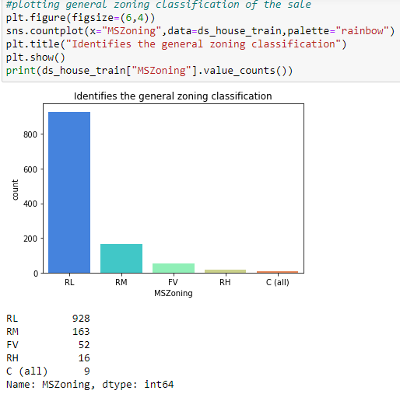

Slide 9
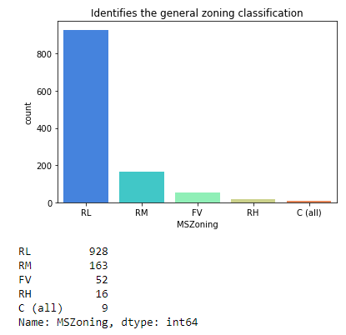

Slide 10
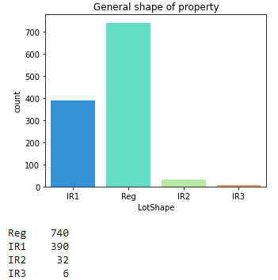

Slide 11
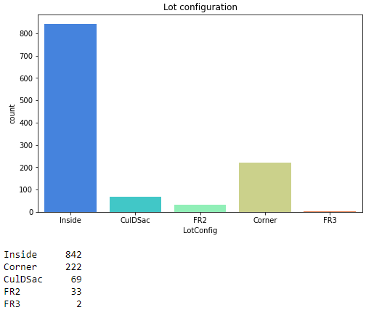

Slide 12
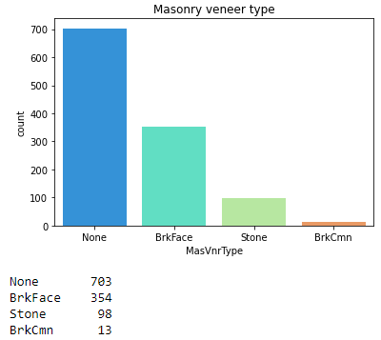

Slide 13
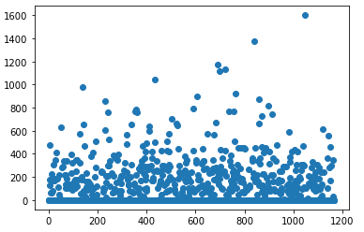

Slide 14
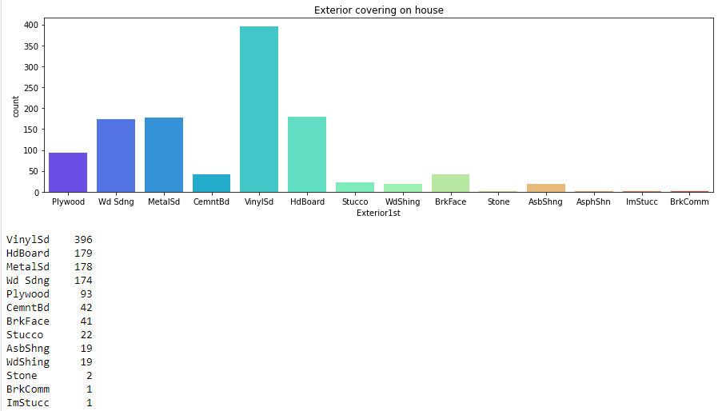

Slide 15
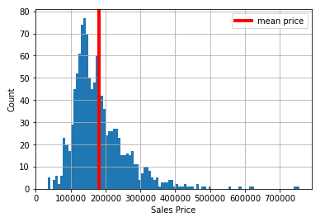

Slide 16
Bivariate Analysis
It is also a part of exploratory data analysis.
Bivariate Analysis deals with visualization of multiple variables and showing the relationship with each other.
In this study different variables are plotted against the target variable which is the price in order to find which variables has a greater say in determining the price of the houses.
Below are some of the visual representation of bivariate analysis.

Slide 17
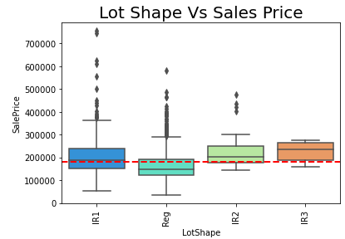

Slide 18
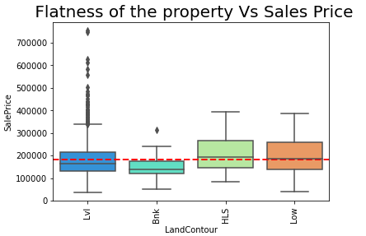

Slide 19
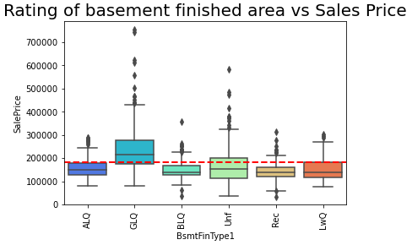

Slide 20
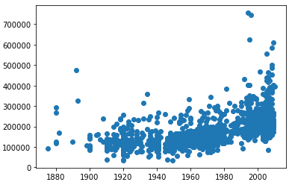

Slide 21
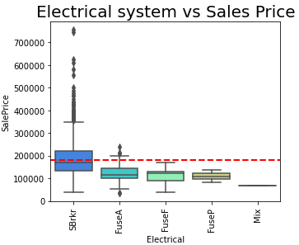

Slide 22
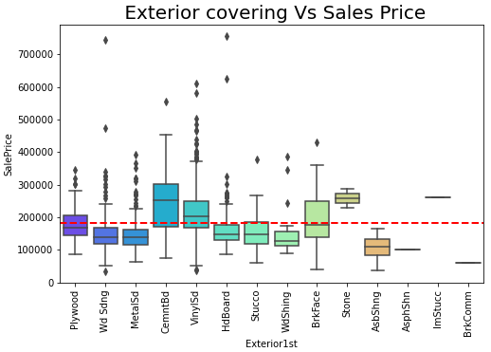

Slide 23
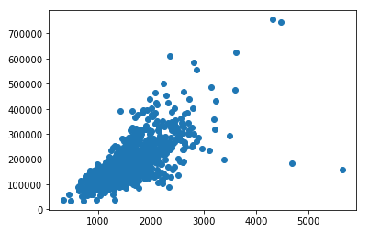

Slide 24
Plotting Outliers
Indentifying and removing outliers are an important step in making a ML model.
Presence of outliers may reduce the efficiency of the model.
We will be using z score to remove the outliers from the dataset.
Below are the outliers of the numeric columns of the dataset.

Slide 25
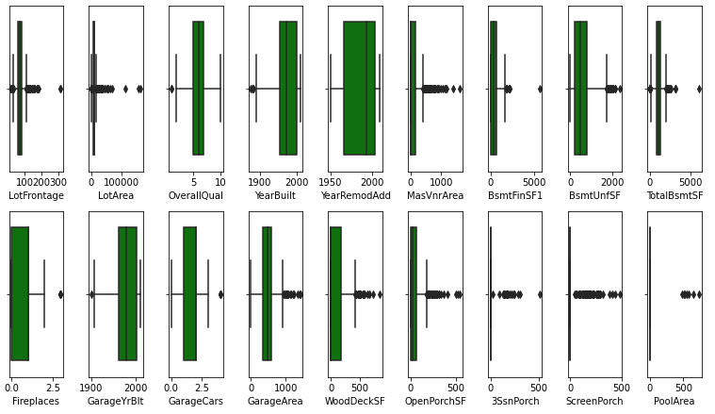

Slide 26
Checking Skewness
Skewness is a measure of the distribution of data.
It’s a measure to understand how far the data is from the normal distribution.
Data could be either right skewed or left skewed.
Skewed data reduces the effectiveness of a model so reduction in skewness helps to improve the efficiency of the model.

Slide 27
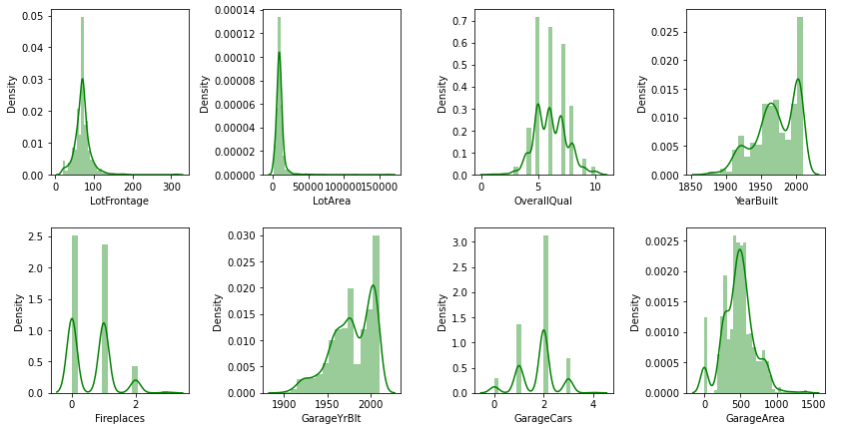
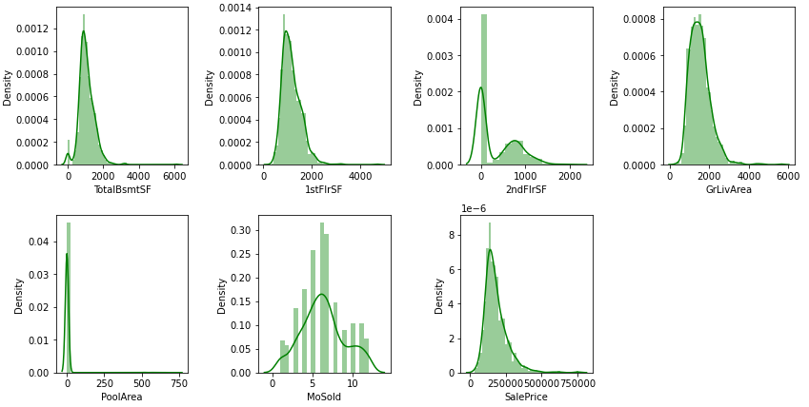

Slide 28
Label Encoding and Quantifying
ML model only understands quantitative data.
For any categorical variables while taking them into the model they have to be quantified.
Label encoding is an useful technique to quantify the categorical variables and take them into the model.

Slide 29
Modeling
Modeling starts with separating the target and input variable.
Then the training and testing data are splitted.
Different algorithms and metrics are tested to find the one with the highest accuracy.

Slide 30
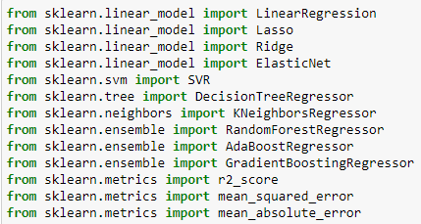
Algorithms and Metrics

Slide 31
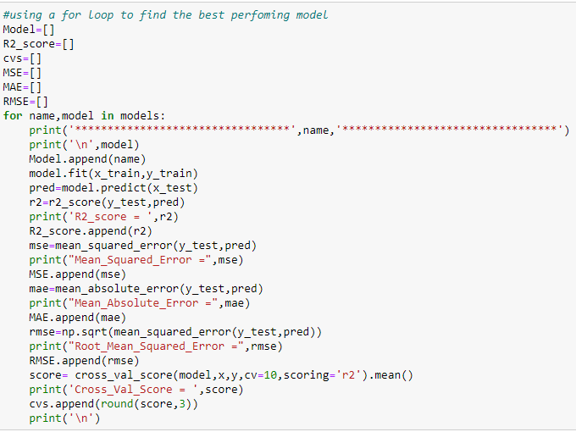
Machine Learning

Slide 32
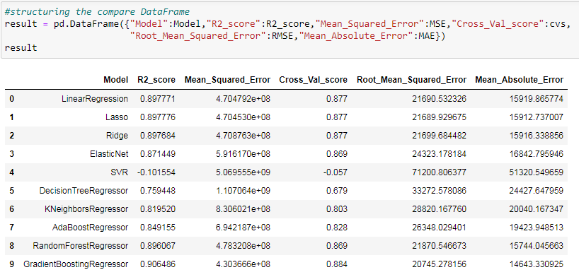
Compare Table

Slide 33
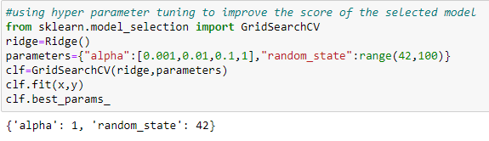
Hyper Parameter Tuning

