Slide 1
Future Work Skills
Talent in a Digitized World
Wes Sonnenreich CEO Intersective
Notes:
Write down 3 questions you have

Slide 2
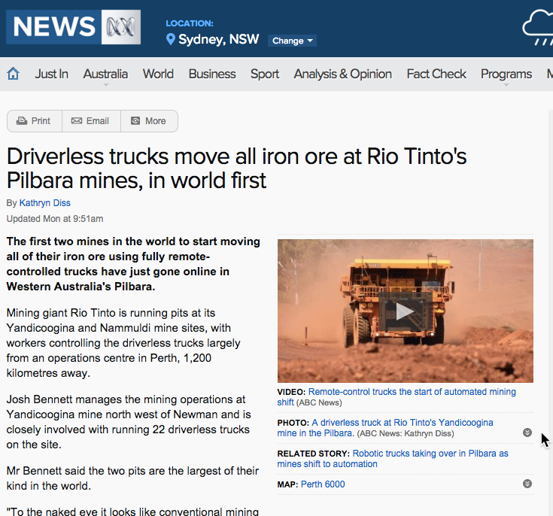
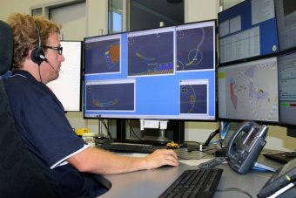
Notes:
Miner = problem solver

Slide 3
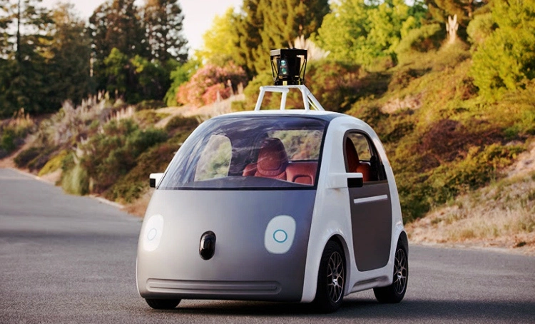
Notes:
Taxi driver = tour guide

Slide 4


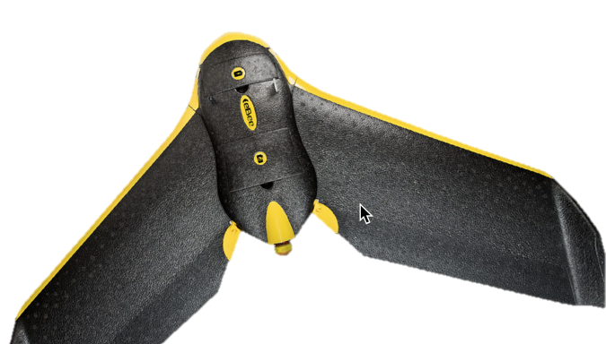
Notes:
Farmer = drone operator, data analyst

Slide 5
What will/won’t digitize?
Much Harder to Automate
Tech Can Automate
Interpersonal Tasks
Drawing Insights
Inconsistent/Variable Tasks
Creative Tasks
Abductive
Value in Process
Physical Tasks
Data Gathering & Reporting
Repetitive Tasks
Precision Tasks
Inductive/Deductive
Value in Outcome
Notes:
Oxford study: 47% of jobs today under threat from automation soon.

Slide 6
Future Jobs
Digital Curator contextual relevance
Emotive Pattern Seeker discover inspiring
Integrator connect knowledge, tech
Gap Filler arbitrage tech evolution

Slide 7
The Experiential Opportunity
Future Education
Current Education
40% How
40% Why
20% Who, What, When. Where
Learn while Doing
70%+ Who, What, When, Where
20% How
10% Why
Learn then Do
Notes:
How does it work, how did I feel, how did they feel?
Why do these things work/not work in practice?
MUCH MORE REFLECTIVE

Slide 8
Why Experiential?
Resume → Network
Credential → Narrative
Students: experiences that build networks and narratives
Employers: more value, less hassle in participation
Educators: assure quality & control costs at scale
Notes:
Scale – online, global – whereever the brand is extended
It’s not what you know… but It’s not who you know any more either… because we all know each other
But how who you know can connect and influence are important – so network QUALITY is essential
What you can do is most important…
How well do you learn from mistakes?
Can you tell a good story?
I lost $1m in the first hour of my first internship
Can you get people excited? Inspired?
Can you teach us something new? Bring in a new view point?

Slide 9
What are we doing?
Helping educators increase the amount of experiential learning
Helping employers get more value out of participation
Using technology to enable scale

Slide 10
Thankyou
Wes Sonnenreich
CEO, intersective
wes@intersective.com
+61 410 366 289

Slide 11
The Additive Value of Employability Skills
Leadership
Entrepreneurship
UX
Value Adding
Pattern Seeking
Project Management
Multi-cultural relations, virtual collaboration
Digital Savvy (Creation and Consumption)
Teamwork, Communication
Reflection, Goal Achieving, Resilience
Creativity, Structured problem solving, Scientific method

