Slide 1

WIL it scale?
Contextualized Business Education
@ Scale
some MILC with your MOOC?
(Massive Integrated Learning Courses)
Wes Sonnenreich
CEO, intersective

Slide 2

My first “Work Experience”
Was supposed to “support” i-bankers
Instead I...
Worked 100 hr weeks on a software system
Didn’t engage with the team that hired me
Missed the point of the “experience” entirely
Nearly got arrested!
Learned more about success in the workplace from that “failure” than from any uni course

Slide 3
WIL @ Scale Today
why I’m here...

Slide 4






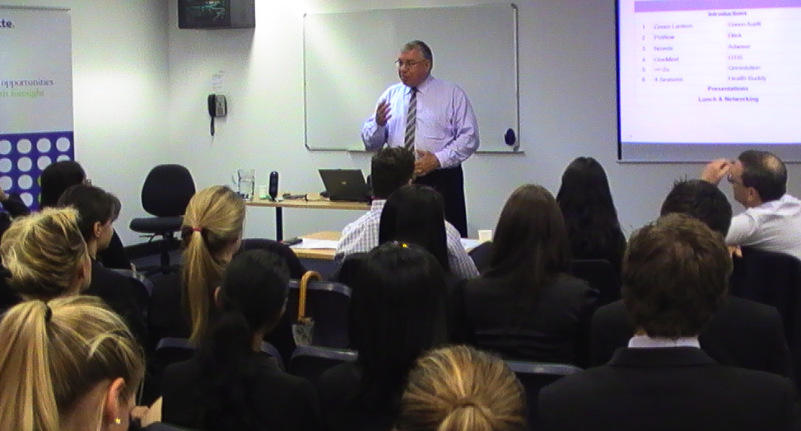
Approaching 1000 students/year
We’re looking to add 0’s
Top student rankings, employment outcomes
Driven by industry – Deloitte, major employer
Developed by the innovation program
More industry partners coming on board
5 Universities and growing ...

Slide 5
WIL @ Scale is...
Not common today
Examples like FASTRACK few and far between
Highly desired
Large student, industry demand
Going to happen soon
Same tech/economic drivers as MOOCs
Via new business & delivery models
Unis can’t keep doing what they’re doing

Slide 6
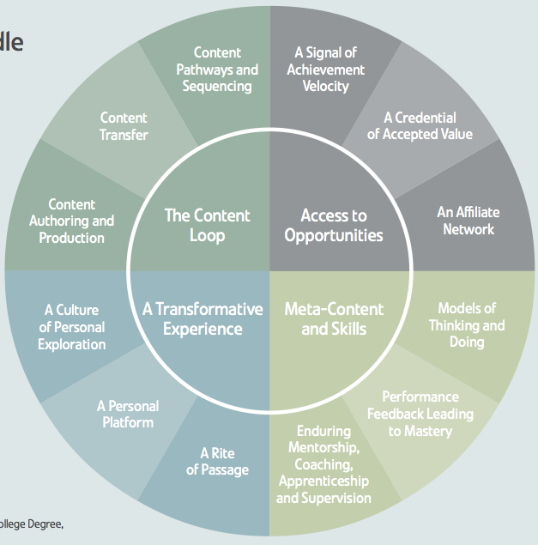

Slide 7
Why go to Uni?
Disruptable, weaker value
To learn how to learn
Foundation knowledge
Access to research
Piece of paper
Party
Defensible, strong value
Premium brand
Deeper connectivity
Social network
Industry access
Contextualized learning

Slide 8
The contextual learning opportunity
Tighter industry connectivity
More employable students
Quickly align business skill needs and curriculum
Applied research & linkages
Big draw card for students
Access to a (local) industry network
Personal story building
Non “academic” feedback that is personally transformative
Notes:
Griffith & Deloitte Fastrack outcomes

Slide 9
WIL is often WwRL
The learning is rarely designed into the work
Reflection is needed to retrospectively determine if theory was actually applied
Hard enough ensuring the work is meaningful; actually ensuring opportunities for applied theory?
Fundamentally different approach needed if the goal is to deliver on “INTEGRATED”

Slide 10
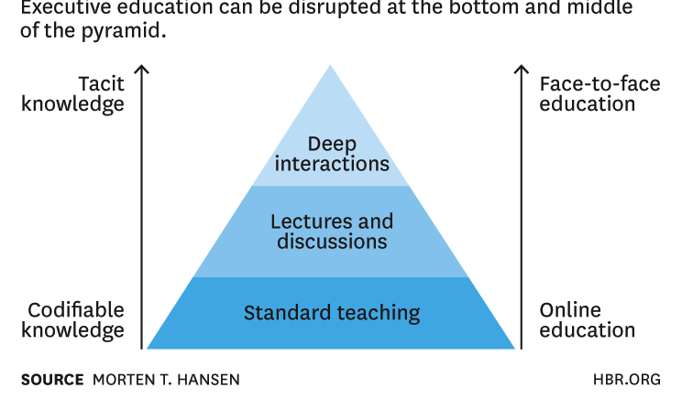
PYRAMID of KNOWLEDGE TYPE and EDUCATION FORMAT
Online Education (inc. MOOCs) are disrupting the bottom and middle...
But what about the top?
WIL

Slide 11
Context, Facilitation, Content
Businesses need to set the context
Not every context is appropriate or will scale
Facilitation is a specialty skill
Neither business mentors nor academics are automatically good at this without training
Content is “easy” – it’s everywhere
But linking it to the context is hard
requires excellence in instructional design

Slide 12
How to scale?
University & Industry relationship
Pilot-Co-Pilot
Not Pilot-Passenger or worse... Pilot-Cargo!
Needs a “middleman” to broker
Get the economics right
Technology needs to streamline admin burden
Great instructional design
Lots of experiments happening – need to collate

Slide 13
What we’re doing
WIL programs for nearly 1000 students/year
Costs unis less than a regular course
Top outcomes without eating up top academics time
Up Next: Serious Games, ASX Growth in Asian Century
We’re building a platform that can sit alongside the MOOCs
Industry bring context
Experts (Academic, Industry) bring content
Instructional designers create great experiences
We make the interfaces transparent and seamless

Slide 14
Summary
Contextual Business Education / WIL is...
Highly valued by students
Highly valued by employers
Not scalable under existing models
Tech/economic forces driving MOOCs apply
Greater global demand, focus on core value
Watch for new business models

Slide 15
Thankyou
wes@intersective.com
learning experiences that work

