Slide 1
Is your computer being used by hackers? Secure servers and cyber attacks
The Resolute Mean

Slide 2
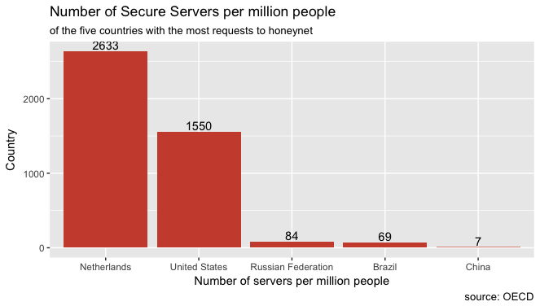
Server Security & Cyber Activity
Histogram: number of secure servers
NL: small number of unique IP addresses, relatively large number of attacks

Slide 3
Cyber Activity across Countries

