Slide 1
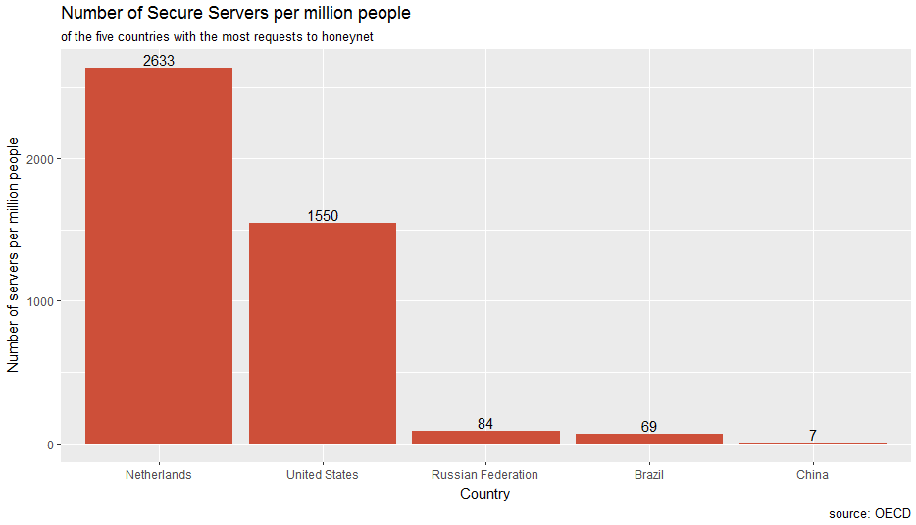
Are hackers using your computer? Secure servers and cyber attacks
The Resolute Mean
Notes:
Talking points:
For DDOS attacks, hackers use a virus to gain control over other computers, using those computers (and their IP addresses) in attacks.
We hypothesise that countries with more secure servers are better protected against these viruses, and therefore their share of IP addresses will not increase (much) during a DDOS attack.
The five countries from which the most attacking IP addresses come from are Russia, the US, China, Brazil, and the Netherlands (excluding Germany, because it distorts the data, and Korea, because we don’t have data on their secure servers)

Slide 2
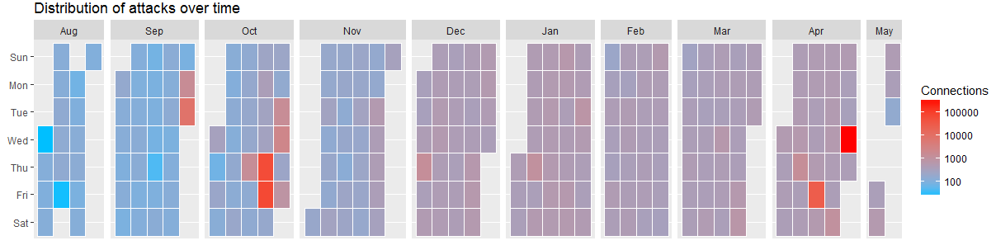
Cyber Activity
Heat calendar indicates two peaks in the number of connections in October 2014 and April 2015
Hypothesis: the shares of Russian, Chinese and Brazilian IP addresses will increase during a DDOS attack, but the shares of Dutch and American IP addresses will not increase much
Notes:
Talking points
We created a heat map showing the concentration of attacks over time. The heat map shows an increasing number of attacks over time, and two peaks in October and April. These peaks are potentially DDOS attacks.
We expect that the countries with the most secure servers (the Netherlands and the United States) will be underrepresented during DDOS attacks.

Slide 3
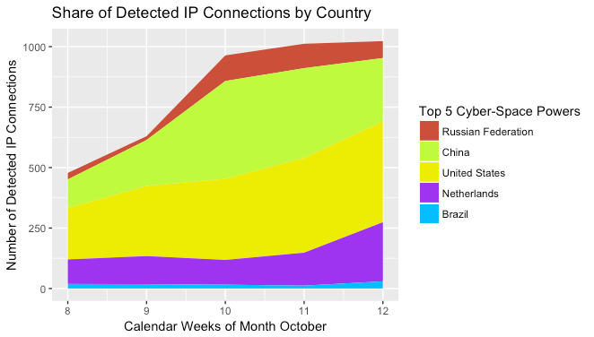
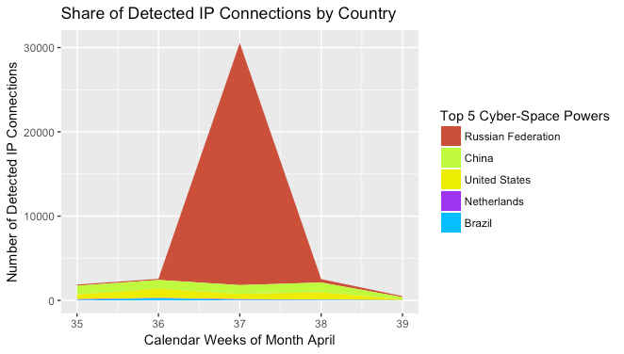
Cyber Activity across Top 5 Countries
April peak: share of Russia increases, other countries‘ shares remain approximately the same
October peak: shares of Russia and China increase, other countries‘ shares remain approximately the same
Notes:
Talking points
Use area plot to zoom in on peaks
Results April: the share of especially Russia increases, the share of the other countries remains approximately equal
Results October: the shares of China and Russia increase, the shares of the other countries remain approximately equal
Conclusion: having less server security is correlated with the use of that country’s IP addresses in DDOS attacks

