Slide 1
Is your computer being used by hackers? Secure servers and cyber attacks
The Resolute Mean

Slide 2
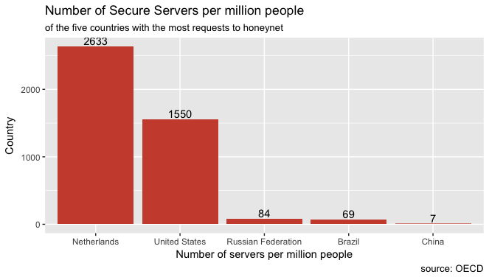
Server Security & Cyber Activity
Make heatmap nicer
Include nice story text/bullet points
Adjust colors to uniform coloring of graphics (e.g. nice blue scales or something)
Order graphics and text nicely on the slides
Maybe include background color on slides?
Histogram: number of secure servers
NL: small number of unique IP addresses, relatively large number of attacks
Focus on: Netherlands, United States, Russia, Brazil and China -> Countries with most originated IP adresses in the data

Slide 3
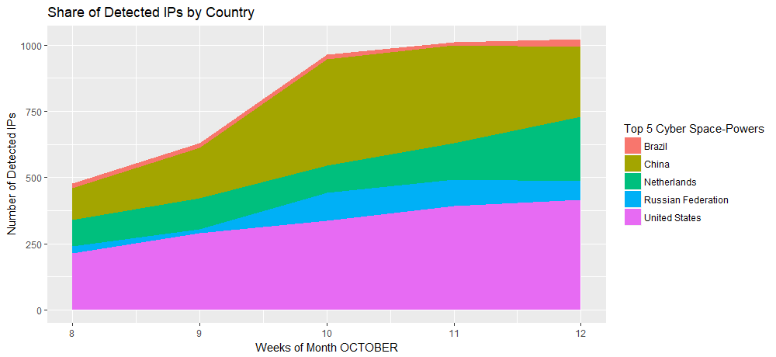
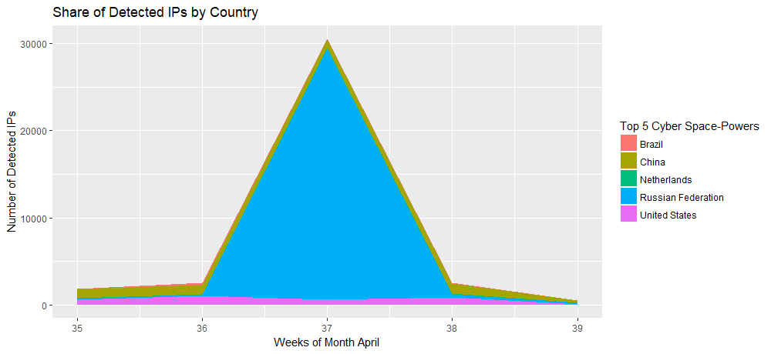
Cyber Activity across Top 5 Countries

