Slide 1
Jev and the Decision Kernel
When AI Stops Talking
A CometCloud Research Note
Seth (Sabastian Bath) · Looloomi · CometCloud AI
2026-09-18

Slide 2
Agenda
▸ What Jev is — and isn't
▸ The API: three primitives (Choice, Score, Noul)
▸ Architecture: non-autoregressive single forward pass
▸ Training: RLCD — what we know and don't
▸ Performance: latency, cost, accuracy
▸ Five substantive critiques + practitioner voices
▸ Where Jev fits — A / B / C roles
▸ What Jev doesn't replace (Observe / Judge / Reason / Act)
▸ The Doom demo — what it does and doesn't show
▸ Outlook: what to watch in the next 90 days
CometCloud Research Note · Jev and the Decision Kernel · 2026-09-18
2 / 14

Slide 3
What Jev Is — and Isn't
System One Model — Kahneman's "fast, parallel, calibrated" cognitive layer.
▸ Released 2026-09-15 by TypeSafe AI — $40M from stealth
▸ Diogo Almeida (co-author of InstructGPT/RLHF) — 2 years in stealth
▸ Cannot write articles, generate code, or explain itself — by design
▸ Returns typed decisions + probabilities. Code owns execution and policy.
▸ Architectural thesis: language generation may be the wrong interface
▸ between models and software
Launch reached 4.21M views / 19.9K likes on announcement post.
CometCloud Research Note · Jev and the Decision Kernel · 2026-09-18
3 / 14

Slide 4
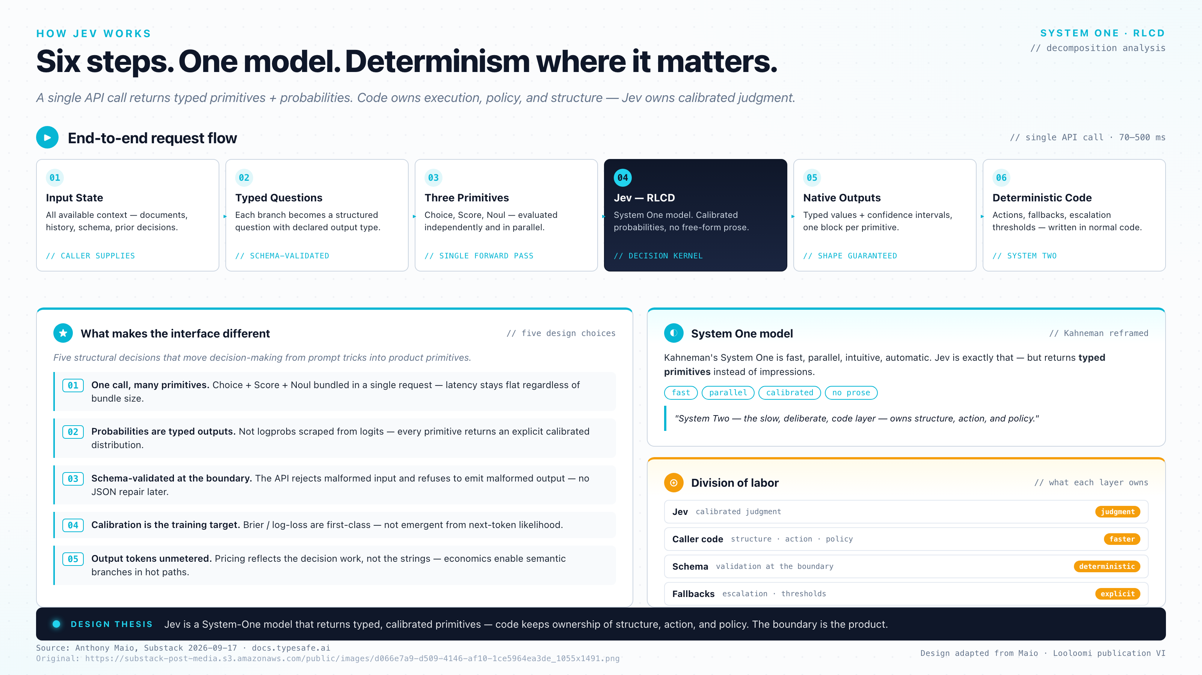
The API Surface: Three Primitives
▸ Choice — pick from declared options + probs
▸ Score — ordered levels + continuous score + dist
▸ Noul — binary proposition + probability true
▸ All three bundle in ONE call, evaluated in parallel
▸ Latency 70–500ms regardless of how many primitives
CometCloud Research Note · Jev and the Decision Kernel · 2026-09-18
4 / 14

Slide 5
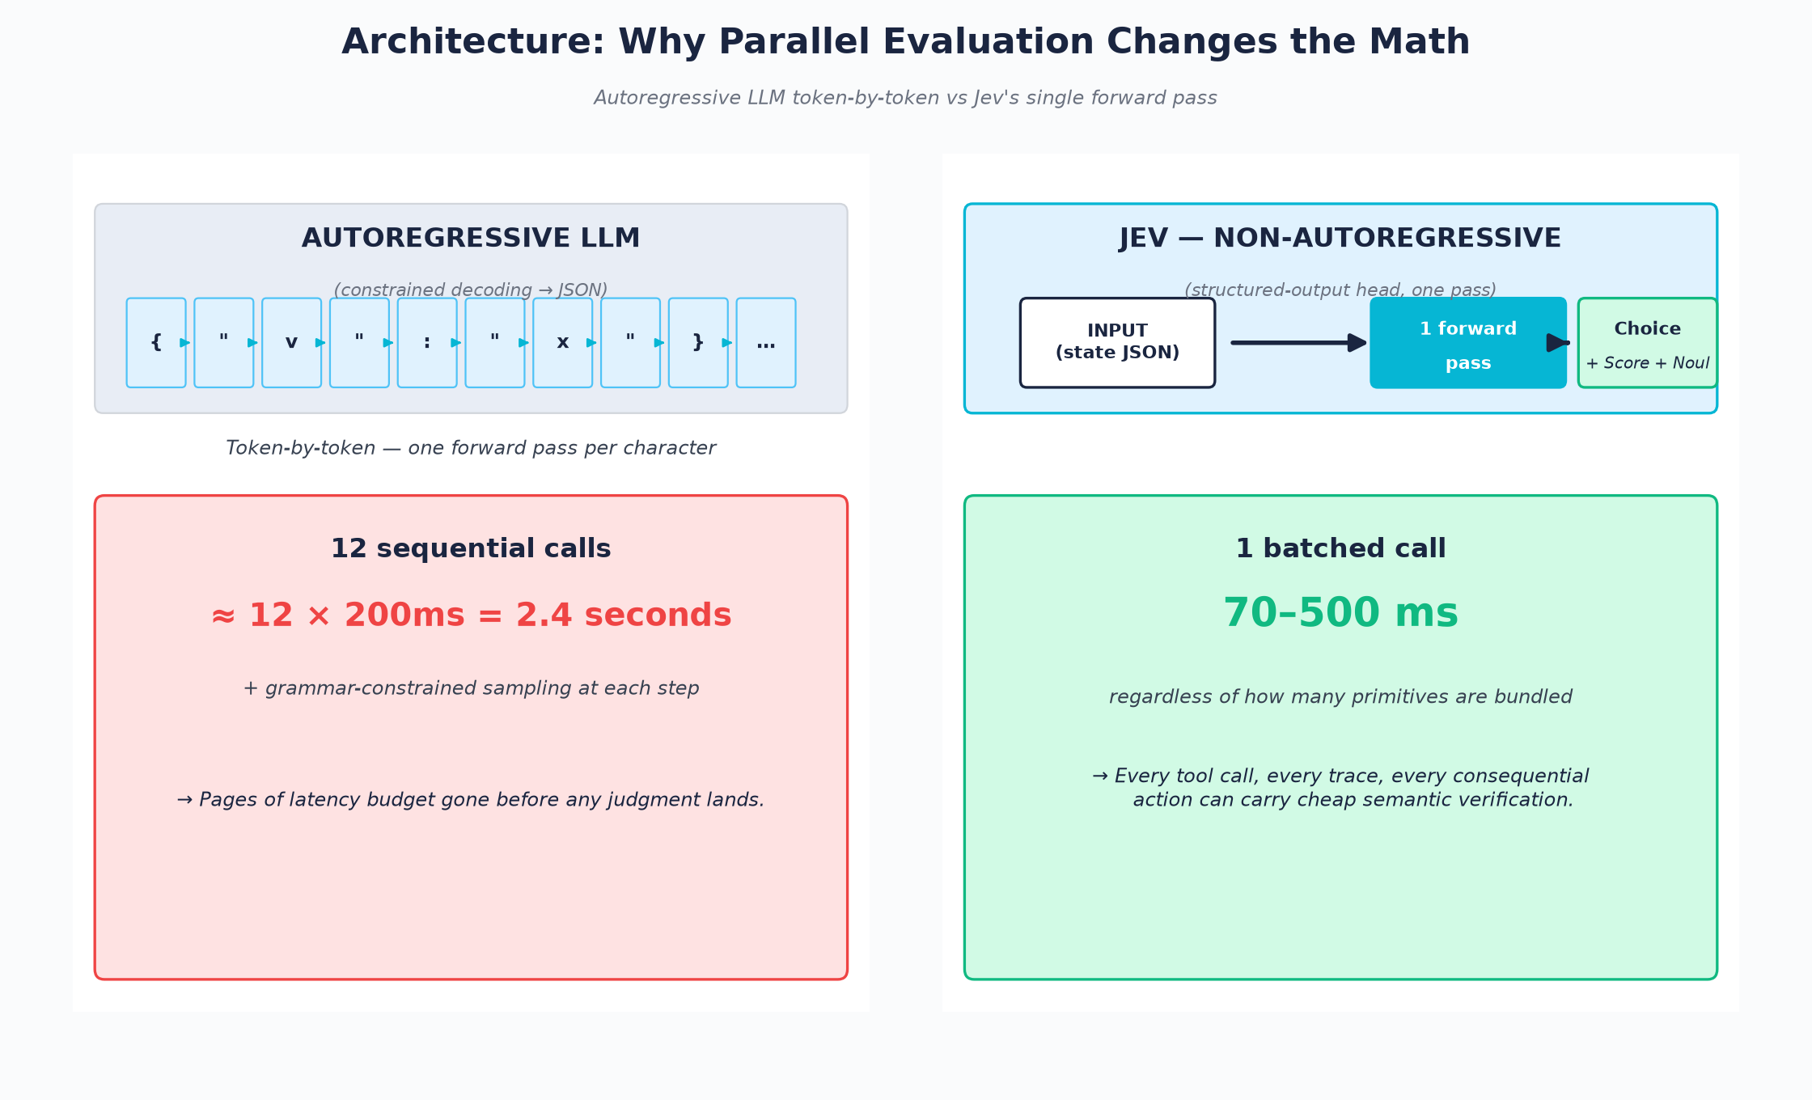
Architecture: Non-Autoregressive Single Pass
CometCloud Research Note · Jev and the Decision Kernel · 2026-09-18
5 / 14

Slide 6
Training: RLCD
Reinforcement Learning for Calibrated Decisions
▸ Trained end-to-end for calibration, not for text likelihood
▸ Reward shape (per HN porridgeraisin 49738448): heavily negative-reward a {yes: 0.9, no: 0.1} when truth is no
▸ Distinguished from RLVR — RLVR upweights any token in a correct trace; RLCD shapes the distribution itself
What TypeSafe has NOT published: reward function, training data, model size, architecture parameters, or independent reproduction.
→ A model whose primary metric is calibration has not had its calibration methodology independently audited. Load-bearing caveat for any production use.
CometCloud Research Note · Jev and the Decision Kernel · 2026-09-18
6 / 14

Slide 7
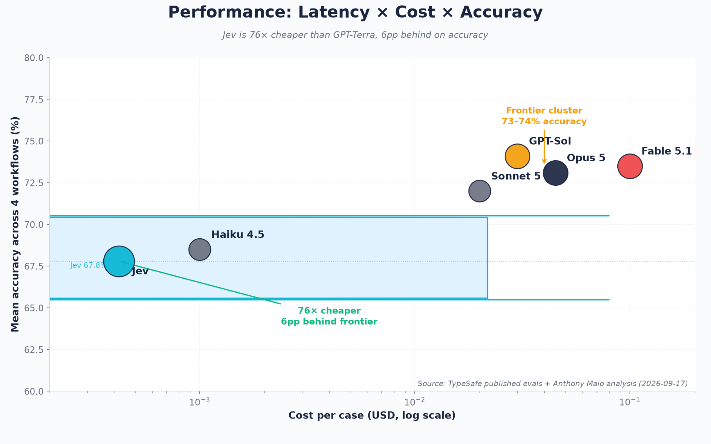
Performance: Latency × Cost × Accuracy
CometCloud Research Note · Jev and the Decision Kernel · 2026-09-18
7 / 14

Slide 8
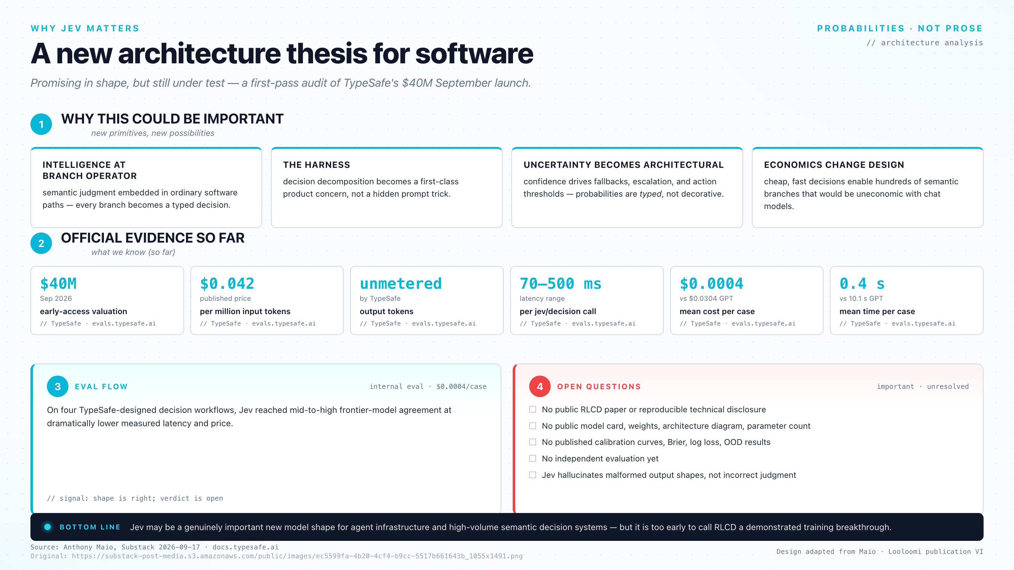
Performance: Accuracy Gap
CometCloud Research Note · Jev and the Decision Kernel · 2026-09-18
8 / 14

Slide 9
Five Substantive Critiques
▸ 1. Accuracy gap is real — 6pp behind frontier avg; 17pp on invoice processing
▸ 2. Calibration is population-level, not per-decision — 8note (HN 49720537)
▸ 3. Composition hazard — 0.85¹² = 0.14; no published composition guarantees
▸ 4. Opacity — probability-only; thduabmd (HN 49720703): "approve for unauthorized action still meets schema guarantee"
▸ 5. Threshold coupling — model updates silently shift your escalation rate
These critiques do not invalidate Jev — they bound its use. The HN thread converged on a single open question: per-decision calibration. elil17 (49724192): "If the value is 0.9 for 1000 different answers, then approximately 900 of those answers should be correct."
CometCloud Research Note · Jev and the Decision Kernel · 2026-09-18
9 / 14

Slide 10
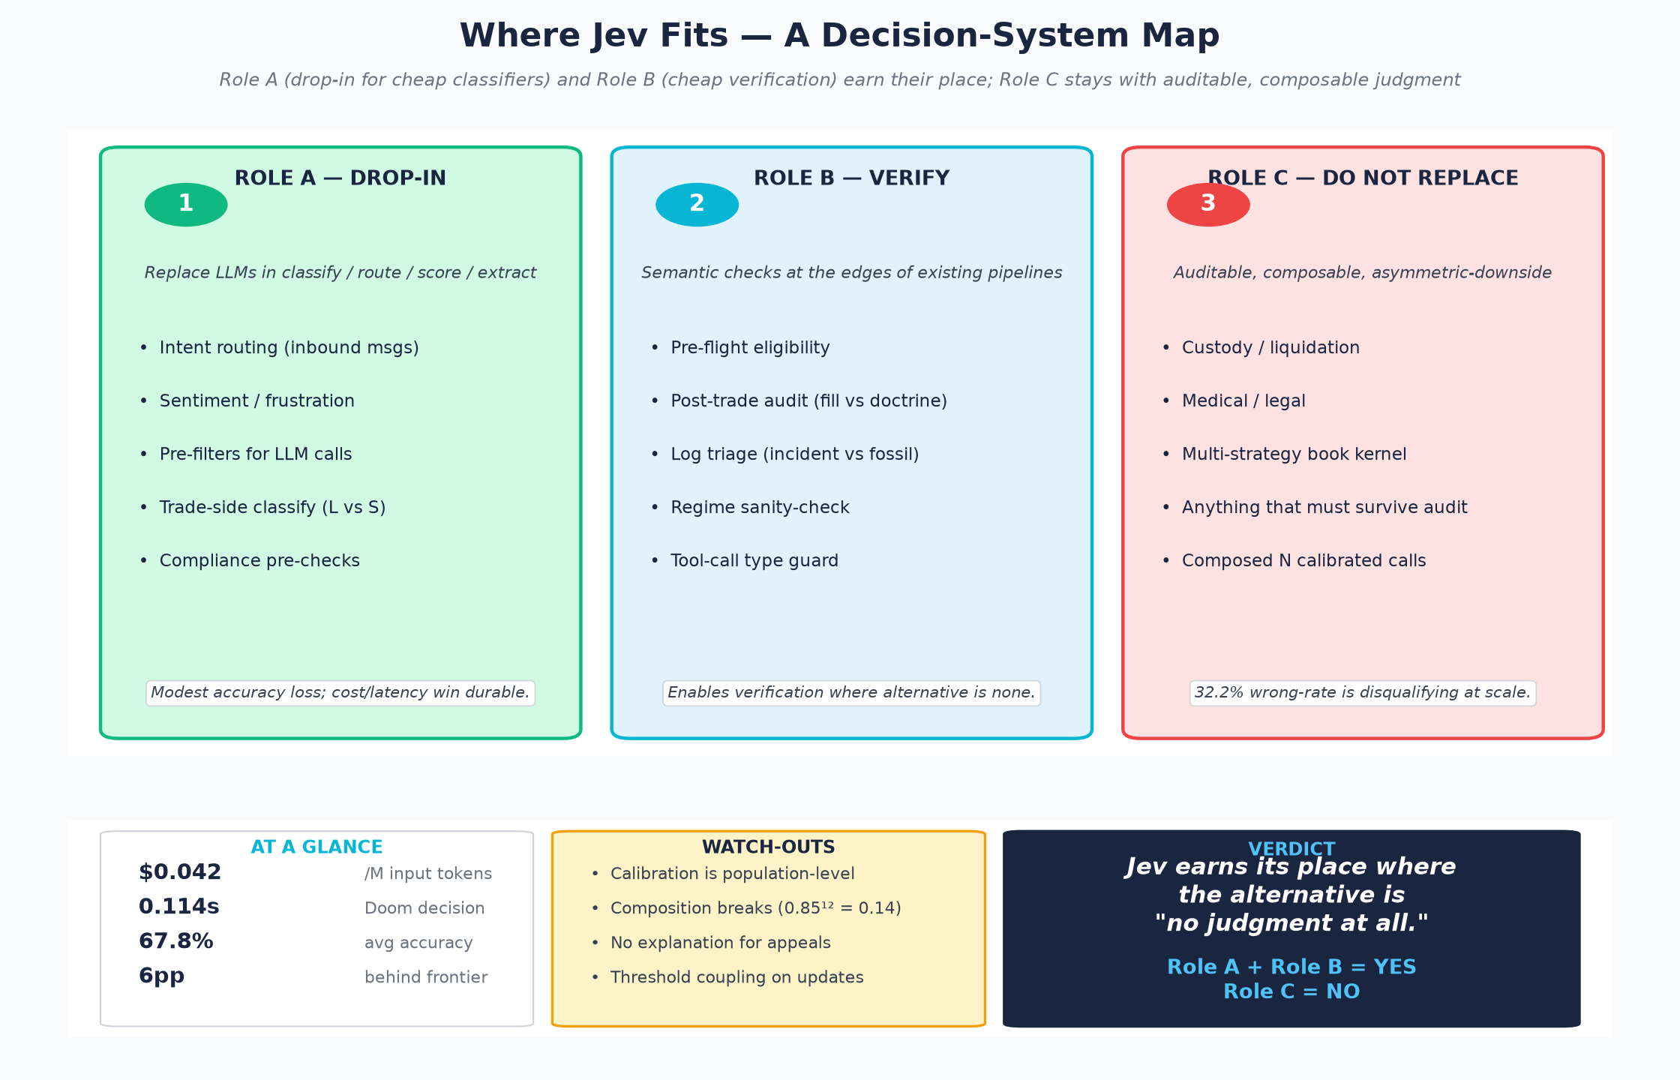
Where Jev Fits: A Decision-System Map
CometCloud Research Note · Jev and the Decision Kernel · 2026-09-18
10 / 14

Slide 11
What Jev Doesn't Replace
▸ Auditable judgment — institutions require a reason that survives review
▸ Composable strategy books — calibration does NOT propagate across composition
▸ Decisions with asymmetric downside — 32.2% wrong-rate unacceptable when stakes are large
▸ Open methodology — RLCD is unpublished; black box with a calibration claim
OBSERVE / JUDGE / REASON / ACT
Code calculates. Jev judges. LLMs reason/create. Humans determine objectives & risk.
Jev = judgment layer between raw application state and deterministic action.
Mistake to avoid: ask any one layer to do another's job.
CometCloud Research Note · Jev and the Decision Kernel · 2026-09-18
11 / 14

Slide 12
The Doom Demo — What It Does and Doesn't Show
WHAT IT SHOWS
HONEST FRAMING
Latency proof point:
• Jev: 0.114 s/frame
• GPT-5.6 Terra: 8.566 s/frame
• 75× faster; ~$7/hour vs ~$525/hour
• Real-time control-loop capable
The Doom demo is a latency proof point, not a general
embodied-agent proof point.
For institutional use:
• Jev is fast enough to live inside real-time control
loops, GIVEN that some other system does perception.
• This bounds Role B: Jev judges state that System 2
already produced. Jev does not produce state.
WHAT IT DOESN'T SHOW
• No perception — text-state dump, not pixels
(bigglebear HN 49720680)
• Hard-coded action space — pre-defined menu
• Depends on game engine doing perception work
• Not a general embodied-agent proof point
CometCloud Research Note · Jev and the Decision Kernel · 2026-09-18
12 / 14

Slide 13
Outlook: What to Watch in 90 Days
▸ Independent benchmarks on neutral tasks — is 67.8% vs 73–74% real or workflow-bias?
▸ Per-decision calibration data — does 0.83 confidence predict 83% correctness? (elil17)
▸ Pricing stability — $0.042/M is early-access; sustainable serving cost unknown
▸ Composition research — anyone publishing how to compose N calibrated calls?
▸ Open-source replication — single-pass inference may be replicable on small open models
▸ Adoption pattern — first 100 production deployments: support/routing or core paths?
CometCloud Research Note · Jev and the Decision Kernel · 2026-09-18
13 / 14

Slide 14
Closing · References
The Kahneman framing is finally operational.
System 1 is real. It is fast. It is cheap.
It is also less accurate, and we should know when to use it.
▸ Maio — "Jev: The Language Model That Won't Talk" — Substack 2026-09-17
▸ The Register — "TypeSafe AI debuts model for machines that plays Doom" — 2026-09-16
▸ Goedecke — "Jev means structured output is interesting again" — sean.goedecke.com
▸ kingy.ai — "TypeSafe Jev Review: Key Takeaways" — 711 cases independently tabulated
▸ HN thread (49717558) — 456 comments, item 49720537 / 49721843 / 49738448
▸ Every.to — "Mini-Vibe Check: TypeSafe's Jev Judged Everything ..." — 2026-09-16
▸ Burnhill — Jev reference notes (GitHub Gist)
▸ TypeSafe AI — typesafe.ai/blog + docs.typesafe.ai + evals.typesafe.ai
▸ Almeida (Diogo) — LinkedIn launch post 2026-09-15
CometCloud Research Note · Jev and the Decision Kernel · 2026-09-18
14 / 14

