Slide 1
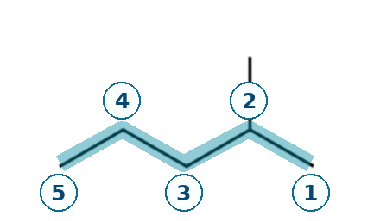
BICOL UNIVERSITY / COLLEGE OF ENGINEERING / CHEM 13
CARD A01 — STRUCTURE → NAME
FOUNDATION • Molecular formula: C6H14 • Structure from instructor PDF
01 / NUMBERED PARENT
02 / NAMING TRAIL
PARENT
5-carbon chain → pentane
PARENT
NUMBERING
NUMBERING
From left: methyl C4; from right: C2. Choose C2.
SUBSTITUENTS
One methyl at C2.
SUBSTITUENTS
FOCUS Find longest chain; number from end nearest branch.
03 / WORKED IUPAC NAME (VERIFY WITH YOUR OWN TRAIL)
04 / THE ALKANE CHECK
2-methylpentane
EXPECTED IUPAC NAME: 2-methylpentane
The Alkane result: NOT YET CHECKED.
Insert genuine cropped tool screenshot after rebuilding the structure.
✓ parent checked ✓ locants checked ✓ formula counted ✓ name punctuated □ website check pending
WORKED SOLUTION FOR STUDY • GENUINE THE ALKANE CHECK STILL REQUIRED
01 / 20

Slide 2
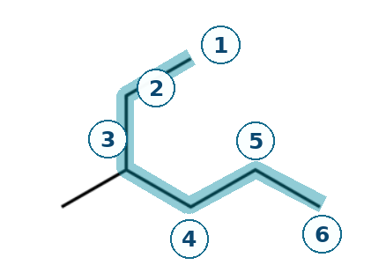
BICOL UNIVERSITY / COLLEGE OF ENGINEERING / CHEM 13
CARD A02 — STRUCTURE → NAME
FOUNDATION • Molecular formula: C7H16 • Structure from instructor PDF
01 / NUMBERED PARENT
02 / NAMING TRAIL
PARENT
6-carbon bent chain → hexane
PARENT
NUMBERING
NUMBERING
From upper end: C3; from right end: C4. Choose C3.
SUBSTITUENTS
One methyl at C3.
SUBSTITUENTS
FOCUS Longest chain bends; do not assume the horizontal line is longest.
03 / WORKED IUPAC NAME (VERIFY WITH YOUR OWN TRAIL)
04 / THE ALKANE CHECK
3-methylhexane
EXPECTED IUPAC NAME: 3-methylhexane
The Alkane result: NOT YET CHECKED.
Insert genuine cropped tool screenshot after rebuilding the structure.
✓ parent checked ✓ locants checked ✓ formula counted ✓ name punctuated □ website check pending
WORKED SOLUTION FOR STUDY • GENUINE THE ALKANE CHECK STILL REQUIRED
02 / 20

Slide 3
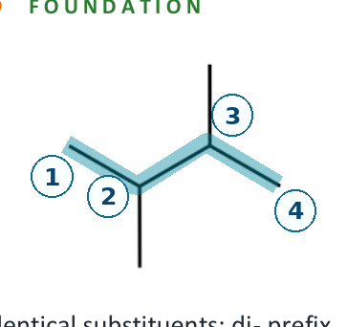
BICOL UNIVERSITY / COLLEGE OF ENGINEERING / CHEM 13
CARD A03 — STRUCTURE → NAME
FOUNDATION • Molecular formula: C6H14 • Structure from instructor PDF
01 / NUMBERED PARENT
02 / NAMING TRAIL
PARENT
4-carbon chain → butane
PARENT
NUMBERING
NUMBERING
Both directions give 2,3 (a symmetry tie).
SUBSTITUENTS
Methyl at C2 and C3; use the di- prefix.
SUBSTITUENTS
FOCUS Use di- and include both locants.
03 / WORKED IUPAC NAME (VERIFY WITH YOUR OWN TRAIL)
04 / THE ALKANE CHECK
2,3-dimethylbutane
EXPECTED IUPAC NAME: 2,3-dimethylbutane
The Alkane result: NOT YET CHECKED.
Insert genuine cropped tool screenshot after rebuilding the structure.
✓ parent checked ✓ locants checked ✓ formula counted ✓ name punctuated □ website check pending
WORKED SOLUTION FOR STUDY • GENUINE THE ALKANE CHECK STILL REQUIRED
03 / 20

Slide 4
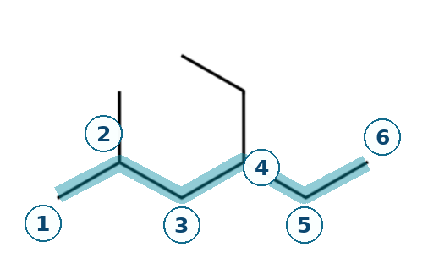
BICOL UNIVERSITY / COLLEGE OF ENGINEERING / CHEM 13
CARD A04 — STRUCTURE → NAME
DEVELOPING • Molecular formula: C9H20 • Structure from instructor PDF
01 / NUMBERED PARENT
02 / NAMING TRAIL
PARENT
6-carbon chain → hexane
PARENT
NUMBERING
NUMBERING
Left to right: 2,4; right to left: 3,5. Choose 2,4.
SUBSTITUENTS
Ethyl at C4; methyl at C2 (alphabetical order).
SUBSTITUENTS
FOCUS Alphabetical citation order does not follow locant order.
03 / WORKED IUPAC NAME (VERIFY WITH YOUR OWN TRAIL)
04 / THE ALKANE CHECK
4-ethyl-2-methylhexane
EXPECTED IUPAC NAME: 4-ethyl-2-methylhexane
The Alkane result: NOT YET CHECKED.
Insert genuine cropped tool screenshot after rebuilding the structure.
✓ parent checked ✓ locants checked ✓ formula counted ✓ name punctuated □ website check pending
WORKED SOLUTION FOR STUDY • GENUINE THE ALKANE CHECK STILL REQUIRED
04 / 20

Slide 5
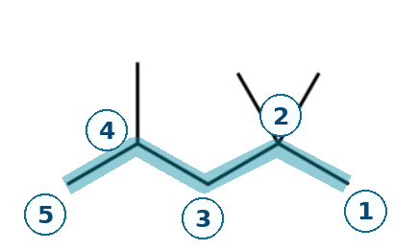
BICOL UNIVERSITY / COLLEGE OF ENGINEERING / CHEM 13
CARD A05 — STRUCTURE → NAME
DEVELOPING • Molecular formula: C8H18 • Structure from instructor PDF
01 / NUMBERED PARENT
02 / NAMING TRAIL
PARENT
5-carbon chain → pentane
PARENT
NUMBERING
NUMBERING
Left to right: 2,4,4; right to left: 2,2,4.
SUBSTITUENTS
Two methyls at C2; one methyl at C4.
SUBSTITUENTS
FOCUS Compare numbering lists at first point of difference.
03 / WORKED IUPAC NAME (VERIFY WITH YOUR OWN TRAIL)
04 / THE ALKANE CHECK
2,2,4-trimethylpentane
EXPECTED IUPAC NAME: 2,2,4-trimethylpentane
The Alkane result: NOT YET CHECKED.
Insert genuine cropped tool screenshot after rebuilding the structure.
✓ parent checked ✓ locants checked ✓ formula counted ✓ name punctuated □ website check pending
WORKED SOLUTION FOR STUDY • GENUINE THE ALKANE CHECK STILL REQUIRED
05 / 20

Slide 6
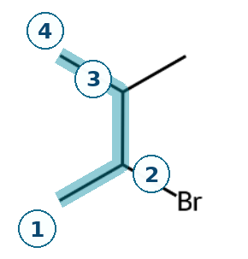
BICOL UNIVERSITY / COLLEGE OF ENGINEERING / CHEM 13
CARD A06 — STRUCTURE → NAME
DEVELOPING • Molecular formula: C5H11Br • Structure from instructor PDF
01 / NUMBERED PARENT
02 / NAMING TRAIL
PARENT
4-carbon chain → butane
PARENT
NUMBERING
NUMBERING
Both ends give 2,3; alphabetical tie: bromo gets C2.
SUBSTITUENTS
Bromo at C2; methyl at C3.
SUBSTITUENTS
FOCUS Treat the halogen as a prefix; resolve ties alphabetically.
03 / WORKED IUPAC NAME (VERIFY WITH YOUR OWN TRAIL)
04 / THE ALKANE CHECK
2-bromo-3-methylbutane
EXPECTED IUPAC NAME: 2-bromo-3-methylbutane
The Alkane result: NOT YET CHECKED.
Insert genuine cropped tool screenshot after rebuilding the structure.
✓ parent checked ✓ locants checked ✓ formula counted ✓ name punctuated □ website check pending
WORKED SOLUTION FOR STUDY • GENUINE THE ALKANE CHECK STILL REQUIRED
06 / 20

Slide 7
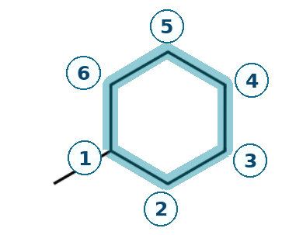
BICOL UNIVERSITY / COLLEGE OF ENGINEERING / CHEM 13
CARD A07 — STRUCTURE → NAME
DEVELOPING • Molecular formula: C7H14 • Structure from instructor PDF
01 / NUMBERED PARENT
02 / NAMING TRAIL
PARENT
6-carbon ring → cyclohexane
PARENT
NUMBERING
NUMBERING
One ring substituent: a locant is unnecessary.
SUBSTITUENTS
One methyl on the cyclohexane ring.
SUBSTITUENTS
FOCUS Use the ring as parent; a lone substituent needs no locant.
03 / WORKED IUPAC NAME (VERIFY WITH YOUR OWN TRAIL)
04 / THE ALKANE CHECK
methylcyclohexane
EXPECTED IUPAC NAME: methylcyclohexane
The Alkane result: NOT YET CHECKED.
Insert genuine cropped tool screenshot after rebuilding the structure.
✓ parent checked ✓ locants checked ✓ formula counted ✓ name punctuated □ website check pending
WORKED SOLUTION FOR STUDY • GENUINE THE ALKANE CHECK STILL REQUIRED
07 / 20

Slide 8
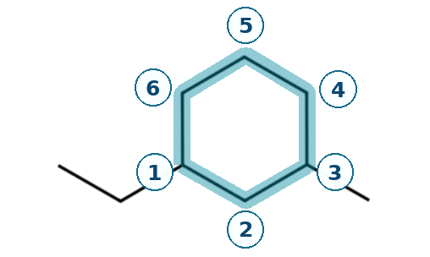
BICOL UNIVERSITY / COLLEGE OF ENGINEERING / CHEM 13
CARD A08 — STRUCTURE → NAME
CHALLENGE • Molecular formula: C9H18 • Structure from instructor PDF
01 / NUMBERED PARENT
02 / NAMING TRAIL
PARENT
6-carbon ring → cyclohexane
PARENT
NUMBERING
NUMBERING
Ethyl as C1: nearest methyl at C3 (not C5).
SUBSTITUENTS
Ethyl at C1; methyl at C3; ethyl alphabetically first.
SUBSTITUENTS
FOCUS Number in both directions, use alphabetical tie-break.
03 / WORKED IUPAC NAME (VERIFY WITH YOUR OWN TRAIL)
04 / THE ALKANE CHECK
1-ethyl-3-methylcyclohexane
EXPECTED IUPAC NAME: 1-ethyl-3-methylcyclohexane
The Alkane result: NOT YET CHECKED.
Insert genuine cropped tool screenshot after rebuilding the structure.
✓ parent checked ✓ locants checked ✓ formula counted ✓ name punctuated □ website check pending
WORKED SOLUTION FOR STUDY • GENUINE THE ALKANE CHECK STILL REQUIRED
08 / 20

Slide 9
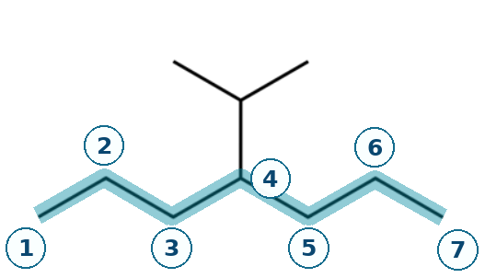
BICOL UNIVERSITY / COLLEGE OF ENGINEERING / CHEM 13
CARD A09 — STRUCTURE → NAME
CHALLENGE • Molecular formula: C10H22 • Structure from instructor PDF
01 / NUMBERED PARENT
02 / NAMING TRAIL
PARENT
7-carbon horizontal chain → heptane
PARENT
NUMBERING
NUMBERING
Either direction locates the substituent at C4.
SUBSTITUENTS
Branched (1-methylethyl) at C4; also isopropyl.
SUBSTITUENTS
FOCUS Trace longest chain through every branch point.
03 / WORKED IUPAC NAME (VERIFY WITH YOUR OWN TRAIL)
04 / THE ALKANE CHECK
4-(1-methylethyl)heptane
EXPECTED IUPAC NAME: 4-(1-methylethyl)heptane
The Alkane result: NOT YET CHECKED.
Insert genuine cropped tool screenshot after rebuilding the structure.
✓ parent checked ✓ locants checked ✓ formula counted ✓ name punctuated □ website check pending
WORKED SOLUTION FOR STUDY • GENUINE THE ALKANE CHECK STILL REQUIRED
09 / 20

Slide 10
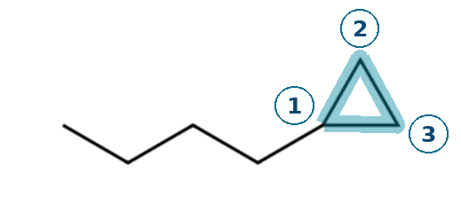
BICOL UNIVERSITY / COLLEGE OF ENGINEERING / CHEM 13
CARD A10 — STRUCTURE → NAME
CHALLENGE • Molecular formula: C7H14 • Structure from instructor PDF
01 / NUMBERED PARENT
02 / NAMING TRAIL
PARENT
3-carbon ring → cyclopropane
PARENT
NUMBERING
NUMBERING
Ring is the parent here, even beside a 4-C chain.
SUBSTITUENTS
One straight-chain butyl group; ring locant omitted.
SUBSTITUENTS
FOCUS For this activity ring takes precedence as parent.
03 / WORKED IUPAC NAME (VERIFY WITH YOUR OWN TRAIL)
04 / THE ALKANE CHECK
butylcyclopropane
EXPECTED IUPAC NAME: butylcyclopropane
The Alkane result: NOT YET CHECKED.
Insert genuine cropped tool screenshot after rebuilding the structure.
✓ parent checked ✓ locants checked ✓ formula counted ✓ name punctuated □ website check pending
WORKED SOLUTION FOR STUDY • GENUINE THE ALKANE CHECK STILL REQUIRED
10 / 20

Slide 11
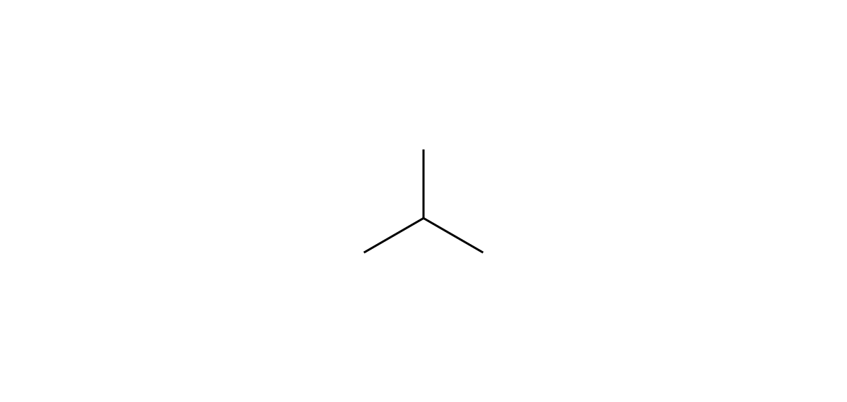
BICOL UNIVERSITY / COLLEGE OF ENGINEERING / CHEM 13
CARD B01 — NAME → STRUCTURE
FOUNDATION • Given name: 2-methylpropane
01 / NAME DECODED
02 / REFERENCE STRUCTURE • THE ALKANE SCREENSHOT NEEDED
GIVEN NAME
2-methylpropane
Parent
Propane (3 C)
Substituents
Methyl on C2
Expected formula
C4H10
03 / FORMULA CHECK + BUILD ORDER
Total carbons
3 + 1 = 4 C
Study drawing only. Recreate it in The Alkane and add your real screenshot.
Formula rule
Open chain: CnH2n+2 = C4H10
NOT a The Alkane capture | Original website check still pending
BUILD GUIDE
Draw a 3-carbon chain, then add one carbon branch to the middle carbon.
04 / BACK-CHECK
Expected: 2-methylpropane | Tool check: pending
✓ formula independently checked □ The Alkane screenshot □ tool name recorded
WORKED STRUCTURE GUIDE • REAL THE ALKANE DRAWING & SCREENSHOT STILL REQUIRED
11 / 20

Slide 12
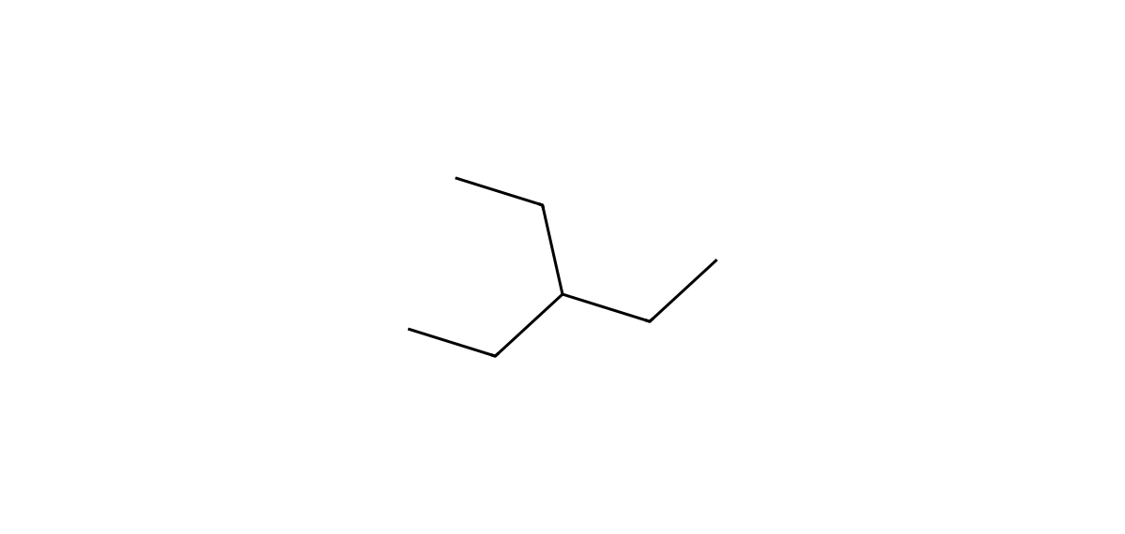
BICOL UNIVERSITY / COLLEGE OF ENGINEERING / CHEM 13
CARD B02 — NAME → STRUCTURE
FOUNDATION • Given name: 3-ethylpentane
01 / NAME DECODED
02 / REFERENCE STRUCTURE • THE ALKANE SCREENSHOT NEEDED
GIVEN NAME
3-ethylpentane
Parent
Pentane (5 C)
Substituents
Ethyl on C3
Expected formula
C7H16
03 / FORMULA CHECK + BUILD ORDER
Total carbons
5 + 2 = 7 C
Study drawing only. Recreate it in The Alkane and add your real screenshot.
Formula rule
Open chain: CnH2n+2 = C7H16
NOT a The Alkane capture | Original website check still pending
BUILD GUIDE
Draw five parent carbons and add a two-carbon branch to carbon 3.
04 / BACK-CHECK
Expected: 3-ethylpentane | Tool check: pending
✓ formula independently checked □ The Alkane screenshot □ tool name recorded
WORKED STRUCTURE GUIDE • REAL THE ALKANE DRAWING & SCREENSHOT STILL REQUIRED
12 / 20

Slide 13
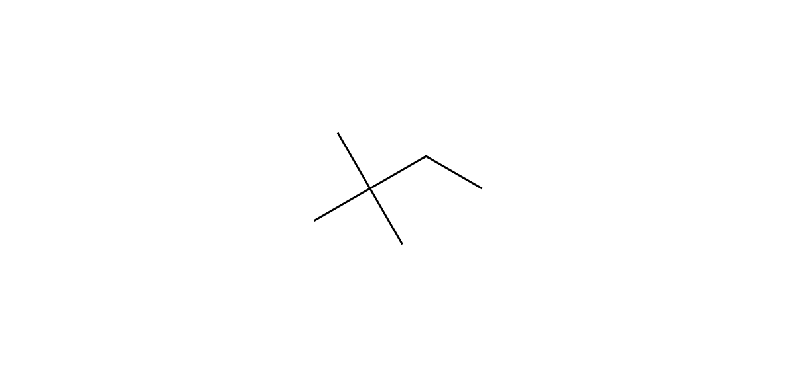
BICOL UNIVERSITY / COLLEGE OF ENGINEERING / CHEM 13
CARD B03 — NAME → STRUCTURE
FOUNDATION • Given name: 2,2-dimethylbutane
01 / NAME DECODED
02 / REFERENCE STRUCTURE • THE ALKANE SCREENSHOT NEEDED
GIVEN NAME
2,2-dimethylbutane
Parent
Butane (4 C)
Substituents
Two methyl groups on C2
Expected formula
C6H14
03 / FORMULA CHECK + BUILD ORDER
Total carbons
4 + 1 + 1 = 6 C
Study drawing only. Recreate it in The Alkane and add your real screenshot.
Formula rule
Open chain: CnH2n+2 = C6H14
NOT a The Alkane capture | Original website check still pending
BUILD GUIDE
Draw four parent carbons; connect two separate methyl branches to C2.
04 / BACK-CHECK
Expected: 2,2-dimethylbutane | Tool check: pending
✓ formula independently checked □ The Alkane screenshot □ tool name recorded
WORKED STRUCTURE GUIDE • REAL THE ALKANE DRAWING & SCREENSHOT STILL REQUIRED
13 / 20

Slide 14
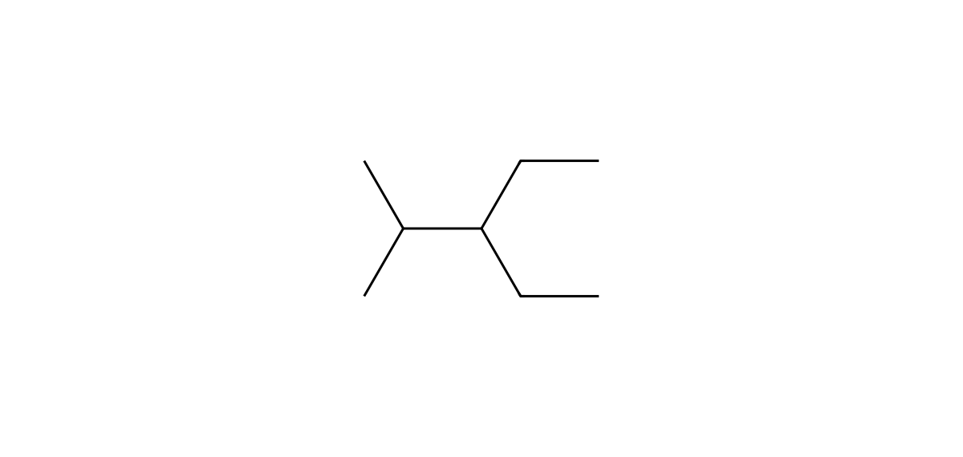
BICOL UNIVERSITY / COLLEGE OF ENGINEERING / CHEM 13
CARD B04 — NAME → STRUCTURE
DEVELOPING • Given name: 3-ethyl-2-methylpentane
01 / NAME DECODED
02 / REFERENCE STRUCTURE • THE ALKANE SCREENSHOT NEEDED
GIVEN NAME
3-ethyl-2-methylpentane
Parent
Pentane (5 C)
Substituents
Ethyl on C3; methyl on C2
Expected formula
C8H18
03 / FORMULA CHECK + BUILD ORDER
Total carbons
5 + 2 + 1 = 8 C
Study drawing only. Recreate it in The Alkane and add your real screenshot.
Formula rule
Open chain: CnH2n+2 = C8H18
NOT a The Alkane capture | Original website check still pending
BUILD GUIDE
Draw pentane; put methyl at C2 and the two-carbon ethyl at C3.
04 / BACK-CHECK
Expected: 3-ethyl-2-methylpentane | Tool check: pending
✓ formula independently checked □ The Alkane screenshot □ tool name recorded
WORKED STRUCTURE GUIDE • REAL THE ALKANE DRAWING & SCREENSHOT STILL REQUIRED
14 / 20

Slide 15
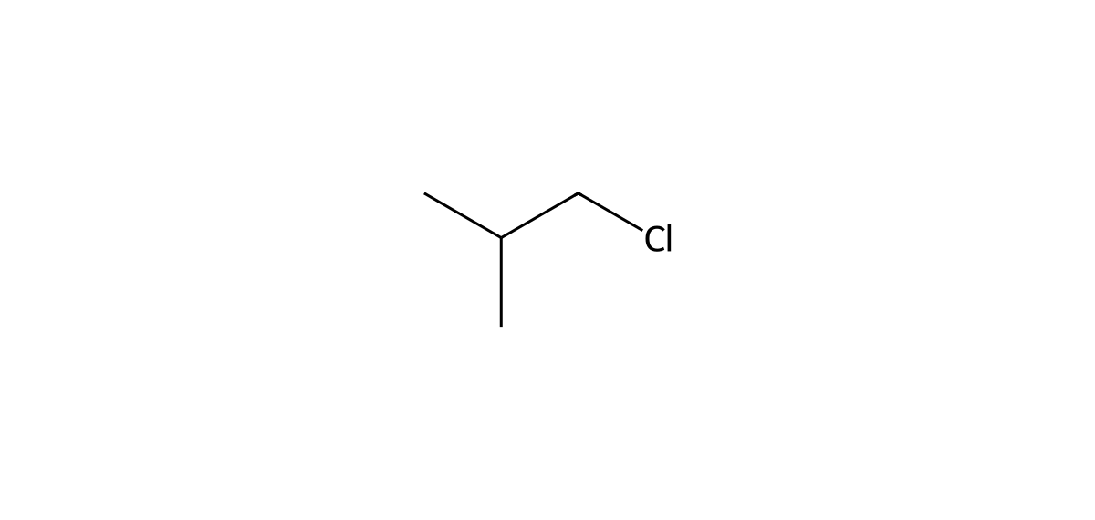
BICOL UNIVERSITY / COLLEGE OF ENGINEERING / CHEM 13
CARD B05 — NAME → STRUCTURE
DEVELOPING • Given name: 1-chloro-2-methylpropane
01 / NAME DECODED
02 / REFERENCE STRUCTURE • THE ALKANE SCREENSHOT NEEDED
GIVEN NAME
1-chloro-2-methylpropane
Parent
Propane (3 C)
Substituents
Chloro on C1; methyl on C2
Expected formula
C4H9Cl
03 / FORMULA CHECK + BUILD ORDER
Total carbons
3 + 1 = 4 C; 1 Cl
Study drawing only. Recreate it in The Alkane and add your real screenshot.
Formula rule
C4H10 − H + Cl = C4H9Cl
NOT a The Alkane capture | Original website check still pending
BUILD GUIDE
Draw propane; add methyl to carbon 2 and Cl to terminal carbon 1.
04 / BACK-CHECK
Expected: 1-chloro-2-methylpropane | Tool check: pending
✓ formula independently checked □ The Alkane screenshot □ tool name recorded
WORKED STRUCTURE GUIDE • REAL THE ALKANE DRAWING & SCREENSHOT STILL REQUIRED
15 / 20

Slide 16
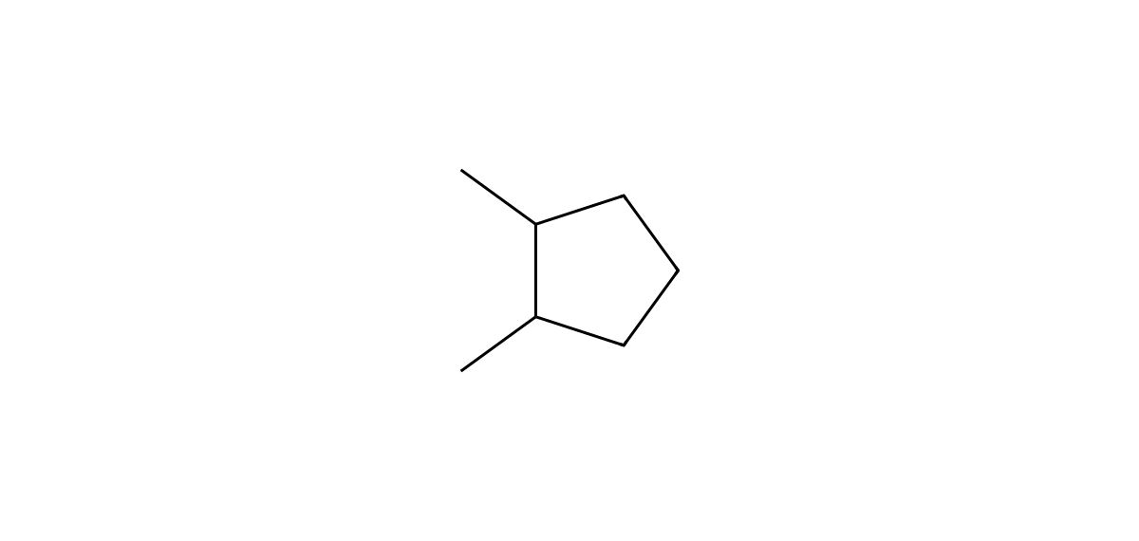
BICOL UNIVERSITY / COLLEGE OF ENGINEERING / CHEM 13
CARD B06 — NAME → STRUCTURE
DEVELOPING • Given name: 1,2-dimethylcyclopentane
01 / NAME DECODED
02 / REFERENCE STRUCTURE • THE ALKANE SCREENSHOT NEEDED
GIVEN NAME
1,2-dimethylcyclopentane
Parent
Cyclopentane (5-C ring)
Substituents
Methyl groups at adjacent C1 and C2
Expected formula
C7H14
03 / FORMULA CHECK + BUILD ORDER
Total carbons
5 + 1 + 1 = 7 C
Study drawing only. Recreate it in The Alkane and add your real screenshot.
Formula rule
One ring: CnH2n = C7H14
NOT a The Alkane capture | Original website check still pending
BUILD GUIDE
Start with a 5-membered single-bond ring; attach methyl to adjacent ring vertices.
04 / BACK-CHECK
Expected: 1,2-dimethylcyclopentane | Tool check: pending
✓ formula independently checked □ The Alkane screenshot □ tool name recorded
WORKED STRUCTURE GUIDE • REAL THE ALKANE DRAWING & SCREENSHOT STILL REQUIRED
16 / 20

Slide 17
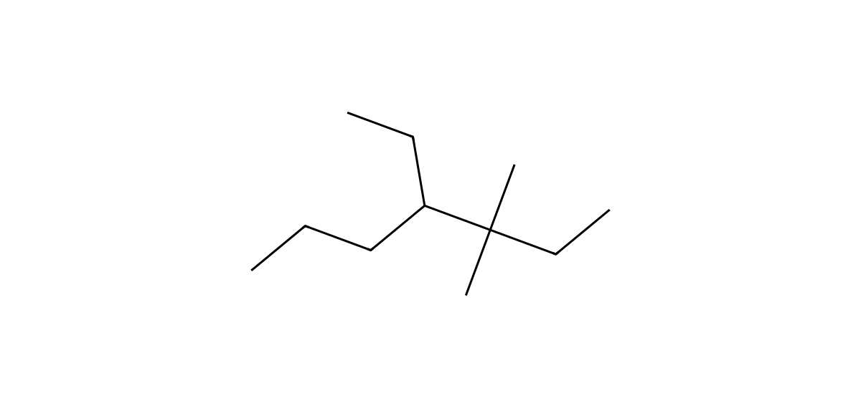
BICOL UNIVERSITY / COLLEGE OF ENGINEERING / CHEM 13
CARD B07 — NAME → STRUCTURE
DEVELOPING • Given name: 4-ethyl-3,3-dimethylheptane
01 / NAME DECODED
02 / REFERENCE STRUCTURE • THE ALKANE SCREENSHOT NEEDED
GIVEN NAME
4-ethyl-3,3-dimethylheptane
Parent
Heptane (7 C)
Substituents
Ethyl on C4; two methyl groups on C3
Expected formula
C11H24
03 / FORMULA CHECK + BUILD ORDER
Total carbons
7 + 2 + 1 + 1 = 11 C
Study drawing only. Recreate it in The Alkane and add your real screenshot.
Formula rule
Open chain: CnH2n+2 = C11H24
NOT a The Alkane capture | Original website check still pending
BUILD GUIDE
Draw seven parent carbons; add two methyl at C3 and an ethyl at C4.
04 / BACK-CHECK
Expected: 4-ethyl-3,3-dimethylheptane | Tool check: pending
✓ formula independently checked □ The Alkane screenshot □ tool name recorded
WORKED STRUCTURE GUIDE • REAL THE ALKANE DRAWING & SCREENSHOT STILL REQUIRED
17 / 20

Slide 18
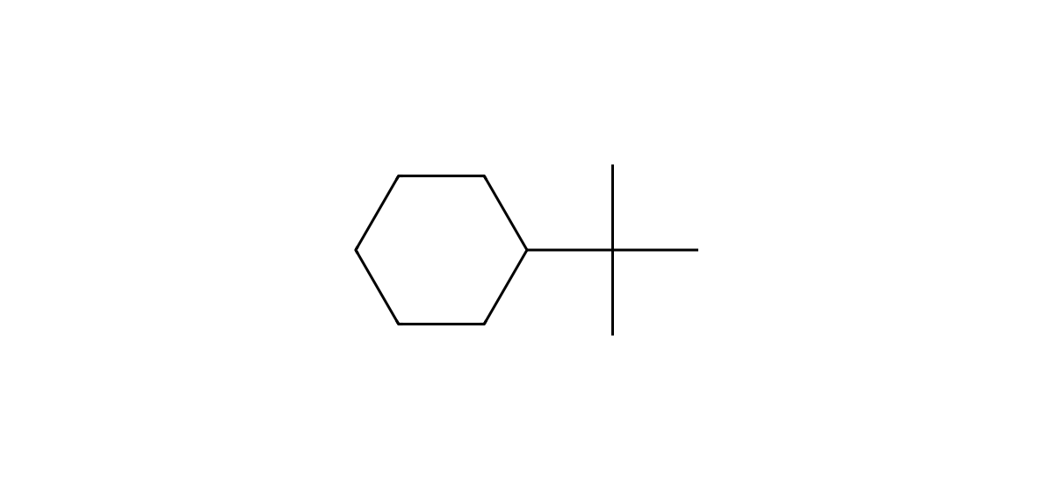
BICOL UNIVERSITY / COLLEGE OF ENGINEERING / CHEM 13
CARD B08 — NAME → STRUCTURE
CHALLENGE • Given name: tert-butylcyclohexane
01 / NAME DECODED
02 / REFERENCE STRUCTURE • THE ALKANE SCREENSHOT NEEDED
GIVEN NAME
tert-butylcyclohexane
Parent
Cyclohexane (6-C ring)
Substituents
tert-Butyl on C1 (no locant needed)
Expected formula
C10H20
03 / FORMULA CHECK + BUILD ORDER
Total carbons
6 + 4 = 10 C
Study drawing only. Recreate it in The Alkane and add your real screenshot.
Formula rule
One ring: CnH2n = C10H20
NOT a The Alkane capture | Original website check still pending
BUILD GUIDE
Draw the 6-ring; attach a carbon directly to the ring, then three methyl groups to that carbon.
04 / BACK-CHECK
Expected: tert-butylcyclohexane | Tool check: pending
✓ formula independently checked □ The Alkane screenshot □ tool name recorded
WORKED STRUCTURE GUIDE • REAL THE ALKANE DRAWING & SCREENSHOT STILL REQUIRED
18 / 20

Slide 19
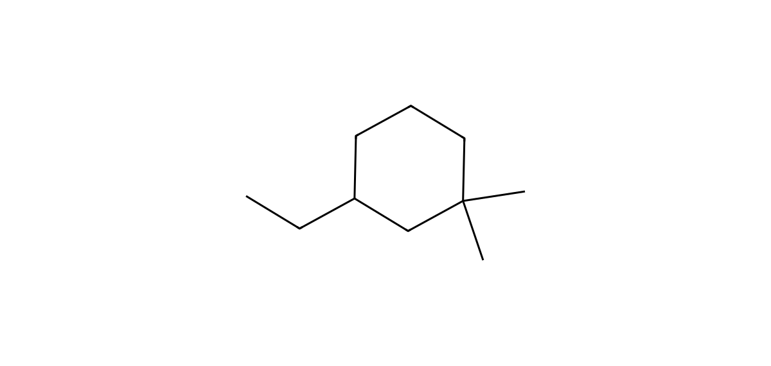
BICOL UNIVERSITY / COLLEGE OF ENGINEERING / CHEM 13
CARD B09 — NAME → STRUCTURE
CHALLENGE • Given name: 3-ethyl-1,1-dimethylcyclohexane
01 / NAME DECODED
02 / REFERENCE STRUCTURE • THE ALKANE SCREENSHOT NEEDED
GIVEN NAME
3-ethyl-1,1-dimethylcyclohexane
Parent
Cyclohexane (6-C ring)
Substituents
Two methyl groups on C1; ethyl on C3
Expected formula
C10H20
03 / FORMULA CHECK + BUILD ORDER
Total carbons
6 + 2 + 1 + 1 = 10 C
Study drawing only. Recreate it in The Alkane and add your real screenshot.
Formula rule
One ring: CnH2n = C10H20
NOT a The Alkane capture | Original website check still pending
BUILD GUIDE
Draw a 6-ring; attach two methyls at the same ring carbon and ethyl two positions away.
04 / BACK-CHECK
Expected: 3-ethyl-1,1-dimethylcyclohexane | Tool check: pending
✓ formula independently checked □ The Alkane screenshot □ tool name recorded
WORKED STRUCTURE GUIDE • REAL THE ALKANE DRAWING & SCREENSHOT STILL REQUIRED
19 / 20

Slide 20
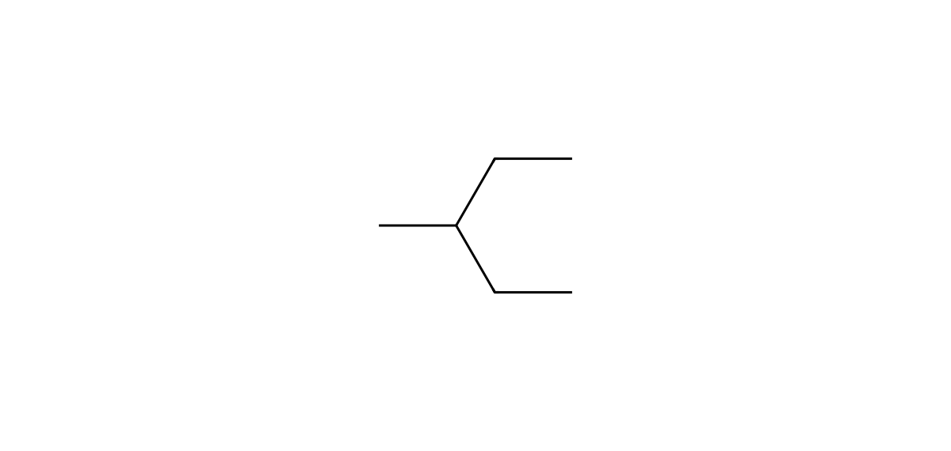
BICOL UNIVERSITY / COLLEGE OF ENGINEERING / CHEM 13
CARD B10 — NAME → STRUCTURE
CHALLENGE • Given name: 2-ethylbutane
01 / NAME DECODED
02 / REFERENCE STRUCTURE • THE ALKANE SCREENSHOT NEEDED
GIVEN NAME
2-ethylbutane
Parent
Butane as WRITTEN (4 C)
Substituents
Ethyl on C2 as WRITTEN
Expected formula
C6H14
03 / FORMULA CHECK + BUILD ORDER
Total carbons
4 + 2 = 6 C
Study drawing only. Recreate it in The Alkane and add your real screenshot.
Formula rule
Open chain: CnH2n+2 = C6H14
NOT a The Alkane capture | Original website check still pending
BUILD GUIDE
Draw four carbons with a two-carbon ethyl on C2. Then trace the longest path.
04 / BACK-CHECK
Expected: 3-methylpentane (B10 name invalid) | Tool check: pending
RULE: 2-ethylbutane violates longest-chain rule. Trace a 5-C chain → 3-methylpentane.
✓ formula independently checked □ The Alkane screenshot □ tool name recorded
WORKED STRUCTURE GUIDE • REAL THE ALKANE DRAWING & SCREENSHOT STILL REQUIRED
20 / 20

