Slide 1
Predictra Threat Map
Design and Development of a Real-Time Spatialized Threat Intelligence Visualization Platform
Authors
Supervisor
Brahim JABALLI & Chiheb AMRI
Mr. Anis DHAHRI — ISET Gafsa
Host Company
Academic Year
Predictra Cybersecurity
2025 / 2026
PFE — Bachelor's Degree in Information Technology · Option: Computer System Development · ISET Gafsa
Jury: Ms. Hadhami ISSAOUI (President) · Mr. Walid HAMMEMI (Reporter)

Slide 2
Presentation Outline
A structured journey from problem definition to full platform realization.
1
Introduction
Global cybersecurity landscape, threat evolution, and project motivation.
2
Pre-Study
Host profile (Predictra), project context, problematic, proposed solution, and Agile Scrum methodology.
3
Conceptual Study
Actors, functional & non-functional requirements, UML use cases, tech stack, and system architecture.
4
Realization
Detailed Sprints 1–4: backlogs, UML diagrams, scraper implementations, and UI dashboards.
5
Conclusion & Perspectives
Achievements, retrospective, and future scalability roadmap.

Slide 3

General Introduction
Expanded Attack Surface
Sun Tzu, The Art of War: "If you know the enemy and know yourself, you need not fear the result of a hundred battles."
The hyper-connectivity of corporate networks, cloud platforms, and critical infrastructures has created an unprecedented and volatile attack surface. Modern organizations rely entirely on software and network availability, making them highly attractive targets.
Shift to Proactivity
Evolved Adversaries
Traditional perimeter defenses — firewalls and antivirus — are no longer sufficient. Organizations must transition from reactive incident response to proactive threat intelligence, gaining external visibility into adversary infrastructure before breaches occur.
Threat actors have evolved from opportunistic scripts into highly coordinated campaigns — ransomware cartels, nation-state APTs, and hacktivists launching disruptive operations at scale.

Slide 4
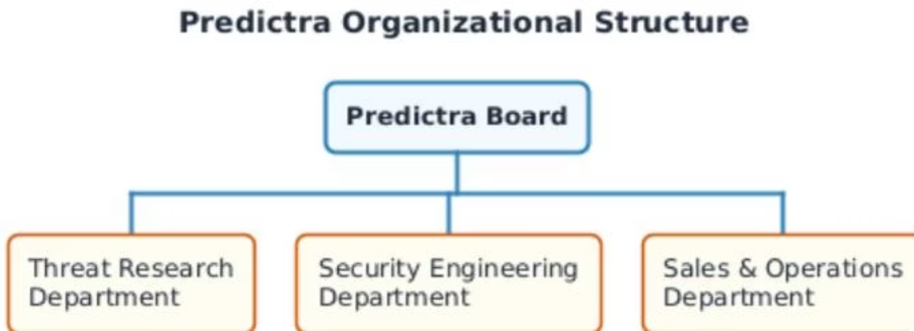
CHAPTER 1 — PRE-STUDY
Project Context & Host Organization
Predictra Profile
Organizational Structure
Key Metric: Dwell Time
Next-generation AI-driven Cyber Threat Intelligence firm. Democratizes threat intelligence by converting raw data into real-time, visually actionable insights for SOCs and enterprise security teams.
Threat Research: Analysts tracking campaigns & malware. Security Engineering: Ingestion pipelines & UI (our team). Sales & Operations: Client relations & enterprise deployments.
Global average compromise dwell time exceeds 200 days. Defenders only detect breaches after internal alerts trigger. The Threat Map shrinks this window from months to seconds.

Slide 5

CHAPTER 1 — PRE-STUDY
The Critical Problematic
Spreadsheet Overload
SOC analysts suffer from visual fatigue reading thousands of static, textual log lines in spreadsheets and simple dashboards. There is no intuitive interface for immediate situational awareness.
Lack of Spatial Context
No geographic representation of threat origins, targets, and trajectories in real-time. Defenders cannot visualize where attacks originate or which sectors are being targeted globally.
Data Heterogeneity
Raw feeds are fragmented across diverse security vendors using incompatible data formats, protocols, and schemas — making unified analysis slow and manual.

Slide 6




CHAPTER 1 — PRE-STUDY
The Proposed Solution: Predictra Threat Map
A four-layer architecture transforming raw cyber threat data into a live, interactive 3D visual intelligence platform.
Ingestion Layer
Enrichment Layer
Asynchronous harvesting from 9+ parallel threat feeds (AlienVault, URLhaus, Checkpoint, Bitdefender, Fortinet, Kaspersky Feodo, RansomWatch, C2 Tracker, MISP Galaxy).
Instant IP geolocation via local geocoding library and 5-layer target sector classification engine covering 9 critical business sectors.
Streaming Layer
Visualization Layer
Unidirectional event broadcasting via Server-Sent Events (SSE) with a 300ms batching queue — keeping browser rendering smooth.
Interactive 3D WebGL Earth with curved attack arcs, plus STIX 2.1 parser and MITRE ATT&CK workspace for deep analysis.

Slide 7

CHAPTER 1 — PRE-STUDY
Agile Scrum Methodology
4 Sprints over 12 Weeks
01
Sprint 1
Backend ingestion: 9 scrapers, MongoDB schemas, enrichment pipeline.
02
Sprint 2
SSE stream endpoint, Zustand store, 3D WebGL Earth at 60fps.
03
Sprint 3
STIX 2.1 JSON parser and MITRE ATT&CK Kill Chain mapping grid.
04
Sprint 4
History browser, Target My IP, RingBuffer, adaptive FPS sampling.
Twice-weekly rituals: Thursdays (code merge & WebGL profiling) and Sundays (architectural consolidation & LaTeX documentation) — 48+ sessions over 6 months.

Slide 8
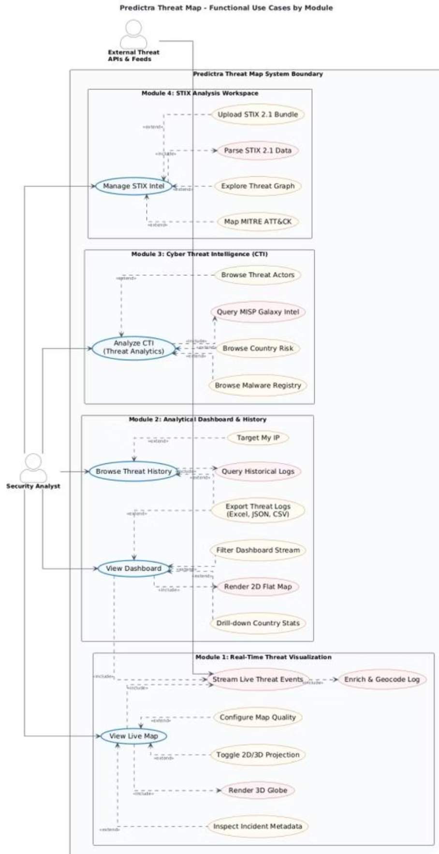

Slide 9
CHAPTER 2 — CONCEPTUAL STUDY
Identification of System Actors
System Actor: External Threat Feeds
Human Actor: Security Analyst (SOC)
Automatically pushes Indicators of Compromise (IOCs) — malicious IPs, domains, malware hashes — via HTTP REST APIs, SSE feeds, and WebSockets.
Interacts with the frontend dashboard to monitor, investigate, and export threat intelligence.
Monitors the 3D globe and 2D dashboard in real-time
Filters alerts by country, sector, and malware type
Searches historical logs and exports to Excel
Uploads and parses local STIX 2.1 intelligence bundles
Geolocates their own public IP via "Target My IP"
Triggers backend ingestion asynchronously
9+ distinct feed sources integrated
Operates continuously without human intervention

Slide 10
CHAPTER 2 — CONCEPTUAL STUDY
Functional Requirements (RF-1 to RF-9)
RF-1
RF-2
RF-3
RF-4
Multi-feed ingestion from 9+ sources (AlienVault, URLhaus, Checkpoint, etc.)
IP geolocation enrichment using local geocoding library (lat/lon, ISO code, ASN)
5-layer sector classification into 9 critical industries (Healthcare, Finance, Gov…)
Real-time SSE streaming with 300ms batching queue and keep-alive heartbeat
RF-5
RF-6
RF-7
RF-8
3D WebGL Threat Map with animated arcs, pulsating markers, 2D/3D toggle
Client-side STIX 2.1 JSON bundle parser (up to 300KB, no server upload)
MITRE ATT&CK Kill Chain mapping across 12 adversary phases
Searchable historical log browser with regex, country, sector, and pagination filters
RF-9
"Target My IP" geolocator and Excel export for up to 5,000 threat logs

Slide 11
CHAPTER 2 — CONCEPTUAL STUDY
Non-Functional Requirements & Global Use Case
Non-Functional Requirements
RNF-1: 60fps Fluidity
RNF-2: Circular Buffer
RNF-3: 30-Day TTL
RNF-4: 500MB Quota Guard
Adaptive quality reduction if frame rate drops below threshold.
10,000-event RingBuffer caps memory usage at a constant footprint.
Threat records auto-expire from MongoDB after 30 days.
Backend switches to in-memory streaming if DB exceeds 500MB.
RNF-5: Glassmorphism UI
Dark theme with semi-transparent panels and severity-based color coding.

Slide 12
CHAPTER 2 — CONCEPTUAL STUDY
Technology Stack & Comparative Analysis
Layer
Selected
Alternative
Rationale
Runtime
Node.js / Express 5
Java Spring Boot
Non-blocking async loop; ideal for open SSE streams under low memory
State Management
Zustand 5
Redux Toolkit
Slice-based reactive updates outside React DOM — preserves 60fps WebGL
3D Graphics
Three.js / R3F
Vanilla Canvas
GPU acceleration, SLERP math, custom GLSL vertex/fragment shaders
Build Tool
React 19 / Vite 7
Angular / Webpack
Native ESM, instant startup, fast HMR vs slow pre-compilation
Database
MongoDB Atlas (BSON)
PostgreSQL / MySQL
Schemaless BSON for heterogeneous CTI logs; no rigid migrations needed

Slide 13
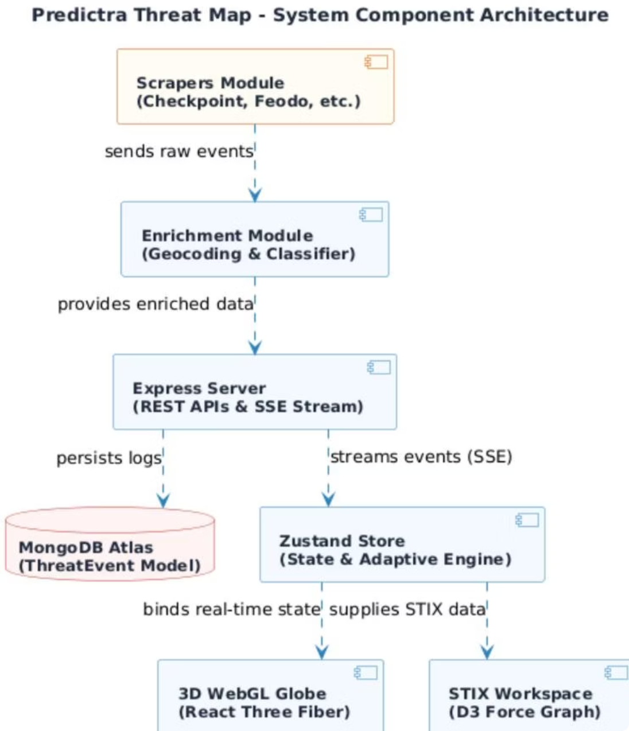
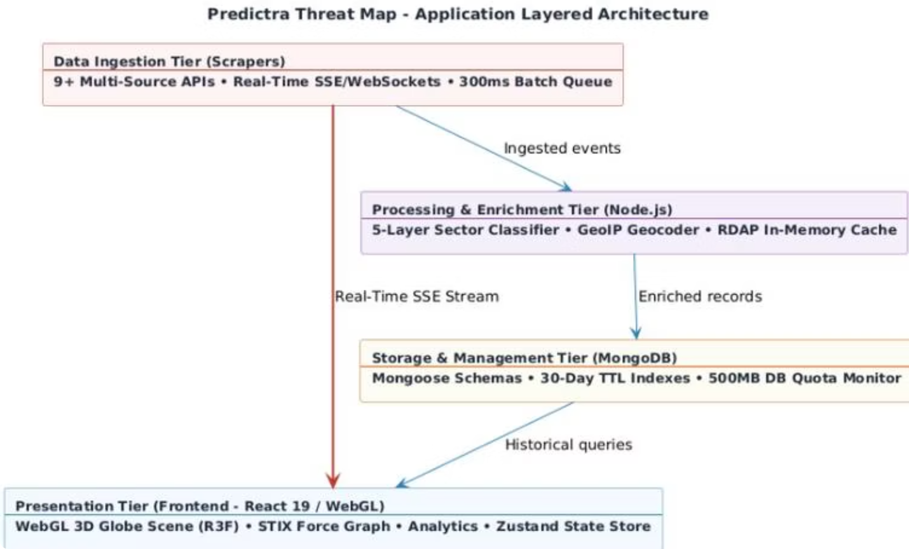
CHAPTER 2 — CONCEPTUAL STUDY
System Architecture
Frontend (Vercel CDN)
Backend (Cloud VM / PM2)
Database (MongoDB Atlas)
React SPA hosted globally; API proxy rewrites via vercel.json eliminate CORS issues.
Node.js Express server clustered across CPU cores with automated crash recovery.
Replicated BSON cluster with 30-day TTL indexes and 500MB quota monitor.

Slide 14
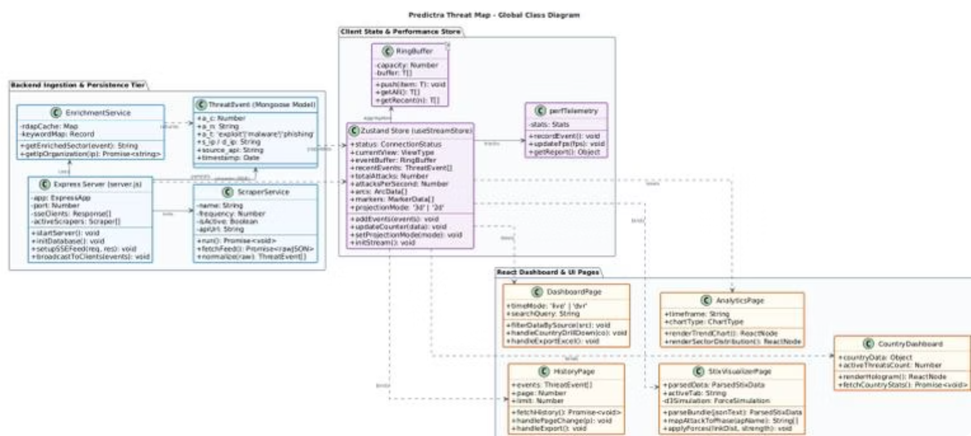
CHAPTER 2 — CONCEPTUAL STUDY
Global Class Diagram
Backend Tier
Zustand Store
React Views
ExpressServer schedules multiple ScraperService instances. EnrichmentService resolves geolocation and sector. MongooseThreatEvent persists compact BSON documents.
useStreamStore manages real-time state with a circular RingBuffer and perfTelemetry tracker to prevent memory leaks and GC spikes.
DashboardPage, HistoryPage, AnalyticsPage, StixDashboard, and CountryDashboard subscribe to Zustand state slices and bind to REST endpoints.

Slide 15
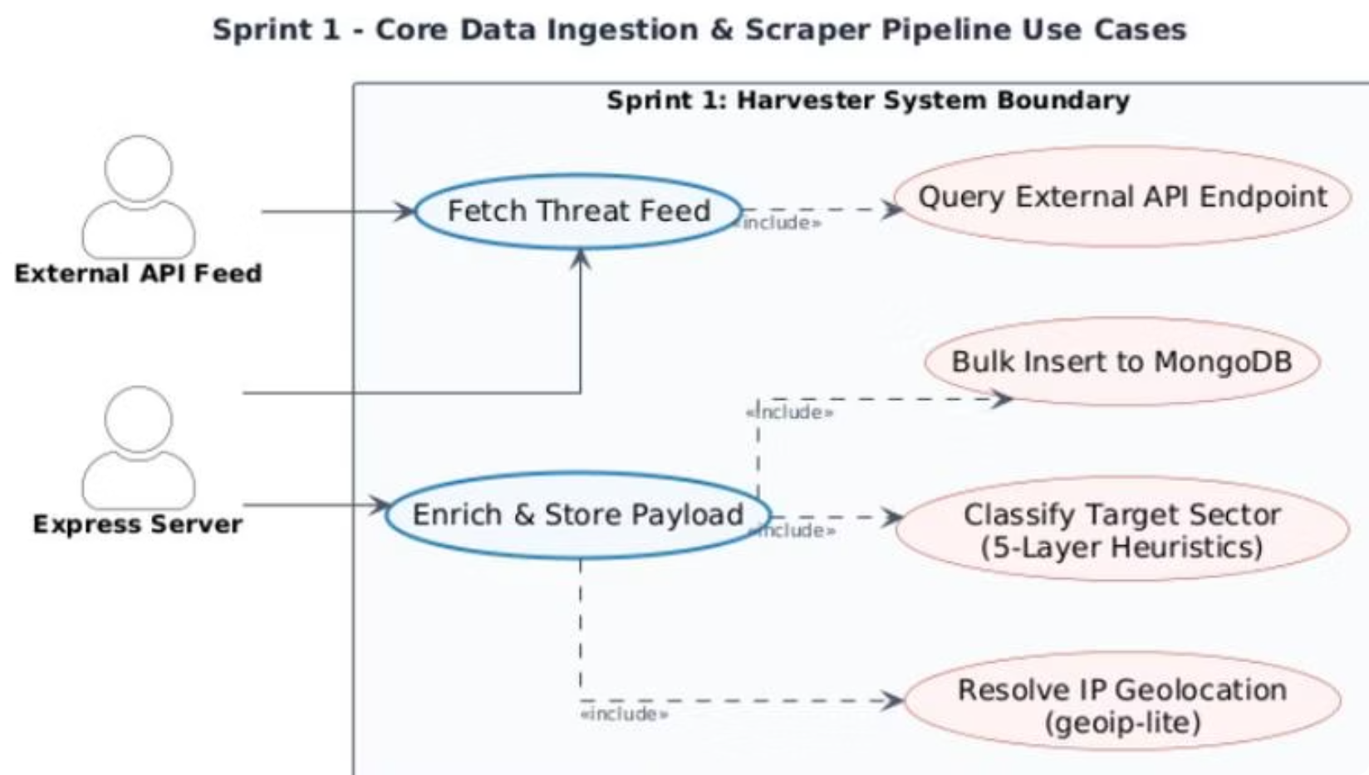

CHAPTER 3 — SPRINT 1
Sprint 1: Data Ingestion & Enrichment Pipeline
Sprint Objectives
9 Integrated Threat Feeds
Configure the Express server, set up Mongoose models, code 9 modular scrapers, and implement the 5-layer sector classification and geolocation enrichment pipeline.
Checkpoint — Persistent SSE stream (TLS 1.3)
Bitdefender — WebSocket, 13 threat channels
Fortinet FortiGuard — REST poll every 4 seconds
URLhaus — abuse.ch malware URL feed
Kaspersky Feodo — C2 botnet CSV blocklist
AlienVault OTX — Subscribed pulse IOCs
RansomWatch — Dark web extortion posts
MontySecurity C2 — Active C2 framework IPs
MISP Galaxy — Synthetic threat actor events
Compact BSON schema reduces document size from 200 bytes → 80 bytes, conserving cloud storage.

Slide 16
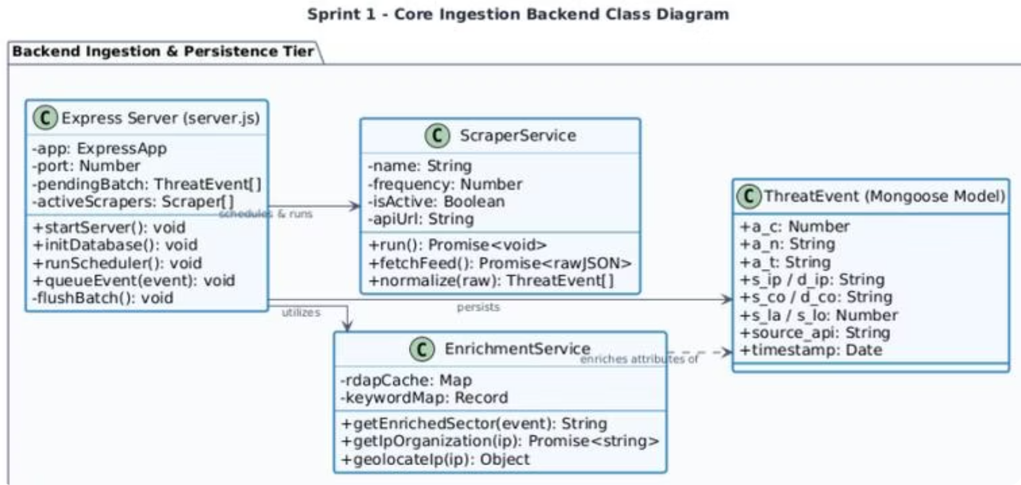
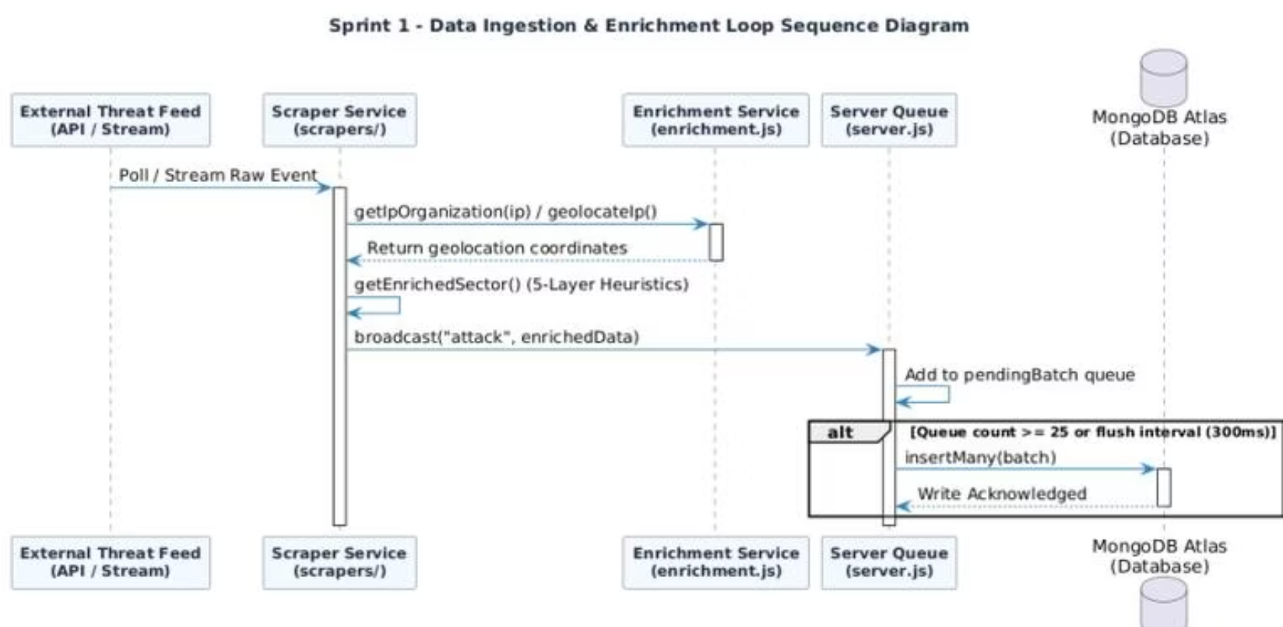
CHAPTER 3 — SPRINT 1
Sprint 1: Class & Sequence Diagrams
The EnrichmentService applies a 5-layer classification engine: (1) victim name keywords, (2) event detail regex, (3) destination port mapping, (4) MISP Galaxy metadata, and (5) source API fallback. An asynchronous RDAP cache resolves IP owners with a 3-second timeout, adding organizational context without blocking the ingestion loop.

Slide 17
CHAPTER 3 — SPRINT 2
Sprint 2: Real-Time SSE Stream & 3D Globe Visualization
SSE Broadcast Engine
3D Globe Mathematics
The GET /api/feed endpoint sets text/event-stream headers and runs a 300ms flush interval scheduler, consolidating queued events into single payloads. A 30-second ping heartbeat keeps connections alive through proxies.
Geographic coordinates are converted to 3D Cartesian vectors using spherical trigonometry. Attack arcs use Spherical Linear Interpolation (SLERP) to follow Earth's curvature, then parametric Bezier elevation lifts arcs above the surface — longer distances arch higher.

Slide 18
CHAPTER 3 — SPRINT 2
Sprint 2: WebGL Shaders & Sequence Diagram
Custom GLSL Shaders
Atmospheric Glow
Fresnel-effect vertex/fragment shader creates a neon cyberblue glow around the globe silhouette using dot-product intensity falloff.
Neon Country Borders
5 overlapping TopoJSON vector line layers at microscopic scale increases (R=1.002 to R=1.010) with decreasing opacities create a glowing border effect.
Bloom Post-Processing
EffectComposer with Bloom shader (luminanceThreshold 0.15, intensity 0.8) makes severity-colored arcs glow like neon light fibers.

Slide 19
CHAPTER 4 — SPRINT 3
Sprint 3: STIX 2.1 Threat Analysis Dashboard
STIX 2.1 Parser
MITRE ATT&CK Mapping
Client-side JSON parser processes intelligence bundles entirely in the browser — sensitive files never leave the analyst's machine. Validates spec_version: "2.1" and extracts all STIX Domain Objects (SDOs): Threat Actors, Campaigns, Malware, Tools, Attack Patterns, Indicators, and Relationships.
Parsed attack-pattern objects are automatically mapped to the 12 phases of the MITRE ATT&CK Kill Chain (Initial Access → Exfiltration). Phase distribution counts update instantly, highlighting the most heavily populated adversary stages to focus mitigation efforts.

Slide 20
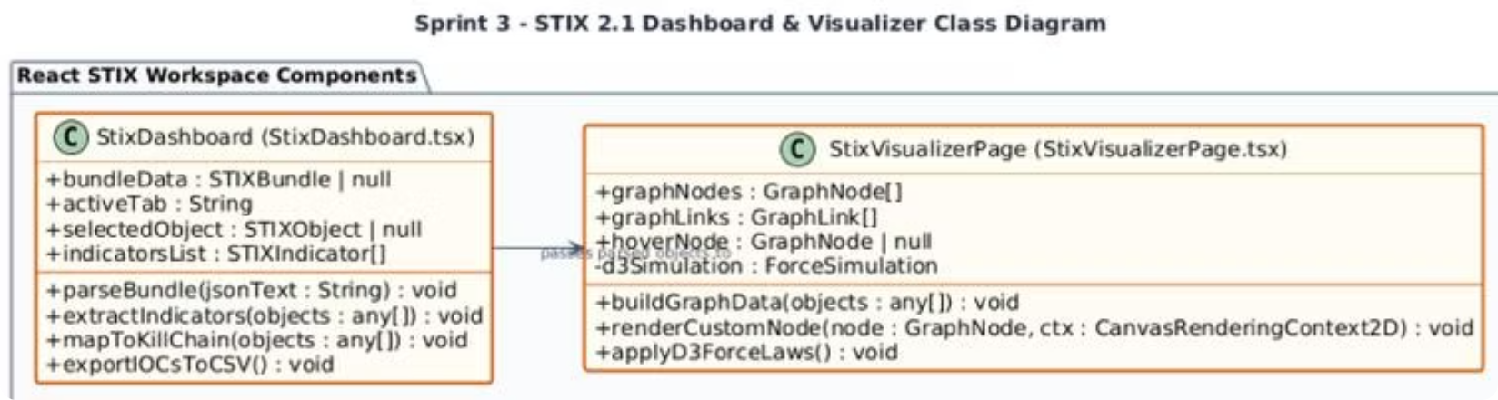
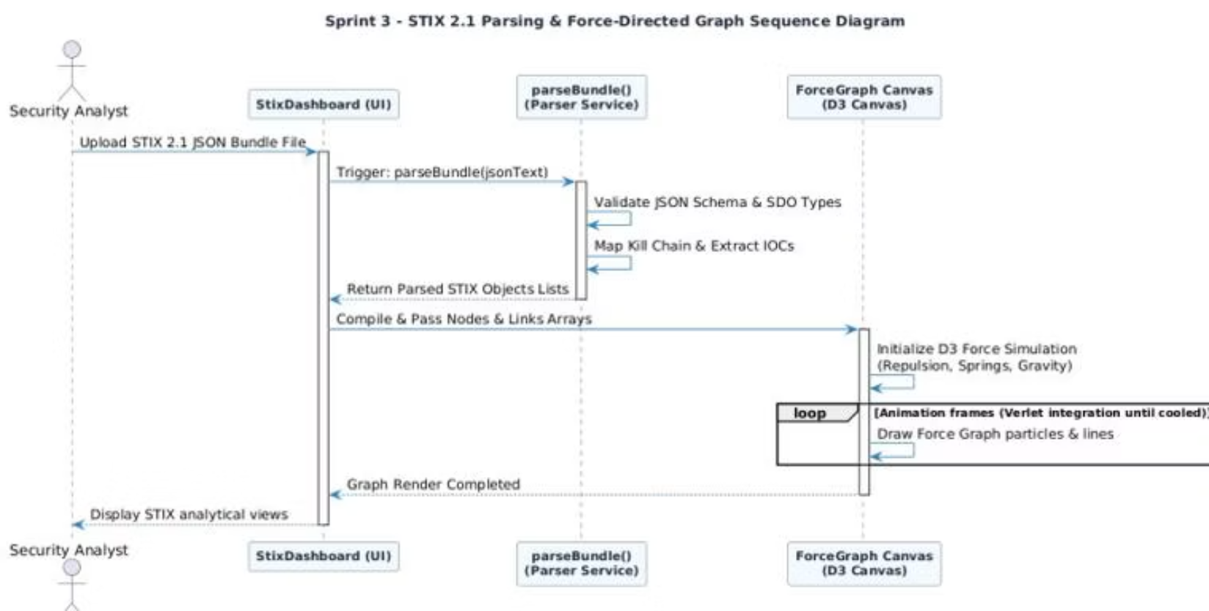
CHAPTER 4 — SPRINT 3
Sprint 3: Class & Sequence Diagrams
The D3 Force Graph renders STIX objects as interactive nodes linked by relationship edges. The simulation applies repulsion, spring, and gravity forces using Verlet integration until the graph cools into a stable layout. Analysts can hover over nodes to inspect raw SDO metadata and click to explore relationship chains.

Slide 21
CHAPTER 4 — SPRINT 4
Sprint 4: Analytics, History & Performance Guardrails
Sprint 4 Deliverables
01
02
Paginated History Browser
Target My IP
MongoDB queries with regex, country, sector filters. Default 50 logs/page, executing in under 50ms via compound indexes.
Queries public IP API, geolocates the analyst, and auto-filters threat history to logs targeting their network subnet.
03
04
Excel Export
Performance Guardrails
Client-side worksheet generation supporting up to 5,000 logs without browser memory exhaustion.
Circular RingBuffer (10,000 slots) + Adaptive FPS Sampling Engine drops 50–75% of visual events under load.

Slide 22
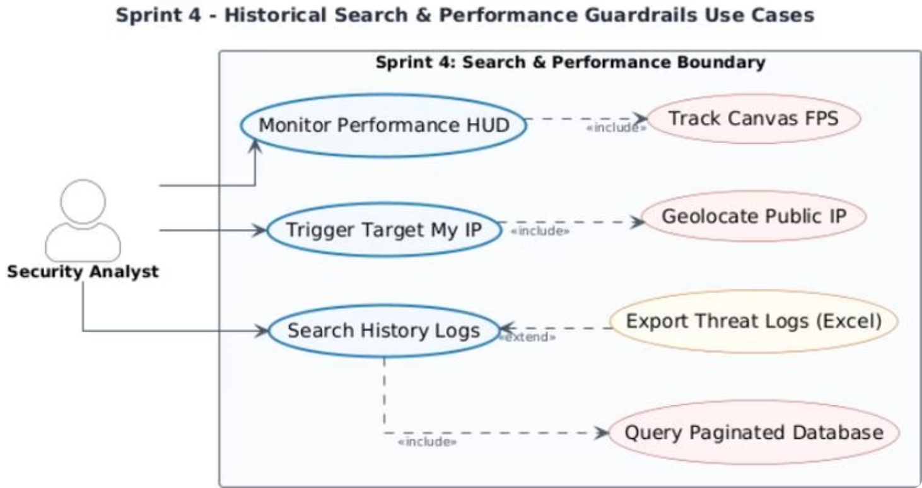

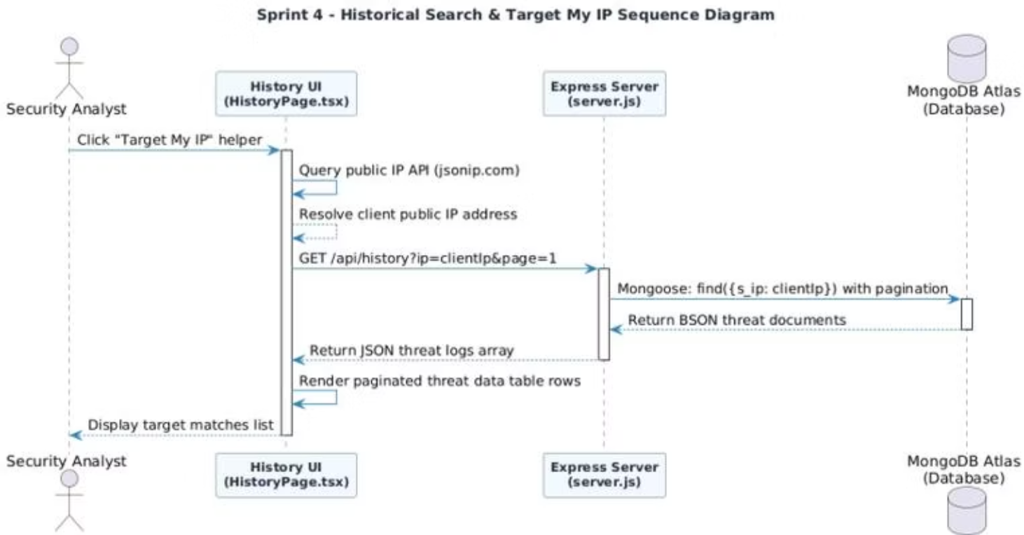
CHAPTER 4 — SPRINT 4
Sprint 4: Performance Mathematics & UML
Adaptive Event Sampling
Mode
FPS Range
Drop Rate
High-Fluidity
≥ 55 fps
0% — all events rendered
Medium-Load
30–55 fps
50% visual events dropped
Stress-Mitigation
≤ 30 fps
75% visual events dropped
RingBuffer push() operates in O(1) constant time — zero GC pressure regardless of event volume.

Slide 23
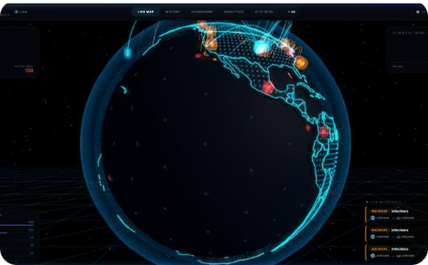
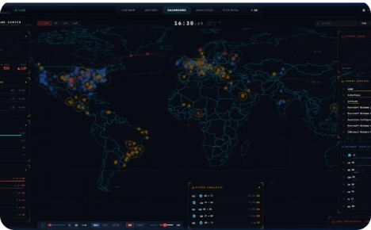
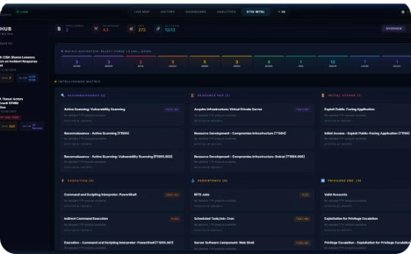
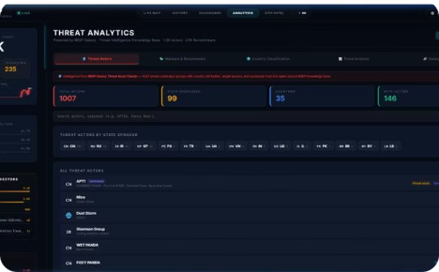
Application Interfaces Overview
3D Live Threat Map
System Dashboard
STIX Intelligence Workspace
Analytics Dashboard
Interactive WebGL Earth with glowing bezier arcs, pulsating markers, and real-time SSE threat feeds.
Tactical command center with real-time metrics, sparklines, 2D flat map, and drill-down country stats.
Aggregate threat metrics, sector distributions, MISP Galaxy threat actor profiles, and trend charts.
Upload STIX 2.1 bundles, explore D3 force graphs, and map adversary TTPs to the MITRE ATT&CK matrix.

Slide 24

Project Retrospective & Technical Challenges
Scrum Velocity
The team maintained a stable velocity of 25–30 story points per sprint, delivering all committed features on schedule. Each Sprint Review concluded with a fully demonstrable software increment.
Three Critical Challenges Resolved
Visual Interface Lag
Resolved via 300ms event grouping queue, 150-arc cap, and adaptive FPS sampling — restoring smooth 60fps performance.
Database Storage Limits
Compact BSON field names reduced storage size by 50%. TTL indexes auto-prune records after 30 days.
CORS Deployment Blocks
Vercel reverse-proxy routing rules direct frontend requests through internal paths, eliminating cross-origin failures.

Slide 25

Future Perspectives & Scalability Roadmap
Kafka Distributed Ingestion
Predictive ML Extensions
Replace direct scraper-to-server writes with Apache Kafka message queues. Scrapers publish to durable topics; the server consumes and streams — ensuring fault-tolerant ingestion under massive threat volumes.
Train machine learning models on historical threat distributions to forecast attack spikes and target sectors, displaying predictions as threat heatmaps on the 3D globe.
Sharded Geo-Database Clustering
Shard MongoDB by geographic region so queries for specific countries route only to their corresponding database segments — minimizing latency and scaling storage capacity horizontally.

Slide 26
General Conclusion
The Predictra Threat Map successfully bridges the critical visibility gap in modern cyber defense — transforming raw, heterogeneous threat feeds into a live, interactive 3D intelligence platform.
Technical Achievement
Operational Impact
Academic Contribution
9+ asynchronous scrapers, real-time SSE streaming, 60fps WebGL 3D globe, client-side STIX 2.1 parser, and MITRE ATT&CK mapping — all delivered across 4 Agile sprints.
Reduces compromise dwell time from 200+ days to seconds by providing SOC analysts with immediate, spatial, external threat visibility.
Demonstrates a rigorous engineering methodology combining Agile Scrum, UML modeling, and cutting-edge web technologies in a production-grade cybersecurity platform.
Thank you — Questions Welcome

