Slide 1
PREDICTRA THREAT MAP
Design and Development of a Real-Time Spatialized Threat Intelligence Visualization Platform
AUTHORS
Brahim JABALLI & Chiheb AMRI
SUPERVISOR
Mr. Anis DHAHRI — ISET Gafsa
HOST FIRM
Predictra Cybersecurity
ACADEMIC YEAR & OPTION
2025 / 2026 · Option: Computer System Development
Jury: Ms. Hadhami ISSAOUI (President) · Mr. Walid HAMMEMI (Reporter)
Notes:
Brahim: Good morning, ladies and gentlemen of the jury. Welcome to our graduation defense for our Bachelor’s Degree in Information Technology. My name is Brahim Jaballi, and alongside my colleague Chiheb Amri, we are proud to present our final year project: the 'Predictra Threat Map'. This project, conducted under the supervision of Mr. Anis Dhahri at ISET Gafsa, and in collaboration with host company Predictra Cybersecurity, focuses on the design and development of a real-time spatialized threat intelligence visualization platform. We would also like to thank Ms. Hadhami Issaoui and Mr. Walid Hammemi for presiding and reporting on our defense today.

Slide 2
AGENDA
Presentation Outline
01 Intro
• Global landscape
• Attack surface
• Strategic threat intel motivation
02 Pre-Study
• Host company
• The problematic
• Proposed solution
• Agile Scrum model
03 Conceptual
• System actors
• Requirements
• Use Case model
• Stack comparison
• Architecture
04 Realization
• Ingestion pipelines
• SSE streaming math
• WebGL Shaders
• STIX & MITRE Map
• Guardrails
05 Conclusion
• Achievement summary
• Retro velocity
• Kafka & ML scalability roadmap
Notes:
Brahim: To guide you through our presentation, we have structured our defense into five key chapters. I will begin with the Introduction and the Pre-Study, outlining the cybersecurity landscape, our problematic, and the Agile Scrum methodology. Next, we will present our Conceptual Study, including system actors, requirements, use cases, and architecture. We will then dive into the Realization phase, detailing Sprints 1 to 4 and showcasing the system interfaces. Finally, we will conclude with a retrospective, technical challenges resolved, and future perspectives.

Slide 3
CHAPTER 1 — INTRODUCTION
General Introduction
The Strategic Shift to Proactive Defense
Sun Tzu, The Art of War:
"If you know the enemy and know yourself, you need not fear the result of a hundred battles."
Defenders must pivot from reactive, perimeter-based alerts (Firewalls & antivirus) to proactive external visibility. By collecting, normalizing, and spatializing threat feeds, we anticipate campaigns before they penetrate our perimeter.
1. Expanded Attack Surface
Hyper-connectivity, cloud infrastructure, and distributed microservices have multiplied threat exposure points, making manual tracking impossible.
2. Evolved Adversaries
Attackers are no longer lone hackers but structured cartels, nation-states, and automated botnets operating rapid campaigns at scale.
Notes:
Brahim: Let us start with the introduction. Today, corporate networks and cloud platforms are faced with an expanded attack surface. Highly coordinated threat groups launch disruptive operations globally. As Sun Tzu wrote in The Art of War: 'If you know the enemy and know yourself, you need not fear the result of a hundred battles.' In cybersecurity, this means shifting from a reactive posture to a proactive threat intelligence model, where we understand external adversary infrastructure before a breach occurs.

Slide 4
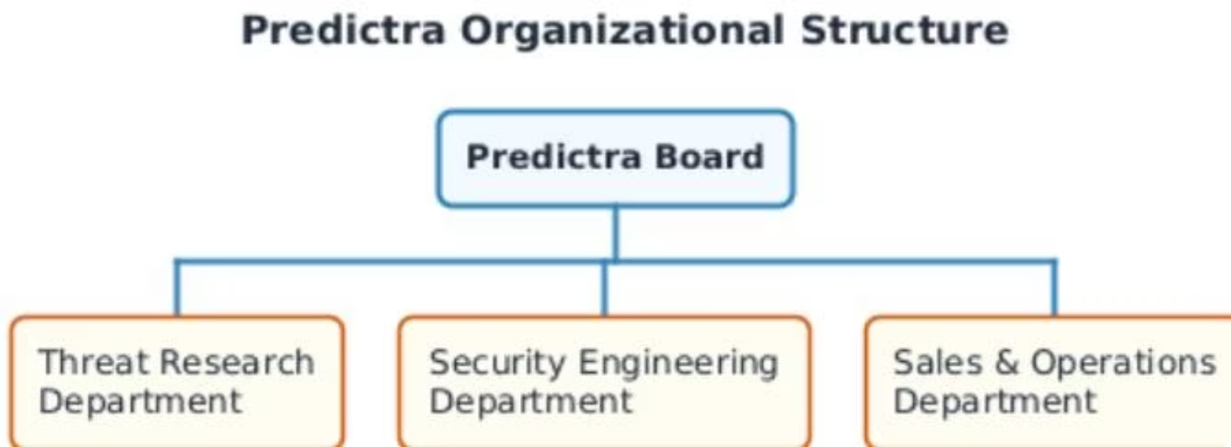
CHAPTER 1 — PRE-STUDY
Project Context & Host Organization
Host: Predictra Cybersecurity
An AI-driven Cyber Threat Intelligence (CTI) firm that focuses on democratizing raw threat datasets into immediate, visually actionable insights for enterprise SOCs.
The Dwell Time Target
The global average dwell time for compromise detection exceeds 200 days. The primary goal of the Threat Map is to shrink this window from months to real-time seconds.
Notes:
Brahim: Our host organization, Predictra Cybersecurity, is an AI-driven Cyber Threat Intelligence firm. Their goal is to democratize threat intelligence, transforming raw feeds into actionable visual insights. A critical industry metric is the compromise dwell time, which globally averages over 200 days. Security teams often detect breaches months after they occur. Our Threat Map aims to shrink this window from months to seconds by providing immediate, real-time visibility.

Slide 5
CHAPTER 1 — PRE-STUDY
The Critical Problematic
Spreadsheet Overload
SOC analysts are overwhelmed by raw, static text logs. Staring at thousands of text rows causes fatigue and delays the detection of critical correlation anomalies.
Lack of Spatial Context
Traditional grids omit geography. Security teams cannot visualize where attacks originate, which sectors are targeted, or the real-time vectors of global campaigns.
Data Heterogeneity
Threat feeds are scattered across separate APIs, WebSocket channels, and raw CSV files. Formats, schemas, and protocols are incompatible, blocking immediate analysis.
Notes:
Brahim: The core problem we address is threefold. First, spreadsheet overload. SOC analysts suffer from visual fatigue reading thousands of static logs. Second, a lack of spatial context. Traditional dashboards fail to show attack origins, targets, and trajectories geographically. Third, data heterogeneity. Threat feeds are scattered across multiple vendors in incompatible formats. This makes manual correlation slow, leading to delayed responses.

Slide 6
CHAPTER 1 — PRE-STUDY
The Proposed Solution: 4-Layer Architecture
1. Ingestion Layer
Asynchronous, non-blocking ingestion scraping from 9+ parallel feeds (AlienVault, URLhaus, Bitdefender, Checkpoint, etc.).
2. Enrichment Layer
Local geolocation dictionary mapping and 5-layer classification engine tagging targets into 9 critical industries.
3. Streaming Layer
Server-Sent Events (SSE) broadcasting queue with a 300ms batch flush that prevents browser rendering overhead.
4. Visualization Layer
WebGL 3D Earth rendered via Three.js at 60fps with glowing bezier arcs, D3 force graph, and MITRE ATT&CK grid.
Notes:
Brahim: To solve this, we propose the Predictra Threat Map, built on a four-layer architecture. First, the Ingestion Layer harvests data asynchronously from 9+ feeds. Second, the Enrichment Layer geolocates attacks and classifies victims into 9 critical sectors. Third, the Streaming Layer broadcasts events using Server-Sent Events with a 300ms batching queue. Fourth, the Visualization Layer displays curved attack arcs on an interactive 3D WebGL Earth, alongside a STIX parser and MITRE ATT&CK grid.

Slide 7
CHAPTER 1 — PRE-STUDY
Agile Scrum Methodology
4 Sprints & Agile Rituals
We ran a 12-week development cycle with clear team velocity metrics (25-30 SP/sprint).
Twice-Weekly Rituals:
• Thursdays: Code integrations, WebGL profiling, performance checks.
• Sundays: Architectural consolidations, LaTeX report reviews.
Result: 48+ collaborative sessions delivering a fully testable, production-ready release increment at each review.
Sprint 1: Backend
Ingestion engine, 9 scrapers, MongoDB schema, enrichment rules.
Sprint 2: Stream & 3D
GET /api/feed SSE endpoint, Zustand store, Three.js 3D Globe.
Sprint 3: STIX Workspace
Client-side parser, D3 relationship force graph, MITRE ATT&CK matrix.
Sprint 4: Analytics & Guards
Paginated logs, Target My IP, Excel export, Adaptive FPS sampling.
Notes:
Brahim: We adopted the Agile Scrum methodology, organizing our work into 4 sprints over a 12-week period. Sprint 1 focused on backend ingestion and schemas. Sprint 2 implemented the SSE stream and the 3D globe. Sprint 3 integrated the STIX 2.1 parser and MITRE ATT&CK grid. Sprint 4 added the history browser, Target My IP, and performance guardrails. We held twice-weekly rituals on Thursdays for code merges and profiling, and Sundays for architectural consolidation and documentation.

Slide 8
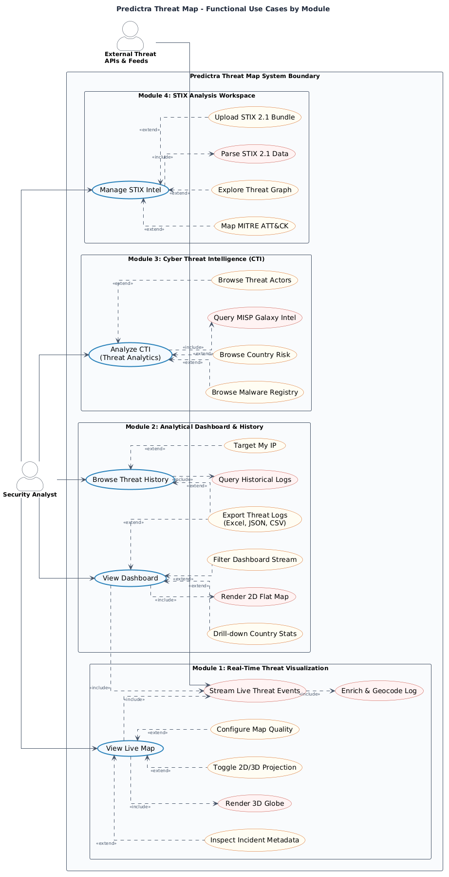
CHAPTER 2 — CONCEPTUAL STUDY
System Boundaries & Global Use Case
Actors & Use Case Boundaries
This model structures system actors and boundaries:
• System Actor: External Threat Feeds
Continuously pushes Indicators of Compromise (IOCs) to trigger ingestion without human intervention.
• Human Actor: Security Analyst
Interacts with the Web UI to monitor live feeds, search history, upload local STIX files, and export reports.
Notes:
Brahim: This is our Global Use Case diagram, showing the system boundaries and interactions. The primary system actor is the set of External Threat Feeds, which automatically trigger backend ingestion. The human actor is the Security Analyst, who monitors the 3D globe and dashboard, filters threat logs, searches historical data, uploads STIX bundles, and exports reports. This diagram establishes the foundational boundaries of the Predictra Threat Map.

Slide 9
CHAPTER 2 — CONCEPTUAL STUDY
System Requirements
Functional Requirements (RF-1 to RF-9)
• Ingest from 9+ feeds asynchronously.
• Resolve IP geolocation and 5-layer target sector.
• Stream real-time data using SSE heartbeat.
• Render WebGL 3D Globe with animated attack arcs.
• Client-side STIX 2.1 parsing & MITRE ATT&CK map.
• Searchable log browser with pagination & filters.
• "Target My IP" geolocation and Excel export.
Non-Functional Requirements (RNF-1 to RNF-5)
• RNF-1 (Fluidity): Maintain 60fps Earth rendering.
• RNF-2 (Memory): 10,000-event circular RingBuffer.
• RNF-3 (Database): MongoDB 30-day TTL auto-expire.
• RNF-4 (Limit Guard): switch to in-memory streaming and stop DB writes if MongoDB exceeds 500MB.
• RNF-5 (Design): Premium dark glassmorphism interface to prevent visual analyst strain.
Notes:
Brahim: We defined 9 functional requirements, denoted RF-1 to RF-9. These include multi-feed ingestion, geolocation enrichment, target sector classification, real-time SSE streaming, the 3D WebGL globe, client-side STIX parsing, MITRE ATT&CK mapping, historical log searching, and the 'Target My IP' feature. Our non-functional requirements cover 60fps fluidity, circular memory buffer, 30-day database TTL, a 500MB quota guard, and a premium dark glassmorphism layout to reduce SOC analyst fatigue.

Slide 10
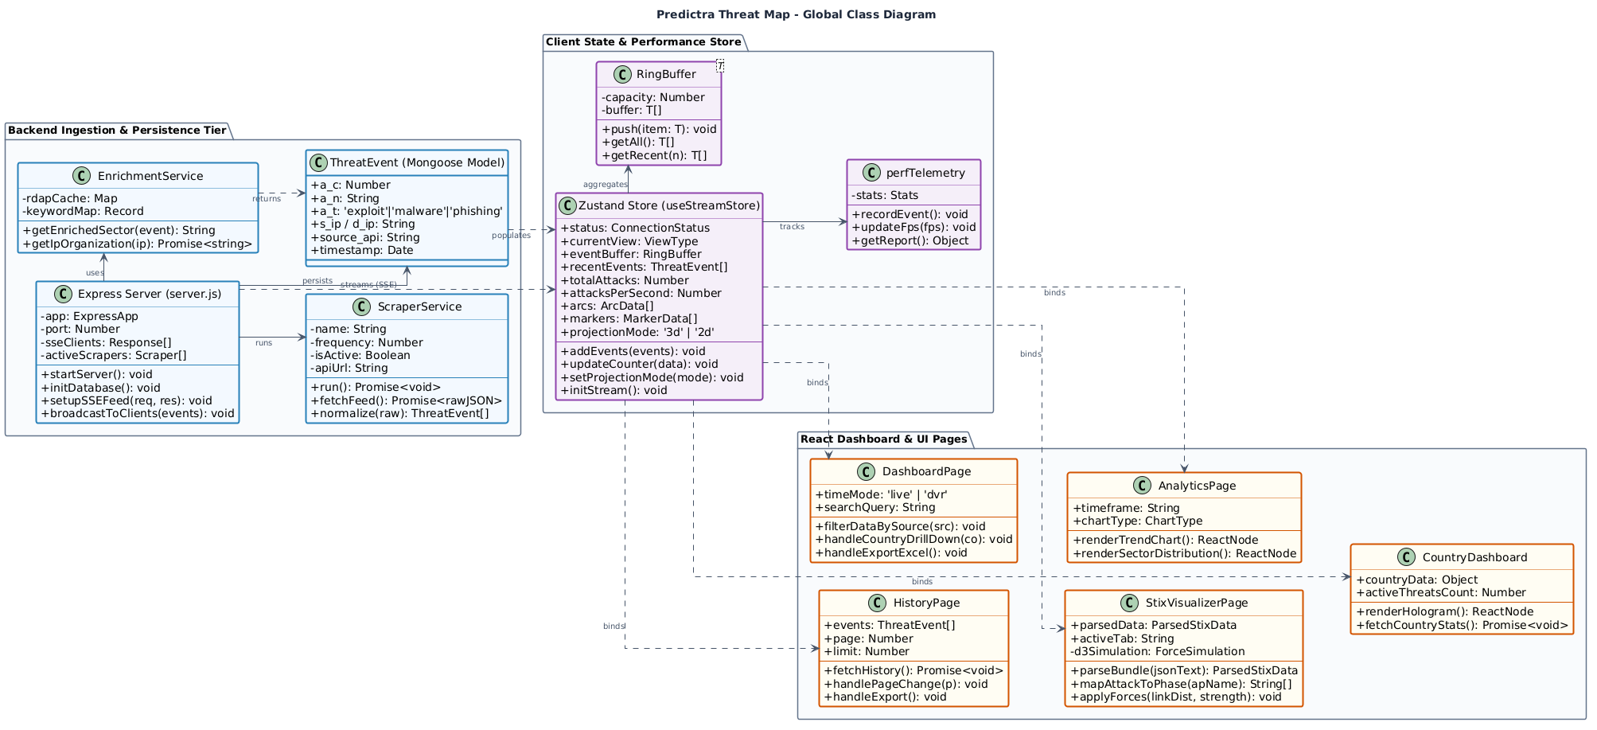
CHAPTER 2 — CONCEPTUAL STUDY
Structural Modeling: Global Class Diagram
System Object Architecture
The static structure consists of three key architectural blocks:
1. Ingestion & Service Tier (Backend):
ExpressServer, ScraperService subclasses, EnrichmentService, Mongoose models.
2. State Store Tier (Frontend):
Zustand useStreamStore holding a circular RingBuffer and perfTelemetry loop.
3. React Views Layer:
Dashboard, STIXWorkspace, AnalyticsPage subscribing to store slices.
Notes:
Chiheb: This is our Global Class Diagram, showing the structural design of the platform. In the Backend tier, the Express Server schedules multiple Scraper Services, which feed into the Enrichment Service to resolve geolocations and sectors. The Zustand Store manages frontend state with a circular RingBuffer and performance telemetry. The React Views, such as the Dashboard, STIX Workspace, and Analytics page, subscribe directly to Zustand slices for reactivity.

Slide 11
CHAPTER 2 — CONCEPTUAL STUDY
Technology Stack Comparative Analysis
Layer
Selected Stack
Alternative
Architectural Rationale
Backend Runtime
Node.js / Express 5
Java Spring Boot
Asynchronous loop; high SSE concurrency
State Management
Zustand 5
Redux Toolkit
Reactive store outside React render loop
3D Graphics engine
Three.js / React Three Fiber
Vanilla HTML Canvas
GPU acceleration, custom GLSL shaders
Database Tier
MongoDB Atlas (BSON)
PostgreSQL
Flexible schemaless BSON for raw feeds
Notes:
Chiheb: For the backend runtime, we selected Node.js and Express 5 over Java Spring Boot due to its non-blocking asynchronous event loop, which is perfect for streaming SSE connections under low memory footprints. For state management, we chose Zustand 5 over Redux for high-speed reactive updates outside the React DOM tree, preserving WebGL rendering cycles. For graphics, we used Three.js and React Three Fiber to build custom shaders with GPU acceleration. For the database, we chose MongoDB Atlas for its schemaless structure.

Slide 12
CHAPTER 2 — CONCEPTUAL STUDY
System Architecture
Frontend (Vercel CDN)
• React Single Page App served via global Edge networks.
• Zustand state-store for real-time reactivity.
• Vercel configuration proxy routing rules to prevent CORS blocks.
Backend (Cloud VM)
• Express REST APIs + SSE event broadcast loop.
• PM2 Clustering to distribute scraping workload across multiple CPU cores.
• Ingestion schedulers managing 9 parallel scrapers.
Database (MongoDB)
• Cloud-hosted replicated BSON cluster.
• Automated 30-day Time-To-Live (TTL) storage pruning indexes.
• Storage monitoring: switches to in-memory streaming if DB size hits 500MB.
Notes:
Chiheb: Our system architecture is split into three main tiers. The Frontend is built in React and served via Vercel CDN, utilizing API routing proxies to eliminate cross-origin resource sharing blocks. The Backend runs on a Cloud VM using PM2 process clustering across CPU cores for automatic crash recovery. The Database tier uses MongoDB Atlas with a replicated cluster, automatic TTL pruning, and size-based quota guards.

Slide 13
CHAPTER 3 — SPRINTS 1 & 2
Sprint 1 & 2: Ingestion & 3D Math
Ingestion Scrapers (9 Feeds)
• Feeds: Checkpoint SSE, Bitdefender WebSockets, FortiGuard REST, URLhaus, Kaspersky, OTX, RansomWatch, C2 Tracker, MISP Galaxy.
• Compact BSON schema compresses JSON models, shrinking database footprint by 60% (200B → 80B per threat document).
5-Layer Enrichment logic
• Layered classification rules (port map, keywords, regex tags, MISP actors, feed defaults).
• Asynchronous RDAP owner lookups with a 3-second timeout cache to prevent API blocks.
3D Spherical Coordinate Math
• Convert coordinates (lat/lon) to 3D vectors via spherical trig.
• Attack arcs compute using Spherical Linear Interpolation (SLERP), combined with quadratic Bezier curves lifting longer paths higher above Earth.
Notes:
Brahim: In Sprints 1 and 2, we built the core ingestion and 3D visualization. We integrated 9 distinct feeds and compressed the BSON schema from 200 bytes to 80 bytes. The enrichment logic resolves geocoding and victim sector using a 5-layer engine. For the 3D globe, geographic coordinates are converted to Cartesian vectors, and attack arcs are animated using SLERP and Bezier elevation math.

Slide 14
CHAPTER 3 — SPRINT 2
Sprint 2: WebGL Custom Shaders
1. Atmospheric Glow
• Custom Fresnel-effect vertex and fragment shaders.
• Dot-product vector math computes viewing angle falloff, rendering a neon cyberblue glow around the Earth's silhouette.
2. Neon Country Borders
• 5 overlapping TopoJSON vector layers placed at microscopic radial scales (R = 1.002 to 1.010).
• Decreasing opacity scales simulate a glowing country border outline effect on the globe mesh.
3. Bloom Post-Processing
• Three.js EffectComposer with UnrealBloomPass shader.
• Luminance threshold set to 0.15 makes the severity-colored attack arcs glow like fiber-optic light strings.
Notes:
Brahim: To make the globe visually stunning, we wrote custom WebGL shaders. The Atmospheric Glow uses a Fresnel-effect vertex and fragment shader. Neon Country Borders are rendered using 5 overlapping TopoJSON vector layers with decreasing opacities. Finally, Bloom Post-Processing applies a luminosity threshold to make severity-colored attack arcs glow like neon light fibers.

Slide 15
CHAPTER 4 — SPRINTS 3 & 4
Sprint 3 & 4: STIX, MITRE & Performance
STIX 2.1 Workspace
• Client-side JSON parser processes files in browser (zero server upload ensures analyst privacy).
• Interactive D3 Force-Directed Graph shows relationships (Verlet integration).
MITRE ATT&CK Matrix
• Maps parsed STIX indicators to 12 ATT&CK kill chain phases.
• Real-time aggregations highlight critical adversary tactics.
Performance Guardrails
• Circular RingBuffer manages memory allocation in O(1) time.
• Adaptive Event Sampling checks FPS. If FPS drops below 55, it drops 50% of visual arcs; if below 30, it drops 75% to preserve smoothness.
Notes:
Chiheb: Sprints 3 and 4 introduced STIX parsing, MITRE mapping, and performance guards. The STIX 2.1 parser runs completely in the browser for privacy, mapping techniques to 12 MITRE phases. The D3 graph uses Verlet integration to layout nodes. To maintain 60fps, we built a circular RingBuffer and an Adaptive Event Sampling loop that drops up to 75% of visual events under heavy CPU load.

Slide 16
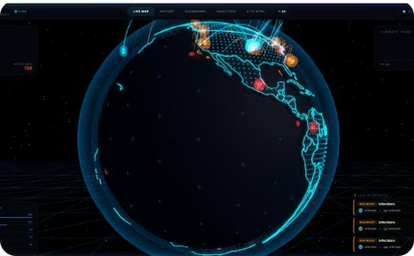
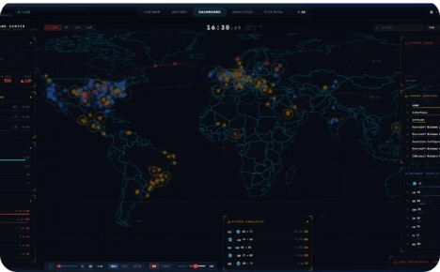
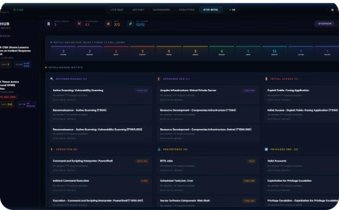
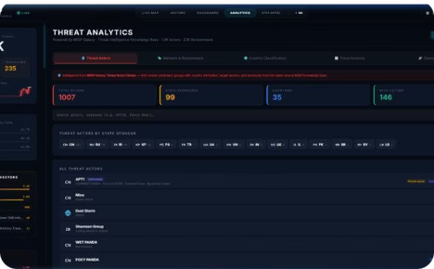
CHAPTER 4 — REALIZATION
Application Interfaces Overview
1. 3D Live Threat Map
Interactive WebGL Earth showing real-time arcs, glowing outlines, and country highlight panels.
2. System Dashboard
Tactical command center displaying volume sparklines, 2D flat map toggles, and country statistics.
3. STIX Workspace
JSON bundle ingestion, relationship force graphs, and technique mapping grids.
4. Analytics Dashboard
Aggregation analytics showing targeted sector metrics, actor trends, and country matrices.
Notes:
Brahim: Here is an overview of our application interfaces. The 3D Live Threat Map displays the rotating Earth with glowing arcs. The System Dashboard provides real-time metrics, country statistics, and a 2D flat map. The STIX Intelligence Workspace features the D3 graph and the MITRE ATT&CK grid. Finally, the Analytics Dashboard aggregates threat metrics, sector distributions, and trends.

Slide 17
CHAPTER 4 — REALIZATION
Technical Challenges Resolved
1. Visual Interface Lag
Cause: Browser canvas bottleneck when processing >500 attacks per second.
Fix: Implemented a 300ms event grouping queue, capped active arcs to 150, and created our custom adaptive FPS sampling engine to drop visual arcs under heavy CPU load.
2. Database Limits
Cause: MongoDB Atlas free tier quotas are easily exhausted by continuous threat feeds.
Fix: Field name compression (BSON models), automated 30-day index TTL pruning, and a 500MB quota guard that stops DB writes to stream data in-memory only.
3. CORS Deployment Blocks
Cause: Browser security prevents React on localhost/Vercel from reading the API on a separate cloud VM.
Fix: Implemented Vercel reverse-proxy redirect rules (`vercel.json`), routing all backend API calls through internal paths to bypass CORS headers.
Notes:
Brahim: During the realization, we successfully resolved three major technical hurdles. First, visual lag was mitigated by event batching, arc limits, and adaptive sampling. Second, database capacity constraints were addressed using BSON compression, MongoDB TTLs, and a 500MB write guard. Third, CORS deployment blocks were resolved via Vercel proxy configuration rules.

Slide 18
CHAPTER 5 — CONCLUSION & PERSPECTIVES
Future Perspectives & Roadmap
Kafka Distributed Ingestion
Decouple scrapers from the server. Scrapers publish events directly to Apache Kafka topics, and the Express runtime consumes streams from Kafka. This prevents server crashes during high traffic.
Predictive ML Extensions
Train ML models (LSTM/time-series) on historical threat databases to forecast attack spikes and sector-targeted waves. These predictions can be overlayed as visual heatmaps on the 3D globe.
Sharded Database Clustering
Partition MongoDB clusters geographically by country code. Queries for regional metrics will route only to the corresponding server slice, minimizing indexing latency and scaling indefinitely.
Notes:
Chiheb: Looking ahead, we have designed a future roadmap focusing on three phases. First, Kafka Distributed Ingestion to decouple backend scraping from the client streaming runtime. Second, Predictive ML Extensions to forecast attack waves and overlay predictive heatmaps on the Earth. Third, Sharded Geo-Database Clustering to partition MongoDB by country code to speed up regional queries.

Slide 19
CHAPTER 5 — CONCLUSION & PERSPECTIVES
General Conclusion
Technical & Operational Impact
• Ingestion & Streaming:
Successful integration of 9+ live threat APIs, normalized schema, and high-performance Server-Sent Events stream.
• 3D WebGL UI Visuals:
A premium 60fps interactive Earth showing curved attack vectors, neon outlines, and custom GLSL atmospheric glows.
• SOC Analyst Efficiency:
Reduces compromise dwell time from 200+ days to seconds by replacing spreadsheet lists with high-impact visual spatial coordinates.
Academic & Professional Growth
• Agile Scrum Application:
Twice-weekly rituals, code merges, story points track, and demonstrable increments delivered at each review.
• Systems Engineering:
Applied rigorous architectural structures, state store abstractions, and database optimization strategies.
• Cybersecurity Focus:
Deep study of Indicator of Compromise (IOC) types, STIX 2.1 schemas, and MITRE ATT&CK kill chain matrices.
Thank You for Your Attention — Questions Welcome
Notes:
Chiheb: In conclusion, the Predictra Threat Map successfully bridges the visibility gap in cyber defense. It integrates 9+ feeds, feeds a 3D WebGL globe at 60fps, and features a STIX 2.1 parser. It reduces dwell time from months to seconds. This project demonstrates a rigorous academic and engineering contribution. Thank you for your time, and we welcome any questions you may have.

