Slide 1
PREDICTRA
THREAT MAP
Design & Development of a Real-Time Spatialized
Threat Intelligence Visualization Platform
AUTHORS Brahim JABALLI & Chiheb AMRI SUPERVISOR Mr. Anis DHAHRI — ISET Gafsa
HOST ORGANIZATION Predictra Cybersecurity ACADEMIC YEAR 2025 / 2026 · Computer System Development
Jury: Ms. Hadhami ISSAOUI (President) · Mr. Walid HAMMEMI (Reporter)
Notes:
Brahim: Good morning, ladies and gentlemen of the jury. Welcome to our graduation defense for our Bachelor's Degree in Information Technology. My name is Brahim Jaballi, and alongside my colleague Chiheb Amri, we are proud to present our final year project: the 'Predictra Threat Map'. This project, conducted under the supervision of Mr. Anis Dhahri at ISET Gafsa, and in collaboration with host company Predictra Cybersecurity, focuses on the design and development of a real-time spatialized threat intelligence visualization platform. We would also like to thank Ms. Hadhami Issaoui and Mr. Walid Hammemi for presiding and reporting on our defense today.

Slide 2
AGENDA
Presentation Outline
01
02
03
04
05
Introduction
Pre-Study
Conceptual Study
Realization
Conclusion
▸ Global threat landscape
▸ Expanding attack surface
▸ Strategic threat intel
▸ Host company profile
▸ The critical problematic
▸ Proposed 4-layer solution
▸ Agile Scrum model
▸ System actors & boundaries
▸ Functional requirements
▸ Use Case & Class models
▸ Technology stack
▸ System architecture
▸ 9 threat feed scrapers
▸ 5-layer enrichment engine
▸ SSE streaming pipeline
▸ STIX & MITRE mapping
▸ Performance guardrails
▸ Achievement summary
▸ Sprint retrospective
▸ Kafka & ML roadmap
Notes:
Brahim: To guide you through our presentation, we have structured our defense into five key chapters. I will begin with the Introduction and the Pre-Study, outlining the cybersecurity landscape, our problematic, and the Agile Scrum methodology. Next, we will present our Conceptual Study, including system actors, requirements, use cases, and architecture. We will then dive into the Realization phase, detailing our 9 threat feed scrapers, enrichment engine, and streaming pipeline. Finally, we will conclude with a retrospective and future perspectives.

Slide 3
CHAPTER 1 — INTRODUCTION
General Introduction
THE STRATEGIC SHIFT TO PROACTIVE DEFENSE "If you know the enemy and know yourself, you need not fear the result of a hundred battles." — Sun Tzu, The Art of War Defenders must pivot from reactive, perimeter-based alerts (Firewalls & antivirus) to proactive external visibility. By collecting, normalizing, and spatializing threat feeds, we anticipate campaigns before they penetrate our perimeter.
Expanded Attack Surface
Hyper-connectivity, cloud infrastructure, and distributed microservices have multiplied threat exposure points, making manual tracking impossible.
▸ 4.7B internet users · IoT devices exceed 15B globally
Evolved Adversaries
Attackers are no longer lone hackers but structured cartels, nation-states, and automated botnets operating rapid campaigns at scale.
▸ Average cost of a data breach: $4.45M (IBM 2023)
Notes:
Brahim: Let us start with the introduction. Today, corporate networks and cloud platforms are faced with an expanded attack surface. Highly coordinated threat groups launch disruptive operations globally. As Sun Tzu wrote in The Art of War: 'If you know the enemy and know yourself, you need not fear the result of a hundred battles.' In cybersecurity, this means shifting from a reactive posture to a proactive threat intelligence model.

Slide 4
CHAPTER 1 — PRE-STUDY
Project Context & Host Organization
Host: Predictra Cybersecurity
CORPORATE STRUCTURE
An AI-driven Cyber Threat Intelligence (CTI) firm that focuses on democratizing raw threat datasets into immediate, visually actionable insights for enterprise SOCs.
Predictra Board
Threat Research Department
Security Engineering Department
Sales & operation Department
The Dwell Time Target
The global average dwell time for compromise detection exceeds 200 days.
▸ Our mission: Shrink this window from months to real-time seconds with spatialized visualization.
Notes:
Brahim: Our host organization, Predictra Cybersecurity, is an AI-driven Cyber Threat Intelligence firm. Their goal is to democratize threat intelligence, transforming raw feeds into actionable visual insights. A critical industry metric is the compromise dwell time, which globally averages over 200 days. Our Threat Map aims to shrink this window from months to seconds by providing immediate, real-time visibility.

Slide 5
CHAPTER 1 — PRE-STUDY
The Critical Problematic
1
Spreadsheet Overload
2
Lack of Spatial Context
3
Data Heterogeneity
SOC analysts are overwhelmed by raw, static text logs.
Staring at thousands of text rows causes fatigue and delays detection of critical anomalies.
Traditional grids omit geography.
Security teams cannot visualize where attacks originate, which sectors are targeted, or global campaign vectors.
Threat feeds are scattered across separate APIs, WebSocket channels, and raw CSV files.
Formats, schemas, and protocols are incompatible, blocking immediate analysis.
Notes:
Brahim: The core problem we address is threefold. First, spreadsheet overload — SOC analysts suffer from visual fatigue reading thousands of static logs. Second, lack of spatial context — traditional dashboards fail to show attack origins geographically. Third, data heterogeneity — threat feeds are scattered across multiple vendors in incompatible formats.

Slide 6
CHAPTER 1 — PRE-STUDY
The Proposed Solution: 4-Layer Architecture
1
2
3
4
Ingestion Layer
Enrichment Layer
Streaming Layer
Visualization Layer
9 asynchronous, non-blocking scrapers harvest threat data from Checkpoint SSE, Bitdefender WebSocket, FortiGuard REST, URLhaus, AlienVault OTX, Kaspersky, RansomWatch, C2 Tracker, and MISP Galaxy.
5-layer classification engine: keyword matching, RDAP organization lookup, port-based inference, MISP Galaxy sectors, and feed-source defaults — tagging targets into 9 critical industries.
Server-Sent Events (SSE) broadcasting queue with 300ms batch flush and 500-event staging cap. Bulk MongoDB inserts every 25 documents.
Interactive 3D WebGL Earth at 60fps with curved attack arcs, D3 force graph for STIX relationships, and MITRE ATT&CK kill chain grid.
▶
▶
▶
Notes:
Brahim: To solve this, we propose the Predictra Threat Map built on four layers. The Ingestion Layer harvests data from 9 different threat feeds using multiple protocols — SSE for Checkpoint, WebSocket for Bitdefender, REST polling for FortiGuard and others. The Enrichment Layer uses a 5-layer classification engine including keyword matching, RDAP lookups, and port-based inference. The Streaming Layer batches events every 300ms via SSE. The Visualization Layer renders the data on a 3D globe with STIX and MITRE mapping.

Slide 7
CHAPTER 1 — PRE-STUDY
Agile Scrum Methodology
4 Sprints & Agile Rituals
Sprint 1: Ingestion Infrastructure
9 feed scrapers (Checkpoint SSE, Bitdefender WS, FortiGuard REST, URLhaus, AlienVault, Kaspersky, RansomWatch, C2 Tracker, MISP Galaxy), MongoDB schema, BSON compression.
We ran a 12-week development cycle with clear team velocity metrics (25-30 SP/sprint).
Twice-Weekly Rituals:
▸ Thursdays: Code integrations, feed scraper testing, performance checks.
▸ Sundays: Architectural consolidations, LaTeX report reviews.
Result: 48+ collaborative sessions delivering a fully testable, production-ready release increment at each review.
Sprint 2: Streaming & Visualization
SSE /api/feed endpoint, 300ms batch flush, Zustand state store, 3D Globe with attack arcs.
Sprint 3: STIX Intelligence Workspace
Client-side STIX 2.1 parser, D3 relationship force graph, MITRE ATT&CK matrix.
Sprint 4: Analytics & Guardrails
Paginated log browser, Target My IP, Excel export, Adaptive FPS sampling, 500MB quota guard.
Notes:
Brahim: We adopted the Agile Scrum methodology over 4 sprints and 12 weeks. Sprint 1 was the heaviest — building all 9 feed scrapers: Checkpoint via Server-Sent Events, Bitdefender via socket.io WebSocket, FortiGuard via REST polling every 4 seconds, URLhaus via REST polling every 90 seconds, AlienVault OTX, Kaspersky, RansomWatch for ransomware leak tracking, C2 Tracker for command-and-control servers, and MISP Galaxy for APT actor intelligence. Sprint 2 built the streaming pipeline and globe. Sprint 3 added STIX parsing. Sprint 4 added analytics and performance guardrails.

Slide 8
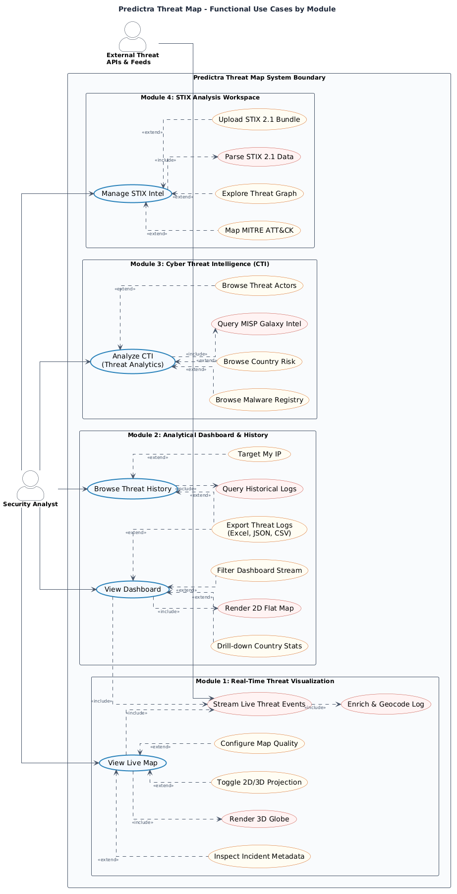
CHAPTER 2 — CONCEPTUAL STUDY
System Boundaries & Global Use Case
Actors & Use Case Boundaries
GLOBAL USE CASE DIAGRAM
This model structures system actors and boundaries:
▸ System Actor: External Threat Feeds
9 parallel scrapers continuously push Indicators of Compromise (IOCs) into the ingestion pipeline.
▸ Human Actor: Security Analyst
Interacts with the Web UI to monitor live feeds, search history, upload STIX bundles, and export reports.
Notes:
Brahim: This is our Global Use Case diagram. The primary system actor is the set of 9 External Threat Feed scrapers that automatically trigger backend ingestion. The human actor is the Security Analyst who monitors the dashboard, filters threat logs, uploads STIX bundles, and exports reports.

Slide 9
CHAPTER 2 — CONCEPTUAL STUDY
System Requirements
Functional Requirements (RF-1 to RF-9)
Non-Functional Requirements (RNF-1 to RNF-5)
▸ RF-1: Ingest from 9+ feeds asynchronously (SSE, WebSocket, REST).
▸ RF-2: Resolve IP geolocation via geoip-lite dictionary.
▸ RF-3: Classify victim sectors using 5-layer enrichment engine.
▸ RF-4: Stream events via SSE with 300ms batch flush.
▸ RF-5: Render interactive 3D Globe with attack arcs.
▸ RF-6: Client-side STIX 2.1 parsing & MITRE ATT&CK map.
▸ RF-7: Searchable log browser with pagination & filters.
▸ RF-8: "Target My IP" geolocation feature.
▸ RF-9: Excel export for threat data.
▸ RNF-1 (Fluidity): Maintain 60fps rendering.
▸ RNF-2 (Memory): 10,000-event circular RingBuffer.
▸ RNF-3 (Database): MongoDB 30-day TTL auto-expire.
▸ RNF-4 (Limit Guard): Switch to in-memory streaming if MongoDB exceeds 500MB.
▸ RNF-5 (Design): Premium glassmorphism interface to prevent analyst strain.
Notes:
Brahim: We defined 9 functional requirements. These include multi-feed ingestion using SSE, WebSocket, and REST protocols, IP geolocation via geoip-lite dictionary, sector classification using our 5-layer enrichment engine, real-time SSE streaming with 300ms batch flush, 3D globe rendering, STIX parsing, MITRE mapping, log search, Target My IP, and Excel export. Non-functional requirements cover 60fps fluidity, circular memory buffer, 30-day database TTL, a 500MB quota guard, and a premium dark glassmorphism layout.

Slide 10
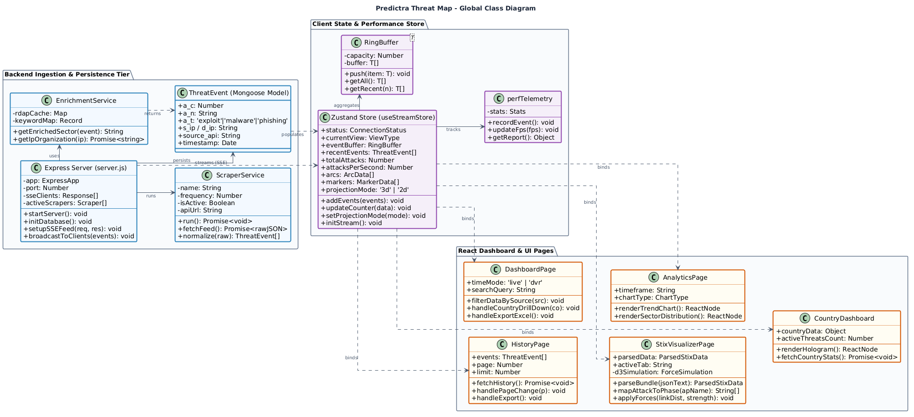
CHAPTER 2 — CONCEPTUAL STUDY
Structural Modeling: Global Class Diagram
System Object Architecture
GLOBAL CLASS DIAGRAM
The static structure has three tiers:
1. Ingestion & Service Tier (Backend):
ExpressServer orchestrates 9 ScraperService subclasses. Each scraper maps vendor-specific formats to a unified ThreatEvent BSON schema. EnrichmentService resolves sectors.
2. State Store Tier (Frontend):
Zustand useStreamStore with circular RingBuffer and perfTelemetry loop.
3. React Views Layer:
Dashboard, STIXWorkspace, AnalyticsPage subscribe to store slices.
Notes:
Chiheb: This is our Global Class Diagram. In the Backend tier, the Express Server orchestrates 9 Scraper Service subclasses — each one handling a different vendor protocol (SSE, WebSocket, REST). They all map to a unified ThreatEvent BSON schema. The Enrichment Service resolves sectors using keyword matching, RDAP lookups, port inference, and MISP Galaxy data. The frontend uses Zustand for reactive state management with a circular RingBuffer.

Slide 11
CHAPTER 2 — CONCEPTUAL STUDY
Technology Stack Comparative Analysis
LAYER
SELECTED STACK
ALTERNATIVE
ARCHITECTURAL RATIONALE
Backend Runtime
Node.js / Express 5
Java Spring Boot
Async event loop; native SSE/WS concurrency
State Management
Zustand 5
Redux Toolkit
Reactive store outside React render loop
3D Graphics
Three.js / R3F
Vanilla Canvas
GPU acceleration, custom GLSL shaders
Database
MongoDB Atlas
PostgreSQL
Flexible schemaless BSON for raw feeds
Deployment
Vercel + Cloud VM
AWS EC2 + S3
CDN edge, zero-config CI/CD
Notes:
Chiheb: We selected Node.js and Express 5 for the backend because its non-blocking event loop natively supports SSE and WebSocket concurrency — critical for our 9 simultaneous scraper connections. Zustand 5 for frontend state gives us reactive updates outside the React render loop. Three.js for the globe, MongoDB Atlas for schemaless BSON, and Vercel for zero-config deployment.

Slide 12
CHAPTER 2 — CONCEPTUAL STUDY
System Architecture
Frontend (Vercel CDN)
Backend (Cloud VM)
Database (MongoDB)
▸ React SPA served via global Edge networks.
▸ Zustand state-store for real-time reactivity.
▸ Vercel proxy routing to prevent CORS blocks.
▸ Express REST APIs + SSE event broadcast.
▸ PM2 Clustering across CPU cores.
▸ 9 parallel ingestion scrapers.
▸ Cloud-hosted replicated BSON cluster.
▸ Automated 30-day TTL storage pruning.
▸ 500MB quota guard for in-memory fallback.
▶
▶
Notes:
Chiheb: Our system architecture has three tiers. The Frontend React SPA is served via Vercel CDN with proxy routing to eliminate CORS issues. The Backend runs on a Cloud VM with PM2 clustering and 9 parallel ingestion scrapers. The Database tier uses MongoDB Atlas with 30-day TTL pruning and a 500MB quota guard.

Slide 13
CHAPTER 3 — SPRINT 1
Threat Feed Scrapers: 9 Parallel Sources
Checkpoint
SSE
Real-time
Bitdefender
WebSocket
Real-time
FortiGuard
REST
4s poll
Server-Sent Events stream from threatmap-api.checkpoint.com. Parses attack type, source/dest coords, country codes.
Socket.io client subscribes to 13 channels (botnet, portscan, telnet, SSH, RDP, VNC, MySQL, HTTP, IoT, spam).
Polls /api/threatmap/live/outbreak endpoint with outbreak_id tracking. Extracts time-sliced attack events with severity.
URLhaus
REST
90s poll
AlienVault
REST
60s poll
Kaspersky
REST
60s poll
Fetches active malicious URLs from abuse.ch API. Resolves host IPs via geoip-lite for source coordinates.
Queries OTX API for latest IoC pulses. Maps pulse indicators to geographic attack events.
Scrapes Kaspersky cybermap data feed. Extracts malware detections with country-level coordinates.
RansomWatch
REST
5min poll
C2 Tracker
REST
5min poll
MISP Galaxy
REST
Boot + 6h
Monitors ransomware gang leak sites. Tracks victim organizations and maps to Finance/Business sector.
Tracks active Command & Control server IPs. Geolocates C2 infrastructure for IT sector mapping.
Loads APT actor profiles with target sectors, motivation, and attributed TTPs from MISP Galaxy clusters.
Notes:
Brahim: Our ingestion layer consists of 9 parallel scrapers, each using a different protocol. Checkpoint connects via Server-Sent Events for real-time streaming. Bitdefender uses a socket.io WebSocket client subscribing to 13 attack channels including botnet, SSH, RDP, VNC, MySQL, HTTP, IoT, and spam. FortiGuard polls a REST endpoint every 4 seconds tracking active outbreak IDs. URLhaus polls abuse.ch every 90 seconds for active malicious URLs. AlienVault queries OTX pulses. Kaspersky scrapes cybermap data. RansomWatch monitors ransomware leak sites. C2 Tracker tracks command-and-control infrastructure. MISP Galaxy loads APT actor profiles at boot and refreshes every 6 hours.

Slide 14
CHAPTER 3 — SPRINT 1
5-Layer Sector Enrichment Engine
Keyword Matching (Victim Name)
Regex word-boundary search on victim hostname against 9 sector keyword dictionaries (healthcare, finance, government, education, energy, technology, manufacturing, retail, telecom).
1
HIGHEST
Keyword Matching (Combined Text)
Broadens search to concatenated attack name + malware family + threat type. Falls back to this if victim-name match fails.
2
LAYER 2
Port-Based Inference
Maps network ports to sectors: HTTP/HTTPS → Web Services, MySQL/PostgreSQL/MongoDB → Database, SSH/DNS → IT, SMB/RDP → Enterprise, SMTP/POP → Email.
3
LAYER 3
MISP Galaxy Sector Tags
Reads target_sectors from MISP Galaxy APT actor metadata. Maps tags like 'government', 'private sector', 'health', 'energy' to enriched sector labels.
4
LAYER 4
Source-API Fallback
Final fallback using the scraper source identifier: ransomwatch → Finance, c2tracker → IT Infrastructure, urlhaus → Web Services, others → General.
5
LOWEST
+ RDAP Organization Lookup: Async IP owner query via rdap.org → ARIN/RIPE registries with 3-second timeout cache
Notes:
Brahim: Our enrichment engine uses a 5-layer priority cascade to classify every attack into one of 9 industry sectors. Layer 1 performs regex keyword matching on the victim hostname — if it contains 'hospital', 'bank', 'university', etc., we get a high-confidence match. Layer 2 broadens the search to combined text. Layer 3 uses port-based inference — MySQL port 3306 maps to Database Services, SSH port 22 to IT Infrastructure. Layer 4 reads MISP Galaxy APT actor target sectors. Layer 5 is a source-API fallback. We also have an async RDAP organization lookup with a 3-second timeout cache.

Slide 15
CHAPTER 3 — SPRINT 2
SSE Streaming Pipeline & Batch Engine
Batching Infrastructure
BSON Schema Compression
Instead of writing one SSE message per event (causing browser processing storms), we queue all incoming attacks and flush them as a single JSON array every 300ms.
▸ BATCH_INTERVAL_MS = 300ms — flush interval
▸ MAX_PENDING = 500 — hard cap with oldest-drop
▸ BATCH_DB_INSERT = 25 — bulk MongoDB inserts
This cuts SSE writes and frontend Zustand updates by ~50×, preventing rendering storms while maintaining real-time feel.
Database quota guard: if MongoDB exceeds 500MB, the system stops DB writes and streams events in-memory only.
Compact field names shrink each threat document from 200 bytes to 80 bytes (60% reduction):
▸ a_c (attack count) · a_n (attack name) · a_t (attack type)
▸ s_ip / s_co / s_la / s_lo (source fields)
▸ d_ip / d_co / d_la / d_lo (destination fields)
▸ meta {} (scraper-specific metadata)
Unified Event Schema
All 9 scrapers map vendor-specific formats to a single ThreatEvent model. Each scraper handles protocol-specific parsing (SSE JSON, WebSocket payloads, REST responses) and normalizes to unified coordinates + attack metadata.
▸ Country code normalization (RF → RU)
▸ Same-region jitter for overlapping coordinates
▸ 30-day MongoDB TTL index auto-expiry
Notes:
Chiheb: Our streaming pipeline uses a 300ms batch flush instead of per-event SSE writes. This cuts frontend Zustand updates by 50×. We use a 500-event staging queue with oldest-drop, and bulk MongoDB inserts every 25 documents. The BSON schema uses compact field names — a_c for attack count, s_ip for source IP — shrinking each document from 200 bytes to 80 bytes. All 9 scrapers normalize to a unified ThreatEvent schema with country code normalization and coordinate jitter.

Slide 16
CHAPTER 4 — SPRINTS 3 & 4
STIX Intelligence, MITRE Mapping & Performance
STIX 2.1 Workspace
MITRE ATT&CK Matrix
Performance Guardrails
▸ Client-side JSON parser processes files in browser (zero server upload ensures analyst privacy).
▸ Interactive D3 Force-Directed Graph visualizes object relationships using Verlet integration physics.
▸ Maps parsed STIX indicators to 12 ATT&CK kill chain phases.
▸ Real-time aggregations highlight critical adversary tactics and techniques.
▸ Circular RingBuffer manages memory in O(1) time with 10,000-event cap.
▸ Adaptive Event Sampling: FPS < 55 → drop 50%; FPS < 30 → drop 75% for smoothness.
Notes:
Chiheb: Sprints 3 and 4 introduced STIX parsing, MITRE mapping, and performance guards. The STIX 2.1 parser runs completely in the browser for privacy, mapping techniques to 12 MITRE phases. To maintain 60fps, we built a circular RingBuffer and Adaptive Event Sampling that drops up to 75% of visual events under heavy CPU load.

Slide 17
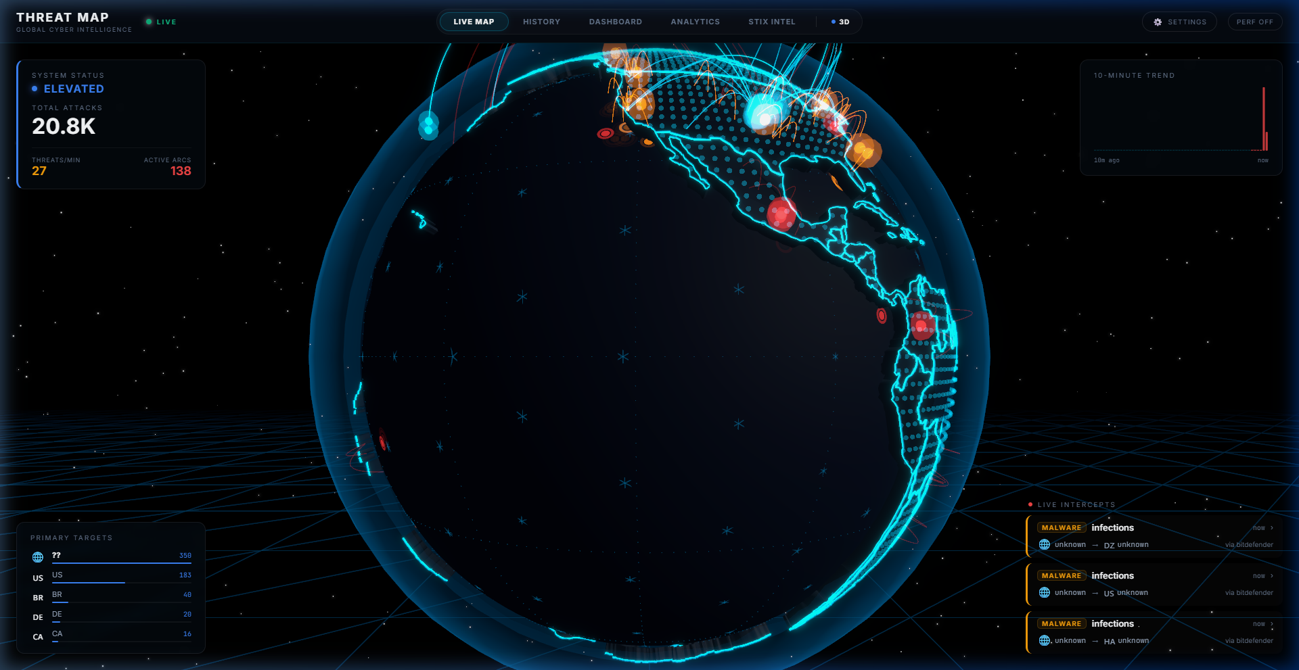
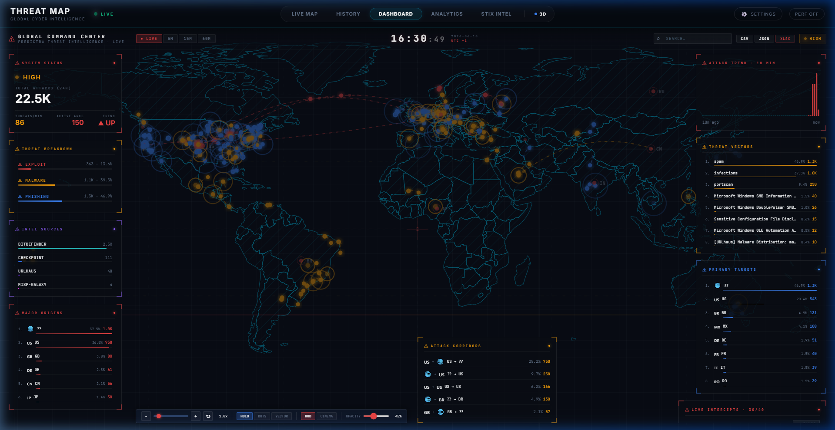
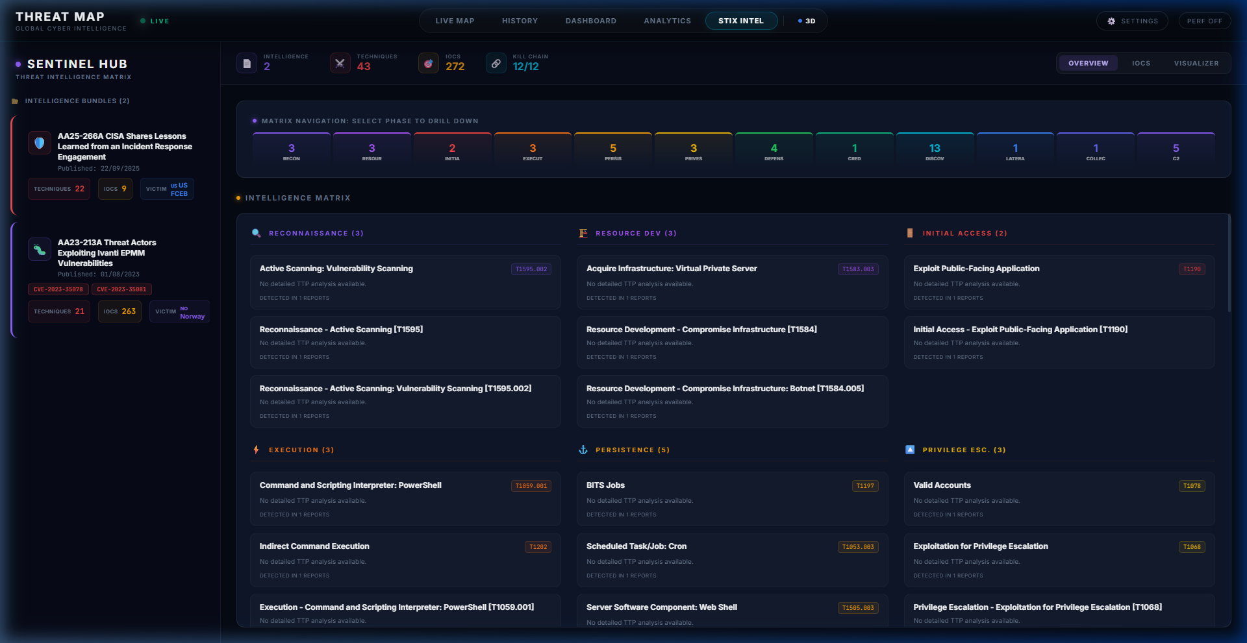
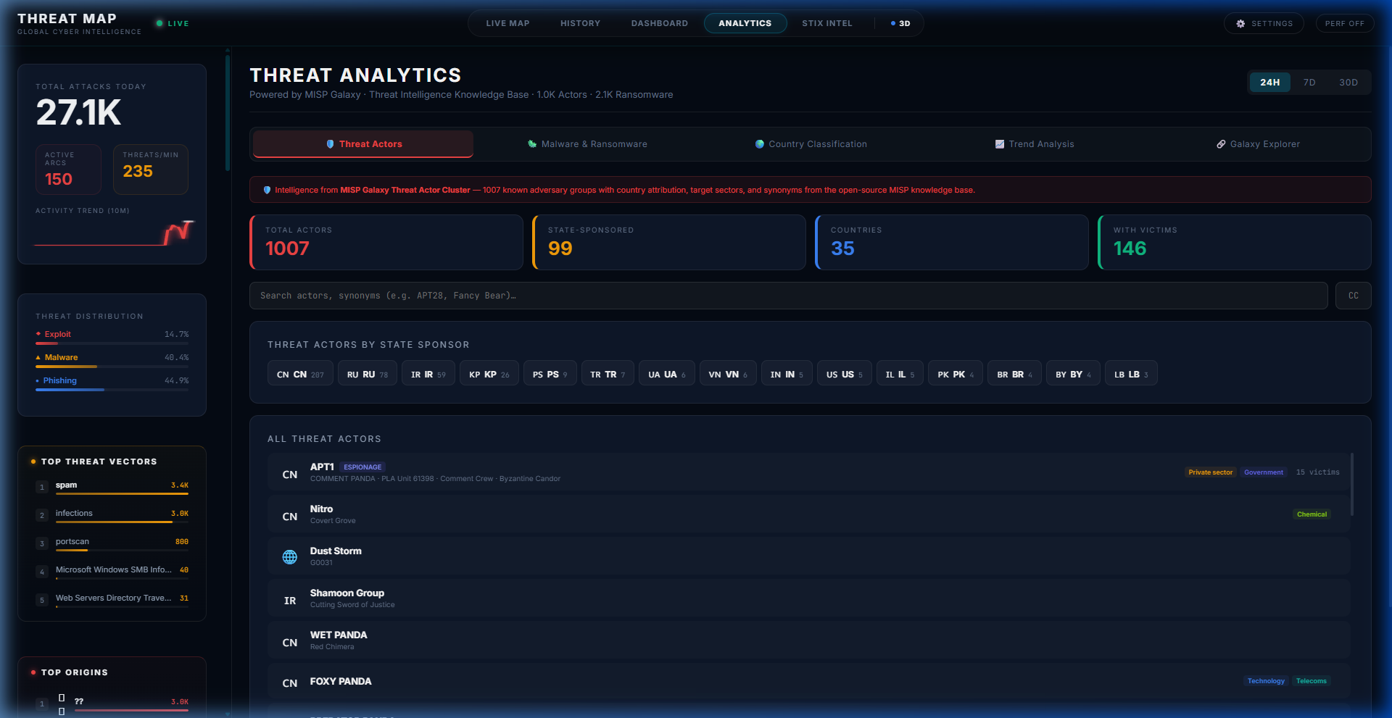
CHAPTER 4 — REALIZATION
Application Interfaces Overview
3D Live Threat Map
System Dashboard
Interactive WebGL Earth showing real-time attack arcs from all 9 scrapers.
Tactical command center with volume sparklines, 2D flat map, and country statistics.
STIX Workspace
Analytics Dashboard
JSON bundle ingestion, relationship force graphs, and MITRE technique mapping.
Aggregation analytics: sector metrics, threat actor trends, and country matrices.
Notes:
Brahim: Here is an overview of our four main interfaces. The 3D Threat Map displays attack arcs from all 9 scrapers on a globe. The System Dashboard provides real-time metrics and country statistics. The STIX Workspace has the D3 force graph and MITRE grid. The Analytics Dashboard aggregates sector distributions and threat actor trends.

Slide 18
CHAPTER 4 — REALIZATION
Technical Challenges Resolved
Browser Rendering Storms
RESOLVED
Database Quota Limits
RESOLVED
CORS Deployment Blocks
RESOLVED
CAUSE
CAUSE
CAUSE
9 scrapers pushing >500 events/sec caused browser canvas bottleneck.
MongoDB Atlas free tier exhausted by continuous multi-feed ingestion.
Browser security prevents React on Vercel from reading Cloud VM API.
RESOLUTION
RESOLUTION
RESOLUTION
300ms batch flush queue, 150-arc cap, adaptive FPS sampling engine.
BSON field compression (60%), 30-day TTL indexes, 500MB quota guard with in-memory fallback.
Vercel reverse-proxy rules in vercel.json routing /api/* through internal paths.
Notes:
Brahim: We resolved three major challenges. First, rendering storms from 9 concurrent scrapers were fixed with 300ms batching and adaptive FPS sampling. Second, MongoDB quota limits were addressed with BSON compression reducing documents by 60%, plus TTL indexes and a 500MB write guard. Third, CORS blocks were eliminated with Vercel reverse-proxy configuration.

Slide 19
CHAPTER 5 — CONCLUSION & PERSPECTIVES
Future Perspectives & Roadmap
PHASE 1
PHASE 2
PHASE 3
Kafka Distributed Ingestion
Predictive ML Extensions
Sharded Database Clustering
Decouple scrapers from the server process. Each scraper publishes events to Apache Kafka topics. The Express runtime consumes from Kafka — preventing crashes when scraper volume spikes.
Train LSTM/time-series models on historical threat databases to forecast attack spikes and sector-targeted waves. Overlay predictions as visual heatmaps.
Partition MongoDB clusters geographically by country code. Regional queries route to corresponding shards, minimizing latency at scale.
▶
▶
Notes:
Chiheb: Our roadmap has three phases. Phase 1: Kafka Distributed Ingestion to decouple our 9 scrapers from the server process, preventing crashes during traffic spikes. Phase 2: ML models to forecast attack patterns. Phase 3: Sharded MongoDB clustering by country code for geographic query optimization.

Slide 20
CHAPTER 5 — CONCLUSION & PERSPECTIVES
General Conclusion
Technical & Operational Impact
Academic & Professional Growth
▸ Multi-Feed Ingestion:
9 parallel scrapers (SSE, WebSocket, REST) unified into a single BSON schema with 60% compression.
▸ 5-Layer Enrichment:
Keyword matching, RDAP lookups, port inference, MISP Galaxy sectors, and source-API fallback classify every attack.
▸ SOC Analyst Efficiency:
Reduces compromise dwell time from 200+ days to seconds by replacing spreadsheets with spatial visualization.
▸ Agile Scrum Application:
Twice-weekly rituals, code merges, story points, and demonstrable increments.
▸ Systems Engineering:
Rigorous architectural structures, state store abstractions, database optimization strategies.
▸ Cybersecurity Focus:
Deep study of IOC types, STIX 2.1 schemas, and MITRE ATT&CK kill chain matrices.
Thank You for Your Attention — Questions Welcome
Notes:
Chiheb: In conclusion, the Predictra Threat Map successfully bridges the visibility gap in cyber defense. We built 9 parallel scrapers using SSE, WebSocket, and REST protocols, unified them into a compressed BSON schema, and enriched every event with a 5-layer sector classification engine. The platform reduces dwell time from months to seconds. Thank you for your time, and we welcome any questions.

