Slide 1
Predictra Threat Map
Design and Development of a Real-Time Spatialized Threat Intelligence Visualization Platform
Authors
Supervisor
Brahim JABALLI & Chiheb AMRI
Mr. Anis DHAHRI — ISET Gafsa
Host Company
Academic Year
Predictra Cybersecurity
2025 / 2026
PFE — Bachelor's Degree in Information Technology · Option: Computer System Development · ISET Gafsa
Jury: Ms. Hadhami ISSAOUI (President) · Mr. Walid HAMMEMI (Reporter)
Notes:
Brahim: Good morning, ladies and gentlemen of the jury. Welcome to our graduation defense for our Bachelor’s Degree in Information Technology. My name is Brahim Jaballi, and alongside my colleague Chiheb Amri, we are proud to present our final year project: the 'Predictra Threat Map'. This project, conducted under the supervision of Mr. Anis Dhahri at ISET Gafsa, and in collaboration with host company Predictra Cybersecurity, focuses on the design and development of a real-time spatialized threat intelligence visualization platform. We would also like to thank Ms. Hadhami Issaoui and Mr. Walid Hammemi for presiding and reporting on our defense today.

Slide 2
Presentation Outline
A structured journey from problem definition to full platform realization.
1
Introduction
Global cybersecurity landscape, threat evolution, and project motivation.
2
Pre-Study
Host profile (Predictra), project context, problematic, proposed solution, and Agile Scrum methodology.
3
Conceptual Study
Actors, functional & non-functional requirements, UML use cases, tech stack, and system architecture.
4
Realization
Detailed Sprints 1–4: backlogs, UML diagrams, scraper implementations, and UI dashboards.
5
Conclusion & Perspectives
Achievements, retrospective, and future scalability roadmap.
Notes:
Brahim: To guide you through our presentation, we have structured our defense into five key chapters. I will begin with the Introduction and the Pre-Study, outlining the cybersecurity landscape, our problematic, and the Agile Scrum methodology. Next, we will present our Conceptual Study, including system actors, requirements, use cases, and architecture. We will then dive into the Realization phase, detailing Sprints 1 to 4 and showcasing the system interfaces. Finally, we will conclude with a retrospective, technical challenges resolved, and future perspectives.

Slide 3

General Introduction
Expanded Attack Surface
Sun Tzu, The Art of War: "If you know the enemy and know yourself, you need not fear the result of a hundred battles."
The hyper-connectivity of corporate networks, cloud platforms, and critical infrastructures has created an unprecedented and volatile attack surface. Modern organizations rely entirely on software and network availability, making them highly attractive targets.
Shift to Proactivity
Evolved Adversaries
Traditional perimeter defenses — firewalls and antivirus — are no longer sufficient. Organizations must transition from reactive incident response to proactive threat intelligence, gaining external visibility into adversary infrastructure before breaches occur.
Threat actors have evolved from opportunistic scripts into highly coordinated campaigns — ransomware cartels, nation-state APTs, and hacktivists launching disruptive operations at scale.
Notes:
Brahim: Let us start with the introduction. Today, corporate networks and cloud platforms are faced with an expanded attack surface. Highly coordinated threat groups launch disruptive operations globally. As Sun Tzu wrote in The Art of War: 'If you know the enemy and know yourself, you need not fear the result of a hundred battles.' In cybersecurity, this means shifting from a reactive posture to a proactive threat intelligence model, where we understand external adversary infrastructure before a breach occurs.

Slide 4
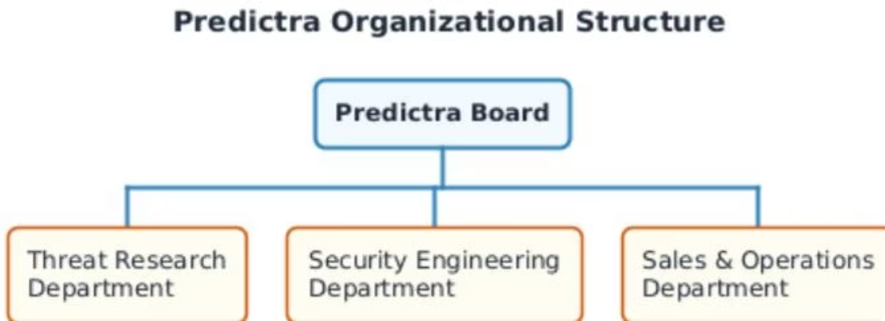
CHAPTER 1 — PRE-STUDY
Project Context & Host Organization
Predictra Profile
Organizational Structure
Key Metric: Dwell Time
Next-generation AI-driven Cyber Threat Intelligence firm. Democratizes threat intelligence by converting raw data into real-time, visually actionable insights for SOCs and enterprise security teams.
Threat Research: Analysts tracking campaigns & malware. Security Engineering: Ingestion pipelines & UI (our team). Sales & Operations: Client relations & enterprise deployments.
Global average compromise dwell time exceeds 200 days. Defenders only detect breaches after internal alerts trigger. The Threat Map shrinks this window from months to seconds.
Notes:
Brahim: Our host organization, Predictra Cybersecurity, is an AI-driven Cyber Threat Intelligence firm. Their goal is to democratize threat intelligence, transforming raw feeds into actionable visual insights. A critical industry metric is the compromise dwell time, which globally averages over 200 days. Security teams often detect breaches months after they occur. Our Threat Map aims to shrink this window from months to seconds by providing immediate, real-time visibility.

Slide 5

CHAPTER 1 — PRE-STUDY
The Critical Problematic
Spreadsheet Overload
SOC analysts suffer from visual fatigue reading thousands of static, textual log lines in spreadsheets and simple dashboards. There is no intuitive interface for immediate situational awareness.
Lack of Spatial Context
No geographic representation of threat origins, targets, and trajectories in real-time. Defenders cannot visualize where attacks originate or which sectors are being targeted globally.
Data Heterogeneity
Raw feeds are fragmented across diverse security vendors using incompatible data formats, protocols, and schemas — making unified analysis slow and manual.
Notes:
Brahim: The core problem we address is threefold. First, spreadsheet overload. SOC analysts suffer from visual fatigue reading thousands of static logs. Second, a lack of spatial context. Traditional dashboards fail to show attack origins, targets, and trajectories geographically. Third, data heterogeneity. Threat feeds are scattered across multiple vendors in incompatible formats. This makes manual correlation slow, leading to delayed responses.

Slide 6




CHAPTER 1 — PRE-STUDY
The Proposed Solution: Predictra Threat Map
A four-layer architecture transforming raw cyber threat data into a live, interactive 3D visual intelligence platform.
Ingestion Layer
Enrichment Layer
Asynchronous harvesting from 9+ parallel threat feeds (AlienVault, URLhaus, Checkpoint, Bitdefender, Fortinet, Kaspersky Feodo, RansomWatch, C2 Tracker, MISP Galaxy).
Instant IP geolocation via local geocoding library and 5-layer target sector classification engine covering 9 critical business sectors.
Streaming Layer
Visualization Layer
Unidirectional event broadcasting via Server-Sent Events (SSE) with a 300ms batching queue — keeping browser rendering smooth.
Interactive 3D WebGL Earth with curved attack arcs, plus STIX 2.1 parser and MITRE ATT&CK workspace for deep analysis.
Notes:
Brahim: To solve this, we propose the Predictra Threat Map, built on a four-layer architecture. First, the Ingestion Layer harvests data asynchronously from 9+ feeds. Second, the Enrichment Layer geolocates attacks and classifies victims into 9 critical sectors. Third, the Streaming Layer broadcasts events using Server-Sent Events with a 300ms batching queue. Fourth, the Visualization Layer displays curved attack arcs on an interactive 3D WebGL Earth, alongside a STIX parser and MITRE ATT&CK grid.

Slide 7

CHAPTER 1 — PRE-STUDY
Agile Scrum Methodology
4 Sprints over 12 Weeks
01
Sprint 1
Backend ingestion: 9 scrapers, MongoDB schemas, enrichment pipeline.
02
Sprint 2
SSE stream endpoint, Zustand store, 3D WebGL Earth at 60fps.
03
Sprint 3
STIX 2.1 JSON parser and MITRE ATT&CK Kill Chain mapping grid.
04
Sprint 4
History browser, Target My IP, RingBuffer, adaptive FPS sampling.
Twice-weekly rituals: Thursdays (code merge & WebGL profiling) and Sundays (architectural consolidation & LaTeX documentation) — 48+ sessions over 6 months.
Notes:
Brahim: We adopted the Agile Scrum methodology, organizing our work into 4 sprints over a 12-week period. Sprint 1 focused on backend ingestion and schemas. Sprint 2 implemented the SSE stream and the 3D globe. Sprint 3 integrated the STIX 2.1 parser and MITRE ATT&CK grid. Sprint 4 added the history browser, Target My IP, and performance guardrails. We held twice-weekly rituals on Thursdays for code merges and profiling, and Sundays for architectural consolidation and documentation.

Slide 8
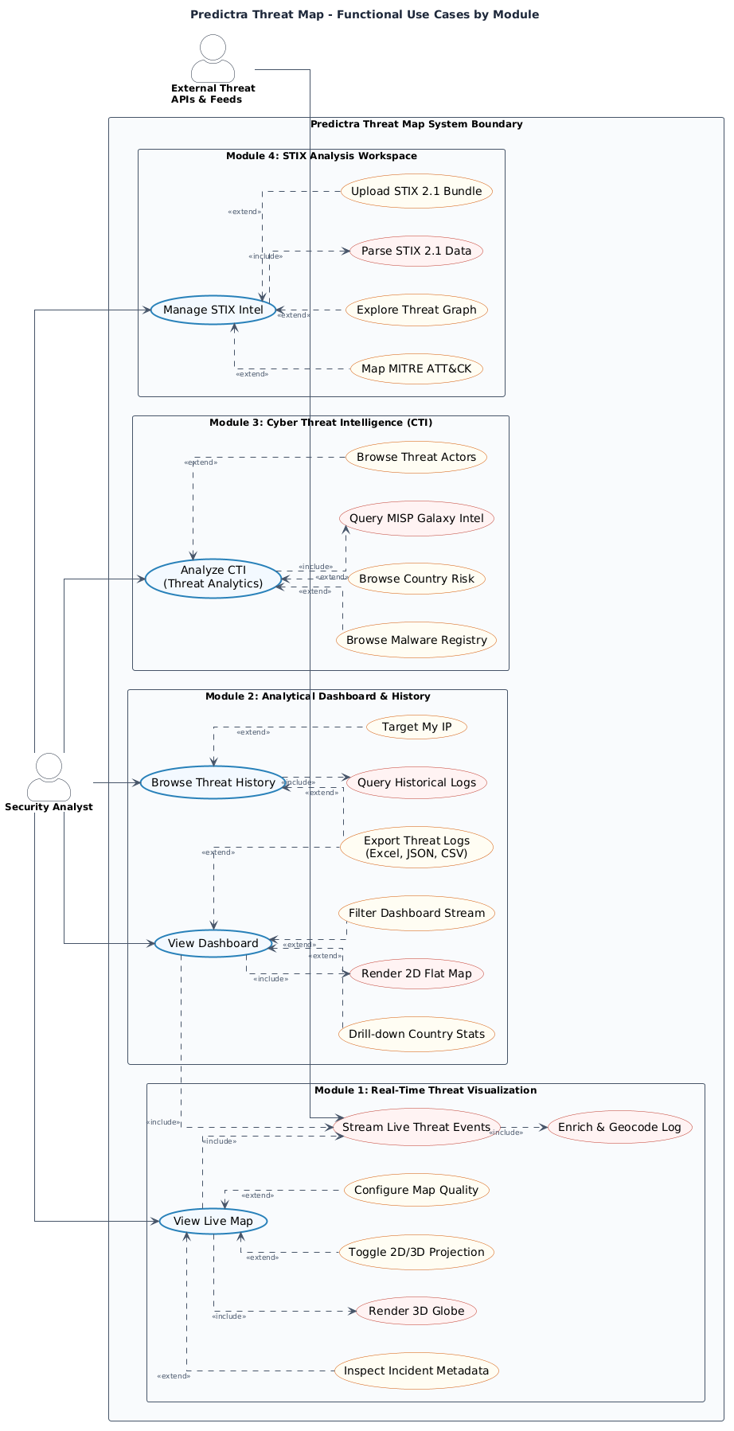
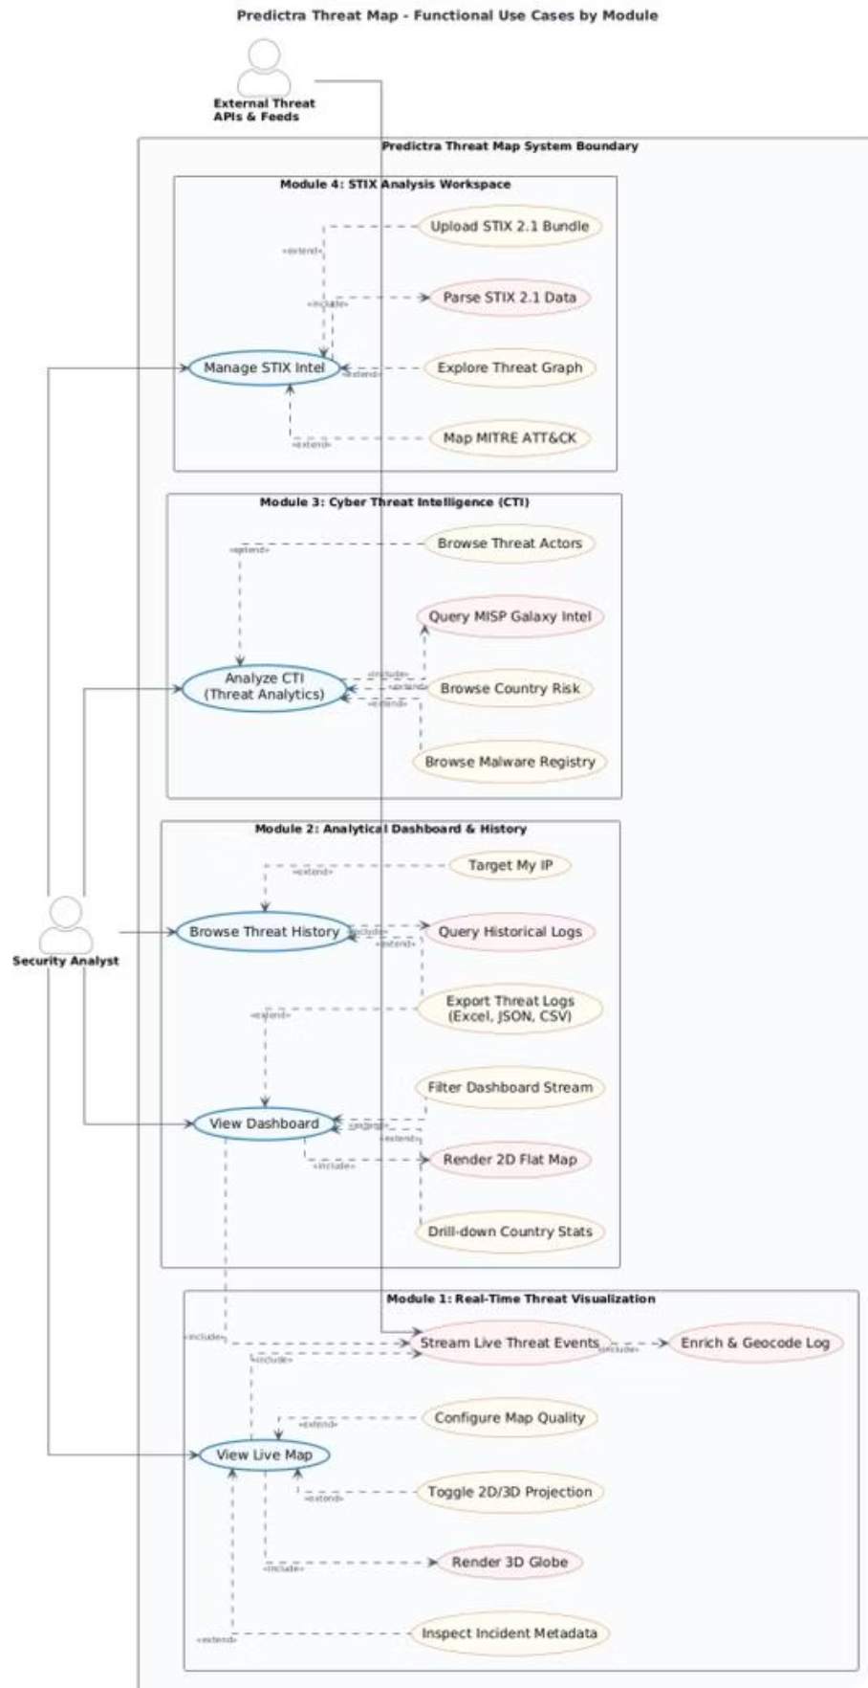
Notes:
Brahim: This is our Global Use Case diagram, showing the system boundaries and interactions. The primary system actor is the set of External Threat Feeds, which automatically trigger backend ingestion. The human actor is the Security Analyst, who monitors the 3D globe and dashboard, filters threat logs, searches historical data, uploads STIX bundles, and exports reports. This diagram establishes the foundational boundaries of the Predictra Threat Map.

Slide 9
CHAPTER 2 — CONCEPTUAL STUDY
Identification of System Actors
System Actor: External Threat Feeds
Human Actor: Security Analyst (SOC)
Automatically pushes Indicators of Compromise (IOCs) — malicious IPs, domains, malware hashes — via HTTP REST APIs, SSE feeds, and WebSockets.
Interacts with the frontend dashboard to monitor, investigate, and export threat intelligence.
Monitors the 3D globe and 2D dashboard in real-time
Filters alerts by country, sector, and malware type
Searches historical logs and exports to Excel
Uploads and parses local STIX 2.1 intelligence bundles
Geolocates their own public IP via "Target My IP"
Triggers backend ingestion asynchronously
9+ distinct feed sources integrated
Operates continuously without human intervention
Notes:
Brahim: To elaborate on the actors: the External Threat Feeds run continuously without human intervention, pushing Indicators of Compromise via HTTP REST, SSE, and WebSockets. On the other side, the Security Analyst interacts with the frontend dashboard. They can observe live threats, filter events by country or sector, analyze STIX files locally for privacy, and map IP details. This separation ensures that the core ingestion runs independently of analyst sessions.

Slide 10
CHAPTER 2 — CONCEPTUAL STUDY
Functional Requirements (RF-1 to RF-9)
RF-1
RF-2
RF-3
RF-4
Multi-feed ingestion from 9+ sources (AlienVault, URLhaus, Checkpoint, etc.)
IP geolocation enrichment using local geocoding library (lat/lon, ISO code, ASN)
5-layer sector classification into 9 critical industries (Healthcare, Finance, Gov…)
Real-time SSE streaming with 300ms batching queue and keep-alive heartbeat
RF-5
RF-6
RF-7
RF-8
3D WebGL Threat Map with animated arcs, pulsating markers, 2D/3D toggle
Client-side STIX 2.1 JSON bundle parser (up to 300KB, no server upload)
MITRE ATT&CK Kill Chain mapping across 12 adversary phases
Searchable historical log browser with regex, country, sector, and pagination filters
RF-9
"Target My IP" geolocator and Excel export for up to 5,000 threat logs
Notes:
Brahim: We defined 9 functional requirements, denoted RF-1 to RF-9. These include multi-feed ingestion, geolocation enrichment, target sector classification, real-time SSE streaming, the 3D WebGL globe, client-side STIX parsing, MITRE ATT&CK mapping, historical log searching, and the 'Target My IP' feature. Each requirement maps directly to a user story delivered in our Scrum backlog.

Slide 11
CHAPTER 2 — CONCEPTUAL STUDY
Non-Functional Requirements & Global Use Case
Non-Functional Requirements
Global Use Case Model Reference
To view the complete system boundaries and user/system actor interactions, please refer to Slide 8. The Use Case model illustrates: • Ingestion triggers by external thread feeds. • Investigation actions by SOC analysts (Filters, STIX Parsing, exports).
RNF-1: 60fps Fluidity
RNF-2: Circular Buffer
RNF-3: 30-Day TTL
RNF-4: 500MB Quota Guard
Adaptive quality reduction if frame rate drops below threshold.
10,000-event RingBuffer caps memory usage at a constant footprint.
Threat records auto-expire from MongoDB after 30 days.
Backend switches to in-memory streaming if DB exceeds 500MB.
RNF-5: Glassmorphism UI
Dark theme with semi-transparent panels and severity-based color coding.
Notes:
Brahim: Our non-functional requirements ensure the quality and stability of the platform. RNF-1 guarantees a 60fps fluidity on the 3D globe. RNF-2 uses a 10,000-event circular RingBuffer to cap memory usage. RNF-3 sets a 30-day TTL index in MongoDB to prune old logs. RNF-4 monitors database quota, switching to in-memory streaming if DB size exceeds 500MB. RNF-5 implements a modern, dark glassmorphism user interface to reduce visual strain.

Slide 12
CHAPTER 2 — CONCEPTUAL STUDY
Technology Stack & Comparative Analysis
Layer
Selected
Alternative
Rationale
Runtime
Node.js / Express 5
Java Spring Boot
Non-blocking async loop; ideal for open SSE streams under low memory
State Management
Zustand 5
Redux Toolkit
Slice-based reactive updates outside React DOM — preserves 60fps WebGL
3D Graphics
Three.js / R3F
Vanilla Canvas
GPU acceleration, SLERP math, custom GLSL vertex/fragment shaders
Build Tool
React 19 / Vite 7
Angular / Webpack
Native ESM, instant startup, fast HMR vs slow pre-compilation
Database
MongoDB Atlas (BSON)
PostgreSQL / MySQL
Schemaless BSON for heterogeneous CTI logs; no rigid migrations needed
Notes:
Chiheb: Thank you, Brahim. I will now present our technology stack. For the backend runtime, we selected Node.js and Express 5 over Java Spring Boot due to its non-blocking asynchronous event loop, which is perfect for streaming SSE connections. For state management, we chose Zustand 5 over Redux for high-speed reactive updates outside the React DOM. For graphics, we used Three.js and React Three Fiber to build custom shaders. We chose Vite 7 for native ESM builds, and MongoDB Atlas for its schemaless BSON structure.

Slide 13
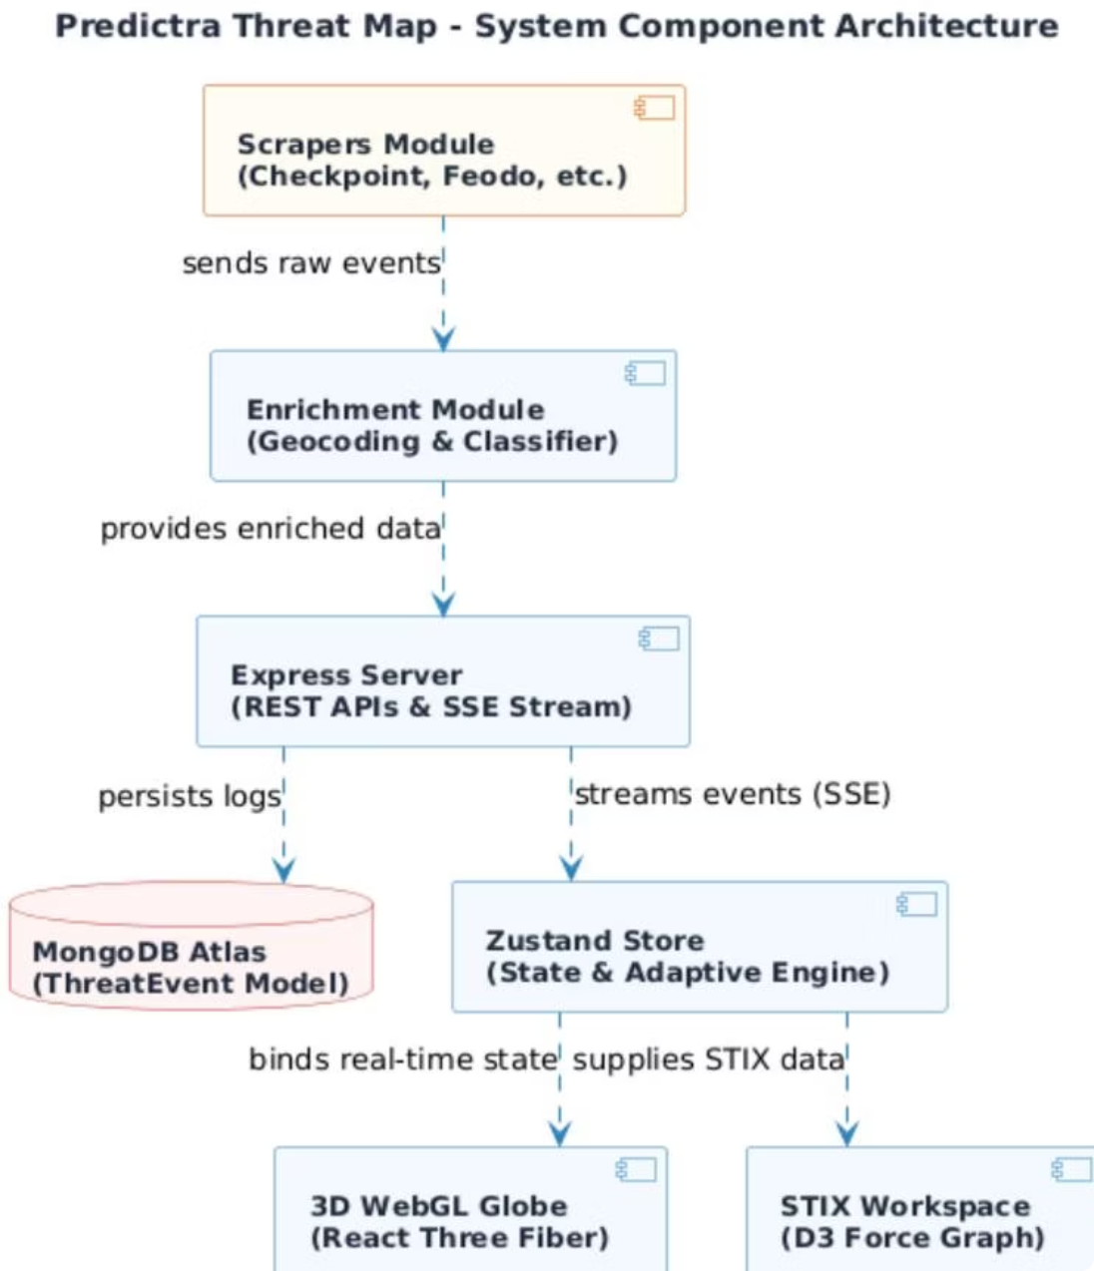
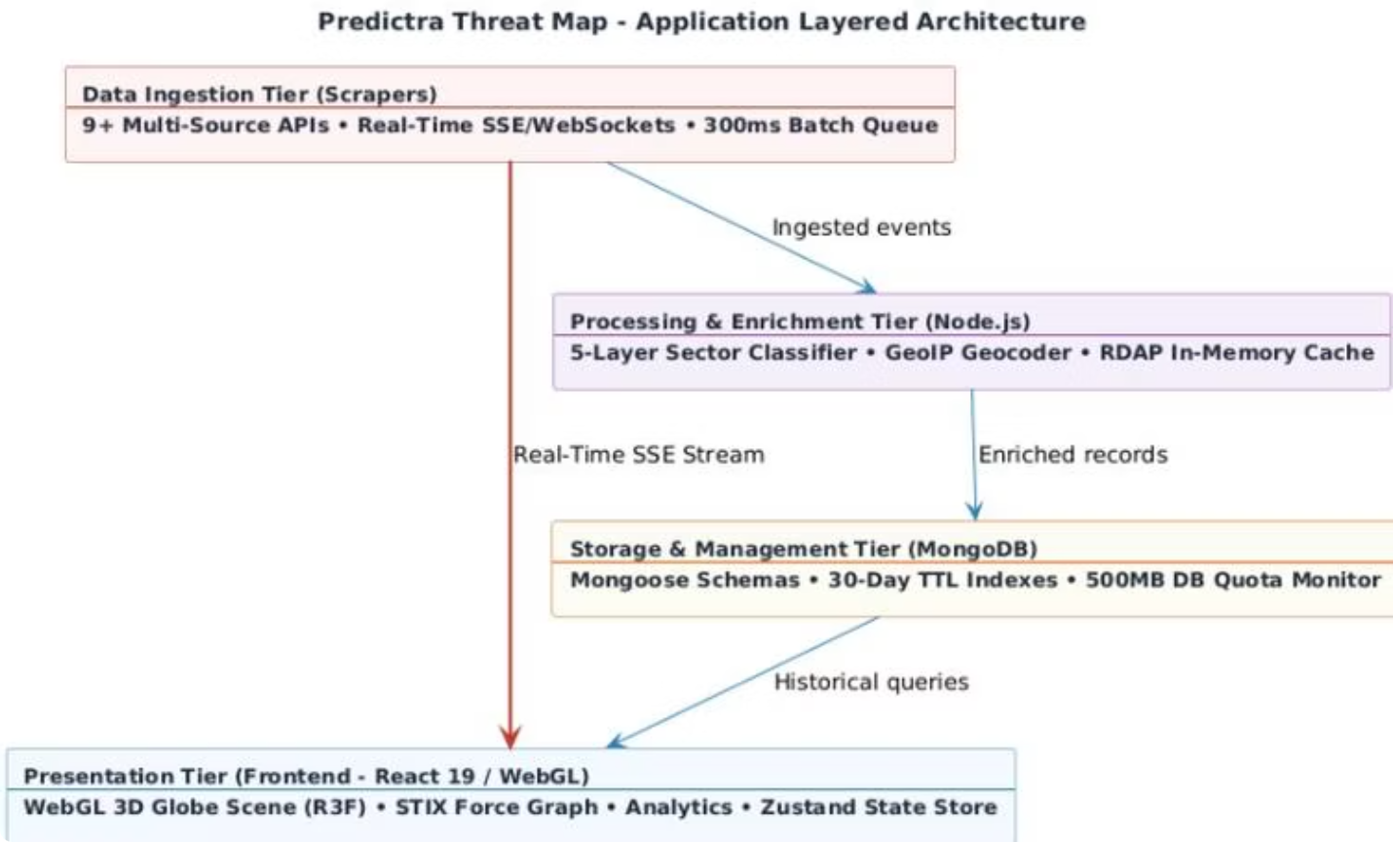
CHAPTER 2 — CONCEPTUAL STUDY
System Architecture
Frontend (Vercel CDN)
Backend (Cloud VM / PM2)
Database (MongoDB Atlas)
React SPA hosted globally; API proxy rewrites via vercel.json eliminate CORS issues.
Node.js Express server clustered across CPU cores with automated crash recovery.
Replicated BSON cluster with 30-day TTL indexes and 500MB quota monitor.
Notes:
Chiheb: Our system architecture is split into three main tiers. The Frontend is built in React and served via Vercel CDN, utilizing API routing proxies to eliminate cross-origin resource sharing blocks. The Backend runs on a Cloud VM using PM2 process clustering across CPU cores for automatic crash recovery. The Database tier uses MongoDB Atlas with a replicated cluster, automatic TTL pruning, and size-based quota guards.

Slide 14
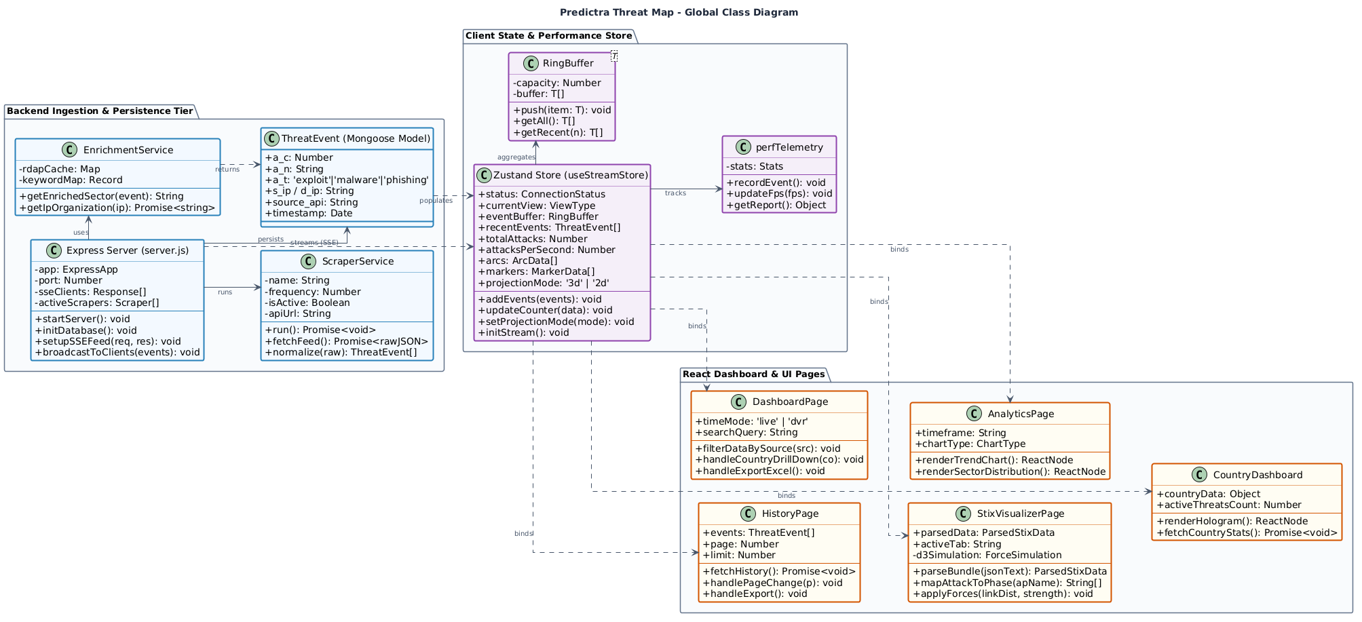
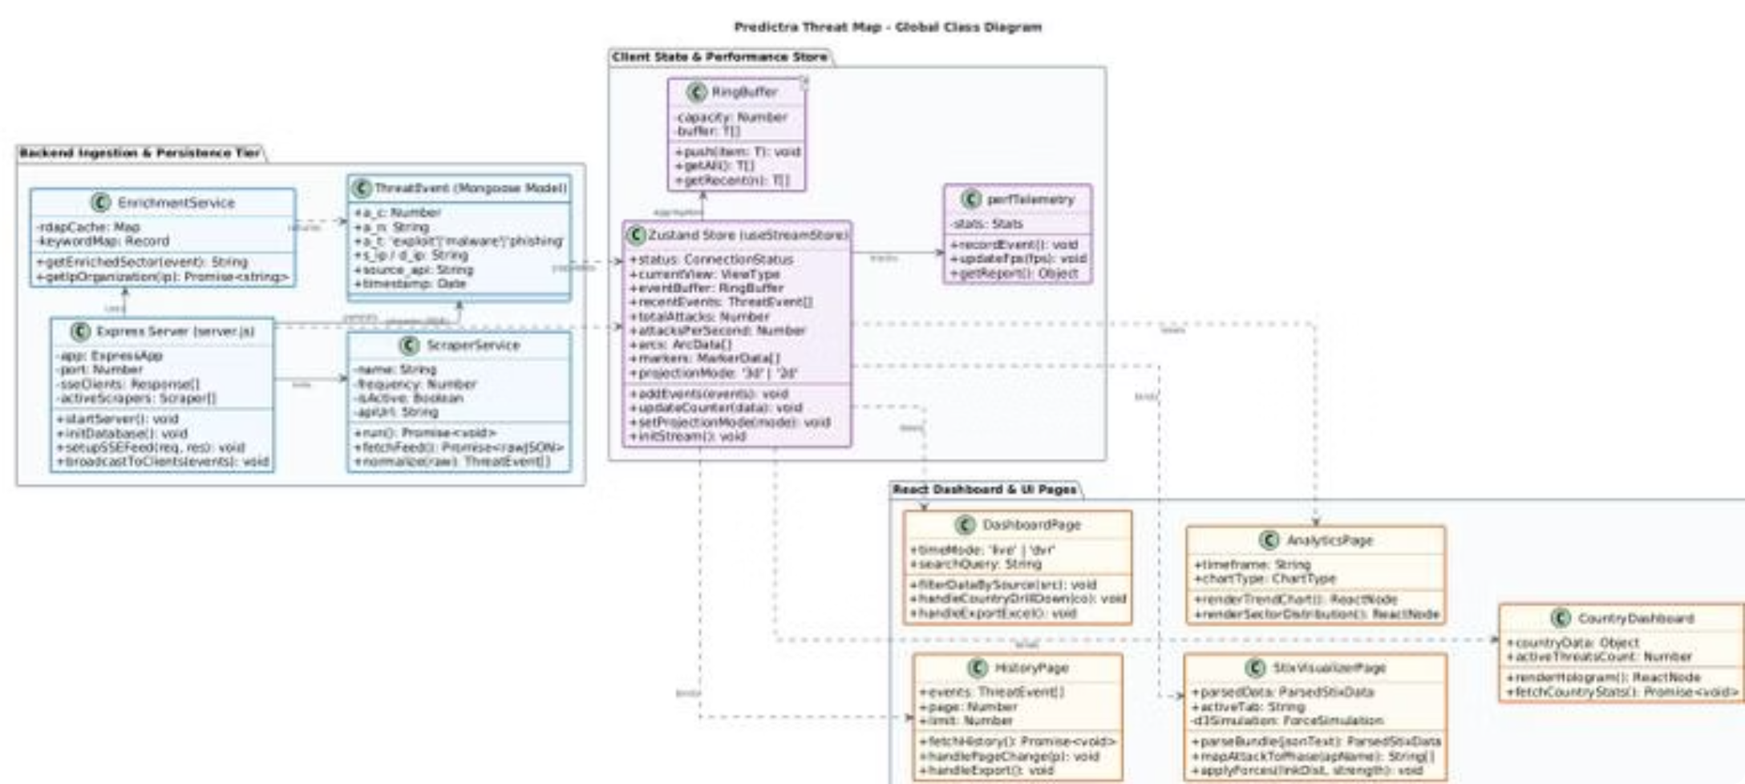
CHAPTER 2 — CONCEPTUAL STUDY
Global Class Diagram
Backend Tier
Zustand Store
React Views
ExpressServer schedules multiple ScraperService instances. EnrichmentService resolves geolocation and sector. MongooseThreatEvent persists compact BSON documents.
useStreamStore manages real-time state with a circular RingBuffer and perfTelemetry tracker to prevent memory leaks and GC spikes.
DashboardPage, HistoryPage, AnalyticsPage, StixDashboard, and CountryDashboard subscribe to Zustand state slices and bind to REST endpoints.
Notes:
Chiheb: This is our Global Class Diagram, showing the structural design of the platform. In the Backend tier, the Express Server schedules multiple Scraper Services, which feed into the Enrichment Service to resolve geolocations and sectors. The Zustand Store manages frontend state with a circular RingBuffer and performance telemetry. The React Views, such as the Dashboard, STIX Workspace, and Analytics page, subscribe directly to Zustand slices for reactivity.

Slide 15
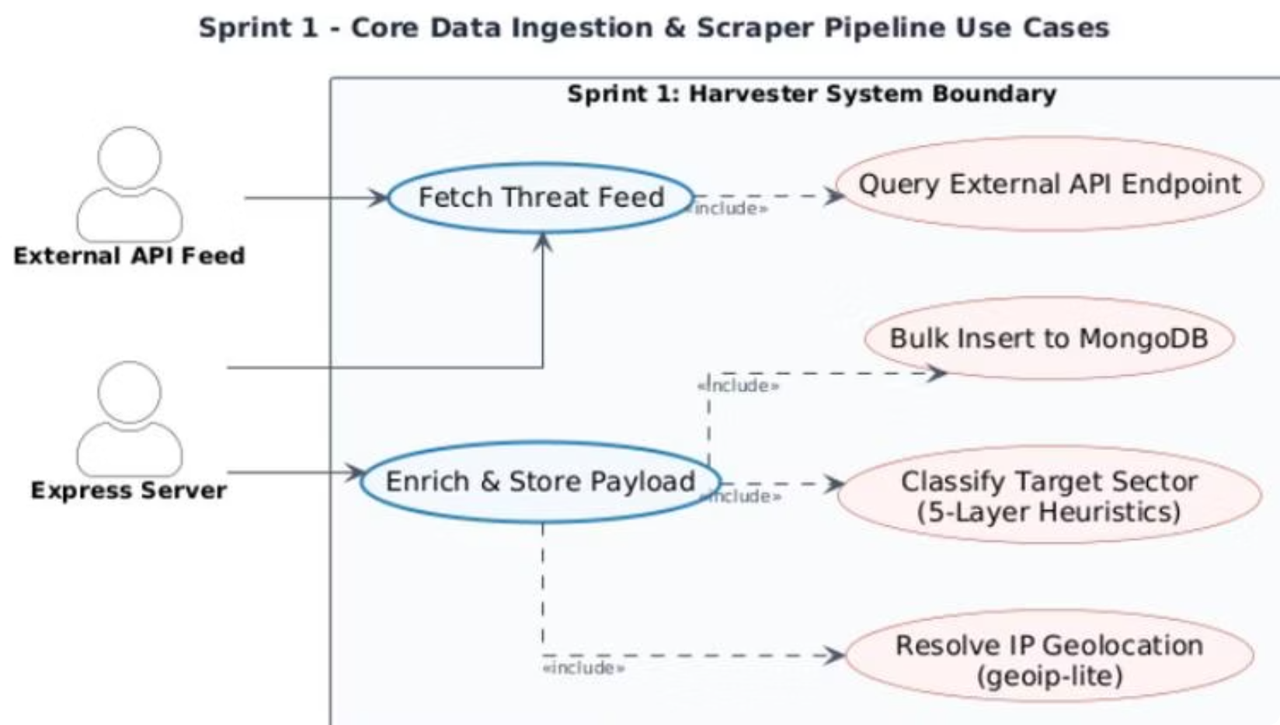

CHAPTER 3 — SPRINT 1
Sprint 1: Data Ingestion & Enrichment Pipeline
Sprint Objectives
9 Integrated Threat Feeds
Configure the Express server, set up Mongoose models, code 9 modular scrapers, and implement the 5-layer sector classification and geolocation enrichment pipeline.
Checkpoint — Persistent SSE stream (TLS 1.3)
Bitdefender — WebSocket, 13 threat channels
Fortinet FortiGuard — REST poll every 4 seconds
URLhaus — abuse.ch malware URL feed
Kaspersky Feodo — C2 botnet CSV blocklist
AlienVault OTX — Subscribed pulse IOCs
RansomWatch — Dark web extortion posts
MontySecurity C2 — Active C2 framework IPs
MISP Galaxy — Synthetic threat actor events
Compact BSON schema reduces document size from 200 bytes → 80 bytes, conserving cloud storage.
Notes:
Brahim: In Sprint 1, we built the core ingestion pipeline. We integrated 9 feeds: Checkpoint, Bitdefender, Fortinet, URLhaus, Kaspersky Feodo, AlienVault, RansomWatch, MontySecurity, and MISP Galaxy. We designed a compact BSON schema in MongoDB, reducing the database footprint from 200 bytes to 80 bytes per document. This ensures long-term database efficiency and lower storage costs.

Slide 16
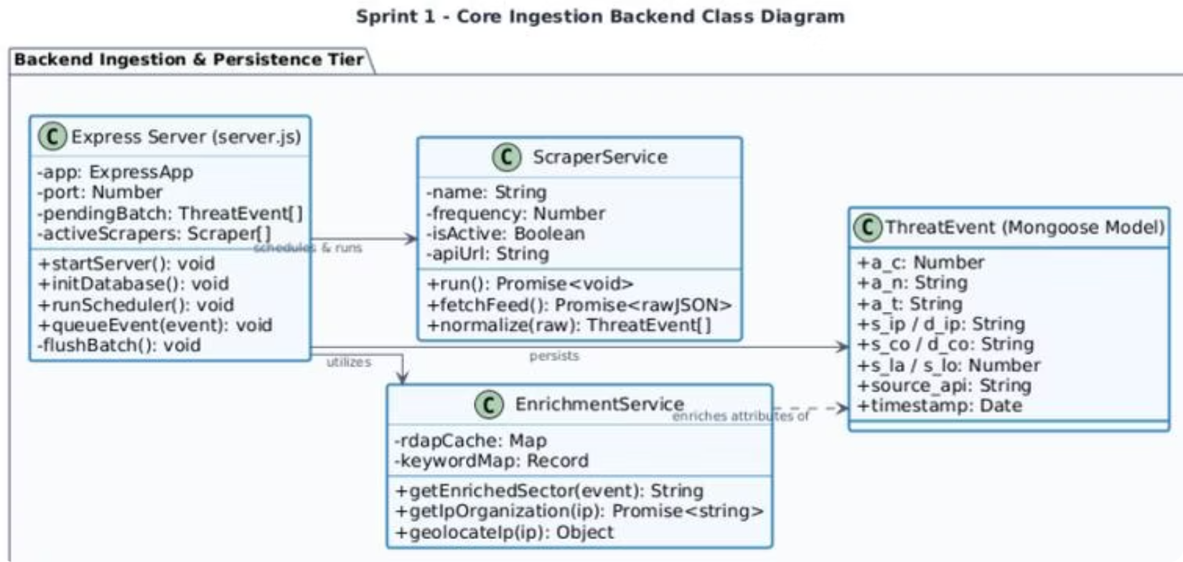
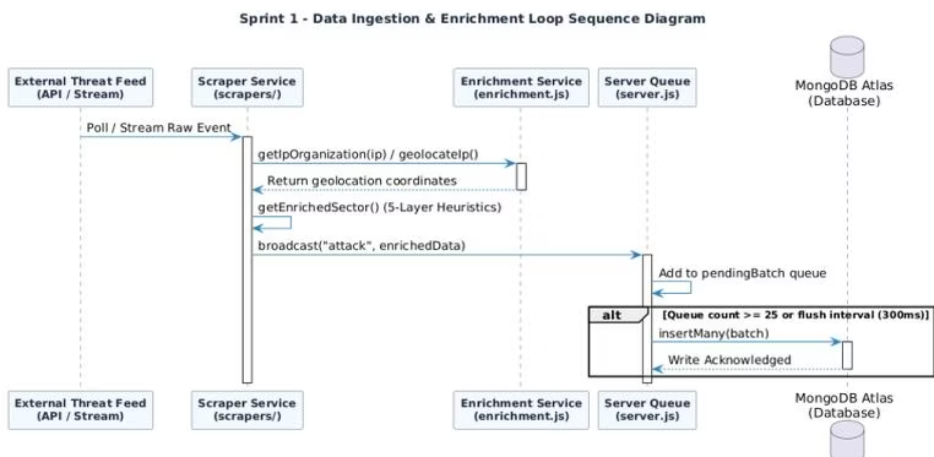
CHAPTER 3 — SPRINT 1
Sprint 1: Enrichment Engine & Ingestion Logic
The EnrichmentService applies a 5-layer classification engine: (1) victim name keywords, (2) event detail regex, (3) destination port mapping, (4) MISP Galaxy metadata, and (5) source API fallback. An asynchronous RDAP cache resolves IP owners with a 3-second timeout, adding organizational context without blocking the ingestion loop.
Notes:
Brahim: During Sprint 1, we modeled the enrichment logic. The Enrichment Service uses a 5-layer classification engine to identify the targeted industry sector: (1) victim keywords, (2) event details regex, (3) destination port mapping, (4) MISP Galaxy metadata, and (5) scraper-specific defaults. We also integrated an asynchronous RDAP cache for IP owner lookups with a 3-second timeout to prevent API blocking.

Slide 17
CHAPTER 3 — SPRINT 2
Sprint 2: Real-Time SSE Stream & 3D Globe Visualization
SSE Broadcast Engine
3D Globe Mathematics
The GET /api/feed endpoint sets text/event-stream headers and runs a 300ms flush interval scheduler, consolidating queued events into single payloads. A 30-second ping heartbeat keeps connections alive through proxies.
Geographic coordinates are converted to 3D Cartesian vectors using spherical trigonometry. Attack arcs use Spherical Linear Interpolation (SLERP) to follow Earth's curvature, then parametric Bezier elevation lifts arcs above the surface — longer distances arch higher.
Notes:
Brahim: Sprint 2 focused on streaming and 3D math. We built the SSE broadcast engine using a 300ms flush scheduler that batches queued events into single payloads to prevent browser flooding. For the 3D globe, geographic coordinates are converted to Cartesian vectors. The attack arcs use Spherical Linear Interpolation, or SLERP, to curve around the Earth, with Bezier elevation lifting longer distance arcs higher.

Slide 18
CHAPTER 3 — SPRINT 2
Sprint 2: WebGL Custom Shaders
Custom GLSL Shaders
Atmospheric Glow
Neon Country Borders
Bloom Post-Processing
Fresnel-effect vertex/fragment shader creates a neon cyberblue glow around the globe silhouette using dot-product intensity falloff.
5 overlapping TopoJSON vector line layers at microscopic scale increases (R=1.002 to R=1.010) with decreasing opacities create a glowing border effect.
EffectComposer with Bloom shader (luminanceThreshold 0.15, intensity 0.8) makes severity-colored arcs glow like neon light fibers.
Notes:
Brahim: To make the globe visually stunning, we wrote custom GLSL shaders. The Atmospheric Glow uses a Fresnel-effect vertex and fragment shader. Neon Country Borders are rendered using 5 overlapping TopoJSON vector layers with decreasing opacities. Finally, Bloom Post-Processing applies a luminosity threshold to make severity-colored attack arcs glow like neon light fibers.

Slide 19
CHAPTER 4 — SPRINT 3
Sprint 3: STIX 2.1 Threat Analysis Dashboard
STIX 2.1 Parser
MITRE ATT&CK Mapping
Client-side JSON parser processes intelligence bundles entirely in the browser — sensitive files never leave the analyst's machine. Validates spec_version: "2.1" and extracts all STIX Domain Objects (SDOs): Threat Actors, Campaigns, Malware, Tools, Attack Patterns, Indicators, and Relationships.
Parsed attack-pattern objects are automatically mapped to the 12 phases of the MITRE ATT&CK Kill Chain (Initial Access → Exfiltration). Phase distribution counts update instantly, highlighting the most heavily populated adversary stages to focus mitigation efforts.
Notes:
Chiheb: In Sprint 3, we built the STIX 2.1 Threat Workspace. The client-side JSON parser processes threat bundles entirely in the browser, ensuring sensitive files never leave the analyst's machine. The parser extracts STIX Domain Objects like Threat Actors, Campaigns, and Malware. These are automatically mapped to the 12 phases of the MITRE ATT&CK Kill Chain, updating the metrics instantly.

Slide 20
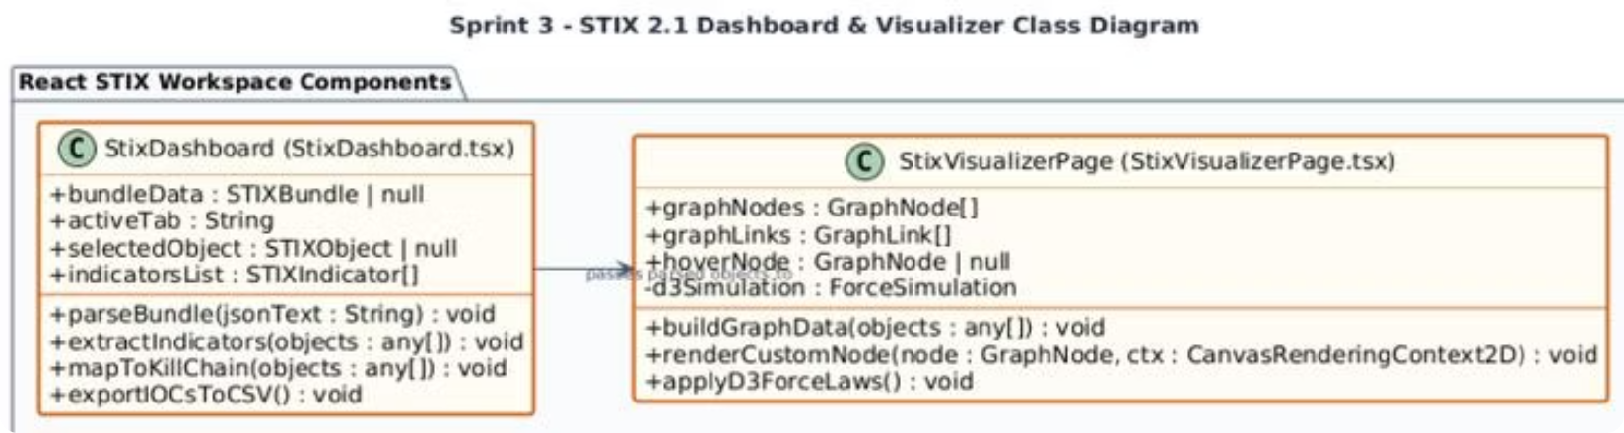
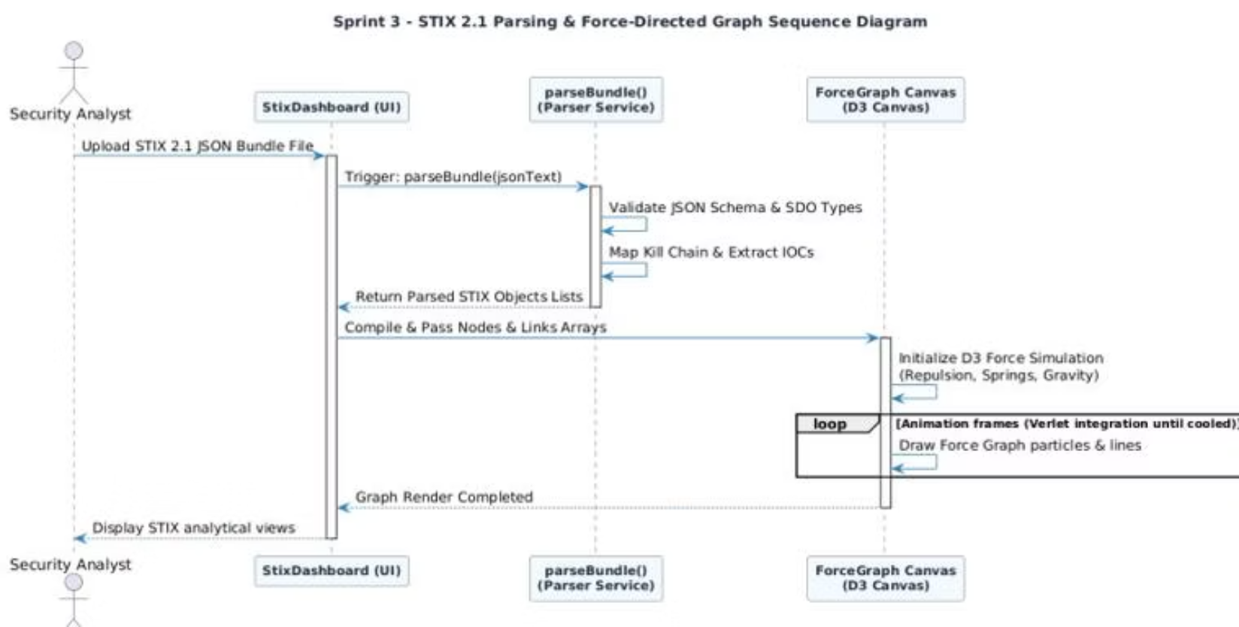
CHAPTER 4 — SPRINT 3
Sprint 3: Threat Relationship Graph Model
The D3 Force Graph renders STIX objects as interactive nodes linked by relationship edges. The simulation applies repulsion, spring, and gravity forces using Verlet integration until the graph cools into a stable layout. Analysts can hover over nodes to inspect raw SDO metadata and click to explore relationship chains.
Notes:
Chiheb: For threat visualization in Sprint 3, we implemented an interactive D3 Force Graph. It renders STIX objects as nodes and their relationships as edges. The simulation applies repulsion, spring, and gravity forces using Verlet integration until it cools into a stable layout. Analysts can hover over nodes to inspect raw SDO metadata and explore relationship chains.

Slide 21
CHAPTER 4 — SPRINT 4
Sprint 4: Analytics, History & Performance Guardrails
Sprint 4 Deliverables
01
02
Paginated History Browser
Target My IP
MongoDB queries with regex, country, sector filters. Default 50 logs/page, executing in under 50ms via compound indexes.
Queries public IP API, geolocates the analyst, and auto-filters threat history to logs targeting their network subnet.
03
04
Excel Export
Performance Guardrails
Client-side worksheet generation supporting up to 5,000 logs without browser memory exhaustion.
Circular RingBuffer (10,000 slots) + Adaptive FPS Sampling Engine drops 50–75% of visual events under load.
Notes:
Chiheb: Sprint 4 focused on UI dashboards, history, and guardrails. We implemented a paginated History Browser query with compound indexes executing under 50ms. 'Target My IP' allows analysts to geolocate themselves and auto-filter threat logs targeting their subnet. Excel Export generates client-side worksheets for up to 5,000 logs. Most importantly, we implemented performance guardrails to preserve frame rate.

Slide 22
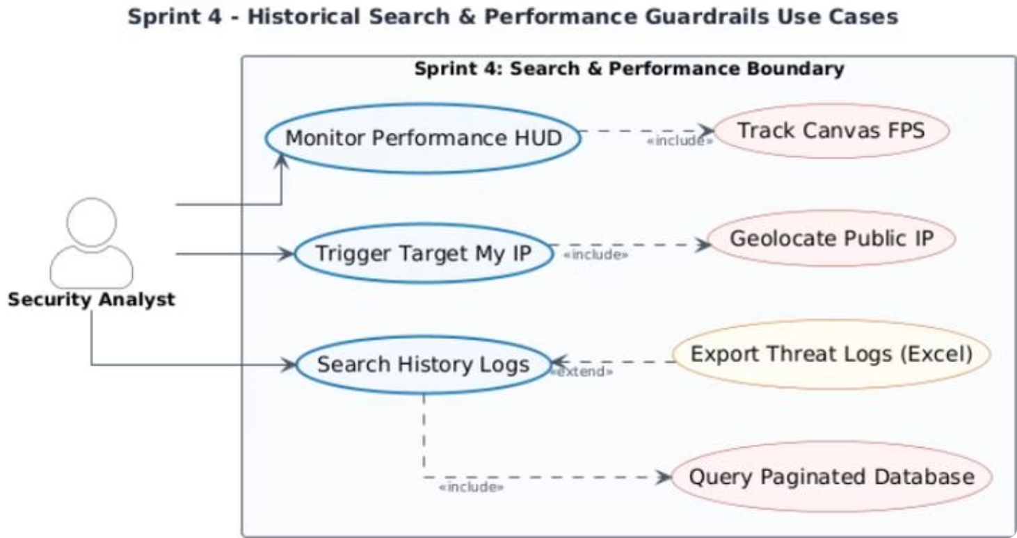
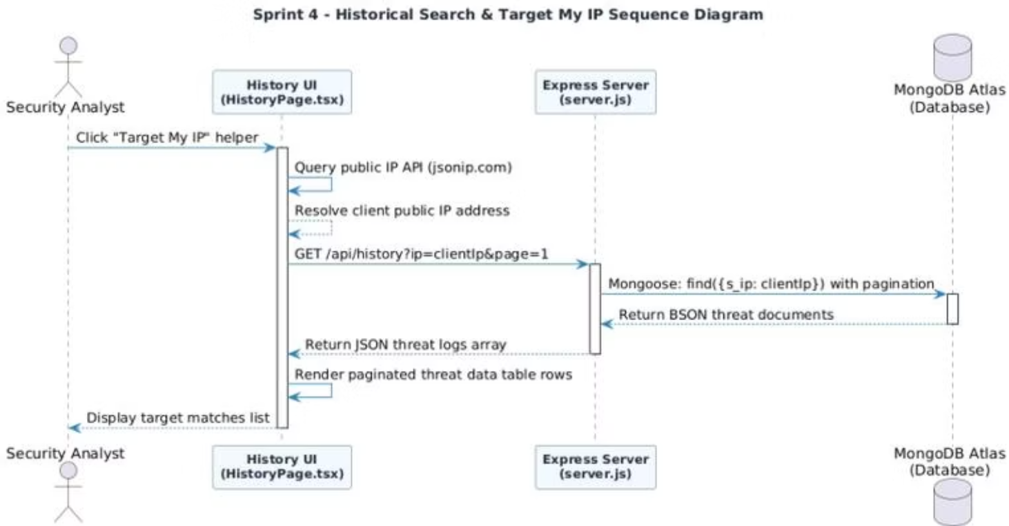

CHAPTER 4 — SPRINT 4
Sprint 4: Performance Guardrails & Event Sampling
Adaptive Event Sampling
Mode
FPS Range
Drop Rate
High-Fluidity
≥ 55 fps
0% — all events rendered
Medium-Load
30–55 fps
50% visual events dropped
Stress-Mitigation
≤ 30 fps
75% visual events dropped
RingBuffer push() operates in O(1) constant time — zero GC pressure regardless of event volume.
Notes:
Chiheb: Our performance engine uses an Adaptive Event Sampling loop. If the frame rate is high (above 55fps), all events are rendered. If load increases and FPS drops between 30 and 55, the drop rate is set to 50%. Under extreme stress (below 30fps), the engine drops 75% of visual events. Supported by the O(1) RingBuffer, this prevents memory leaks and garbage collection spikes.

Slide 23
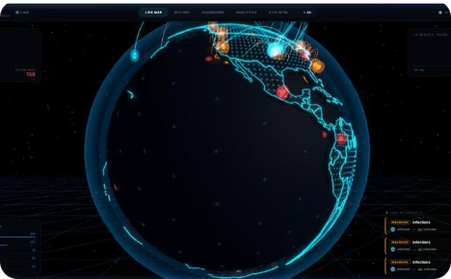
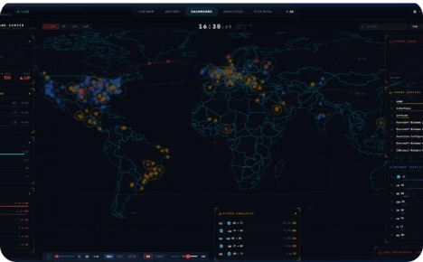
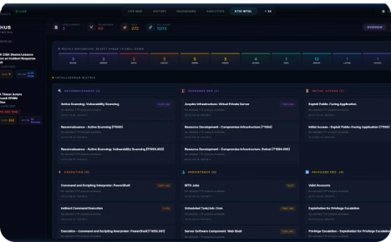
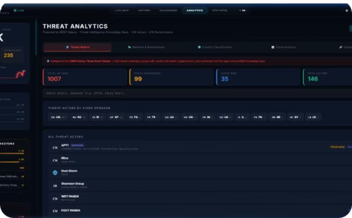
Application Interfaces Overview
3D Live Threat Map
System Dashboard
STIX Intelligence Workspace
Analytics Dashboard
Interactive WebGL Earth with glowing bezier arcs, pulsating markers, and real-time SSE threat feeds.
Tactical command center with real-time metrics, sparklines, 2D flat map, and drill-down country stats.
Aggregate threat metrics, sector distributions, MISP Galaxy threat actor profiles, and trend charts.
Upload STIX 2.1 bundles, explore D3 force graphs, and map adversary TTPs to the MITRE ATT&CK matrix.
Notes:
Brahim: Here is an overview of our application interfaces. The 3D Live Threat Map displays the rotating Earth with glowing arcs. The System Dashboard provides real-time metrics, country statistics, and a 2D flat map. The STIX Intelligence Workspace features the D3 graph and the MITRE ATT&CK grid. Finally, the Analytics Dashboard aggregates threat metrics, sector distributions, and trends.

Slide 24

Project Retrospective & Technical Challenges
Scrum Velocity
The team maintained a stable velocity of 25–30 story points per sprint, delivering all committed features on schedule. Each Sprint Review concluded with a fully demonstrable software increment.
Three Critical Challenges Resolved
Visual Interface Lag
Resolved via 300ms event grouping queue, 150-arc cap, and adaptive FPS sampling — restoring smooth 60fps performance.
Database Storage Limits
Compact BSON field names reduced storage size by 50%. TTL indexes auto-prune records after 30 days.
CORS Deployment Blocks
Vercel reverse-proxy routing rules direct frontend requests through internal paths, eliminating cross-origin failures.
Notes:
Brahim: Looking back, our team maintained a stable Scrum velocity of 25–30 story points per sprint, delivering all features. We resolved three critical challenges: visual lag via event batching and adaptive sampling; database limits via BSON compression and TTL indexes; and deployment blocks via Vercel reverse-proxy routing rules to eliminate CORS issues.

Slide 25

Future Perspectives & Scalability Roadmap
Kafka Distributed Ingestion
Predictive ML Extensions
Replace direct scraper-to-server writes with Apache Kafka message queues. Scrapers publish to durable topics; the server consumes and streams — ensuring fault-tolerant ingestion under massive threat volumes.
Train machine learning models on historical threat distributions to forecast attack spikes and target sectors, displaying predictions as threat heatmaps on the 3D globe.
Sharded Geo-Database Clustering
Shard MongoDB by geographic region so queries for specific countries route only to their corresponding database segments — minimizing latency and scaling storage capacity horizontally.
Notes:
Chiheb: For future work, we have designed a three-step scalability roadmap. First, Kafka Distributed Ingestion to decouple scrapers from the server. Second, Predictive ML Extensions to forecast attack spikes and project heatmaps onto the globe. Third, Sharded Geo-Database Clustering to partition MongoDB by geographic region, minimizing latency and scaling horizontally.

Slide 26
General Conclusion
The Predictra Threat Map successfully bridges the critical visibility gap in modern cyber defense — transforming raw, heterogeneous threat feeds into a live, interactive 3D intelligence platform.
Technical Achievement
Operational Impact
Academic Contribution
9+ asynchronous scrapers, real-time SSE streaming, 60fps WebGL 3D globe, client-side STIX 2.1 parser, and MITRE ATT&CK mapping — all delivered across 4 Agile sprints.
Reduces compromise dwell time from 200+ days to seconds by providing SOC analysts with immediate, spatial, external threat visibility.
Demonstrates a rigorous engineering methodology combining Agile Scrum, UML modeling, and cutting-edge web technologies in a production-grade cybersecurity platform.
Thank you — Questions Welcome
Notes:
Chiheb: In conclusion, the Predictra Threat Map successfully bridges the visibility gap in cyber defense. It integrates 9+ feeds, feeds a 3D WebGL globe at 60fps, and features a STIX 2.1 parser. It reduces dwell time from months to seconds. This project demonstrates a rigorous academic and engineering contribution. Thank you for your time, and we welcome any questions you may have.

