Slide 1
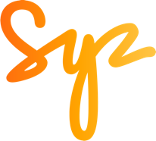
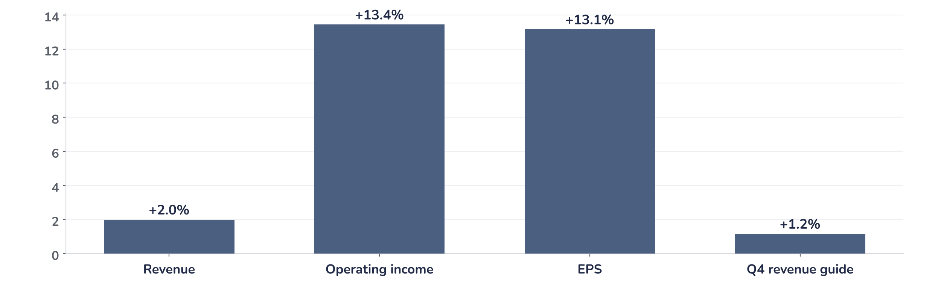
Earnings update
Meta Q3 2026: the ads deliver, the 2027 bill waits
22 October 2026 · Syz Research
“The benefits our AI investments are delivering to the core business, combined with emerging opportunities from model advances and product launches, position us to sustain strong overall revenue growth throughout 2027.”
Susan Li, Chief Financial Officer, Q3 2026 earnings call, 21 October 2026
Key takeaways
Beat
Revenue +2% vs. consensus; EPS of USD 7.40 (+13%) excludes a USD 9.9bn legal charge, reported USD 3.83.
Muse
Over 10 million Muse users in six weeks; a quarter of them are active on any given day.
Watch
Free cash flow of USD -2.1bn as capex reached USD 34.9bn; no 2027 capex figure until January.
Valuation
21.3x forward earnings, close to the 22.4x average since 2016: the rally since July is all multiple.
Revenue
EPS excl. legal charge
Q4 revenue guide
Free cash flow
USD 64.6bn
USD 7.40
USD 73–76bn
USD -2.1bn
+2.0% vs. consensus
+13.1% vs. cons.; reported 3.83
Mid-point +1.2% vs. consensus
Capex USD 34.9bn
The core business is funding the AI build-out
The quarter answered two of the three questions we set before the print: advertising delivered, and Muse, Meta’s new personal AI agent, came with usage data rather than downloads alone. Reported earnings, however, need careful reading: the legal settlement charge, partly non-deductible, halves reported EPS, so the headline figure is not an operating miss. The third question, the 2027 investment bill, is deferred to January, while free cash flow turned negative.
Chart 1 · META: Q3 2026 results vs. consensus
Surprise vs. FactSet pre-results consensus, % · operating income and EPS exclude the USD 9.9bn legal charge · Q4 guide at the mid-point
The beat came from profitability more than from sales. Revenue was 2% above consensus, but operating income and earnings per share, both excluding the legal charge, beat by 13%, helped by a 14% rise in the price per ad while headcount fell 12% from Q2. The Q4 revenue guide brackets consensus, with the mid-point 1.2% above.
Base case and implications
We stay constructive on Meta over the long term. The share is on the Syz master list but not on the focus list, and this update is not a recommendation to buy it. We underwrite an advertising-led earnings path: management expects strong revenue growth throughout 2027 and Reality Labs losses to narrow to about USD 15bn. The debate is now the cost of the AI build-out, as the reaction showed: after a 19% rise since July, the share spiked by about 7% after hours, then gave back most of the gain once management said Muse’s serving costs would rise. The next test is the 2027 guidance in late January.
What would strengthen our view
What would change our view
Consensus 12-month forward earnings rising again after a 10% cut since July. A 2027 capex guide in January that operating cash flow can fund. First Muse revenue, retention and cost-per-user figures, and traction for the paid tier, the API and Muse Code.
Capex guided well above the USD 135–145bn of 2026 without matching revenue. Ad impression growth slowing below 10%. Use of the new non-voting share to raise equity. Adverse rulings in the US youth-related trials scheduled for the coming months.
Syz Research · Earnings update · 22 October 2026
1 / 3

Slide 2
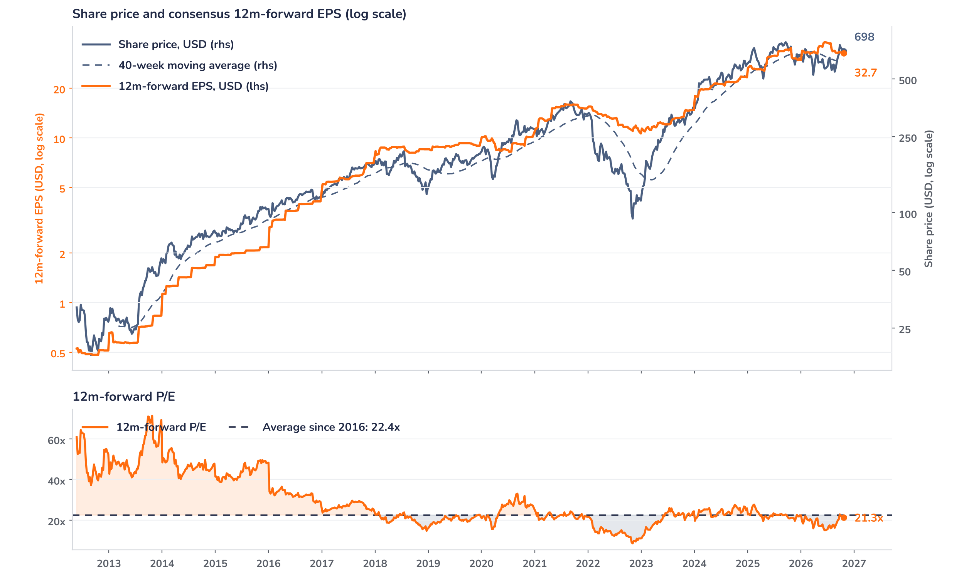
Beyond the key takeaways
Results: pricing carried a clean beat
Family of Apps revenue reached USD 64.2bn, up 26%, with advertising at USD 63.1bn, also up 26% at constant currency. Ad impressions grew 10%, and the average price per ad rose 14% on better ad performance and an easier macro backdrop. Daily active people reached 3.64bn. Other Family of Apps revenue grew 59% to USD 1.1bn on WhatsApp paid messaging and subscriptions, and Meta One, the new subscription bundle, passed 15 million subscriptions and trials. Reality Labs revenue fell 6% to USD 443m as lower Quest sales offset growth in AI glasses.
Total expenses rose 68% to USD 51.6bn, including the USD 9.9bn charge for the August settlement with US state attorneys general; the rest came from infrastructure and third-party AI token costs. Headcount fell 12% from Q2 to about 66,000. Reported operating income dropped 37% to USD 13.0bn, a 20% margin; excluding the charge it rose 11% to USD 22.9bn, a margin of about 35% against 40% a year ago. Capex of USD 34.9bn left free cash flow negative at USD 2.1bn, and debt of USD 83.7bn now slightly exceeds cash and marketable securities of USD 82.4bn.
Outlook: 2027 waits for January, Muse for scale
The Q4 revenue guide of USD 73–76bn compares with FactSet consensus of USD 73.65bn. Full-year 2026 expenses of USD 175–179bn are the previous range plus the legal charge, and the 2026 capex range was narrowed to USD 135–145bn. For 2027, management expects to keep investing aggressively but gives no figure before the Q4 call. A new non-voting share, distributed one for one from late January, widens funding options; no financing is planned.
Muse is where the 2027 bill and the upside meet. Over a quarter of weekly users shop through it, with an average purchase above USD 200, and Muse Wonder, in the paid tier, lifts retention. Most users would stay free, with businesses paying a fee on transactions, while subscriptions cover advanced models and business use. Its US users already bring several hundred dollars a year each in app revenue, and Meta expects Muse to reach a higher level through commerce. Serving costs will rise as capacity is built for over 1 billion users; Meta targets a more than tenfold efficiency gain next year but gives no cost per user.
Valuation: the rally since July is all multiple
Chart 2 · META: share price vs. consensus earnings and valuation
Weekly, May 2012 to 21 October 2026 · last price is the 21 October close, before the release · Bloomberg 12m-forward consensus EPS · 40-week moving average · log scale · P/E vs. its average since 2016
At USD 697.5, 10% above its 40-week average, the share is 2.7% lower than a year ago while forward consensus earnings fell 5.3%. Since July the gap is wider: the price is up 19.1% and forward earnings are down 10.4%, taking the multiple from 16.1x to 21.3x. That is 4.8% below the 22.4x average since 2016, but above the one-year average of 19.2x and the 14.9x low of June 2026. A 10% earnings upgrade at an unchanged price would bring the multiple back to 19.4x, its one-year average.
Syz Research · Earnings update · 22 October 2026
2 / 3

Slide 3
SYZ Source: Syz Research, Bloomberg, FactSet, Meta Platforms Q3 2026 earnings release and call transcript of 21 October 2026
Disclaimer
This communication has been issued and made available to recipients for the purpose of advertising investment services and/or financial instruments. It has been sent for information purposes and cannot be considered as an offer or a personalised recommendation to buy or sell a financial instrument or any other investment or currency. This communication does not constitute investment research within the meaning of regulatory rules applicable in the European Economic Area, or research under the rules of the U.S. Self-Regulatory Organizations.
This information is made solely for professional and institutional clients as defined by the Swiss Financial Services Act, as well as qualified investors according to the Swiss Collective Investment Schemes Act. It is not intended for retail clients or non-qualified investors and consequently cannot be transmitted to any third party.
This communication is not directed to any person in any jurisdiction where, by reason of that person’s nationality, residence or otherwise, its dissemination or use is prohibited. It cannot be quoted, reproduced, disclosed, distributed or otherwise referred to, in whole or in part, to any third party without the Bank’s prior written consent.
This communication may contain information on past performances of a financial product, all kinds of economic and financial valuations and analyses, as well as opinions of the Bank or of third parties. Any market valuations, terms and calculation methods, yields and opinions expressed are subject to change without notice. The information and opinions contained herein have been compiled and provided in good faith, based on information obtained from sources believed to be trustworthy. However, such information has not been independently verified. No guarantee, representation, or warranty of any kind, whether express or implied, is provided by the Bank or by relevant data vendors and other sources with respect to the accuracy, reliability, currentness or exhaustiveness of the information communicated, the methodology employed or the prices contained herein.
Past performance is not a reliable indicator of current or future results. Any reference to the past performance of an investment does not guarantee its future performance. Fluctuations in exchange rates may adversely affect the value, price or income of any investment.
Nothing in the present communication constitutes investment, legal, accounting or tax advice. This information is purely objective since it does not take into consideration the personal situation (including financial knowledge and experience), the investment objectives and risk profile of any recipient. Moreover, certain financial instruments mentioned (in particular, but not exclusively, derivatives, options and futures) involve a high risk of loss and may not be suitable. Accordingly, recipients should consult their own advisors on such matters, including but not limited to the possible tax consequences of investing in any financial product mentioned herein, and make their own assessment of the suitability of such investment product.
Should a recipient make an investment on the basis of the present communication, the recipient alone shall bear the consequences thereof. In no event shall the Bank, its directors, employees, affiliates or agents be held responsible for damages of any kind arising out of the use of all or part of the information provided herein.
Syz Research · Earnings update · 22 October 2026
3 / 3

