Slide 1

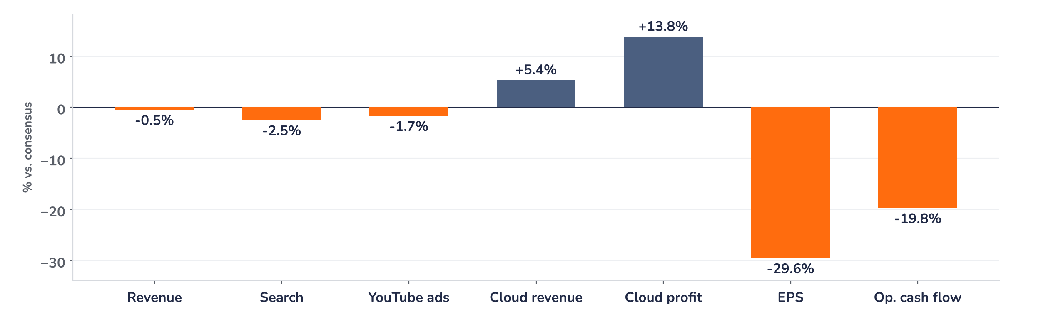
Earnings update
Alphabet Q3 2026: good for AI growth, tough on margins
29 October 2026 · Syz Research
“The strong growth in AI Mode queries had an impact because of the lower monetization we were seeing in AI Mode. To be clear, we feel very good about our trajectory here.”
Philipp Schindler, Chief Business Officer, Google, Alphabet Q3 2026 earnings call, 28 October 2026
Alphabet owns Google Search, YouTube, Android and Google Cloud. Google Services, mostly advertising, brings in 75% of revenue and Google Cloud 24%. Revenue now runs above USD 500bn a year; the shares trade on Nasdaq.
Key takeaways
Miss
EPS of USD 2.12 missed consensus by 30%, mostly on a USD 0.55 loss on the SpaceX stake.
Margin
Operating margin fell to 31.8% from 34.0% as depreciation rose; operating profit missed by about 6%.
Growth
Revenue grew 25% and Google Cloud doubled to USD 30.7bn, with USD 561bn of contracts booked.
Reaction
Shares are down over 10% pre-market on 29 October, to about 17.7x forward earnings, below average.
EPS
Operating margin
Google Cloud revenue
Free cash flow
USD 2.12
31.8%
USD 30.7bn
USD -9.1bn
-29.6% vs. consensus
34.0% in Q2 2026
+5.4% vs. consensus
Consensus USD -2.7bn
Margins explain the fall better than EPS
EPS missed consensus by 30% and the shares are down over 10% pre-market on 29 October, below USD 300. The EPS miss says little about Search, YouTube or Cloud: most of it is a loss on the SpaceX stake. The margin matters more. It fell to 31.8% from 34.0% in Q2 as depreciation on the AI build-out rose, and operating profit missed by about 6%.
Chart 1 · GOOGL: Q3 2026 results vs. consensus
Reported vs. consensus before the release, % · Cloud profit = Google Cloud operating income · EPS includes a USD 0.55 loss on equity securities
Google Cloud beat consensus by 5% on revenue and by 14% on operating income. Advertising fell short: total ads of USD 82bn were 1.8% below estimates. Excluding the equity loss, EPS of USD 2.67 sits 11% under consensus. Negative free cash flow of USD 9.1bn includes a USD 5.2bn EC fine; without it, the outflow is about USD 3.9bn.
Base case and implications
The investment case remains intact: good for AI growth, tough on near-term earnings. We underwrite revenue growth of around 20% into 2027. Cloud offsets part of the Search pressure in profit, with just over 55% of its USD 561bn backlog due within 24 months; the cash payback comes later. Consensus EPS should come down as depreciation rises and capex grows again in 2027. Near USD 292, the stock trades 10% below its long-run multiple and the risk/reward has improved. The next test is the Q4 report in February.
What would strengthen our view
What would change our view
Ads in AI Mode closing the monetisation gap as they roll out abroad; Search growth holding in Q4 despite FX; Cloud margin above 30% through the third-party capacity ramp; buybacks resuming.
Free cash flow negative again in Q4 without a fine payment; Search slowing further as AI Mode takes queries; 2027 capex rising faster than the USD 561bn Cloud backlog turns into revenue.
Syz Research · Earnings update · 29 October 2026
1 / 3

Slide 2
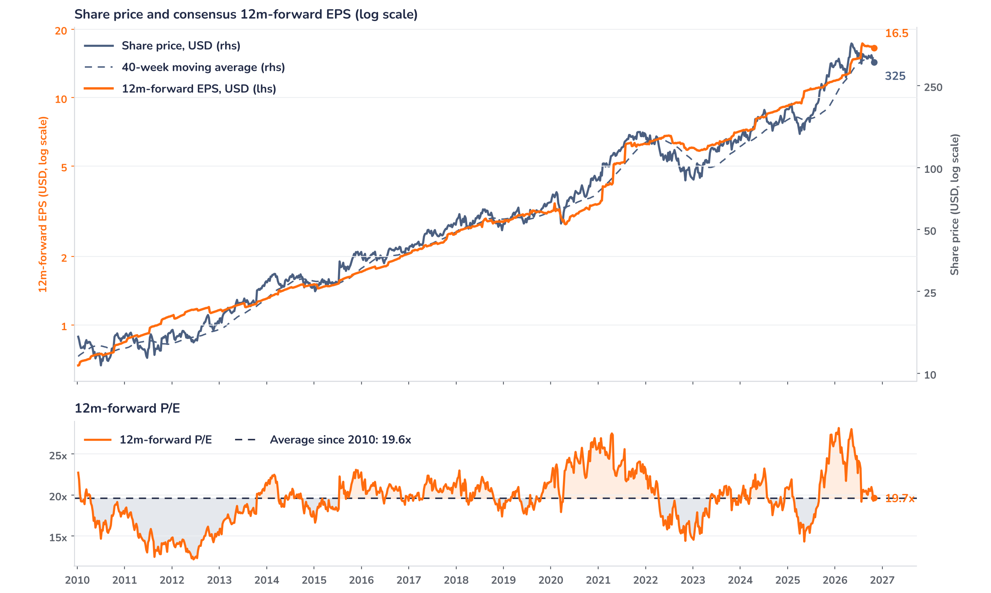
Beyond the key takeaways
Results: Search slowed on FX and AI Mode
Revenue rose 25% to USD 127.6bn and operating income 30% to USD 40.6bn. Search grew 12% to USD 63.3bn, down from 17% in Q2. Philipp Schindler named FX the single largest driver of that slowdown, then APAC retailers hit by the end of the EU de minimis exemption, World Cup budgets spent in June and lower monetisation in AI Mode. The FX comment covers the slowdown versus Q2 and leaves the miss versus consensus open. The numbers show monetisation pressure as queries move to AI Mode, where Google is now scaling ads, abroad for the first time. Management did not cite OpenAI, and nothing in the results shows it taking material ad budgets.
The miss and the pre-market fall of more than 10% on 29 October point the same way, and the size of the move tracks the margin, hit by depreciation and a USD 7.7bn Alphabet-level loss, mainly from shared AI research. Negative free cash flow of USD 9.1bn needs a split. The USD 5.2bn payment for a 2018 EC fine is exceptional; without it, the outflow would be about USD 3.9bn, our calculation. The rest reflects ongoing AI investment and TPU inventory and remains a heavy drain. No shares were bought back. We think investors now question the payback on capex.
Outlook: Cloud covers profit, cash lags
Google Cloud revenue grew 103% to USD 30.7bn and operating income more than tripled to USD 11.1bn, a 36.2% margin. Cloud profit rose by about USD 7.5bn year on year, our estimate, against a USD 27bn rise in quarterly capex. The segment margin leaves out the shared AI research costs, and the CFO expects “margin headwinds in the near term” as Google uses third-party compute in Q4. Cloud can cover weaker Search monetisation at the profit line; cash returns lag until TPU system revenue ramps in 2027. Management kept the 2026 capex range of USD 195bn to 205bn and expects a steep rise in 2027.
Valuation: the premium is gone
Chart 2 · GOOGL: share price vs. consensus earnings and valuation
Weekly, 2010 to 28 Oct 2026 · Bloomberg 12m-forward consensus EPS · 40-week MA · Log scale · Last price is the 28 October close, before the release
At the 28 October close of USD 324.9, before the release, the stock traded on 19.7x 12-month forward EPS of USD 16.5, in line with its 19.6x average since 2010 and far below the 28.2x peak of January 2026. Over 12 months the price rose 25% and consensus EPS 46%, so earnings did the work and the multiple compressed. The price sat 5% below its 40-week average of USD 340.8. Near USD 292 pre-market, the multiple drops to 17.7x, 10% below average. A 5% cut to consensus EPS at that price would lift it to 18.6x, still under the average.
Syz Research · Earnings update · 29 October 2026
2 / 3

Slide 3
SYZ Source: Syz Research, Bloomberg, company filings, Alphabet Q3 2026 earnings call of 28 October 2026, press coverage and analyst research notes of 29 October 2026
Disclaimer
This communication has been issued and made available to recipients for the purpose of advertising investment services and/or financial instruments. It has been sent for information purposes and cannot be considered as an offer or a personalised recommendation to buy or sell a financial instrument or any other investment or currency. This communication does not constitute investment research within the meaning of regulatory rules applicable in the European Economic Area, or research under the rules of the U.S. Self-Regulatory Organizations.
This information is made solely for professional and institutional clients as defined by the Swiss Financial Services Act, as well as qualified investors according to the Swiss Collective Investment Schemes Act. It is not intended for retail clients or non-qualified investors and consequently cannot be transmitted to any third party.
This communication is not directed to any person in any jurisdiction where, by reason of that person’s nationality, residence or otherwise, its dissemination or use is prohibited. It cannot be quoted, reproduced, disclosed, distributed or otherwise referred to, in whole or in part, to any third party without the Bank’s prior written consent.
This communication may contain information on past performances of a financial product, all kinds of economic and financial valuations and analyses, as well as opinions of the Bank or of third parties. Any market valuations, terms and calculation methods, yields and opinions expressed are subject to change without notice. The information and opinions contained herein have been compiled and provided in good faith, based on information obtained from sources believed to be trustworthy. However, such information has not been independently verified. No guarantee, representation, or warranty of any kind, whether express or implied, is provided by the Bank or by relevant data vendors and other sources with respect to the accuracy, reliability, currentness or exhaustiveness of the information communicated, the methodology employed or the prices contained herein.
Past performance is not a reliable indicator of current or future results. Any reference to the past performance of an investment does not guarantee its future performance. Fluctuations in exchange rates may adversely affect the value, price or income of any investment.
Nothing in the present communication constitutes investment, legal, accounting or tax advice. This information is purely objective since it does not take into consideration the personal situation (including financial knowledge and experience), the investment objectives and risk profile of any recipient. Moreover, certain financial instruments mentioned (in particular, but not exclusively, derivatives, options and futures) involve a high risk of loss and may not be suitable. Accordingly, recipients should consult their own advisors on such matters, including but not limited to the possible tax consequences of investing in any financial product mentioned herein, and make their own assessment of the suitability of such investment product.
Should a recipient make an investment on the basis of the present communication, the recipient alone shall bear the consequences thereof. In no event shall the Bank, its directors, employees, affiliates or agents be held responsible for damages of any kind arising out of the use of all or part of the information provided herein.
Syz Research · Earnings update · 29 October 2026
3 / 3

