Slide 1

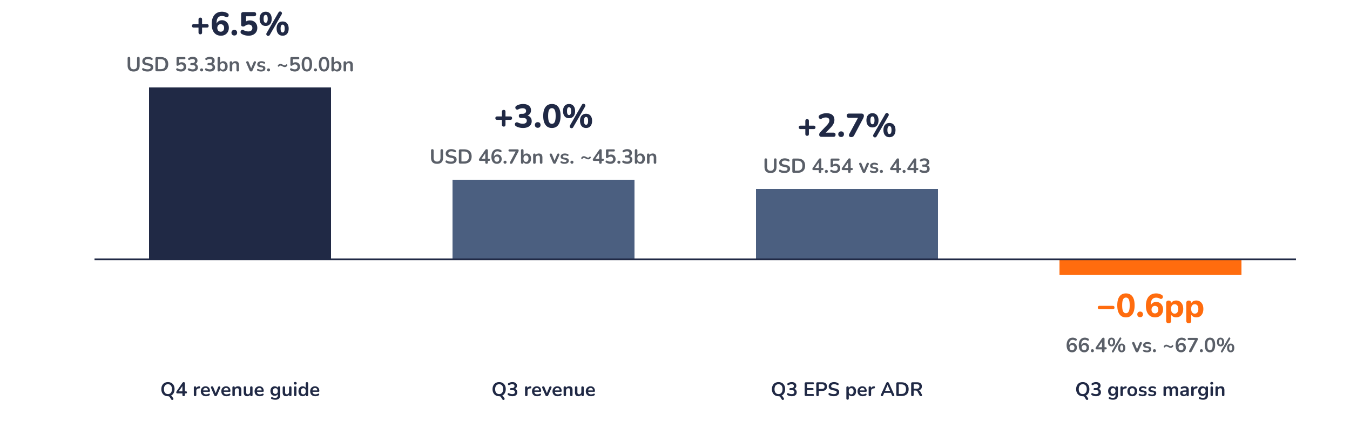
Earnings update · Semiconductors
TSMC Q3 2026: AI outruns capacity, margins are the debate
15 October 2026 · Syz Research
“Demand is extremely robust.” … “There is no ceiling for [TSMC’s] profitability.”
C.C. Wei, Chief Executive Officer, Q3 2026 earnings call, 15 October 2026 (as reproduced in analyst research notes)
Key takeaways
Beat
Revenue of USD 46.7bn (+41%) and EPS of USD 4.54 per ADR both beat consensus by about 3%.
Raised
The Q4 guide of USD 52.3–54.3bn sits 5–8% above prior consensus, locking in 44% growth for 2026.
Watch
Gross margin of 66.4% missed by 0.6 points on 2nm dilution; overseas fabs cost 3–4 points in 2027.
Valuation
19.7x forward earnings: 16% above the 2010 to 2026 average, well below the one-year average of 23.3x.
Q3 revenue
Q3 EPS per ADR
Q3 gross margin
Q4 revenue guide
USD 46.7bn
USD 4.54
66.4%
USD 53.3bn
+3% vs. consensus
+2.7% vs. consensus
-0.6pp vs. consensus
+5–8% vs. consensus
AI now sets the pace, not the cycle
The quarter matters less for the 3% beat than for what management said about the years ahead. Taiwan Semiconductor Manufacturing Company (TSMC) now expects revenue from artificial intelligence (AI) accelerators to grow faster than the mid-to-high 50s% annual pace it guided for 2024 to 2029, and plans to more than double its 2-nanometre (2nm) capacity in 2027. Demand is no longer the question: the debate has moved to how much of it reaches margins and free cash flow.
Chart 1 · TSM: everything beat except the margin
Surprise vs. pre-results consensus in %, gross margin in percentage points · Q4 guide at its USD 53.3bn midpoint vs. prior consensus · EPS per ADR in USD at the 15 October exchange rate · Revenue and margin consensus approximate
The pattern is clear: the top line beat, the margin slipped. Revenue and earnings per share (EPS) both beat consensus by about 3%, and the fourth-quarter guide sits around 6.5% above prior expectations, a 14% sequential step-up. The only miss was gross margin, 0.6 points short at 66.4%, entirely from the 2nm ramp, which should fade as yields improve.
Base case and implications
We stay positive on TSMC and would add on weakness around the results. We underwrite US dollar revenue growth of 44% in 2026 and an AI business compounding at more than 50% a year; consensus 12-month forward EPS is already up 88% in a year. The debate has moved from demand to returns: capital spending of USD 60–64bn this year rises sharply in 2027 to 2028, and overseas fabs dilute gross margin by 3–4 points, which analysts expect pricing to cut to about 1 point. Tactically, the American depositary receipt (ADR) sits 13% below its 2 October record. The next test is the fourth-quarter release in mid-January 2027.
What would strengthen our view
What would change our view
Fourth-quarter gross margin at or above the 67% top of guidance in January; AI accelerator growth confirmed above the mid-to-high 50s% pace; 2nm yields fast enough to lift 2027 capacity beyond the planned doubling; subsidies or customer commitments funding the Dallas complex.
Gross margin below 65%, the bottom of the fourth-quarter guide, and staying there through the 2nm and A14 ramps; capital spending above USD 100bn in 2027 without matching revenue; higher US tariffs on chips; an AI derating that takes the multiple below its 16.9x average.
Syz Research · Earnings update · 15 October 2026
1 / 3

Slide 2
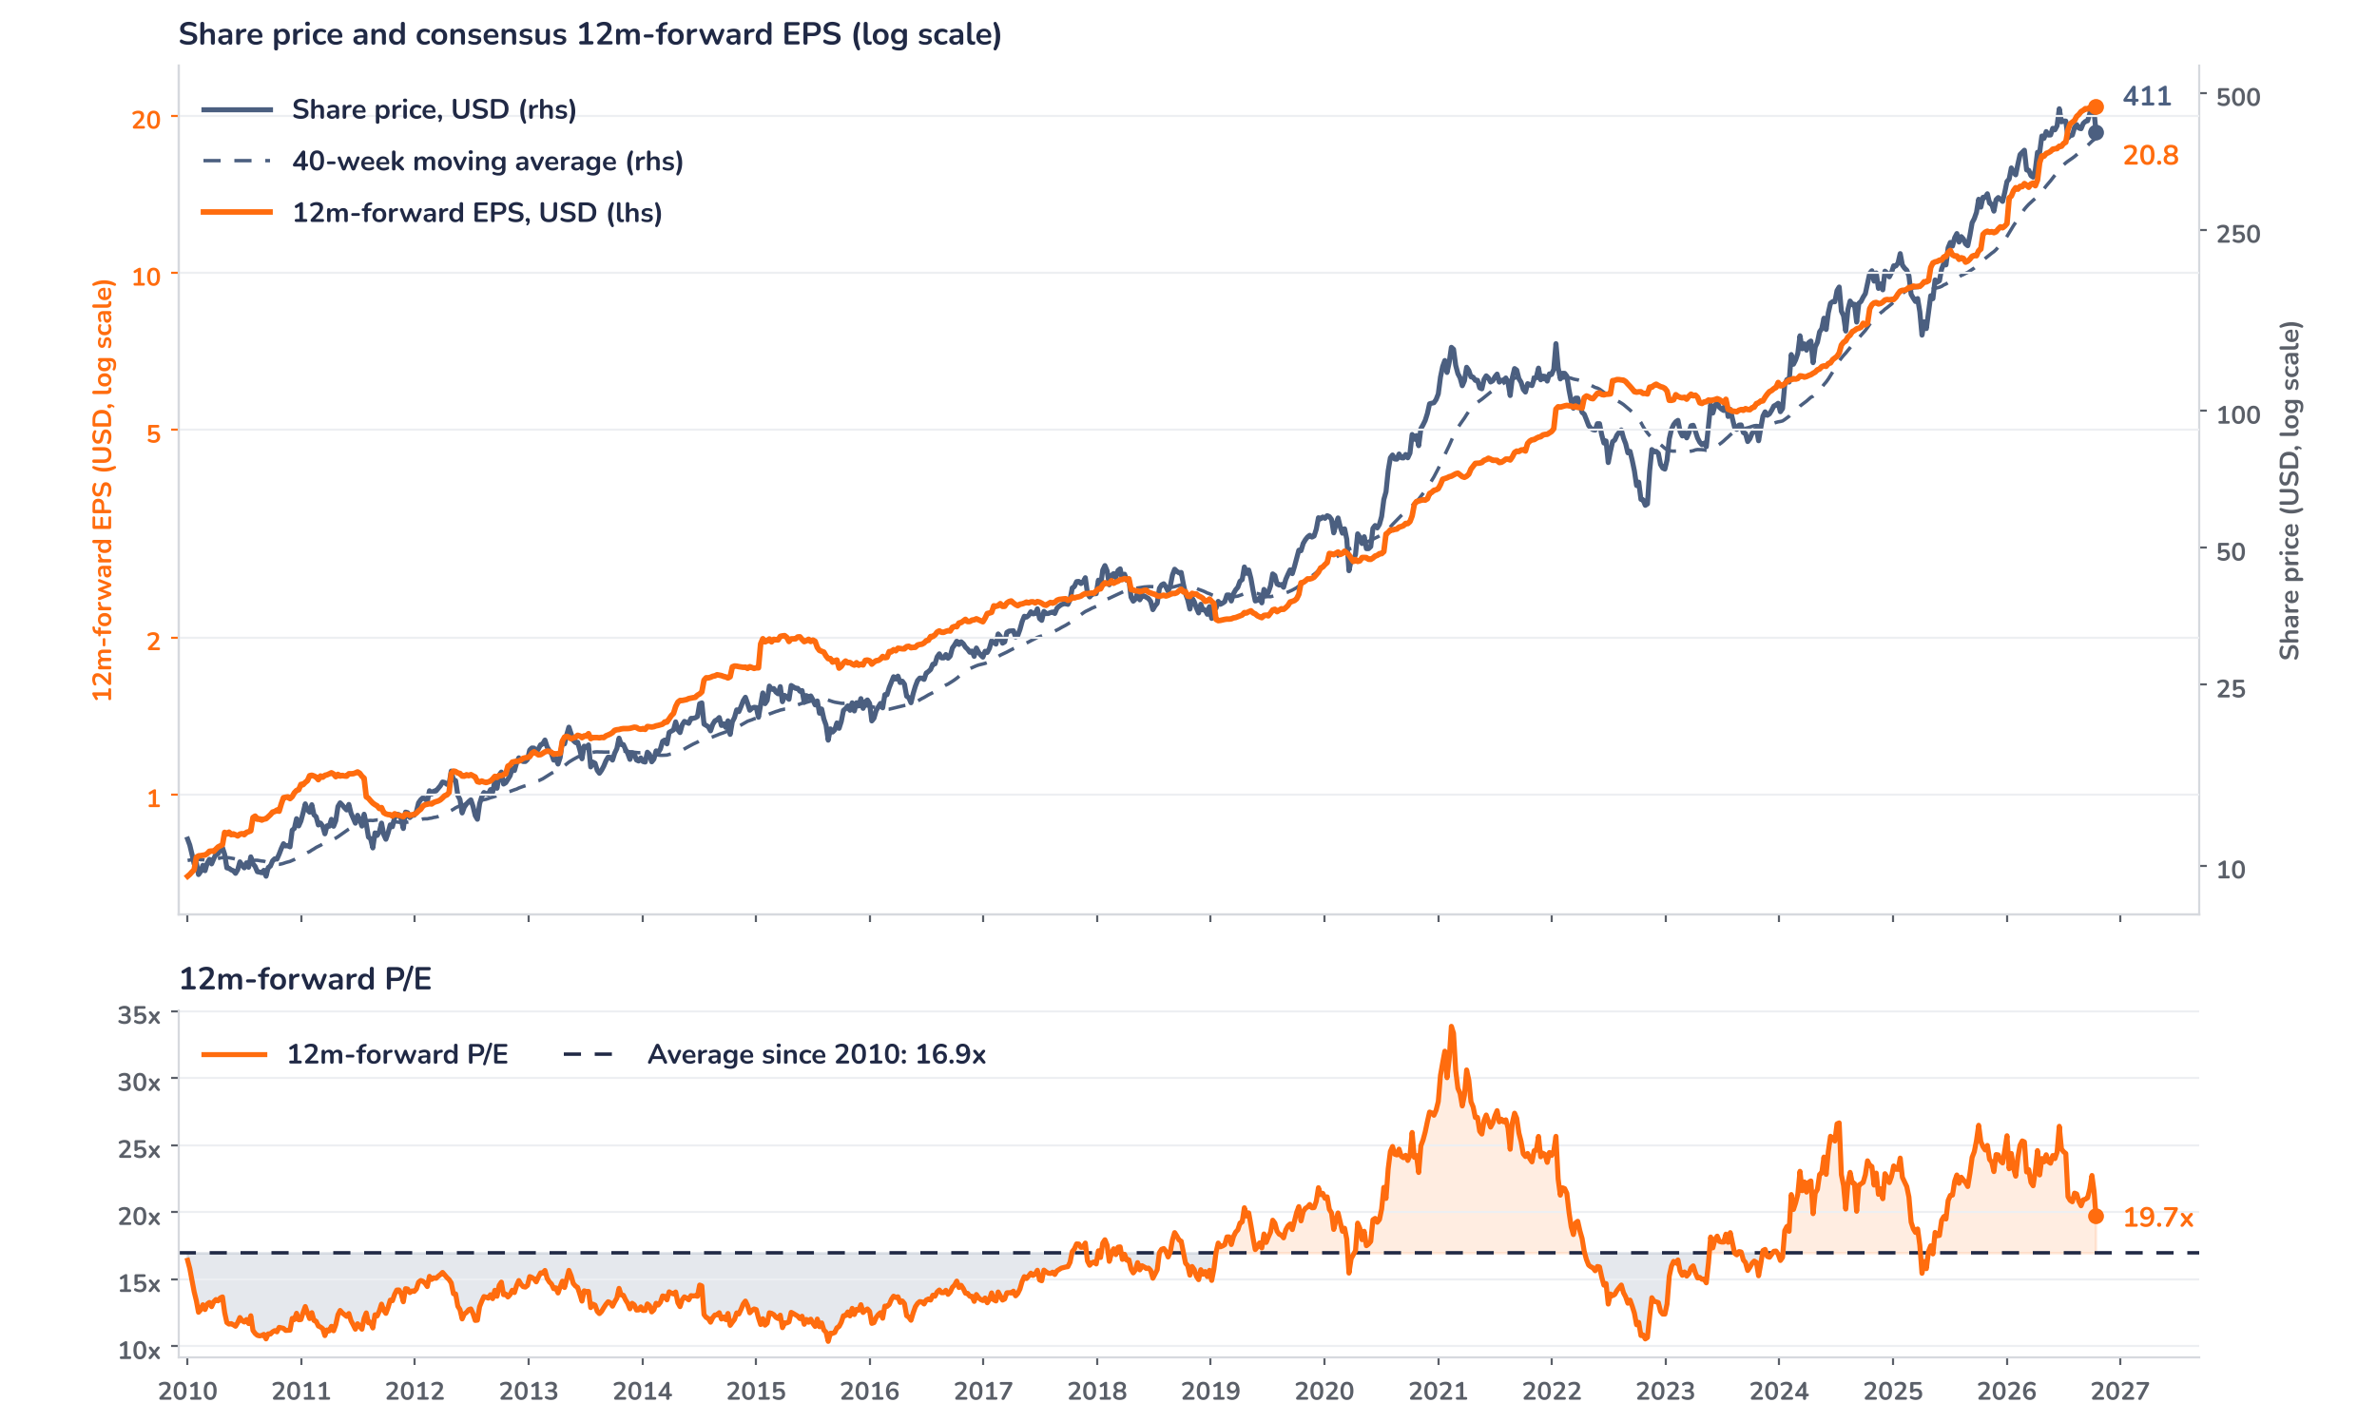
Beyond the key takeaways
Results: volume beat, 2nm dented the margin
Third-quarter revenue of USD 46.7bn rose 16.2% quarter on quarter, above guidance, and 41% year on year, about 3% ahead of consensus. High-performance computing (HPC), smartphones and automotive led demand, and the strength was broad rather than a single product cycle. Operating leverage was strong: the operating margin reached 58.7%, ahead of expectations, and EPS of USD 4.54 per ADR beat the USD 4.43 consensus by 2.7% and rose 69% year on year, in line with net income. This is the third consecutive quarter of beat-and-raise, and it came with an upgrade to the multi-year AI outlook, with agentic AI named as an additional growth engine on top of the cloud AI build-out.
Gross margin was the one soft line. At 66.4% it came in about 0.6 points below elevated expectations of 67% and 1.3 points below the 67.7% of the second quarter, a decline management attributes entirely to the dilution from the 2nm ramp. We read this as a cost of leadership rather than pricing pressure: the dilution was limited for a first-year node, and analysts see it as support for scarcity-driven pricing in 2027. Analyst estimates put 2026 return on equity near 44%, with a net cash balance sheet, so the margin step-down does not constrain the investment plan.
Outlook: capacity, not demand, is the limit
The fourth-quarter guide of USD 52.3–54.3bn, with gross margin of 65–67%, implies 44% US dollar revenue growth for 2026. Capital spending stays at USD 60–64bn this year, but 2026 to 2028 spending is guided well above the USD 101bn of the previous three years; analyst estimates range from USD 80–85bn to USD 90bn for 2027 and reach USD 105bn for 2028. Capacity follows: 2nm more than doubles in 2027, Arizona Fab 2 (3nm) starts volume production in the third quarter of 2027, and a Dallas complex could take planned US investment to about USD 530bn. Overseas margin dilution rises from about 2 points in 2026 to 3–4 points in 2027.
Valuation: earnings did the work, not the multiple
Chart 2 · TSM: share price vs. consensus earnings and valuation
ADR in USD, weekly, January 2010 to 15 October 2026 · Bloomberg 12m-forward consensus EPS per ADR in USD, at Bloomberg’s implied exchange rate · 40-week simple moving average · Log scale · Last price is the 15 October (results day) print
Over 12 months the ADR is up 46% to USD 411 while consensus 12-month forward EPS rose 88% to USD 20.8 per ADR, so the forward price-to-earnings ratio (P/E) fell from 25.3x to 19.7x. That is 16% above the 16.9x average since 2010, but below the one-year average of 23.3x and the 33.9x peak of February 2021. The price is 13% below its 2 October record and 3% above its 40-week moving average of USD 397. Analysts put the stock at about 16x 2027 earnings; a 10% upgrade at an unchanged price takes the multiple to 17.9x, near its average.
Syz Research · Earnings update · 15 October 2026
2 / 3

Slide 3
SYZ Source: Syz Research, Bloomberg, company filings, analyst research notes of 15 October 2026
Disclaimer
This communication has been issued and made available to recipients for the purpose of advertising investment services and/or financial instruments. It has been sent for information purposes and cannot be considered as an offer or a personalised recommendation to buy or sell a financial instrument or any other investment or currency. This communication does not constitute investment research within the meaning of regulatory rules applicable in the European Economic Area, or research under the rules of the U.S. Self-Regulatory Organizations.
This information is made solely for professional and institutional clients as defined by the Swiss Financial Services Act, as well as qualified investors according to the Swiss Collective Investment Schemes Act. It is not intended for retail clients or non-qualified investors and consequently cannot be transmitted to any third party.
This communication is not directed to any person in any jurisdiction where, by reason of that person’s nationality, residence or otherwise, its dissemination or use is prohibited. It cannot be quoted, reproduced, disclosed, distributed or otherwise referred to, in whole or in part, to any third party without the Bank’s prior written consent.
This communication may contain information on past performances of a financial product, all kinds of economic and financial valuations and analyses, as well as opinions of the Bank or of third parties. Any market valuations, terms and calculation methods, yields and opinions expressed are subject to change without notice. The information and opinions contained herein have been compiled and provided in good faith, based on information obtained from sources believed to be trustworthy. However, such information has not been independently verified. No guarantee, representation, or warranty of any kind, whether express or implied, is provided by the Bank or by relevant data vendors and other sources with respect to the accuracy, reliability, currentness or exhaustiveness of the information communicated, the methodology employed or the prices contained herein.
Past performance is not a reliable indicator of current or future results. Any reference to the past performance of an investment does not guarantee its future performance. Fluctuations in exchange rates may adversely affect the value, price or income of any investment.
Nothing in the present communication constitutes investment, legal, accounting or tax advice. This information is purely objective since it does not take into consideration the personal situation (including financial knowledge and experience), the investment objectives and risk profile of any recipient. Moreover, certain financial instruments mentioned (in particular, but not exclusively, derivatives, options and futures) involve a high risk of loss and may not be suitable. Accordingly, recipients should consult their own advisors on such matters, including but not limited to the possible tax consequences of investing in any financial product mentioned herein, and make their own assessment of the suitability of such investment product.
Should a recipient make an investment on the basis of the present communication, the recipient alone shall bear the consequences thereof. In no event shall the Bank, its directors, employees, affiliates or agents be held responsible for damages of any kind arising out of the use of all or part of the information provided herein.
Syz Research · Earnings update · 15 October 2026
3 / 3

