Slide 1
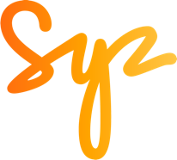
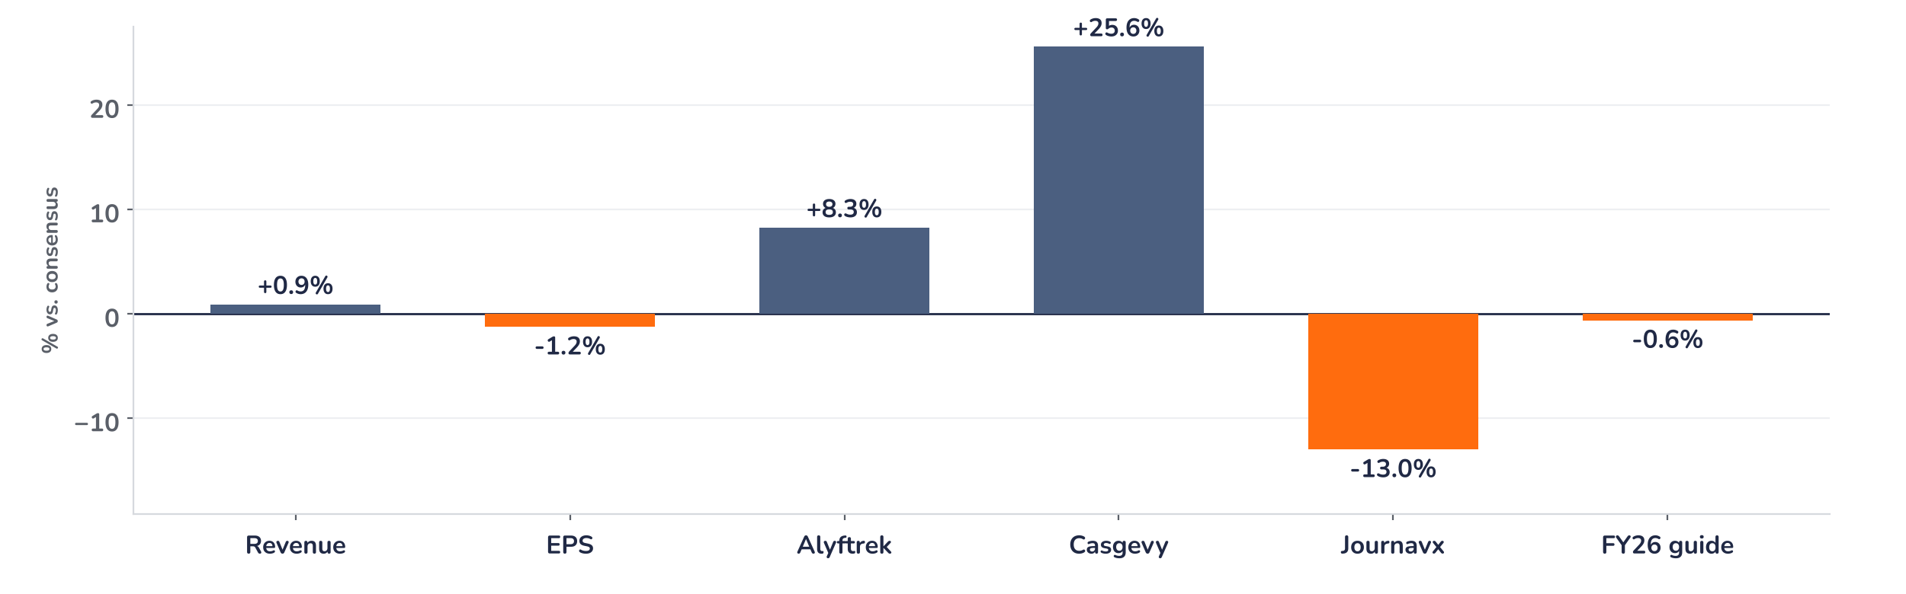
Earnings update
Vertex Q3 2026: steady CF, the kidney launch sets the price
3 November 2026 · Syz Research
“With the potential povetacicept approval in IgAN coming later this month, we are well positioned to establish nephrology as our fifth commercial franchise…”
Reshma Kewalramani, CEO and President, Q3 2026 results release, 2 November 2026
Vertex Pharmaceuticals makes medicines for serious diseases. Cystic fibrosis drugs bring 95% of sales; Casgevy (gene editing), Journavx (pain) and Palsonify (acromegaly) add the rest. 2025 revenue $12.0bn; Nasdaq-listed, worth $140bn.
Key takeaways
Beat
Revenue $3.44bn, up 12% and 0.9% above consensus; Alyftrek beat by 8% as patients switch from Trikafta.
Miss
Earnings per share $4.76, 1.2% short: costs up 19% with Crinetics; Journavx sales 13% below consensus.
Reaction
Shares flat to 1.4% higher after hours on 2 November: the 30 November kidney drug decision matters more.
Valuation
27.2x forward earnings, 19% above the average since 2020: approval is largely priced, launch uptake is not.
Revenue
Non-GAAP EPS
Alyftrek
FY26 revenue guide (mid)
$3.44bn
$4.76
$706m
$13.2bn
+0.9% vs. consensus
-1.2% vs. consensus
+8.3% vs. consensus
-0.6% vs. consensus
A mixed print, a muted move, a bigger date
Revenue of $3.44bn beat consensus by 0.9% and non-GAAP earnings per share of $4.76 missed by 1.2%, and the shares were little changed after hours on 2 November (flat to +1.4%): a mixed print met by a muted move. Cystic fibrosis delivered, Casgevy surprised, Journavx lagged. The 30 November decision on povetacicept (pove), its kidney drug, matters more.
Chart 1 · VRTX: Q3 2026 results vs. consensus
Reported vs. consensus, % · Casgevy vs. the midpoint of $76–82m estimates · FY26 guide: revenue guidance midpoint vs. consensus of $13.28bn
Alyftrek, the once-daily successor to Trikafta, beat by 8% and Casgevy by about 26%, while Journavx fell 13% short although prescriptions rose more than 40% on the quarter. Earnings missed because operating costs rose 19%, mostly for the Crinetics acquisition and the kidney launch. The guidance midpoint sits 0.6% below consensus.
Base case and implications
The case remains constructive and the risk/reward modestly skewed to the upside. We underwrite a cystic fibrosis franchise growing in mid-to-high single digits as patients move to Alyftrek, and new medicines lifting non-cystic fibrosis revenue towards 30% of sales by 2030, an analyst estimate. The catalyst is an on-time pove approval on 30 November, then kidney data in early 2027. With the shares up 17.5% since early August, approval looks largely priced: launch uptake and the 2027 guidance, due with fourth-quarter results, are the next tests.
What would strengthen our view
What would change our view
Pove approved on time by 30 November, with no extra monitoring; Journavx revenue catching up with prescriptions in Q4; inaxaplin interim kidney data in early 2027 supporting a US filing.
A delay or a restrictive pove label; Casgevy and Journavx below the ~$134m needed in Q4 for their $500m goal; Alyftrek switching slowing; 2027 costs rising above this year's $6bn.
Syz Research · Earnings update · 3 November 2026
1 / 3

Slide 2
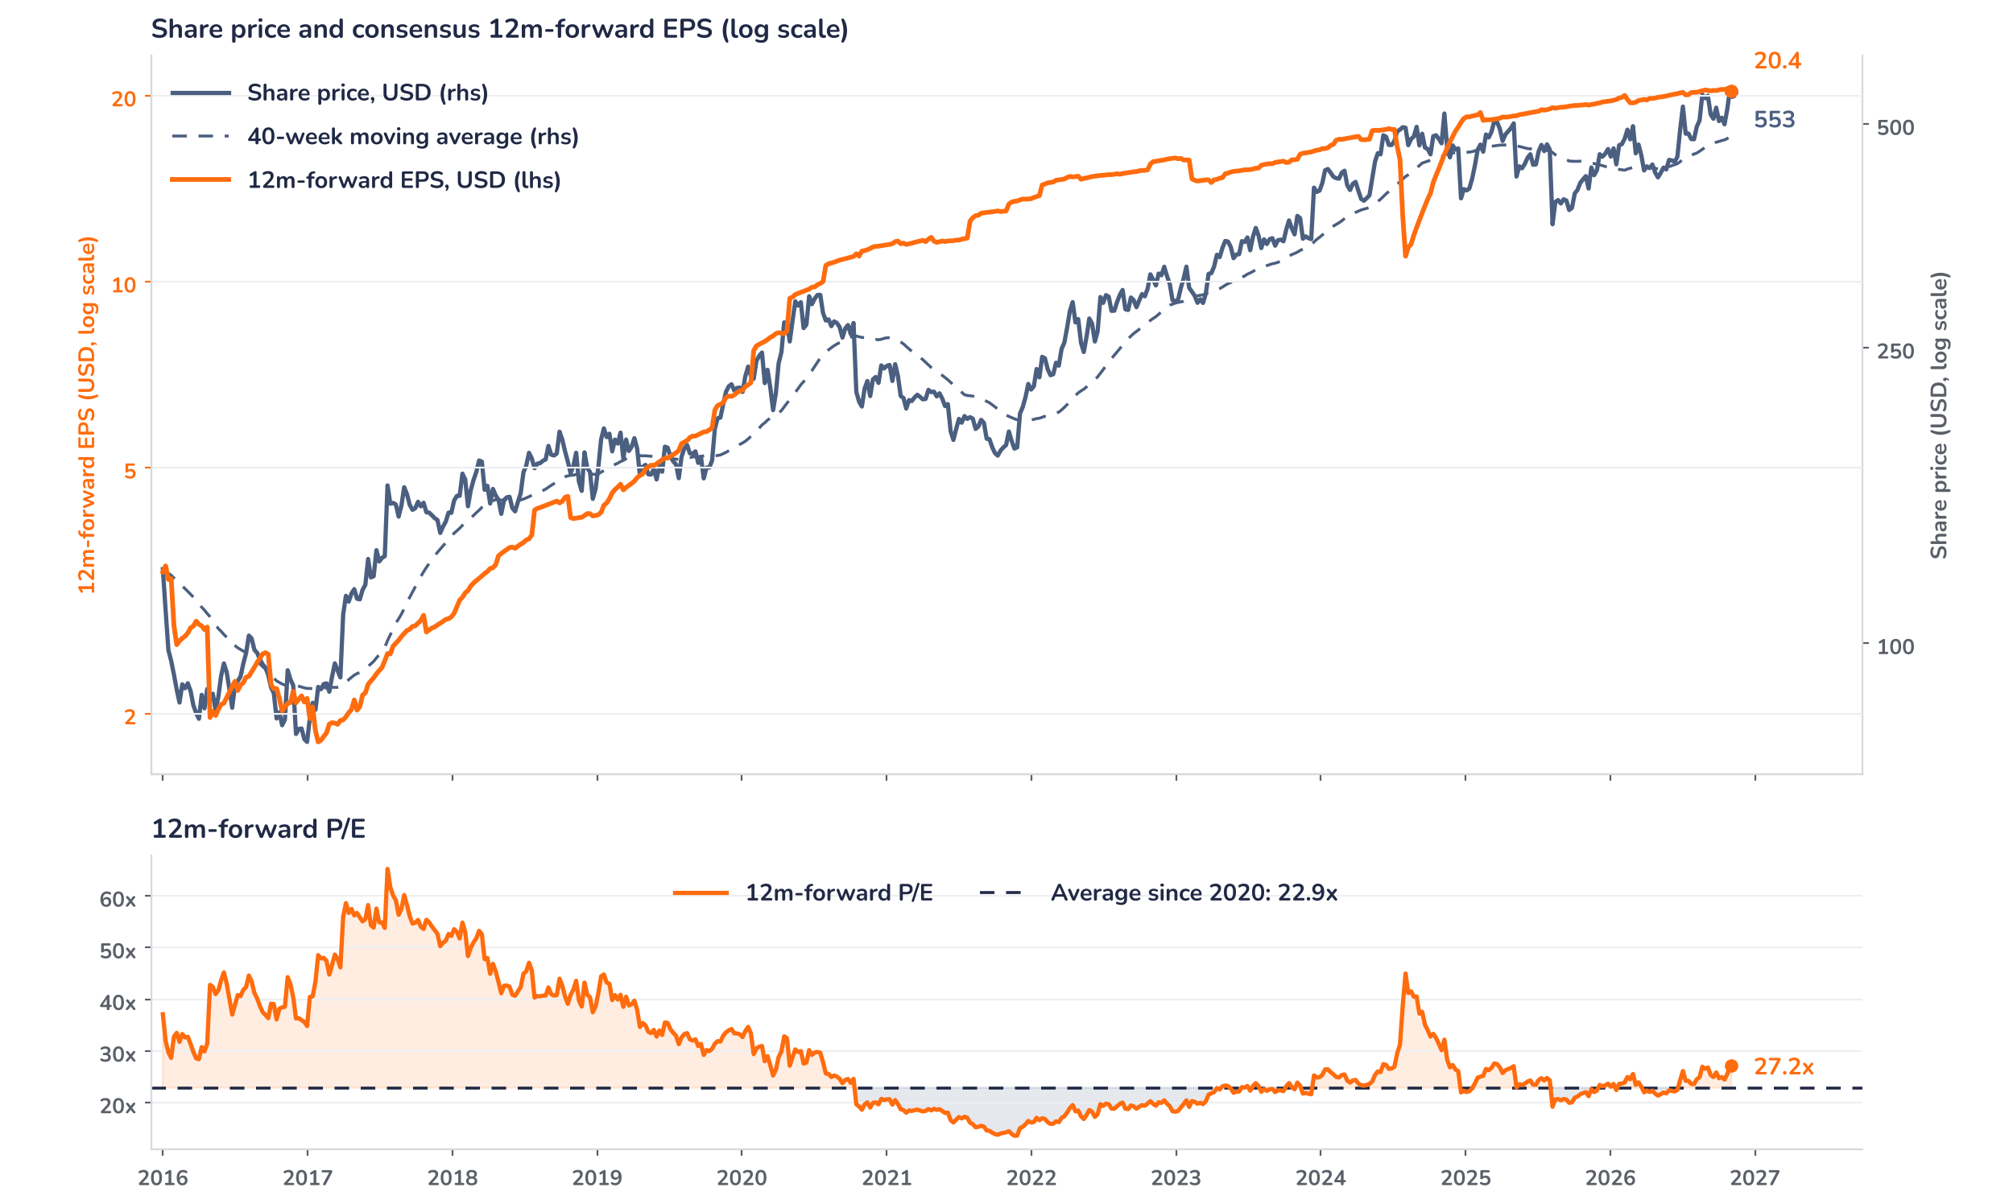
Beyond the key takeaways
Results: Alyftrek and Casgevy did the work
Total revenue rose 12% to $3.44bn, 10% in the US and 16% outside, where currency helped. Cystic fibrosis revenue grew 7.7% to $3.27bn. Trikafta fell 8% to $2.44bn as patients switched to Alyftrek, which nearly tripled to $706m: Alyftrek is now 22.5% of the two medicines against 8.5% a year ago, and is reimbursed in 32 countries. The switch helps margins, as Alyftrek carries a lighter royalty. Casgevy reached $99m, up 30% on the quarter, with more than 100 patients starting treatment for a fourth quarter running; Journavx grew 18% to $58m and Palsonify added $10m in September, its first month.
Revenue beat by 0.9% and earnings per share missed by 1.2%, and the shares were broadly unchanged after hours on 2 November: surprise and reaction are aligned, a mixed print and a small move. The confirmed driver of the miss is costs, not sales. Combined non-GAAP operating expenses rose 19% to $1.53bn with Crinetics, the kidney franchise build-out and the Journavx launch, taking the operating margin to 41.0% from 45.0%, while interest on the $4.5bn term loan cut net income 2%. Journavx revenue grew less than prescriptions; analysts attribute the gap to patient assistance programmes. We think investors looked through the quarter to 30 November.
Outlook: Palsonify lifts sales and costs
Vertex raised its 2026 revenue guidance by $50m to $13.15bn to $13.25bn, matching the $40m to $50m Palsonify is expected to add after the 1 September close of the Crinetics acquisition: the guidance for the existing business is unchanged. It implies fourth-quarter revenue of $3.39bn to $3.49bn, flat on the third quarter at the midpoint. Casgevy and Journavx are still expected to reach $500m or more together; analysts estimate about $134m is needed in the fourth quarter, against $158m in the third. Operating expense guidance rises to about $6.0bn from $5.65bn to $5.75bn, all from Crinetics, where analysts expect around a fifth of costs to be saved within a year.
Valuation: a premium the launch must earn
Chart 2 · VRTX: share price vs. consensus earnings and valuation
VRTX US Equity, daily data sampled weekly, 2016 to 2 November 2026 · BEst 12m-forward consensus · 40-week simple MA · log scale · P/E shaded vs. its 2020 to 2026 average · last price is the 2 November close, before the release
The shares trade at 27.2x 12-month forward earnings, 19% above the 22.9x average since 2020, when Trikafta made Vertex a mature earner, and above the 23.8x one-year average. The rerating is recent: the price rose 29.8% over 12 months against 5.2% for consensus earnings, and 17.5% since early August against 1.5%. At $553 the stock sits 15% above its 40-week moving average, near its 52-week high. Consensus earnings slipped 0.4% on 3 November with the higher cost guidance. At an unchanged price, earnings would need to rise 19% to bring the multiple back to its average.
Syz Research · Earnings update · 3 November 2026
2 / 3

Slide 3
SYZ Source: Syz Research, Bloomberg, company filings, Vertex Q3 2026 results release of 2 November 2026, analyst research notes of 2 and 3 November 2026
Disclaimer
This communication has been issued and made available to recipients for the purpose of advertising investment services and/or financial instruments. It has been sent for information purposes and cannot be considered as an offer or a personalised recommendation to buy or sell a financial instrument or any other investment or currency. This communication does not constitute investment research within the meaning of regulatory rules applicable in the European Economic Area, or research under the rules of the U.S. Self-Regulatory Organizations.
This information is made solely for professional and institutional clients as defined by the Swiss Financial Services Act, as well as qualified investors according to the Swiss Collective Investment Schemes Act. It is not intended for retail clients or non-qualified investors and consequently cannot be transmitted to any third party.
This communication is not directed to any person in any jurisdiction where, by reason of that person’s nationality, residence or otherwise, its dissemination or use is prohibited. It cannot be quoted, reproduced, disclosed, distributed or otherwise referred to, in whole or in part, to any third party without the Bank’s prior written consent.
This communication may contain information on past performances of a financial product, all kinds of economic and financial valuations and analyses, as well as opinions of the Bank or of third parties. Any market valuations, terms and calculation methods, yields and opinions expressed are subject to change without notice. The information and opinions contained herein have been compiled and provided in good faith, based on information obtained from sources believed to be trustworthy. However, such information has not been independently verified. No guarantee, representation, or warranty of any kind, whether express or implied, is provided by the Bank or by relevant data vendors and other sources with respect to the accuracy, reliability, currentness or exhaustiveness of the information communicated, the methodology employed or the prices contained herein.
Past performance is not a reliable indicator of current or future results. Any reference to the past performance of an investment does not guarantee its future performance. Fluctuations in exchange rates may adversely affect the value, price or income of any investment.
Nothing in the present communication constitutes investment, legal, accounting or tax advice. This information is purely objective since it does not take into consideration the personal situation (including financial knowledge and experience), the investment objectives and risk profile of any recipient. Moreover, certain financial instruments mentioned (in particular, but not exclusively, derivatives, options and futures) involve a high risk of loss and may not be suitable. Accordingly, recipients should consult their own advisors on such matters, including but not limited to the possible tax consequences of investing in any financial product mentioned herein, and make their own assessment of the suitability of such investment product.
Should a recipient make an investment on the basis of the present communication, the recipient alone shall bear the consequences thereof. In no event shall the Bank, its directors, employees, affiliates or agents be held responsible for damages of any kind arising out of the use of all or part of the information provided herein.
Syz Research · Earnings update · 3 November 2026
3 / 3

