Slide 1

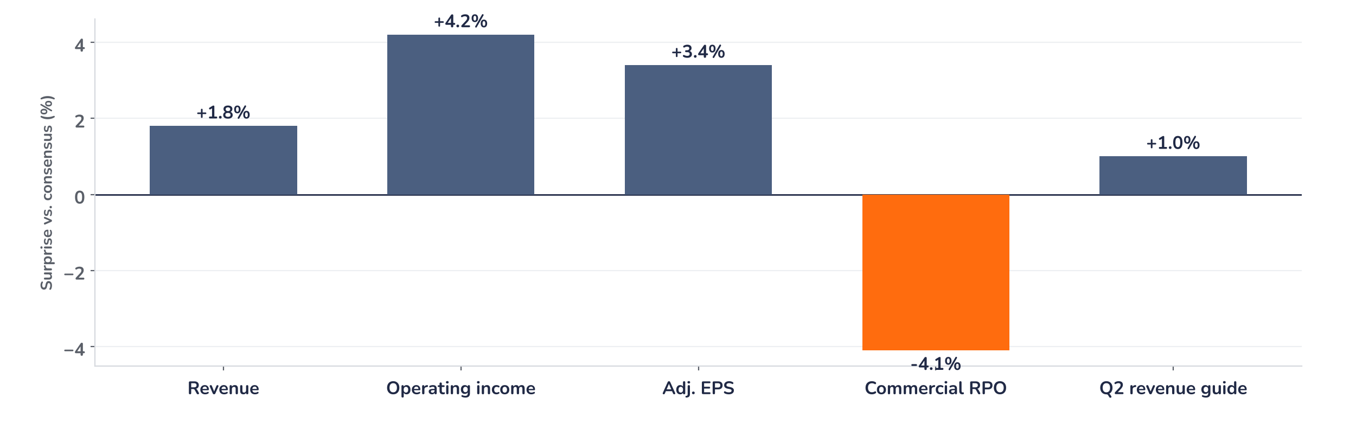
Earnings update
Microsoft Q1 FY2027: faster Azure, costlier capacity
29 October 2026 · Syz Research
“In closing, based on the demand we see, the strength of our products, and the efficiency we are driving across the stack, I’ve never been more confident in the long-term returns for our investments.”
Satya Nadella, Chairman and CEO, Q1 FY2027 earnings call, 28 October 2026
Microsoft sells cloud infrastructure (Azure), workplace software (Microsoft 365, Copilot), Windows, Xbox and LinkedIn worldwide. Its Agents and Infra segment earned 83% of quarterly revenue of USD 92.3bn. Listed on Nasdaq.
Key takeaways
Beat
Revenue of USD 92.3bn beat consensus by 1.8%; Azure grew 48%, three points ahead of expectations.
Raised
The Q2 Azure guide of 49% to 50% tops consensus of about 45%, despite delayed capacity.
Reaction
Shares only 1% higher pre-market on 29 October: a Q2 margin near 47% and capex weighed.
Valuation
25.2x forward earnings, down from 30.6x a year ago: earnings did the work, not the multiple.
Revenue
Adj. EPS
Azure growth
Q2 Azure guide (cc)
USD 92.3bn
USD 4.89
48%
49–50%
+1.8% vs. consensus
+3.4% vs. consensus
+3 pts vs. consensus
+4.5 pts vs. consensus
Capacity, not demand, sets the pace
Revenue beat consensus by 1.8%, operating income by 4.2% and EPS by 3.4%, and the Azure guide cleared expectations by about 4.5 points, yet the shares were only 1% higher pre-market on 29 October, after an after-hours gain of about 4%. Demand still exceeds supply; what investors now weigh is the cost of the capacity, not a lack of customers.
Chart 1 · MSFT: Q1 FY2027 results and Q2 guide vs. consensus
Reported vs. pre-results consensus, % · Q2 revenue guide at the midpoint · adj. EPS excludes the OpenAI impact · RPO: remaining performance obligation
Every reported line beat, and the Q2 revenue guide midpoint sits 1.0% above consensus. The one miss is the commercial order backlog, USD 677bn against an estimated USD 706bn, with bookings down 12% against a large prior-year Azure contract. We read this as timing: the part due within 12 months still grew 29%.
Base case and implications
We are constructive on Microsoft. We underwrite Azure growth near 50% in the first half and Microsoft 365 commercial cloud picking up from 18%, which points to upgrades to the USD 21.2 forward EPS consensus. The debate has moved from demand to returns on USD 170bn of 2026 capex. At 25.2x, below the five-year average of 28.0x, the multiple does not price the pick-up. Next test: the Q2 print in late January.
What would strengthen our view
What would change our view
Azure growth at or above 50% in Q2 with Microsoft Cloud gross margin holding at 65%; delayed GPU capacity arriving on time in the second half; a Copilot seat count showing consumption beyond GitHub.
Azure growth below 45% in Q2 as efficiency gains fade; an operating margin below 46% on capacity costs; fiscal 2027 capex above USD 200bn funded with debt, without a matching rise in the near-term backlog.
Syz Research · Earnings update · 29 October 2026
1 / 3

Slide 2
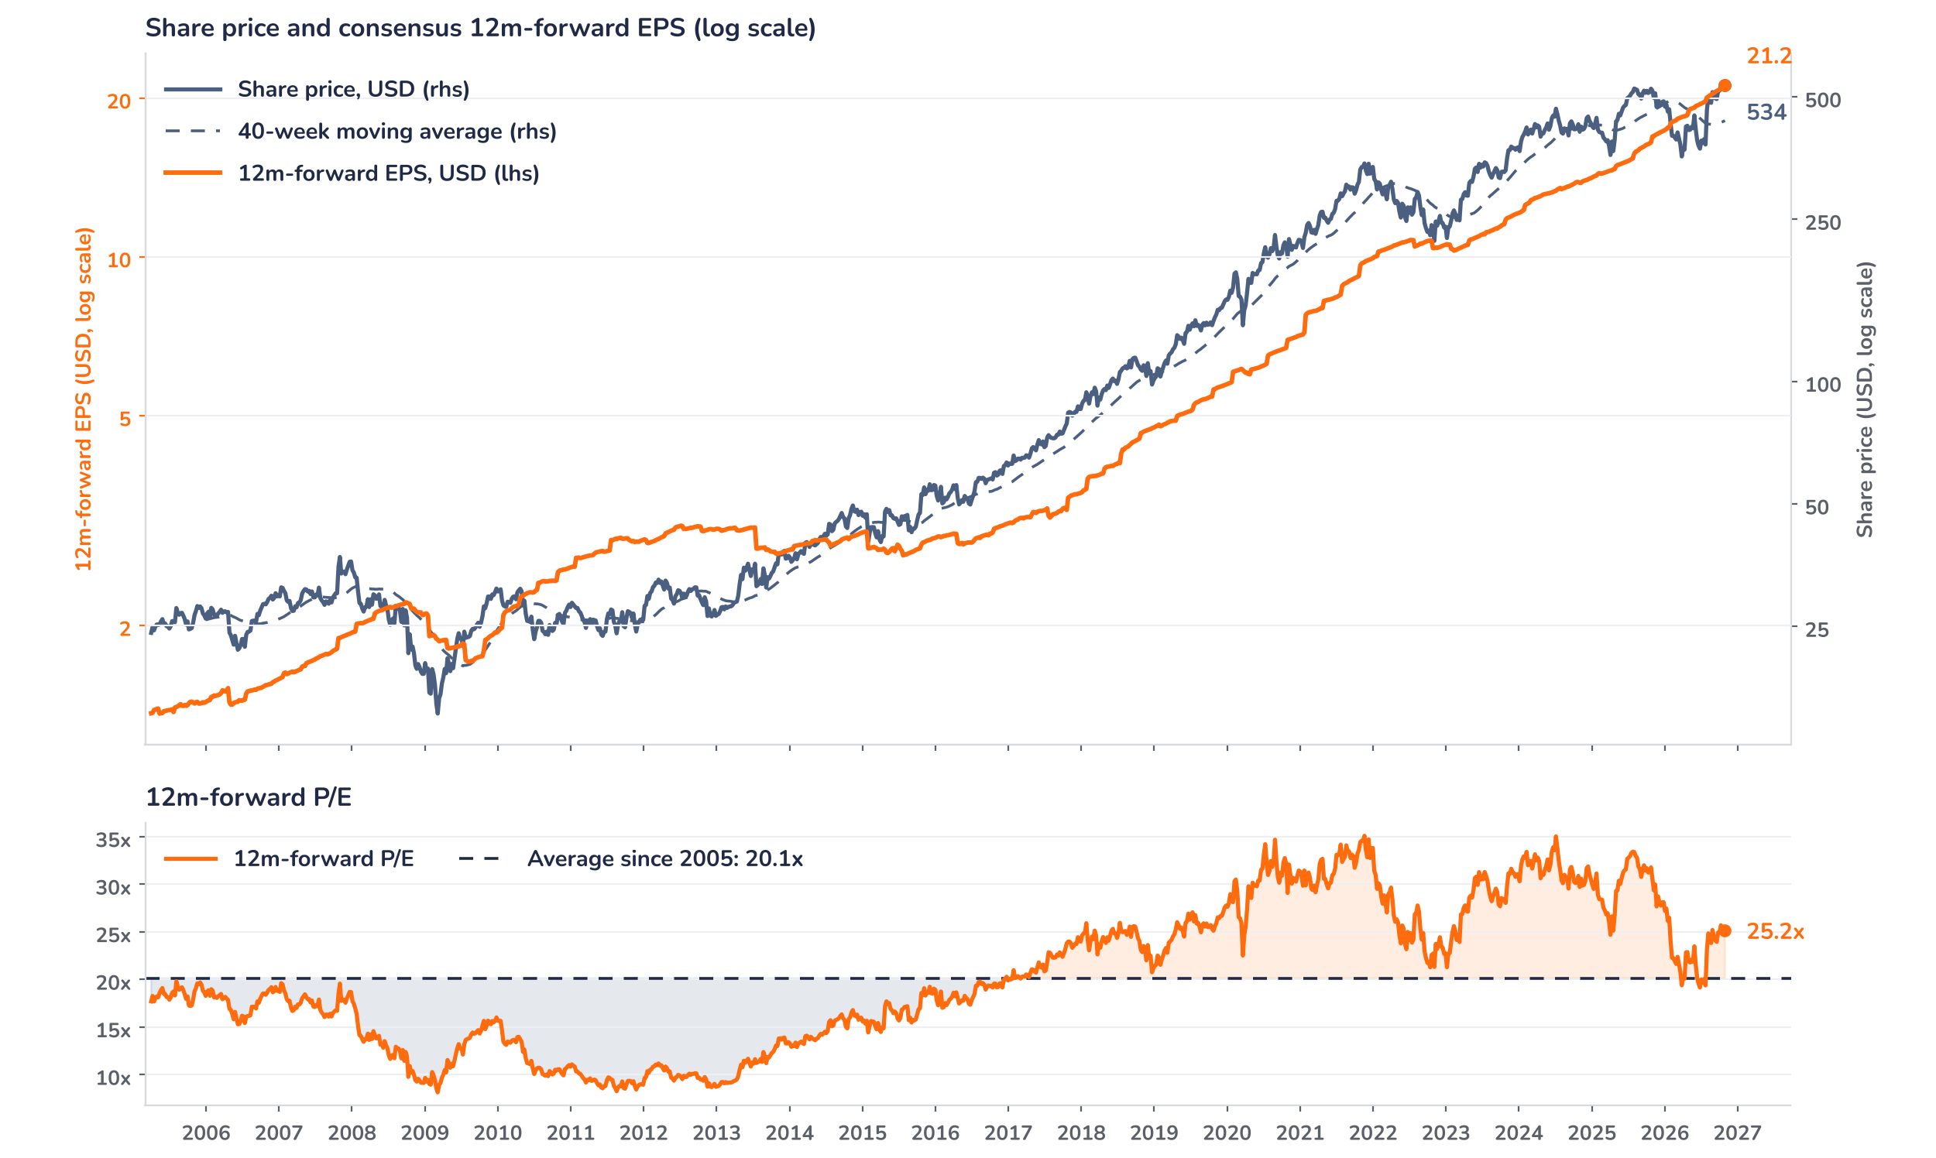
Beyond the key takeaways
Results: Azure and efficiency carried it
Revenue rose 19% to USD 92.3bn, above the top of Microsoft’s own USD 89.9bn to 91.0bn guide. Agents and Infra, the new segment holding the cloud, grew 25% to USD 76.8bn and Microsoft Cloud 30% to USD 63.9bn. Azure accelerated to 48%: engineering work freed GPU capacity that went to Foundry, whose revenue more than tripled, token prices were higher than planned, and idle CPU capacity was monetised. Opex rose only 6%, so operating income grew 21% and the margin held near 50%. Devices and Consumer fell 3%: Windows OEM dropped 27% on the Windows 10 end-of-support comparison and high inventory, while search and advertising ex traffic acquisition costs grew 12%.
The surprise was broad, the reaction small: shares were 1% higher pre-market on 29 October, against an after-hours gain of about 4%. Confirmed drivers temper the beat: the Q2 cost guide implies an operating margin near 46.8%, from 49.8%; Microsoft Cloud gross margin fell to 66%; bookings fell 12% and the order backlog came in 4% below the estimate; and management raised external funding. We think positioning explains the rest: the shares had risen 15% since the July results to a record USD 535 in early October. Alphabet’s near 10% after-hours fall that evening is consistent with, not proof of, a sector drag.
Outlook: faster Azure, thinner margins
Q2 guidance calls for revenue of USD 96.0bn to 97.1bn, up 18% to 19%, 1.0% above consensus at the midpoint, with Azure growth of 49% to 50% in constant currency against about 45% expected. The guide leans on more efficiency gains to offset GPU contracts delayed to the second half, and token pricing is a variable. Costs rise faster: cost of goods sold up 26% to 27% and opex up 9%, with the voluntary exit offer. Capex exceeds USD 50bn in Q2 and reaches about USD 170bn for calendar 2026, accelerating in the second half. Windows OEM and Devices is guided down in the mid-30s; free cash flow stays positive.
Valuation: earnings outran the share price
Chart 2 · MSFT: share price vs. consensus earnings and valuation
MSFT US Equity, weekly, April 2005 to October 2026 · BEst 12m-forward consensus · 40-week simple MA · log scale · P/E shaded vs. its 2005 to 2026 average · last price USD 533.9 is a 29 October pre-market level, after the release
Earnings did the work: over 12 months consensus forward EPS rose 25% to USD 21.2 while the share price gained 3%, so the forward P/E fell from 30.6x to 25.2x. The multiple troughed at 19.1x in June 2026 and re-rated after the July results, with the price up 15% against 6% for EPS. At 25.2x it trades 25% above its 20.1x average since 2005, but below the five-year average of 28.0x and the 35.1x peak of November 2021. The price is 22% above its 40-week average. A 10% EPS upgrade at an unchanged price would take the multiple to 22.9x.
Syz Research · Earnings update · 29 October 2026
2 / 3

Slide 3
SYZ Source: Syz Research, Bloomberg, company filings, Microsoft Q1 FY2027 earnings release and call of 28 October 2026, analyst research notes of 29 October 2026
Disclaimer
This communication has been issued and made available to recipients for the purpose of advertising investment services and/or financial instruments. It has been sent for information purposes and cannot be considered as an offer or a personalised recommendation to buy or sell a financial instrument or any other investment or currency. This communication does not constitute investment research within the meaning of regulatory rules applicable in the European Economic Area, or research under the rules of the U.S. Self-Regulatory Organizations.
This information is made solely for professional and institutional clients as defined by the Swiss Financial Services Act, as well as qualified investors according to the Swiss Collective Investment Schemes Act. It is not intended for retail clients or non-qualified investors and consequently cannot be transmitted to any third party.
This communication is not directed to any person in any jurisdiction where, by reason of that person’s nationality, residence or otherwise, its dissemination or use is prohibited. It cannot be quoted, reproduced, disclosed, distributed or otherwise referred to, in whole or in part, to any third party without the Bank’s prior written consent.
This communication may contain information on past performances of a financial product, all kinds of economic and financial valuations and analyses, as well as opinions of the Bank or of third parties. Any market valuations, terms and calculation methods, yields and opinions expressed are subject to change without notice. The information and opinions contained herein have been compiled and provided in good faith, based on information obtained from sources believed to be trustworthy. However, such information has not been independently verified. No guarantee, representation, or warranty of any kind, whether express or implied, is provided by the Bank or by relevant data vendors and other sources with respect to the accuracy, reliability, currentness or exhaustiveness of the information communicated, the methodology employed or the prices contained herein.
Past performance is not a reliable indicator of current or future results. Any reference to the past performance of an investment does not guarantee its future performance. Fluctuations in exchange rates may adversely affect the value, price or income of any investment.
Nothing in the present communication constitutes investment, legal, accounting or tax advice. This information is purely objective since it does not take into consideration the personal situation (including financial knowledge and experience), the investment objectives and risk profile of any recipient. Moreover, certain financial instruments mentioned (in particular, but not exclusively, derivatives, options and futures) involve a high risk of loss and may not be suitable. Accordingly, recipients should consult their own advisors on such matters, including but not limited to the possible tax consequences of investing in any financial product mentioned herein, and make their own assessment of the suitability of such investment product.
Should a recipient make an investment on the basis of the present communication, the recipient alone shall bear the consequences thereof. In no event shall the Bank, its directors, employees, affiliates or agents be held responsible for damages of any kind arising out of the use of all or part of the information provided herein.
Syz Research · Earnings update · 29 October 2026
3 / 3

