Slide 1

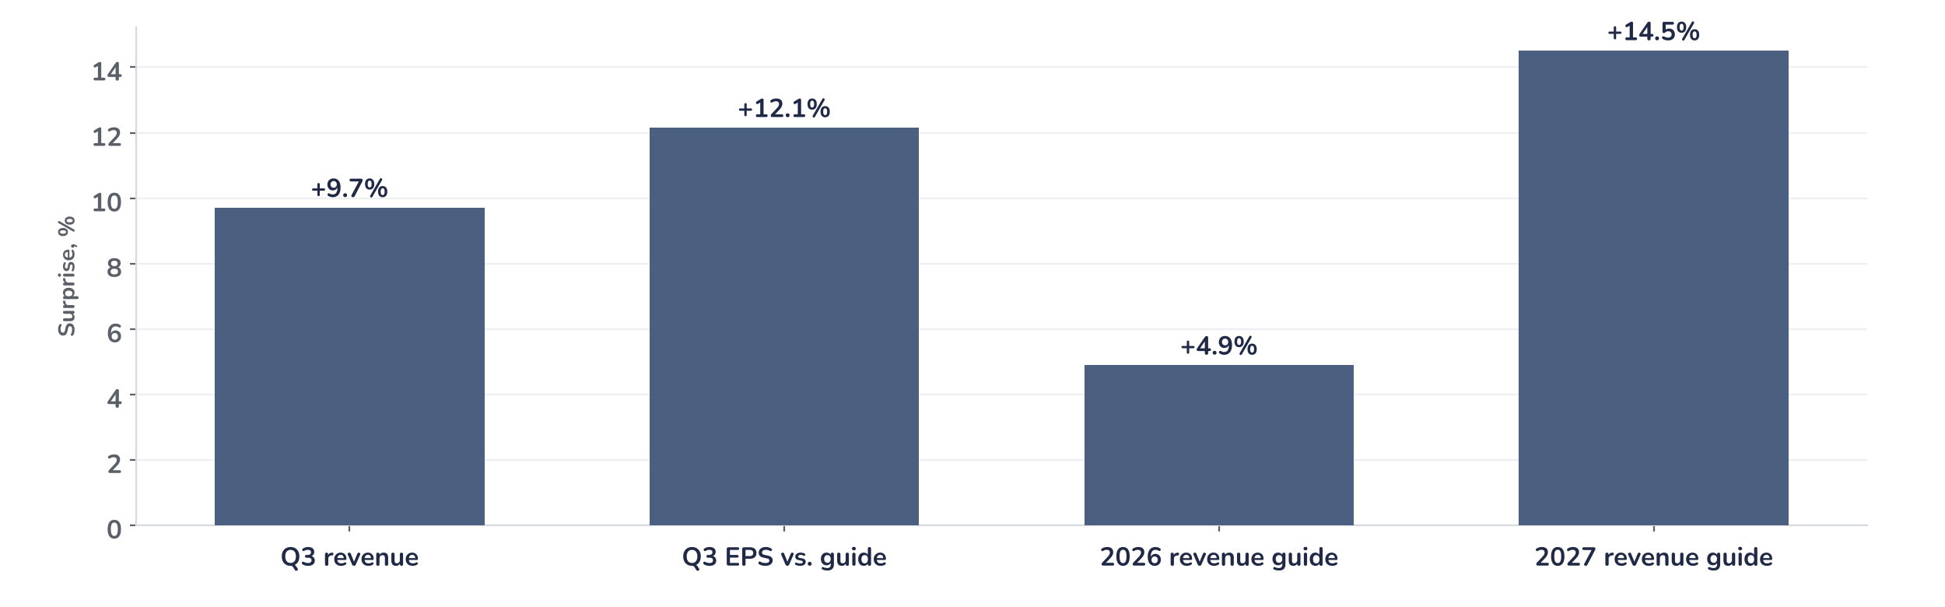
Earnings update
Arista Q3 2026: an $18.5bn 2027 guide resets estimates
4 November 2026 · Syz Research
“Our first look at 2027 guidance range puts us in the 38%–40% range for growth annually to approximately $18.5 billion.”
Jayshree Ullal, Chairperson and CEO, Q3 2026 earnings call, 3 November 2026
Arista Networks sells Ethernet switches, routers and EOS software to cloud operators, AI data centres and enterprises. Products are 87% of revenue; 2026 revenue is guided at $13.3bn. Listed on the NYSE, market value about $214bn.
Key takeaways
Beat
Revenue 9.7% above consensus and EPS 11% above the top of the guide; shares up 9% pre-market.
Raised
First 2027 guide, $18.5bn or 38% to 40% growth, sits 14.5% above consensus; AI fabrics double to $7bn.
Watch
Gross margin fell to 64.0% from 65.2% a year ago; 2027 is guided at 62% to 64%.
Valuation
32.8x forward earnings at the 3 November close; estimates aligned to 2027 guidance would cut it to 29x.
Revenue
Non-GAAP gross margin
Non-GAAP EPS
2027 revenue guide
$3.66bn
64.0%
$1.20
$18.5bn
+9.7% vs. consensus
+90bp vs. consensus
+12% vs. guide midpoint
+14.5% vs. consensus
The 2027 guide lifts the earnings base
Revenue beat consensus by 9.7%, the first 2027 guide sits 14.5% above it, and the shares rose about 9% in pre-market trading on 4 November, the session after the release: surprise and reaction are aligned. Growth accelerated to 58.5% on a $3.66bn base, and management commits to 38% to 40% more in 2027 at a 49% operating margin.
Chart 1 · ANET: Q3 2026 results and guidance vs. expectations
Surprise in %, reported or guided vs. pre-results consensus · Q3 EPS vs. the midpoint of the $1.06–1.08 guide · 2026 and 2027 guides at the midpoint
The largest surprise sits in 2027: the $18.5bn guide is 14.5% above the $16.2bn consensus, and management raised its 2026 outlook for the fourth time this year, to $13.3bn. The quarter came with operating leverage: non-GAAP operating income rose 60.1% to $1.80bn, faster than revenue, for a 49.1% margin, against 48.6% a year ago.
Base case and implications
The $18.5bn 2027 guide sits 14.5% above consensus at a 49% operating margin, so next year’s earnings estimates should rise by a similar amount, taking the 32.8x forward multiple to about 29x on the pre-results price. The case remains very constructive and the risk/reward skewed to the upside: we underwrite 38% to 40% growth led by AI fabrics at $7bn and campus at $2bn. In our view, the 22% October fall cleared crowded positioning. The next test is the Q4 report in February.
What would strengthen our view
What would change our view
Q4 revenue above the $4.0bn top of the guide; a third and fourth customer above 10% of revenue; the $11.4bn of purchase commitments shipping with gross margin at 63% or more.
A 2027 gross margin below the 62% floor; inventory, now $3.2bn, rising faster than revenue; a capex cut at one of the large cloud customers or deferred revenue below $6.8bn.
Syz Research · Earnings update · 4 November 2026
1 / 3

Slide 2
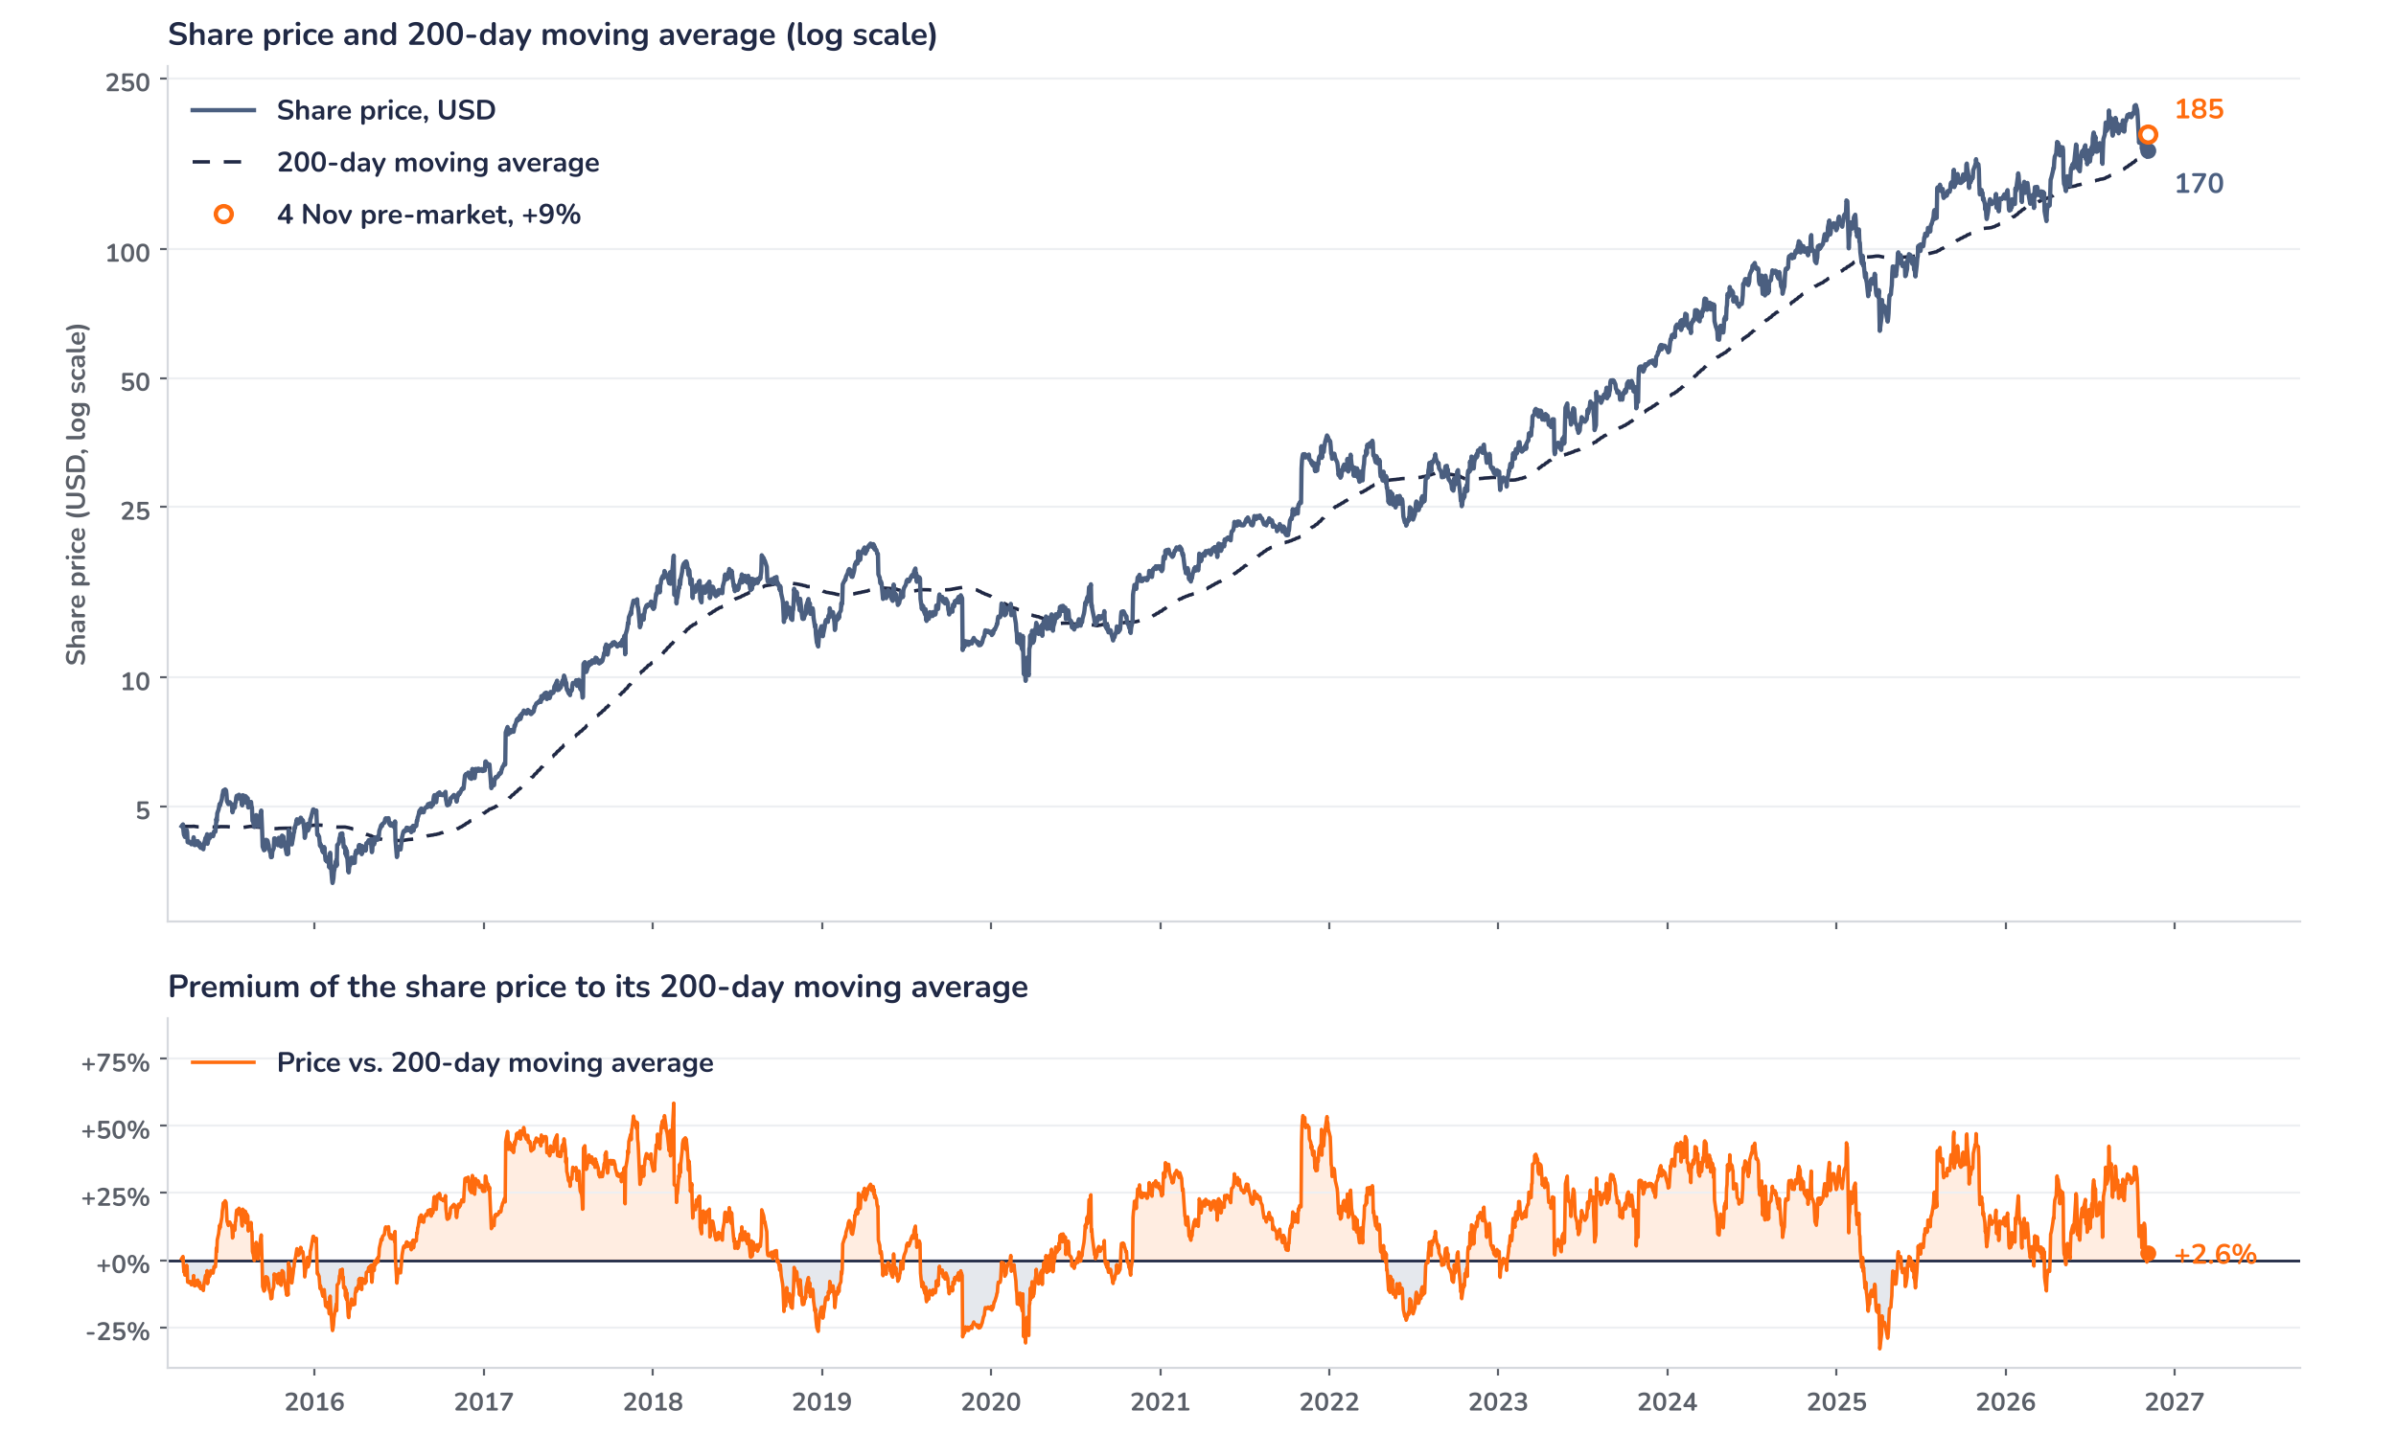
Beyond the key takeaways
Results: AI and enterprise drove the beat
Product revenue rose 67% year on year to $3.19bn and services 18% to $468m, taking total revenue up 20.5% on the quarter to $3.66bn, with growth led by AI and enterprise customers. Non-GAAP gross margin of 64.0% came in above the 63% guide and 90bp above consensus on a favourable customer and product mix, 120bp below the 65.2% of Q3 2025. Operating expenses rose, yet non-GAAP operating income grew 60.1% to $1.80bn for a 49.1% margin, and EPS rose 56% to $1.20. Arista now counts more than 100 AI customers on its Etherlink platform and expects three to four customers above 10% of revenue in 2026, from two in 2025.
Surprise and reaction point the same way. Revenue beat consensus by 9.7% and EPS cleared the top of the guide by 11%, and the shares rose about 9% in pre-market trading on 4 November from a $169.91 close on 3 November. The confirmed drivers are the 2027 guide, 14.5% above consensus, the fourth raise to the 2026 outlook and purchase commitments of $11.4bn, up from $9.7bn at the end of Q2. The size of the move is consistent with lighter positioning, which we cannot confirm: the stock had fallen 21.6% from its 9 October record of $216.74 and 10.8% since the Q2 results.
Outlook: a fourth raise and 38% to 40% next
For Q4, management guides to revenue of $3.9bn to $4.0bn, gross margin of 63% to 64%, an operating margin of 48% to 49% and EPS of $1.26 to $1.30 on 1.28bn shares, which puts 2026 revenue just over $13.3bn, up 48%. The first 2027 guide calls for 38% to 40% growth to $18.5bn, with AI fabrics doubling to about $7bn, campus up 60% to about $2bn, gross margin of 62% to 64% and an operating margin near 49%. Scale-up trials start in 2027 and production in 2028, so the guide excludes material scale-up revenue. Supply is better covered: inventory reached $3.2bn from $2.5bn and the CFO stated confidence in supply.
Valuation: earnings outran the share price
Chart 2 · ANET: share price vs. its 200-day moving average
Daily closes, March 2015 to 3 November 2026 (last price is the 3 November close, before the release) · 200-day simple moving average · Log scale · Premium shaded orange above, blue below · 4 November pre-market level indicative
The share price rose 7.8% over 12 months to $169.91, against Q3 EPS growth of 56%, so the multiple absorbed most of the earnings gain. The stock peaked at $216.74 on 9 October and fell 21.6% into the print, ending 2.6% above its 200-day moving average of $165.5 and 12.6% below its 40-day average of $194.4. The forward P/E stood at 32.8x on the 3 November close. If 2027 earnings estimates rise in line with the 14.5% revenue gap, the multiple drops to about 29x at that price and 31x after the pre-market gain.
Syz Research · Earnings update · 4 November 2026
2 / 3

Slide 3
SYZ Source: Syz Research, Bloomberg, company filings, Arista Networks release and earnings call of 3 November 2026, stockanalysis.com, analyst research notes of 23 October to 4 November 2026
Disclaimer
This communication has been issued and made available to recipients for the purpose of advertising investment services and/or financial instruments. It has been sent for information purposes and cannot be considered as an offer or a personalised recommendation to buy or sell a financial instrument or any other investment or currency. This communication does not constitute investment research within the meaning of regulatory rules applicable in the European Economic Area, or research under the rules of the U.S. Self-Regulatory Organizations.
This information is made solely for professional and institutional clients as defined by the Swiss Financial Services Act, as well as qualified investors according to the Swiss Collective Investment Schemes Act. It is not intended for retail clients or non-qualified investors and consequently cannot be transmitted to any third party.
This communication is not directed to any person in any jurisdiction where, by reason of that person’s nationality, residence or otherwise, its dissemination or use is prohibited. It cannot be quoted, reproduced, disclosed, distributed or otherwise referred to, in whole or in part, to any third party without the Bank’s prior written consent.
This communication may contain information on past performances of a financial product, all kinds of economic and financial valuations and analyses, as well as opinions of the Bank or of third parties. Any market valuations, terms and calculation methods, yields and opinions expressed are subject to change without notice. The information and opinions contained herein have been compiled and provided in good faith, based on information obtained from sources believed to be trustworthy. However, such information has not been independently verified. No guarantee, representation, or warranty of any kind, whether express or implied, is provided by the Bank or by relevant data vendors and other sources with respect to the accuracy, reliability, currentness or exhaustiveness of the information communicated, the methodology employed or the prices contained herein.
Past performance is not a reliable indicator of current or future results. Any reference to the past performance of an investment does not guarantee its future performance. Fluctuations in exchange rates may adversely affect the value, price or income of any investment.
Nothing in the present communication constitutes investment, legal, accounting or tax advice. This information is purely objective since it does not take into consideration the personal situation (including financial knowledge and experience), the investment objectives and risk profile of any recipient. Moreover, certain financial instruments mentioned (in particular, but not exclusively, derivatives, options and futures) involve a high risk of loss and may not be suitable. Accordingly, recipients should consult their own advisors on such matters, including but not limited to the possible tax consequences of investing in any financial product mentioned herein, and make their own assessment of the suitability of such investment product.
Should a recipient make an investment on the basis of the present communication, the recipient alone shall bear the consequences thereof. In no event shall the Bank, its directors, employees, affiliates or agents be held responsible for damages of any kind arising out of the use of all or part of the information provided herein.
Syz Research · Earnings update · 4 November 2026
3 / 3

