Slide 1

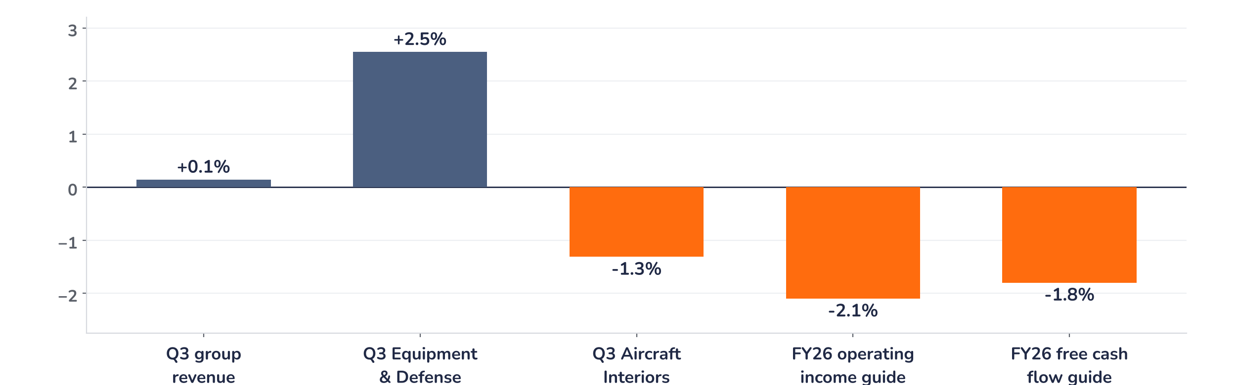
Earnings update · Aerospace and defence
Safran Q3 2026: a solid engine, no fuel for upgrades
23 October 2026 · Syz Research
“This [the jet fuel price increase] will eat into the profits of the airlines in 2026, but globally, when we compound all the profits of all the airlines, we believe, overall, they are going to stay positive.”
Olivier Andriès, Chief Executive Officer, Q3 2026 revenue call, 23 October 2026
Key takeaways
Solid
Revenue of EUR 9.0bn was in line and civil spare parts rose 17%: the aftermarket holds.
No raise
Unchanged targets offer no upgrade catalyst: consensus operating income sits 2.1% above the guided midpoint.
Watch
Jet fuel above $100, a longer French surtax and GE’s caution feed workscope and pricing fears.
Valuation
The shares fell 6.2% to 27.0x forward earnings, below their five-year average of 30.0x.
Q3 revenue
Civil spare parts (USD)
LEAP deliveries, 9 months
FY26 op. income guide
EUR 9.0bn
+17%
1,565
EUR 6.4–6.5bn
+13.4% organic, in line
Q4 guided mid to high 20s
+26% y/y, FY above 2,100
-2.1% vs. consensus
What the quarter means for the investment case
The quarter was solid: revenue matched consensus and the civil engine aftermarket kept growing strongly. But unchanged guidance offers no catalyst for upgrades, with consensus operating income already above the range. Near term, jet fuel at $100 or more, the proposed extension of the French surtax and GE’s caution feed fears of workscope compression and weaker pricing. The call pushed back: management expects workscopes to “remain at this high level next year”.
Chart 1 · SAF: Q3 2026 revenue and 2026 guidance vs. consensus
% vs. consensus · Q3: company-compiled consensus · FY26: guidance midpoints vs. consensus per analyst first takes
Group revenue matched the company-compiled consensus within 0.1% and Equipment & Defense beat by 2.5% on guided bombs, optronics, navigation and missile seekers. Aircraft Interiors missed by 1.3%, as seat certification still paces deliveries. The two bars on the right carry the message: confirmed targets sit about 2% below consensus, so estimates edge down rather than up.
Base case and implications
We stay positive on Safran: the structural case is intact and we would use near-term weakness to build positions. The earnings path we underwrite holds: 2026 operating income of EUR 6.4bn to EUR 6.5bn reached without the LEAP-1B profit release, which now adds to 2027, and a 2028 target of EUR 7bn to EUR 7.5bn that management said in July may be revisited. The debate has moved to the durability of aftermarket pricing and workscopes. The catalyst is 2027 guidance at the full-year results in February. Until then, geopolitics, jet fuel and the French surtax can keep the shares weak.
What would strengthen our view
What would change our view
2027 guidance in February implying operating income growth above 10%, helped by the LEAP-1B profit release; Q4 spare parts up in the mid to high 20s as guided; advance payments on India’s 114 Rafale order; a good price for the cabin business.
Evidence of workscope compression or softer CFM56 pricing in Q4 as airlines absorb jet fuel at $100 or more; the French surtax kept at the 2026 rate, worth EUR 500m or more in 2027; capex above 6% of sales eroding cash conversion.
Syz Research · Earnings update · 23 October 2026
1 / 3

Slide 2
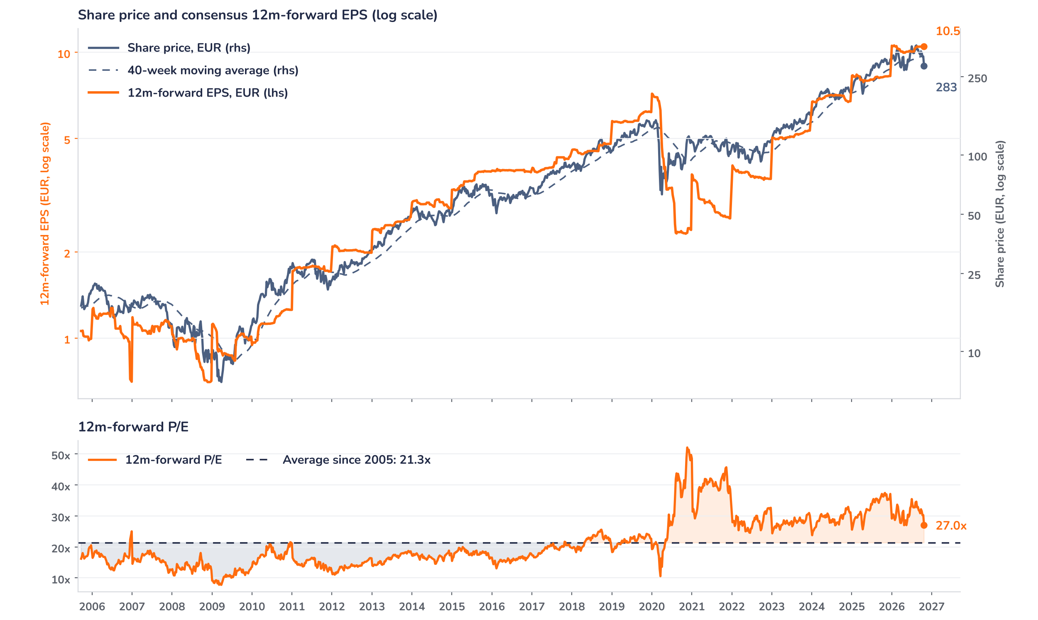
Beyond the key takeaways
Results: the aftermarket still carries the group
Revenue reached EUR 9.0bn, up 14.7% reported and 13.4% organically, in line with the EUR 8.99bn company-compiled consensus; currency added 1.1 points and scope was neutral. Propulsion revenue rose 13% organically to EUR 4.6bn. Civil engine spare parts grew 17% in dollars, showing “no sign of deceleration” according to management: the gap with 24% over nine months reflects a strong Q3 2025 base, and sales rose 4% on Q2. Services grew 19%, led by LEAP maintenance contracts, while military engines declined on the Rafale delivery schedule. LEAP deliveries reached 535, up 5%, and 1,565 over nine months, up 26%, on track for more than 2,100 this year.
Equipment & Defense revenue rose 16% organically to EUR 3.6bn, ahead of the EUR 3.53bn expected, on strong demand for Hammer guided bombs, optronics, inertial navigation and missile seekers. Aircraft Interiors grew 6% to EUR 751m, against EUR 761m expected; certification still paces seat deliveries and may push some into early 2027. Safran has launched the sale of its cabin business, about EUR 2bn of revenue with positive operating profit and cash flow. Airbus selected the SkyNaute inertial navigation system for the A220, Safran’s entry into commercial navigation. No profit figures are reported at the third quarter.
Outlook: 2026 held, 2027 rests on price and LEAP
Safran confirmed its 2026 targets: revenue growth in the mid-teens, recurring operating income of EUR 6.4bn to EUR 6.5bn and free cash flow of EUR 4.7bn to EUR 4.9bn, despite moving a LEAP-1B profit release in the low hundreds of millions of euros to 2027. Demand for shop visits still “exceeds the available capacity” and no airline has asked to defer deliveries. For 2027, management expects CFM56 shop visits flat at 2,400 and workscopes stable at today’s high level, so growth comes from price and LEAP. Capex will exceed 6% of sales every year, and the draft 2027 budget extends the surtax, at a cost of around EUR 400m.
Valuation: the multiple has done the adjusting
Chart 2 · SAF: share price vs. consensus earnings and valuation
Weekly, Sep 2005 to 23 Oct 2026 · Bloomberg BEst 12m-forward EPS · 40-week MA · Log scale · Last price: 23 October, intraday, after the release
Over 12 months the share price fell 7.9% while consensus forward EPS rose 27.9%: earnings kept rising and the multiple absorbed the whole correction. At 27.0x forward earnings the stock trades 27% above its 21.3x average since 2005, but below its one-year average of 31.7x and its five-year average of 30.0x. The multiple has fallen from 34.9x at the record high of EUR 363.6 on 12 August, and the price sits 10% below its 40-week average of EUR 317. Even a 5% cut to consensus EPS at today’s price would leave the multiple at 28.5x, still below its five-year average.
Syz Research · Earnings update · 23 October 2026
2 / 3

Slide 3
SYZ Source: Syz Research, Bloomberg, Safran Q3 2026 revenue call of 23 October 2026, Safran H1 2026 earnings call of 28 July 2026, company-compiled consensus, analyst research notes of 23 October 2026
Disclaimer
This communication has been issued and made available to recipients for the purpose of advertising investment services and/or financial instruments. It has been sent for information purposes and cannot be considered as an offer or a personalised recommendation to buy or sell a financial instrument or any other investment or currency. This communication does not constitute investment research within the meaning of regulatory rules applicable in the European Economic Area, or research under the rules of the U.S. Self-Regulatory Organizations.
This information is made solely for professional and institutional clients as defined by the Swiss Financial Services Act, as well as qualified investors according to the Swiss Collective Investment Schemes Act. It is not intended for retail clients or non-qualified investors and consequently cannot be transmitted to any third party.
This communication is not directed to any person in any jurisdiction where, by reason of that person’s nationality, residence or otherwise, its dissemination or use is prohibited. It cannot be quoted, reproduced, disclosed, distributed or otherwise referred to, in whole or in part, to any third party without the Bank’s prior written consent.
This communication may contain information on past performances of a financial product, all kinds of economic and financial valuations and analyses, as well as opinions of the Bank or of third parties. Any market valuations, terms and calculation methods, yields and opinions expressed are subject to change without notice. The information and opinions contained herein have been compiled and provided in good faith, based on information obtained from sources believed to be trustworthy. However, such information has not been independently verified. No guarantee, representation, or warranty of any kind, whether express or implied, is provided by the Bank or by relevant data vendors and other sources with respect to the accuracy, reliability, currentness or exhaustiveness of the information communicated, the methodology employed or the prices contained herein.
Past performance is not a reliable indicator of current or future results. Any reference to the past performance of an investment does not guarantee its future performance. Fluctuations in exchange rates may adversely affect the value, price or income of any investment.
Nothing in the present communication constitutes investment, legal, accounting or tax advice. This information is purely objective since it does not take into consideration the personal situation (including financial knowledge and experience), the investment objectives and risk profile of any recipient. Moreover, certain financial instruments mentioned (in particular, but not exclusively, derivatives, options and futures) involve a high risk of loss and may not be suitable. Accordingly, recipients should consult their own advisors on such matters, including but not limited to the possible tax consequences of investing in any financial product mentioned herein, and make their own assessment of the suitability of such investment product.
Should a recipient make an investment on the basis of the present communication, the recipient alone shall bear the consequences thereof. In no event shall the Bank, its directors, employees, affiliates or agents be held responsible for damages of any kind arising out of the use of all or part of the information provided herein.
Syz Research · Earnings update · 23 October 2026
3 / 3

