Slide 1

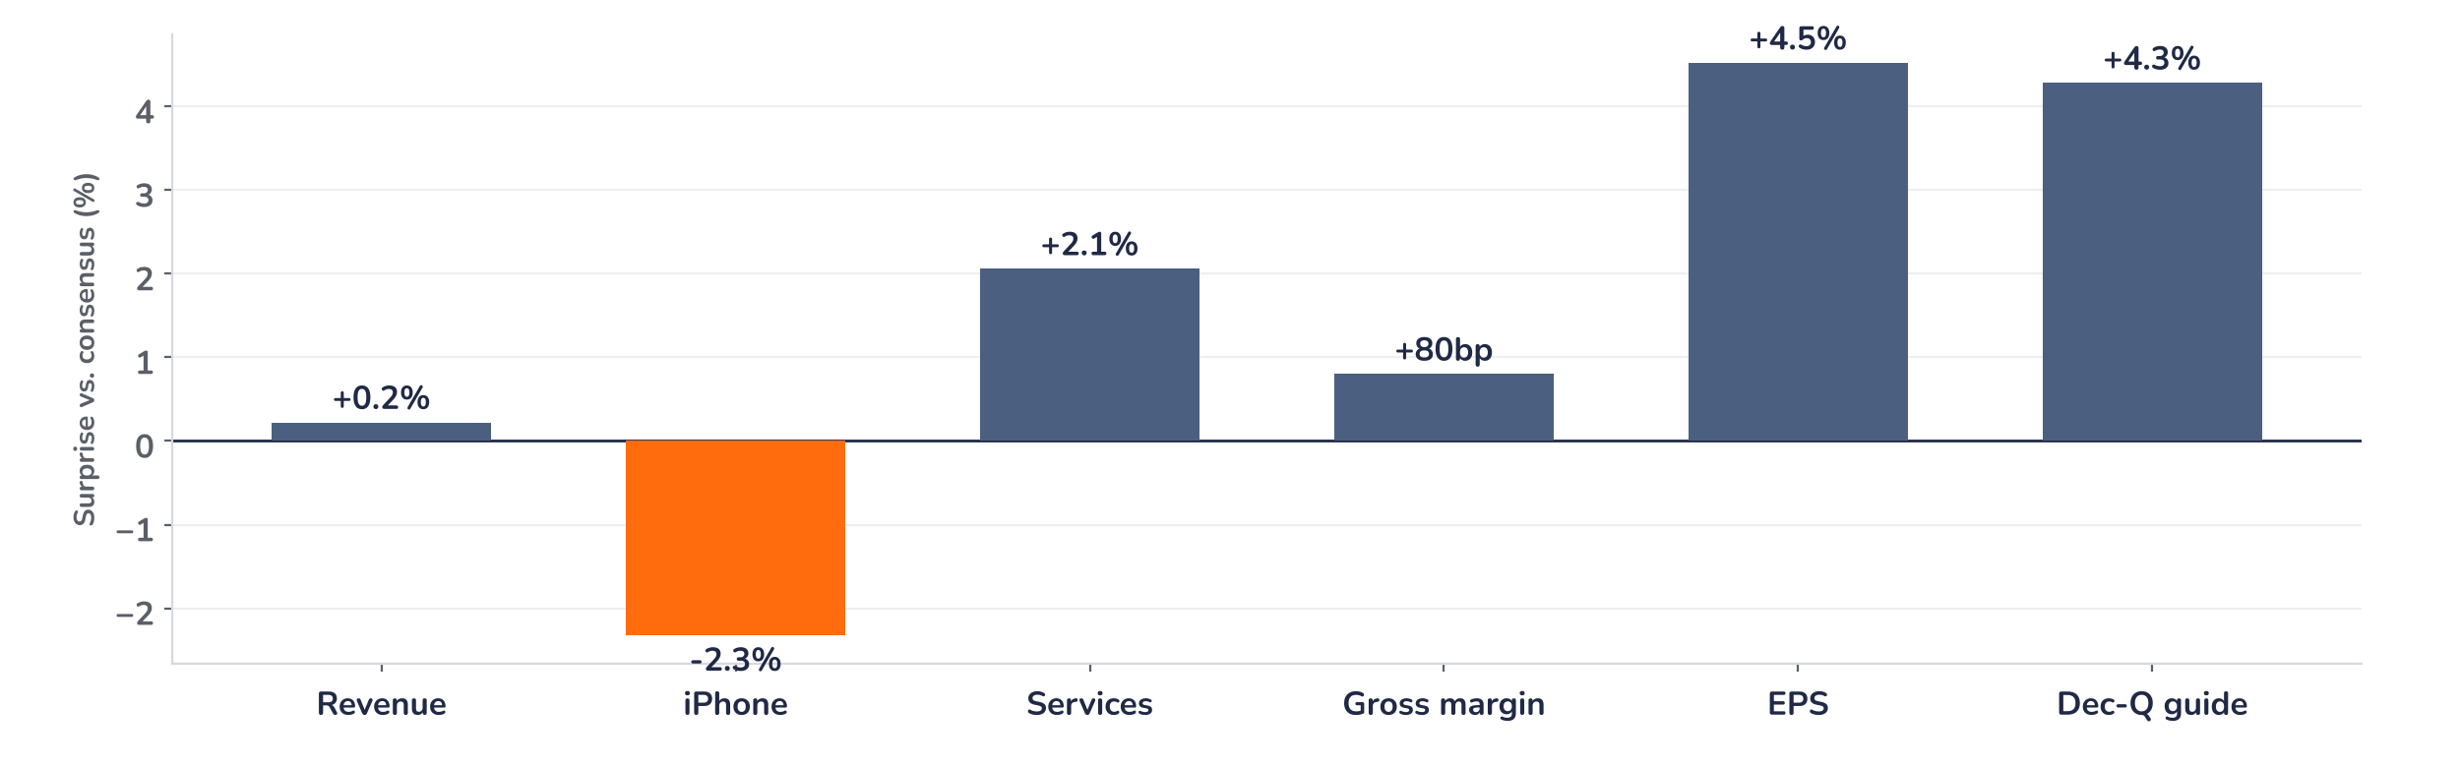
Earnings update
Apple Q4 FY2025: strong guide, fully priced stock
31 October 2025 · Syz Research
“In September, we were thrilled to launch our best iPhone lineup ever, including iPhone 17, iPhone 17 Pro and Pro Max, and iPhone Air.”
Tim Cook, CEO, Apple Q4 FY2025 results release, 30 October 2025
Apple designs the iPhone, Mac, iPad and wearables and earns a rising share from services. iPhone made 50% of fiscal 2025 revenue of USD 416bn, Services 26%. Listed on Nasdaq, worth about USD 4tn.
Key takeaways
Beat
Revenue USD 102.5bn and EPS USD 1.85 beat consensus by 0.2% and 4.5%, led by Services and margin.
Guide
December-quarter guide of 10–12% growth sits 4% above consensus, with iPhone up double digits.
Reaction
Shares slipped 0.4% on 31 October as the Nasdaq rose 0.6%: iPhone revenue missed consensus by 2.3%.
Valuation
32.7x forward earnings, 20% above the five-year average and close to the 33.9x peak of December 2024.
Revenue
Diluted EPS
Gross margin
Dec-Q revenue guide
USD 102.5bn
USD 1.85
47.2%
+10–12% y/y
+0.2% vs. consensus
+4.5% vs. consensus
+80bp vs. consensus
+4.3% vs. consensus
The iPhone 17 cycle is real and supply-bound
Apple beat consensus by 4.5% on EPS and guided December-quarter revenue about 4% above expectations, yet the shares slipped 0.4% on 31 October while the Nasdaq rose 0.6%. The confirmed drag was iPhone revenue, 2.3% short of consensus as supply of several models fell short. We read the muted move as positioning after an 11% run into the print.
Chart 1 · AAPL: Q4 FY2025 surprises vs. consensus
Reported vs. LSEG consensus in % · gross margin in margin points (bp) · December-quarter guide at the 11% midpoint vs. USD 132.3bn consensus
Every line beat except iPhone. Services, up 15% to a record USD 28.8bn, and an 80bp gross margin beat did the work, despite USD 1.1bn of tariff costs. The guide is the bigger surprise: 11% growth at the midpoint implies about USD 138bn of revenue against USD 132.3bn expected, with iPhone back to double-digit growth.
Base case and implications
The investment case remains constructive, but the multiple leaves little slack. We underwrite double-digit December-quarter growth and 12m-forward consensus EPS of USD 8.3, rising as iPhone 17 supply catches up with demand. The debate has moved from demand to supply, memory costs and the return on higher AI spending. At 32.7x, after an 11% run into the print, we see the risk/reward as balanced rather than skewed to the upside. The next test is the December-quarter report in late January 2026.
What would strengthen our view
What would change our view
iPhone 17 supply catching up by January with Greater China back to growth; gross margin at the top of the 47–48% guide despite memory costs; EPS upgrades above 5% after the print.
December-quarter growth below 10% or Greater China down again; memory or tariff costs pushing gross margin below 47%; operating expenses above USD 18.5bn with no visible AI payoff in 2026.
Syz Research · Earnings update · 31 October 2025
1 / 3

Slide 2
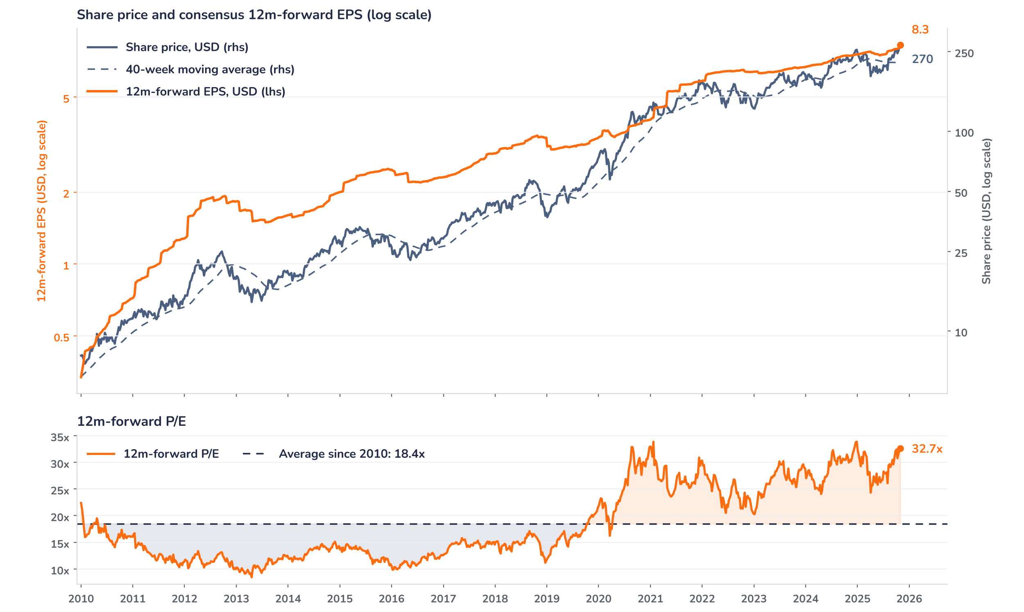
Beyond the key takeaways
Results: Services and margin carried the beat
Revenue rose 8% to a September-quarter record of USD 102.5bn, 0.2% above consensus, and fiscal 2025 closed at USD 416bn. iPhone grew 6% to USD 49.0bn, also a September-quarter record, but missed consensus of USD 50.2bn: management said several iPhone 17 models were supply-constrained and the quarter ended with very lean channel inventory. Services rose 15% to an all-time high of USD 28.8bn, 2% above consensus, with records in advertising, the App Store, cloud, music, payments and video, and passed USD 100bn for the year. Mac grew 13% to USD 8.7bn, while iPad (USD 7.0bn) and wearables (USD 9.0bn) were flat.
Gross margin of 47.2% beat consensus by 80bp despite USD 1.1bn of tariff costs, and net income reached USD 27.5bn. EPS of USD 1.85 beat consensus by 4.5% and rose 13% on an adjusted basis, excluding a one-off EU state aid tax charge a year earlier. Against that, the shares fell 0.4% on 31 October, the first session after the release, while the Nasdaq gained 0.6%. The confirmed drivers of the gap are the iPhone shortfall and Greater China, down 4% to USD 14.5bn. Our interpretation is that a pre-results multiple of 33.1x and an 11% run-up had already discounted a strong guide.
Outlook: double-digit growth, higher costs
For the December quarter, management guided revenue growth of 10–12%, with iPhone up double digits, against a consensus that implied about 6%. Gross margin is guided at 47–48%, including an estimated USD 1.4bn of tariff costs, up from USD 1.1bn. Operating expenses step up to USD 18.1–18.5bn from USD 15.9bn, about 18% above a year earlier at the midpoint, as research and development spending on AI rises. Management attributed the China decline to supply, not demand, and expects a return to growth this quarter. The open questions are on supply: advanced-node capacity for Apple silicon and rising memory prices, which we see as the main risk to margins in 2026.
Valuation: priced for the cycle, not beyond
Chart 2 · AAPL: share price vs. consensus earnings and valuation
Weekly Friday closes sampled from daily Bloomberg data, 1 Jan 2010 to 31 Oct 2025 · BEst 12m-forward consensus EPS · 40-week simple MA · log scale · last price is the 31 October close, the first session after the release
Price has run well ahead of earnings: the shares are up 21% over twelve months against 11% for 12m-forward consensus EPS, and up 34% since the Q3 print against 7% for EPS. The multiple has expanded from 26.1x in early August to 32.7x, 77% above the 18.4x average since 2010 and 20% above the five-year average of 27.3x, close to the 33.9x peak of December 2024. The price sits 21% above its 40-week average. A 10% EPS upgrade at an unchanged price would take the multiple to 29.7x, the one-year average: from here, earnings have to do the work.
Syz Research · Earnings update · 31 October 2025
2 / 3

Slide 3
SYZ Source: Syz Research, Bloomberg, company filings, Apple results release and earnings call of 30 Oct 2025, LSEG consensus via press coverage, analyst research notes of 31 Oct 2025
Disclaimer
This communication has been issued and made available to recipients for the purpose of advertising investment services and/or financial instruments. It has been sent for information purposes and cannot be considered as an offer or a personalised recommendation to buy or sell a financial instrument or any other investment or currency. This communication does not constitute investment research within the meaning of regulatory rules applicable in the European Economic Area, or research under the rules of the U.S. Self-Regulatory Organizations.
This information is made solely for professional and institutional clients as defined by the Swiss Financial Services Act, as well as qualified investors according to the Swiss Collective Investment Schemes Act. It is not intended for retail clients or non-qualified investors and consequently cannot be transmitted to any third party.
This communication is not directed to any person in any jurisdiction where, by reason of that person’s nationality, residence or otherwise, its dissemination or use is prohibited. It cannot be quoted, reproduced, disclosed, distributed or otherwise referred to, in whole or in part, to any third party without the Bank’s prior written consent.
This communication may contain information on past performances of a financial product, all kinds of economic and financial valuations and analyses, as well as opinions of the Bank or of third parties. Any market valuations, terms and calculation methods, yields and opinions expressed are subject to change without notice. The information and opinions contained herein have been compiled and provided in good faith, based on information obtained from sources believed to be trustworthy. However, such information has not been independently verified. No guarantee, representation, or warranty of any kind, whether express or implied, is provided by the Bank or by relevant data vendors and other sources with respect to the accuracy, reliability, currentness or exhaustiveness of the information communicated, the methodology employed or the prices contained herein.
Past performance is not a reliable indicator of current or future results. Any reference to the past performance of an investment does not guarantee its future performance. Fluctuations in exchange rates may adversely affect the value, price or income of any investment.
Nothing in the present communication constitutes investment, legal, accounting or tax advice. This information is purely objective since it does not take into consideration the personal situation (including financial knowledge and experience), the investment objectives and risk profile of any recipient. Moreover, certain financial instruments mentioned (in particular, but not exclusively, derivatives, options and futures) involve a high risk of loss and may not be suitable. Accordingly, recipients should consult their own advisors on such matters, including but not limited to the possible tax consequences of investing in any financial product mentioned herein, and make their own assessment of the suitability of such investment product.
Should a recipient make an investment on the basis of the present communication, the recipient alone shall bear the consequences thereof. In no event shall the Bank, its directors, employees, affiliates or agents be held responsible for damages of any kind arising out of the use of all or part of the information provided herein.
Syz Research · Earnings update · 31 October 2025
3 / 3

