Slide 1

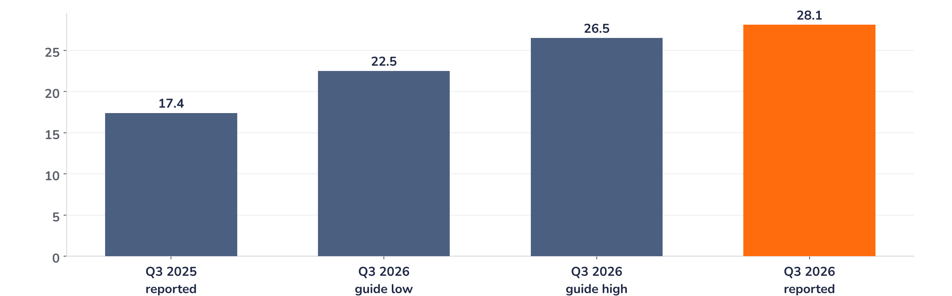
Earnings update
Amazon Q3 2026: AWS speeds up, capex weighs on the shares
30 October 2026 · Syz Research
“Our AWS investment in functionality and infrastructure is working … There has never been a trillion dollar revenue business, and we may have two of them in the next 5-10 years.”
Andy Jassy, President and CEO, Amazon Q3 2026 results release, 29 October 2026
Amazon runs online stores, an advertising business and the AWS cloud platform. AWS earned 63% of Q3 operating income on 23% of sales. 2025 revenue USD 717bn; Nasdaq market value around USD 2.6trn.
Key takeaways
Beat
AWS revenue +39.3%, a sixth quarter of acceleration; operating income USD 28.1bn at a record 13.9% margin.
Reaction
Shares down 7% pre-market on 30 October: Q4 guide below consensus, USD 33.5bn quarterly cash outflow.
Watch
2026 capex of about USD 220bn and more in 2027; free cash flow -USD 42.4bn over twelve months.
Valuation
26.1x forward earnings before the release, near the 26.3x average since 2018; about 24x after the drop.
Revenue
AWS revenue
Operating income
Q4 operating income guide
USD 201.9bn
USD 46.0bn
USD 28.1bn
USD 28.5–33.5bn
-0.2% vs. consensus
+39.3% y/y vs. +38% consensus
+6% vs. top of guide
Midpoint below consensus
Record profit meets a softer Q4 guide
Operating income beat the top of guidance by USD 1.6bn and AWS growth beat consensus by 1.3 points, yet the shares were down 7% pre-market on 30 October, after a 4.2% fall on 29 October. The Q4 guide, softer advertising and a USD 33.5bn free cash outflow drove the reaction. AWS earnings power improved; the cash return on the build-out lies further out.
Chart 1 · AMZN: Q3 2026 operating income vs. guidance and prior year
USD bn · Q3 2025 and Q3 2026 reported · Q3 2026 guidance range from the Q2 2026 release
Operating income rose 61% to USD 28.1bn, 6% above the top of the USD 22.5bn to 26.5bn range. AWS contributed USD 17.8bn at a 38.7% margin, and the North America margin rose to 7.7% from 4.5%. Mix, lower cost per unit shipped and marketing leverage drove the beat, with revenue 0.2% below consensus.
Base case and implications
The investment case remains constructive. We underwrite AWS growth near 40% in 2027, supported by a USD 578bn backlog against about USD 200bn a year ago, and a return to positive free cash flow in Q4 as capex timing evens out. The share price now depends on the return on USD 220bn of annual capex, most of it for AWS. At about 24x forward earnings after the drop, expectations have reset. The next test is the Q4 report in early February 2027.
What would strengthen our view
What would change our view
AWS growth above 40% in Q4, with quarterly dollar additions back above USD 4.6bn; positive Q4 free cash flow; advertising growth back in the high teens in Q4, as guided.
AWS dollar additions below USD 3.8bn for a second quarter; a 2027 capex guide far above USD 220bn without a step-up in backlog; new debt ahead of a free cash flow recovery.
Syz Research · Earnings update · 30 October 2026
1 / 3

Slide 2
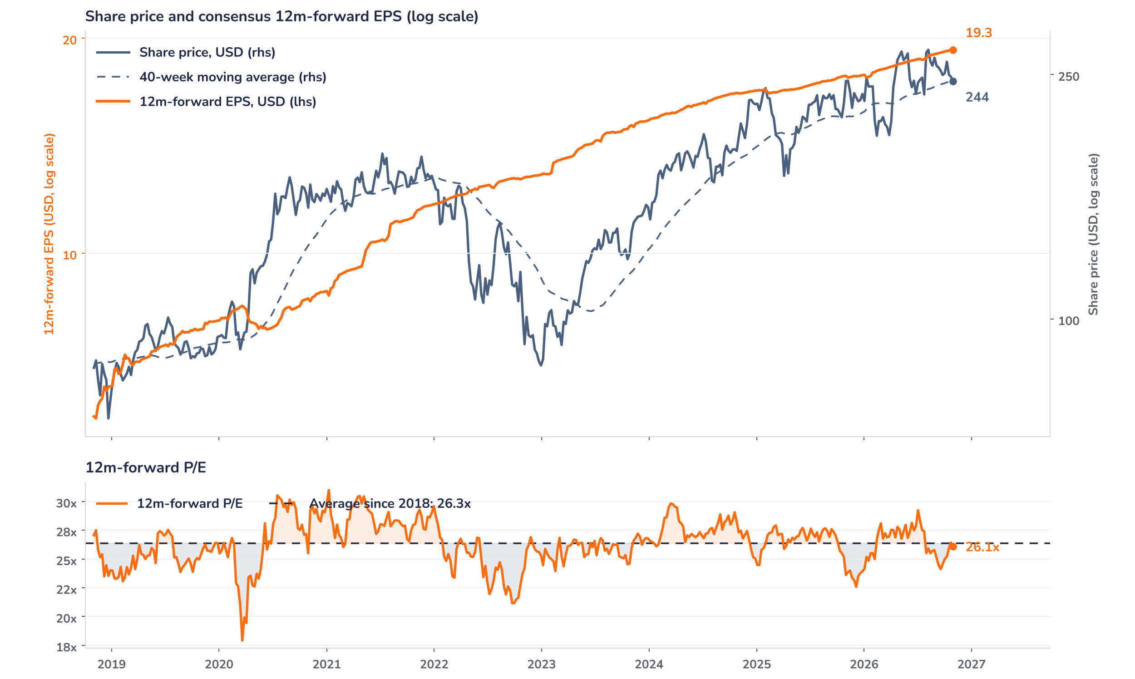
Beyond the key takeaways
Results: AWS mix and unit costs drove margin
Revenue rose 12% to USD 201.9bn (13% excluding currency), 0.2% below the USD 202.3bn consensus and at the top of the USD 197bn to 202bn guide. Growth slowed 8 points from Q2 as Prime Day fell in Q2 this year. AWS revenue of USD 46.0bn grew 39.3%, ahead of the 38% consensus, with operating income up 55% to USD 17.8bn. North America sales rose 6% to USD 112.9bn at a 7.7% margin, helped by lower fulfilment and shipping cost per unit. Stores unit growth reached 17%, the highest since the pandemic lockdowns. EPS was USD 1.89 against USD 1.95, as non-operating items and tax absorbed the operating gain.
The shares were down 7% pre-market on 30 October against an operating beat of 15% on the guide midpoint: price and results diverged. Confirmed drivers: the Q4 midpoints of USD 243.5bn for revenue and USD 31.0bn for operating income sit below consensus; advertising grew 12% excluding currency, short of expectations; free cash flow was about -USD 33.5bn against an analyst estimate near -USD 15bn, on USD 75.9bn of cash capex. We think, without confirmation from the company, that expectations ran high into the print: the stock rose 15.3% after the Q2 results to a USD 284 record, and investors looked for AWS growth near 42%.
Outlook: capacity sets the AWS pace into 2027
Q4 guidance calls for revenue of USD 240bn to 247bn, up 12% to 16%, and operating income of USD 28.5bn to 33.5bn against USD 25.0bn a year earlier. Management kept 2026 cash capex at about USD 220bn and pointed to meaningfully more in 2027. The company expects AWS growth above 40% in 2027 and 2028 and advertising growth back in the high teens. AWS dollar additions slowed to USD 3.8bn from USD 4.6bn in Q2, consistent with capacity limits. Long-term debt stands at USD 173bn against USD 66bn at the end of 2025; analysts see no need for equity and a possible further USD 50bn of debt late in 2027.
Valuation: at the long-run average multiple
Chart 2 · AMZN: share price vs. consensus earnings and valuation
Weekly, November 2018 (first consensus EPS) to 29 October 2026 · Bloomberg BEst 12m-forward EPS and P/E · 40-week MA from weekly closes · log scale · last price is the 29 October close, before the release
The share price closed at USD 243.79 on 29 October, flat over twelve months, as consensus 12m-forward EPS rose 8.8% over the same period and 3.0% since the Q2 print. Bloomberg’s forward P/E stood at 26.1x, 1% below its 26.3x average since 2018, in line with the one-year average of 26.0x and well below the 31.0x peak of January 2021. The price sat on its 40-week average of USD 243.4. A 7% fall at unchanged estimates takes the multiple to about 24.3x, 8% below the long-run average and above the 22.6x low of December 2025.
Syz Research · Earnings update · 30 October 2026
2 / 3

Slide 3
SYZ Source: Syz Research, Bloomberg, company filings, Amazon.com Q3 2026 results release of 29 October 2026, analyst research notes of 30 October 2026
Disclaimer
This communication has been issued and made available to recipients for the purpose of advertising investment services and/or financial instruments. It has been sent for information purposes and cannot be considered as an offer or a personalised recommendation to buy or sell a financial instrument or any other investment or currency. This communication does not constitute investment research within the meaning of regulatory rules applicable in the European Economic Area, or research under the rules of the U.S. Self-Regulatory Organizations.
This information is made solely for professional and institutional clients as defined by the Swiss Financial Services Act, as well as qualified investors according to the Swiss Collective Investment Schemes Act. It is not intended for retail clients or non-qualified investors and consequently cannot be transmitted to any third party.
This communication is not directed to any person in any jurisdiction where, by reason of that person’s nationality, residence or otherwise, its dissemination or use is prohibited. It cannot be quoted, reproduced, disclosed, distributed or otherwise referred to, in whole or in part, to any third party without the Bank’s prior written consent.
This communication may contain information on past performances of a financial product, all kinds of economic and financial valuations and analyses, as well as opinions of the Bank or of third parties. Any market valuations, terms and calculation methods, yields and opinions expressed are subject to change without notice. The information and opinions contained herein have been compiled and provided in good faith, based on information obtained from sources believed to be trustworthy. However, such information has not been independently verified. No guarantee, representation, or warranty of any kind, whether express or implied, is provided by the Bank or by relevant data vendors and other sources with respect to the accuracy, reliability, currentness or exhaustiveness of the information communicated, the methodology employed or the prices contained herein.
Past performance is not a reliable indicator of current or future results. Any reference to the past performance of an investment does not guarantee its future performance. Fluctuations in exchange rates may adversely affect the value, price or income of any investment.
Nothing in the present communication constitutes investment, legal, accounting or tax advice. This information is purely objective since it does not take into consideration the personal situation (including financial knowledge and experience), the investment objectives and risk profile of any recipient. Moreover, certain financial instruments mentioned (in particular, but not exclusively, derivatives, options and futures) involve a high risk of loss and may not be suitable. Accordingly, recipients should consult their own advisors on such matters, including but not limited to the possible tax consequences of investing in any financial product mentioned herein, and make their own assessment of the suitability of such investment product.
Should a recipient make an investment on the basis of the present communication, the recipient alone shall bear the consequences thereof. In no event shall the Bank, its directors, employees, affiliates or agents be held responsible for damages of any kind arising out of the use of all or part of the information provided herein.
Syz Research · Earnings update · 30 October 2026
3 / 3

