Slide 1

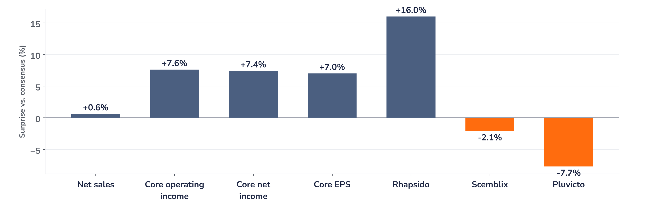
Earnings update
Novartis Q3 2026: the beat is costs, the debate is pipeline
27 October 2026 · Syz Research
“Novartis delivered solid sales growth in Q3, as priority brands and launches more than offset generic erosion, demonstrating the replacement power of the business.”
Vas Narasimhan, CEO, Q3 2026 results release, 27 October 2026
Novartis is a Basel-based innovative medicines company in cardiovascular, immunology, neuroscience and oncology. Its top 20 brands made up 83% of third-quarter sales of USD 14.5bn. Listed on SIX, market value around CHF 240bn.
Key takeaways
Beat
Core earnings per share (EPS) of USD 2.46 beat consensus by 7%, driven by costs rather than sales.
Raised
2026 core operating income guidance raised to flat to low single-digit growth, from a decline.
Watch
Two late-stage trial failures triggered a USD 1.9bn impairment; reported net income fell 71%.
Valuation
17.4x forward earnings, 33% above the 2005 to 2026 average: much pipeline success is already priced.
Net sales
Core EPS
Core operating margin
2026 core profit guide
USD 14.5bn
USD 2.46
41.6%
Raised
In line, +0.6% vs. consensus
+7% vs. consensus
+270bp vs. consensus
To flat to +low single digit
Replacement power holds, costs do the rest
Core EPS beat consensus by 7% on in-line sales, and the shares were indicated 1.2% higher before the open on 27 October, at CHF 129.05: aligned but muted, with the close not yet available. Priority brands lifted sales 4% despite Entresto falling 38% to generics, which supports the replacement story; the beat came from costs, not demand.
Chart 1 · NOVN: Q3 2026 results vs. consensus
Reported vs. pre-results consensus, % · Group lines and selected brands · Consensus: analyst estimates compiled in first takes of 27 Oct 2026
Group profit lines beat by 7% to 8% on a sales line that only matched expectations. Selling, general and administrative costs ran 9% below estimates, while two growth brands fell short: Pluvicto, the prostate cancer radioligand, and Scemblix, for leukaemia. Rhapsido, the new urticaria pill, beat by 16% and is the early launch to watch.
Base case and implications
We stay constructive on Novartis and keep the position, but would not chase the shares at 17.4x forward earnings; we would add on pipeline-driven weakness towards the 200-day average near CHF 121. We underwrite flat to low single-digit core operating income growth in 2026, around 3% consensus EPS upgrades and faster sales growth in 2027 as generic erosion fades. The debate has moved from the patent cliff to the pipeline. Next test: the 19 November management event and its 2031 outlook.
What would strengthen our view
What would change our view
A 19 November outlook that keeps sales growing through the 2029 to 2031 patent expiries of Cosentyx, Kisqali and Kesimpta; fourth-quarter sales growth near 9%; positive abelacimab Phase III data in atrial fibrillation by mid-2027.
Another late-stage failure or impairment, above all abelacimab; a fourth-quarter core margin back below 38%, showing the third-quarter savings were timing; Pluvicto still missing estimates if the new prostate cancer label fails to lift US demand.
Syz Research · Earnings update · 27 October 2026
1 / 3

Slide 2
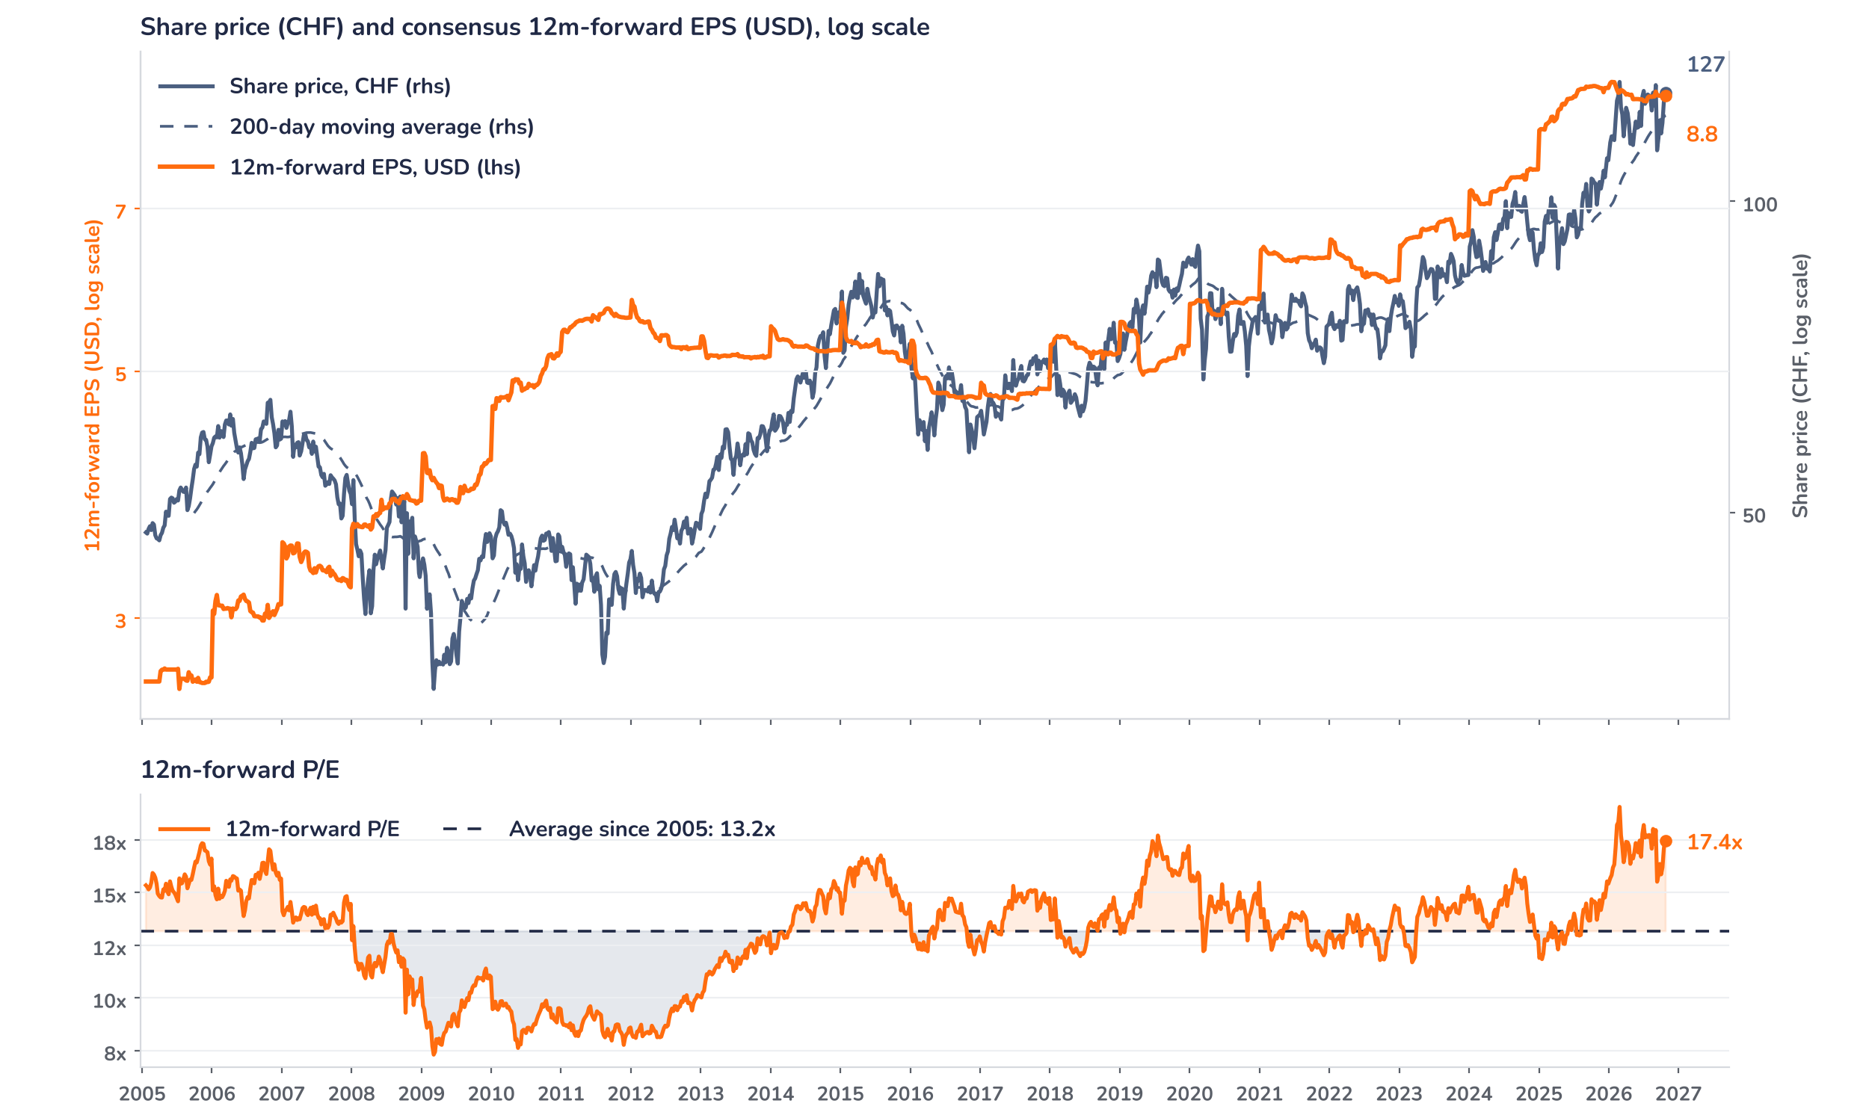
Beyond the key takeaways
Results: launches offset generics, costs beat
Net sales rose 4% in constant currencies (cc) to USD 14.5bn: volume added 14 percentage points, generic competition took 9 and pricing 1, with no currency effect. Priority brands carried the quarter. Kisqali grew 37% to USD 1.82bn, Kesimpta 22% to USD 1.48bn and Cosentyx 9% to USD 1.86bn, while Scemblix and Leqvio grew 67% and 63%. Entresto fell 38% to USD 1.17bn and Promacta 61%. Core operating income rose 10% cc to USD 6.04bn, a 41.6% margin, up 2 points cc and 7.6% to 8.1% above consensus depending on the estimate set. Core EPS rose 8% cc to USD 2.46. The USD 1.9bn del-desiran impairment cut reported net income 71% to USD 1.2bn.
Surprise and reaction point the same way, but a 1.2% pre-market gain on 27 October is small for a 7% core EPS beat. Confirmed drivers temper it: sales were only in line, the profit beat came from SG&A costs 9% below estimates, and Pluvicto and Scemblix missed by 7.7% and 2.1%. Our reading, not confirmed by management, is that expectations were already high: the shares had recovered 14% from the 8 September low, after the Phase III failures cut them 10.9% in a day, and slipped 0.4% on 26 October, with the SMI up 0.5%, as detailed remibrutinib data in multiple sclerosis drew mixed reviews.
Outlook: the raise needs a strong Q4
Management now expects 2026 core operating income to be flat to up low single digits in cc, from a low single-digit decline, and keeps net sales growth at low single digits; at late-October rates, currency adds 1 point to each. With nine-month core profit down 2% cc, the raise implies a strong fourth quarter: analyst estimates model sales growth near 9% and around 3% upgrades to 2026 consensus core EPS. The CEO expects sales growth to accelerate in 2027. Next come the 19 November management event, a US filing for remibrutinib in multiple sclerosis by end-2026 using a priority review voucher, and abelacimab atrial fibrillation data by mid-2027.
Valuation: the multiple did the work
Chart 2 · NOVN: share price vs. consensus earnings and valuation
Weekly, 21 Jan 2005 to 26 Oct 2026 · Bloomberg 12m-forward consensus EPS in USD, price in CHF · 200-day MA · P/E vs. its 2005–26 average · Last price is the 26 October close, before the release
The shares have run ahead of earnings. Over 12 months the price rose 22.5% to CHF 127.48 while 12m-forward consensus EPS fell 2.0% to USD 8.84, so the whole gain came from the multiple. At 17.4x, the P/E is 33% above its 13.2x average since 2005 and above the 16.7x one-year average, though below the 19.1x peak of 27 February 2026. The price sits 5% above its 200-day average and 3% below the 2 September high. A 3% EPS upgrade at an unchanged price would take the multiple to 16.9x: earnings, not re-rating, now have to carry the stock.
Syz Research · Earnings update · 27 October 2026
2 / 3

Slide 3
SYZ Source: Syz Research, Bloomberg, company filings, Novartis Q3 2026 results release of 27 October 2026, analyst research notes of 26 and 27 October 2026, Finanz und Wirtschaft and finanzen.net of 27 October 2026 (pre-market indication)
Disclaimer
This communication has been issued and made available to recipients for the purpose of advertising investment services and/or financial instruments. It has been sent for information purposes and cannot be considered as an offer or a personalised recommendation to buy or sell a financial instrument or any other investment or currency. This communication does not constitute investment research within the meaning of regulatory rules applicable in the European Economic Area, or research under the rules of the U.S. Self-Regulatory Organizations.
This information is made solely for professional and institutional clients as defined by the Swiss Financial Services Act, as well as qualified investors according to the Swiss Collective Investment Schemes Act. It is not intended for retail clients or non-qualified investors and consequently cannot be transmitted to any third party.
This communication is not directed to any person in any jurisdiction where, by reason of that person’s nationality, residence or otherwise, its dissemination or use is prohibited. It cannot be quoted, reproduced, disclosed, distributed or otherwise referred to, in whole or in part, to any third party without the Bank’s prior written consent.
This communication may contain information on past performances of a financial product, all kinds of economic and financial valuations and analyses, as well as opinions of the Bank or of third parties. Any market valuations, terms and calculation methods, yields and opinions expressed are subject to change without notice. The information and opinions contained herein have been compiled and provided in good faith, based on information obtained from sources believed to be trustworthy. However, such information has not been independently verified. No guarantee, representation, or warranty of any kind, whether express or implied, is provided by the Bank or by relevant data vendors and other sources with respect to the accuracy, reliability, currentness or exhaustiveness of the information communicated, the methodology employed or the prices contained herein.
Past performance is not a reliable indicator of current or future results. Any reference to the past performance of an investment does not guarantee its future performance. Fluctuations in exchange rates may adversely affect the value, price or income of any investment.
Nothing in the present communication constitutes investment, legal, accounting or tax advice. This information is purely objective since it does not take into consideration the personal situation (including financial knowledge and experience), the investment objectives and risk profile of any recipient. Moreover, certain financial instruments mentioned (in particular, but not exclusively, derivatives, options and futures) involve a high risk of loss and may not be suitable. Accordingly, recipients should consult their own advisors on such matters, including but not limited to the possible tax consequences of investing in any financial product mentioned herein, and make their own assessment of the suitability of such investment product.
Should a recipient make an investment on the basis of the present communication, the recipient alone shall bear the consequences thereof. In no event shall the Bank, its directors, employees, affiliates or agents be held responsible for damages of any kind arising out of the use of all or part of the information provided herein.
Syz Research · Earnings update · 27 October 2026
3 / 3

