Slide 1

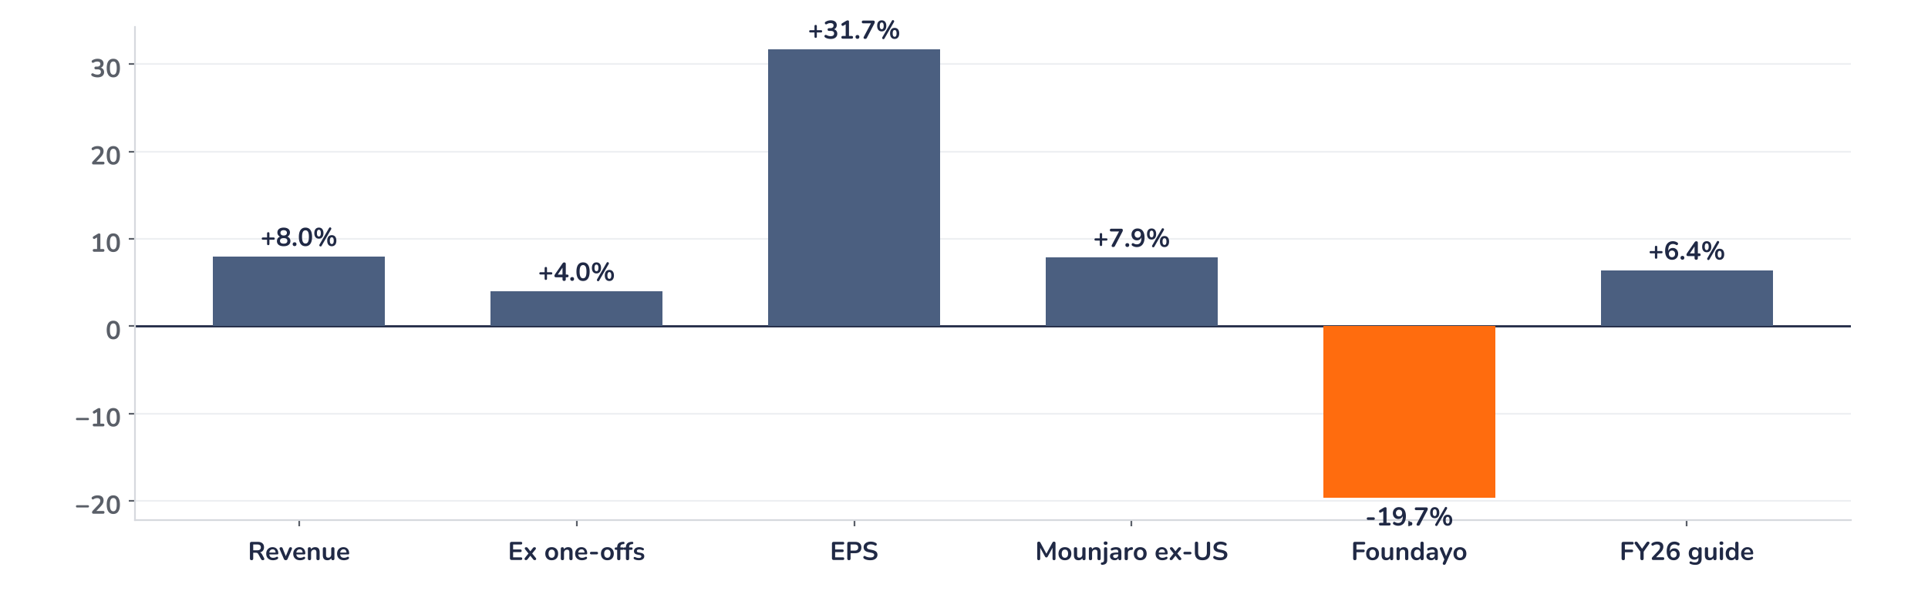
Earnings update
Eli Lilly Q3 2026: volume drives a beat and raise at 26x
29 October 2026 · Syz Research
“Lilly had another strong quarter, exceeding our prior expectations and allowing us to raise our full-year outlook. Revenue growth was driven by broad global consumer demand for Mounjaro and Zepbound…”
David A. Ricks, chair and CEO, Q3 2026 results release, 29 October 2026
Eli Lilly develops medicines for diabetes, obesity, cancer, immune disorders and Alzheimer’s disease. Mounjaro and Zepbound made up 66% of Q3 2026 revenue of USD 24.4bn; the US accounts for 62%. Listed in New York.
Key takeaways
Beat
Revenue USD 24.4bn (+8% vs. consensus) and EPS USD 7.48 (+32%); shares up 8.2% intraday on 29 October.
Raised
2026 revenue guide raised by USD 5.5bn to USD 91 to 92bn; the implied Q4 looks cautious.
Watch
About USD 0.9bn of one-offs flattered revenue, and realised prices fell 15% as cheaper channels grow.
Valuation
26.2x 12m-forward earnings, in line with the 26.3x average since 2018, for 39% revenue growth.
Revenue
Non-GAAP EPS
Gross margin (non-GAAP)
2026 revenue guide
USD 24.4bn
USD 7.48
84.4%
USD 91–92bn
+8.0% vs. consensus
+31.7% vs. consensus
+100bp vs. expectations
+USD 5.5bn at midpoint
Volume carries the quarter and the guidance
Revenue beat consensus by 8% and non-GAAP EPS by 32%, and the shares rose 8.2% intraday on 29 October to a record USD 1,393. The move matches the size of the beat and of the USD 5.5bn guidance raise. Volume grew 53% and absorbed a 15% fall in realised prices: demand for Mounjaro and Zepbound keeps widening the earnings base faster than price erodes it.
Chart 1 · LLY: Q3 2026 results vs. consensus
Surprise vs. consensus, % · ex one-offs strips about USD 0.9bn of non-recurring revenue · FY26 guide: midpoint vs. prior guide
Half of the revenue beat came from one-offs: USD 410m of Jardiance milestones, the last ones, and about USD 490m of rebate and discount adjustments. Stripped of both, revenue still beat by 4%. International Mounjaro gave the cleanest upside, 8% above consensus. Foundayo, the new oral GLP-1, missed by 20% at USD 184m.
Base case and implications
The case remains very constructive and the risk/reward skewed to the upside. We underwrite 2026 revenue in the top half of the USD 91 to 92bn range and EPS of about USD 35.50 after USD 4.57 per share of acquired research charges. For 2027 the open point is price: volume has to keep outrunning price cuts as Medicare and lower-priced channels expand. The retatrutide filing in Q1 2027 is the next catalyst, and the Q4 print with first 2027 guidance is the next test.
What would strengthen our view
What would change our view
Q4 revenue above USD 24.8bn, the top of the implied range; international Mounjaro adding another USD 0.5bn on Q3; the retatrutide filing on time in Q1 2027; realised price declines easing below 10% a year.
US realised price falling faster than 7% a year without matching volume; Foundayo missing consensus again in Q4; a retatrutide filing slipping beyond Q1 2027; new US rules capping obesity drug prices in Medicare.
Syz Research · Earnings update · 29 October 2026
1 / 3

Slide 2
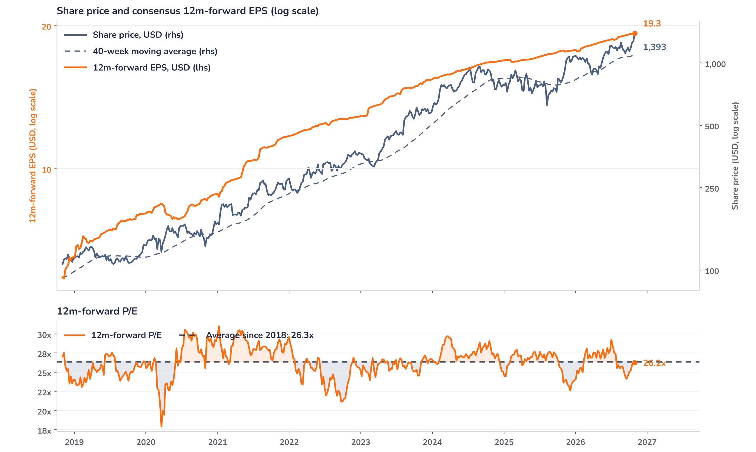
Beyond the key takeaways
Results: volume did the work
Worldwide volume rose 53% and realised prices fell 15%. In the US, volume grew 41% at a 7% lower price; outside the US, volume rose 76% at a 29% lower price, as launches reach lower-priced markets. Mounjaro sales reached USD 10.7bn (+65%), of which USD 5.7bn came from outside the US (+93%), more than USD 570m above Q2 and USD 415m above consensus. Zepbound added USD 5.4bn (+49%) on wider US coverage and a ramp in Medicare. Key products in oncology, immunology and neuroscience doubled. Non-GAAP gross margin reached 84.4%, 80bp above Q3 2025 and about 100bp above expectations, the main reason EPS beat by more than revenue.
Revenue beat consensus by 8% and EPS by 32%, and the shares rose 8.2% intraday on 29 October against the 28 October close of USD 1,288: surprise and reaction are aligned. The confirmed drivers are the USD 5.5bn raise to revenue guidance and a 250bp lift to the performance margin guide, now 52.0 to 52.5%. About USD 0.9bn of revenue will not repeat, and no further Jardiance milestones remain. EPS of USD 7.48 already absorbs USD 4.57 per share of acquired research charges. We read the rally as a response to the underlying trend, with revenue 4% ahead of consensus after one-offs.
Outlook: the raised guide still looks cautious
Lilly now guides 2026 revenue at USD 91 to 92bn, from USD 85 to 87bn, and non-GAAP EPS at USD 35.00 to 36.00, from USD 35.50 to 36.50. The lower EPS range reflects the Q3 research charge of USD 4.57 per share; on our arithmetic the underlying EPS outlook rose by about USD 4. Against nine-month revenue of USD 67.2bn, the midpoint implies Q4 revenue of about USD 24.3bn, flat on Q3, and Q4 EPS of about USD 11.10, below the USD 12.05 Q3 figure before research charges. A higher tax rate guide of 19 to 20% explains part of that gap.
Valuation: earnings carried the rally
Chart 2 · LLY: share price vs. consensus earnings and valuation
LLY US Equity, weekly from November 2018 (first consensus EPS) · BEst 12m-forward consensus · 40-week simple MA · log scale · P/E shaded above (orange) / below (blue) its 2018 to 2026 average · last point is the 29 October intraday price, after the release
The shares trade at a record USD 1,393, 69% above the level of a year ago and 27% above the 40-week moving average of USD 1,097. The 12m-forward P/E stands at 26.2x on Bloomberg data, in line with the 26.3x average since 2018 and the 26.0x one-year average, and well below the 31.0x peak of January 2021. A year ago the multiple stood at 25.2x, so earnings growth delivered most of the gain. On the 2026 EPS guidance midpoint of USD 35.50 the shares trade at 39x, a multiple that 2027 growth has to bring down quickly.
Syz Research · Earnings update · 29 October 2026
2 / 3

Slide 3
SYZ Source: Syz Research, Bloomberg, company filings, Eli Lilly results release of 29 October 2026, analyst research notes of 5 August to 29 October 2026
Disclaimer
This communication has been issued and made available to recipients for the purpose of advertising investment services and/or financial instruments. It has been sent for information purposes and cannot be considered as an offer or a personalised recommendation to buy or sell a financial instrument or any other investment or currency. This communication does not constitute investment research within the meaning of regulatory rules applicable in the European Economic Area, or research under the rules of the U.S. Self-Regulatory Organizations.
This information is made solely for professional and institutional clients as defined by the Swiss Financial Services Act, as well as qualified investors according to the Swiss Collective Investment Schemes Act. It is not intended for retail clients or non-qualified investors and consequently cannot be transmitted to any third party.
This communication is not directed to any person in any jurisdiction where, by reason of that person’s nationality, residence or otherwise, its dissemination or use is prohibited. It cannot be quoted, reproduced, disclosed, distributed or otherwise referred to, in whole or in part, to any third party without the Bank’s prior written consent.
This communication may contain information on past performances of a financial product, all kinds of economic and financial valuations and analyses, as well as opinions of the Bank or of third parties. Any market valuations, terms and calculation methods, yields and opinions expressed are subject to change without notice. The information and opinions contained herein have been compiled and provided in good faith, based on information obtained from sources believed to be trustworthy. However, such information has not been independently verified. No guarantee, representation, or warranty of any kind, whether express or implied, is provided by the Bank or by relevant data vendors and other sources with respect to the accuracy, reliability, currentness or exhaustiveness of the information communicated, the methodology employed or the prices contained herein.
Past performance is not a reliable indicator of current or future results. Any reference to the past performance of an investment does not guarantee its future performance. Fluctuations in exchange rates may adversely affect the value, price or income of any investment.
Nothing in the present communication constitutes investment, legal, accounting or tax advice. This information is purely objective since it does not take into consideration the personal situation (including financial knowledge and experience), the investment objectives and risk profile of any recipient. Moreover, certain financial instruments mentioned (in particular, but not exclusively, derivatives, options and futures) involve a high risk of loss and may not be suitable. Accordingly, recipients should consult their own advisors on such matters, including but not limited to the possible tax consequences of investing in any financial product mentioned herein, and make their own assessment of the suitability of such investment product.
Should a recipient make an investment on the basis of the present communication, the recipient alone shall bear the consequences thereof. In no event shall the Bank, its directors, employees, affiliates or agents be held responsible for damages of any kind arising out of the use of all or part of the information provided herein.
Syz Research · Earnings update · 29 October 2026
3 / 3

