Slide 1

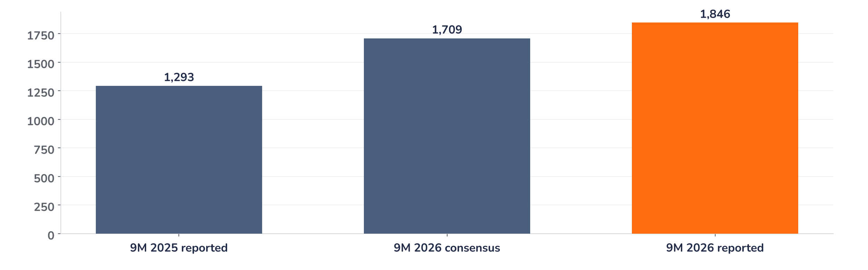
Earnings update
RWE Q3 2026: trading lifts the year, 2027 is the next test
11 November 2026 · Syz Research
“We have delivered a strong financial performance in the first nine months of 2026. … we have already achieved around 85% of our full year adjusted EPS target.”
Michael Müller, CFO, Q3 2026 earnings call, 11 November 2026 (initial draft transcript)
RWE generates electricity from offshore and onshore wind, solar, batteries and gas plants in Europe and the US, and runs a global energy trading business. Listed in Frankfurt; market value around EUR 44bn.
Key takeaways
Beat
Adjusted EBITDA EUR 4.58bn, 3% above consensus; adjusted net income EUR 1.85bn, 8% above.
Reaction
Shares up 1.9% on 11 November, DAX about +1%: a measured response to a trading-led beat.
Outlook
2026 now seen at the upper end; 85% of the EUR 2.6 to 3.3 EPS range already earned.
Valuation
17.7x forward earnings, 21% above the 2014 to 2026 average, below the 21.6x May peak.
Adjusted EBITDA
Adjusted net income
Adjusted EPS
FY26 guidance
EUR 4.58bn
EUR 1.85bn
EUR 2.52
Upper end
+3.3% vs. consensus
+8.0% vs. consensus
+42% year on year
Confirmed, not raised
Earnings, not the multiple, carry the stock
Adjusted EBITDA beat the company-collected consensus by 3% and adjusted net income by 8%, and the shares rose 1.9% on 11 November against a DAX up about 1%: an aligned but measured reaction. The beat came mostly from trading, which management does not extrapolate, while renewables grew on new capacity and normal wind. The quarter confirms the earnings path.
Chart 1 · RWE: 9M 2026 adjusted net income vs. consensus and prior year
Adjusted net income, EUR m · consensus: company-collected poll · 9M 2025 derived from the reported +42.8% growth
Adjusted net income rose 43% to EUR 1,846m, EUR 137m above consensus. Trading alone added about EUR 390m of EBITDA year on year, so the beat is of lower quality than the headline. Offshore wind and onshore wind and solar each grew 21%: that is the recurring part of the story.
Base case and implications
The case remains constructive, with a balanced to positive risk/reward at 17.7x forward earnings. We underwrite adjusted EPS at the top of the EUR 2.6 to 3.3 range for 2026 and growth beyond it from 4.5 gigawatts of offshore wind under construction, 2.5 gigawatts of contracted gas plants and batteries with returns above 10%. The debate has moved to the 2027 base once trading normalises. The next tests are the second German capacity auction in December and the 2027 guidance in early March.
What would strengthen our view
What would change our view
A second German auction award from the 1.5 gigawatt pipeline; a 2027 guide above consensus in March; one of the two data centre site deals signed by year end.
A 2027 guide below consensus as trading falls back to its EUR 300m normal level; Sofia offline beyond year end; year-end net debt well above EUR 12bn.
Syz Research · Earnings update · 11 November 2026
1 / 3

Slide 2
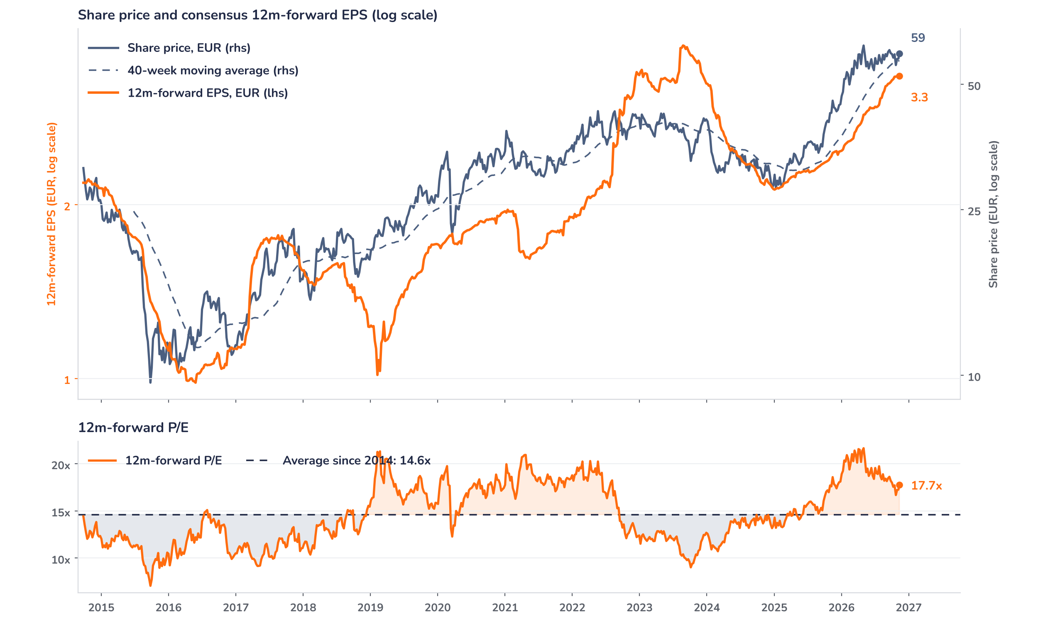
Beyond the key takeaways
Results: trading beat, wind delivered growth
Adjusted EBITDA rose 35% to EUR 4.6bn. Offshore wind grew to EUR 1,110m from EUR 915m on normalised wind and the ramp-up of Sofia, Thor and Nordseecluster A. Onshore wind and solar rose to EUR 1,497m from EUR 1,242m on new capacity and better European wind, despite a weaker US dollar. Flexible generation delivered EUR 1,343m, helped by higher margins, UK capacity payments and a one-off EUR 332m compensation from the Dutch state for the 2022 Eemshaven restriction. Supply and trading recovered from first-quarter losses on gas and CO2 positions to EUR 543m, against EUR 150m a year earlier. Adjusted EPS rose 42% to EUR 2.52.
Surprise and reaction are aligned: an 8% beat on adjusted net income met a 1.9% rise on 11 November, close to one point better than the DAX. The reasons the move stayed measured are confirmed in the release and the call: guidance was confirmed at the upper end rather than raised, the Eemshaven payment is a one-off, and management keeps EUR 300m as the normal trading result, so the trading swing is not extrapolated. We think positioning also played a part: the stock had rerated to 21.6x in May and entered the print 39% higher over twelve months.
Outlook: upper end now, 2027 is the question
RWE confirmed its 2026 ranges and now expects the upper end: adjusted EBITDA EUR 5.75bn to 6.35bn, adjusted net income EUR 1.95bn to 2.45bn and adjusted EPS EUR 2.6 to 3.3, with the EUR 1.32 dividend confirmed. The CFO said the guide assumes average fourth-quarter wind and excludes the strong trading seen in the quarter, while the other segments should land around their midpoints. Net debt of EUR 17bn at September should fall to around EUR 12bn by December, mainly because some activities will be deconsolidated, that is, taken off the balance sheet. Commodity assumptions have not been updated; new price sensitivities and 2027 guidance come with the full-year results in early March.
Valuation: earnings did the work this year
Chart 2 · RWE: share price vs. consensus earnings and valuation
RWE GY Equity, weekly, Sep 2014 to 11 Nov 2026 · BEst 12m-forward consensus · 40-week simple MA · log scale · P/E shaded above (orange) / below (blue) its 2014 to 2026 average · last point is the 11 November (results day) level
Over twelve months the share price rose 39% and consensus 12m-forward EPS 38%: the rerating has paused and earnings growth now does the lifting. Since the half-year results in August, EPS has risen 7% while the price is up 1%, taking the P/E down from 18.9x to 17.7x. The multiple stands 21% above its 14.6x average since 2014, but below the 19.1x one-year average and the 21.6x peak of May 2026. The price sits 4% above its 40-week moving average of EUR 57.1. A 10% EPS upgrade at an unchanged price would take the multiple to 16.1x.
Syz Research · Earnings update · 11 November 2026
2 / 3

Slide 3
SYZ Source: Syz Research, Bloomberg, company filings, RWE release and Q3 2026 earnings call of 11 November 2026
Disclaimer
This communication has been issued and made available to recipients for the purpose of advertising investment services and/or financial instruments. It has been sent for information purposes and cannot be considered as an offer or a personalised recommendation to buy or sell a financial instrument or any other investment or currency. This communication does not constitute investment research within the meaning of regulatory rules applicable in the European Economic Area, or research under the rules of the U.S. Self-Regulatory Organizations.
This information is made solely for professional and institutional clients as defined by the Swiss Financial Services Act, as well as qualified investors according to the Swiss Collective Investment Schemes Act. It is not intended for retail clients or non-qualified investors and consequently cannot be transmitted to any third party.
This communication is not directed to any person in any jurisdiction where, by reason of that person’s nationality, residence or otherwise, its dissemination or use is prohibited. It cannot be quoted, reproduced, disclosed, distributed or otherwise referred to, in whole or in part, to any third party without the Bank’s prior written consent.
This communication may contain information on past performances of a financial product, all kinds of economic and financial valuations and analyses, as well as opinions of the Bank or of third parties. Any market valuations, terms and calculation methods, yields and opinions expressed are subject to change without notice. The information and opinions contained herein have been compiled and provided in good faith, based on information obtained from sources believed to be trustworthy. However, such information has not been independently verified. No guarantee, representation, or warranty of any kind, whether express or implied, is provided by the Bank or by relevant data vendors and other sources with respect to the accuracy, reliability, currentness or exhaustiveness of the information communicated, the methodology employed or the prices contained herein.
Past performance is not a reliable indicator of current or future results. Any reference to the past performance of an investment does not guarantee its future performance. Fluctuations in exchange rates may adversely affect the value, price or income of any investment.
Nothing in the present communication constitutes investment, legal, accounting or tax advice. This information is purely objective since it does not take into consideration the personal situation (including financial knowledge and experience), the investment objectives and risk profile of any recipient. Moreover, certain financial instruments mentioned (in particular, but not exclusively, derivatives, options and futures) involve a high risk of loss and may not be suitable. Accordingly, recipients should consult their own advisors on such matters, including but not limited to the possible tax consequences of investing in any financial product mentioned herein, and make their own assessment of the suitability of such investment product.
Should a recipient make an investment on the basis of the present communication, the recipient alone shall bear the consequences thereof. In no event shall the Bank, its directors, employees, affiliates or agents be held responsible for damages of any kind arising out of the use of all or part of the information provided herein.
Syz Research · Earnings update · 11 November 2026
3 / 3

