Slide 1

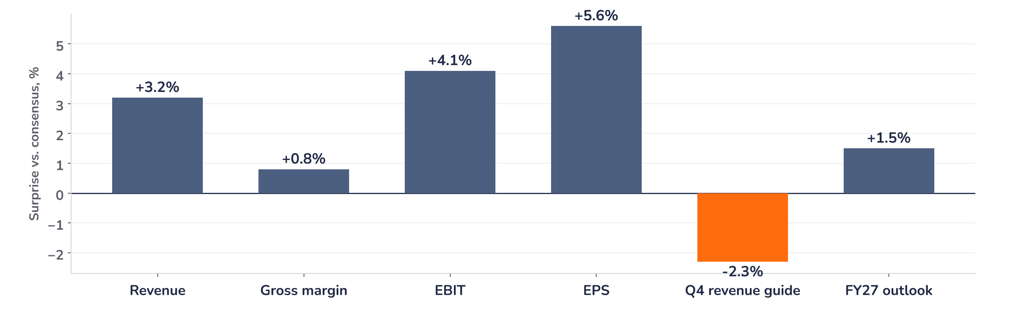
Earnings update · Semiconductors
ASML Q3 2026: orders confirm the upcycle, valuation leaves little slack
14 October 2026 · Syz Research
“Illustrative management quote of about twenty to thirty words that captures the tone of the call and the key message to investors.”
Illustrative Name, CEO, Q3 2026 earnings call, 14 October 2026
Key takeaways
Beat
Revenue EUR 9.2bn (+4% vs. consensus) and EPS EUR 7.85 (+6%), driven by EUV mix and services.
Raised
FY26 revenue guide lifted to the top of the EUR 34 to 36bn range; gross margin 52 to 53%.
Watch
China fell to 22% of system sales from 29%, and export-licence timing remains the main swing factor.
Valuation
30.6x forward earnings, 18% above the 2010 to 2026 average: the upcycle is priced, not the next leg.
Revenue
EPS
Gross margin
Q4 revenue guide
EUR 9.2bn
EUR 7.85
53.4%
EUR 9.6bn
+4.1% vs. consensus
+5.6% vs. consensus
+80bp vs. consensus
-2.3% vs. consensus
What the quarter means for the investment case
Orders of EUR 7.1bn beat consensus by 12% and the EUV share rose to 58%, the highest since Q2 2024, while gross margin reached 53.4% against a guide of 51 to 53%. We read the mix shift as structural rather than cyclical, and the guidance for Q4 implies a run-rate above the FY27 consensus. The debate now moves from demand to capacity. Orders of EUR 7.1bn beat consensus by 12% and the EUV share rose to 58%, the highest since Q2 2024, while gross margin.
Chart 1 · ASML Q3 2026: results vs. consensus
Surprise vs. Bloomberg consensus, % · guidance midpoint vs. consensus · illustrative numbers
Orders of EUR 7.1bn beat consensus by 12% and the EUV share rose to 58%, the highest since Q2 2024, while gross margin reached 53.4% against a guide of 51 to 53%. We read the mix shift as structural rather than cyclical, and the guidance for Q4 implies a run-rate above the FY27 consensus. The debate now moves from demand to capacity. Orders of EUR.
Base case and implications
Orders of EUR 7.1bn beat consensus by 12% and the EUV share rose to 58%, the highest since Q2 2024, while gross margin reached 53.4% against a guide of 51 to 53%. We read the mix shift as structural rather than cyclical, and the guidance for Q4 implies a run-rate above the FY27 consensus. The debate now moves from demand to capacity. Orders of EUR 7.1bn beat consensus by 12%.
What would strengthen our view
What would change our view
Orders of EUR 7.1bn beat consensus by 12% and the EUV share rose to 58%, the highest since Q2 2024, while gross margin reached 53.4% against a guide of 51 to 53%. We read the mix shift as structural rather than cyclical, and the guidance for Q4 implies a run-rate.
Orders of EUR 7.1bn beat consensus by 12% and the EUV share rose to 58%, the highest since Q2 2024, while gross margin reached 53.4% against a guide of 51 to 53%. We read the mix shift as structural rather than cyclical, and the guidance for Q4 implies a run-rate.
Syz Research · Earnings update · 14 October 2026
1 / 3

Slide 2
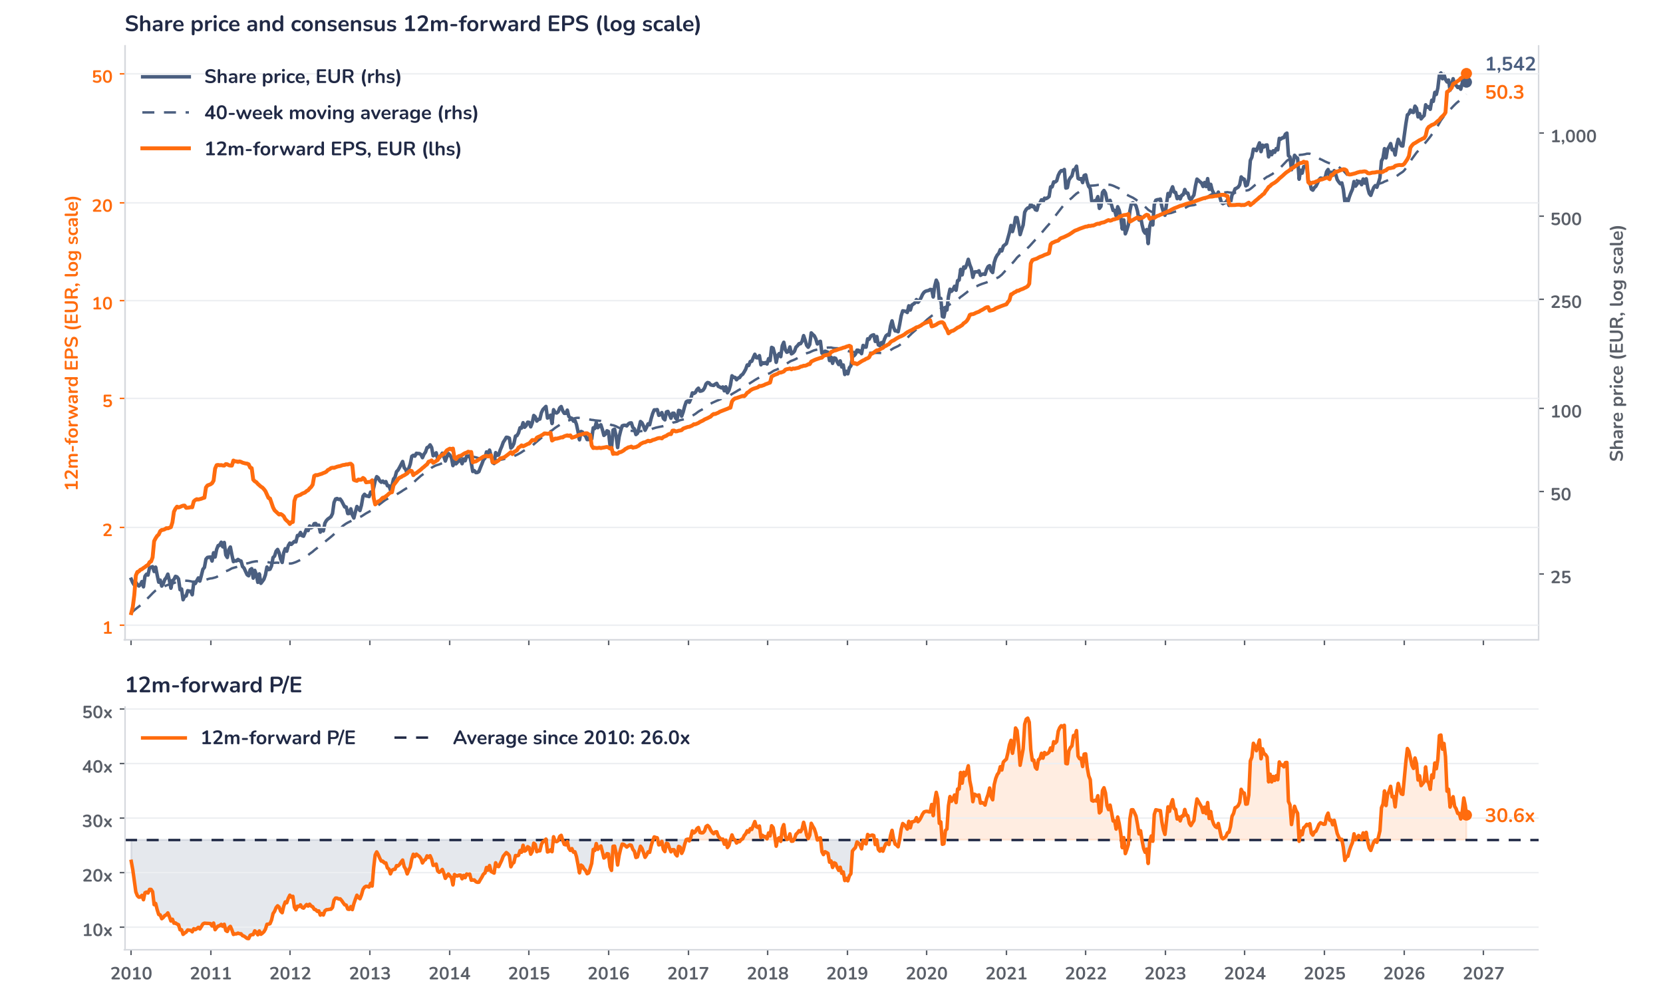
Results: the beat was mix, not volume
Orders of EUR 7.1bn beat consensus by 12% and the EUV share rose to 58%, the highest since Q2 2024, while gross margin reached 53.4% against a guide of 51 to 53%. We read the mix shift as structural rather than cyclical, and the guidance for Q4 implies a run-rate above the FY27 consensus. The debate now moves from demand to capacity. Orders of EUR 7.1bn beat consensus by 12% and the EUV share rose to 58%, the highest since Q2 2024, while gross margin reached 53.4% against a guide of 51 to 53%. We read the mix shift as structural rather than cyclical, and the guidance for Q4 implies.
Orders of EUR 7.1bn beat consensus by 12% and the EUV share rose to 58%, the highest since Q2 2024, while gross margin reached 53.4% against a guide of 51 to 53%. We read the mix shift as structural rather than cyclical, and the guidance for Q4 implies a run-rate above the FY27 consensus. The debate now moves from demand to capacity. Orders of EUR 7.1bn beat consensus by 12% and the EUV share rose to 58%, the highest since Q2 2024, while gross margin reached 53.4% against a guide of 51 to 53%. We read the mix shift as.
Outlook: guidance leans on EUV and services
Orders of EUR 7.1bn beat consensus by 12% and the EUV share rose to 58%, the highest since Q2 2024, while gross margin reached 53.4% against a guide of 51 to 53%. We read the mix shift as structural rather than cyclical, and the guidance for Q4 implies a run-rate above the FY27 consensus. The debate now moves from demand to capacity. Orders of EUR 7.1bn beat consensus by 12% and the EUV share rose to 58%, the highest since Q2 2024, while gross margin reached 53.4% against a guide of 51 to 53%. We read the mix shift as structural rather than cyclical, and.
Valuation: the upcycle is priced, the next leg is not
Chart 2 · ASML: share price vs. consensus earnings and valuation
ASML NA Equity, weekly · BEst 12m-forward consensus · 40-week simple MA · log scale · P/E shaded above (orange) / below (blue) its 2010 to 2026 average
Orders of EUR 7.1bn beat consensus by 12% and the EUV share rose to 58%, the highest since Q2 2024, while gross margin reached 53.4% against a guide of 51 to 53%. We read the mix shift as structural rather than cyclical, and the guidance for Q4 implies a run-rate above the FY27 consensus. The debate now moves from demand to capacity. Orders of EUR 7.1bn beat consensus by 12% and the EUV share rose to 58%, the highest since Q2 2024, while gross margin reached 53.4% against a guide of 51 to 53%. We.
Investment implications and positioning
Orders of EUR 7.1bn beat consensus by 12% and the EUV share rose to 58%, the highest since Q2 2024, while gross margin reached 53.4% against a guide of 51 to 53%. We read the mix shift as structural rather than cyclical, and the guidance for Q4 implies a run-rate above the FY27 consensus. The debate now moves from demand to capacity. Orders of EUR 7.1bn beat consensus by 12% and the EUV share rose to 58%, the highest since Q2 2024, while gross margin reached 53.4% against a guide of 51 to 53%. We read the mix shift as.
Syz Research · Earnings update · 14 October 2026
2 / 3

Slide 3
SYZ Source: Syz Research, Bloomberg, company filings
Disclaimer
This communication has been issued and made available to recipients for the purpose of advertising investment services and/or financial instruments. It has been sent for information purposes and cannot be considered as an offer or a personalised recommendation to buy or sell a financial instrument or any other investment or currency. This communication does not constitute investment research within the meaning of regulatory rules applicable in the European Economic Area, or research under the rules of the U.S. Self-Regulatory Organizations.
This information is made solely for professional and institutional clients as defined by the Swiss Financial Services Act, as well as qualified investors according to the Swiss Collective Investment Schemes Act. It is not intended for retail clients or non-qualified investors and consequently cannot be transmitted to any third party.
This communication is not directed to any person in any jurisdiction where, by reason of that person’s nationality, residence or otherwise, its dissemination or use is prohibited. It cannot be quoted, reproduced, disclosed, distributed or otherwise referred to, in whole or in part, to any third party without the Bank’s prior written consent.
This communication may contain information on past performances of a financial product, all kinds of economic and financial valuations and analyses, as well as opinions of the Bank or of third parties. Any market valuations, terms and calculation methods, yields and opinions expressed are subject to change without notice. The information and opinions contained herein have been compiled and provided in good faith, based on information obtained from sources believed to be trustworthy. However, such information has not been independently verified. No guarantee, representation, or warranty of any kind, whether express or implied, is provided by the Bank or by relevant data vendors and other sources with respect to the accuracy, reliability, currentness or exhaustiveness of the information communicated, the methodology employed or the prices contained herein.
Past performance is not a reliable indicator of current or future results. Any reference to the past performance of an investment does not guarantee its future performance. Fluctuations in exchange rates may adversely affect the value, price or income of any investment.
Nothing in the present communication constitutes investment, legal, accounting or tax advice. This information is purely objective since it does not take into consideration the personal situation (including financial knowledge and experience), the investment objectives and risk profile of any recipient. Moreover, certain financial instruments mentioned (in particular, but not exclusively, derivatives, options and futures) involve a high risk of loss and may not be suitable. Accordingly, recipients should consult their own advisors on such matters, including but not limited to the possible tax consequences of investing in any financial product mentioned herein, and make their own assessment of the suitability of such investment product.
Should a recipient make an investment on the basis of the present communication, the recipient alone shall bear the consequences thereof. In no event shall the Bank, its directors, employees, affiliates or agents be held responsible for damages of any kind arising out of the use of all or part of the information provided herein.
Syz Research · Earnings update · 14 October 2026
3 / 3

