Slide 1

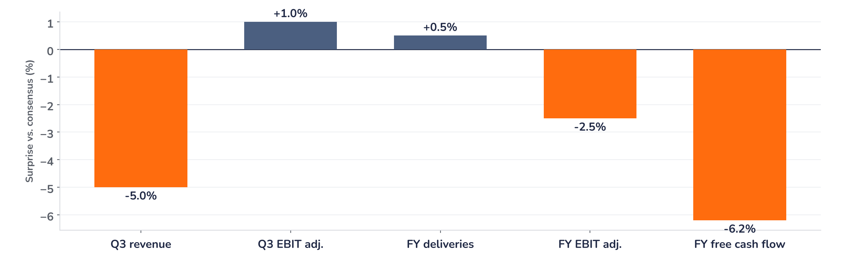
Earnings update
Airbus Q3 2026: the guide holds, Q4 must deliver
29 October 2026 · Syz Research
“Overall, we feel comfortable with the ramp up. As you see, we are confirming the outlook for this year. We were comfortable enough at the Farnborough Airshow to give a 2029 mid-term target.”
Guillaume Faury, CEO, Q3 2026 earnings call, 28 October 2026
Airbus builds commercial aircraft (A220, A320, A330, A350), helicopters and defence and space systems. Commercial aircraft were 73% of Q3 revenue; nine-month revenue EUR 50.6bn. Listed in Paris, Frankfurt and Madrid.
Key takeaways
In line
Q3 adjusted EBIT of EUR 1.77bn matched consensus; revenue missed by 5% on fewer deliveries.
Reaction
Shares closed 3.3% higher on 29 October, against 0.8% for the Stoxx Europe 600.
Watch
The unchanged guide needs about 323 Q4 deliveries and EUR 5.8bn of Q4 free cash flow.
Valuation
23.5x forward earnings, 35% above the 17.4x average since 2005, below January’s 27.7x.
Q3 adjusted EBIT
Q3 revenue
Q3 free cash flow
2026 EBIT guide
EUR 1.77bn
EUR 17.5bn
EUR -0.10bn
EUR 7.5bn
+1.0% vs. consensus
-5.0% vs. consensus
vs. EUR +0.33bn consensus
Held, 2.5% below consensus
Relief on the guide, the cash test is Q4
Q3 adjusted EBIT matched consensus while revenue missed by 5% and free cash flow by about EUR 0.4bn, yet the shares closed 3.3% higher on 29 October, against 0.8% for the Stoxx Europe 600. The guide and the buyback plan held, and orders keep building: 1,105 net orders in nine months, double last year. The case now rests on delivering Q4.
Chart 1 · AIR: Q3 2026 results and 2026 guide vs. consensus
Q3 reported vs. Q3 consensus · maintained 2026 guide vs. 2026 consensus, % · free cash flow before customer financing
The misses are volume and cash, not margin: commercial EBIT held up as fewer aircraft left the line. The maintained 2026 guide sits 2.5% below consensus on EBIT and 6% below on free cash flow, a gap that already existed before the release; the delivery guide is slightly above consensus.
Base case and implications
We are constructive on Airbus. We underwrite about 870 deliveries this year, adjusted EBIT of about EUR 7.5bn and a 2027 ramp paced by engines, backed by a backlog of 9,310 aircraft. Forward EPS of EUR 8.4 is 15% above its 2019 peak, and defence orders, up 70%, add a second leg. The debate has moved from demand to execution: the Spirit integration and the cash release from about EUR 10bn of extra inventory. At 23.5x, delivery must follow. Next test: the full-year results in February.
What would strengthen our view
What would change our view
Q4 deliveries at or above 323 with free cash flow before customer financing of at least EUR 4.5bn; the EUR 5bn buyback launched before year-end; Project Bromo signed in 2026 as planned.
Deliveries below 850, the low end of the range; free cash flow short of EUR 4bn as inventory fails to unwind; Spirit costs above the guided effect; fewer engines than planned for 2027.
Syz Research · Earnings update · 29 October 2026
1 / 3

Slide 2
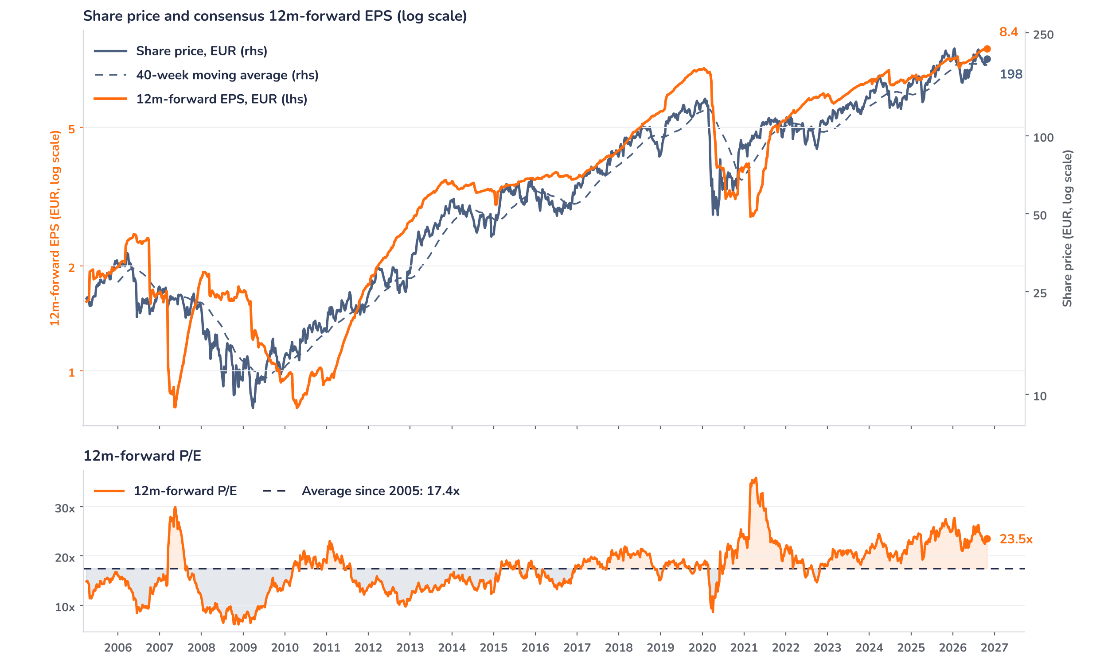
Beyond the key takeaways
Results: fewer deliveries, firmer margins
Q3 revenue fell 2% to EUR 17.5bn and adjusted EBIT 9% to EUR 1.77bn on 196 deliveries. Commercial Aircraft revenue fell 2% to EUR 12.8bn and its adjusted EBIT 12% to EUR 1.38bn, a 10.8% margin against the 10.4% analysts expected, on fewer deliveries, a less favourable mix and the integration of the former Spirit AeroSystems work packages, which also cost EUR 112m in charges below adjusted EBIT. Helicopters fell 17% to EUR 205m and Defence and Space rose 19% to EUR 185m. Free cash flow before customer financing was EUR -102m, as inventory rose about EUR 10bn since January to support the ramp. Net cash fell to EUR 7.0bn from EUR 12.2bn at end-2025.
The reaction diverged from the misses: the shares closed 3.3% higher on 29 October, against 0.8% for the Stoxx Europe 600. Confirmed drivers: the guide held; management said the A321 stringer issue would not push deliveries toward the low end of the 850 to 890 range nor affect 2027; commercial margins beat; and the CFO said the plan to start the EUR 5bn buyback in the second half was unchanged. We think relief did the rest: the shares went into the print 12% below their January peak, at 22.9x, under the one-year average of 24.2x.
Outlook: a heavy fourth quarter
The unchanged guide of about 870 deliveries, EUR 7.5bn of adjusted EBIT and EUR 4.5bn of free cash flow before customer financing leaves a heavy Q4: about 323 deliveries, 37 more than a year earlier; about EUR 3.0bn of EBIT, roughly flat as the A220 mix, Spirit costs and back-loaded R&D absorb the volume; and about EUR 5.8bn of cash, which depends on unwinding the inventory built this year. Engines pace 2027, and Airbus will not build extra airframes ahead of them. An A350 rate above 12 is under review, and the 2029 target set in July, EUR 12bn to 13bn of adjusted EBIT at USD 1.22, stands.
Valuation: a premium to history, not to 2026
Chart 2 · AIR: share price vs. consensus earnings and valuation
AIR FP Equity, weekly, April 2005 to October 2026 · BEst 12m-forward consensus · 40-week simple MA · log scale · P/E shaded vs. its 2005 to 2026 average · last price EUR 198.30 is the 29 October close, the first session after the release
Earnings have outrun the price: over 12 months consensus forward EPS rose 8% to EUR 8.4 while the shares fell 7%, so the forward P/E fell from 27.5x to 23.5x. That is 35% above the 17.4x average since 2005 and above the ten-year average of 20.8x, but below the one-year average of 24.2x and the 27.7x reached at the January record of EUR 217. The 2021 peak of 35.8x reflected depressed post-pandemic earnings. The price is 6% above its 40-week average. A 10% EPS upgrade at an unchanged price would take the multiple to 21.4x, the five-year average.
Syz Research · Earnings update · 29 October 2026
2 / 3

Slide 3
SYZ Source: Syz Research, Bloomberg, company filings, Airbus nine-month 2026 release and call of 28 October 2026, analyst research notes of 29 October 2026
Disclaimer
This communication has been issued and made available to recipients for the purpose of advertising investment services and/or financial instruments. It has been sent for information purposes and cannot be considered as an offer or a personalised recommendation to buy or sell a financial instrument or any other investment or currency. This communication does not constitute investment research within the meaning of regulatory rules applicable in the European Economic Area, or research under the rules of the U.S. Self-Regulatory Organizations.
This information is made solely for professional and institutional clients as defined by the Swiss Financial Services Act, as well as qualified investors according to the Swiss Collective Investment Schemes Act. It is not intended for retail clients or non-qualified investors and consequently cannot be transmitted to any third party.
This communication is not directed to any person in any jurisdiction where, by reason of that person’s nationality, residence or otherwise, its dissemination or use is prohibited. It cannot be quoted, reproduced, disclosed, distributed or otherwise referred to, in whole or in part, to any third party without the Bank’s prior written consent.
This communication may contain information on past performances of a financial product, all kinds of economic and financial valuations and analyses, as well as opinions of the Bank or of third parties. Any market valuations, terms and calculation methods, yields and opinions expressed are subject to change without notice. The information and opinions contained herein have been compiled and provided in good faith, based on information obtained from sources believed to be trustworthy. However, such information has not been independently verified. No guarantee, representation, or warranty of any kind, whether express or implied, is provided by the Bank or by relevant data vendors and other sources with respect to the accuracy, reliability, currentness or exhaustiveness of the information communicated, the methodology employed or the prices contained herein.
Past performance is not a reliable indicator of current or future results. Any reference to the past performance of an investment does not guarantee its future performance. Fluctuations in exchange rates may adversely affect the value, price or income of any investment.
Nothing in the present communication constitutes investment, legal, accounting or tax advice. This information is purely objective since it does not take into consideration the personal situation (including financial knowledge and experience), the investment objectives and risk profile of any recipient. Moreover, certain financial instruments mentioned (in particular, but not exclusively, derivatives, options and futures) involve a high risk of loss and may not be suitable. Accordingly, recipients should consult their own advisors on such matters, including but not limited to the possible tax consequences of investing in any financial product mentioned herein, and make their own assessment of the suitability of such investment product.
Should a recipient make an investment on the basis of the present communication, the recipient alone shall bear the consequences thereof. In no event shall the Bank, its directors, employees, affiliates or agents be held responsible for damages of any kind arising out of the use of all or part of the information provided herein.
Syz Research · Earnings update · 29 October 2026
3 / 3

